Slide 1
Citizen science in support of policy decisions and action
Dr. Dilek Fraisl
Email: fraisl@iiasa.ac.at
Twitter: @dilekfraisl1
Web: www.iiasa.ac.at
www.geo-wiki.org

Slide 2
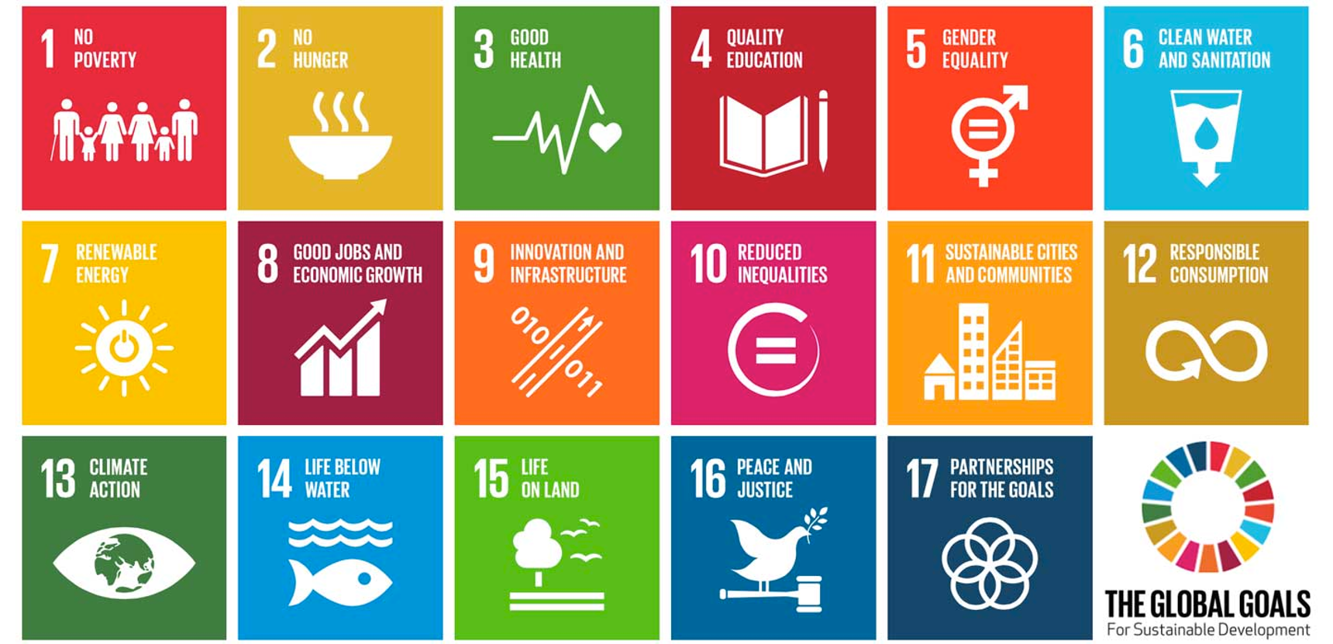
Notes:
SDGs are a call to action to address

Slide 3
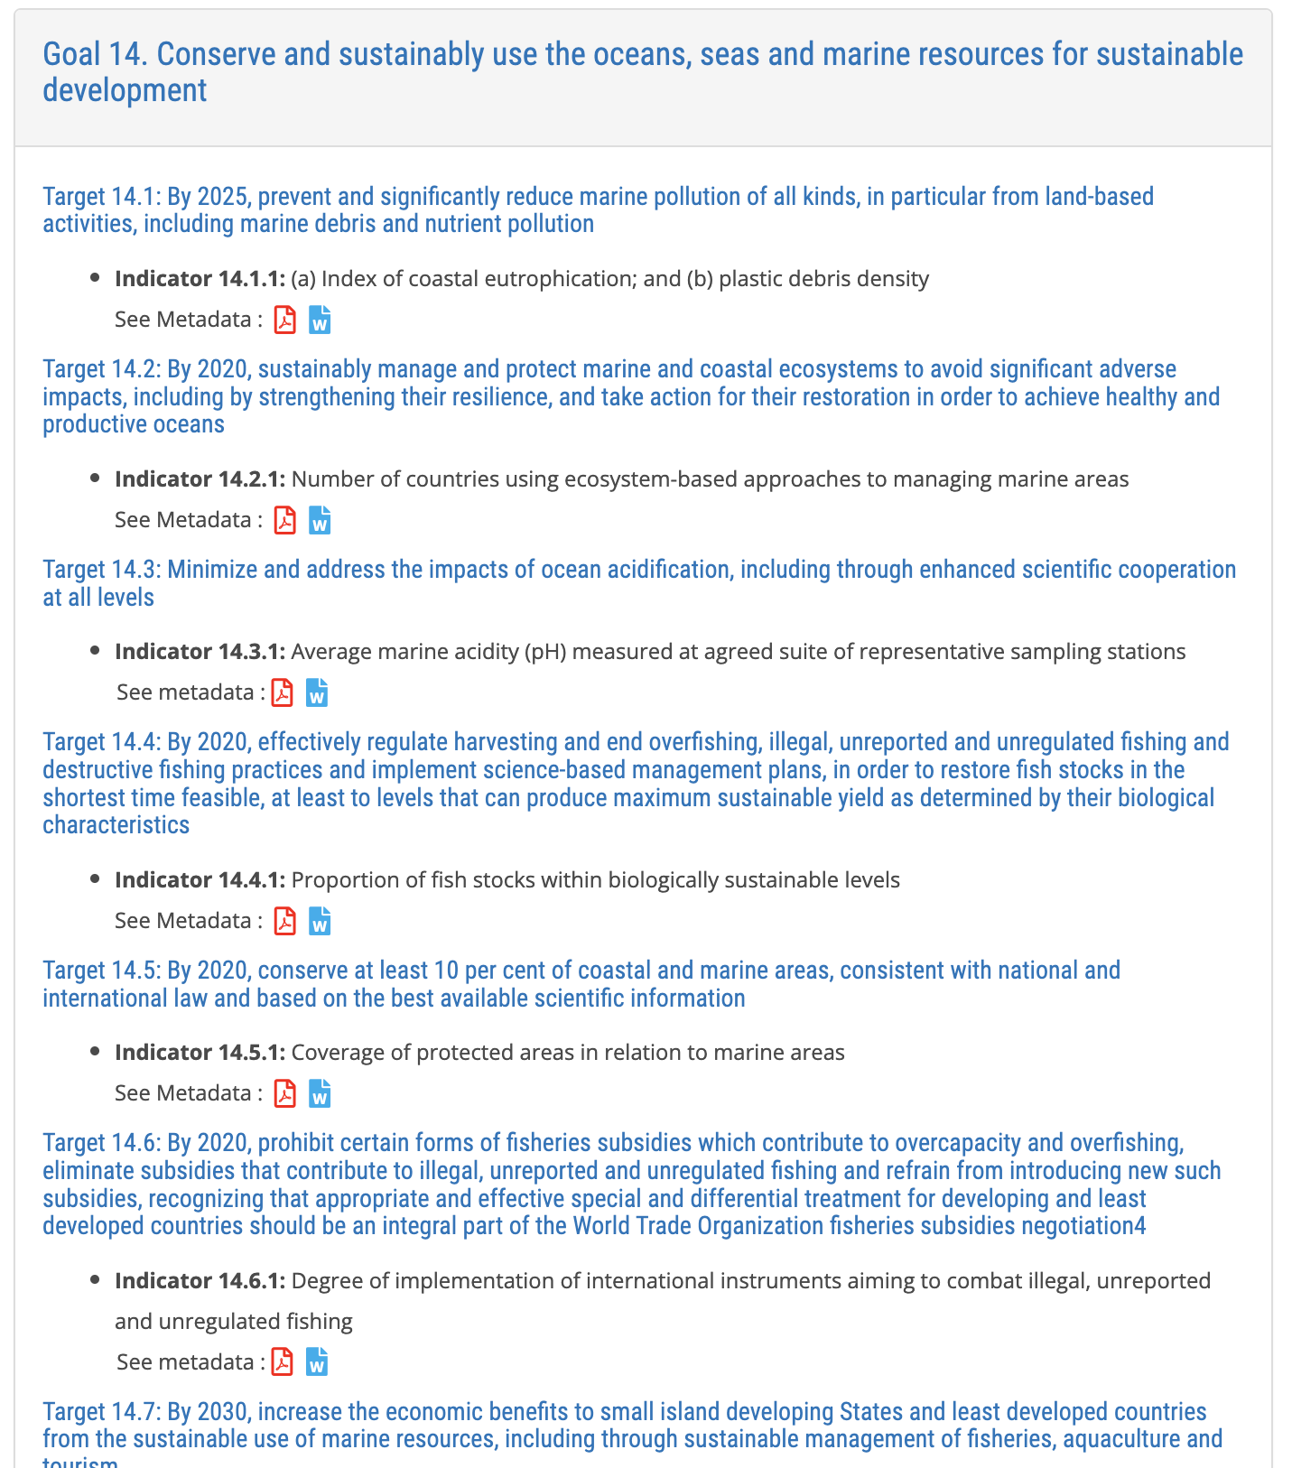
Notes:
to achieve the SDGs, we need timely, reliable and comprehensive data

Slide 4
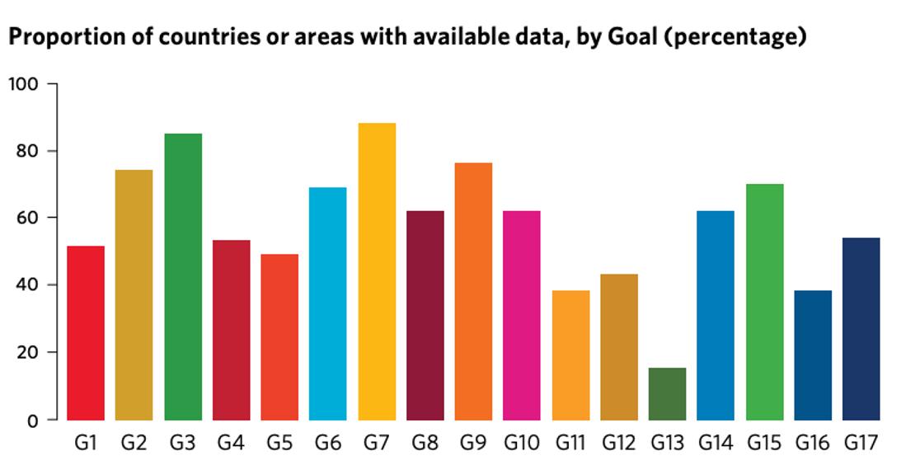

Slide 5
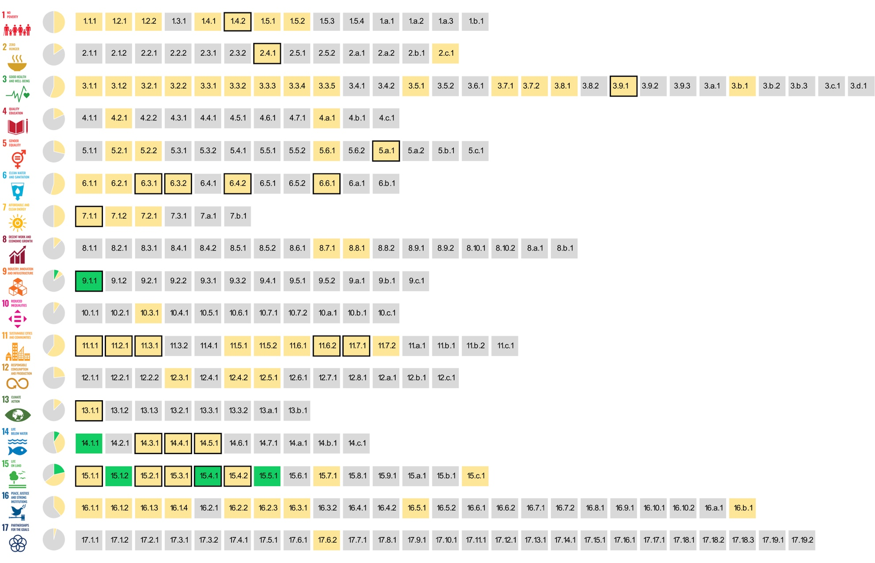
The SDG indicators where citizen science projects are ‘already contributing’, ‘could contribute’ or where there is ‘no alignment'
Fraisl, D., Campbell, J., See, L. et al. Mapping citizen science contributions to the UN sustainable development goals. Sustain Sci 15, 1735–1751 (2020). https://doi.org/10.1007/s11625-020-00833-7

Slide 6
The greatest contribution of citizen science data to SDG monitoring would be in:
Notes:
Link to planetary health

Slide 7
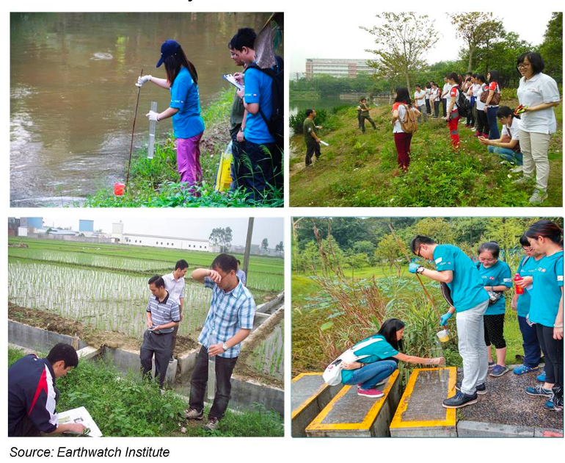
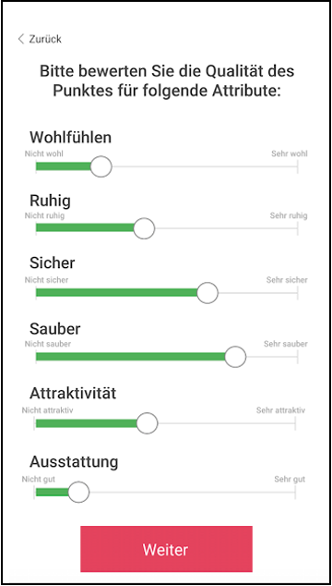
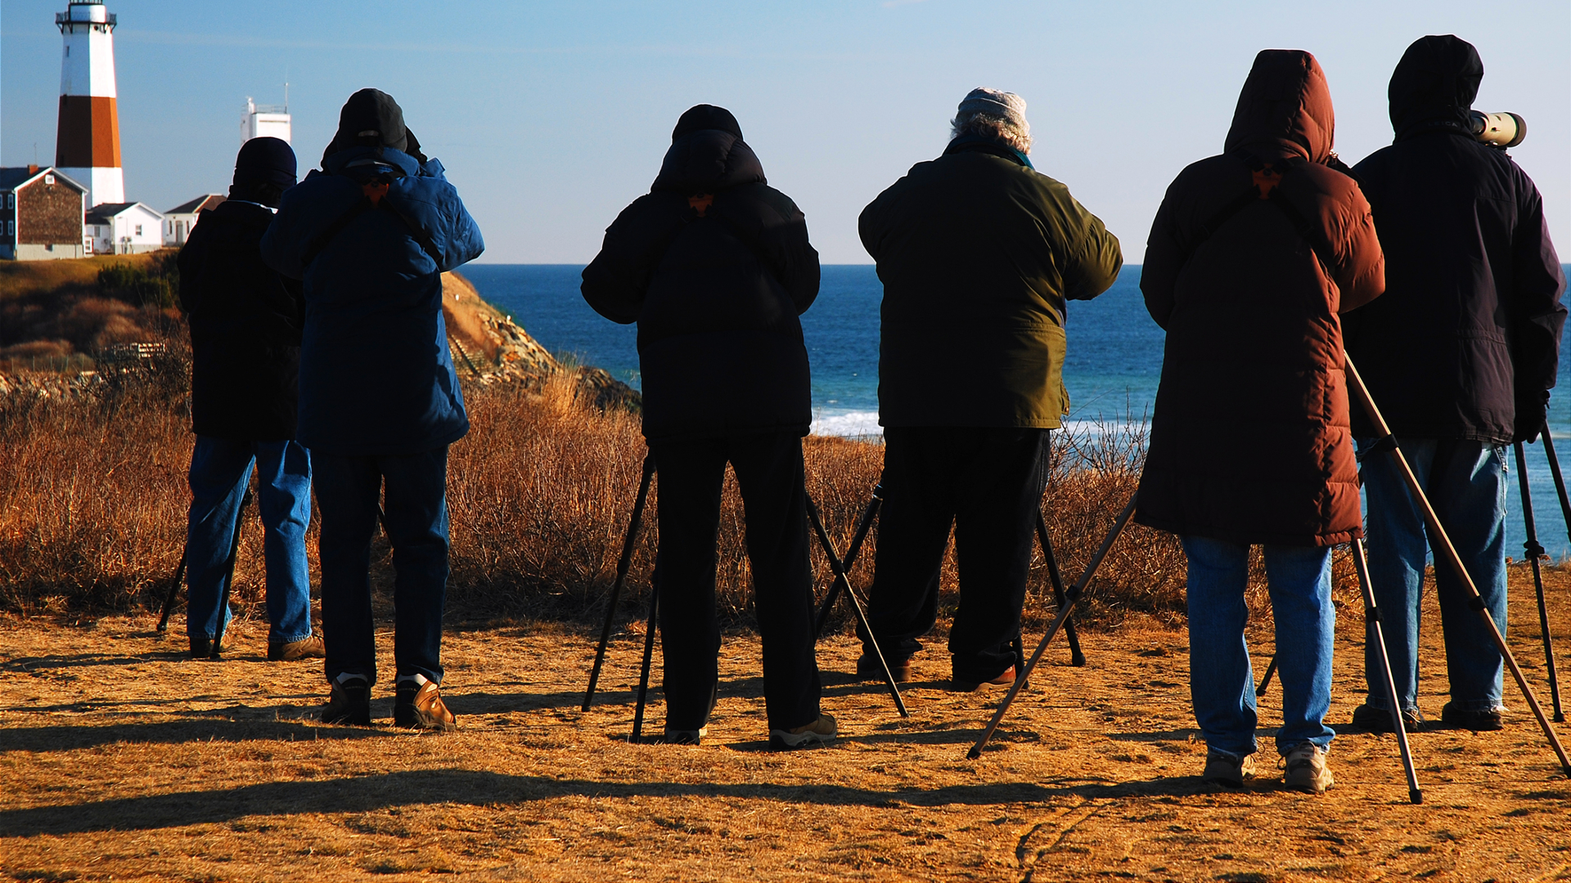
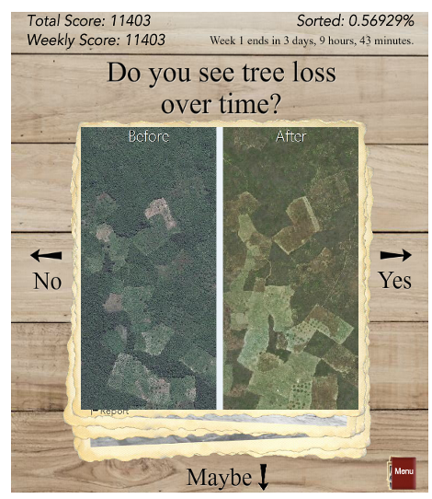
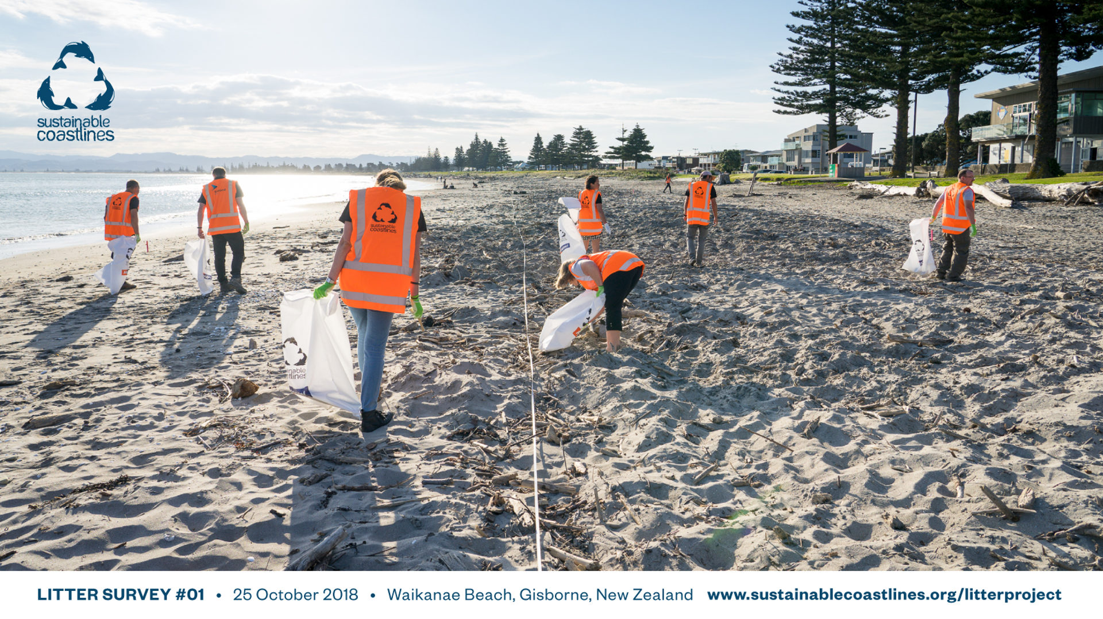
Examples

Slide 8
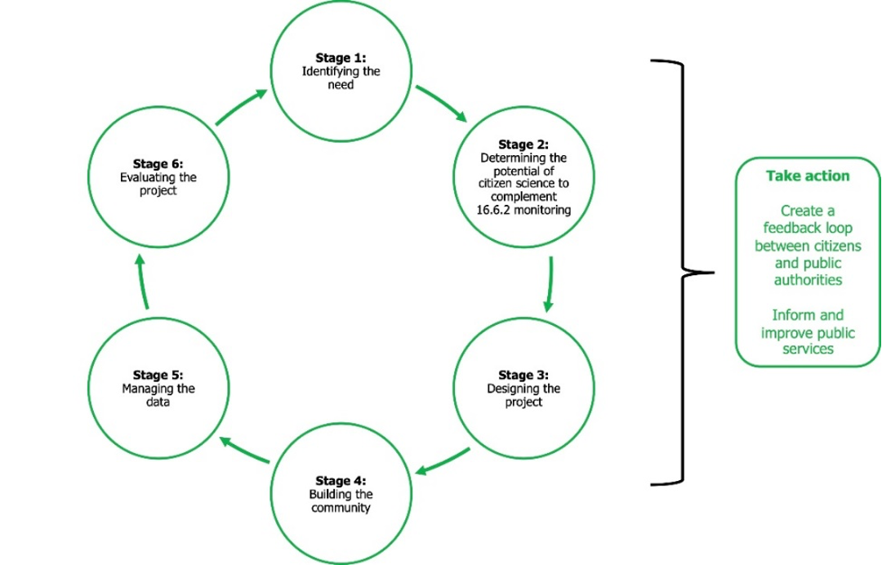
A STRATEGY FOR A CITIZEN SCIENCE APPROACH IN MEASURING SDG INDICATOR 16.6.2
PROPORTION OF POPULATION SATISFIED WITH THEIR LAST EXPERIENCE OF PUBLIC SERVICES
Fraisl, D., Hager, G., Bedessem, B. et al. Citizen science in environmental and ecological sciences. Nat Rev Methods Primers 2, 64 (2022). https://doi.org/10.1038/s43586-022-00144-4

Slide 9
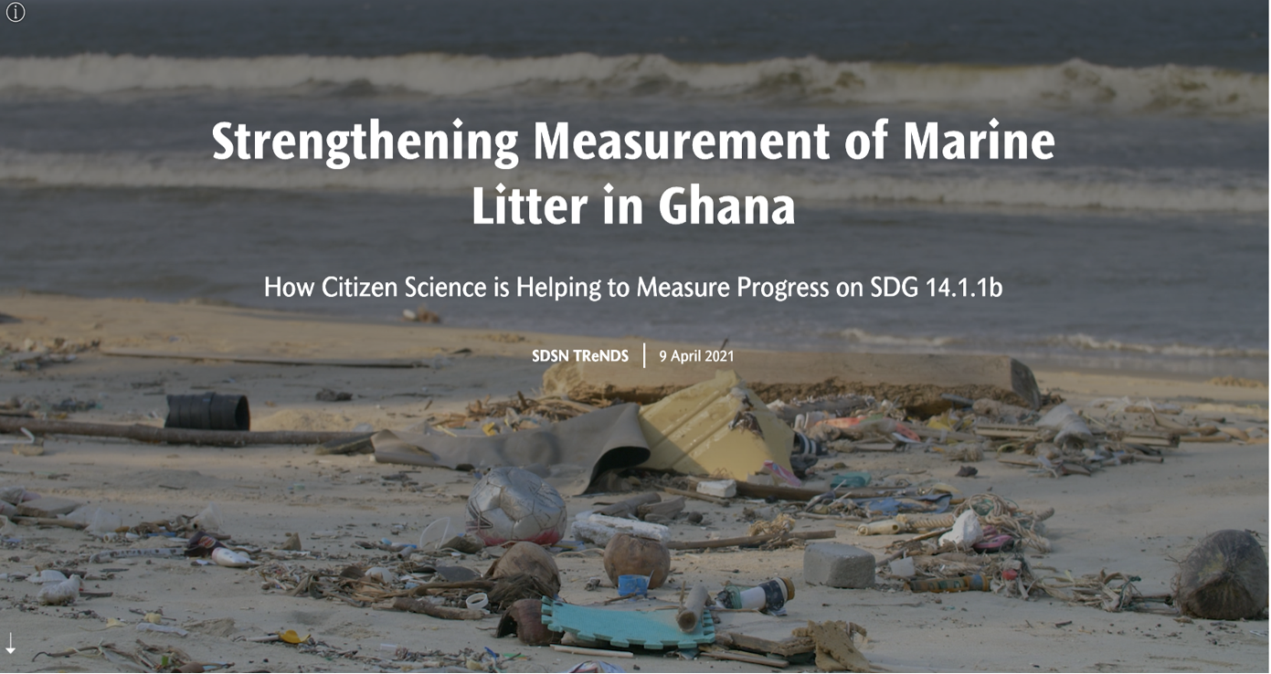
Citizen Science for the SDGs StoryMap: https://dataforchange.net/strengthening-measurement-of-marine-litter-in-Ghana

Slide 10
Citizen Science Data…
…for monitoring beach litter have been integrated into the official SDG monitoring and reporting mechanisms of Ghana in a sustainable way, which makes Ghana the first country to report on SDG indicator 14.1.1b and first country to use citizen science data for that purpose.
…will serve as inputs to Ghana’s Integrated Coastal and Marine Policy, currently under development, as well as other relevant policies to address the marine litter problem.
…has helped to bridge local data collection efforts with global monitoring processes by leveraging the SDG framework.

Slide 11
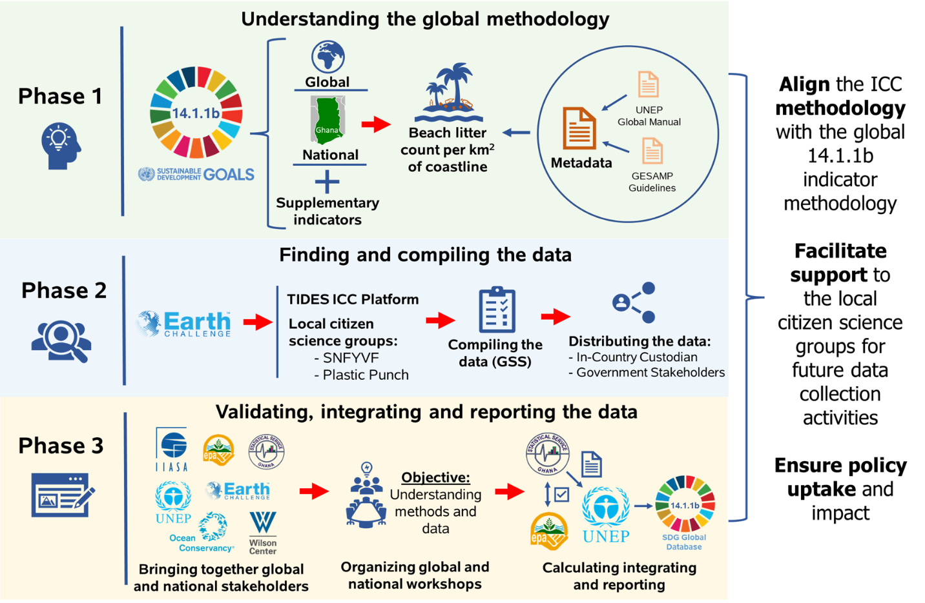
The process of integrating citizen science data on marine litter for SDG indicator 14.1.1b reporting in Ghana
Fraisl, D., et al., Under Review

Slide 12
Lessons
Rather than the time- and resource-intensive process of designing a project from scratch, using off-the-shelf solutions requires fewer resources to implement and enabled the reuse of data.
By tapping into Smart Nature Freaks Youth Volunteers and Plastic Punch, who are already established and sustainable networks, data could be efficiently collected as a by-product of existing activities.
Importance of creating time and spaces for the government, international organisation and CSOs to meet, in order to build trust, common goals and ownership over the result.

Slide 13
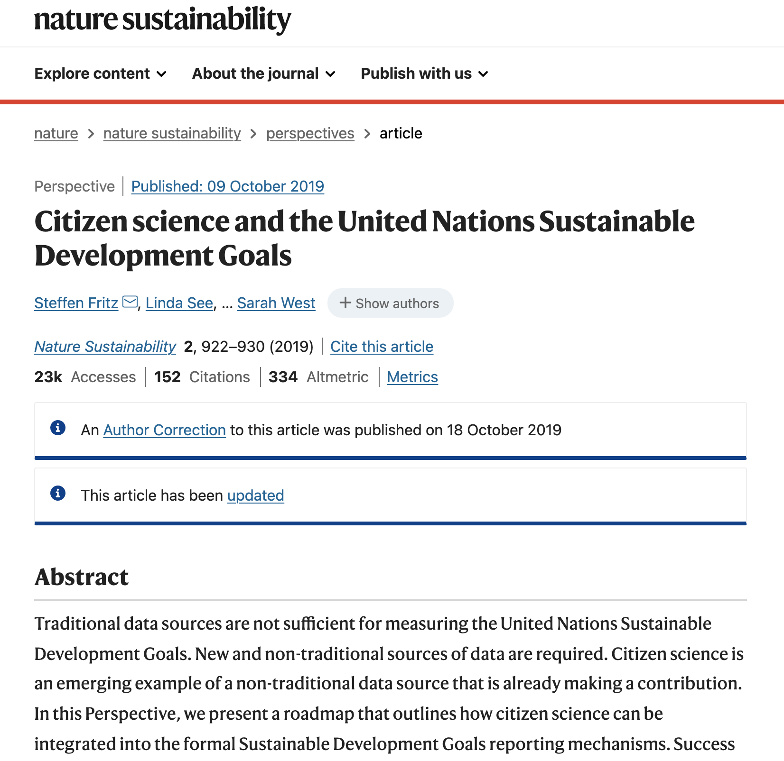
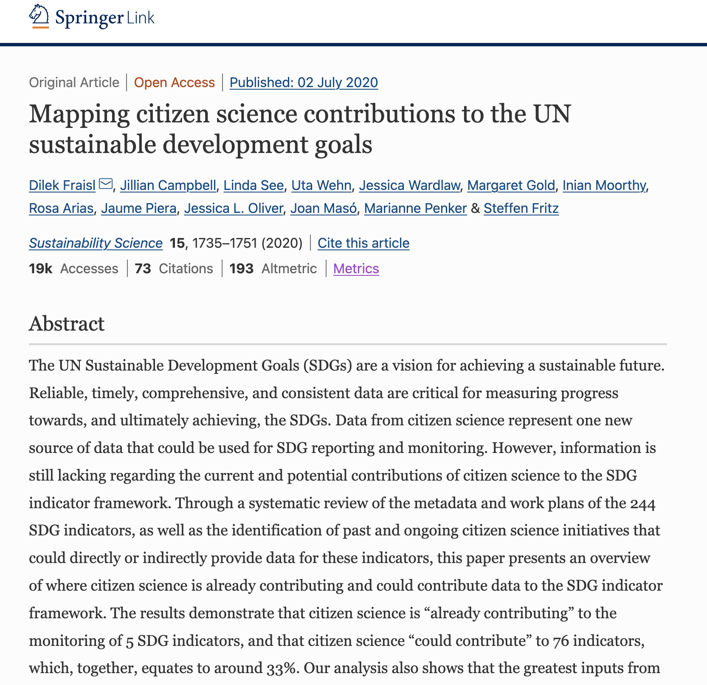
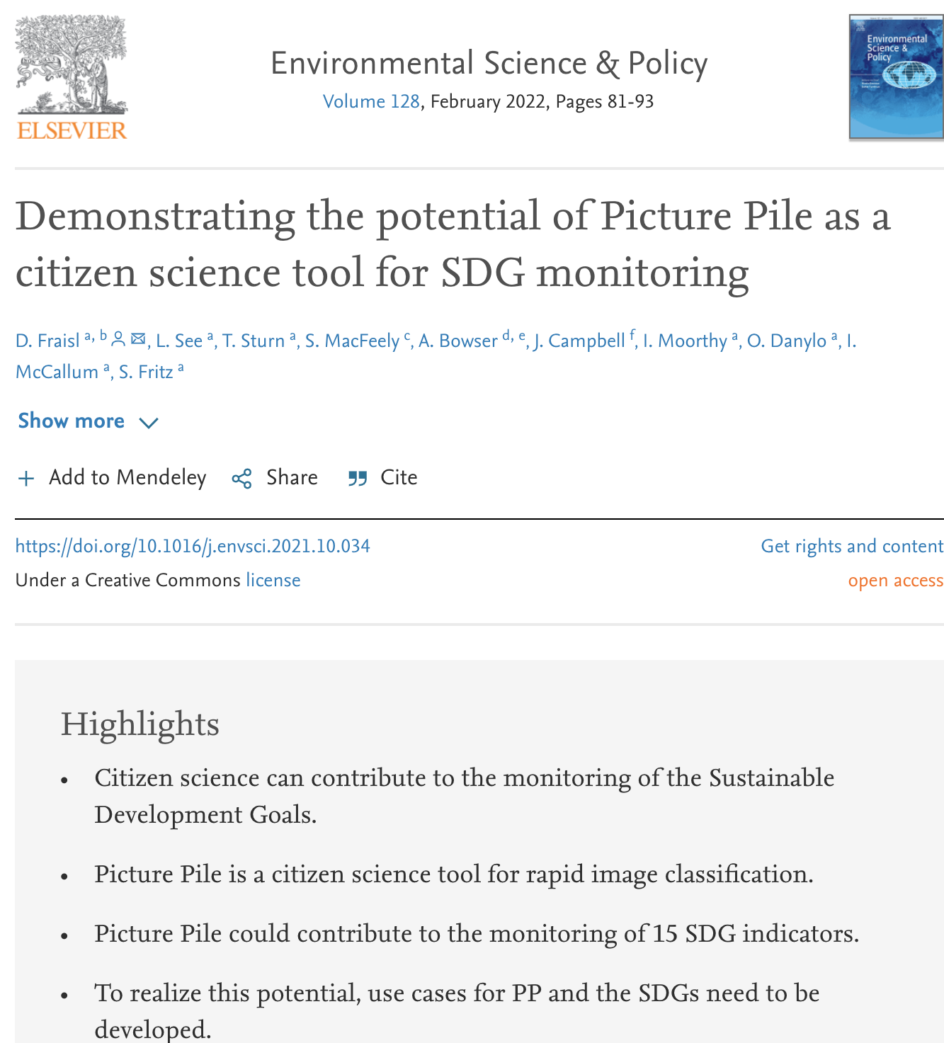

Slide 15
Thank you!
Dr. Dilek Fraisl
Dilek Fraisl
Research Scholar International Institute for Applied Systems Analysis (IIASA)
Email: fraisl@iiasa.ac.at
Twitter: @dilekfraisl1
Web: www.iiasa.ac.at

