Slide 1
Artificial Intelligence, Machine Learning,
and Intelligent Decision Support Systems:
Iterative “Learning” SQG-based procedures
for Distributed Models’ Linkage
NASU-IIASA projects
Tatiana Ermolieva, Yurii M. Ermoliev,
Anatoliy G. Zagorodny, Vyacheslav L. Bogdanov,
Petr Havlik, Nadejda Komendantova,
Olena M. Borodina, Pavel S. Knopov, Vasyl M. Gorbachuk,
Vladimir I. Norkin, Vladimir A. Zaslavskyi
XXII International Scientific and Technical Conference
ARTIFICIAL INTELLIGENCE AND INTELLEGENT SYSTEMS, AIIS’2022

Slide 2

Modeling and management of interdependent food-water-energy-health security nexus
First stage: 2012 – 2016; Second stage: 2017 – 2021; Third stage: 2022 – 2026
--- Current format of collaboration between IIASA and NASU
--- NASU’s (Ukrainian NMO) project’s participants crease a partnership of seven leading disciplinary institutes of NASU, two Universities, collaborating with networks of national and international scientific and policy-making organizations
--- The goal of this project is to develop further and implement novel systems analysis approaches, to investigate interdependencies within and between Food-Energy-Water-Environmental-Social (FEWES),
--- create Intelligent multimodel Decision Support System (IDSS) and Platform (IDSP), which can integrate national Food, Water, Energy, Social models with the models operating at the global scale (e.g., IIASA GLOBIOM and MESSAGE), in some cases ‘downscaling’ the results of the latter to a national level,
--- data harmonization procedures rely on new type non-smooth stochastic optimization and stochastic quasigradient (SQG) [3-4] methods for robust of-line and on-line decisions involving large-scale machine learning and Artificial Intelligence (AI) problems in particular, Deep Learning (DL) including deep neural learning or deep artificial neural network (ANN),
--- develop “Models’ Linkage” algorithms which are in the core of the IDSS as they enable distributed models’ linkage and data integration into one system on a platform
Energy for fertilizer production, harvest transportation & processing
Energy for food, feed, irrigation
Biomass for bio-fuel production
Water for food, feed and fiber crops
Water for bio-fuel crops
GHG emission & nitrogen pollution
Water resources vs. disasters
Infrastructure reliability, vulnerability and accessibility
Water contamination
GHG emission & nitrogen pollution

Slide 3
--- The linkage algorithms solve the problem of linking distributed models, e.g., sectorial and/or regional, into an inter-sectorial inter-regional integrated models
--- The linkage problem can be viewed as a general endogenous reinforced learning problem of how software agents (models) take decisions in order to maximize the “cumulative reward".
--- we illustrate the importance of the iterative “learning” solution algorithms based on stochastic quasigradient (SQG) procedures for robust of-line and on-line decisions involving large-scale Machine Learning, Big Data analysis, Distributed Models Linkage, and robust decision-making problems.
--- Advanced robust statistical analysis and machine learning models of, in general, nonstationary stochastic optimization allow to account for potential distributional shifts, heavy tails, and nonstationarities in data streams that can mislead traditional statistical and machine learning models, in particular, deep neural learning or deep artificial neural network (ANN).
--- For highly nonconvex models such as the deep ANN network, the SQGs allow to avoid local solutions. In cases of nonstationary data, the SQGs allow for sequential revisions and adaptation of parameters to the changing environment, possibly, based on of-line adaptive simulations.

Slide 5
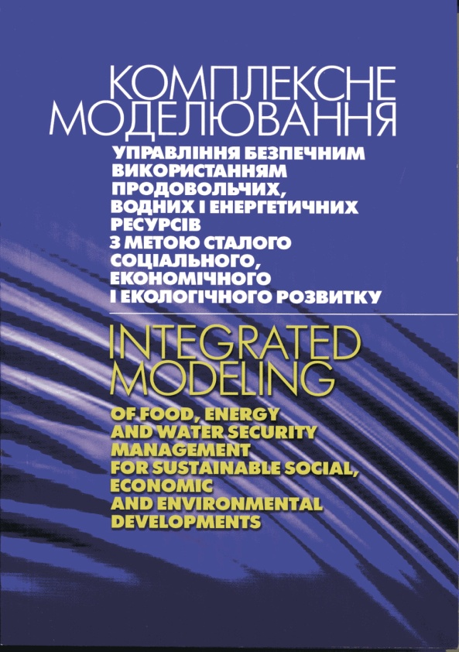

Integrated modeling, Data Harmonization, Capacity Building

Slide 6
Advanced Analysis of Systemic Interdependencies
Growing demand vs environmental standards (SDGs);
Food security, electricity infrastructure innovations and investments; systemic security; increasing returns vs sunk costs;
climate change and uncertainty; strategic- and operational planning; long- vs short-term decisions; competition for resources, etc
Energy
Agriculture
Energy security and water security; supply standards; Energy, food, water prices; Diversification of energy supply;
Ex-ante and ex-post risk management; electricity supply security;
global and local threats to electricity supply systems; endogenous risks; cyberattacks;
protection of critical infrastructure
Multi-model NEXUS analysis and systemic security management
Incomes; economic and population growth; demand changes; life and nutrition standards; prices;
Impacts of energy prices on food prices; Dependencies between agricultural and energy markets through bio-fuels; Agricultural subsidies; renewables subsidies, etc.
Water
Socio -Economic
Control of water resources and supply-demand (im)balances; reliability; monitoring of infrastructure; monitoring of water resources vulnerability and accessibility;
Monitoring & control of water contamination;
Notes:
Three fundamental elements (energy) security: ―Physical supply: availability and accessibility; ―Economic: affordability; ―Environmental sustainability: acceptability. Most important factor determining the energy system is risks, which depend on how the system is considered as a whole
emphasis on a systemic approach to risk management: regulating the system as a whole, not just its individual components
Systemic risks is risks in a complex “network” driven by supply-demand-price relations
Framework that can be scaled to capture the key components and relationships at different levels
A tool which helps identify regional energy security gaps and self-sufficiency levels depending on various other factors and areas of priority
A tool which allows to set the priorities and initiate a discussion with decision-makers
International (traditional) energy security frameworks were developed primarily following the crude oil supply disruptions of the 1970s
Significant changes in energy markets over the last 40 years
•Increased diversification of the fuel mix, with oil use displaced by increasing use of coal and natural gas.
•A shift in consumption patterns towards non-OECD emerging economies.
•Changes in the structure of the international crude oil market, from vertically integrated market of the 1970’s to the current segmented and highly specialised market.
•The move from long term contracts to an increasing share of spot transactions and the emergence of oil futures and derivatives markets, increasing the depth and liquidity of the market.
•New causes of imbalance between supply and demand beyond geopolitical shocks to crude oil supply. For example, refinery shutdowns (e.g. Hurricane Katrina 2005), demand surges (e.g. Asia 2013) and the loss of specific types of crude (Libya 2011

Slide 7
Integrated Approach to FEWES systems Analysis,
Approaches to hard and soft linkage of models
Different large-scale models exist describing separate activities and systems of a real economy and resource management, e.g., energy, agriculture, water, etc.
The research addresses challenging methodological task of linking the models under inherent uncertainties and risks.
The models have exogenous variables which describe interactions between the activities and systems. One can consider these variables as endogenous or as decision variables when the submodels are linked together.
Possible ways to formulate the problem of linkage mathematically and possibilities for applying methods of optimization under uncertainty and risk have been considered.
The integrated model incorporates quantile-based indicators and factors reflecting intra- and inter-model uncertainties, risks, and security constraints.
Key issues:
Integrating large scale sectoral and regional models with global models (GLOBIOM, GAINS, MESSAGE) developing probabilistic robust non-Bayesian rescaling procedures.
Development of quantile-based indicators
Analysis of rural areas developments, micro financing, insurance, credits, etc.

Slide 8
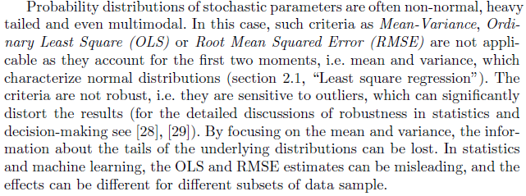

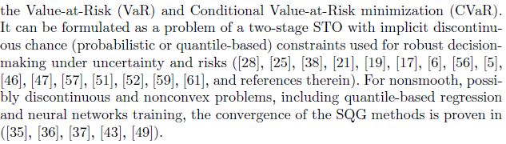

Slide 9
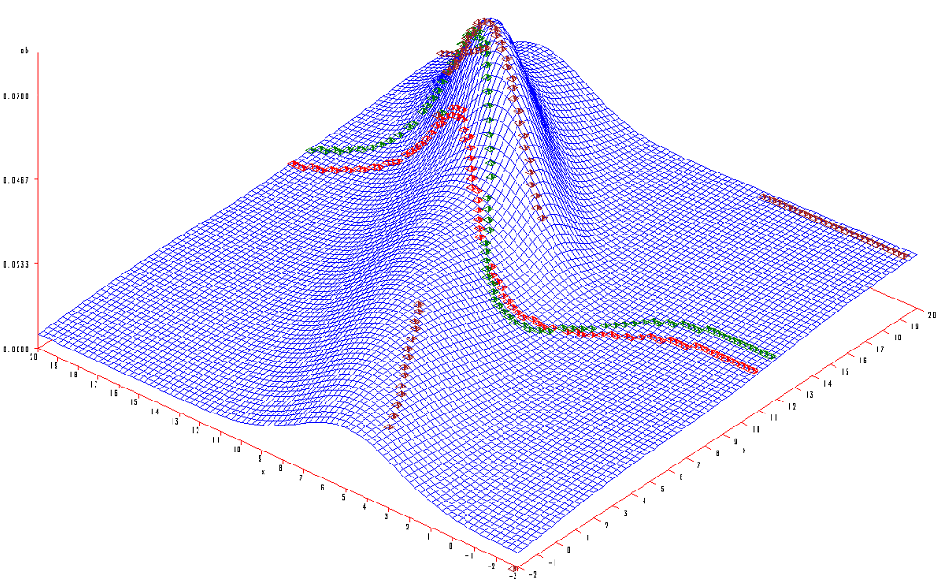
Discontinuous mode and median, continuous mean
Standard regression curves vs probabilistic dependencies
Mean
Median
Mode
y
x
4

Slide 10
Percentile-based non-smooth goodness-of-fit and Two-stage
Overestimation is penalized differently from underestimation
Percentile-based non-smooth goodness-of-fit performance indicators
Two-stage stochastic optimization procedure: at first stage – make estimate before new information arrives, at second stage – adjust the estimate with respect to new data and information, minimize associated costs for both stages
“x = ω”: x, ω, y(ω)=(y⁺ (ω), y⁻ (ω)),
x = ω - y⁺(ω) + y⁻ (ω), y⁺(ω) >=0, y⁻ (ω) >= 0; f(x,y, ω) = cx + ay⁺ (ω)) – by⁻ (ω)
F(x) = cx + E(y⁺ (ω) - y⁻ (ω))
f(x, ω) = a(x – ω), x>= ω (oversupply, overestimation)
b(ω - x), x< ω (undersupply, underestimation)
F(x) = Ef(x, ω); x^{k+1} = x^{k} + ρ a, x >= ω
- b, x < ω,

Slide 11
Abrupt changes and deterministic models
The following simple growth model of capital (insurance risk) reserve
with abrupt changes (claims) shows that the use of average characteristics
converts this model to a linear model
Sensitivity analysis of resulting linear deterministic model is not able to
detect abrupt changes: it can easily provoke an environmental collapse may significantly depend on x, e.g.

Slide 12
Significance of extreme events/outliers
The significance of “extreme events” arguments for global climate change policies has been summarized by B. Clark: “Impacts accrue ... not so much from slow fluctuations in the mean, but from the tails of the distributions, from extreme events”.
Yet, extreme events are usually characterized by their expected arrival time, for example, as a 1000-year flood.
Accordingly, they are evaluated as improbable during a human lifetime. In fact,
a 1000-year flood may occur next year. For example, floods across
Central Europe in 2002 were classified as 1000-, 500-, 250-, and 100-year events.

Slide 13
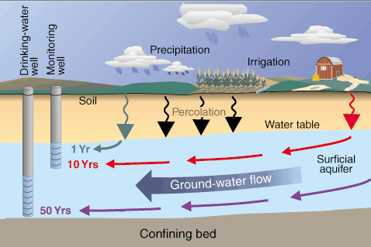
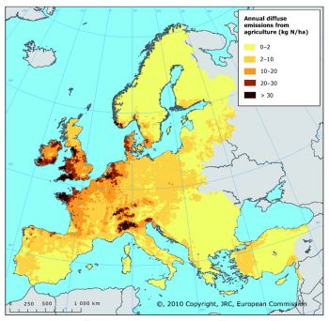
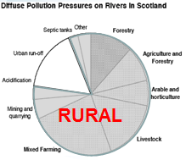
Joint Research Centre, European Commission (2009)
Linkage of Agricultural and Environmental models, and social, and risk indicators: Nitrate Pollution Problem
-- To reach ambient water quality and ecological standards set in EU WFD
-- To reduce the cost of pollution control
Impacts og heavy precipitation events on agricultural pollution
Notes:
Annual diffuse agricultural emissions of nitrogen to freshwater (kg N/ha of total land area)

Slide 14
Dynamic Nutrients Management Model under Weather Variability
Sources
Receptors
N load at t=0
Traveling time
From the same N load at t=0, nitrogen traveling time to receptors can reach T-1 (from 10 to more than 100) years. In general, the traveling time is uncertain, depends on soil type, weather conditions, activities, etc.
Notes:
A dynamic version of the traditional matrix links farms, pollution sources and receptors and corresponding traveling time Ƭiy and portion of pollution over multiple years (in total indicated by T) rather than a single period.

Slide 15
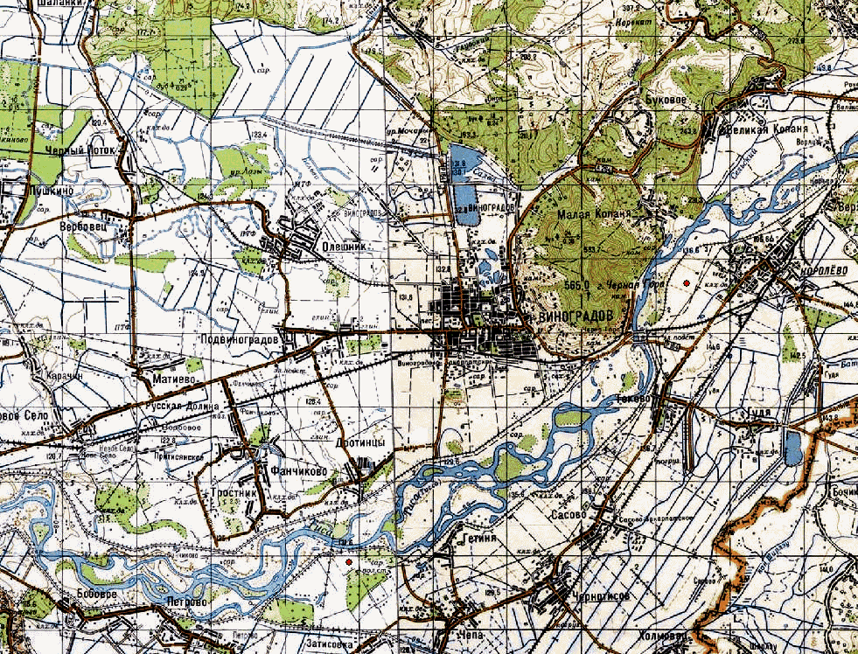
Linkage of Flood scenario generator and Flood risk Management model on Tisza river, Ukraine and Hungary
Deforestation upstream increases chances of floods downstream
Dams’ reliability, maintenance (dynamic STO)
Agricultural, industrial and households losses
International and/or local insurance and/or mutual fund
Risk pricing: insurance demand vs supply
Endogenous discounting
Linkage of stakeholders/systems simulation and optimization models
Non-smooth, discontinuous indicators and constraints
Scenario generator: river + innundation moduls

Slide 16
Integrated Flood Risk Management on Tisza river:
Ukraine and Hungary
Iterative linkage procedure

Slide 17
General probability distribution
Distributions have disconnected attainability sets, the use of the mean,
normal distribution, fuzzy sets is misleading
Need for quantile-base approaches

Slide 18
Linkage energy-agricultural-water models and
Climate Change scenarios
Temporal resolutions of the strategic planning model.

Slide 19
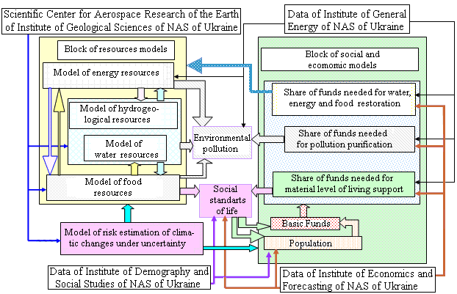
NASU-IIASA FWEES model

Slide 20
Linkage of energy-agricultural-water models
Coal Mining
Coal Processing
Coal Conversion
Output
Long wall face
Coal Wash
Power generation
The optimal coal production in 11 cities
Backfill mining
Gasification
Dry Wash
Coke
Opencast
Others
The portfolio of technology
Chemical
Others
Water supply
Water-dependent coal technology
Uncertainty of water supply
Uncertainty of water demand
Systemic Risks:
  Shortages of coal production
  Food shortages
What year happens – dry or wet ?
Water consummation and water storage
Water resource
Land subsidence
Land reclamation
Water supply
Crop structure and Irrigation technology
Land use/food production
The optimal crop production in 11 cities and crop structure
Wheat
Corn
Millet
Sorghum
Oats
Buckwheat
Bean
Potato
Notes:
The model for systems analysis of coal production and energy-food-water security is developed between IIASA and my university. At the beginning, the model is developed as a deterministic model. In this summer, we want to turn the deterministic model to the stochastic model. With the model, we can do the analysis.

Slide 21

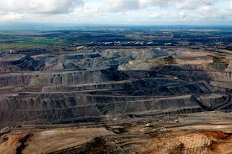
Iterative algorithms for ML of robust distributed systems:
Distributed systems linkage with SQG iterative learning for robust decisions
Model of sector/region A
Model of sector/region E
Minimizing costs
Constraints on volume of production
Constraints on available resources (land, water, etc.)
☹
☹
Can be separated for simplicity but in reality are inter-linked!
☺ ☺ ☺

Slide 22
“Naïve” approach: direct iterative exchange between models
Notes:
This is not very clear now, should be discussed

Slide 23
“Naïve” approach: example – dependence on the initial condition!
Notes:
Here there should be an example

Slide 24
Hard linking approach: minimization of the overall welfare function
Implementation may be challenging – computing time, needs to re-code etc.

Slide 25
Linking models via a central “hub” under uncertainty and asymmetric information
Notes:
\nu_A, \nu_E – are the solutions to the max problem or given dual variables???

Slide 26
Convergence theorem
Let
Then
where
Yuri Ermoliev (1988), Yuri Ermoliev et al. ( 2017, 2019) for Deterministic and stochastic cases

