Slide 1
Big Data, Artificial Intelligence and Machine Learning problems for Robust Food-Water-Energy NEXUS Analysis and
Risk-Adjusted Agricultural Insurance Schemes
Tatiana Ermolieva,
Yurii M. Ermoliev, Anatoliy G. Zagorodny, Vjacheslav L. Bogdanov,
Pavel S. Knopov, Vasyl M. Gorbachuk, Vladimir A. Zaslavskyi,
Petr Havlik, Andrey Lessa Derci Augustynczik, Rastislav Skalsky, Juraj Balkovic,
Christian Folberth, Taher Kahil , Gang Wang.
Міжнароднa науково-практичнa конференції «Глушковські читання», 8th December, 2022

Slide 2
Advanced Analysis of Systemic Interdependencies
Growing demand vs environmental standards (SDGs);
Food security, electricity infrastructure innovations and investments; systemic security; increasing returns vs sunk costs;
climate change and uncertainty; strategic- and operational planning; long- vs short-term decisions; competition for resources, etc
Energy
Agriculture
Energy security and water security; supply standards; Energy, food, water prices; Diversification of energy supply;
Ex-ante and ex-post risk management; electricity supply security;
global and local threats to electricity supply systems; endogenous risks; cyberattacks;
protection of critical infrastructure
Multi-model NEXUS analysis and systemic security management
Incomes; economic and population growth; demand changes; life and nutrition standards; prices;
Impacts of energy prices on food prices; Dependencies between agricultural and energy markets through bio-fuels; Agricultural subsidies; renewables subsidies, etc.
Water
Socio -Economic
Control of water resources and supply-demand (im)balances; reliability; monitoring of infrastructure; monitoring of water resources vulnerability and accessibility;
Monitoring & control of water contamination;
Notes:
Three fundamental elements (energy) security: ―Physical supply: availability and accessibility; ―Economic: affordability; ―Environmental sustainability: acceptability. Most important factor determining the energy system is risks, which depend on how the system is considered as a whole
emphasis on a systemic approach to risk management: regulating the system as a whole, not just its individual components
Systemic risks is risks in a complex “network” driven by supply-demand-price relations
Framework that can be scaled to capture the key components and relationships at different levels
A tool which helps identify regional energy security gaps and self-sufficiency levels depending on various other factors and areas of priority
A tool which allows to set the priorities and initiate a discussion with decision-makers
International (traditional) energy security frameworks were developed primarily following the crude oil supply disruptions of the 1970s
Significant changes in energy markets over the last 40 years
•Increased diversification of the fuel mix, with oil use displaced by increasing use of coal and natural gas.
•A shift in consumption patterns towards non-OECD emerging economies.
•Changes in the structure of the international crude oil market, from vertically integrated market of the 1970’s to the current segmented and highly specialised market.
•The move from long term contracts to an increasing share of spot transactions and the emergence of oil futures and derivatives markets, increasing the depth and liquidity of the market.
•New causes of imbalance between supply and demand beyond geopolitical shocks to crude oil supply. For example, refinery shutdowns (e.g. Hurricane Katrina 2005), demand surges (e.g. Asia 2013) and the loss of specific types of crude (Libya 2011

Slide 3
Systemic interdependencies: GLOBIOM land use model
Stochastic events (shocks), extreme events generators
Nutrition norms
Stochastic yields, production, resources, ...
W(s)
s=1,…,n
Environmnetal norms
Stochastic costs, prices, demans, etc.
Energy-water-
Etc. norms
Stochastic convertion coefficients,
technol. parameters
Notes:
Modeling of internal and external schocks

Slide 4

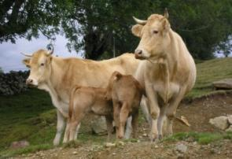
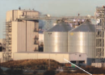

Demand
Drivers: Population, tech. change, F-W-E security targets, GDP, diets, preferences
Food
Fibers
Energy
Industry
Markets
ECONOMIC MARKET + Spatial equilibrium trade → PRICES
2050-2100
Production
RUMINANT
Digestibility model
Feed intake
Animal production
GHG emissions
BIOENERGY
Processing
MJ biofuel
MJ bioelectric
Coproducts
G4M
Global Forest model
Harvestable wood
Harvesting costs
…
18 crops (FAO + SPAM)
Wheat, Rice, Maize, Soybean, Barley, Sorghum, Millet, Cotton, Dry beans, Rapeseed, Groundnut, Sugarcane, Potatoes, Cassava, Sunflower, Chickpeas, Palm Fruit, Sweet potatoes
3 different systems
7 animals
(FAO + Gridded livestock)
Cattle & Buffalo
Sheep & Goat
Pig
Poultry
8 different systems
Land suitable for Poplar
Pillow
Eucalyptus
Productivity from literature
Downscaled FAO FRA at grid level
Area
Carbon stock
Age
Tree size
Species
Rotation time
Thinning
2010
Land use
2000
Land cover
Cropland
Grassland
Short rotation plantations
Managed forest
Natural
forest
Other natural land
Global Land Cover 2000

Slide 5
A percentile is a measure used in statistics indicating the value below which a given percentage of observations in a group of observations fall. For example, the 5th (50th, 75th) percentile is the value (or score) below which 5th (50th, 75th) of the observations may be found
The 25th percentile is also known as the first quartile (Q1), the 50th percentile as the median or second quartile (Q2), and the 75th percentile as the third quartile (Q3). In general, percentiles and quartiles are specific types of quantiles.
Percentile (Quantile) regression produces robust estimates not very sensitive to new data
India

Slide 6
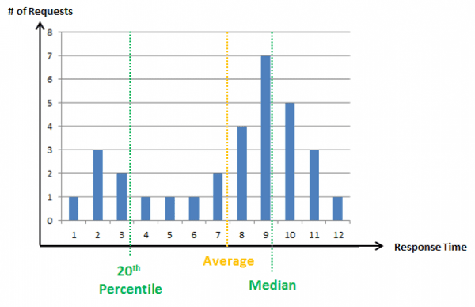
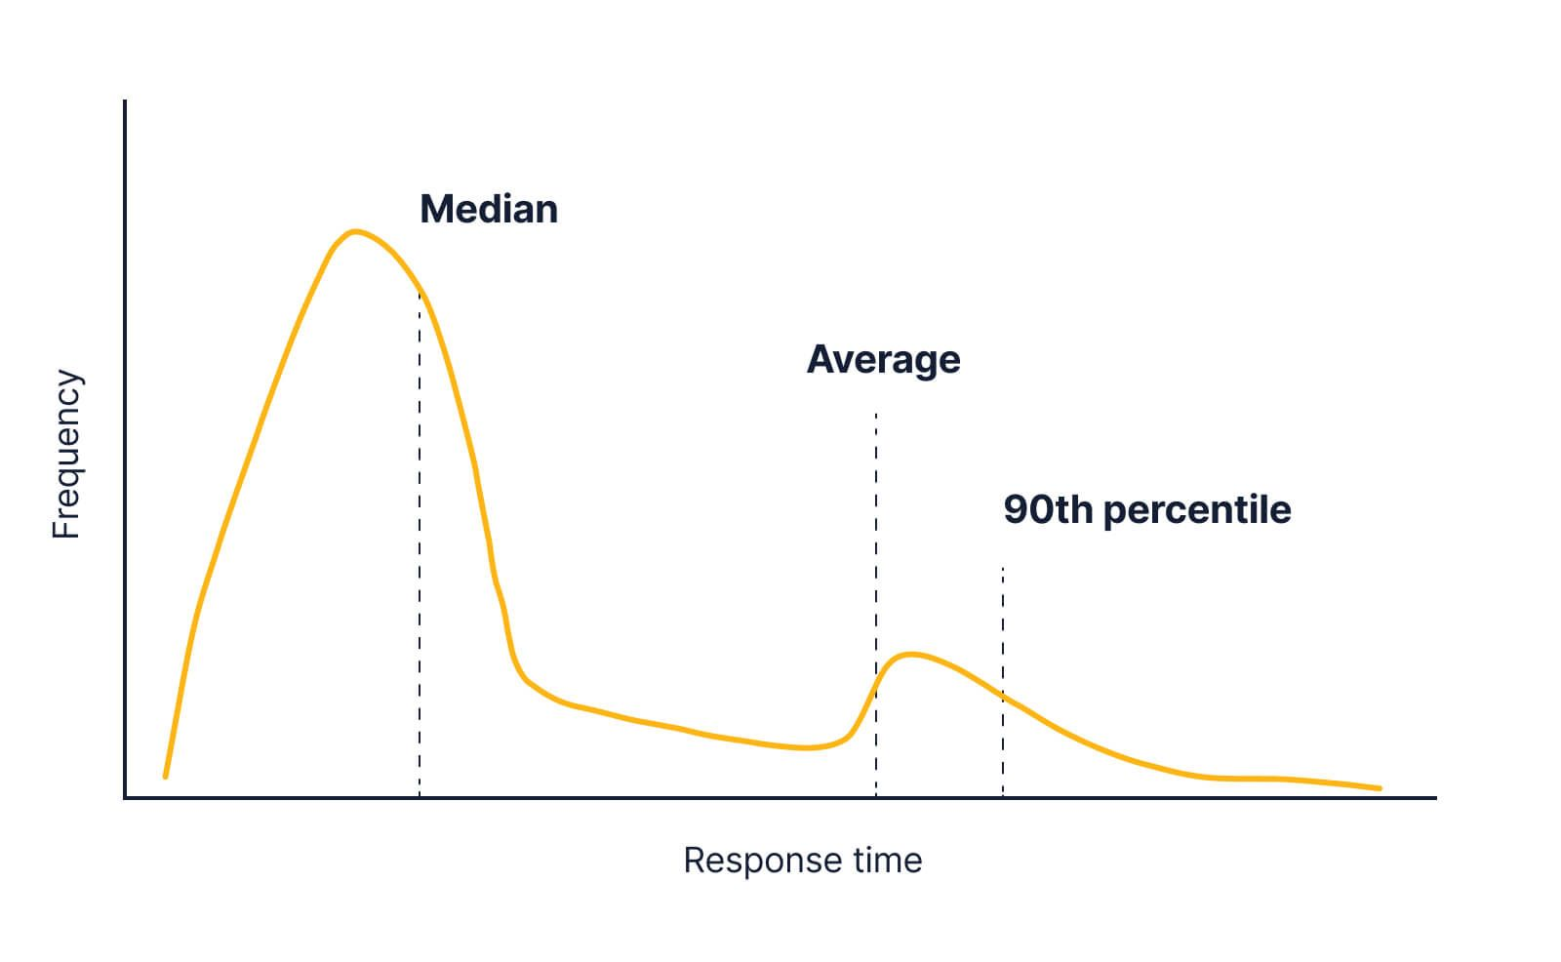
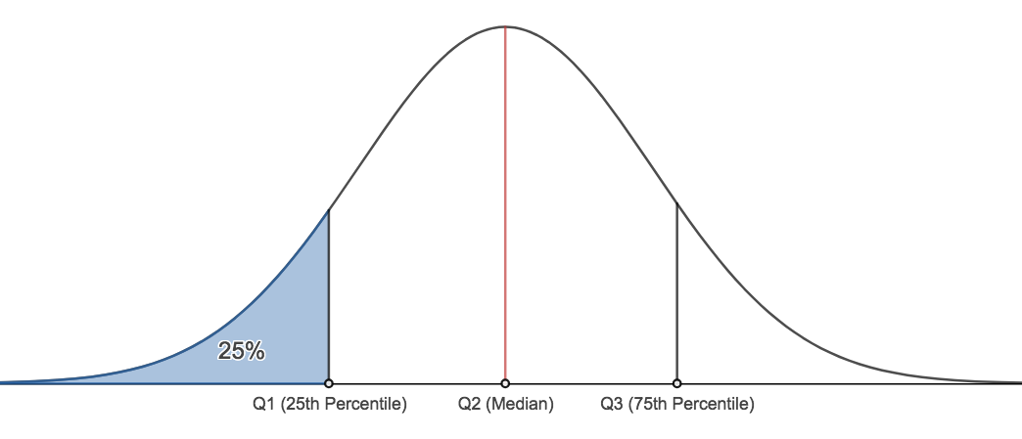
Nonsymmetrical distribution
Yield
Symmetrical distribution
Yield

Slide 7
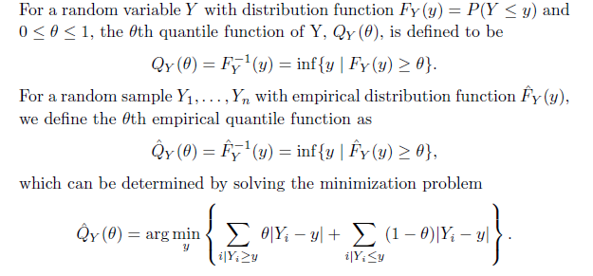

Percentile (Quantile) estimation
The objective function for quantile regression is:
Here q is the quantile we used in prediction. XBq is the prediction of Y at quantile q. The idea is: given X, if Y >= Yq, the error is: q*|Y-Yq|. If Y<Yq, then error is (1-q)*|Yq-Y|. Here Yq is the target variable satisfying F(Y)<=q. We can easily know that regression to median, which is quantile regression with q=0.5 is simply to minimize sum|Y-Xb|.

Slide 8
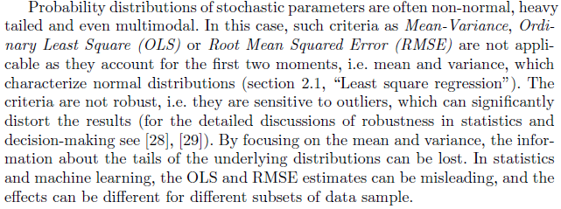

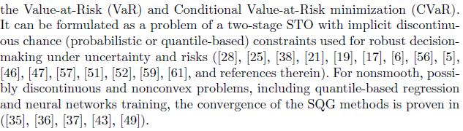

Slide 9
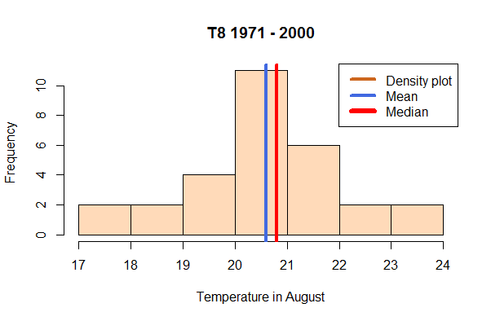
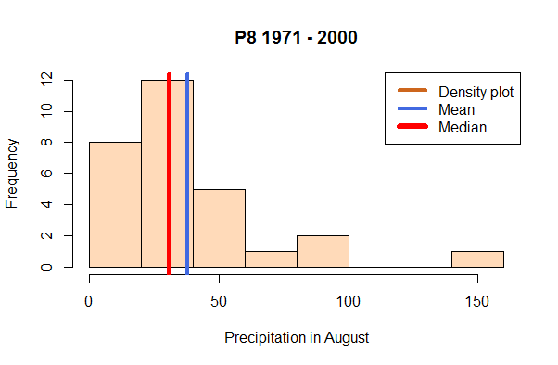
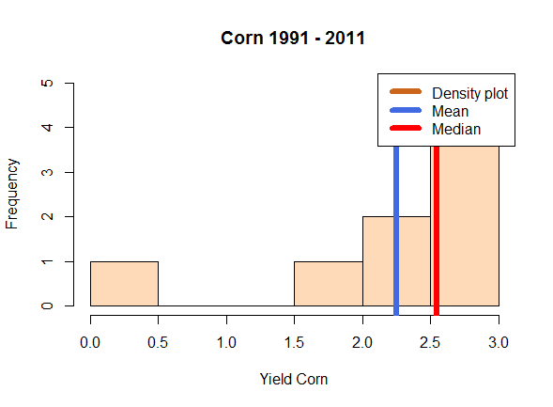
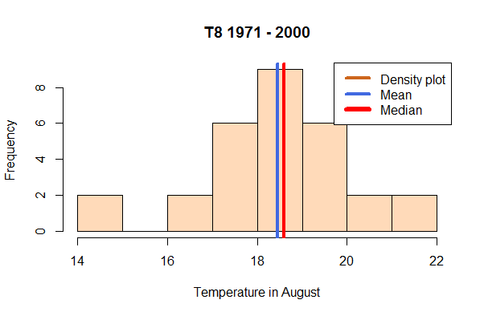
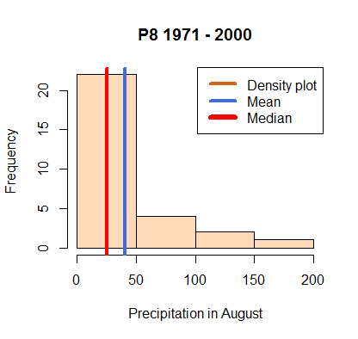
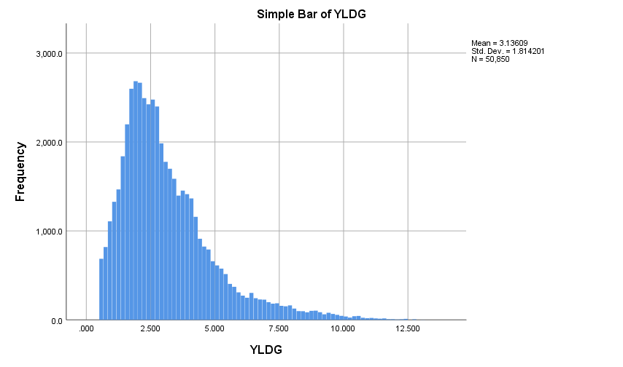
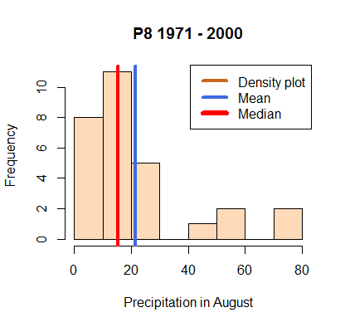
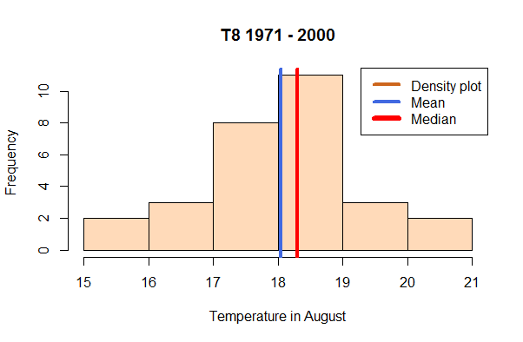
Example of ML and ANN: Stochastic generator of crop yields based on GIS data of
T, P, SPEI, soil, water, EPIC data, Monthly, 1km2 resolution, RCPs
Input (P, T, soil quality, water, nutrients)
Input (weather, climate, bio-physical processes, management)
Transfer/process function, kernels, etc
Predicted output (yield)
Observed yields (losses) are skewed
Goal function:
Percentile/
quantile-based risk measures
Yield loss
Iterative
Revision of estimates
Weights/parameters/transfer functions/etc.

Slide 10
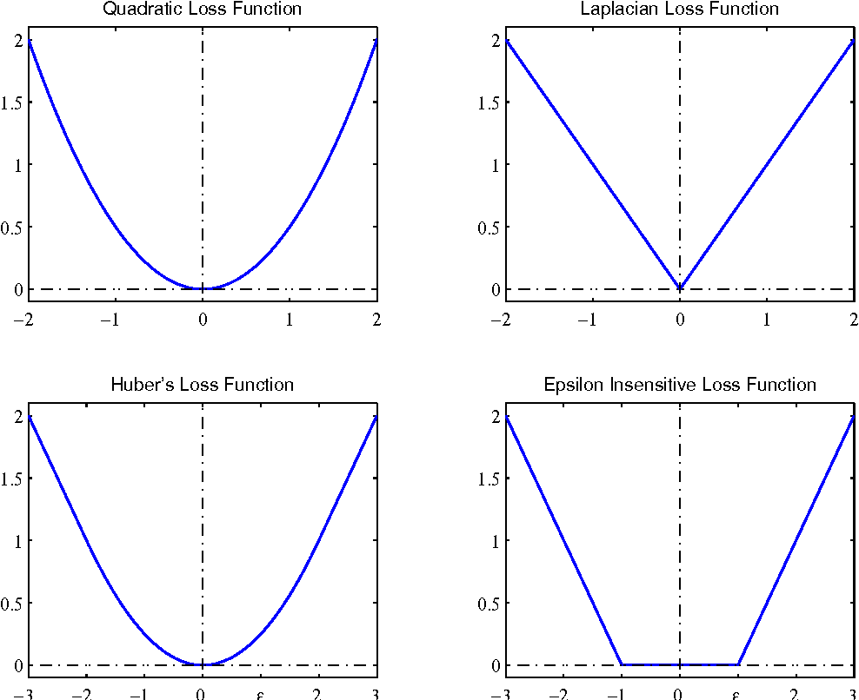
Goodness of fit: smooth vs non-smooth loss/goal function
Gradient vs generalized gradient – problem with gradient descent method
Non-smooth goal functions based on quantile loss/regret function (the loss incurred in case of catastrophic losses)
Loss function has to be selected consistently with the actual, acceptable, or required variations (spread) of independent and dependent (predicted) variables in the context of a particular applied problem
Generalized gradient

Slide 11
General robust estimation problem
Notes:
Here we illustrates how the concept of a two-stage stochastic optimization and robust strategic-adaptive decisions can assist robust decision analysis and system’s security management. Consider a basic model, which may correspond to a problem of a decision maker (regional planner) concerned with investments into agricultural production technologies (irrigation, storage), bio-based electricity production facility, water reservoir infrastructure or any other long-term and costly project associated with possible irreversibility costs. Assume there is only one producer (region) operating in uncertain environment and this producer needs to satisfy some demand. One of the variables (or both variables) can be stochastic. In this section let us consider a very simple relation between the production capacity x and the stochastic demand $ω$.
The imbalance between the demand and supply can induce an exceedance of a vital systemic threshold and, as a result, a systemic failure. Planning production $x$ before exact information on the level of stochastic demand $ω$ is available can result in two situations: a) If the production is lower than the demand, then the producer can potentially fulfill the demand by storage withdrawal (“borrowing”) at price ${α>c}_{}^{}$. If the demand is lower than the production $x$, the producer can store the excess production at price $β<c$. The shortage and the excess production indicate systemic imbalances and risks, which require additional actions and costs for borrowing and storing. In general, costs

Slide 13
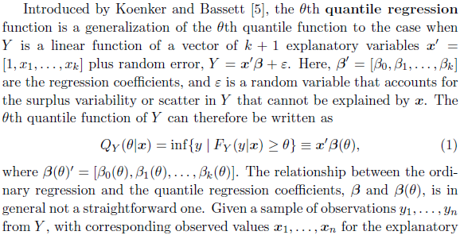
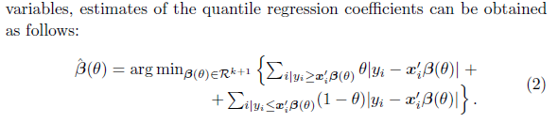
Percentile (Quantile) regression

Slide 16
Input variables
Data content: Selected site and soil characteristics for European simulation units (EU SimU dataset v.2), subset for Corine LC classes 210 (Arable land) and 240 (Heterogenous agricultural areas), N = 88054 SimU (table records)
Contact person (EU SimU dataset v.2): Juraj Balkovic, BNR/AFE group, balkovic@iiasa.ac.at; Rastislav Skalsky, BNR/AFE group, skalsky@iiasa.ac.at
Table descriptor:
Field Type Description
SimUID Number identification number of the simulation unit (SimU), unique identificator
SimU String alpha-numerical ontological code of simulation unit (SimU), unique identificator
YLAT Number y-coordinate (WGS, decimal degree) of the SimU centroid (SimU geometry = multi-part polygon, spatial aggregation of N 1k spatial resolution grid cells)
XLONG Number x-coordinate (WGS, decimal degree) of the SimU centroid (SimU geometry = multi-part polygon, spatial aggregation of N 1k spatial resolution grid cells)
ELEV Number mean altitude of the SimU (m)
SLOPE_PERC Number dominat slope of the SimU (%)
PROFILE_DEPTH Number soil profile depth (cm), sum of topsoil and subsoil layers, set to 100 cm for all soils
TOP_DEPTH Number depth (cm) of topsoil layer lower boundary (measured from mineral soil surface), set to 30 cm for all soils
SUB_DEPTH Number depth (cm) of subsoil layer lower boundary (measured from mineral soil surface), set to 100 cm for all soils
EFFECTIVE_PRF_DEPTH Number effective soil profile depth (cm), soil profile depth lowered by volume of stones (i.e. inert volume not holding water, not conaining nutrients, and with no roots)
AWC_PROF Number available water capacity of the soil profile (mm), effective soil depth assumed, potential amount of water in soil which is availble for plants and which can soil hold over periods without rainfall
SAND_TOP Number sand content (%) in topsoil layer
SAND_SUB Number sand content (%) in subsoil layer
SILT_TOP Number silt content (%) in topsoil layer
SILT_SUB Number silt content (%) in subsoil layer
CLAY_TOP Number clay content (%) in topsoil layer
CLAY_SUB Number clay content (%) in subsoil layer
BD_TOP Number bulk density (g.cm-3) of topsoil layer
BD_SUB Number bulk density (g.cm-3) of subsoil layer
VS_TOP Number volume (%) of stones in topsoil layer
VS_SUB Number volume (%) of stones in topsoil layer
OC_TOP Number concentration (%) of soil organic carbon in topsoil layer
OC_SUB Number concentration (%) of soil organic carbon in subsoil layer

Slide 17
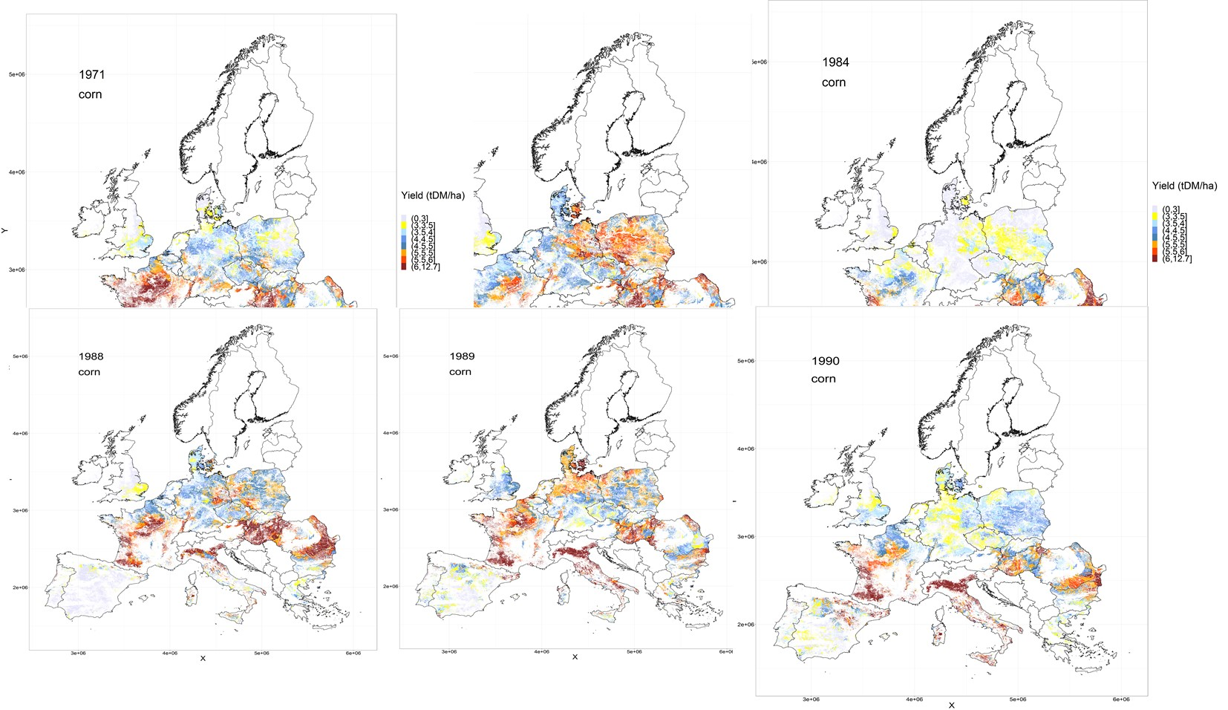

Slide 18
Percentile regression model, training data from 1971 to 2020, SimUID 69279,
Outliers?

Slide 19
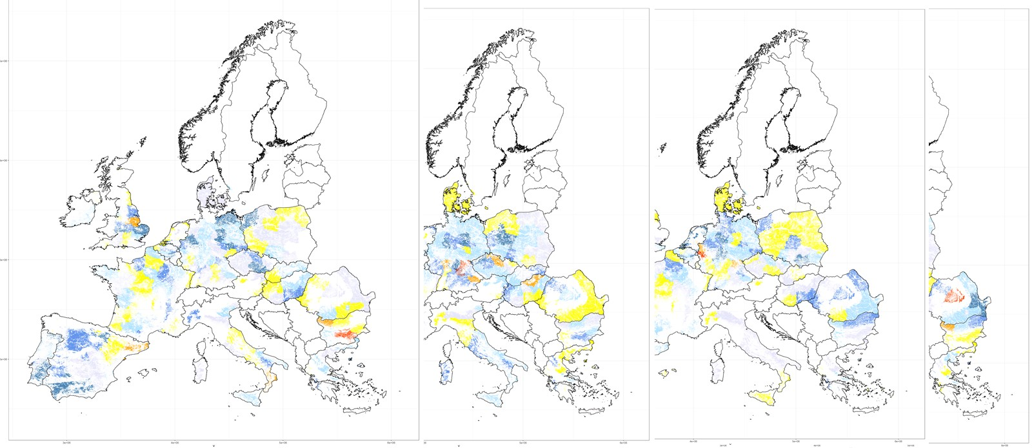
Classification of yield losses:
100*(Yield(Grid)-YieldAv)/ YieldAv
Quantile regression:
Probability of yield deviation
from Yield Average or a Yield Qunatile
As a function of 12 month T and P, soil characteristics
Prob (50% loss (wrt average yield)), 2011-2030
2031-2050
2051-2070
2071-2090

Slide 20
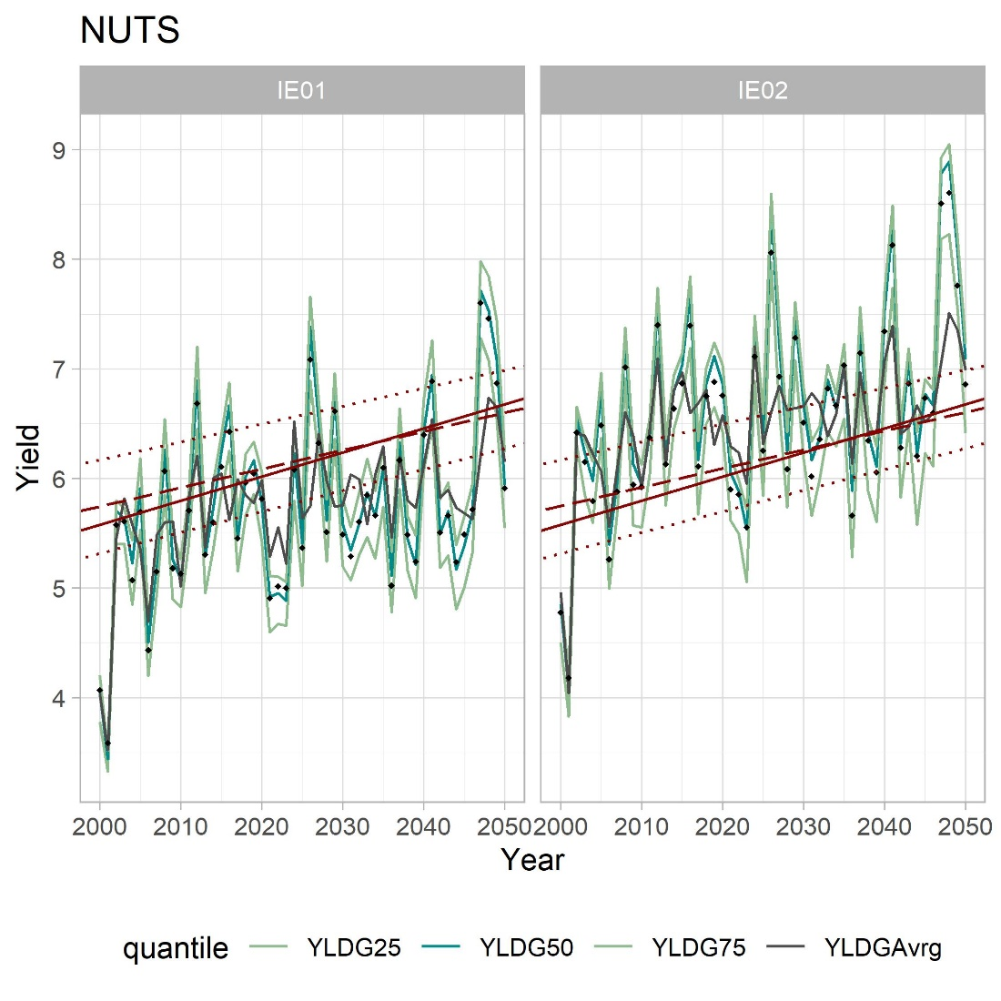
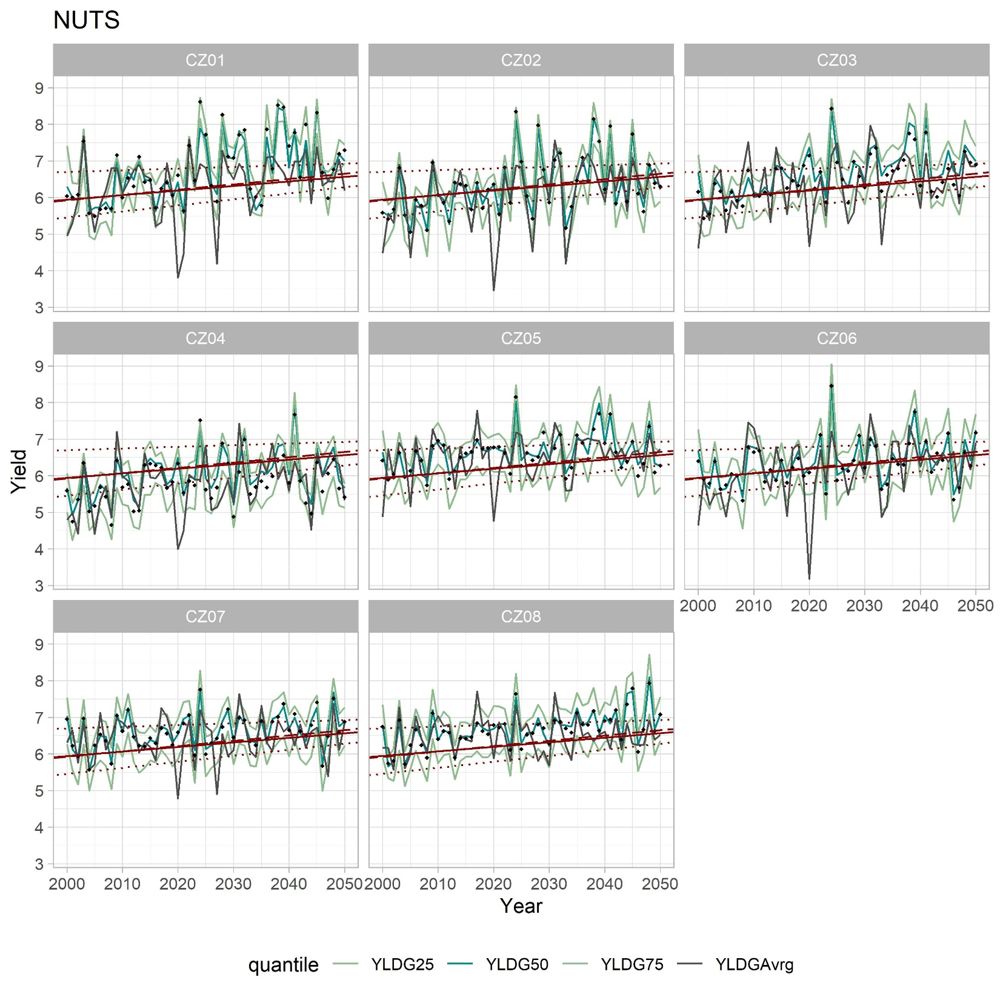
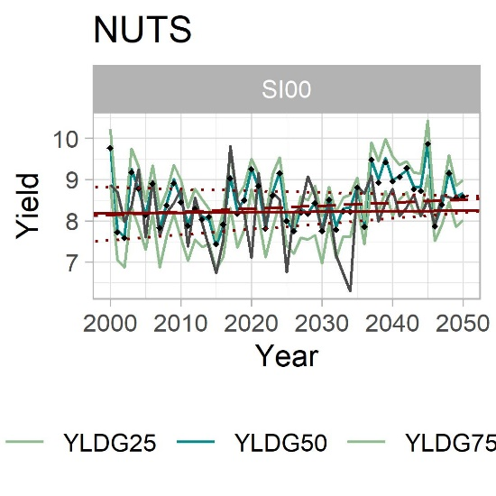
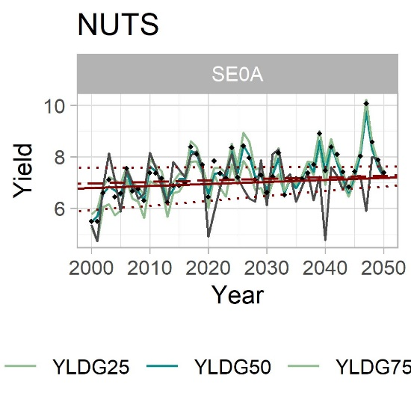

Slide 21
