Slide 1




Integrating climate impacts across energy, water, land systems within a global framework
European Geosciences Union’ 22
May 23, Vienna
Muhammad Awais, Adriano Vinca, Edward Byers, Oliver Fricko, Stefan Frank, Yusuke Satoh, Volker Krey, and Keywan Riahi
Energy Climate and Environment Program
International Institute for Applied Systems analysis

Slide 2
Rationale
“Human-induced climate change, including more frequent and intense extreme events, has caused widespread adverse impacts and related losses and damages to nature and people, beyond natural climate variability. Some development and adaptation efforts have reduced vulnerability.“ IPCC AR6 WGII SPM
Knowledge gap: | Implications of reaching Climate, Water, Energy, Land (CWEL) SDGs on impacts and vice versa Synergies & trade-offs required for climate impacts and policy objectives across CWEL sectors
This work: | Improves the representation of the nexus between water, energy, land and climate to identify realistic pathways that can achieve the goal to limit warming to well below 2°C and simultaneously other sustainable development goals
Notes:
To improve the representation of the nexus between water, energy, land and climate to identify realistic pathways that can achieve the goal to limit warming to well below 2°C and simultaneously other sustainable development goals

Slide 3

MESSAGEix-GLOBIOM
Global Integrated Assessment Model
MAGICC
simple climate model
Population
Economy
National level Projections
socio-economic drivers
G4M
spatially explicit forest management model
GLOBIOM
integrated agricultural, bioenergy and forestry model
socio-
economic
drivers
EPIC
agricultural
crop model
GHG and aerosol emissions
GAINS
GHG and air pollution mitigation model
air pollution emission
MESSAGEix
systems engineering model
(all GHGs and all energy sectors)
carbon and biomass price
energy structure
consistency of land-cover changes (spatially explicit maps of agricultural, urban, and forest land)
demand
response
agricultural and forest bioenergy potentials, land-use emissions and mitigation potential
MACRO
Aggregated macro-economic model
iteration
This work
service
prices
Buildings
buildings stock, appliances, energy access
Materials production and recycling of key materials
Water
infrastructure, supply and demand constraints
LPJmL
Global hydrological model
Documentation: https://docs.messageix.org/projects/global/
Notes:
IAMS & MESSAGE ix GLOBIOM

Slide 4
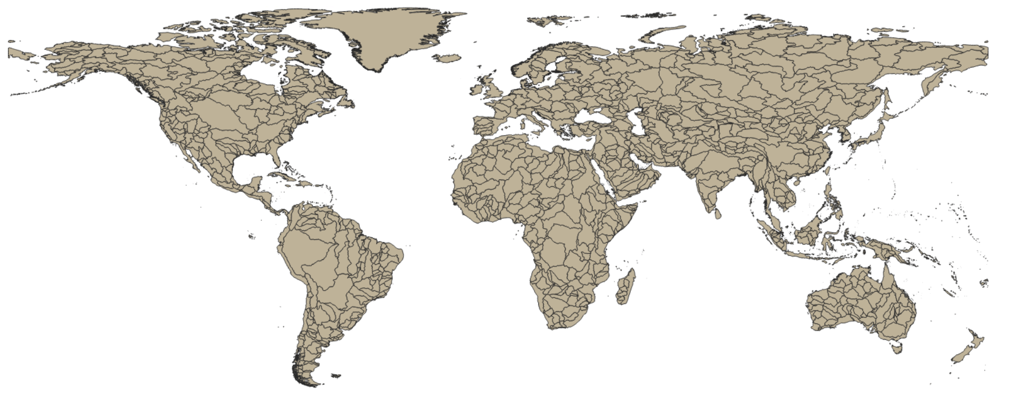
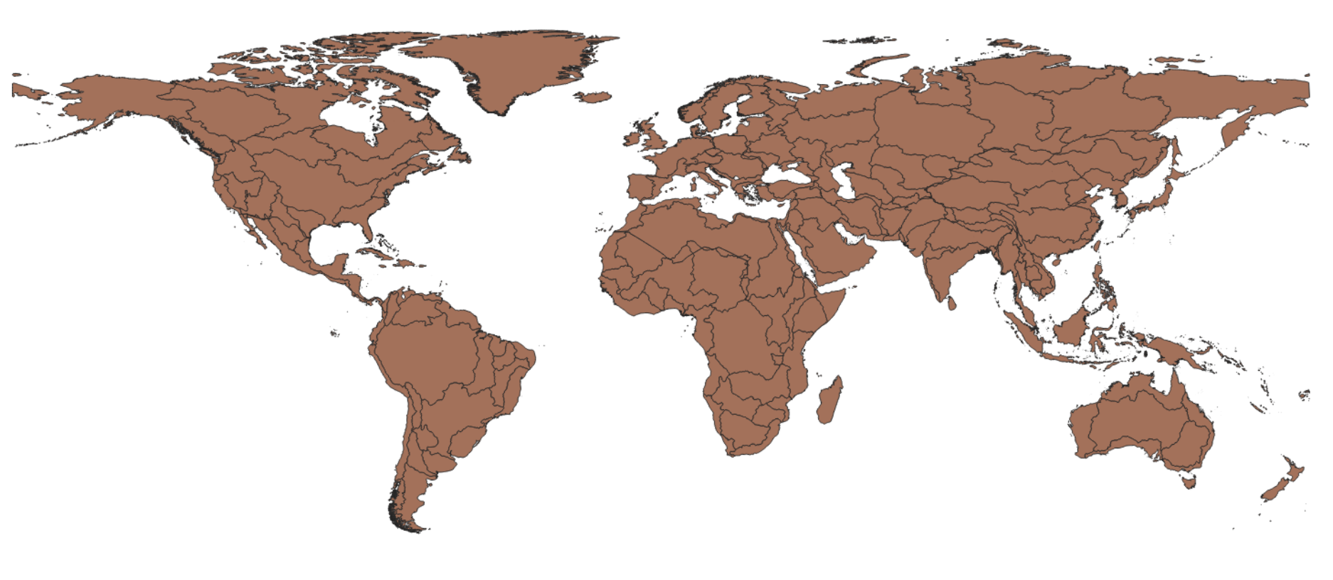
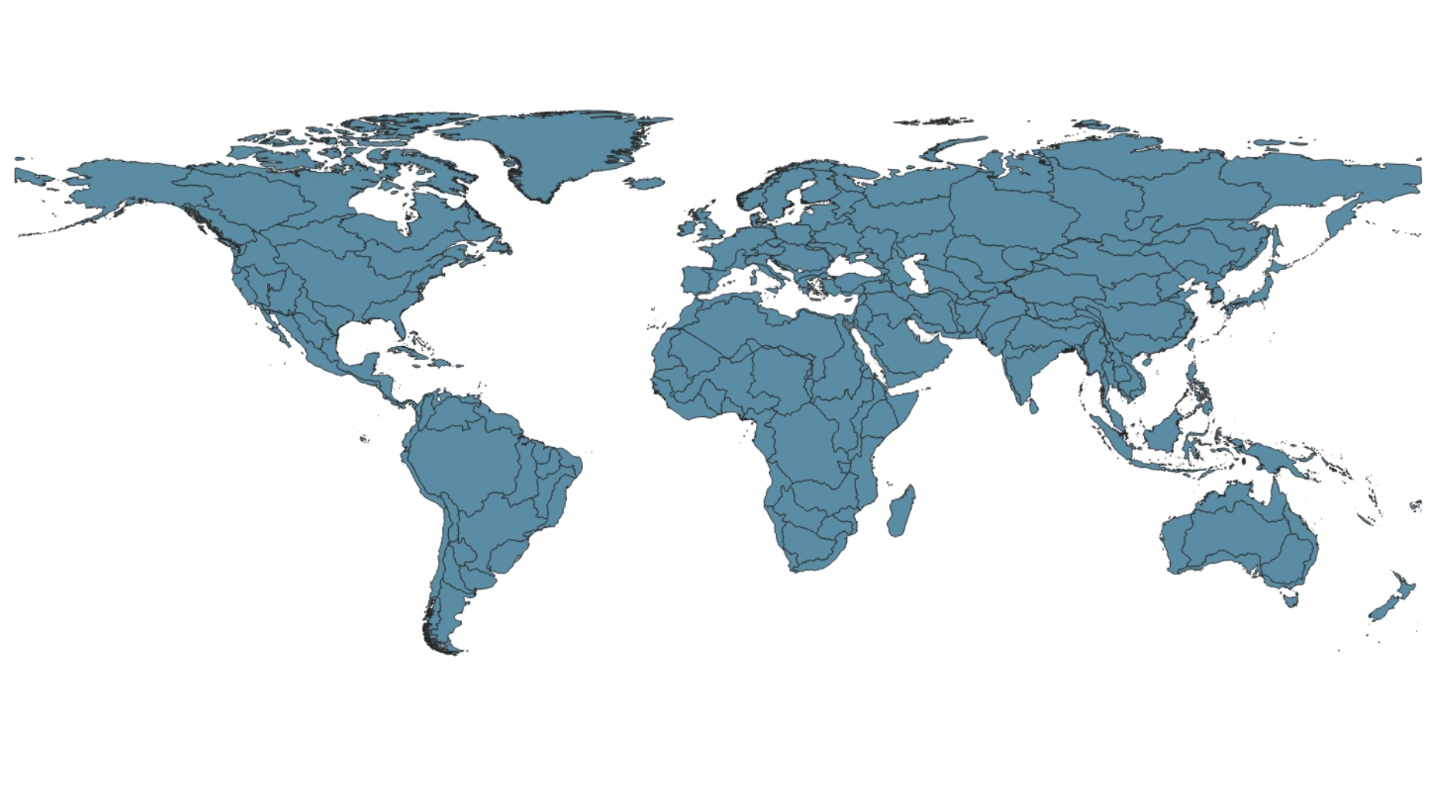
Choosing appropriate scale
Existing MESSAGEix-GLOBIOM on 11 region
Water system loses significant information on such aggregation
Choice of appropriate global basins representation to retain key hydrological information
Spatial intersection of global basins with MESSAGE regions.
~210 basins
Spatial resolution, complexity
HydroSHEDS Global Basin Database: https://www.hydrosheds.org/
4/18
Notes:
For water sector , choosing approporiate sector to be able to map to global IAM is a challenging part. The existing IAM is at 11 region which makes it challenging for the water sector to retain key hydrological information and transboundary aspects. We tested different levels of hydrobasins from HydroSHEDS global basin database to see what level of information could be appropriate. We consolidated level 2 & 3 hydrobasins which assumes approx. 195 basins . Some of the basins were intersecting the MESSAGE regions so we further intersected and the total number of basins became 205. We plan to use these 205 basins as a spatial unit in the water sector of the global IAM.

Slide 5


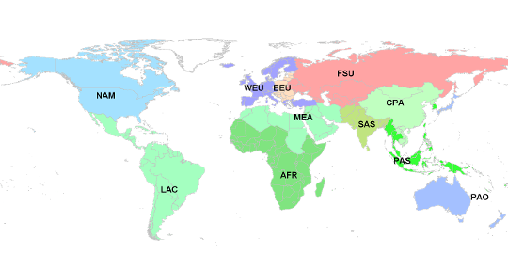
MESSAGEix-Nexus
Module of the MESSAGEix-GLOBIOM family
Water System
Water availibility
Sectoral water demands
Supply & distribution
Water table depth
Land System
Irrigation water
Crop efficiency
Crop types
Biomass trajectories
Harmonization &
upscaling
GLOBIOM emulator
Water Sector
~202 regions/basins
Energy Sector
11 region
water <->energy, land sector
*ISIMIP Output data from Global Hydrological Models - https://www.isimip.org/
**GLOBIOM – Global Biospehere Management model - https://iiasa.github.io/GLOBIOM/
5/18
Notes:
We plan to implement water constraints suhc as availabel water, water sectoral demands on these 202 basins by using the harmonized outputs from the global hydorlogical model, CWATM. These constraints will be mapped to energy sector i.e 11 regions wherever there is need to access the implications of sectoral activities. We are also having discussion with the modelling team of GLOBIOM to provide us more information on irrigation water demand and use from the outputs from GLOBIOM to better access the water use for irrigation and its energy implications.

Slide 6
MESSAGEix-Nexus
Module of the MESSAGEix-GLOBIOM family
Water System
Water availibility
Sectoral water demands
Supply & distribution
Water table depth
Land System
Irrigation water
Crop efficiency
Crop types
Biomass trajectories
Harmonization &
upscaling
GLOBIOM emulator
Water Sector
~202 regions/basins
Energy Sector
11 region
water <->energy, land sector
*ISIMIP Output data from Global Hydrological Models - https://www.isimip.org/
**GLOBIOM – Global Biospehere Management model - https://iiasa.github.io/GLOBIOM/
5/18
Notes:
We plan to implement water constraints suhc as availabel water, water sectoral demands on these 202 basins by using the harmonized outputs from the global hydorlogical model, CWATM. These constraints will be mapped to energy sector i.e 11 regions wherever there is need to access the implications of sectoral activities. We are also having discussion with the modelling team of GLOBIOM to provide us more information on irrigation water demand and use from the outputs from GLOBIOM to better access the water use for irrigation and its energy implications.

Slide 7
Model Structure & Workflows
Input Data
- spatial/temporal processing
Projections for future
cost estimations
Historical data calibration
Core model
Modular approach
Scenario instances
Output Data
Post-processing (computations & costs assessments)
Plots
6/18
Notes:
5 arc min

Slide 8
Reference System
Freshwater (Region)
Irrigation
Distribution
Saline water supply
Treatment
Freshwater (Basin)
River Basin
Irrigation
Irrigation water demand (GLOBIOM) ¹
Surface water (SW)
(GHM)
Cooling technologies requiring freshwater
Rural municipal
water demand²
Return Flows
Urban municipal water demand²
Cooling technologies requiring seawater
Renewable Ground water (GW)
(GHM)
Urban transmission & distribution
Rural disconnected water demand³
Energy resources & extraction
Sea water
Urban disconnected water demand³
Rural transmission & distribution
Desalinated Water
Urban treatment
Urban collected Wastewater⁴
Rural end-use
recycling
Fossil Ground water (GW)
Rural treatment
Rural collected wastewater⁴
Urban end-use
recycling
Urban uncollected Wastewater⁵
Rural uncollected wastewater⁵
Energy Supply (MESSAGE)
¹Irrigation withdrawals from GLOBIOM model emulator
²Urban/Rural municipal water demand = Urban/Rural Withdrawals X connection rate
³Urban/Rural disconnected water = Urban/Rural Withdrawals X (1- connection rate)
⁴Urban/Rural collected wastewater = Urban/Rural Return flows X treatment rate
⁵Urban/Rural uncollected wastewater = Urban/Rural Return flows X (1-treatment rate)
Legend
Energy
Return flows
SW: Surface Water
GW: Groundwater
GHM: Global Hydrological Model
WW: Wastewater
Basin: 210 basins
Region: MESSAGE R11
Exogenous input (demand)
Resource
extraction
Technology / process
Output /
sink
Water (basin)
7/18
Basins- Region

Slide 9
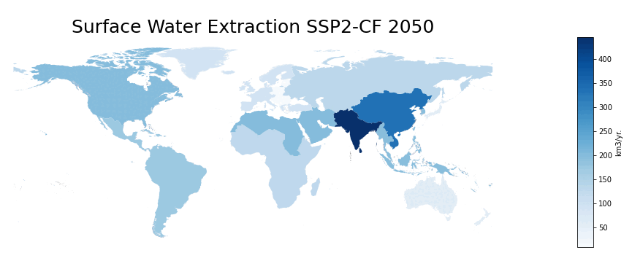
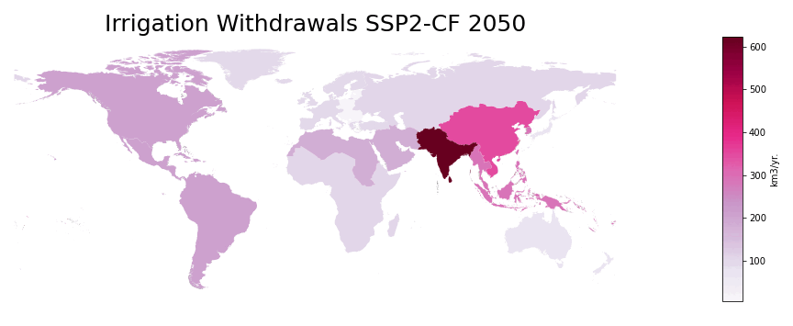
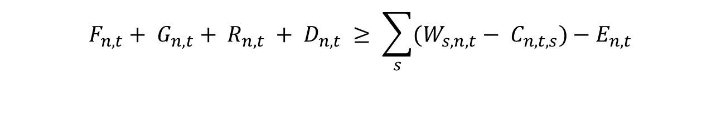
Water balance
$$F_{n,t}+ G_{n,t}+ R_{n,t} + D_{n,t} ≥ \sum_{s}{(W_{s,n,t}− C_{n,t,s})−E_{n,t}}$$
F - Freshwater supplied from river basins
G - Freshwater supplied from groundwater aquifers
R - freshwater supplied from wastewater recycling facilities
W - Withdrawals from sectors (agriculture, municipal, energy, industrial)
C - Conservation measures
E - Environmental flows
s - sectors (agriculture, energy, industrial)
n - nodes (river basins)
t - time periods
6/18
Notes:
5 arc min

Slide 10
Approach – Climate Impacts
Climate impact | Approach | IMAGE | MESSAGEix-GLOBIOM
Renewable supply (wind, PV, CSP, hydro, bioenergy) | Different costs supply curves based on 0.5x0.5 grid calculations [Gernaat, et al. 2021] | Yes | Yes, hydropower only
Heating / cooling demand | Impact via population weighted HDD, CDD based on 0.5 x 0.5 grid [Byers, et al. 2018] | Yes | Yes
Water availability | Runoff and groundwater recharge from LPJmL calculated at 0.5 x 0.5 grid (ISIMIP 2b) [Frieler et al., 2017] | Yes | Yes
Crop yields | IMAGE: Crop yield change due to climate change calculated in LPJmL on 0.5 x 0.5 grid [Schaphoff et al., 2018 ] MESSAGE-GLOBIOM: Crop yields from [Byers et al., 2018] are used in the GLOBIOM model. | Yes | Yes
Power plant cooling & desalination potential | Power plant cooling: van Vliet 2016 Desalination: specific analysis | No | yes
13/18

Slide 11
Climate Impacts: Hydrology
Flexible structure to adapt gridded hydrological data from any Global Hydrological Model
Q90 flows to maintain reliable flows throughout the year
Variability across impact scenarios
Environmental flowws based on Variable Monthly Flow (VMF) method1
7/19

Slide 12
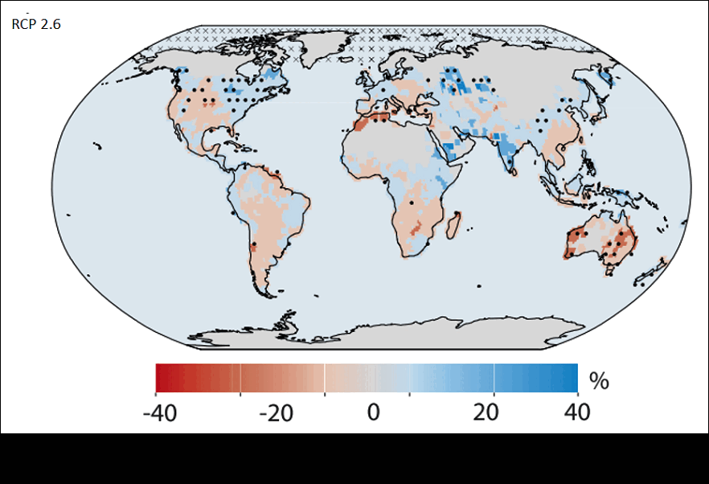
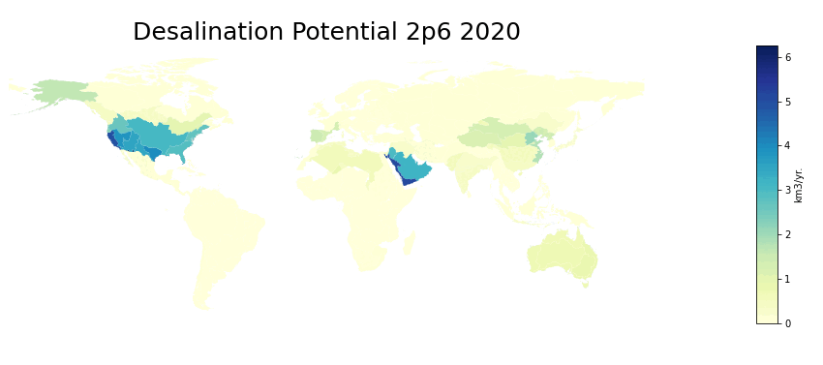
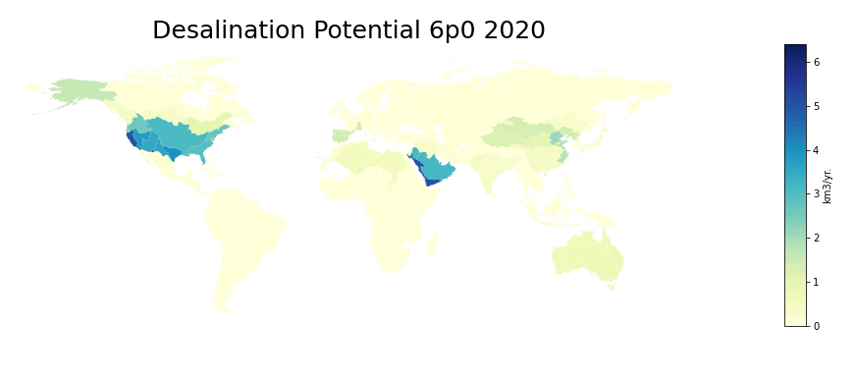
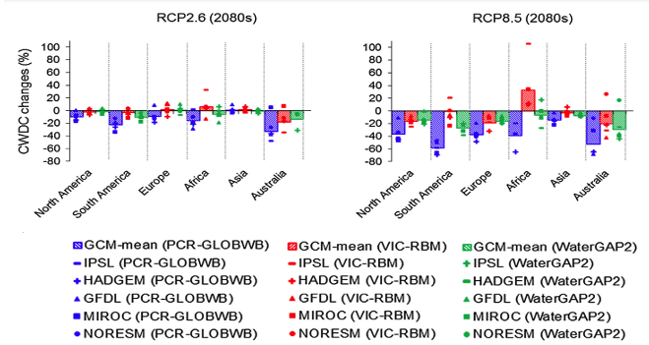
Climate Impacts
Desalination, Hydropower, Thermal plants potential
Hydropower Potential
[Gernaat et al., 2021 Nature Climate Change]
Cooling Water Discharge
[van Villet et al. 2016 , Global Environmental Change]

Slide 13
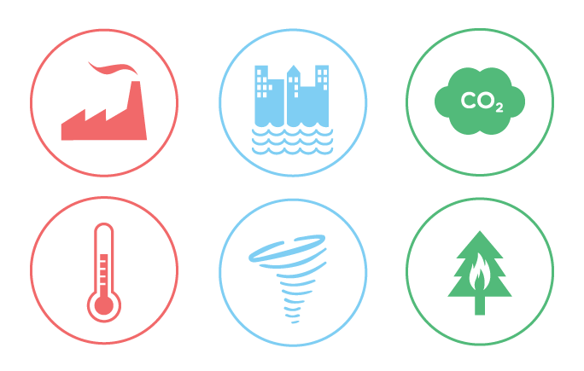





Scenario | Climate Forcing (W/m²) | SDGs | Impacts
SSP2-noCF | 6.0 | No additional effort | Frozen to 2020
SSP2-CF | 6.0 | No additional effort
SSP2-SDG-noCF | 6.0 |  | Frozen to 2020
SSP2-SDG-CF | 6.0
SSP2-26-SDG-CF | 2.6
SSP2-26-CF | 2.6 | No additional effort
SSP2 – Middle of the Road Socio Economic Pathway
CF – Climate Feedback
9/18
Notes:
This section describes the nexus SDG measures as included in both the models in the SDG scenarios. Table 2 provides an overview of the measures and their representation in the models. I will briefly explain the The underlying methodology and approach In the following slides.
Most measures are implemented in an equal or very similar way in both models, to allow for a fair comparison. An exception is the water SDG, where MESSAGEix-GLOBIOM includes measures on sanitation and wastewater and IMAGE has a stronger focus on water efficiency. The interaction between these measures and the other SDG categories is relatively limited.
Where relevant in the analyses, we have looked at single-model results in these cases.
Radiative forcing (or climate forcing^{[1]}) is the change in energy flux in the atmosphere caused by natural or anthropogenic factors of climate change as measured by watts / metre

Slide 14
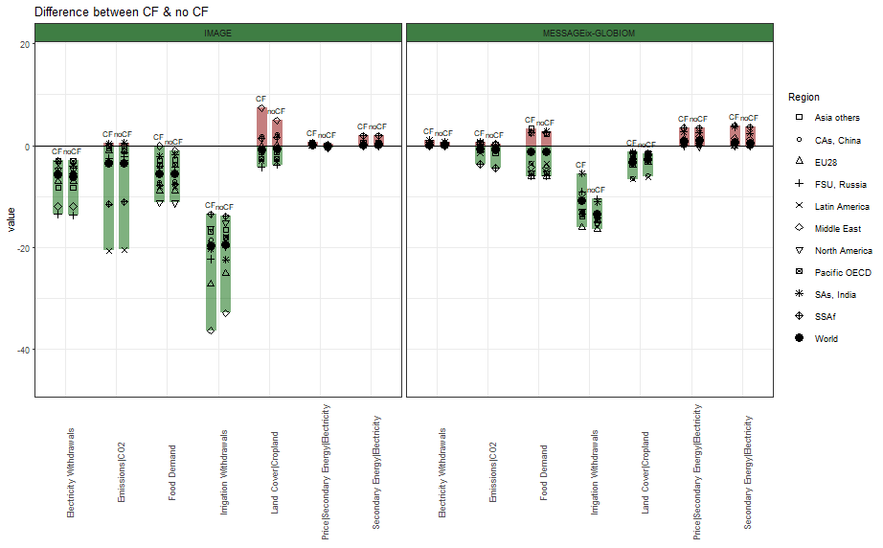
Results: SDG implications w and w/o climate feedbacks
What are the implications of meeting nexus SDGs (2,6,7,13,15), and how are these affected by
climate change impacts (rcp 6.0) ?
Results are average difference (2030-2100) from baseline scenario (no SDG & no CF)
Short vs long term changes.
The SDG impacts themself are however higher on the long term.
14/18
Preliminary results, do not cite!
Notes:
Reductions in irrigation withdrawals from the land sector allocate more water to ecosystem protection and contribute to the needs of domestic and energy withdrawals. Improving wastewater treatment ratio and more efficient water management technologies have societal and environmental benefits considering their investment needs. They help reduce pressure on freshwater withdrawals in the water-stressed regions and provide the poor population access to clean drinking water. Some regions show sensitivity to climate impacts (the Middle East and South Asia) in the water sector, leading to higher costs in water efficiency investments.
Ambitious and healthy diet changes and a reduction in food waste (in the absence of climate policy) lead to a reduction in global food demand (7-13%), irrigation withdrawals (20-30%) and AFOLU emissions (30-71%) .Changes in the land sector reduce the overall SDG policy costs and strongly reduce energy and water expenditures and thus also contribute to improving the needs of the poor.

Slide 15


Discussion
High resolution models, data, analyses
Smoothing data flows
Choice amongst different possible flows
Trade-offs between the complexity and validity
Integrating extremes
Preferred sources/methods for consistency of data
Muhammad Awais
awais@iiasa.ac.at
@_awaismuhammad
Thank You!
15/15

Slide 16
Data Assumptions
Hydrological Data
Spatial & temporal processing of gridded large-scale data from ISIMIP Global Hydrological Model outputs
Economic parameters & energy intensity for water sector from literature sources
Wastewater Recycling
Based on treatment rates of different regions, wastewater recycling is exogenously calculated across basins
Desalination potential
Desalination potential based on GDP, water stress, distance of the region from coast and other proxy indicators
Energy
  Calibrated water Consumption per unit of energy activity
  Irrigation Withdrawals linked from GLOBIOM module coming from CWATM Global Hydrological Model aggregated from gridded monthly data to 5-year annual averages
Water demands
Agriculture
Municipal/Industrial
  Municipal/Industrial demands aggregated from gridded data
6/18
Notes:
5 arc min

Slide 17
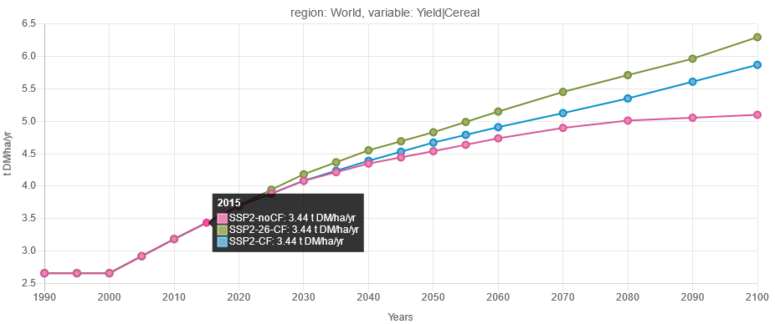
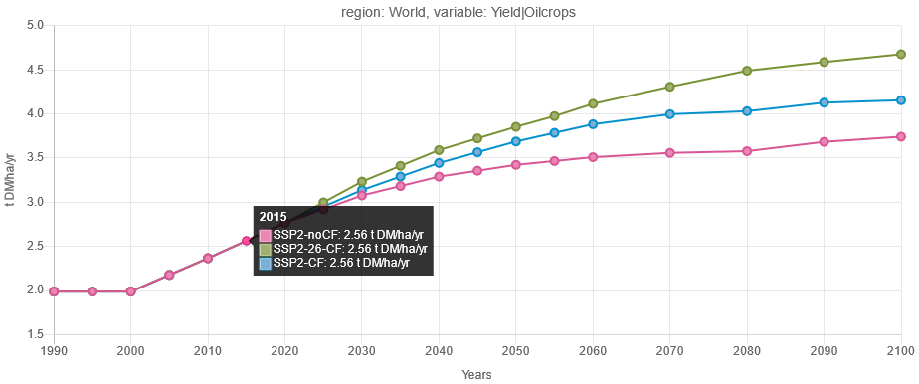
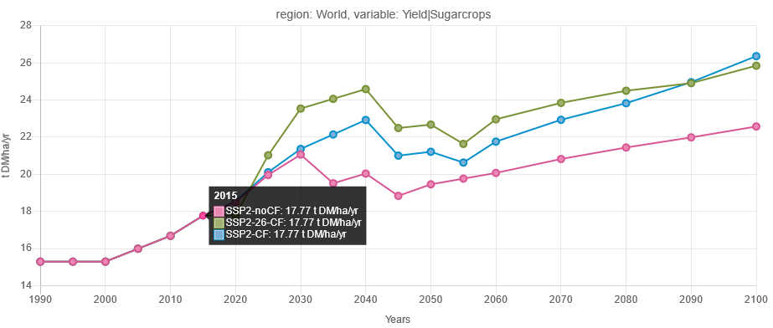
Climate Feedback: Crop yields
Global resulting yields per crop category, SSP2
Very region-dependent, some regions will gain yield, other will have yield losses.
EPIC crop model (ISIMIP, LPJmL input) → MESSAGEix-GLOBIOM
→ affect SDG 2, 15 crop choices and SDG6 irrigation water withdrawals
RCP 2.6
RCP 6.0
No CF

Slide 18
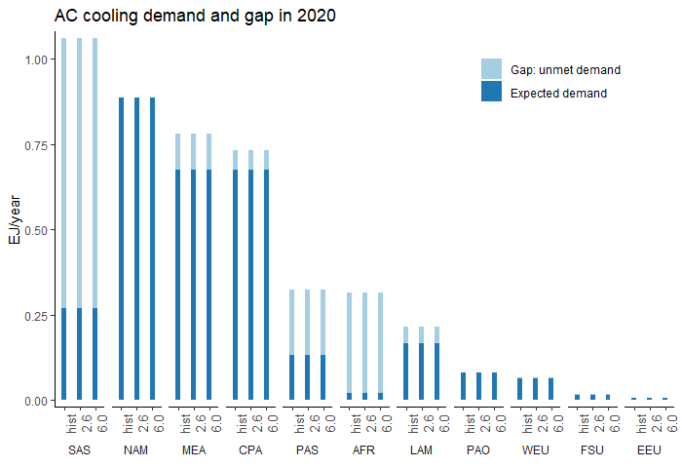
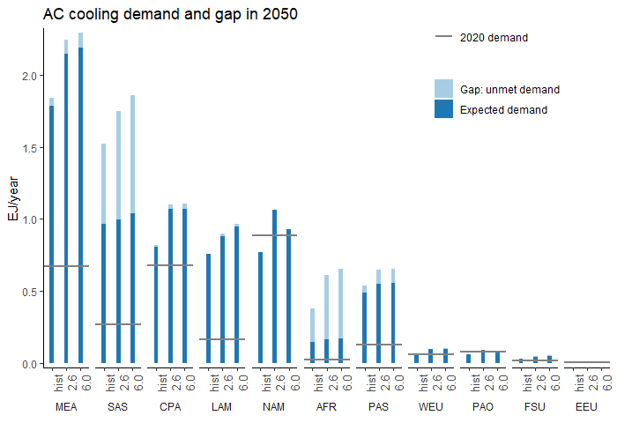
Climate Impacts: AC cooling demand and gap
Cooling demand is likely to increase. South Asia and Africa have large % of population with not adequate cooling (Gap: unmet demand). Different climate affects GMT and CDD
→ interactions with SDG 7, energy access, higher energy requirements for RCP 6.0
climate
SSP2 projections from Mastrucci et al. 2021, Climatic Change

Slide 19
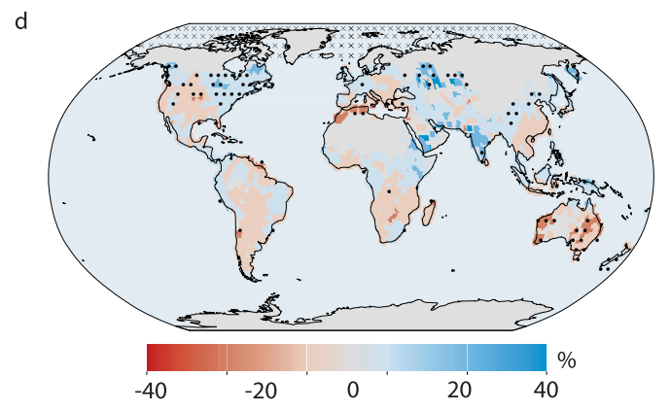
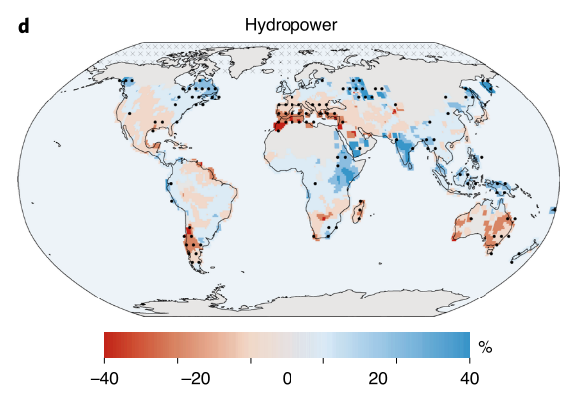
Climate Feedback: Hydropower potential & Thermal plants cooling
Some regions can experience higher precipitation patterns in the coming decades under RCP 6.0, with a potential increase in hydropower capacity. Other areas will suffer of water scarcity and increased droughts.
→ Both benefits and trade-off with SDG 7 and SDG 13
RCP 2.6
RCP 6.0
The differences in the multi-model mean (over GCMs GFLD-ESM2M, HadGEM2-ES, IPSL-CM5A-LR and MIROC5) of the historical period (1970–2000) compared with the future period (2070–2100). Gernaat et al., 2021 Nature Climate Change

Slide 20
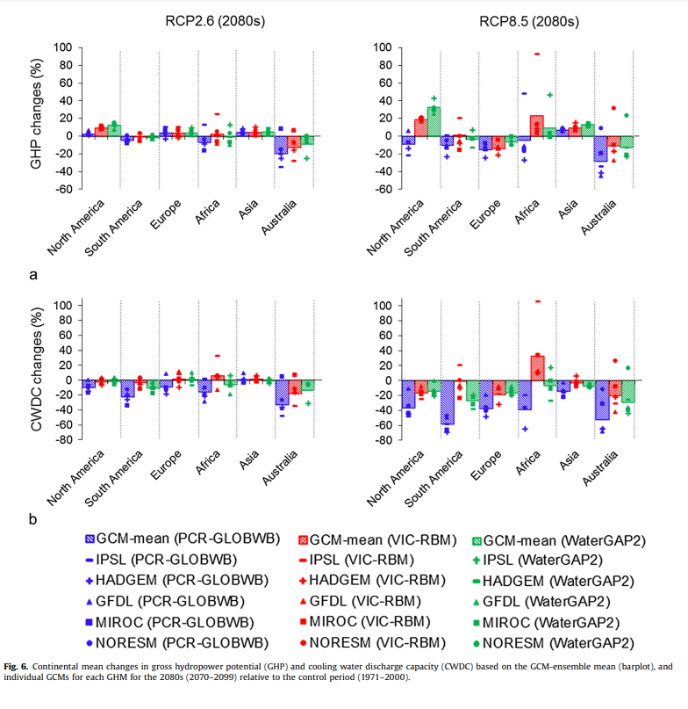
Climate Feedback: Cooling Water Discharge
van Villet et al. 2016 , Global Environmental Change

Slide 21
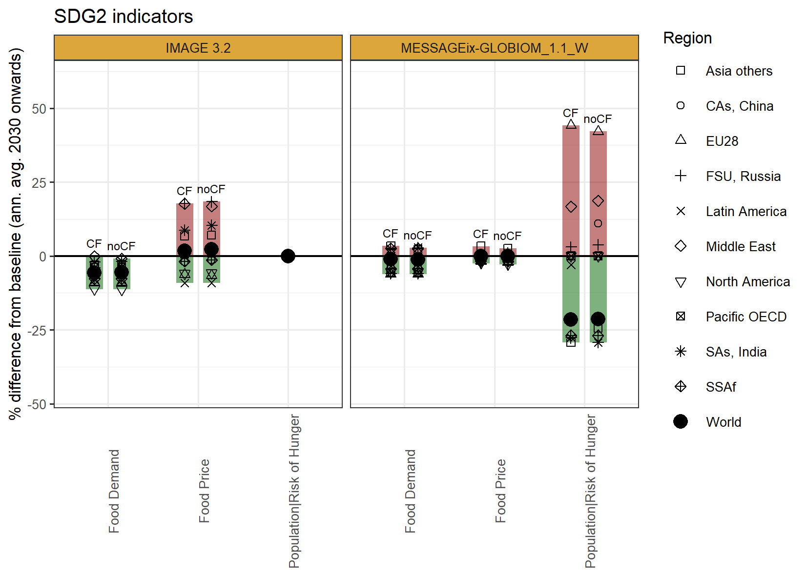
Results: SDG implications w and w/o climate feedbacks
What are the major system changes required to achieve SDG objectives in SSP2 RCP6.0 ?
Healthy diet and food waste compensate the increase in calories intake on overall food demand
Small and mostly negative food price changes, apart from central Asia
Small changes with and w/o Climate Feedback (CF)
Note: short vs long term changes.
the same results for before or after 2050 show similar effect of CF on SDG indicators. The SDG impacts themself are however higher on the long term.
Prelimary results, please don’t cite
Notes:
We grouped food demand, food price index and population with risk of hunger to evaluate scenario developments in relation to SDG2 (Figure 4). We then assess how following the EAT-Lancet diet , limiting calorie intake to cater undernourishment and reducing food waste affects the model responses, in terms of SDG2 related indicators (food demand, food price, risk of hunger). Improvements in healthy diet and food waste compensate for the increase in calories intake on overall food demand. We observe that globally food demand decreases by 7.1-13.5 % (321-349 kcal/cap/day) considering climate feedback compared to 7.2-13.9% (330-357 kcal/cap/day) in a no feedback case. This shows that achieving SDGs have a significant impact on food demand, compared to climate feedbacks when averaged over the globe. However, in the global north, we observe significantly lower effects of climate feedback across scenarios in both models, yet, in the global south, food demand increases until 2045 and then it starts decreasing. The food prices increase in the order of 4-10 % in Asia, Former Soviet Union, Middle-East, India until 2040 to adapt the food measures for SDGs whereas global north regions show a decrease in food prices across the years. The increase in food prices in the Mmiddle Eeast and former Ssoviet Uunion is predominantly due to environmental flow requirements which reduce production in irrigated areas. The imbalance between the model results of food prices for climate feedback is because of how the targets are set across scenarios. The reduced pressure on the land sector causes food prices to decrease in a sustainable development pathway in general. Approx. 334 million people are provided enough food until 2030 and another additional 310 million people are provided food to contribute to the zero hunger SDG target.
should be explained here as well.

Slide 22
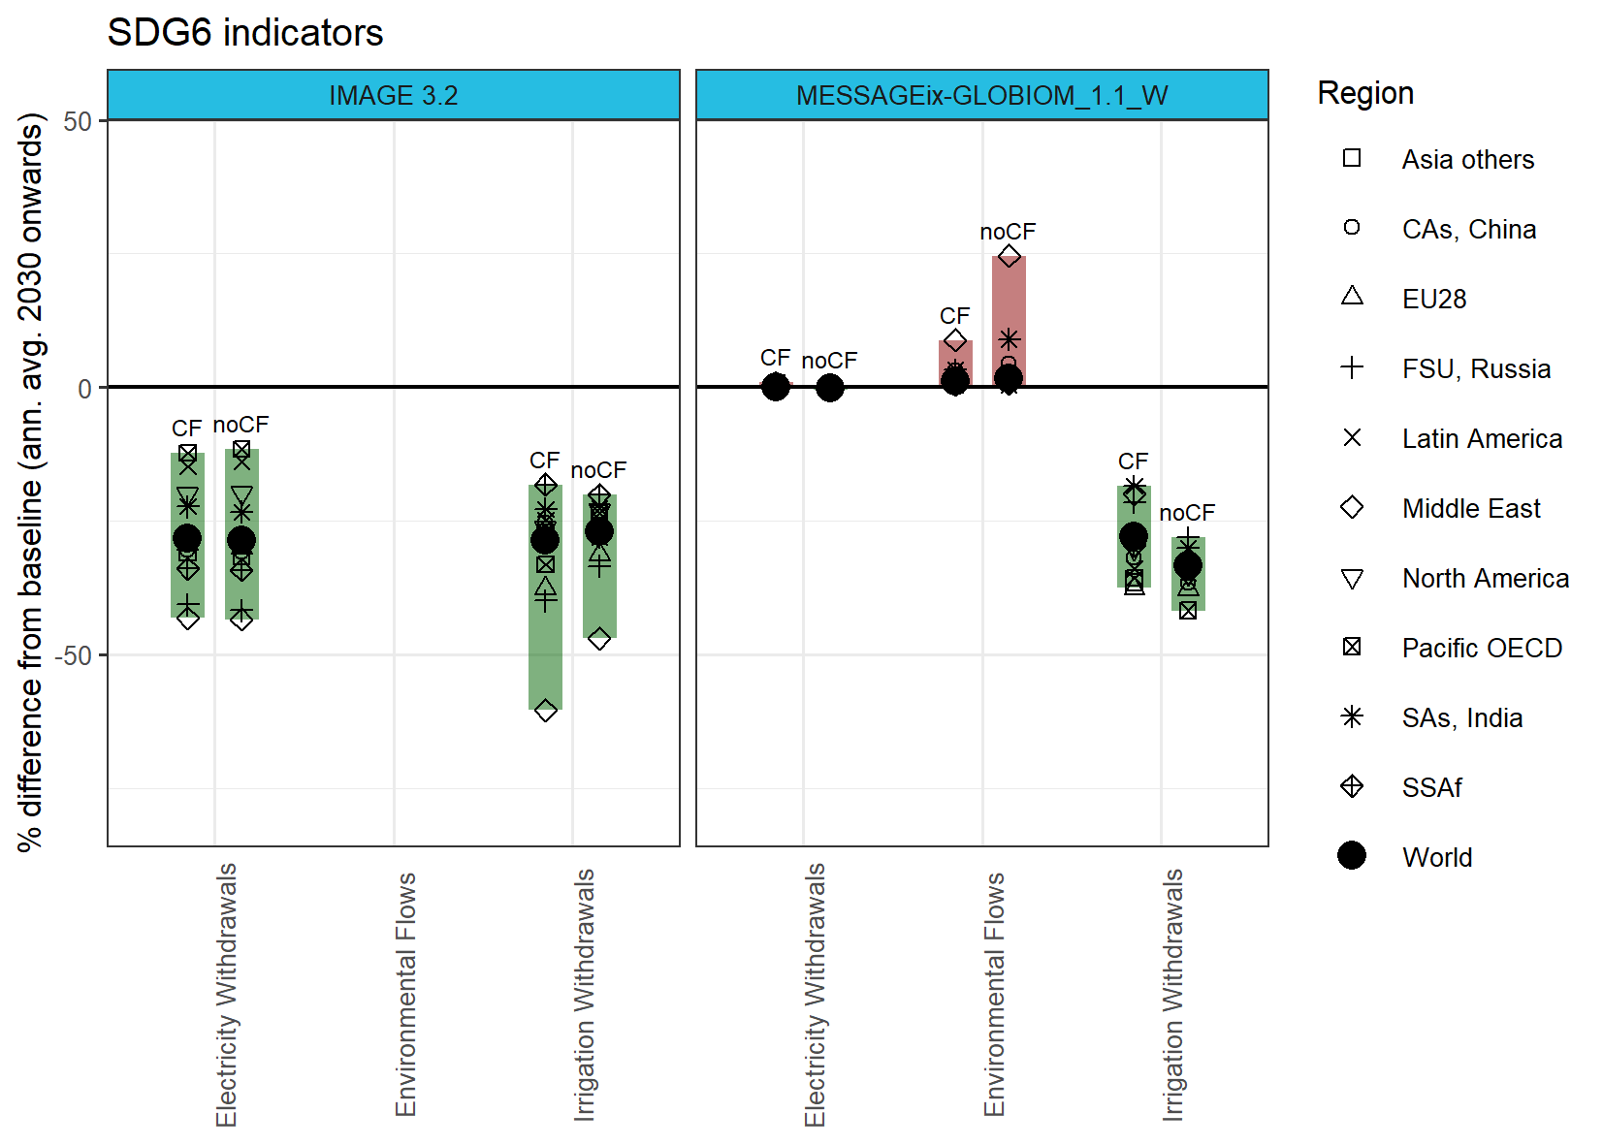
SDG implications w and w/o climate feedbacks
Expected positive effects on all indicators
Climate Feedback affect mostly environmental flow and irrigation withdrawals
Some regions show high vulnerability to climate impacts and show high water stress e.g Middle East & South Asia
Approx. 1900 million people provided with clean drinking water access globally
Prelimary results, please don’t cite
Notes:
The SDG6 cluster includes assessing impacts of scenarios on agriculture & energy withdrawals, and environmental flows. We observe a decrease in agricultural withdrawals compared to the baseline scenario overall (see Figure 5). However, cClimate impacts lead to ashow lesser decrease in withdrawals than a no climate impacts case. For the Pacific OECD and North America, reduction in irrigation withdrawals vary from 29.7-32.97 % in a climate feedback scenario as compared to 23.3-38.3 % in a non impact scenario. Asian regions show average reduction in withdrawals from 25-27% in a climate feedback scenario compared to 27-31.4% in a non impact case in SDG case. These reductions in irrigation withdrawals promote sustainable water use in water stressed regions. The SDG scenarios from the results assume that approx. 1900 million people are provided clean drinking water access by 2050 globally. The model response shows that the climate feedback case allows less environmental flow allocation than a non-impact case. The Middle East shows the highest difference between the climate feedback (around 15%), which shows the very high vulnerability of this region regions to climate impacts.

Slide 23
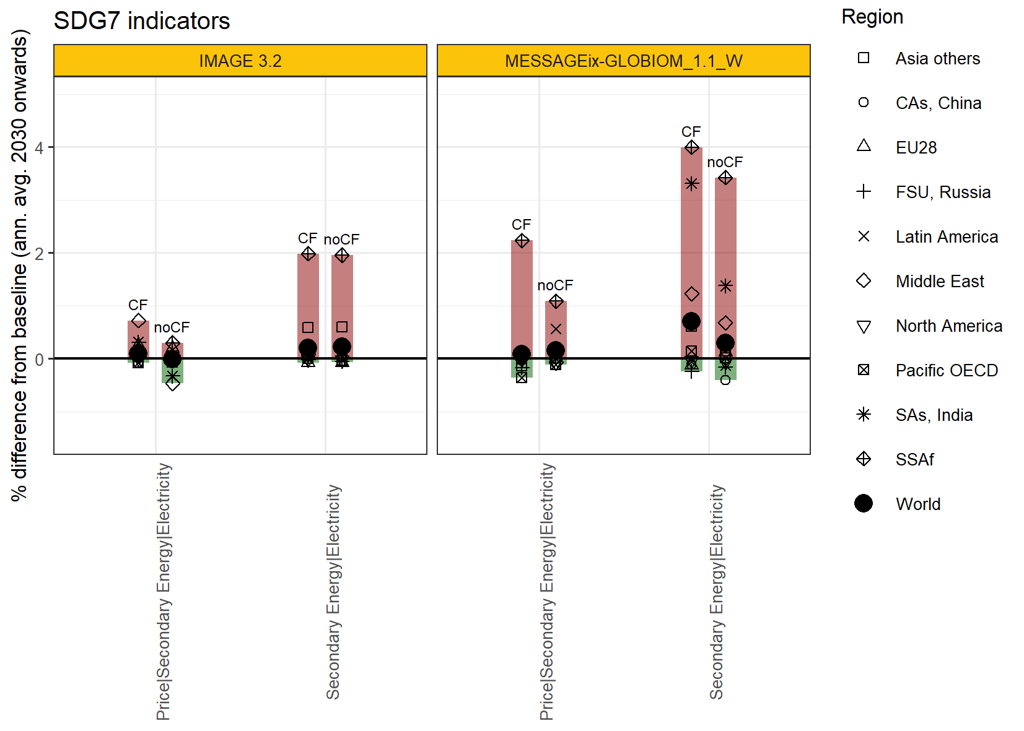
SDG implications w and w/o climate feedbacks
Improving energy and water access, and AC demand increases electricity production and prices
Variations lower than 3% and almost 0 globally
Highest increases in South Asia, Sub-Saharan Africa and Middle East
Prelimary results, please don’t cite
Notes:
For assessing the impacts of SDG7, we clustered energy prices and electricity uses to show effects of SDG measures across a climate impact dimension. The results on electricity usage showed a major difference in the increase of usage due to the difference of implementation of SDG7 measures across both models (see Figure 6). The results overall show an increase of 0.2-0.7 % in the electricity usage considering climate feedbacks as compared to 0.2-0.3 % in a no feedback case globally. The global results show a net increase in usage of electricity however regional results show that global south shows an increase in usage of electricity primarily due to provision of electricity and modern energy while global north regions show a decrease in electricity usage considering SDG measures. The increase from the baseline (non-SDG case) is lesser however MESSAGEix-GLOBIOM shows a significant variation in the results between the climate feedbacks. Climate feedback results in higher electricity usage in the Middle East, India, and Central Asian countries. Electricity price variation is vaery less as compared to other indicators globally (0.0-0.15 %). IMAGE shows a decrease in electricity price from a baseline case in a no climate feedback scenario in most of the regions; however, MESSAGEix-GLOBIOM results show reduced prices in most of the global north regions (North America, Pacific OECD countries). Both models show slightly larger prices in electricity in a climate feedback case with MESSAGEix-GLOBIOM being more sensitive to climate feedback due to the impacts on the renewable energy systems.

Slide 24
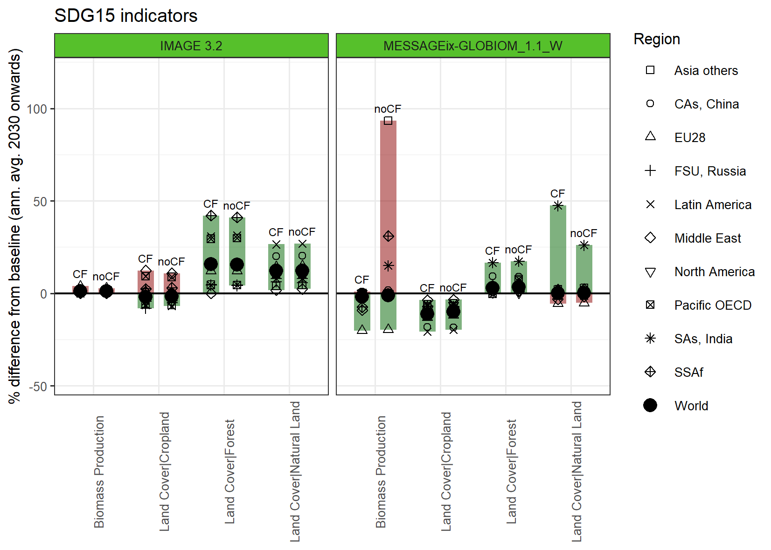
SDG implications w and w/o climate feedbacks
Great variations especially for Central Asia, South Asia and Sub-Saharan Africa
Noticeable differences between IMAGE and MESSAGE-GLOBIOM, particularly in Biomass Production and Cropland
Prelimary results, please don’t cite
Notes:
We clustered biomass production and land cover outlook to show the results of SDG and climate feedbacks (See Figure 7). The results indicate that biomass production increased by 1.09 (no feedback), decreased by -1.2% (climate feedback) (IMAGE 3.2) and decreased by -1.19 (no feedback) -1.7% (climate feedback) MESSAGEIx-GLOBIOM) globally. However, results from MESSAGEix-GLOBIOM show a greater sensitivity to climate feedback across different regions. Biomass production increases significantly in India due to the impacts of climate. Other regions show lesser biomass production under the impacts of climate. Overall Asian countries show a significant difference in biomass production. The results on biomass production vary across the two models based on different sets of assumptions and model responses for the SDG measures. Central Asian, South Asian & Sub-Saharan African countries have relatively larger differences in achieving SDG 15. Both models show net positive increase in share of natural land which consequently helps in biodiversity protection. MESSAGEix-GLOBIOM shows the impact of climate feedback on the share of natural land with a significant difference in India due to the pressure on natural resources with higher population density.

Slide 25
SDG implications w and w/o climate feedbacks
What are the implications of meeting nexus SDGs (2,6,7,13,15), and how are these affected by climate change impacts (rcp 6.0) ?
In the context of SDG scenarios, Climate feedbacks effects are much lower than SDG policy effects
Including climate feedbacks in the model does change the results with larger variations (between 5-20%) for electricity production, AFOLU emissions and irrigation water withdrawals
Electrification of households and clean cooking services increase the energy demand in the developing regions and some poor regions. It requires household incomes to increase 50-80% across scenario
South Asia, Central Asia, Middle East and Sub-Saharan Africa are the regions that shows largest benefits from the SDG agenda, but are also the most vulnerable to climate feedback
Limitations:
Identify causalities between CF and changes in SDG targets is complicated due to the large number of sectors and dimensions
Model sensitivity to climate uncertainty

