Slide 1
Citizen science data for tracking progress towards sustainable development
Dr. Dilek Fraisl
Research Scholar, International Institute for Applied Systems Analysis (IIASA)
Managing Director, Citizen Science Global Partnership (CSGP)
fraisl@iiasa.ac.at
@dilekfraisl1

Slide 2
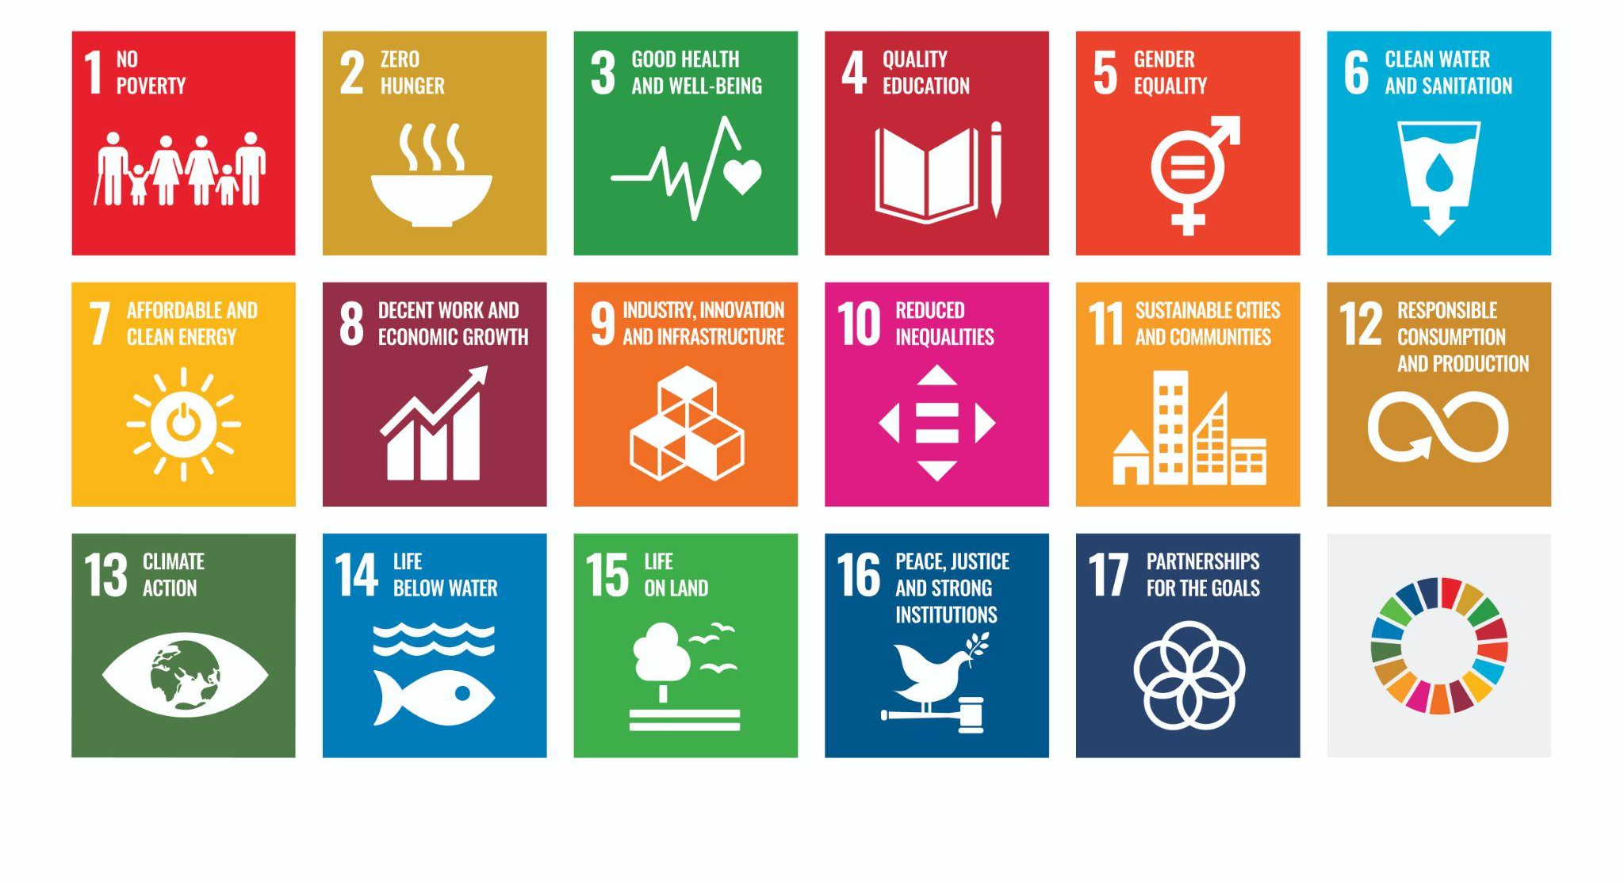
Sustainable Development Goals (SDGs):
17 Goals, 169 Targets

Slide 3
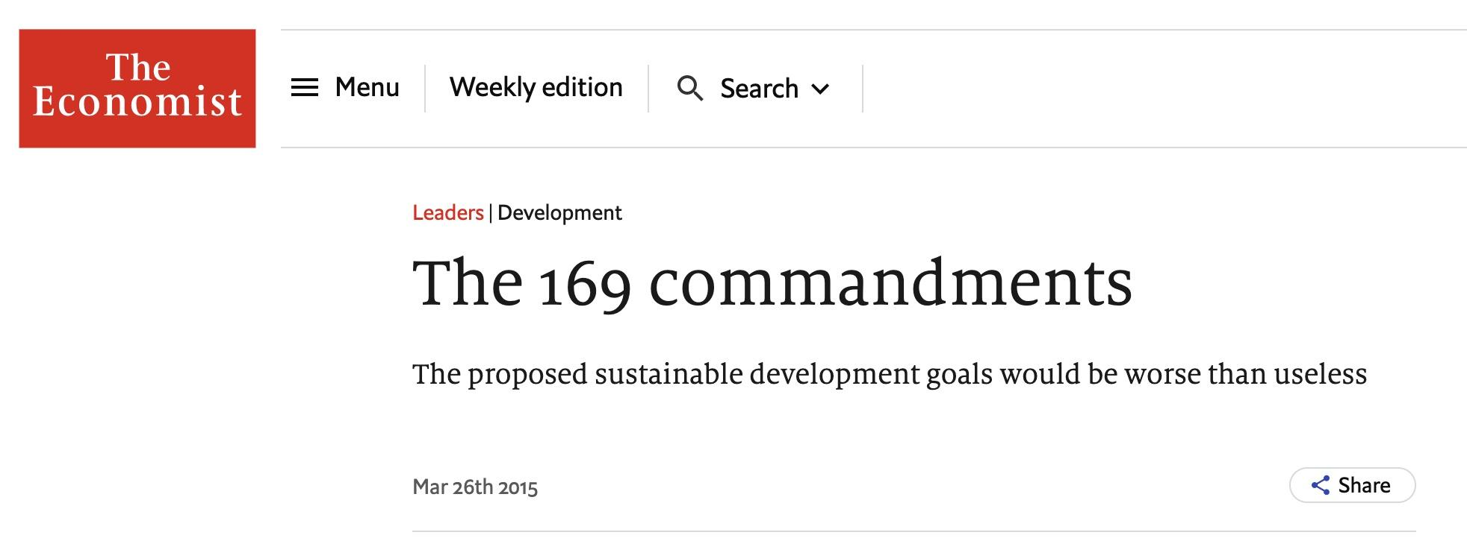

Slide 4
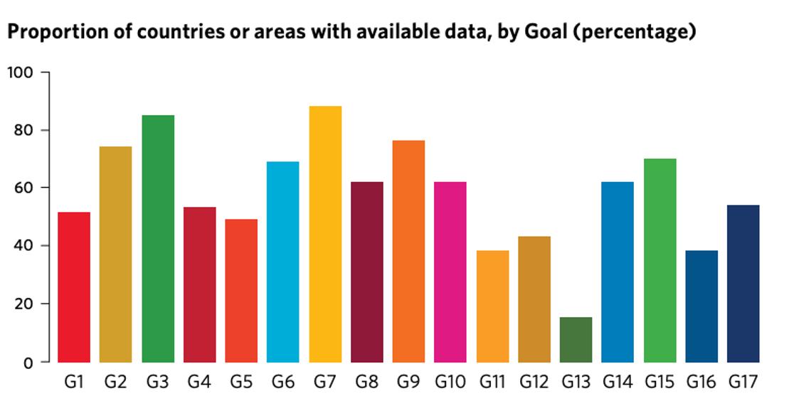
58% of the environmental SDG indicators lack data
Source: UN SDG Report, 2022

Slide 5
Sustainable Coastlines Charitable Trust is a New Zealand charity that exists to connect people to nature and inspire change.

Slide 6
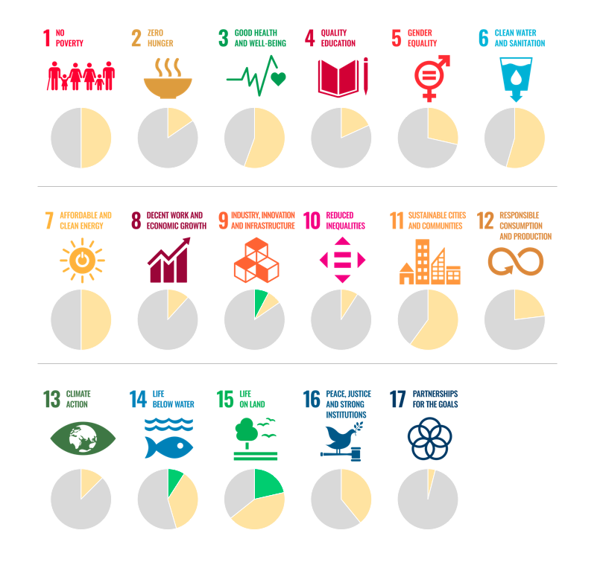
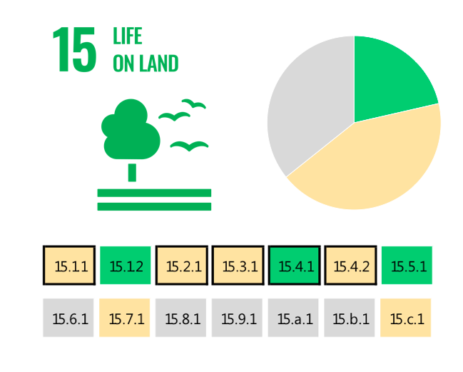
The SDG indicators where citizen science projects are
‘already contributing’, ‘could contribute’ or where there is ‘no alignment’
No alignment
Already contribute
Could
contribute
The SDG indicators where citizen science projects are “already contributing” (in green), “could contribute” (in yellow) or where there is “no alignment” (in grey). The overall citizen science contributions to each SDG are summarized as pie charts.

Slide 7
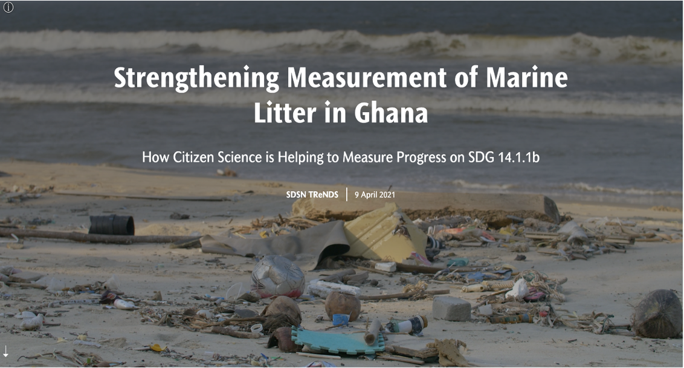
Olen, S.M. Citizen science tackles plastics in Ghana. Nat Sustain 5, 814–815 (2022). https://doi.org/10.1038/s41893-022-00980-y
Citizen Science for the SDGs StoryMap: https://dataforchange.net/strengthening-measurement-of-marine-litter-in-Ghana

Slide 8
The process of integrating citizen science data on marine litter
for SDG indicator 14.1.1b reporting in Ghana
Source: Fraisl, D., et al., In review

Slide 9
Citizen science data for monitoring beach litter have been integrated into the official SDG monitoring and reporting mechanisms of Ghana
Ghana the first country to report on SDG indicator 14.1.1b and first country to use citizen science data for that purpose.
Citizen science data will serve as inputs to Ghana’s Integrated Coastal and Marine Policy, currently under development, as well as other relevant policies to address the marine litter problem.

Slide 10
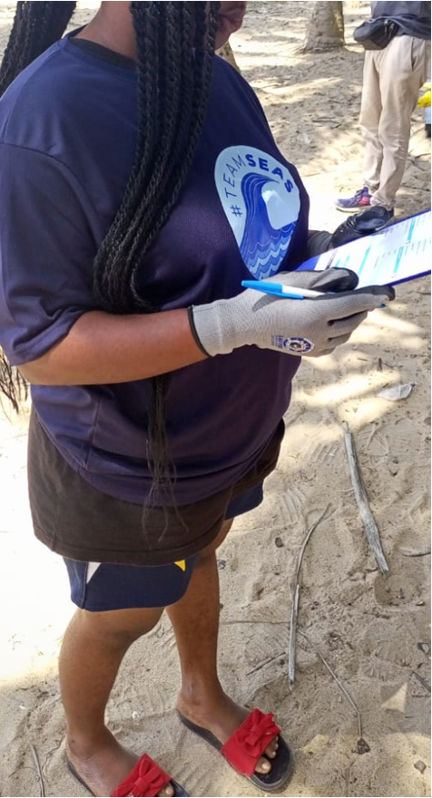
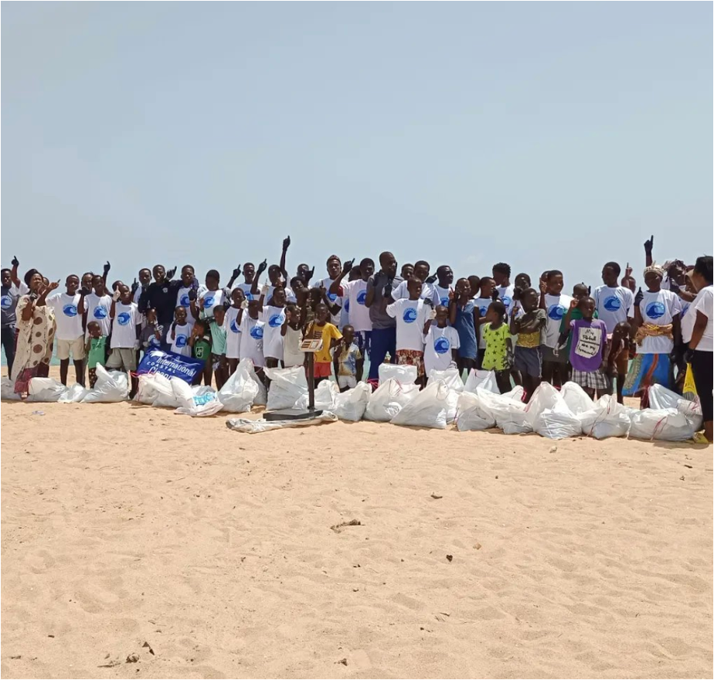
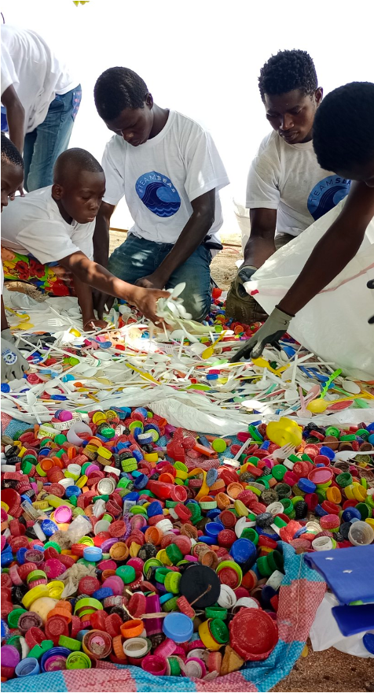
Create time and space for all the stakeholders
to build trust, common goals and ownership
@Smart Nature Freaks Youth Volunteers Foundation

Slide 11
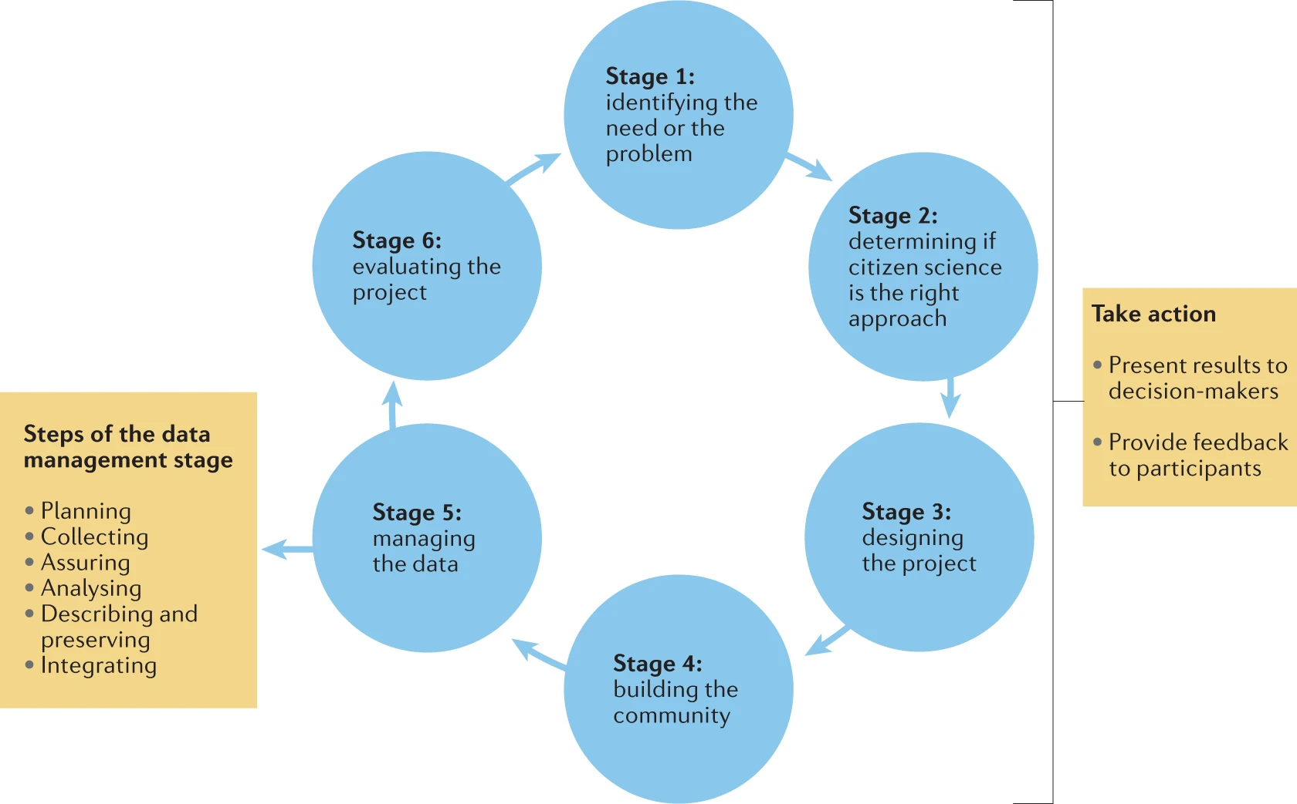
UNDP - 16.6.2 Proportion of population
satisfied with their last experience of public services
Investing in citizen science data can empower hard-to-reach individuals and communities and support more inclusive decision making, complementary to official ways of collecting data.
Fraisl, D., Hager, G., et al. Citizen science in environmental and ecological sciences. Nat Rev Methods Primers 2, 64 (2022). https://doi.org/10.1038/s43586-022-00144-4

Slide 12
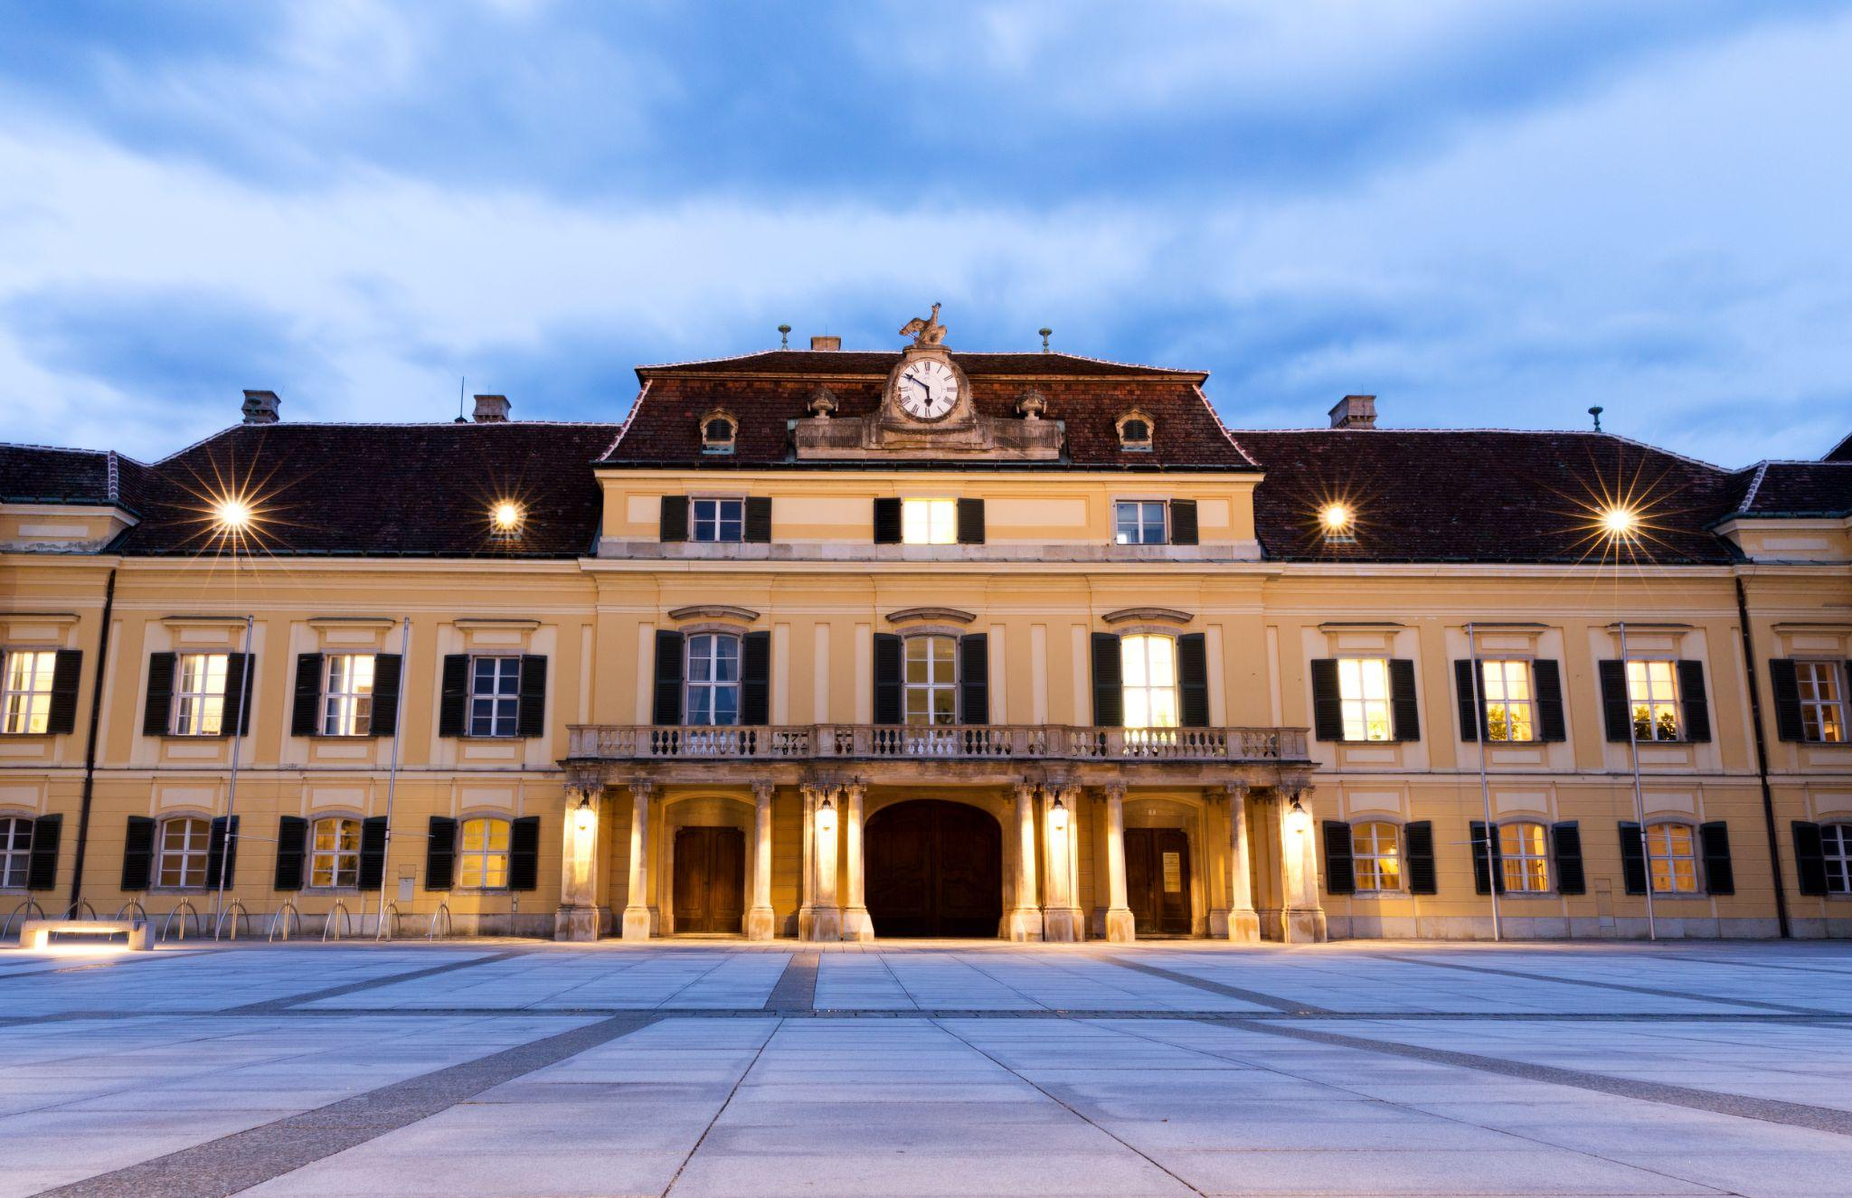
CSGP is a network that aims to advance citizen science for a sustainable world,
hosted at IIASA with a hub in Geneva

Slide 13
YOMA Operational Research
Launched under the impetus of UNICEF and led by University of Geneva
Operational Research to support the development of the Yoma platform for youth
Builds on the methodology and results of the Crowd4SDG project
Crowd4SDG partners: CSIC, UPC, UNIGE
Other partners: ABC, Caliberco, IIASA, RLabs, CitSci Africa Association
Objectives:
Support young Africans developing learning to earning opportunities using citizen science
Growing the digital skills and environmental awareness of young people
Developing grass-roots answers to climate resilience challenges that communities face
Integrating new technologies into the Yoma platform (AI, blockchain, crowdsourcing tools)
Contribution of IIASA: developing robust citizen science apps based on youth-made prototypes
Contribution of CSGP: CitSci Africa Association supporting local teams with local experts

Slide 14
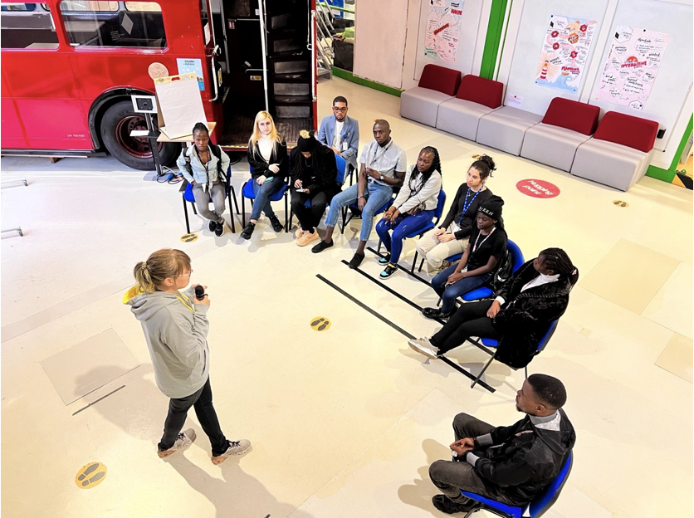
Press release, 15 March 2023
Helping young Africans innovate for climate resilience
Africa is the continent that will be most adversely affected by climate change. IIASA researchers are collaborating on Yoma OR – an ambitious project aimed at helping young people grow their digital skills as a first step on a journey from learning to earning.

