Slide 1
Social media and platforms as a new source of data for understanding societies and humans
Elena Rovenskaya
rovenska@iiasa.ac.at
Program Director
Advancing Systems Analysis Program
IIASA, Laxenburg, Austria

Slide 2
About IIASA
Established in 1972 by USA and USSR: bridge between East and West, science diplomacy.
2023: International, independent, interdisciplinary research on major global problems; currently 22 nation and regional member organizations
Mission: To support research in relation to problems of modern societies arising from scientific and technological development.
Dimensions: economy, energy, land use, climate, air quality, technology, biodiversity, demography, natural hazards, etc.
Solution oriented, integrated systems analysis into the issues of sustainability and global transformation, drawing on the strengths of systems science and interdisciplinarity.

Slide 3
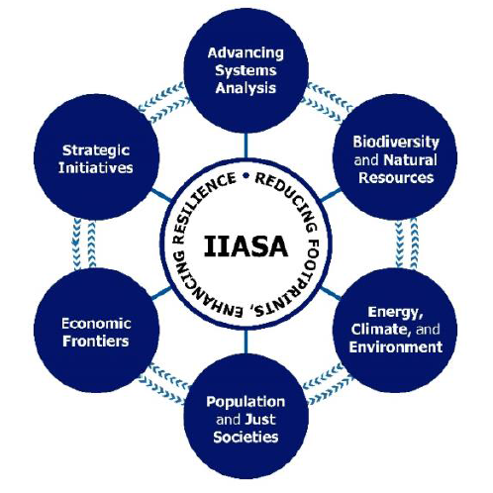
Advancing Systems Analysis
Advancing Systems Analysis (ASA) Program research aims to identify, develop and deploy new systems-analytical methods, tools, and data that address the most pressing global sustainability challenges with greater agility and that help find solutions to those challenges that are both realistic and appropriate

Slide 4
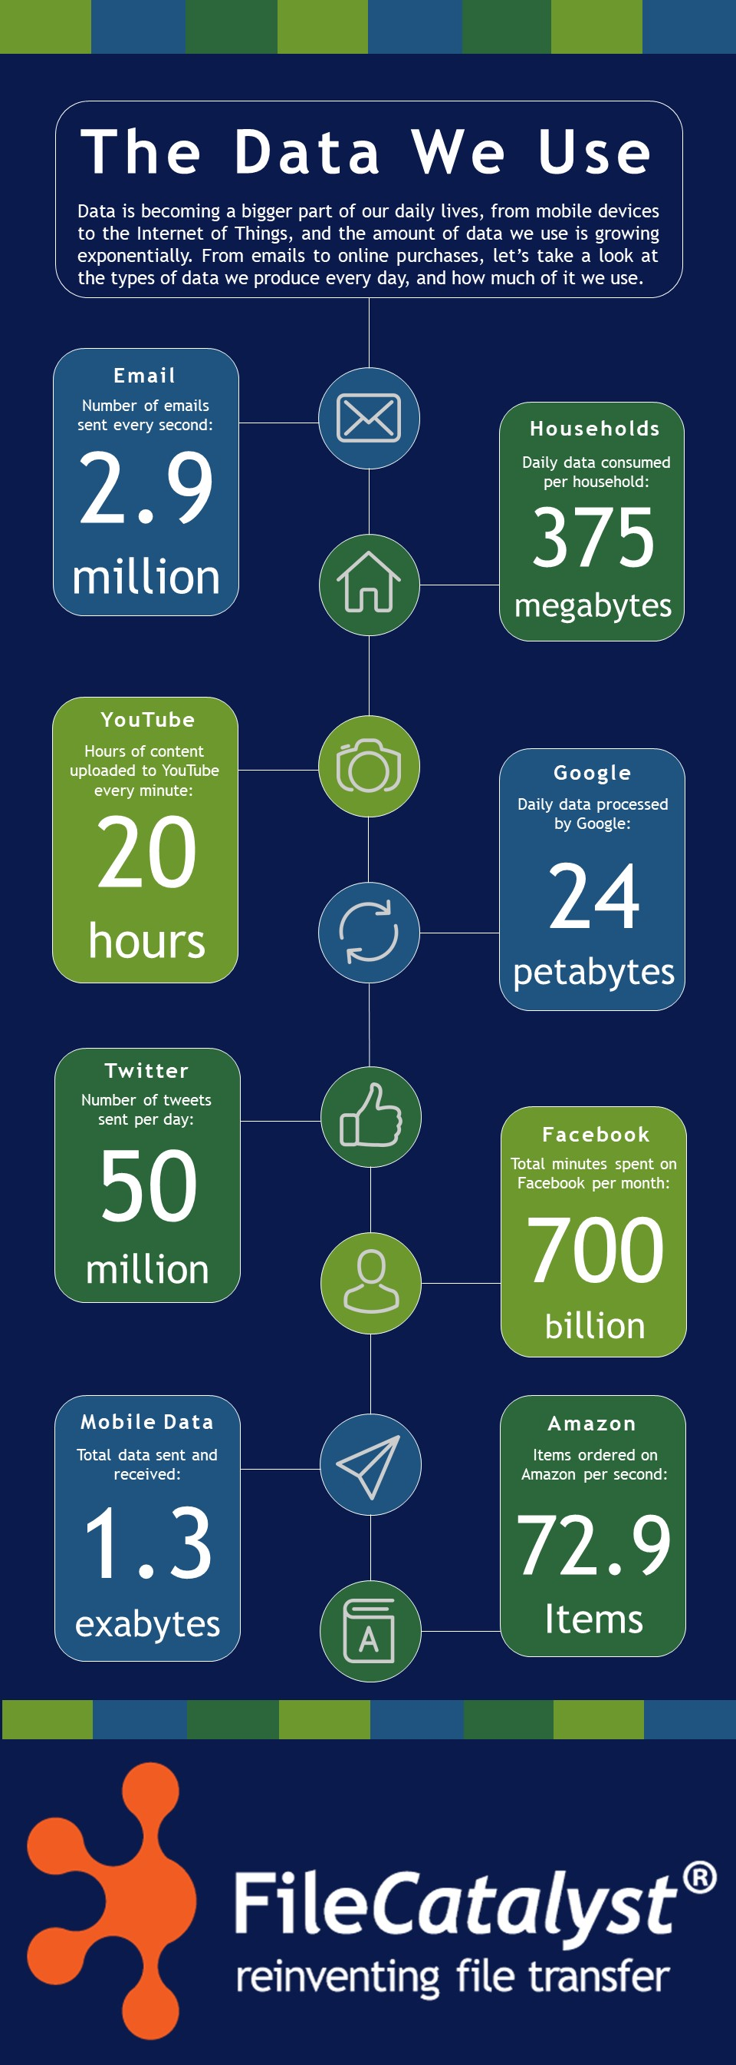
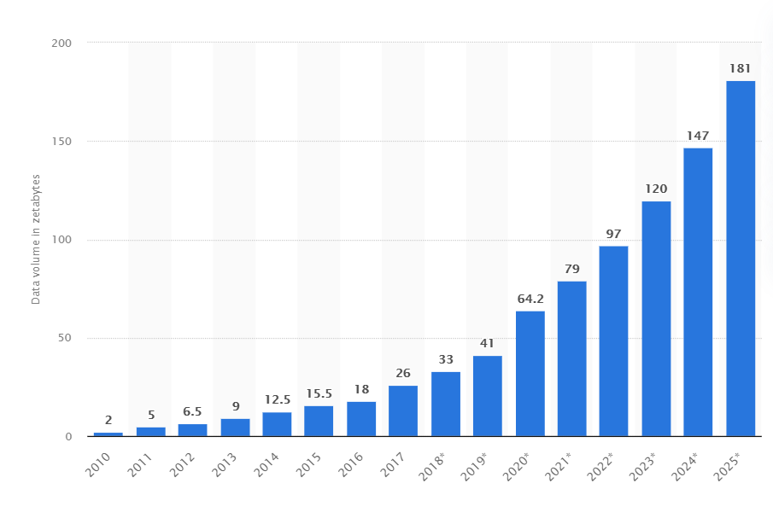
Data world
Data volume in zettabytes
Source: https://siteefy.com/how-much-data-and-content-is-created-every-day/
Source: https://www.filecatalyst.com/blog/a-day-in-data/

Slide 5
Social media and platforms is a new source of a wealth of data which can be used to understand societies and humans

Slide 6
Example 1: Self-isolation and COVID-19
Piotr Zebrowski, Elena Rovenskaya, Grigory Boyarshinov, et al.

Slide 7
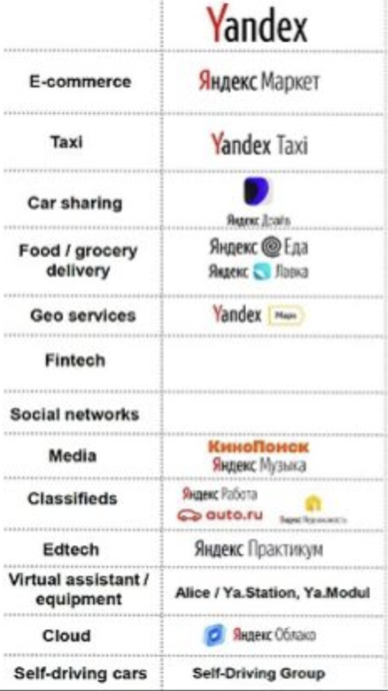
Self-isolation and COVID-19
Yandex’s Self-Isolation Index: Measured the level of “urban activity” in cities based on the use of Yandex services as well as Yandex traffic monitoring.
Source: https://ecomhub.ru/ecosystem-russian-business-sber-yandex-mail-ivanov/

Slide 8
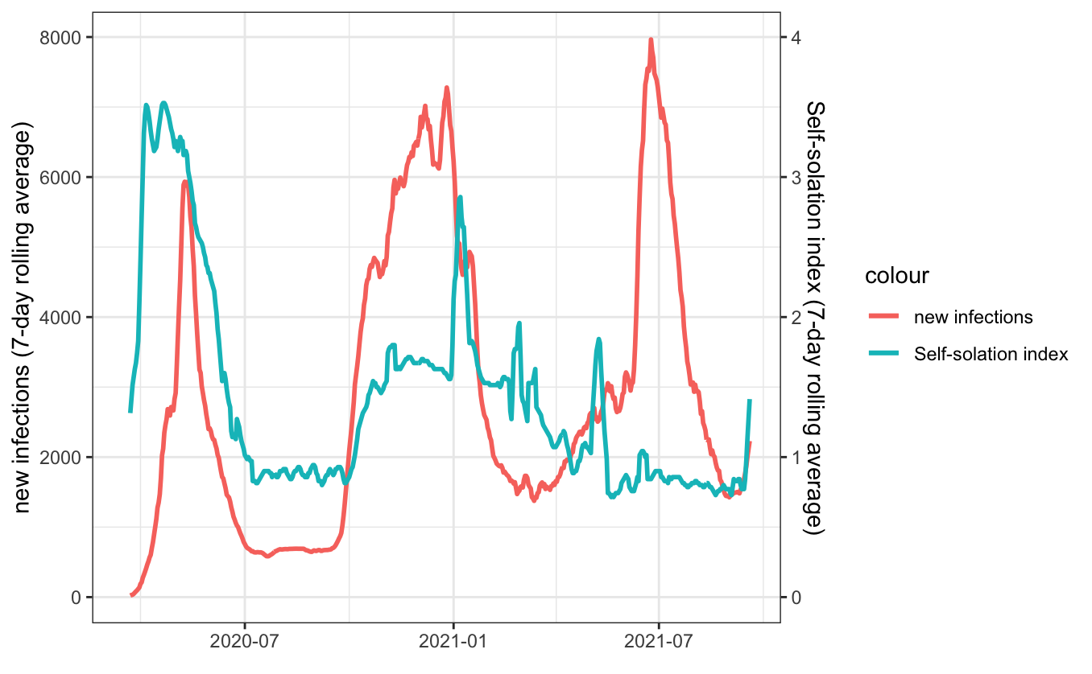
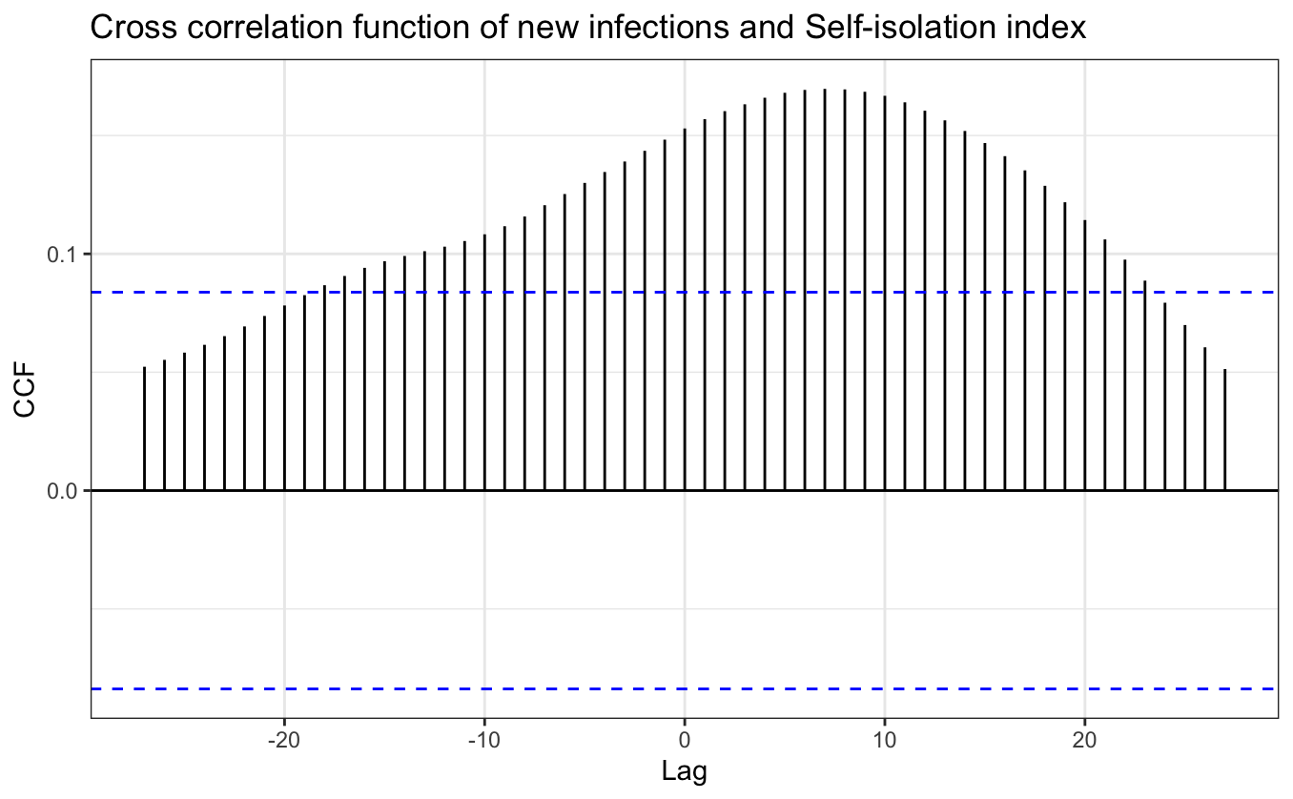
Self-isolation and COVID-19
Case study of Moscow
Source of data: стопкоронавирус.рф; https://datalens.yandex/7o7is1q6ikh23
Challenge: Measure compliance with policy restricting social contacts and voluntary self-isolation to optimize policy interventions
Using statistical analysis, we reveal a statistically significant cointegration relationship indicating a long-run equilibrium between daily new infection numbers and Self-Isolation Index

Slide 9
Example 2: Various dimensions of security
Hossein Hassani, Nadezhda Komendantova, Elena Rovenskaya

Slide 10
Various dimensions of security
National security has grown into multi-faceted notion to include food, energy, cyber, and other dimensions
Challenge: Gain valuable insights into emerging risks and trends in real-time to proactively mitigate security risks
Data: Social media and publicly available data: Google, Twitter, etc.

Slide 11
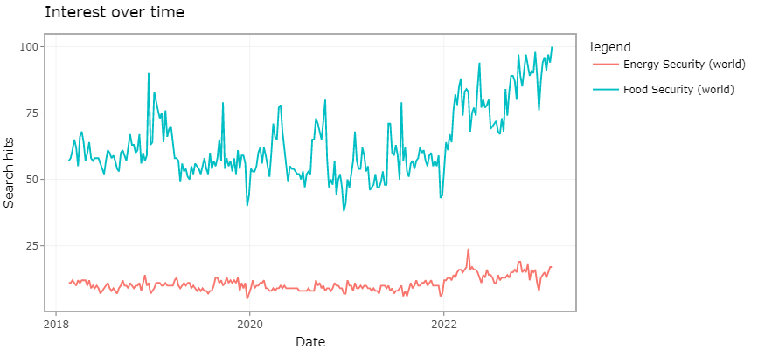
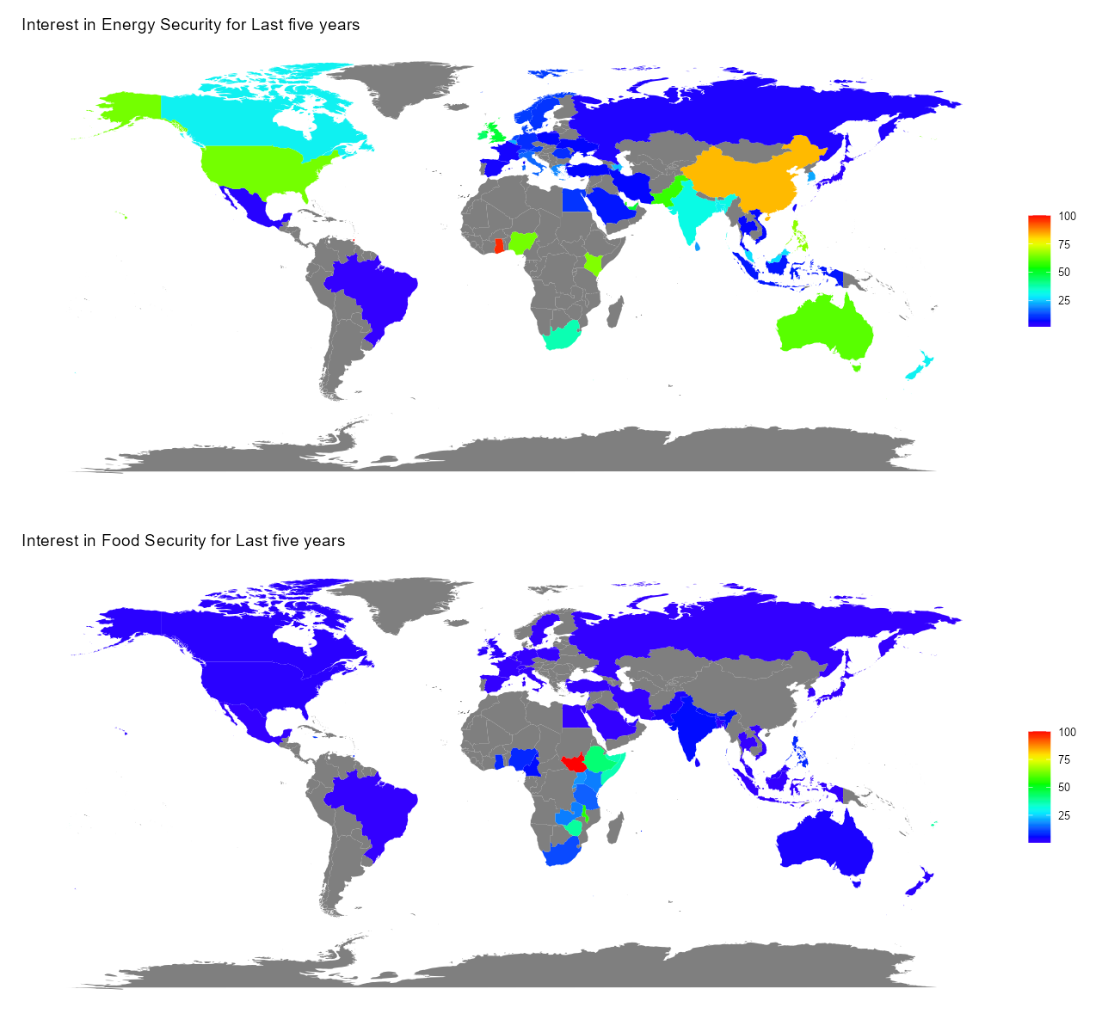
Food security and energy security
Source of data: Google
The public interest in food security has consistently outpaced that in energy security, with the gap becoming more pronounced recently
The public interest in food and energy security varies across the world

Slide 12
More dimensions of security
Source of data: Google
The public interest in cyber security has outpaced food, energy and water security concerns since about 10 years

Slide 13
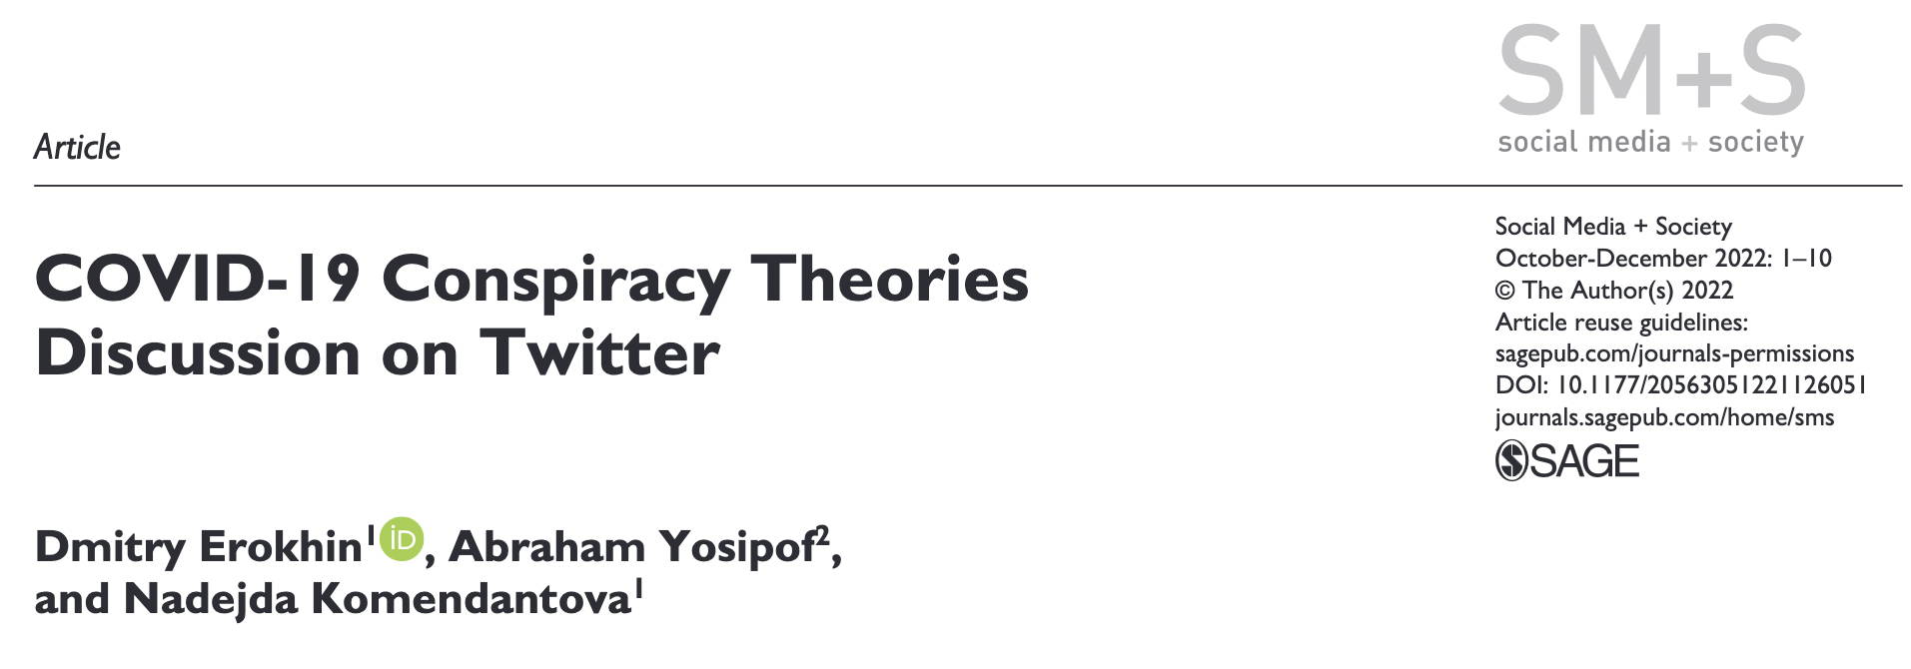
Example 3: Conspiracy theories and Twitter
Dmitry Erokhin, Abraham Yosipof, Nadejda Komendantova

Slide 14
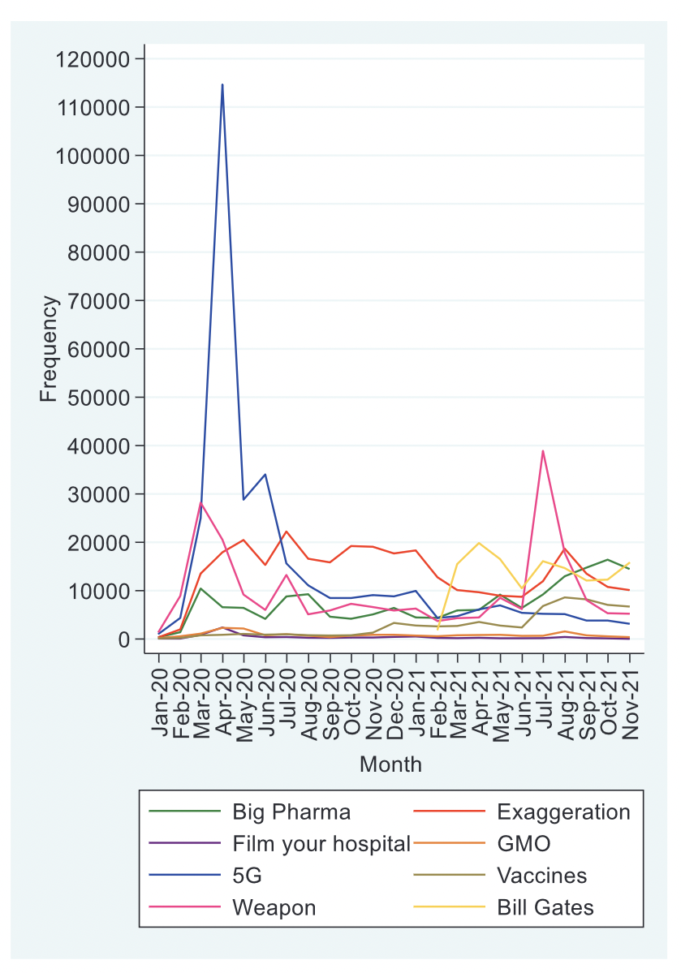
Conspiracy theories and Twitter
Collected a data set of 1.269 million tweets associated with the discussion on conspiracy theories between January 2020 and November 2021
Revealed temporary patterns of and interrelationships between different theories
In addition, the number of COVID-19 new cases was found to be a significant predictor for the next week tweet frequency for most of the conspiracies

Slide 15
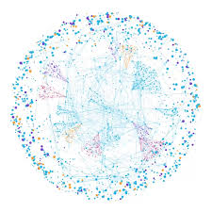
Questions? Comments? Would like to collaborate with us?
Reach out: Elena Rovenskaya rovenska@iiasa.ac.at

