Slide 1
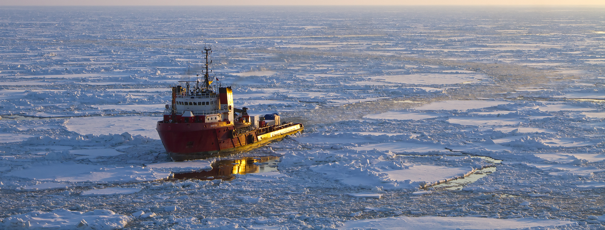
Scenarios of Destination and Transit Shipping in the Euro-Asian Arctic until 2050
Photo 39040095 / Arctic © Alexv73 | Dreamstime.com
Nikita Strelkovskii, Dmitry Erokhin, Elena Rovenskaya
Cooperation and Transformative Governance (CAT) Research Group
Advancing Systems Analysis (ASA) Program
International Institute for Applied Systems Analysis (IIASA), Laxenburg, Austria
Arctic Science Summit Week (ASSW) 2023
Science Symposium: The Arctic in the Anthropocene
Vienna, Austria 21 February 2023

Slide 2
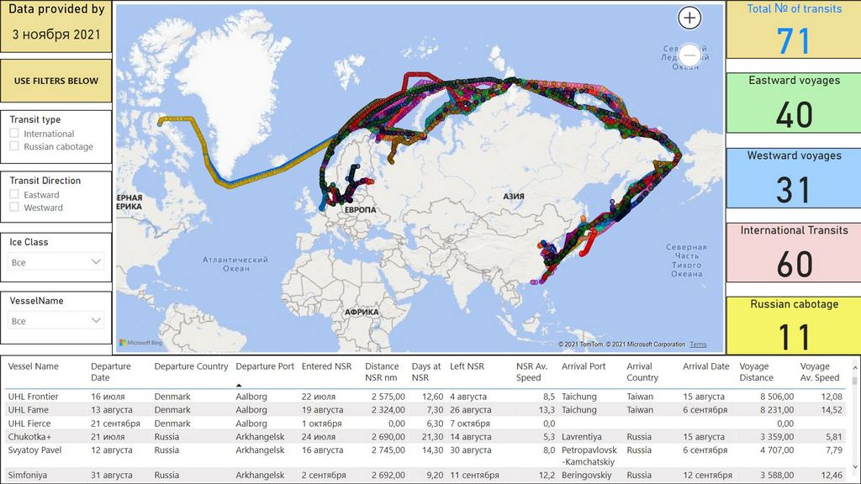
Shipping in the Euro-Asian Arctic – a wicked problem
Recent sea ice retreat and the latest climate projections => “ice–free” Arctic Ocean?
Increasing demand for natural resources => new extraction projects
A shorter shipping route between Europe and Asia => more feasible?
Calls for protection and conservation of the fragile Arctic environment
Competing interests of various states, including non-Arctic, commercial actors, and local and indigenous populations.
Destinational shipping:
  From outside the Arctic to the Arctic or from the Arctic to outside the Arctic
  Ships going to the Arctic to load, unload, or perform an economic activity there
AND
Transit shipping
Source: CHNL Information Office, https://arctic-lio.com/

Slide 3





Foresight for the Euro-Asian Arctic:
Socio-economic scenarios to inform shipping development
A scenario is a plausible and thought-provoking narrative about how the future of the considered system could look like
Goal: develop scenarios describing various plausible socio-economic futures of the Euro-Asian Arctic until 2050
Account for both global and regional (Arctic) factors – political, economic, social, technological, environmental, legal (PESTEL)
Scenarios are based on extensive literature research and input from various experts from academia and industry using the backcasting and morphological analysis methods
Original focus on emerging trade routes between Europe and Asia, i.e., shipping in the Euro-Asian Arctic
Now
Future
13 experts from 7 countries
5 advisors from 4 countries
80+ publications
3 online workshops
2 surveys
5 scenarios

Slide 4
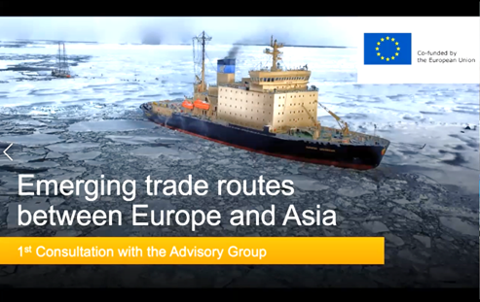
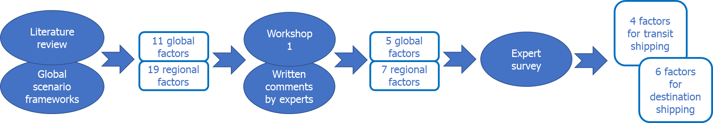
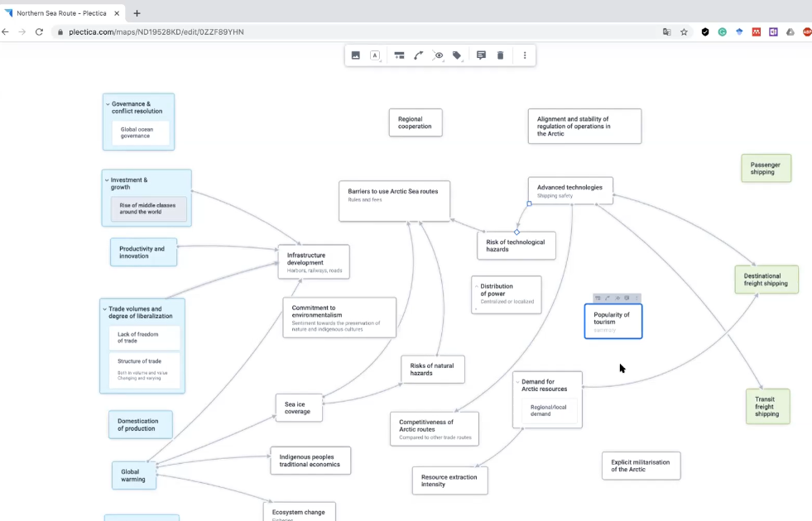
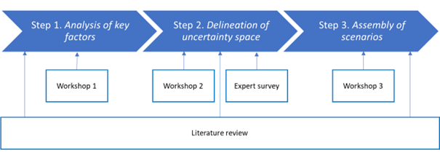
Scenario building exercise

Slide 5


Backcasting from plausible visions of shipping in the Euro-Asian Arctic
Volume of destinational shipping
High volume of destination & low volume of transit shipping
High volume of destination & transit shipping
Low volume of destination & transit shipping
Low volume of destination & high volume of transit shipping
Volume of transit shipping

Slide 6
Morphological analysis
Morphological analysis - reveals uncertain factors and their possible manifestations (Zwicky, 1969; Ritchey, 2011)
Morphological matrix (MM) as a visual tool for morphological analysis
Global |  |  | Regional (Arctic)
Climate change effects | Decarbonization pace | Global order | Infrastructure investment | Arctic governance | Arctic technologies | Regulatory barriers
Extreme | Slow decarbonization | Unilateral action | Low investment | No cooperation in the Arctic | Gradually upgraded technologies | High barriers or unstable rules
Moderate-to-severe | Radical decarbonization | Several competing blocs | National investment | Arctic for Arctic | Disruptive technologies | Restricted access
Limited | Radical and rapid decarbonization | Strong international cooperation | Large international investments | Open Arctic for all states |  | Low barriers
Global Resource Base: High vol. of destination & low vol. of transit shipping
Global Route: High vols. of destination & transit shipping
Abandoned Land: Low vols. of destination & transit shipping
Sanctuary: Low vols. of destination & transit shipping
Transpolar Shortcut: Low vol. of destination & high vol. of transit shipping

Slide 7
Scenario narratives

Slide 8
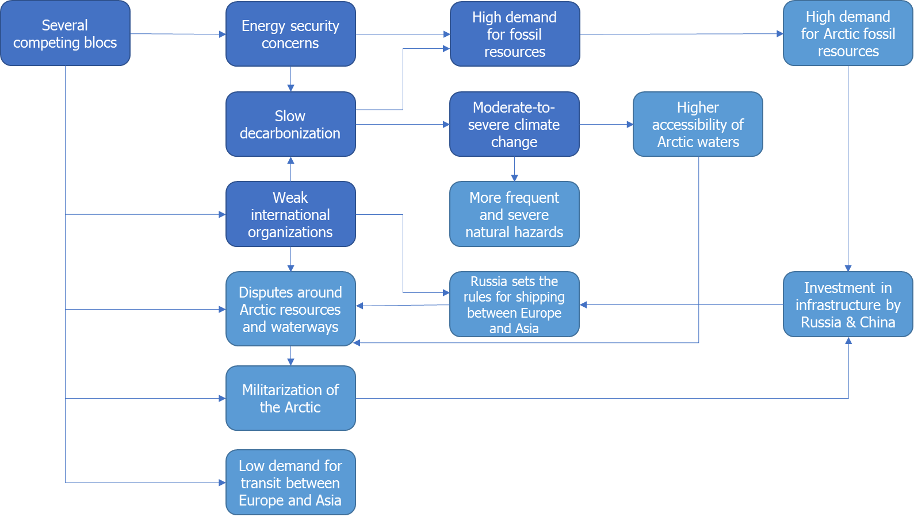
Scenario “Global Resource Base”
The world is divided into several geopolitical and geoeconomic blocs. The global trade shifts from Asia-to-Europe to other regions. Technological progress and decarbonization are slow. The demand for Arctic fossil resources rises. Climate change brings about moderate-to-severe effects including more frequent and dangerous natural hazards such as drifting ice and icebergs, as well as stronger winds and higher waves. Marine infrastructure develops gradually and is often of dual purpose. Militarization of the Arctic increases, however, it does not lead to an armed conflict. Investment in large-scale land-based transport infrastructure proves infeasible due to climate risks and an unstable geopolitical landscape.

Slide 9
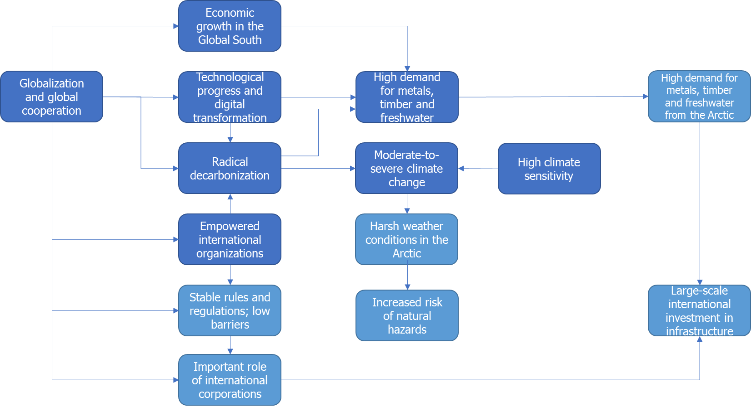
Scenario “Global Transportation Route”
Global cooperation facilitates rapid technological progress. International organizations lead the collective action of countries to combat climate change. The Arctic acts as a key source of indispensable metals for the low-carbon economy. However, high climate sensitivity hampers reaching the Paris agreement goals. As a result, the warming of the Arctic continues. Modern infrastructure supported by large-scale international investment is deployed to support destination shipping which develops rapidly.

Slide 10
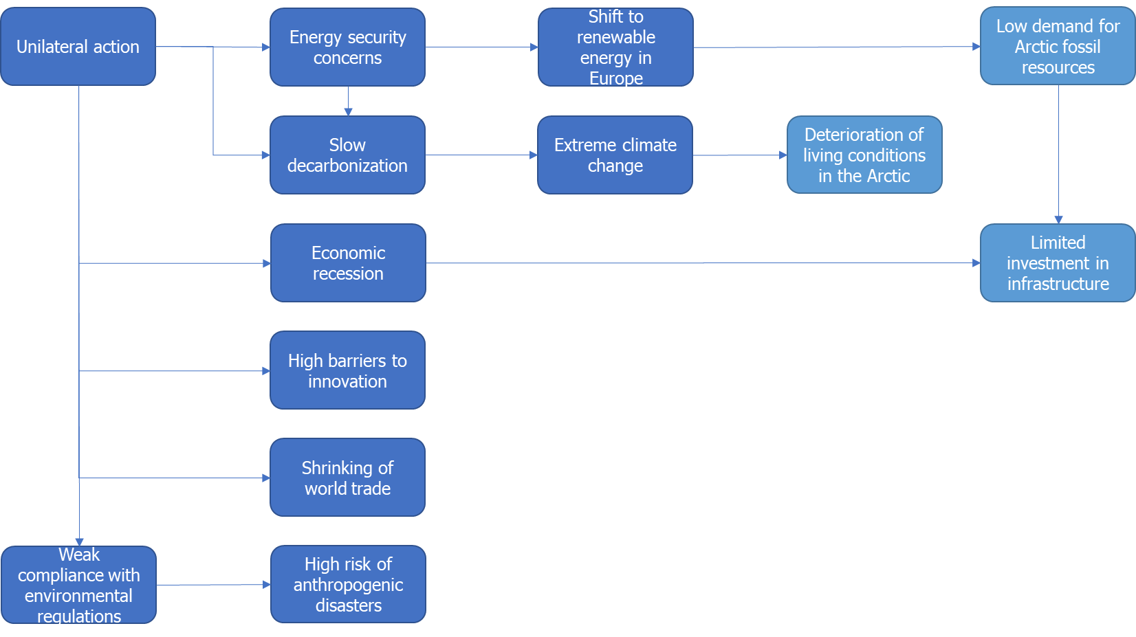
Scenario “Abandoned Land”
Countries act on a unilateral basis. The global economic recession continues. Energy security concerns slow down decarbonization worldwide. Innovation is lacking. Extreme climate change effects manifest. Activities and investments in the Arctic are limited and focus on extracting fossils which are mostly used domestically.

Slide 11
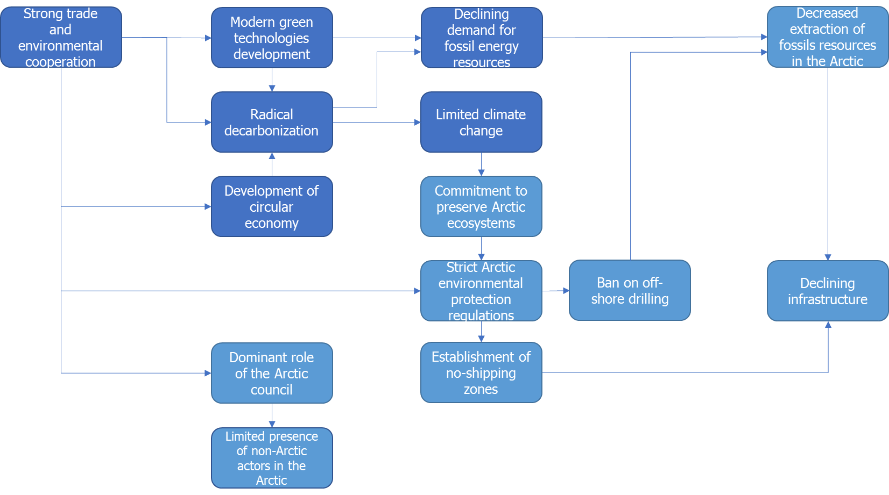
Scenario “Sanctuary”
Strong political and economic cooperation among all countries develops. Growing national and citizen aspirations for modern green technologies facilitate rapid decarbonization. The climate change effects in the Arctic are relatively limited. The Arctic Council plays a prominent role in the governance of the Arctic. The Arctic states ban economic activity of non-Arctic actors in the Arctic and stop any new fossil extraction projects to conserve the unique nature. The Arctic economies diversify. Infrastructure development is limited.

Slide 12
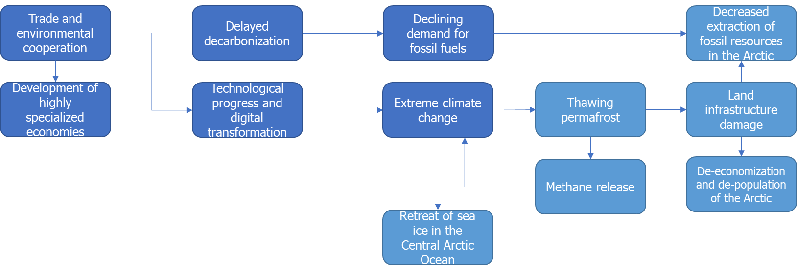
Scenario “Transpolar Shortcut”
Countries cooperate in the economic and technological spheres. The Earth continues to get warmer following suboptimal decarbonization paths undertaken by the international community. Melting permafrost destroys the existing onshore infrastructure. Mining in the Arctic becomes impossible. Economic activities decline. The population leaves the Arctic. Significant retreat of the sea ice in the Central Arctic Ocean is observed.

Slide 13
Scenario plausibility and relevance assessment

Slide 14
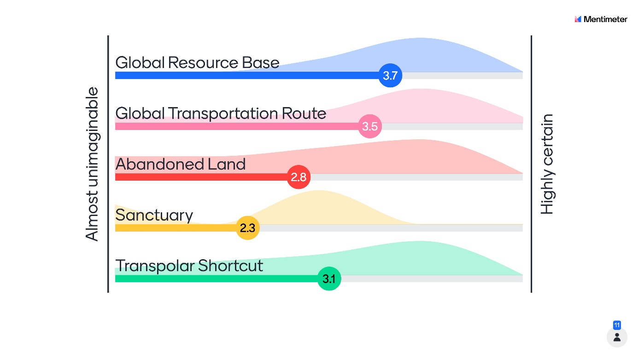
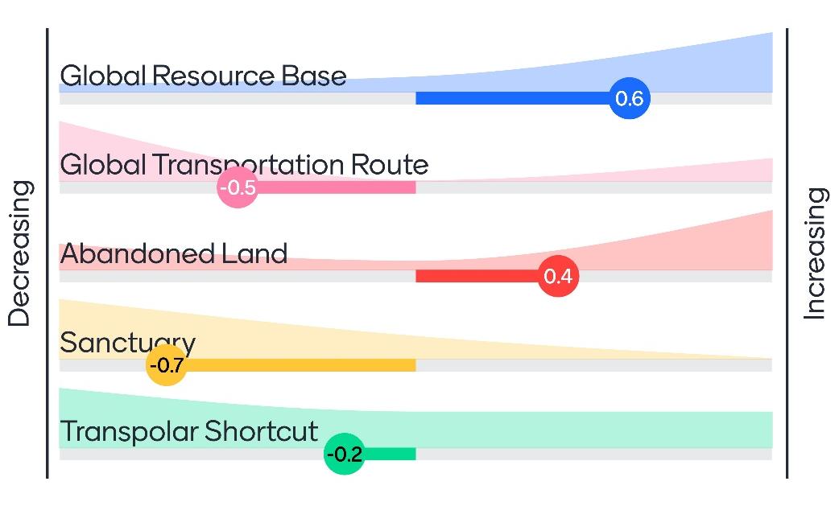
Scenario plausibility and relevance assessment
Results of the expert survey (n=11, March-June 2022) on…
…the current plausibility of the developed scenarios
…the recent change in plausibility of the developed scenarios

Slide 15

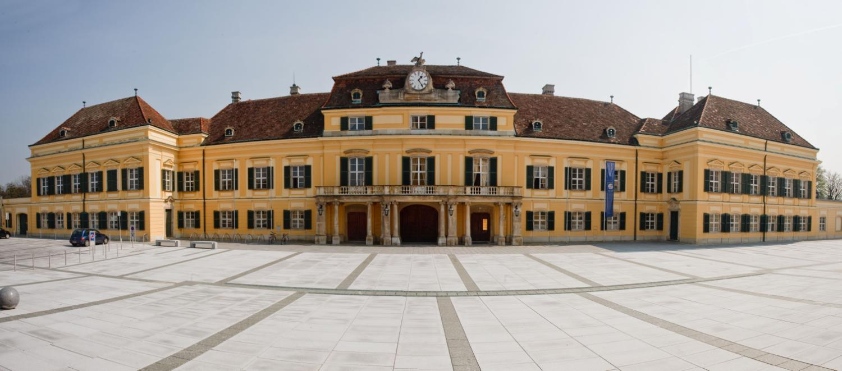
Thank you for your time! Questions?

