Slide 1
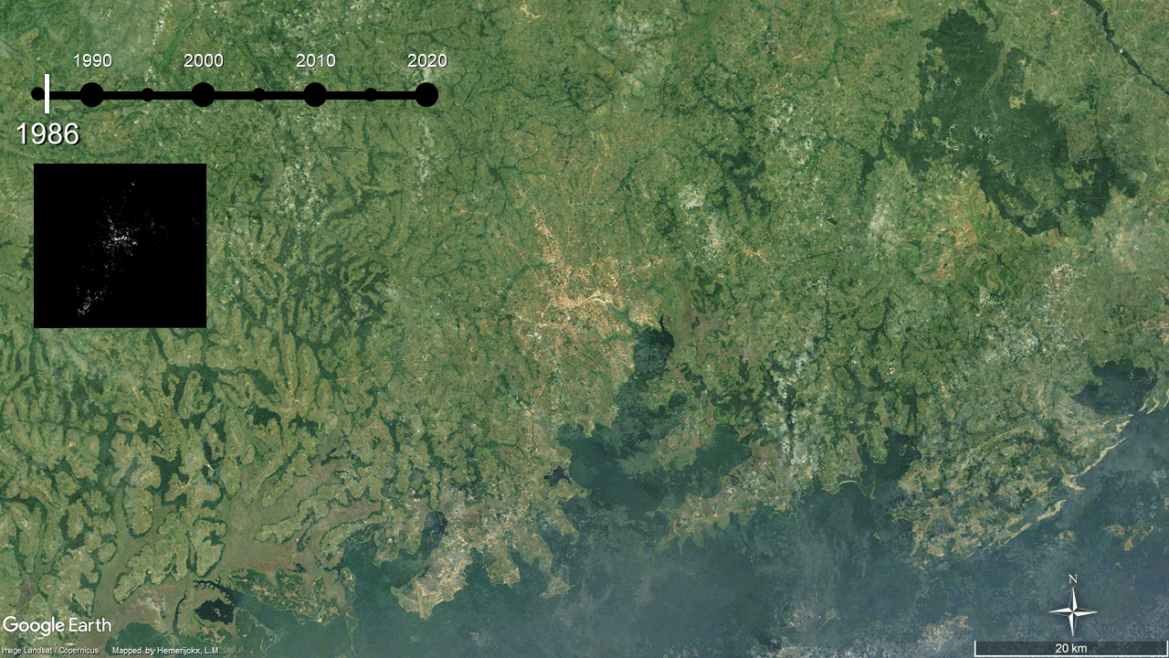
What about human behaviour? The case of urbanization and rice in Africa
ERE1.7
Greater Kampala, Uganda
Koen De Vos^{1,2,3}, Charlotte Janssens^{1,3}, Liesbet Jacobs^{1,4}, Benjamin Campforts⁵, Esther Boere³, Marta Kozicka³, Petr Havlík³, Lisa-Marie Hemerijckx^{1,2}, Anton Van Rompaey¹, Miet Maertens¹ & Gerard Govers¹
1: KU Leuven, Belgium,
2: Research Foundation Flanders (FWO), Belgium,
3: International Institute for Applied Systems Analysis (IIASA), Austria,
4: University of Amsterdam, Netherlands,
5: University of Colorado at Boulder, USA
Koen.devos@kuleuven.be
devos@iiasa.ac.at

Slide 2
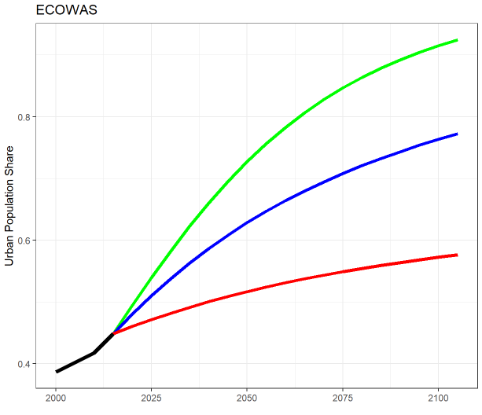
Urbanization in Africa– is it really that important?
ERE1.7
SSP1
SSP2
SSP3
Direct Land cover changes by urban expansion – own processing following spatial-explicit urban expansion estimates by Chen et al. (2020) and the CGLS-LC100 global land cover map (Buchhorn et al., 2020)
Urban population share projections under different Shared Socioeconomic Pathways (SSP) – own processing following Jiang & O’Neill (2017)

Slide 3
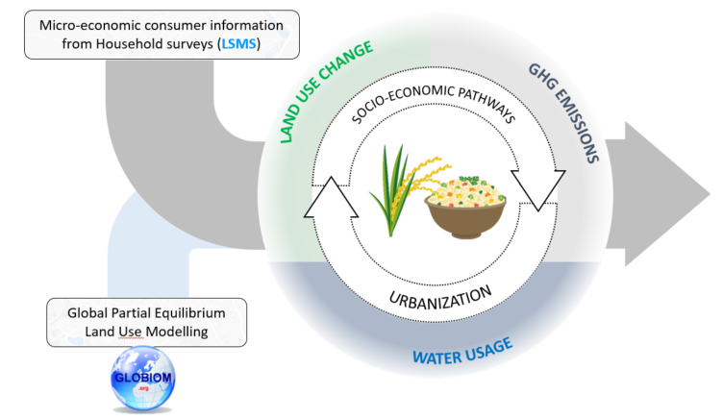
Research Setup
ERE1.7
Objective
Identify the expected effects of future urbanization (urban expansion + shifting rice preferences) in Africa on rice availability and the environment

Slide 4
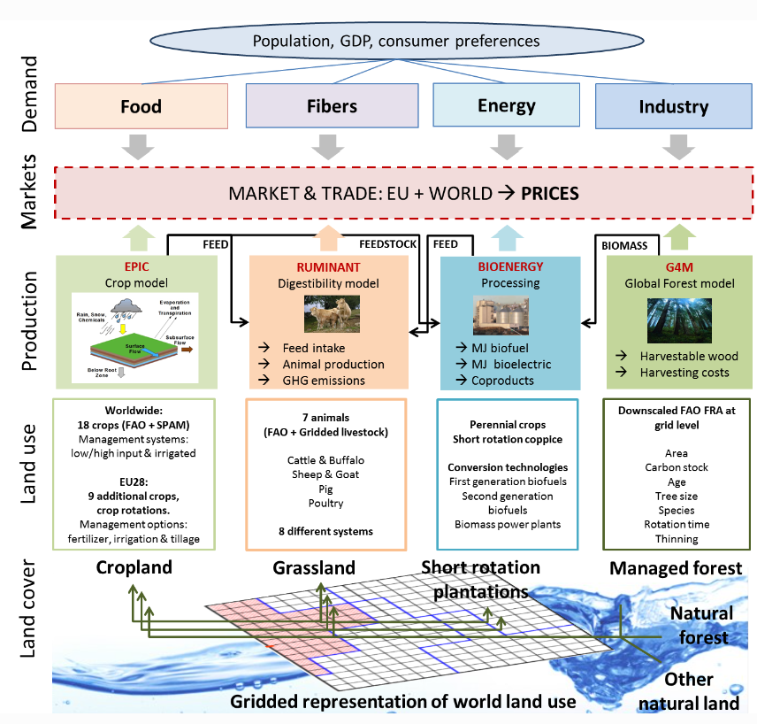
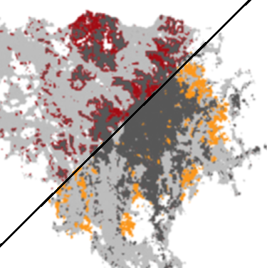
Global Biosphere Management Model
ERE1.7
Static Representative Consumer
Urban Expansion
Havlík et al., 2018

Slide 5
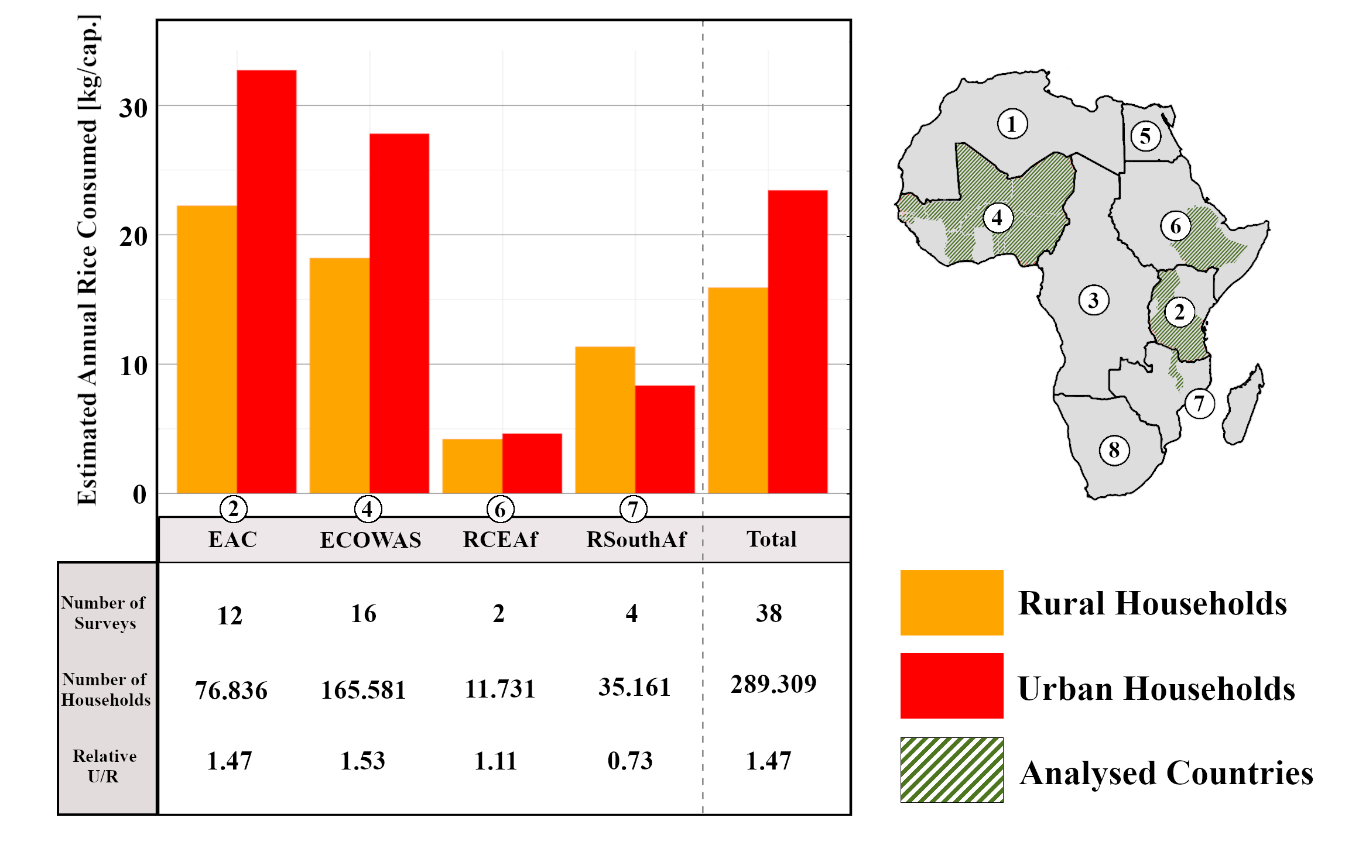
Living Standards Measurement Study
SSP2

Slide 6
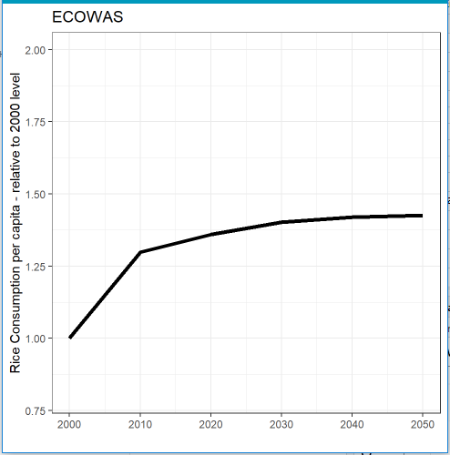
How does it work?
Static Representative Consumer

Slide 7
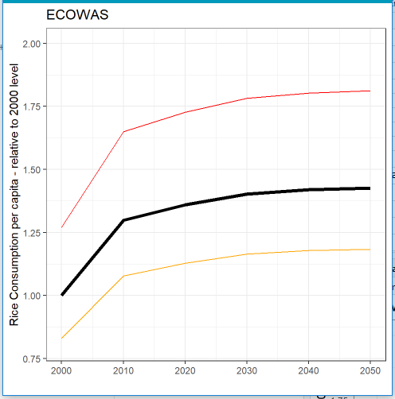
How does it work?
Urban Consumer
Static Representative Consumer
Rural Consumer

Slide 8
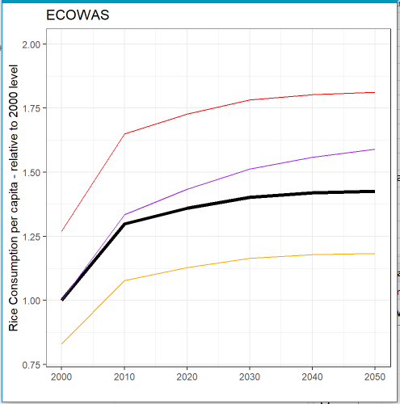
How does it work?
Urban Consumer
Dynamic Representative Consumer
Static Representative Consumer
Rural Consumer

Slide 9
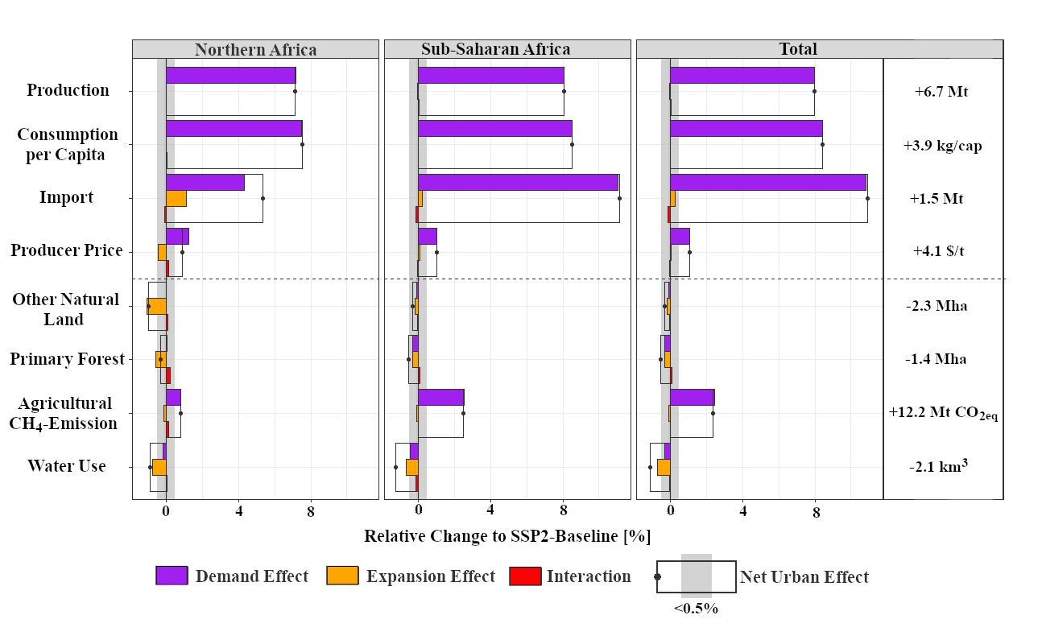
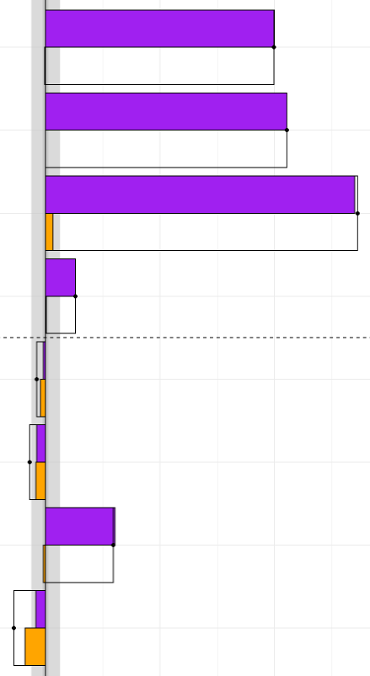
Results
2050
Rice-Specific
Agricultural
Water Use
koen.devos@kuleuven.be

Slide 10
Results
2050
Demand effects are most important and are substantial
Rice-Specific
Urban effects are “minor”
Considerate demand effects for all CH₄ (+2.4%)
Substantial for Rice CH₄ (+8.4%)
Agricultural
Water Use
Net decrease for African water use
Demand effect particularly from RSouthAf
Expansion effect is ‘more’ important
koen.devos@kuleuven.be

Slide 11
Summary
Urban dietary shifts can be considerate and are not well captured in impact models because of aggregation bias
For the case of rice in Africa, they result in a substantial increase in demand, production, imports, agricultural CH₄ emissions and producer price, while effects of urban expansion are limited (<0.5%).
Effects of urban expansion are more pronounced (yet limited) on natural land cover loss or water use in Africa. Only considering for rice-related dietary shifts already resulted in land-cover and water changes of around 1%
→ What if we include more food types?
koen.devos@kuleuven.be

Slide 12
Thank you!
Contact me to Discuss further!
koen.devos@kuleuven.be
devos@iiasa.ac.at

Slide 13
References
ERE1.7
Buchhorn, M. ,Lesiv, M. ,Tsendbazar, N. - E., Herold, M., Bertels, L., Smets, B. (2020) Copernicus Global Land Cover Layers-Collection 2. Remote Sensing, 12 Volume 108, 1044. doi:10.3390/rs12061044
Chen G, Li X, Liu X, Chen Y, Liang X, Leng J, et al. (2020) Global projections of future urban land expansion under shared socioeconomic pathways. Nature Communications,11:1–12. https://doi.org/10.1038/s41467-020-14386-x
Havlík, P., Valin, H., Mosnier, A., Frank, S., Lauri, P., Leclère, D., et al. (2018) GLOBIOM documentation. International Institute for Applied Systems Analysis (IIASA). https://iiasa.github.io/GLOBIOM/GLOBIOM_Documentation_20180604.pdf
Janssens, C., Havlík, P., Boere, E., Palazzo, A., Mosnier, A., et al. (2022) A sustainable future for Africa through continental free trade and agricultural development. Nature Food. 3(8): 608-618. doi:10.1038/s43016-022-00572-1
Jiang, L., O’Neill, B.C. (2017) Global urbanization projections for the Shared Socioeconomic Pathways. Global Environmental Change, 42: 193-199. https://doi.org/10.1016/j.gloenvcha.2015.03.008

