Slide 1
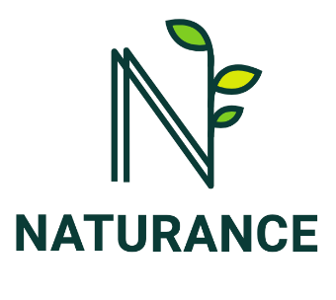
Nature-based solutions for wildfire risk management The role of insurance
JoAnne Linnerooth-Bayer¹, Teresa Deubelli-Hwang^{1,} Valentina Bacciu²,
Eduard Plana³, Luis Sousa⁴, Swenja Surminski⁵
¹IIASA, Laxenburg, Austria (bayer@iiasa.ac.at) ²National Research Council, Institute of BioEconomy, Sassari, Italy; CMCC Foundation, Sassari, Italy ³Forest Science and Technology Centre of Catalonia, Spain ⁴Mitiga Solutions, Barcelona, Spain ⁵Grantham Research Institute, London School of Economics and Political Science, London, UK

Slide 2
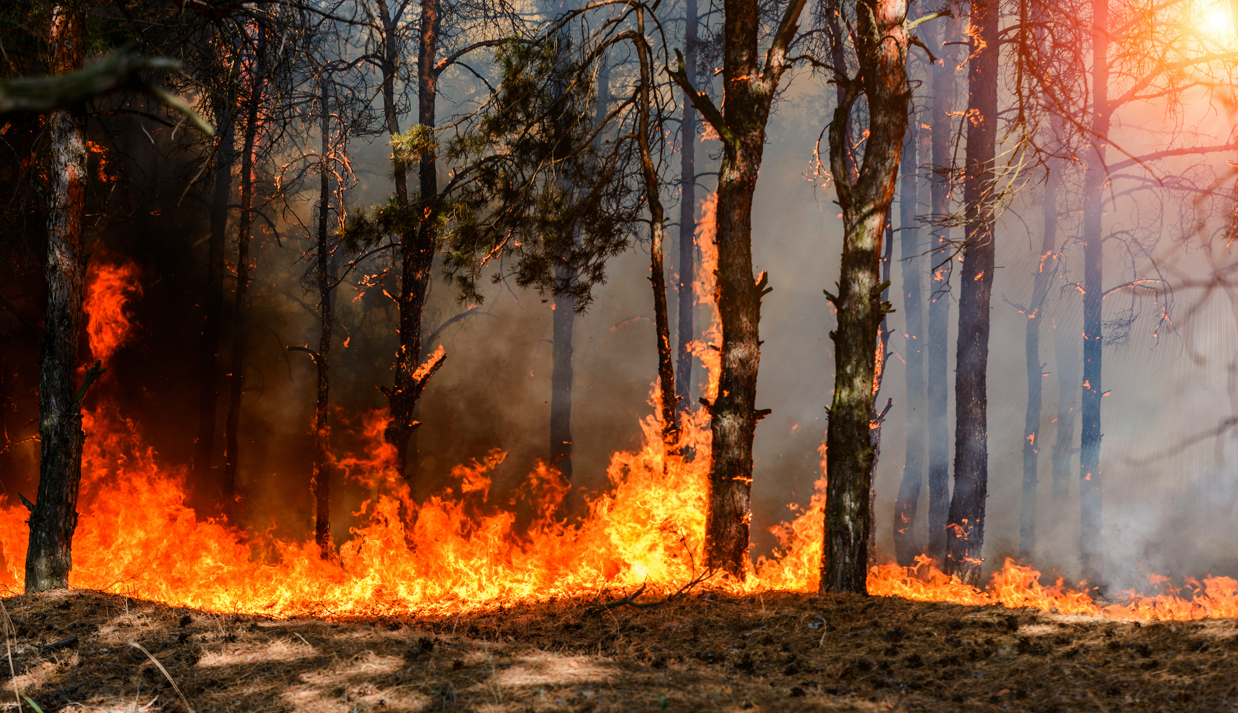
Questions
What are nature-based solutions (NBS) for wildfire risk reduction?
How can insurance promote them?

Slide 3
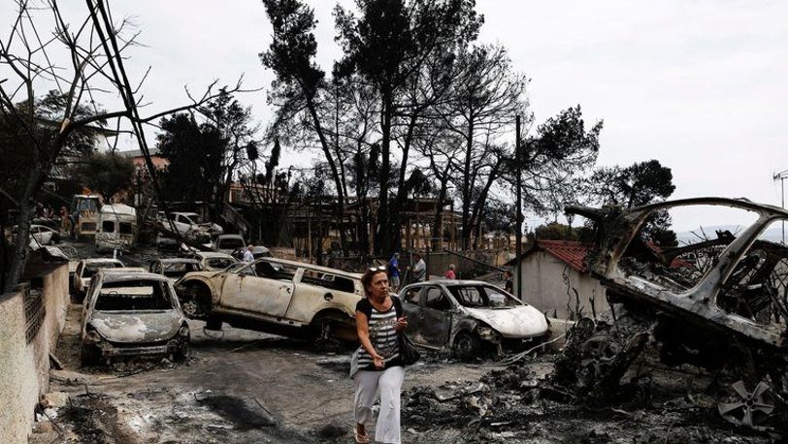
Multiple fire types and insurance products
Property/assets
Forests
Crops
Lives/Health
Businesses
Ecosystems
Forest
Bush
Shrub
Grass
Peat
Vegetation
Wildland-Urban Interface
Source: Handmer 2021

Slide 4
What are nature-based solutions (NBS)?
“Actions to protect, sustainably manage, and restore natural or modified ecosystems, that address societal challenges effectively and adaptively, simultaneously providing human well-being and biodiversity benefits” (IUCN, 2022)

Slide 5
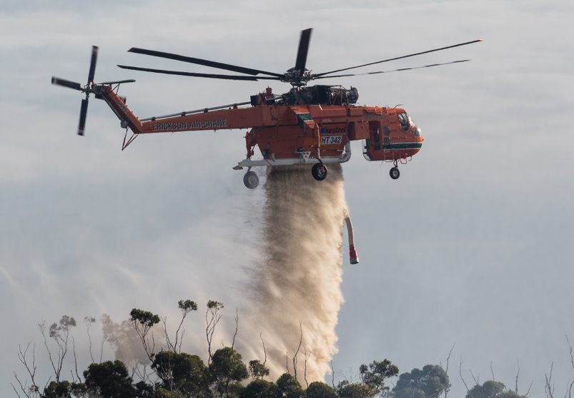
Agreement on what is NOT an NBS for wildfire
Source: Handmer, 2021

Slide 6
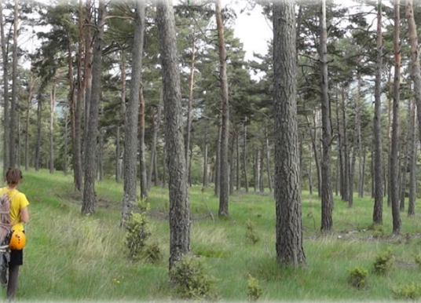
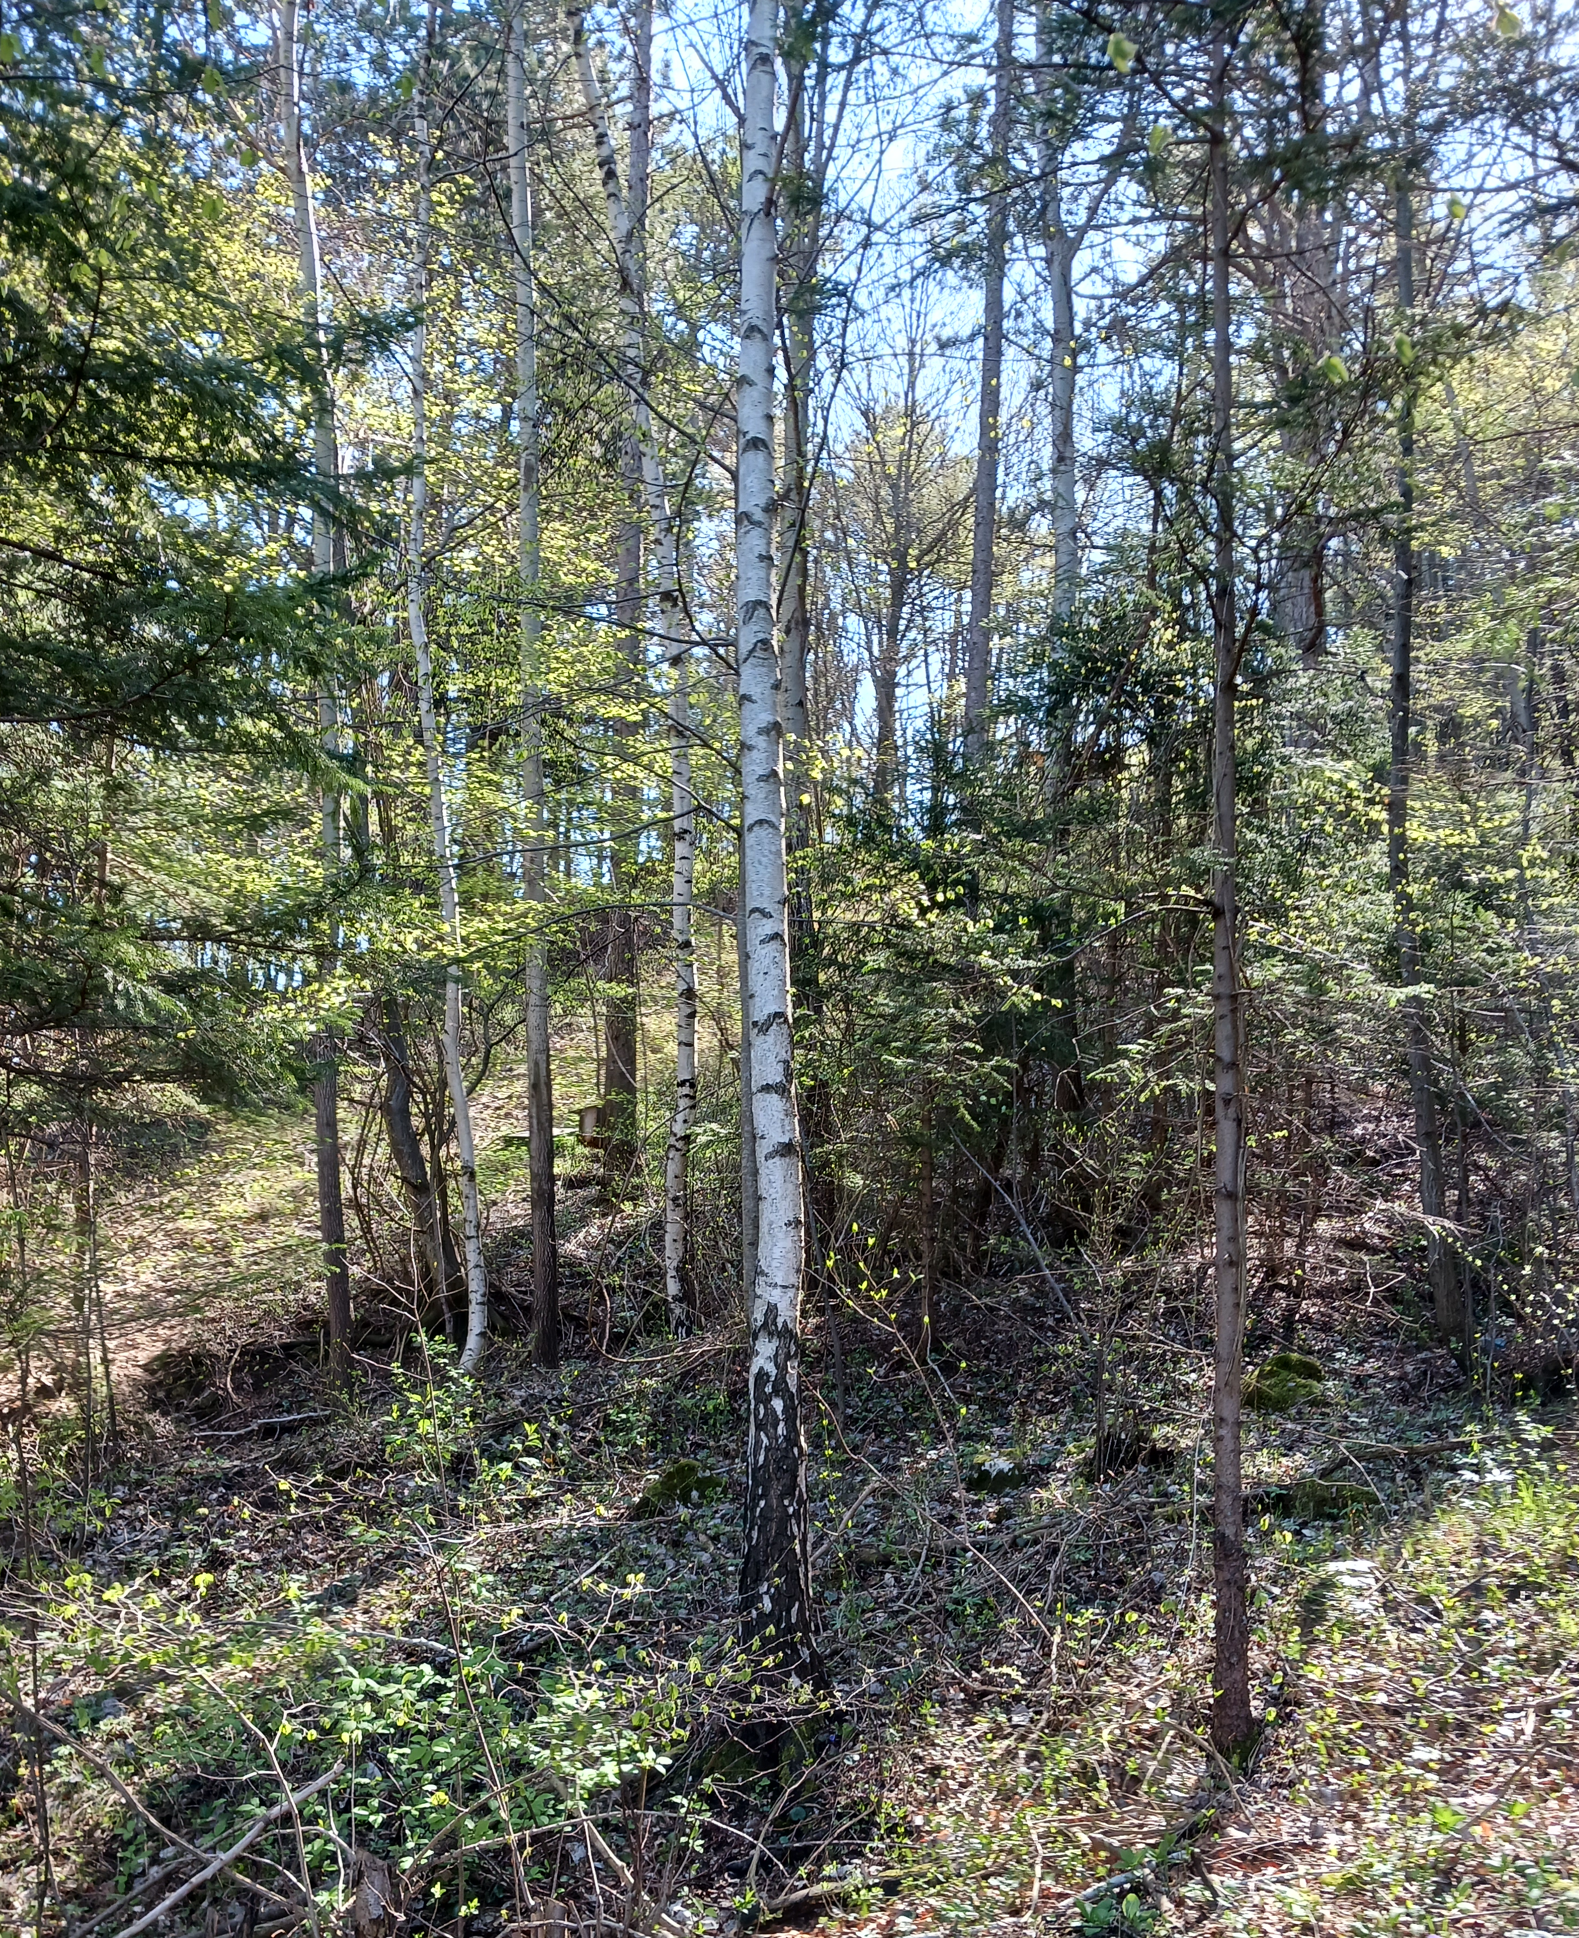
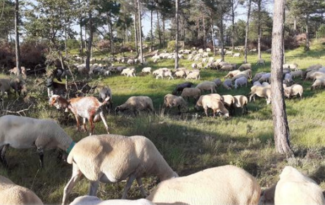
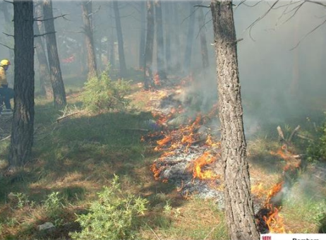
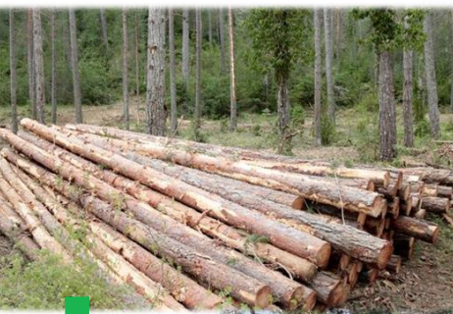
Less agreement on what IS an NBS for wildfire
Ecological forestry
Thinning/grazing
Controlled burns
Forest products
Conservation/biodiversity
Source: Plana, 2021

Slide 7
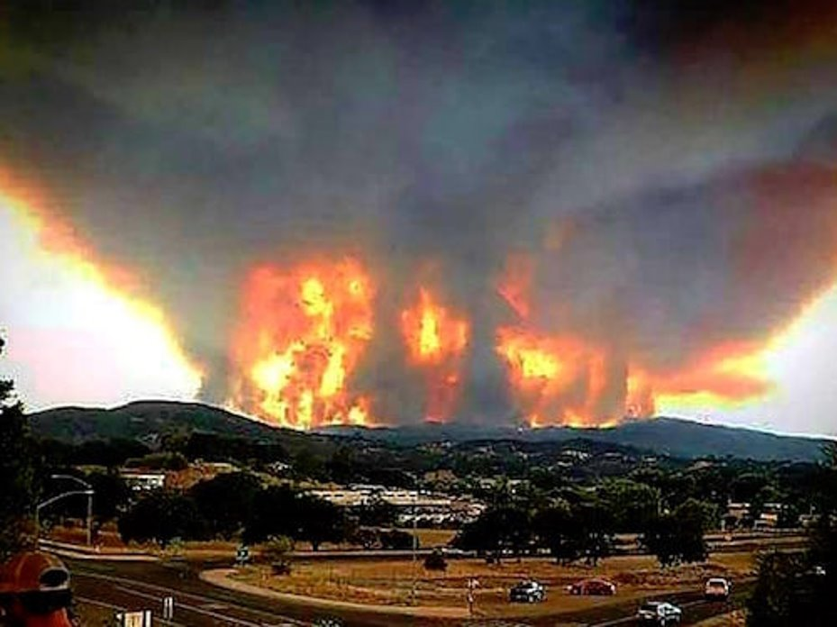
How can insurance promote NBS for wildfire risk reduction?
Restore NBS
Incentivize NBS with premium reductions
De-risk NBS
Facilitate NBS markets
Divest from nature-negative assets

Slide 8
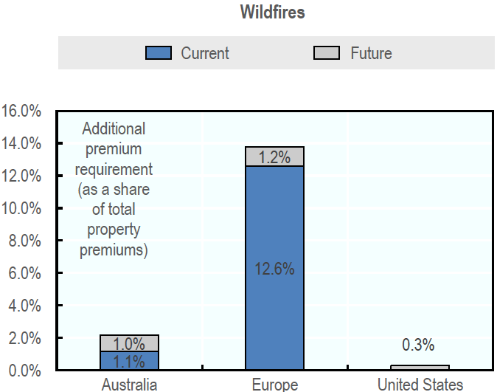
Background: wildfire insurance
Among four perils (earthquakes, storms, floods and wildfires) wildfire losses have accounted for the smallest share of economic losses (3.1%) and the highest level of insurance coverage (63%).
Estimated additional annual premium needed to address wildfire insurance gaps (changing climate)
Source: OECD, 2021

Slide 9
Restore loss & damage to NBS (Underwriting Nature)
Swiss Re and The Nature Conservancy have implemented a parametric insurance product that provides payouts after a hurricane to repair coral reefs. Regional governments in Mexico have purchased the product to help protect the Mesoamerican reef.
Application to wildfire
Insurers are keenly interested in developing parametric products for wildfire.

Slide 10
Incentivize NBS with premium reductions
Study by The Nature Conservancy and Willis Towers Watson showed that ecological forestry (thinning and controlled burns) in California's French Meadows national forest could lead to a decrease in insurance premiums by 41% for homes.
The Nature Conservancy, 2019

Slide 11
De-risk NBS
Ruidoso in the US state of New Mexico was nearly destroyed by a wildfire originating from a controlled burn by the US Forestry Service.
Insurance can transfer liability risk from losses to
Property and assets
Health impacts from smoke
Wildfire smoke is responsible for 5–8% of annual premature deaths from air pollution
Firefighting
Costs up to $3 million/day
ALEXANDER MEDITZ / AP

Slide 12
Facilitate carbon markets
Swiss Re is partnering with Conservation International to facilitate carbon credit markets by covering loss and damage e.g., to mangroves and forests from extreme weather.
Premiums would be paid in part with carbon credits.

Slide 13
Green investment, and divestment from nature-negative assets
Insurers have large investment portfolios. US insurance industry, alone, has $1.4 trillion in capital.
EBRD, Smith, 2016
Huge potential, e.g., investments in green bonds (that can finance wildfire NBS) and divestment from nature-negative assets
…"while many insurers have begun to incorporate climate-risk considerations in their investment processes, new-product launches and underwriting processes are mostly unchanged" (McKinsey 2022)

Slide 14
Thank you!
www//iiasa.ac.at

