Slide 1
Roles of diversity and adaptation in the responses of biodiverse forests to climate change
Jaideep Joshi, Florian Hofhansl, Shipra Singh, Benjamin D. Stocker, Toyo Vignal, Åke Brännström, Oskar Franklin, Carolina C. Blanco, Izabela F. Aleixo, David Lapola, Iain Colin Prentice, and Ulf Dieckmann
25 Apr 2023, EGU 2023

Slide 2
How does a biodiverse ecosystem respond to climate change?
Community composition
Demographic community shifts
Intraspecific variation
Community
Organizational levels
Functional diversity,
Species interactions
Evolutionarily stable strategies
Phenotypic plasticity
Species genetic evolution
Species
Fluxes
Plastic trait acclimation
Individual
Hours-months Years-decades Centuries
Timescales

Slide 3
How does a biodiverse ecosystem respond to climate change?
Community composition
Demographic community shifts
Community
e-CO₂
GPP ↑
$V_{cmax}$ ↓
$g_{s}$ ↓
Drought
GPP ↓
$V_{cmax}$ ↓
$g_{s}$ ↓
Organizational levels
Drought
Mortality ↑
Stand age ↓
Successional stage ↓
Evolutionarily stable strategies
Species genetic evolution
Species
Drought
Xylem $ψ_{50}$↓ (?)
Fluxes
Plastic trait acclimation
Individual
Hours-months Years-decades Centuries
Timescales

Slide 4
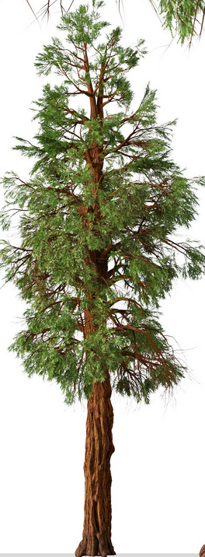
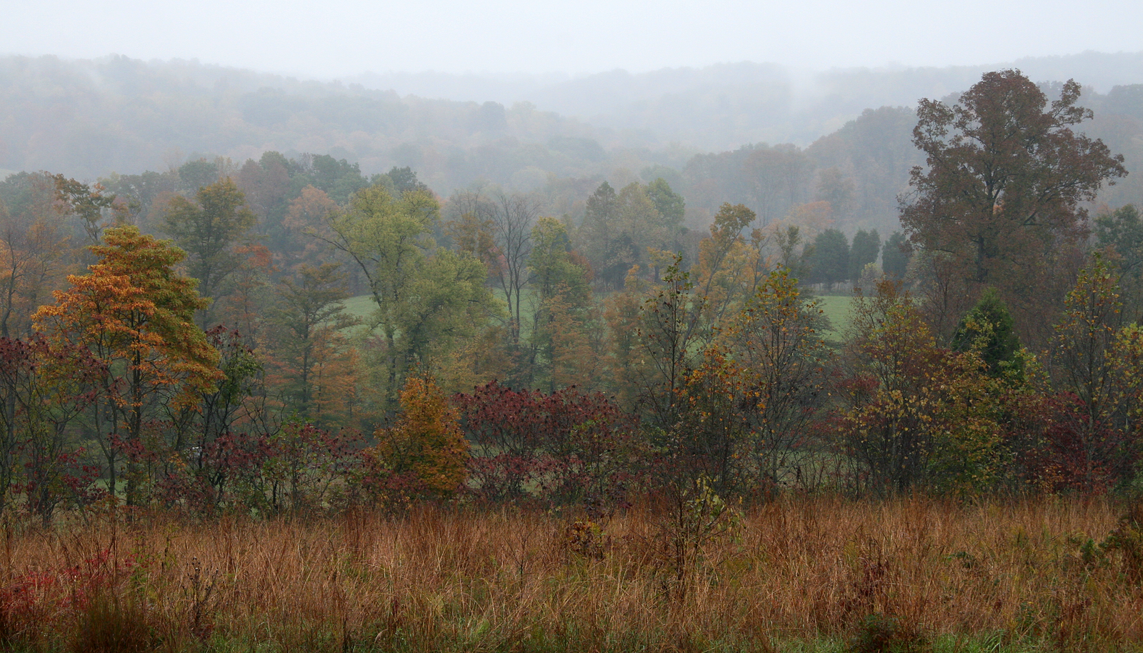
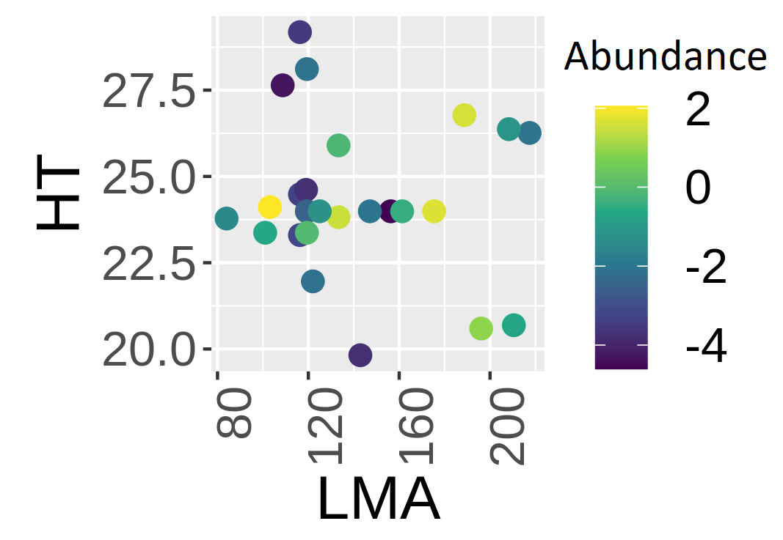
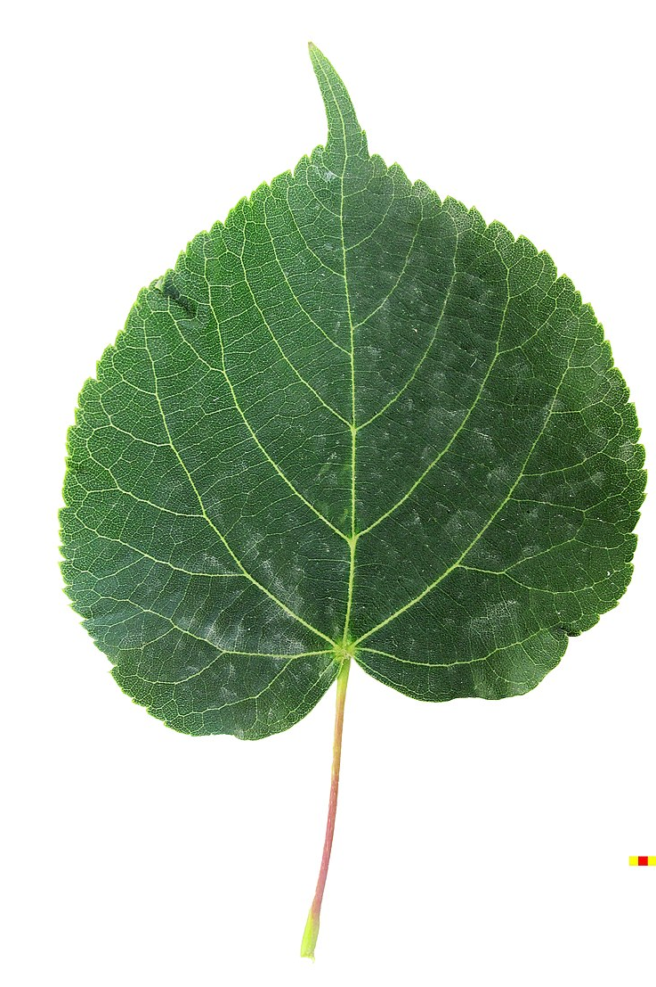
Plant-FATE: Our eco-evolutionary vegetation model
Physiological acclimation
Optimality principles
Vegetation demographics
Size-structured population modelling
Species evolution
Evolutionary dynamics
Optimal photosynthesis, hydraulics, allocation
Competition for light and water, demographic processes
Gradual ascension of the fitness landscape
Plant physiology
Height-structured
light competition
Soil moisture stress
Days - Months
Years - Decades
Centuries
Image Credits: Muffet, Huw Williams

Slide 5
We address four key Questions
What are the changes in fluxes (GPP, transpiration) under elevated CO₂ (eCO₂) compared to ambient CO₂ (aCO₂)?
What are the timescales of responses at the three organizational levels?
Are there potential species shifts under eCO₂?
What are the ESS strategies under different CO₂ and moisture regimes?

Slide 6
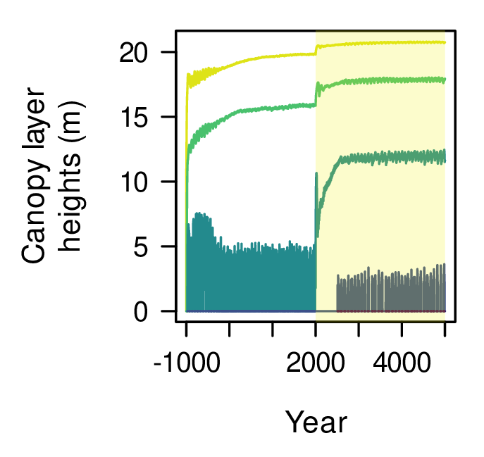
We apply the model to a hyperdiverse Amazonian forest
Forced with periodic extension of observed meteorological data from 2000-2015
Species defined as unique combinations of 4 traits: LMA, max. height, wood density, xylem $ψ_{50}$
Start with 100 species with random trait values with equal abundance
Let community composition evolve via competitive exclusion
614
CO₂ (ppm)
414
Abundance
Abundance
Abundance
Trait
Trait
Trait
6

Slide 7
GPP increases, transpiration decreases under eCO₂
Observed
range

Slide 8
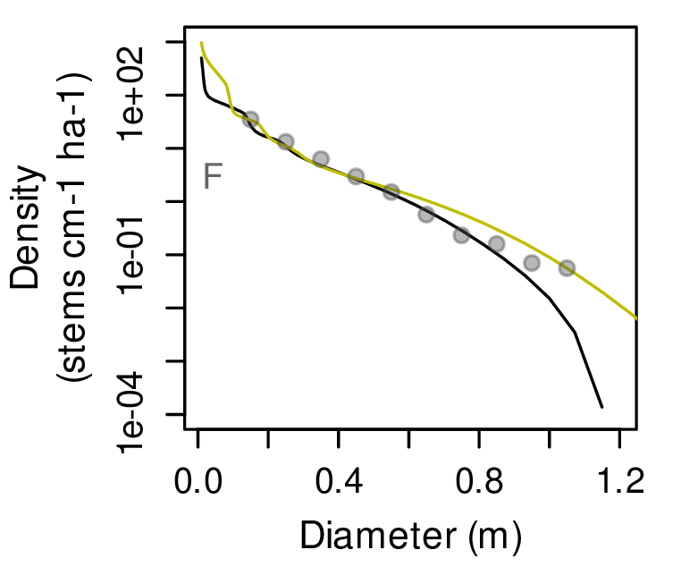
Community shifts to larger trees and species with lower wood density under eCO₂
Predictions (aCO₂) Predictions (eCO₂) Observations

Slide 9
Community responds on three timescales
1. Physiological response in increased leaf-level photosynthesis $\sim$1 year
2. Demographic change due to changing light environment $\sim$500 years
3. Evolutionary change due to changing species composition $\sim$2000 years

Slide 10
Population-environment feedbacks alter the direction of the community shift
Predicted optimal wood density
(for different combinations of LMA, Max Height, and P50)
Baseline
eCO2 but no change in vertical light profile
eCO2 with demographic feedbacks on light profile

Slide 11
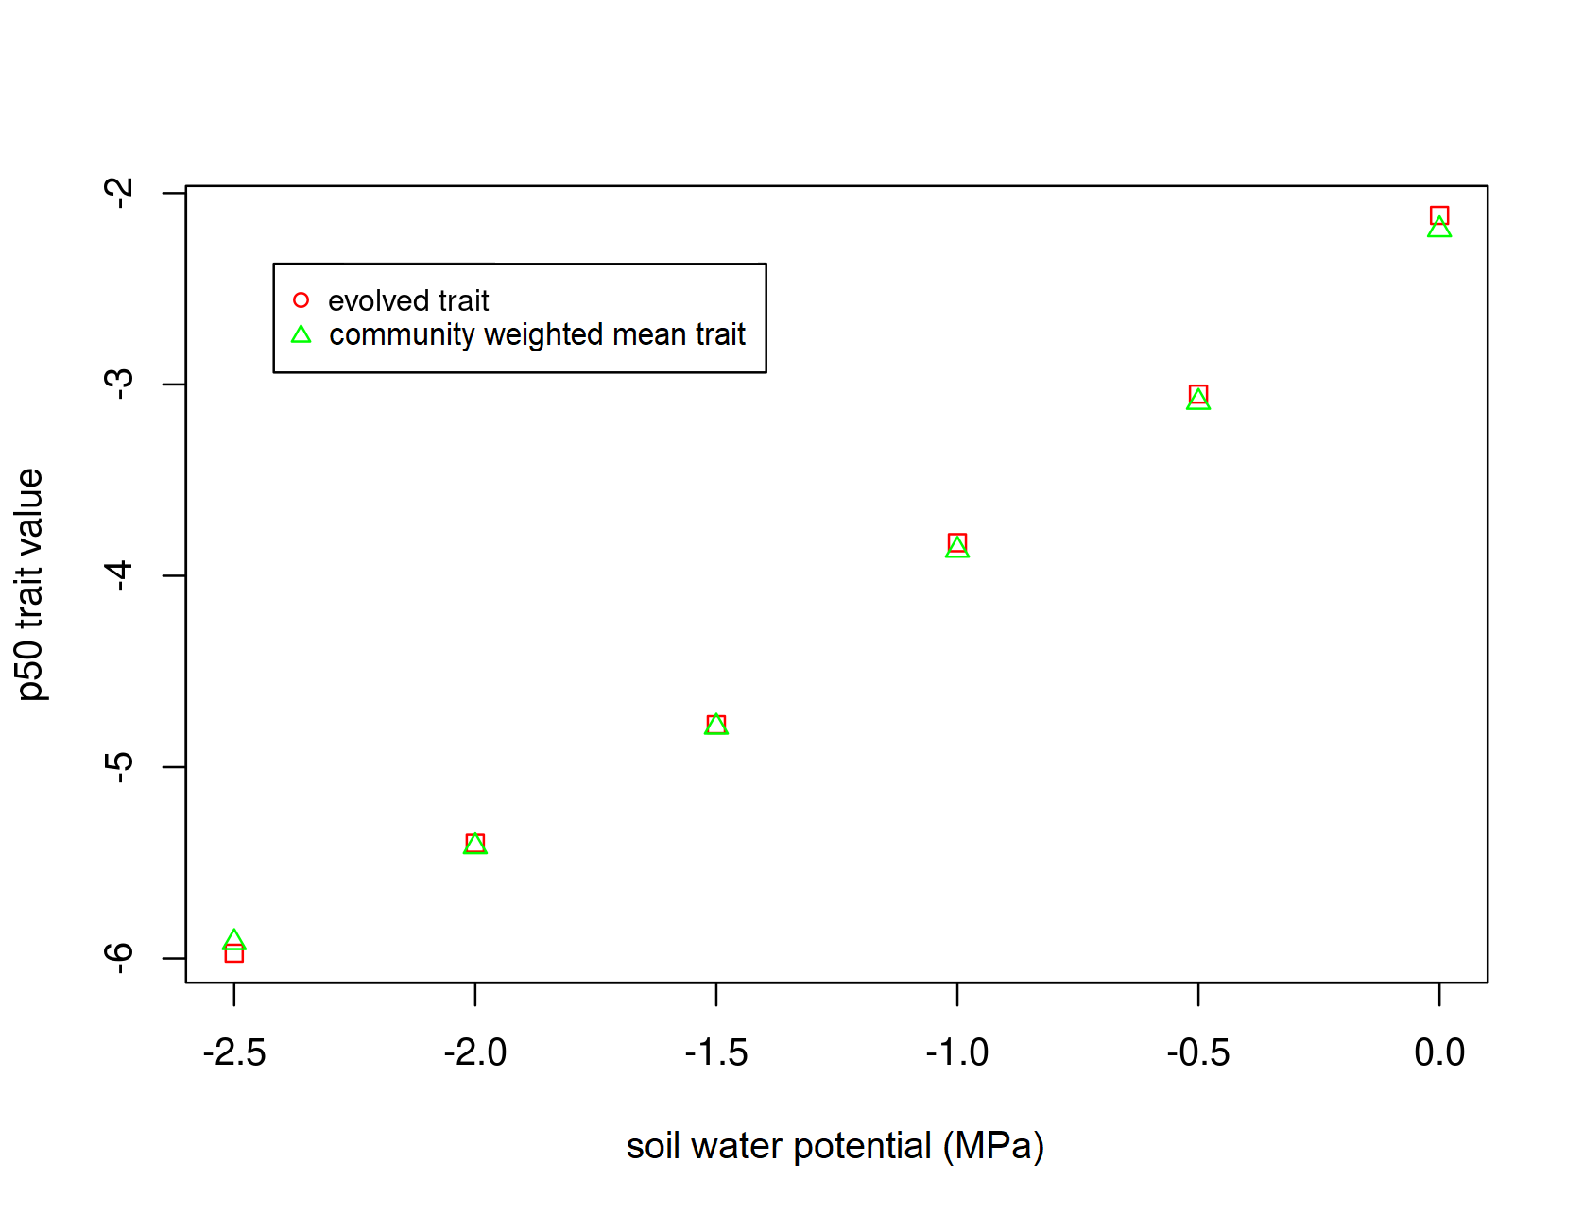
Quick preliminary result on drought ESS Xylem $ψ_{50}$ increases with soil water potential
ESS Xylem $ψ_{50}$ (MPa)
Soil water potential (MPa)

Slide 12
Take home messages
The Plant-FATE model correctly predicts ecosystem fluxes, forest structure, and species composition under ambient CO₂
Under elevated CO₂, productivity increases but community shifts to lower wood density
The direction of the shift is determined by feedbacks between forest structure and the environment
Not accounting for environmental feedbacks can predict opposite outcomes

Slide 13
Thank you
Questions?
jaideep.joshi@giub.unibe.ch

