Slide 1
Consistent linkage of distributed food, water, energy, environmental (FWEE) models: perspectives of data and modeling platform for integrated FWEE security NEXUS analysis and planning.
Ermolieva, T., Zagorodny, A. G., Bogdanov, V. L.,
Havlik, P., Rovenskaya, E., Komendantova, N.,
Kahil, T., Ortiz-Partida, J.-P., Wang, G.,
Balkovic, J., Skalsky, R., and Folberth, C.
EGU General Assembly 2023, Vienna, Austria, 24–28 Apr 2023, EGU23-4116, https://doi.org/10.5194/egusphere-egu23-4116, 2023.

Slide 2
Interdependencies between food, energy, water, environmental systems
Modeling (green) energy production for fertilizer production; energy demand for food, feed, irrigation; resource (land, water, investments) allocation to renewable energy vs agricultural production with respect to food-energy security goals; involvement of stakeholders’ and experts’ goals, constraints, performance indicators
Energy system
LandUse/
Agricultural production system
Modeling of (green) energy production for water and hydrogen production;
energy for water desalination, processing, pumping, industries, households;
stakeholders’ and experts’ goals, constraints, performance indicators
Integrated energy-water-food-environmental
management
Modeling of agricultural production for food security; analysis of energy and water demand for food, feed and fiber crops; agricultural land and water pollution and GHG emissions; smart agriculture; Stakeholders’ and experts’ goals, constraints, performance indicators
Water
system
Environmental
system
Analysis of water resources for food, energy, environmental needs; water production and saving technologies, water pollution and water quality indicators; Stakeholders’ and experts’ goals, constraints, performance indicators

Slide 3
Distributed models’ linkages: Simulation, optimization, …
Models’ linkage problems
Independent distributed models can exist on remote computers and belong to different communities not wishing to share the models and data; or the models are too large to be explicitly integrated
Simulation models’ outputs depend on decisions, i.e., decision-scenario --- model simulation --- solution results
Distributed optimization models optimize decisions for individual food-water-energy sectors
Examples of simulation – optimization models’ linkage
Biophysical simulation model EPIC (Balkovic et al.,2013, 2014; Skalsky et al., Folberth et al., ) and land use partial equilibrium optimization GLOBIOM (Havlik et al., 2014, 2018)
  Link models to derive scenario-by-scenario analysis
  Link models to derive optimal and robust solution of GLOBIOM model
  Link stochastic quantile-based generator of crop-yields (Ermolieva et al., 2023) and GLOBIOM
A natural hazard (flood, windstorm, earthquake) losses model and a multi-agent socio-economic model
  Starting from initial solution, iterative revision of solution towards fulfilment of goals and constraints, i.e., towards a robust solution
Hydrological simulation model and optimization procedure (Kahil at al., , Ortiz-Partida et al.,2023)
Examples of distributed optimization models’ linkage
Land use, water, and energy optimization models
  Link distributed optimization models to derive an optimal solution for all models under individual goals and joint constraints
  Linkage algorithm is based on stochastic quasi-gradient procedure for non-smooth possibly discontinuous (stochastic) optimization, when only generalized gradients can be used (Ermoliev1968, 2009)
Connections between iterative Stochastic Optimization (STO) solution procedure, Machine Learning and Distributed Models’ Linkage
Iterative solution procedure of nonsmooth and discontinuous two-stage STO based on generalized gradients (SQG algorithms by Ermoliev Yurii, holds an honorable award of Pioneer of Stochastic Optimization)
Two-stage STO Quantile regression model (EPIC meta model of stochastic crop yields; precipitation prediction, demand-supply-price prediction, etc.) (Ermolieva et al., 2022,2023)
Distributed models algorithms based on iterative SQG for nonsmooth and discontinuous STO

Slide 4
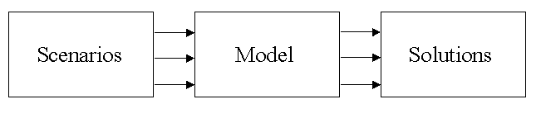
Simulation decision-dependent model for Integrated Catastrophe Risk modeling: Flood model

Slide 5
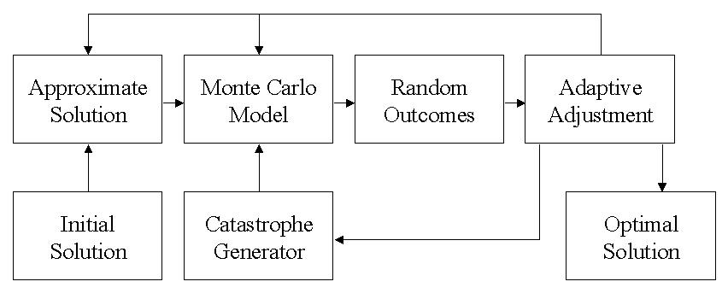
Linkage algorithms:
Linking a generator of stochastic (catastrophe flood) scenarios and
catastrophe risk management optimization model
Iterative SQG optimization procedure
Iterative linkage procedure based on SQG algorithm for nonsmooth and discontinuous stochastic optimization

Slide 6
Ermoliev, Y., 2009a. Two-stage stochastic programming: Quasigradient method. In: Pardalos, P.M. (Ed.), Encyclopedia of optimization. Springer Verlag, New York, USA, 3955–3959.
Ermoliev Y., 2009b. Stochastic quasigradient methods in minimax problems. In: Pardalos, P.M. (Ed.), Encyclopedia of optimization. Springer Verlag, New York, USAErmolieva T.,
Ermolieva, T., Ermoliev, Y.,, Obersteiner, M., & Rovenskaya, E. (2021b). Chapter 4 Two-Stage Nonsmooth Stochastic Optimization and Iterative Stochastic Quasigradient Procedure for Robust Estimation, Machine Learning and Decision Making. In: Resilience in the Digital Age. pp. 45-74 Springer. ISBN 978-3-030-70369-1 10.1007/978-3-030-70370-7_4.
Ermoliev, Y., Komendantova, N., Norkin, V., Knopov, P., Gorbachuk, V. Linking catastrophe modeling and stochastic optimization techniques for integrated catastrophe risk analysis and management. In: (Ed., Knopov P.S.) Modern Optimization Methods for Decision Making Under Risk and Uncertainty, ELSEVIER, HB ISBN 9781032196411.
Ermoliev YM, Ermolieva TY, MacDonald GJ, Norkin VI (2001). Optimization of catastrophic risk processes. Cybernetics and Systems Analysis, 2:90-110
Ermoliev YM, Ermolieva TY, MacDonald GJ, Norkin VI, Amendola A (2000). A systems approach to management of catastrophic risks. European Journal of Operational Research, 122(2):452-460
Kahil, M.T., Dinar, A., Albiac, J. Modeling water scarcity and droughts for policy adaptation to climate change in arid and semiarid regions. Journal of Hydrology 2015a, 522, 95-109.
Kahil, M.T., Connor, J.D., Albiac, J. Efficient water management policies for irrigation adaptation to climate change in Southern Europe. Ecol. Econ. 2015b, 120, 226-233.
Ortiz-Partida, J. P., Kahil, T., Ermolieva, T., Ermoliev, Y., Lane, B., Sandoval-Solis, S., & Wada, Y. (2019). A Two-Stage Stochastic Optimization for Robust Operation of Multipurpose Reservoirs. Water Resources Management, 33(11), 3815–3830. https://doi.org/10.1007/s11269-019-02337-1

Slide 7
Systemic interdependencies: GLOBIOM land use model
Stochastic events (shocks), extreme events generators
Nutrition norms
Stochastic yields, production, resources, ...W(s)
s=1,…,n
Environmnetal norms
Stochastic costs, prices, demans, etc.
Energy-water-
Etc. norms
Stochastic convertion coefficients,
technol. parameters
Notes:
Modeling of internal and external schocks

Slide 8
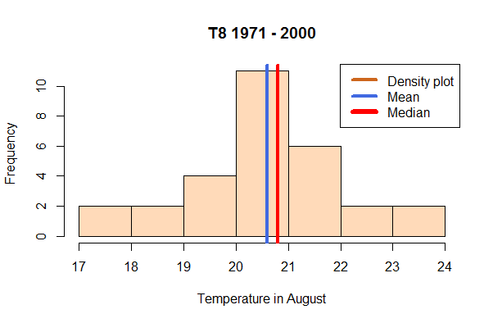
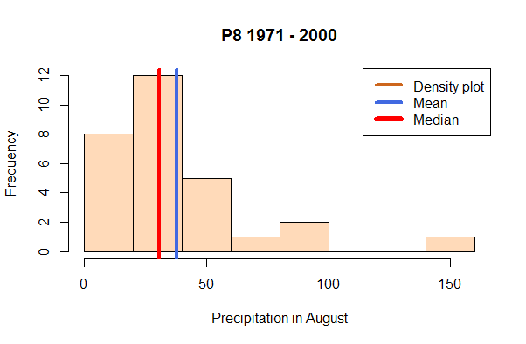
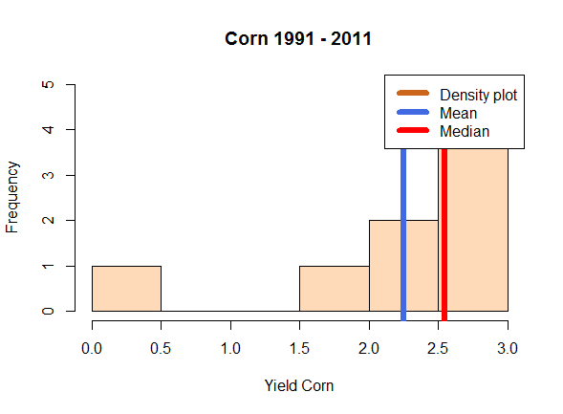
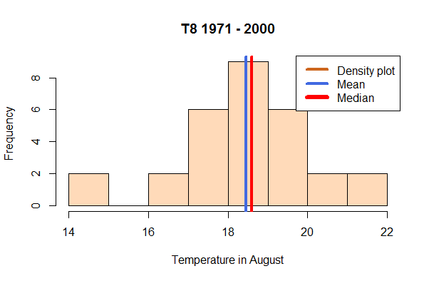
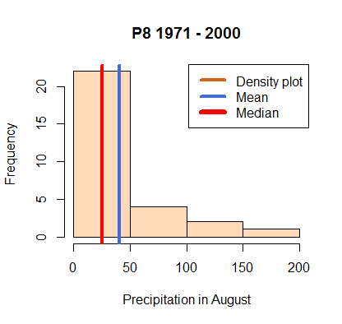
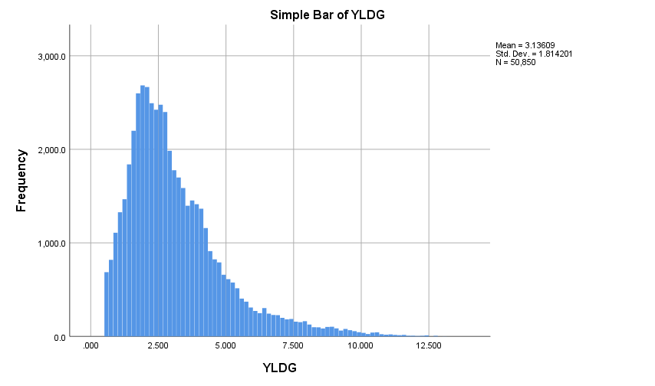
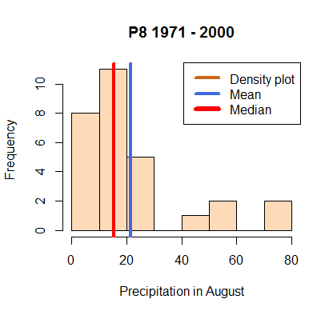
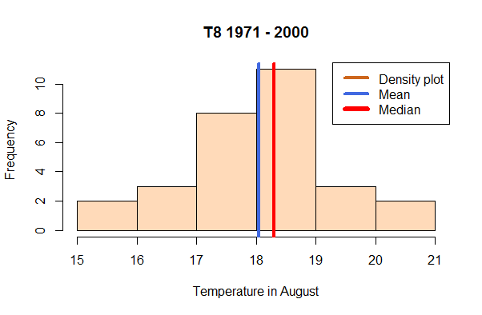
Stochastic EPIC-based generator of crop yields based on GIS data of
T, P, SPEI, soil, water, Monthly, 1km2 resolution, RCPs
Input (P, T, soil quality, water, nutrients)
Input (weather, climate, bio-physical processes, management)
Transfer/process function, kernels, etc
Predicted output (yield)
Observed yields (losses) are skewed
Goal function:
Percentile/
quantile-based risk measures
Yield loss
Iterative
Revision of estimates
Weights/parameters/transfer functions/etc.

Slide 9
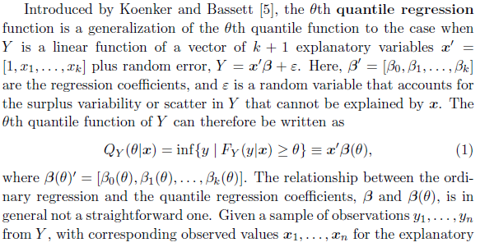
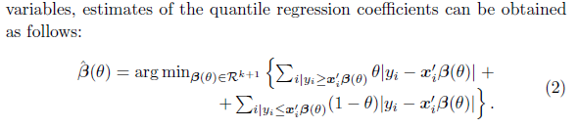
Percentile (Quantile) regression

Slide 10
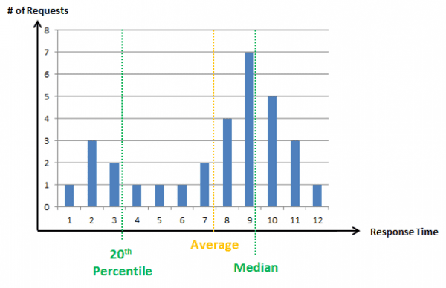
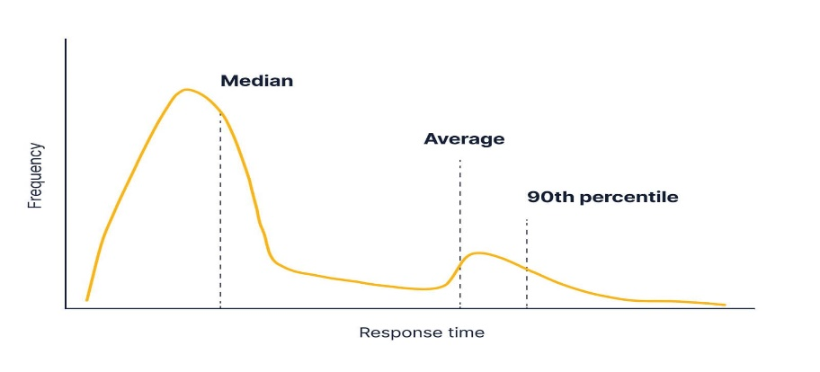
The need for Percentile (Quantile) regression
Nonsymetrical multimodal probability distribution of wheat yield for several countries – major grain producers.
Yield

Slide 11
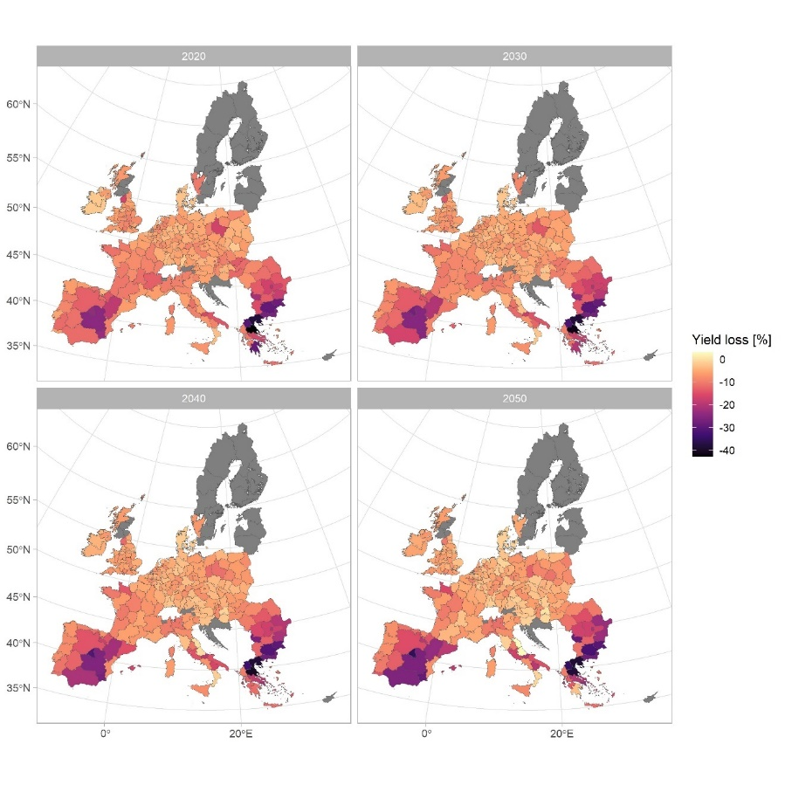
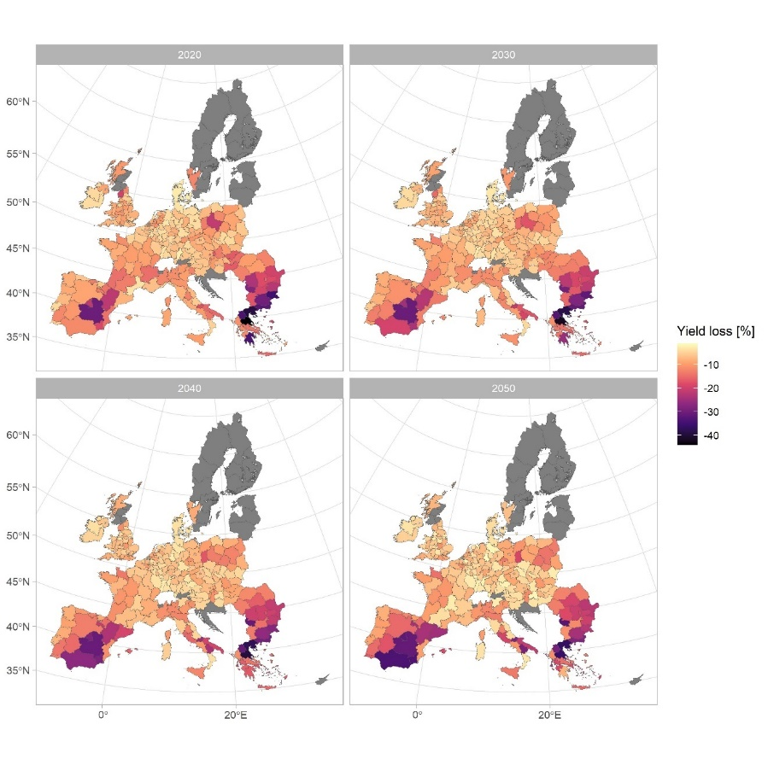
Quantile-based crop yield meta model
Crop yield loss as the difference between the 25th and the average crop yield, from 2000 to 2050, in percentage terms, for rainfed maize, RCP26
Crop yield loss as the difference between the 25th and the median of the crop yield, from 2000 to 2050, in percentage terms, for rainfed maize, RCP26.

Slide 12
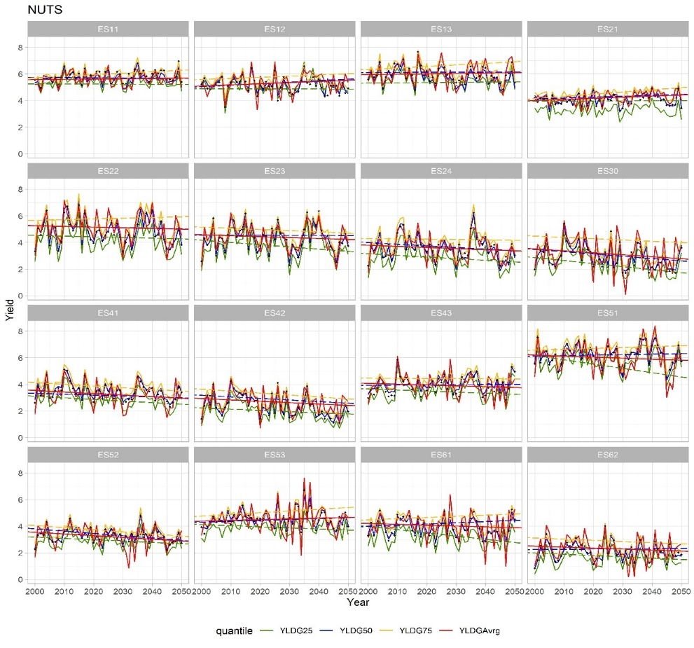
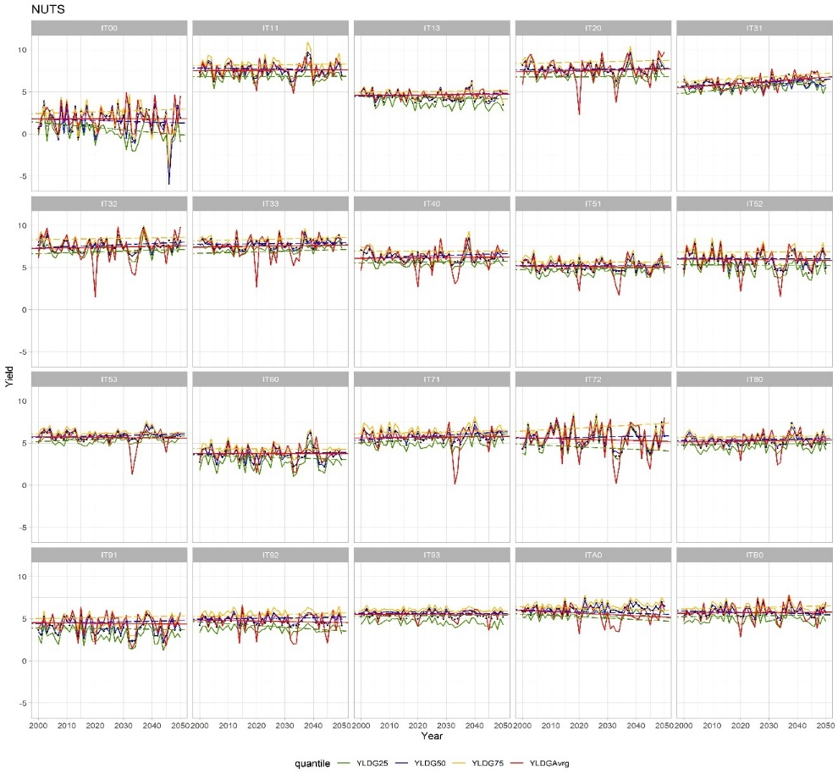
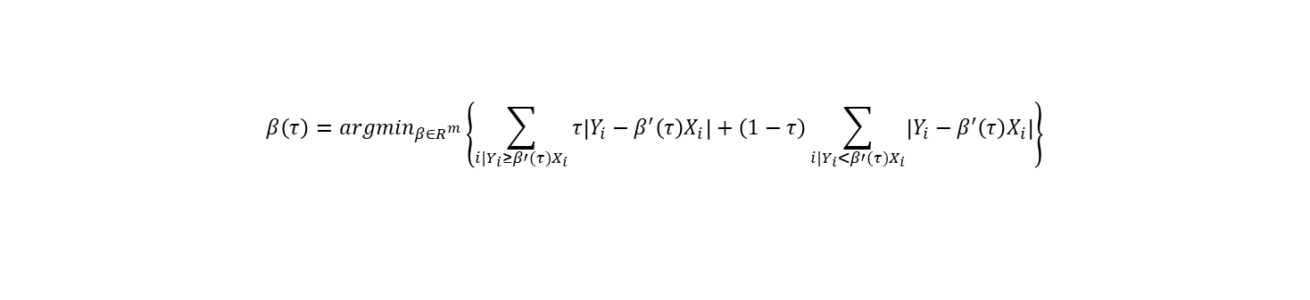
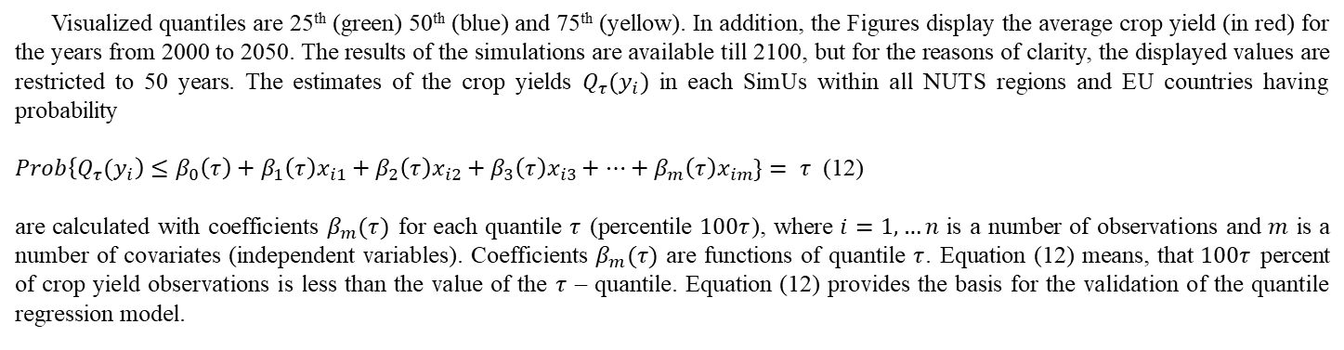
Visualized quantiles are 25th (green) 50th (blue) and 75th (yellow). In addition, the Figures display the average crop yield (in red) for the years from 2000 to 2050. The results of the simulations are available till 2100, but for the reasons of clarity, the displayed values are restricted to 50 years. The estimates of the crop yields ${Q_{τ}(y}_{i})$ in each SimUs within all NUTS regions and EU countries having probability
$Prob\left\{{Q_{τ}(y}_{i}\right)≤β_{0}\left(τ\right)+β_{1}\left(τ\right)x_{i1}+β_{2}{\left(τ\right)x}_{i2}+β_{3}{\left(τ\right)x}_{i3}+…+β_{m}\left(τ\right)x_{im}\}= τ$ (12)
are calculated with coefficients $β_{m}(τ)$ for each quantile $τ$ (percentile $100τ$), where $i=1,…n$ is a number of observations and $m$ is a number of covariates (independent variables). Coefficients $β_{m}(τ)$ are functions of quantile $τ$. Equation (12) means, that $100τ$ percent of crop yield observations is less than the value of the $τ$ – quantile. Equation (12) provides the basis for the validation of the quantile regression model.
$$β\left(τ\right)={argmin}_{β∈R^{m}}\left\{\sum_{i|Y_{i}≥β′(τ)X_{i}}{τ\left|Y_{i}−β^{′}\left(τ\right)X_{i}\right|}+\left(1−τ\right)\sum_{i|Y_{i}<β′(τ)X_{i}}{\left|Y_{i}−β^{′}\left(τ\right)X_{i}\right|}\right\}$$

Slide 13
Ermolieva, T., Ermoliev, Y., Havlik, P., Lessa-Dersi-Augustynczik, A., Kahil, T., Balkovic, J., Skalsky, R., Folberth, C., Knopov, P.S., Wang, G. 2023. Connections between robust statistical estimation, robust decision making withtwo-stage stochastic optimization, and robust machine learning problems. Cybernetics and Systems Analysis 3,
Ermolieva,T., Havlik, P., Lessa-Derci-Augustynczik, A., Boere, E., Frank, S., Kahil, T., Wang,G., Balkovic, J., Skalsky, R., Folberth, C., Komendantova, N., Knopov, P.S. (2023 forthcoming) A novel robust meta-model framework for predicting crop yield probability distributions using multisource data.
Ermolieva, T., Havlik, P., Frank, S., Kahil, T., Balkovič, J., Skalský, R., Ermoliev, Y., Knopov, P.S., et al. (2022). A Risk-Informed Decision-Making Framework for Climate Change Adaptation through Robust Land Use and Irrigation Planning. Sustainability 14 (3) p. 1430. 10.3390/su14031430
Ermolieva, T., Ermoliev, Y.M., Zagorodny, A., Bogdanov, V., Borodina, O., Havlik, P., Komendantova, N.,, Knopov, P., et al. (2022). Artificial Intelligence, Machine Learning, and Intelligent Decision Support Systems: Iterative “Learning” SQG-based procedures for Distributed Models’ Linkage. In: XXII International Scientific and Technical Conference Artificial Intelligence and Intelligent Systems, Kiev, Ukraine.
Ermolieva, T., Zagorodny, A., Bogdanov, V., Knopov, P., Gorbachuk, V., Zaslavski, V., Havlik, P., Derci Augustynczik, A.L., Balkovic, J., Skalsky, R., Folberth, C., Cao, G.-Y., Wang, G. (2022). Big Data, Artificial Intelligence and Machine Learning problems for Robust Food-Water-Energy NEXUS Analysis and Risk-Adjusted Agricultural Insurance Schemes. In: 11th International Conference “V.M. Glushkov’s Lectures”, 8th December 2022, Kiev, Ukraine.
Ermolieva, T., Knopov, P.S., Gorbachuk, V.M., Zaslavskyi, V.A., Borodina, O.M., Gaivoronski, A.A., Havlik, P., Balkovic, J., Skalsky, R., Folberth, C. (2022). Agricultural Adaptation to Climate Change through Risk-Based Crop Insurance: Estimating Probability Distributions of Crop Yields using Weather Parameters, Climate Change Indicators and Soil Characteristics. In: Norwegian-Georgian-Moldavian-Ukrainian School on Innovation and Risk Management, November 19-26, 2022, Batumi Shota Rustaveli State University, Georgia.

Slide 14
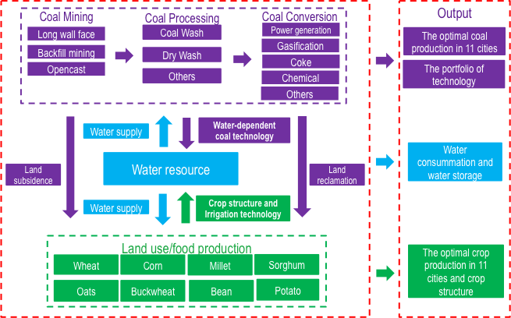
Linkage of Distributed Energy, Water, Land Use Models Linkage (Ermoliev et al., 2022)
Naïve linkage – no consistent solution
Integrated model –too large dimensionality
Iterative linkage procedure based on SQG algorithm for nonsmooth and discontinuous stochastic optimization

Slide 15
Linking distributed optimization models via a central planner (“hub”) under uncertainty and asymmetric information
Linkage of distributed sectoral/regional models does not require “hard integration”, recoding, or reprogramming.
Models are installed on distributed computers and act as “agents”
The “agents” (modeling teams) solve their LP submodels independently and in parallel by a specific iterative subgradient algorithm.
Linkage variable y: , defines constraint on joint resources
Linkage procedure can be considered as Supervised Machine Learning when individual agents maximize their goals to attain socially optimal solution under joint constraints (resource, investments, demand, supply, etc.
Notes:
\nu_A, \nu_E – are the solutions to the max problem or given dual variables???

Slide 16
Ermolieva, T., Ermoliev, Y., Zagorodny, A., Bogdanov, V., Borodina, O., Havlik, P., Komendantova, N, Knopov, P., et al. (2022). Artificial Intelligence, Machine Learning, and Intelligent Decision Support Systems: Iterative “Learning” SQG-based procedures for Distributed Models’ Linkage. In: XXII International Scientific and Technical Conference Artificial Intelligence and Intelligent Systems, Kiev, Ukraine.
Y., Zagorodny, A.G., Bogdanov, V.L., Ermolieva, T., Havlik, P., Rovenskaya, P., Ermoliev, Komendantova, N., Obersteiner, M. Robust food-energy-water-environmental security management: stochastic quasigradient procedure for linkage of distributed optimization models under asymmetric information and uncertainty. Cybernetics and System Analysis, 2022.
Ermoliev, Y.,, Zagorodny, A.G., Bogdanov, V. L., Ermolieva, T., Havlik, P., Rovenskaya, E., Komendantova, N., & Obersteiner, M.(2022). Robust Food–Energy–Water–Environmental Security Management: Stochastic Quasigradient Procedure for Linkage of Distributed Optimization Models under Asymmetric Information and Uncertainty. Cybernetics and Systems Analysis 58 (1) 45-57. 10.1007/s10559-022-00434-5.
Zagorodny, A.G., Ermoliev, Y., Bogdanov, V.L., Ermolieva, T. (2020) Integrated modeling and management of Food-Energy-Water NEXUS for sustainable development. Kiev, Ukraine: Committee for Systems Analysis at Presidium of National Academy of Sciences of Ukraine — National Member Organization of Ukraine in International Institute for Applied Systems Analysis (IIASA). ISBN 978-966-02-9344-1
Gao, J., Xu, X., Cao, G.-Y., Ermoliev, Y., Ermolieva, T., & Rovenskaya, E. (2021). Strategic decision-support modeling for robust management of the food–energy–water nexus under uncertainty. Journal of Cleaner Production 292 e125995. 10.1016/j.jclepro.2021.125995.
Komendantova, N., Neumueller, S., Nkoana, E. Public attitudes, co-production and polycentric governance in energy policy. // Energy Policy. – 2021.- Vol. 153, 10.1016/j.enpol.2021.112241.

