Slide 1
Flammable Futures – A storyline of climatic and land-use change impacts on wildfire extremes in Indonesia
Shelby Corning¹, Esther Boere², Andrey Krasovksiy1, Andrey Lessa-Derci-Augustynczik², and Florian Kraxner¹
Agriculture Forestry and Ecosystem Services (AFE) Group, Biodiversity and Natural Resources (BNR) Program, IIASA
Integrated Biospheres Futures Research (IBF) Group, Biodiversity and Natural Resources (BNR) Program, IIASA

Slide 2
Remote Climate Effects and their Impact on European sustainability, Policy and Trade (RECEIPT)
Aim: to better understand how climate-driven drought events, economic policies, and adaptation efforts affect burned area, agricultural production losses, and land use decisions in Indonesia
the impact of current and future climate-induced fires in Indonesia, their effects on market disturbances and the environment, and mitigation options
2

Slide 3
Overview
Storyline theme |  | Impact of current and future fires as influenced by climate, policy, and land use factors
Hotspot area |  | Indonesia
Land use |  | Agricultural – oil palm plantations
Climatic event | Hazards | Drought, wildfire
 | Counterfactual – climate change | 2, 3, 4 degrees warming by 2050
Local impact of hazard, as related to wildfires |  | Area burned or considered at high risk of wildfire; loss of biodiversity, forested land, oil palm production
Potential impacts to Indonesia | Environmental | Burnt areas Loss of agricultural land, forested land Loss of biodiversity, forest resilience
 | Economical | Export volume Oil palm price and consumption Value added
Alternative socio-economic scenarios | 1. EU policy | Reduction in demand from the EU by the share that’s intended for biofuel use
 | 2. Oil palm moratorium | Ban on deforestation related to oil palm plantations in Indonesia
Adaptation scenarios | 1. No peatland conversion | No land cover conversion of existing peatlands
 | 2. Rewetting | Restoration of peatlands from plantations or agricultural land
1

Slide 4
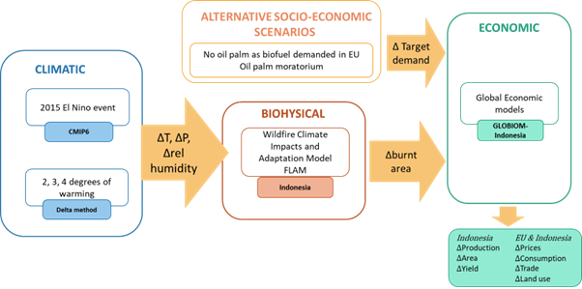
Methodology – climatology and model chain
Model chain of partial equilibrium biosphere management model (GLOBIOM) and wildfire impacts and climate adaptation model (FLAM)
FLAM: Predict burned area (total and oil palm plantations) under these conditions
GLOBIOM: Calculate market and environmental consequences due to predicted fire losses
Consider El Nino event impacts on climatic parameters under +2, 3, 4 degrees warming (delta approach)
Climate from 28 coupled models using historical and simulation data
Separate climate change response from other drivers (eg Sea Surface Tension patterns) – scale accordingly
Estimate projected degrees of global warming in terms of changes to climate variables
Add to isolated 2015 El Nino event
Mean ensemble and high-risk climate change storylines
Compare results between warming conditions and scenarios
3

Slide 5
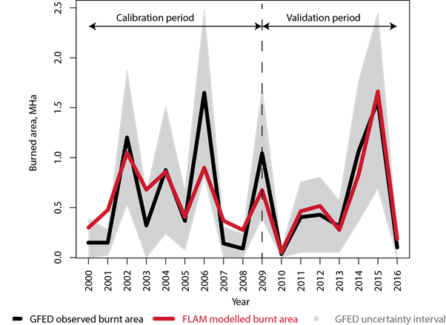
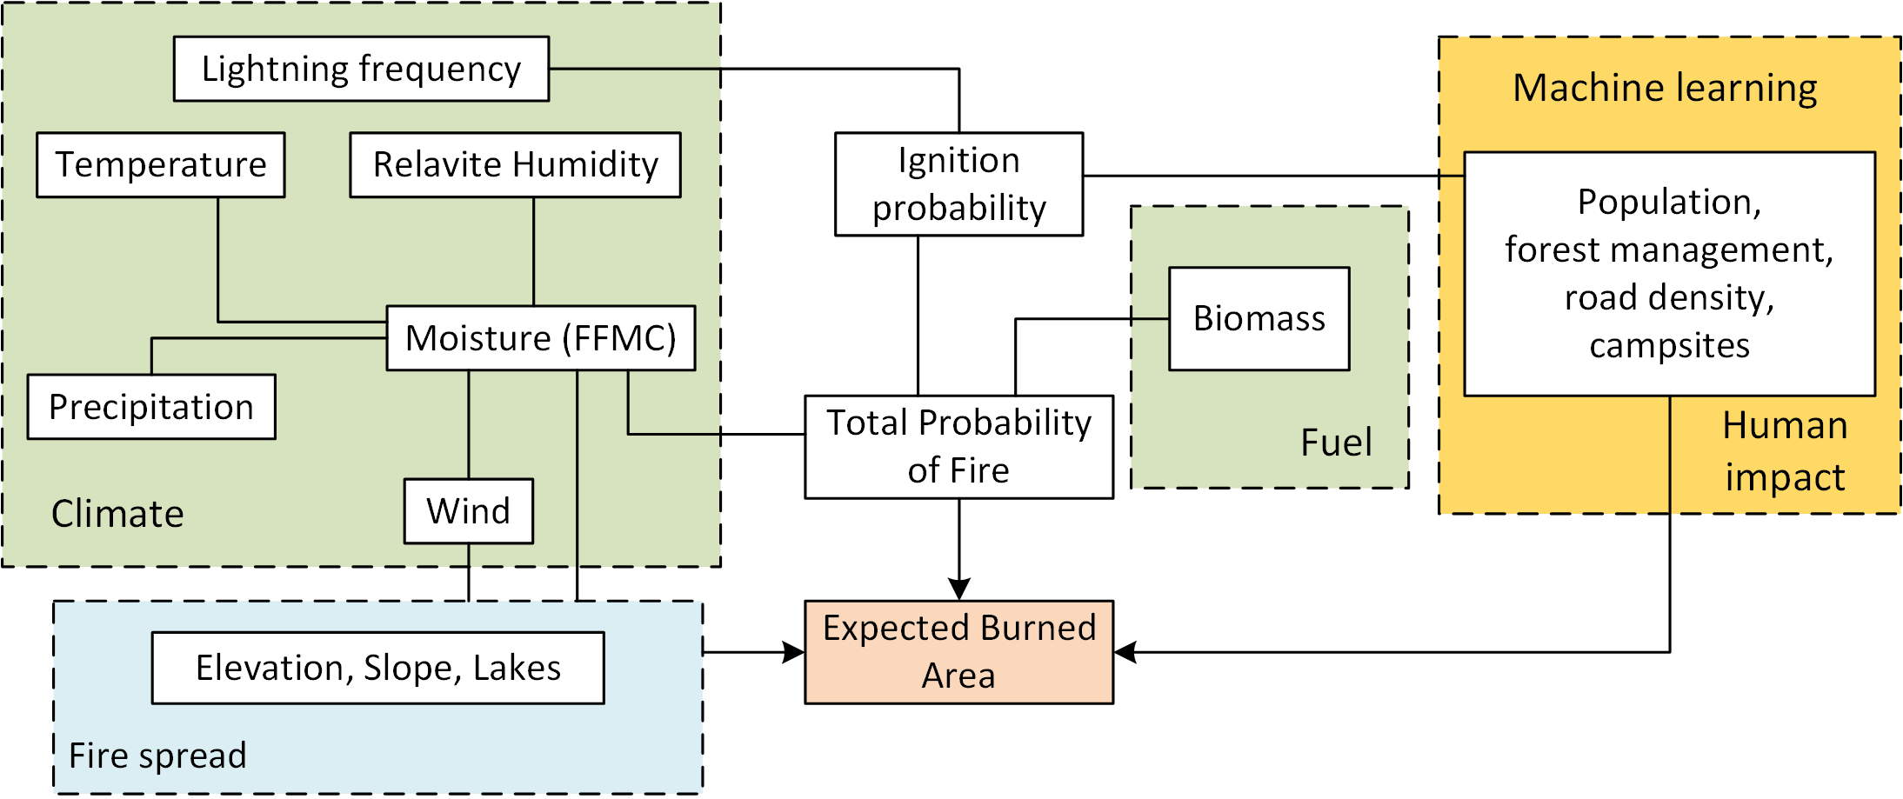
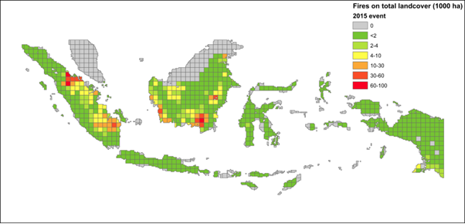
Methodology – FLAM
Population,
Peatland burning,
Forest management
Figure 1: FLAM schematic. Run on a daily time-step at a resolution of 0.25° x 0.25°, aggregated to 0.5° x 0.5° polygons used by GLOBIOM
Figure 2: Calibrated over 2000-09 and validated over 2010-16 using the Global Fire Emissions Database (GFED) dataset
Figure 3: Spatial distribution of modelled burned areas, 2015. ~1.6million ha, approximately 1.5% of Indonesia’s total land mass
4
Notes:
Temperature, precipitation, relative humidity

Slide 6
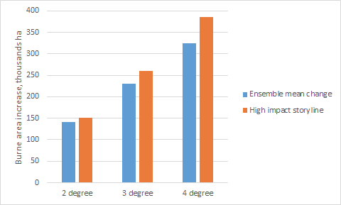
Results
Overall increase in total burned area and production loss across scenarios and storylines
High impact storyline resulted in higher burned areas and production losses than mean climate (ensemble) storyline
Multiply burned area by productivity of oil palm plantations in grid cell to calculate loss due to fire
Increase seen especially in southern islands of Indonesia (Sumatra and Kalimantan) – agreement in observed and predicted trends of prominent drying response
Production losses as great as 25% in southern islands under 4 degree warming
Separated by land cover, oil palm area burned: 450,000 ha (actual) vs 515,000 ha (modelled)
Figure 1: change in burned area across scenarios and storylines
Degrees warming (C) | Burned area (1000 ha) – Ensemble | Burned area (1000 ha) – High impact | Production loss (1000 ha) – Ensemble | Production loss (1000 ha) – High impact
1 (baseline) | 515.0 | 515.0 | 7154.4 | 7154.4
2 | 567.0 (+9%) | 568.0 (+9%) | 7883.2 (+10) | 7888.6 (+10%)
3 | 606.0 (+14%) | 610.0 (+16%) | 8440.4 (+18) | 8478.3 (+19%)
4 | 645.0 (+20%) | 650.0 (+24%) | 8985.6 (+26%) | 9044.9 (+26%)
Table 1: change in burned area and palm oil production across scenarios and storylines

Slide 7
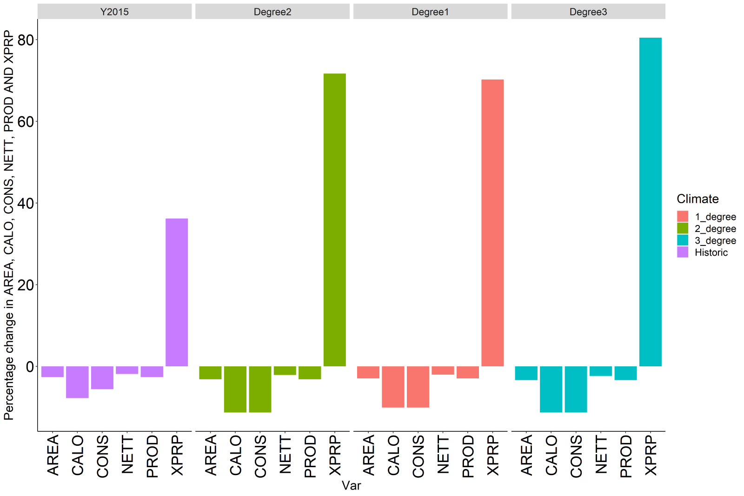
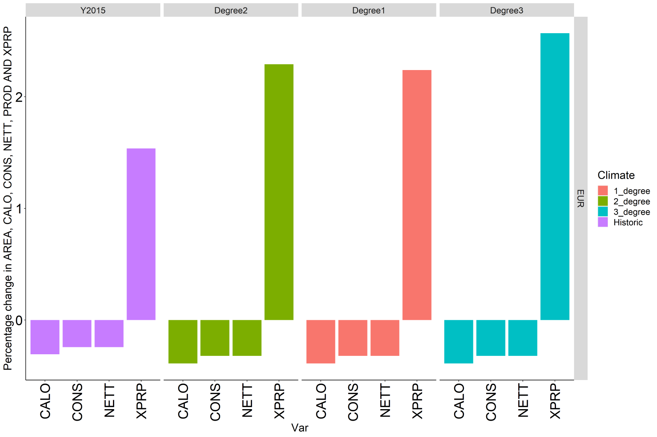
Results
Area of oil palm burned: increases with each degree warming, both in absolute area and as a percentage of land cover burned
2.7% in 2015, 2.9% in +1, 3.4% in +3
Indonesia (top graph):
Overall decrease in area allocated to palm oil plantations
Overall decrease in calories consumed and total consumption
Increase in price (+36-80.5%)
Decrease in exports – local supply impacted more!
European Union (bottom graph)
Overall decrease in imports, calories consumed, and total consumption
Total change in trade flow: reduction of 70-103 thousand tons
Increase in price (+1.5-2.6%)

Slide 8
Conclusions and next steps
Across ensemble of climate scenarios and storylines (eg regardless of climate warming situation), burned area and oil palm production losses increased with each degree of warming
Without intervention, we can expect an increase in frequency and extent of wildfires
FLAM captured regional variability; GLOBIOM captured local and regional variability
Next steps:
To what extent can the climate impacts be mitigated through policy?
Socio-economic adaptations
Environmental adaptations
To what extent does the environment/biodiversity suffer or recover under the above adaptations?
6

Slide 9
Thanks for your time and attention! Questions?
For further information:
FLAM – http://www.iiasa.ac.at/flam
Shelby Corning (corning@iiasa.ac.at)
Andrey Krasovskiy (krasov@iiasa.ac.at)
GLOBIOM – http://www.iiasa.ac.at/globiom
Esther Boere (boere@iiasa.ac.at)
Andrey Lessa (augustynczik@iiasa.ac.at)

