Slide 1
Modeling wildfire dynamics and future projections under climate change scenarios: the FLAM approach
Andrey Krasovskiy¹, Shelby Corning¹, Esther Boere¹, Nikolay Khabarov¹, Reinis Cimdins², Florian Kraxner¹
1) International Institute for Applied Systems Analysis (IIASA), Laxenburg, Austria 2) University of Eastern Finland, Joensuu, Finland
EGU General Assembly 2023
Session NH7.2: “The effect of weather and climate extremes on wildfires and their impacts”
April 25, 2023
Vienna, Austria

Slide 2
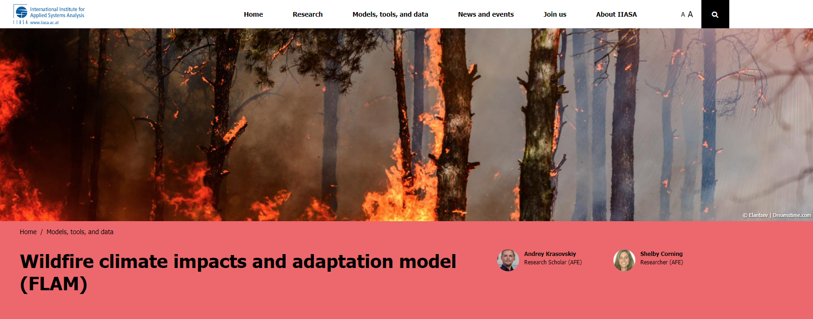
wildFire cLimate impacts and Adaptation Model (FLAM)
Mechanistic fire model that uses algorithms to parameterize the impacts of climate, fuel availability, and human activities on wildfire probabilities, frequencies, and burned areas
Operates with a daily time step at various resolutions (100m to 25km)
FLAM was calibrated and validated using the most recent publicly available GIS and remote sensing datasets
Allows for inclusion of additional fire-related factors into model
Ability to model and compare situations locally, regionally, and globally, under different warming and RCP scenarios.
Find more info at: www.iiasa.ac.at/flam

Slide 3
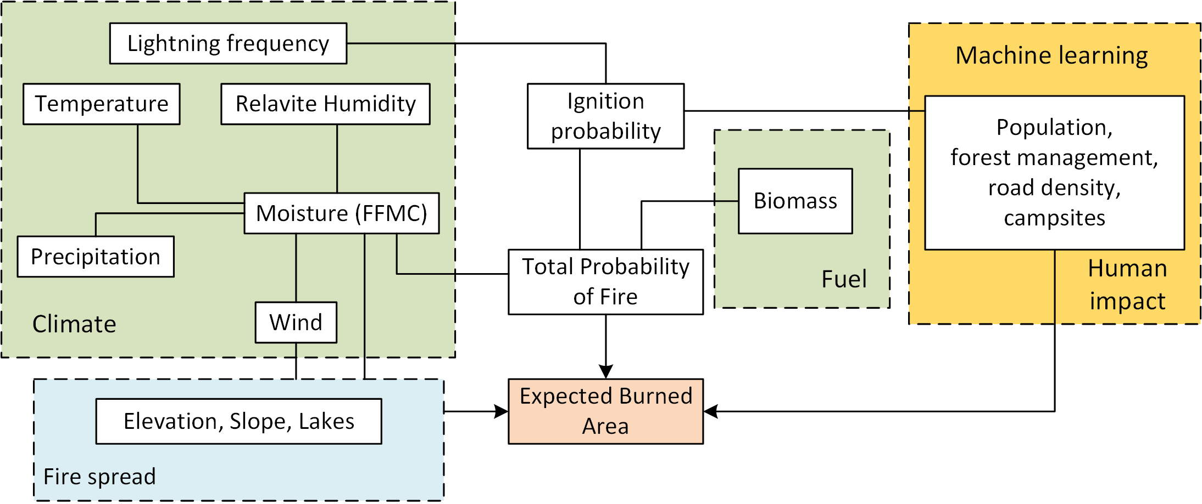
Wildfire climate impacts and adaptation model (FLAM)
Schematic of FLAM workflow
www.iiasa.ac.at/flam

Slide 4
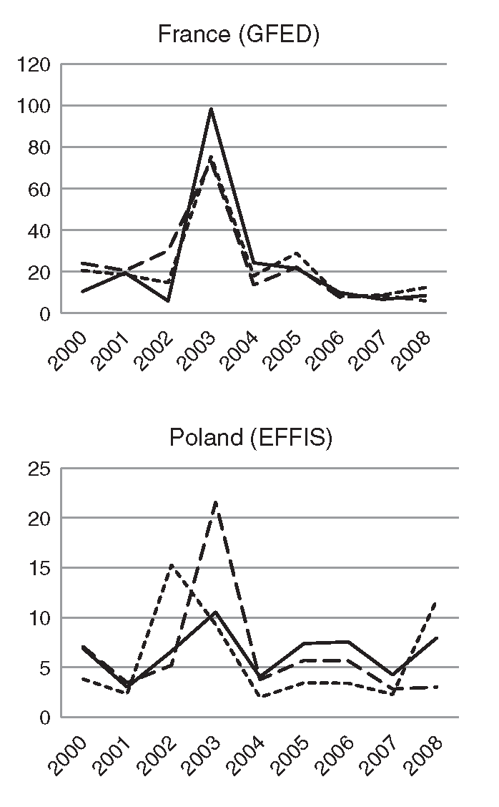
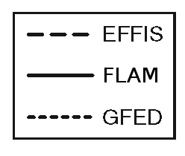
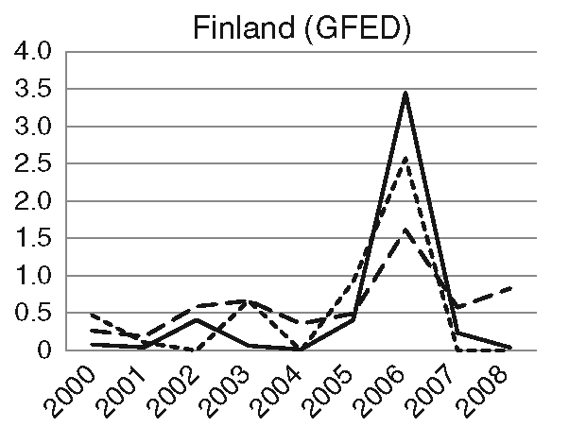
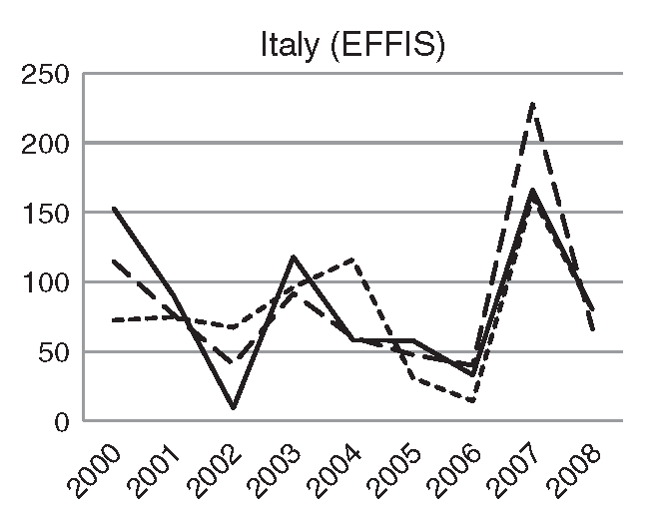
FLAM calibration approach: Europe
Annual burned areas (in thousands of hectares):
GFED, Global Fire Emissions Database; EFFIS, European Forest Fire Information System.

Slide 5
FLAM projections for Europe

Slide 6
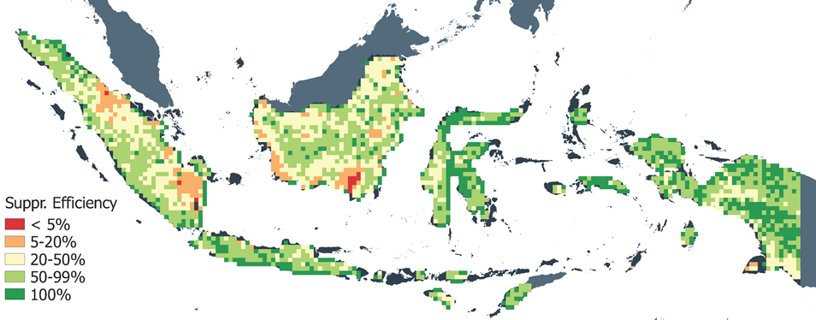
FLAM - captures spatial hot spots in Indonesia
Spatial suppression efficiency (at 25 km² resolution) calibrated in FLAM using burned area reported in GFED for wildfire in Indonesia, accumulated over 2000-2009
Notes:
We see that suppression efficiency is found low in the peatland areas. This parameter is connected to the duration of fire. In some peatland areas fire can last for months, once it is ignited. So far it is rather aggregated indicator, but we will identify what is behind this parameter (infrastructure, land use, etc.)

Slide 7
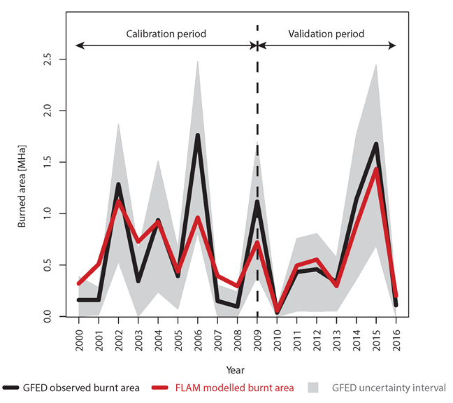
FLAM - captures temporal dynamics
Annual dynamics of burned area (wildfire) in Indonesia [MHa]. During the calibration period GFED burned area (black line), accumulated over 2000-2009, is used for FLAM calibration. In 2010-2016 GFED data is used for validation of the burned area estimated by FLAM (red line). GFED uncertainty (grey area).
Source: Krasovskii et al, Modeling Burned Areas in Indonesia: The FLAM Approach. Forests 2018, 9, 437. https://doi.org/10.3390/f9070437
Notes:
One can see that red line FLAM projection is close to the black line - data from GFED.
In the validation period we did not use any real (satelite) data

Slide 8
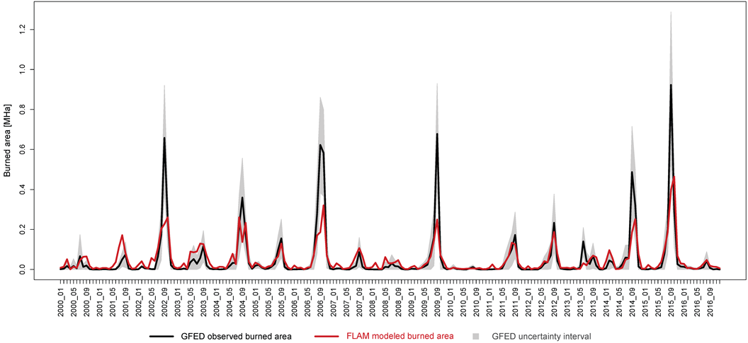
FLAM - captures seasonal dynamics
Monthly dynamics of burned area (wildfire) in Indonesia [MHa]. (FLAM: red line, data: black line)
See recurring fire season in Indonesia picking each September.
Notes:
We could also capture monthly dynamics (FLAM - red line, data - Black)
The fire season is usually in September in Indonesia

Slide 9
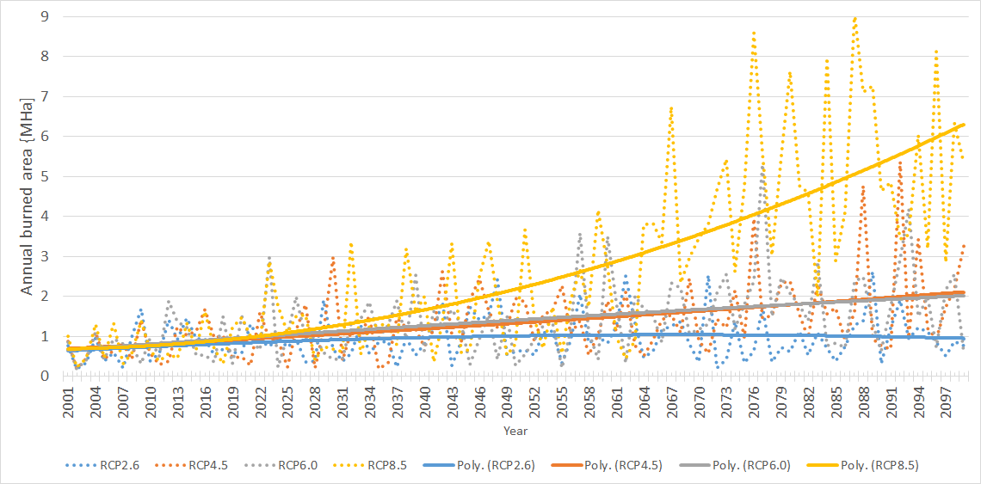
FLAM projection under CC scenarios
Future burned areas projected by FLAM under four RCP scenarios in Indonesia (daily weather from ISIMIP2b). Dashed lines: annual burned areas in Indonesia; solid lines: polynomial trends of second order. Period 2000-2016 is used for calibration, and 2017-2099 for projection. Source: RECEIPT project deliverable.

Slide 10
Global projections – burned area under RCPs
FLAM
Calibration period: 2001-2016
Projection period: 2017-2099
Climate data: HadGEM2-ES model (ISIMIP2b)
Forest growth: G4M
Source: IIASA-FLAM, Krasovskiy et al, 2019

Slide 11
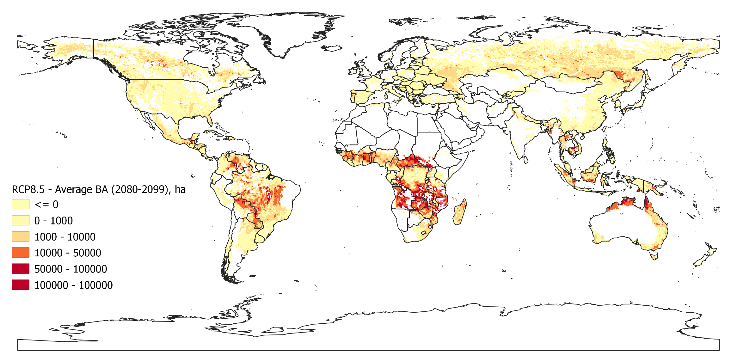
FLAM: Globale Waldbrandfläche / Hot Spots (2080-2100) RCP 8.5 Szenario
Source: IIASA-FLAM, Krasovskiy et al, 2019

Slide 12
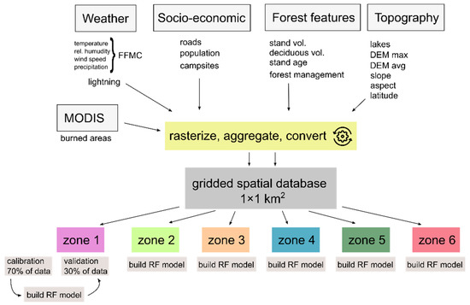
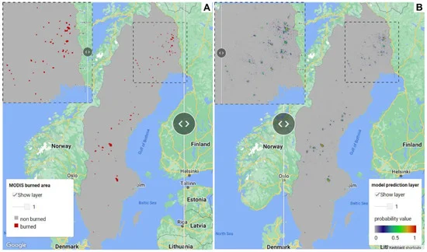
Regional Variability and Driving Forces behind Forest Fires in Sweden
Understand vulnerability of Swedish forests to wildfires
1km x 1km spatial grid on a monthly time step, with 6 biogeographical zones
Addition of road density, topography, and campsites to the parameters
Random forest to determine importance features for wildfire probability within zones
Hotspot mapping with visualization in Google Earth Engine (GEE)
Cimdins, R., Krasovskiy, A., Kraxner, F. "Regional Variability and Driving Forces behind Forest Fires in Sweden." Remote Sensing, vol. 14, no. 22, 2022.

Slide 13
Thank you for your attention!
Contact:
Dr. Andrey Krasovskiy
Research Scholar
Agriculture Forestry and Ecosystem Services (AFE)
Biodiversity and Natural Resources (BNR)
International Institute for Applied Systems Analysis (IIASA)
https://iiasa.ac.at/staff/andrey-krasovskiy
https://iiasa.ac.at/flam

Slide 14
IIASA Integrated Assessment Framework
GEO-WIKI.ORG
Citizen Science
MAGICC
simple climate model
Population
Economy
National level Projections
socio-economic drivers
EPIC
agricultural crop model
GLOBIOM
integrated agricultural, bioenergy and forestry model
socio-
economic
drivers
G4M
spatially explicit forest management model
GAINS
GHG and air pollution mitigation model
GHG emissions
MESSAGE
systems engineering model (all energy sectors, all GHGs, pollutants and water)
air pollution emission
coefficients & abatement costs
carbon and biomass price
FLAM
wildfire climate impacts and adaptation model
demand
response
agricultural and forest bioenergy potentials,
land-use emissions and mitigation potential
iteration
MACRO
Aggregated macro-economic model
BeWhere
Spatially explicit Techno-economic energy system optimization model
energy
service
prices
Access
Fuel choice model for cooking
Transport Module Modal split,
cost and value of time
Source: IIASA, 2018

Slide 15
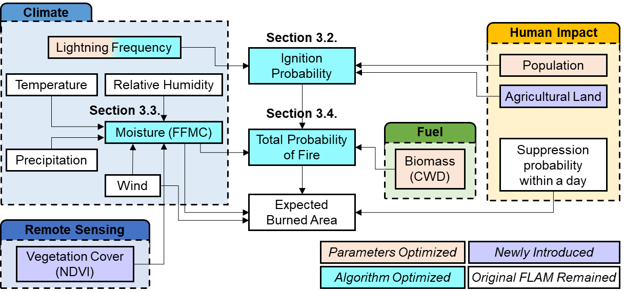
Recent FLAM-related publications - 2
Optimization of the IIASA’s FLAM model to represent forest fires in South Korea¹
Optimize FLAM to reflect (seasonal) fire frequency patterns in South Korea
1km x 1km spatial grid on a daily time step
Addition of peatland burning and proximity of forests to agricultural fields to parameters
Alterations to lightning occurrence (daily vs monthly), population density threshold value for ignition, and use of remote sensing moisture data for FFMC
Showed benefits of optimization of FLAM to regional characteristics (spatial patterns, frequency, additional human-related activities)
Jo, H.-W., Krasovskiy, A. , Hong, M., Corning, S., Kim, W., Kraxner, F., & Lee, W.-K. (2023). Modeling Historical and Future Forest Fires in South Korea: The FLAM Optimization Approach. Remote Sensing 15 (5) e1446. 10.3390/rs15051446.
FLAM workflow diagram

