Slide 1
HFC mitigation pathways compatible with 1.5 ºC in the context of the Kigali Amendment
Pallav Purohit, Lena Höglund-Isaksson and Zbigniew Klimont
IIASA - Energy, Climate and Environment (ECE) Program
Pollution Management (PM) Research Group
Ninth International Symposium on Non-CO₂ Greenhouse Gases (NCGG9)
Amsterdam, The Netherlands
June 21-23, 2023

Slide 2
The GAINS Model
(Greenhouse gas - Air Pollution INteractions and Synergies)
Macro-economic drivers
F-gas (HFC, PFC, SF₆, NF₃) activities
Decision making on F-gas management and co-benefit assessment
National emission ceilings
Emission control options
(F-gas regulations, policies and measures)
Exogenous projections
Global (i.e., IEA-WEO/MESSAGE)
Regional (i.e., PRIMES/AIM)
National (i.e., MARKAL)
Mitigation strategies
Unit costs
Emission factor
Costs
Marginal abatement cost-curves for F-gases
Emissions
Radiative forcing impacts of F-gases (via GWP)
Source: IIASA/GAINS

Slide 3
The Kigali Amendment
The Parties to the Montreal Protocol reached agreement at their 28th Meeting of the Parties on 15 Oct 2016 in Kigali, Rwanda to phase-down HFCs.
Countries agreed to add HFCs to the list of controlled substances, and approved a timeline for their gradual reduction by 80-85% by the late 2040s
Entry into force: 1st Jan 2019
Ratification status: 150
  Article 5, Group 2: Bahrain, India, Iran, Iraq, Kuwait, Oman, Pakistan, Qatar, Saudi Arabia, and the United Arab Emirates.
  Non-Article 5, later start: Russia, Belarus, Kazakhstan, Tajikistan, Uzbekistan

Slide 4
HFC emissions in the baseline, Kigali Amendment
(KA) and Maximum Technically Feasible
Reductions (MTFR) scenarios
4.0-5.3 Gt CO₂eq
(Velders et al., 2015)
Source: Purohit et al. (2020) Atmos. Chem. Phys., 20: 11305–11327

Slide 5
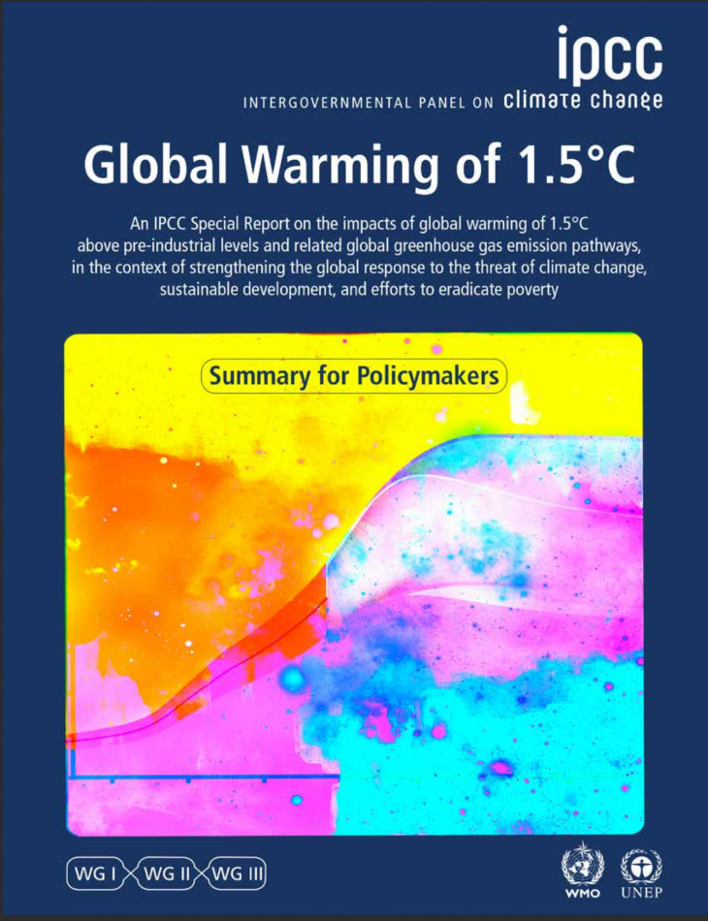
HFC emissions in the baseline, Kigali Amendment
(KA) and Maximum Technically Feasible
Reductions (MTFR) scenarios
The 1.5°C-consistent scenarios used in IPCC’s Special Report on Global Warming of 1.5 °C (SR15) include a 75-80% reduction in HFC emissions by 2050, compared to 2010 levels, along with deep and simultaneous reductions of CO₂ and all non-CO₂ climate-forcing emissions.
Full compliance with the Kigali amendment is expected to achieve a 56% reduction in HFC emissions by 2050, compared to 2010 levels.
4.0-5.3 Gt CO₂eq
(Velders et al., 2015)
56%
75-80%
Source: Purohit et al. (2020) Atmos. Chem. Phys., 20: 11305–11327

Slide 6
Kigali Amendment: A5 Group 1&2 alignment scenario
Non-Article 5, earlier start
Non-Article 5, later start
Article 5, Group 1
Article 5, Group 2

Slide 7
Kigali Amendment: 95% scenario
Non-Article 5, earlier start
Non-Article 5, later start
Article 5, Group 1
Article 5, Group 2

Slide 8
Kigali Amendment: Combined scenario
Non-Article 5, earlier start
Non-Article 5, later start
Article 5, Group 1
Article 5, Group 2

Slide 9
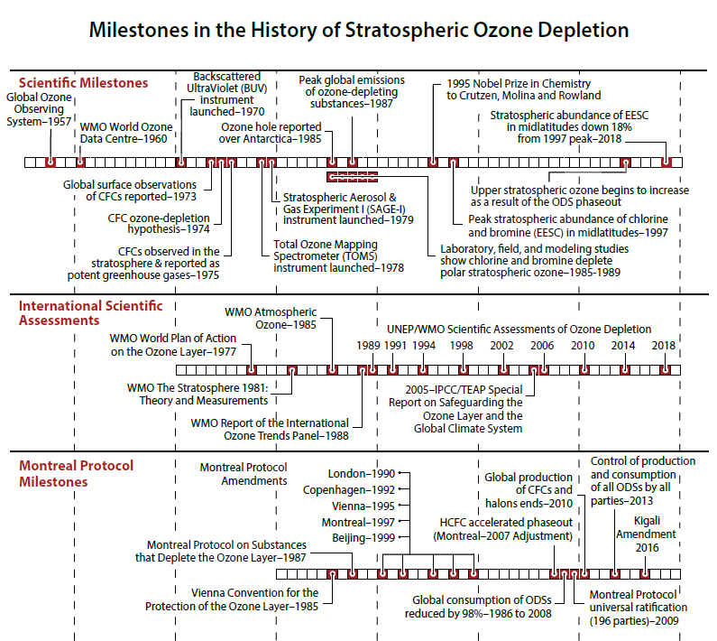
Source: Salawitch et al. (2018)

Slide 10
Kigali Amendment : Accelerated combined scenario
Source: Purohit et al. (2022) Nat. Clim. Chang. 12: 339–342

Slide 11
HFC emissions in the baseline and alternative scenarios
Source: Purohit et al. (2022) Nat. Clim. Chang. 12: 339–342

Slide 12
HFC emissions in the baseline and alternative scenarios
Source: Purohit et al. (2022) Nat. Clim. Chang. 12: 339–342

Slide 13
Summary
Hydrofluorocarbon emissions have increased rapidly and are managed by the Kigali Amendment to the Montreal Protocol.
The current ambition of the Kigali Amendment is not consistent with the 1.5 °C Paris Agreement goal.
The start-and-strengthen approach of the Montreal Protocol on refrigerant management shows that accelerated HFC phase-down under the Kigali Amendment could result in additional reductions of 72% in 2050, increasing chances of staying below 1.5 °C throughout this century.

Slide 14
Thank you!
E-mail: purohit@iiasa.ac.at

