Slide 1
Teaching Integrated Assessment Modeling for Sustainable Transitions: Lessons and Insights
By Madeleine Seatle, Muhammad Awais, Madeleine McPherson
Engineering Education for Sustainable Development
June 19, 2023

Slide 2
Outline
Course structure
Teaching principles
Course outcomes
Purpose
IAMs in education

Slide 3
Why focus on IAMs?
Problems we’re facing:
Benefits of using IAMs:
Climate change
Depletion of natural resources
Environmental degradation
Able to investigate complex problems
Consideration given to different indices of the problems
  Physical
  Technological
  Environmental

Slide 4
The role of the engineer
Engineers are uniquely placed to help address these sustainability challenges¹
Traditional engineering education does not facilitate interdisciplinary solutions
  Focus on specific technologies and technical solutions
Engineering education must evolve to better prepare future engineers for sustainability challenges
IAMs are excellent at exploring solutions to interdisciplinary challenges
¹ Kevin, T. (2010). The role of engineers in framing national policy responses to Australia’s climate crisis. Australian Journal of Electrical and Electronics Engineering, 7(2), 195-201.

Slide 5
Using IAMs in engineering education
IAMs can be complex to teach
  Toy models make IAMs teachable over a single semester
Toy model of MESSAGEix used
  Prototype from global MESSAGEix-GLOBIOM
  Canadian country-level model
Easier for students to utilize, even without significant modelling experience
  Parametrization and data saved in spreadsheets
  Run through Jupyter notebooks
Notes:
Students familiar with spreadsheet software such as excel
Jupyter notebooks facilitate a more interactive coding experience

Slide 6
How is this material taught?
University of Victoria offers a course using the IAM toy model
  Integrated Assessment Modeling for Energy System Transitions
  Term project must utilize the toy model
Partial flipped classroom approach
  Content delivered by instructor and guest lecturers
  Student-led discussions based on assigned readings
  Structured work time on term project
Notes:
Research shows that a flipped classroom approach promotes active learning and enhances course outcomes, reflected by student attitudes (Awidi & Paynter, 2019; Butt, 2014; Danker, 2015). It has also been hypothesized that student-led lectures further improve flipped class-rooms' benefits to students (Butt, 2014).

Slide 7
How is this material taught?
Structured work time on term project
Getting started
Implementation of the toy model
Planning the project
Reporting
Notes:
The initial phase, Getting Started, ensures that everyone has installed and completed the tutorials. To evaluate a student's comprehension of the les-sons, assignments may be offered.
In the second step, Planning the Project, students investigate several concepts and engage in conversations with the instructor to establish their proposed project's viability. This phase is essential for verifying that the students' proposed projects match with the course learning outcomes.
The third stage, Implementation in the MESSAGE model, entails the bulk of the effort, as students implement their concepts in the model. This phase includes the quantification of model assumptions, data processing, and other technical components.
The fourth phase, Reporting, focuses on teaching students how to successfully report their data, construct visualizations, and convey their findings. This phase is essential for training students for professions in energy systems modelling and sustainability in the future.

Slide 8
Evaluating success of IAM comprehension
Term project evaluated on several criteria:
  Connection to core concepts from teachings and readings
  Achievement of previously set objectives
  Contextualization of the topic within the broader landscape
  Quality of the model
  Quality of the results
  Quality of the analysis
  Presentation clarity
  Quality of slides
Ability to understand appropriate scope
Connection of the model to the real world
Modelling capabilities

Slide 9
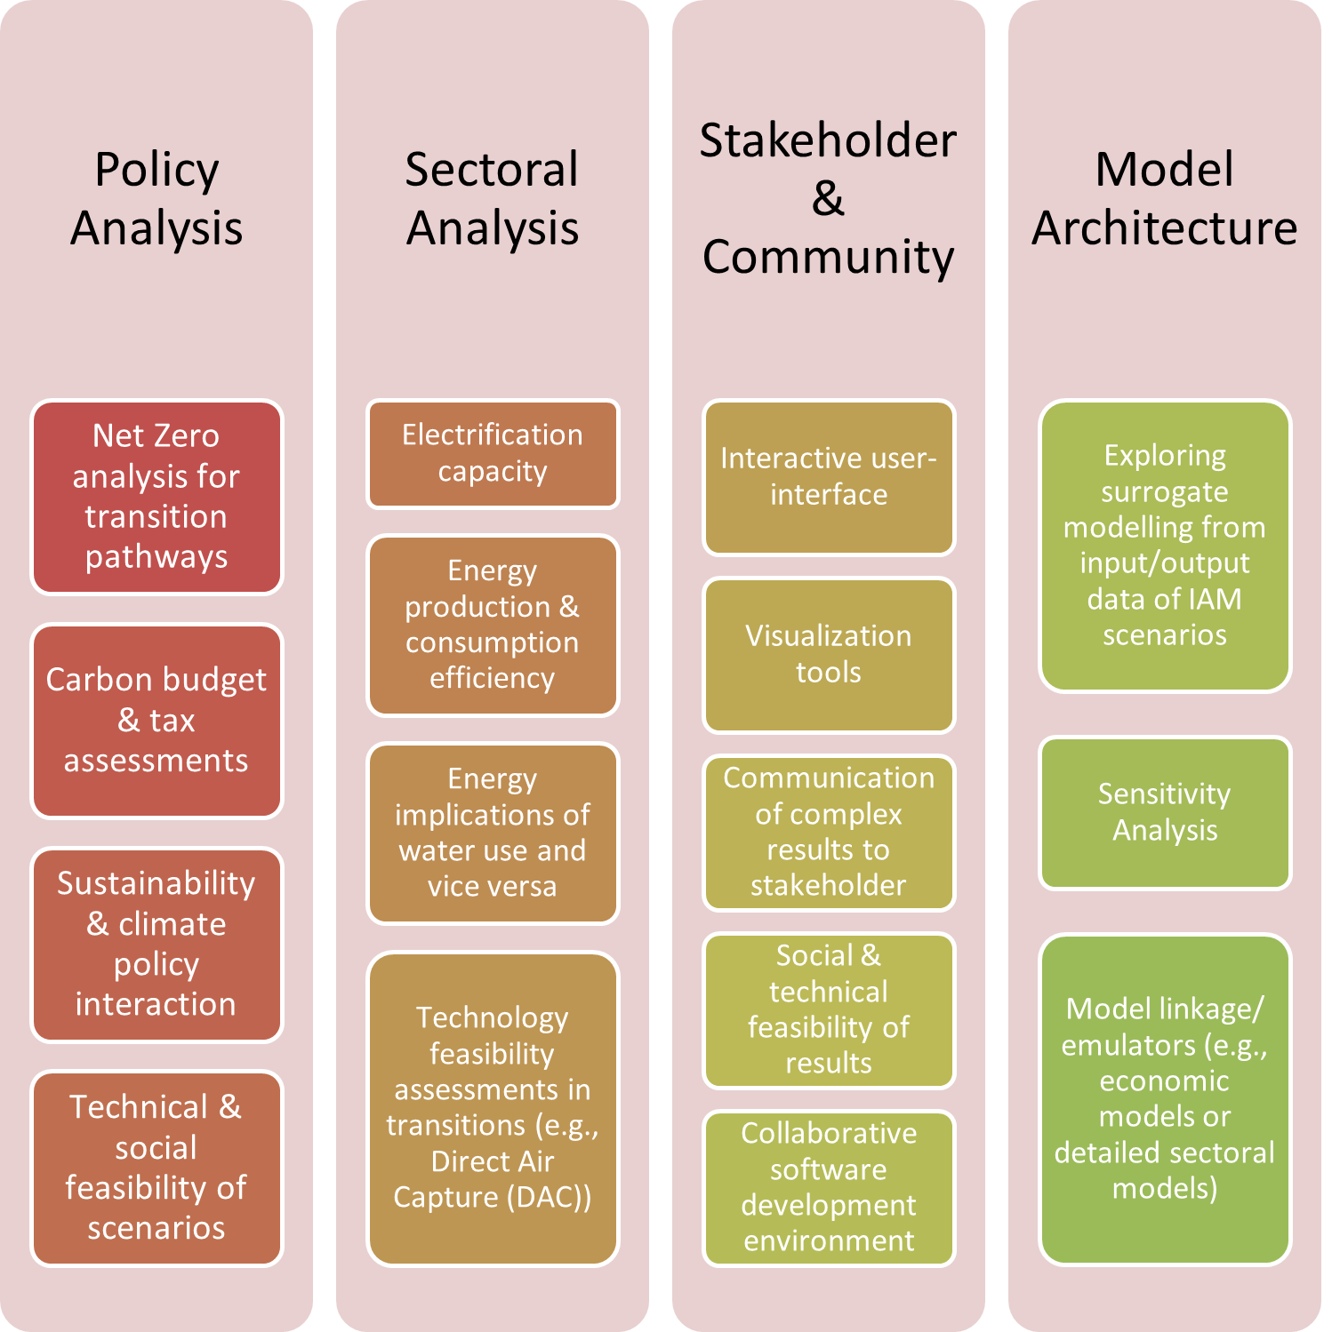
Trends in term projects
Notes:
Policy analysis
Notably, a number of term projects analyzed mitigation and net zero path-ways focused on Canadian policy landscape
Evaluated the efficacy of various policy options and looking at their impacts on emissions reduction and sustainable development objectives
Sectoral analysis
Evaluation of electrification capacity has been a significant component of sectoral analysis
The feasibility and repercussions of transitioning from fossil fuel-based systems to electrified solutions have also been a focus of term projects, typically approached by analyzing factors such as infrastructure investment requirements and technological advancements
Some students looked at emerging technologies, such as direct air capture, looking at the technological feasibility across various sectors
Stakeholder and community
Visualization tools
Interactive user interface
Collaborative software development environment
Model architecture
Model linkage (capacity expansion, production cost, sector specific demand models)
Surrogate modelling

Slide 10
Conclusion
The incorporation of IAMs into engineering education provides students with a unique opportunity to apply their knowledge from multiple disciplines to address real-world sustainability challenges
New methods of instruction should be considered to enhance student understanding and engagement
  Toy models
  Case studies
  Visualization tools
Ideally, will make students better equipped to navigate complex sustainability problems and make meaningful contributions to creating a sustainable world

Slide 11
Thank you for your attention
Questions?

