Slide 1
Modeling risks of climate-driven wildfires in boreal forests: the FLAM approach
Andrey Krasovskiy¹, Shelby Corning¹, Florian Kraxner¹
Agriculture Forestry and Ecosystem Services (AFE) Group, Biodiversity and Natural Resources (BNR) Program, International Institute of Applied Systems Analysis (IIASA), Austria
Acknowledgements to our colleagues Reinis Cimdins, Camila Maciel Viana, and Pavel Kiparisov for their contributions
International Boreal Forest Research Association (IBFRA)
Helsinki, Finland
28 - 31 August 2023

Slide 2
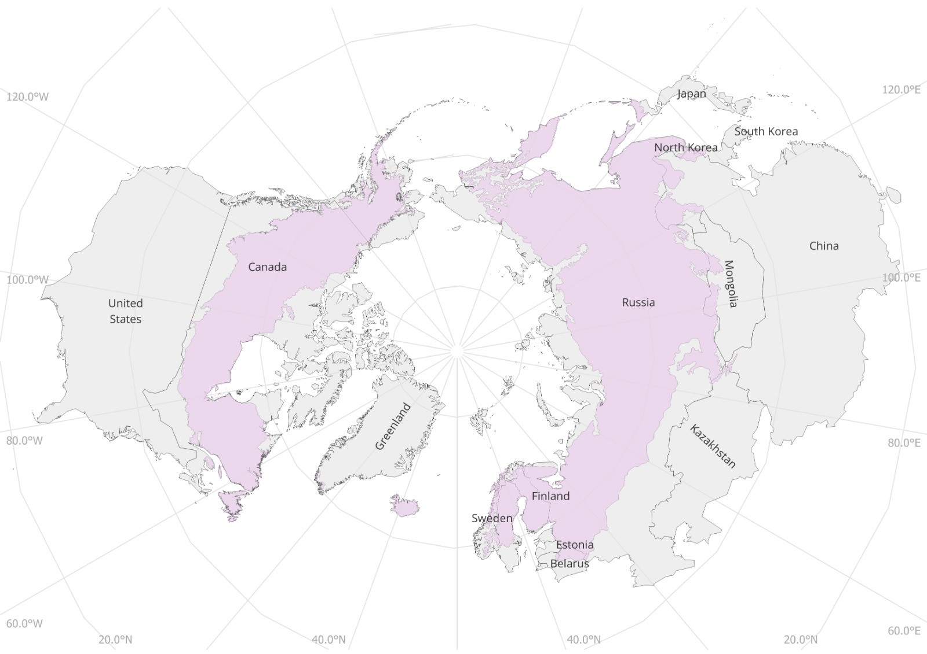
Boreal Forests
The boreal ecozone primarily spans 8 countries:
Canada (~27.5%)
China
Finland (~1%)
Japan
Norway
Russia (~60%)
Sweden (~1.5%)
United States (~3.7%)

Slide 3
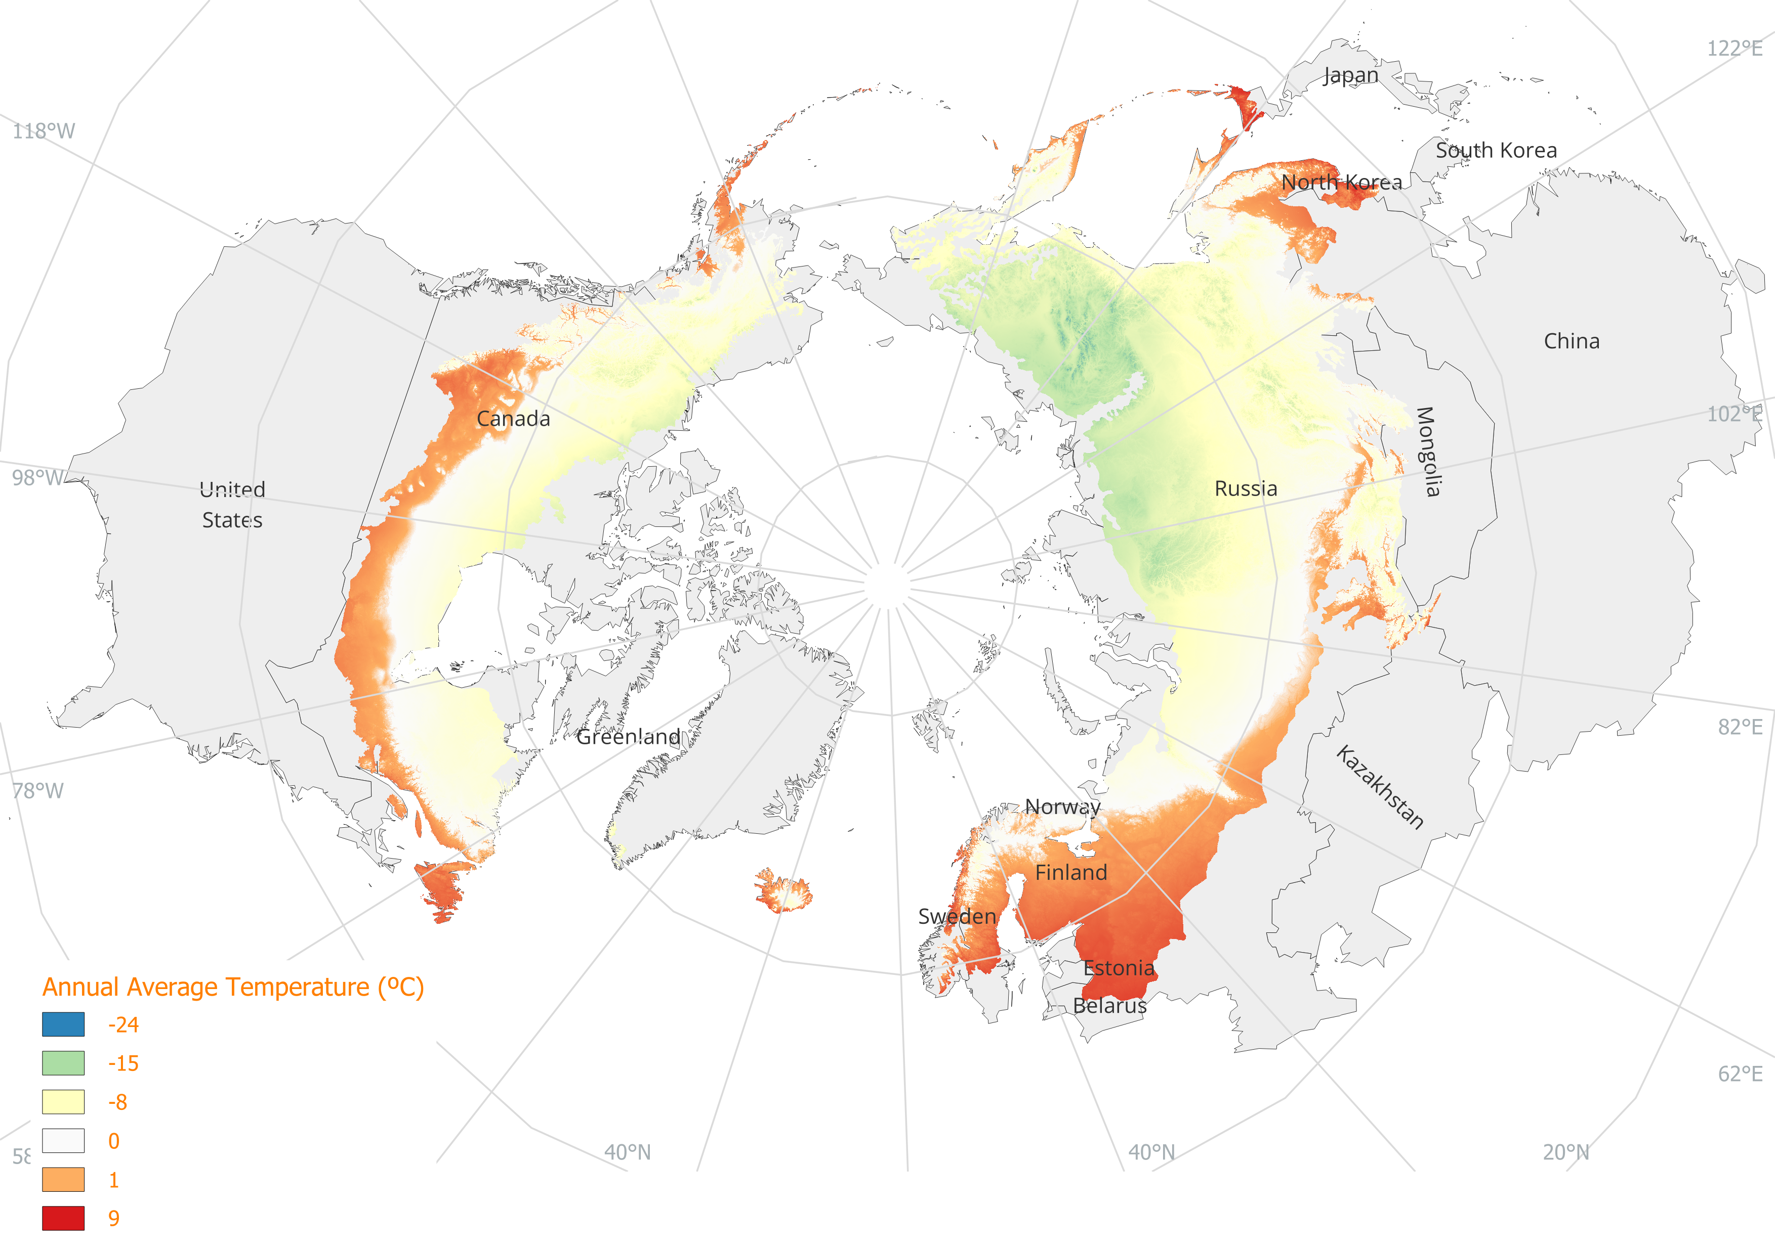
Data - Climate Change in a Boreal Context (visualization)
CHELSA (http://chelsa-climate.org/) is a high resolution (30 arc sec, ~1 km) climate data set for the earth land surface areas.
We used version 1.2
Data from the Global Circulation Model (GCM)
HadGEM2-AO
Historical period: 1979-2013
Future periods: 2041-2060, 2061-2080
RCP’s: RCP2.6, RCP4.5, RCP8.5
Bioclimatic variables used:
Annual Mean Temperature [°C]
Annual Precipitation [mm/year]
Historical annual average temperature

Slide 4
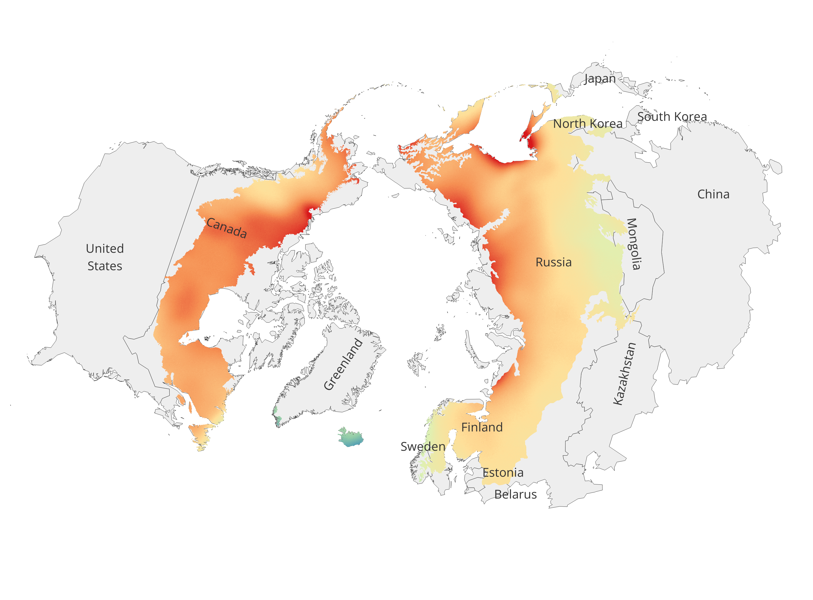
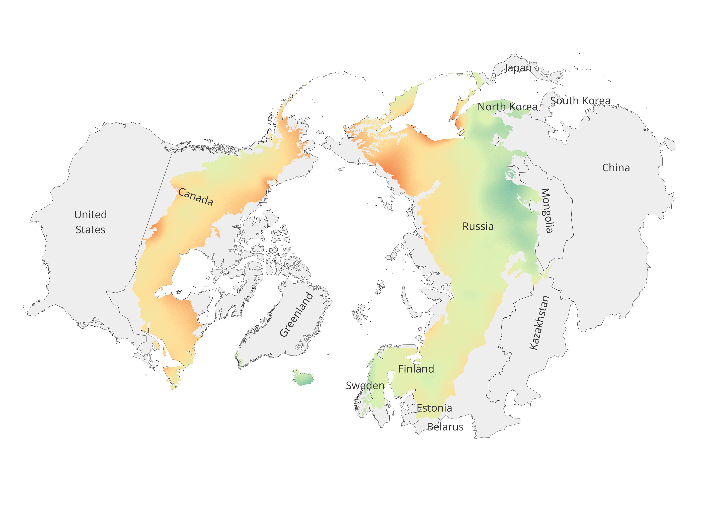
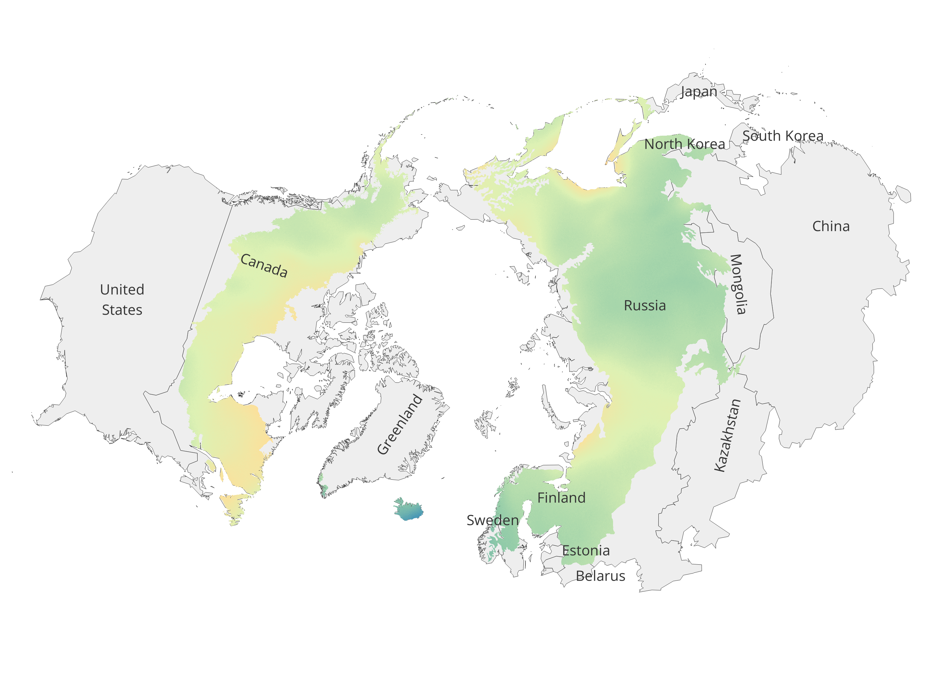
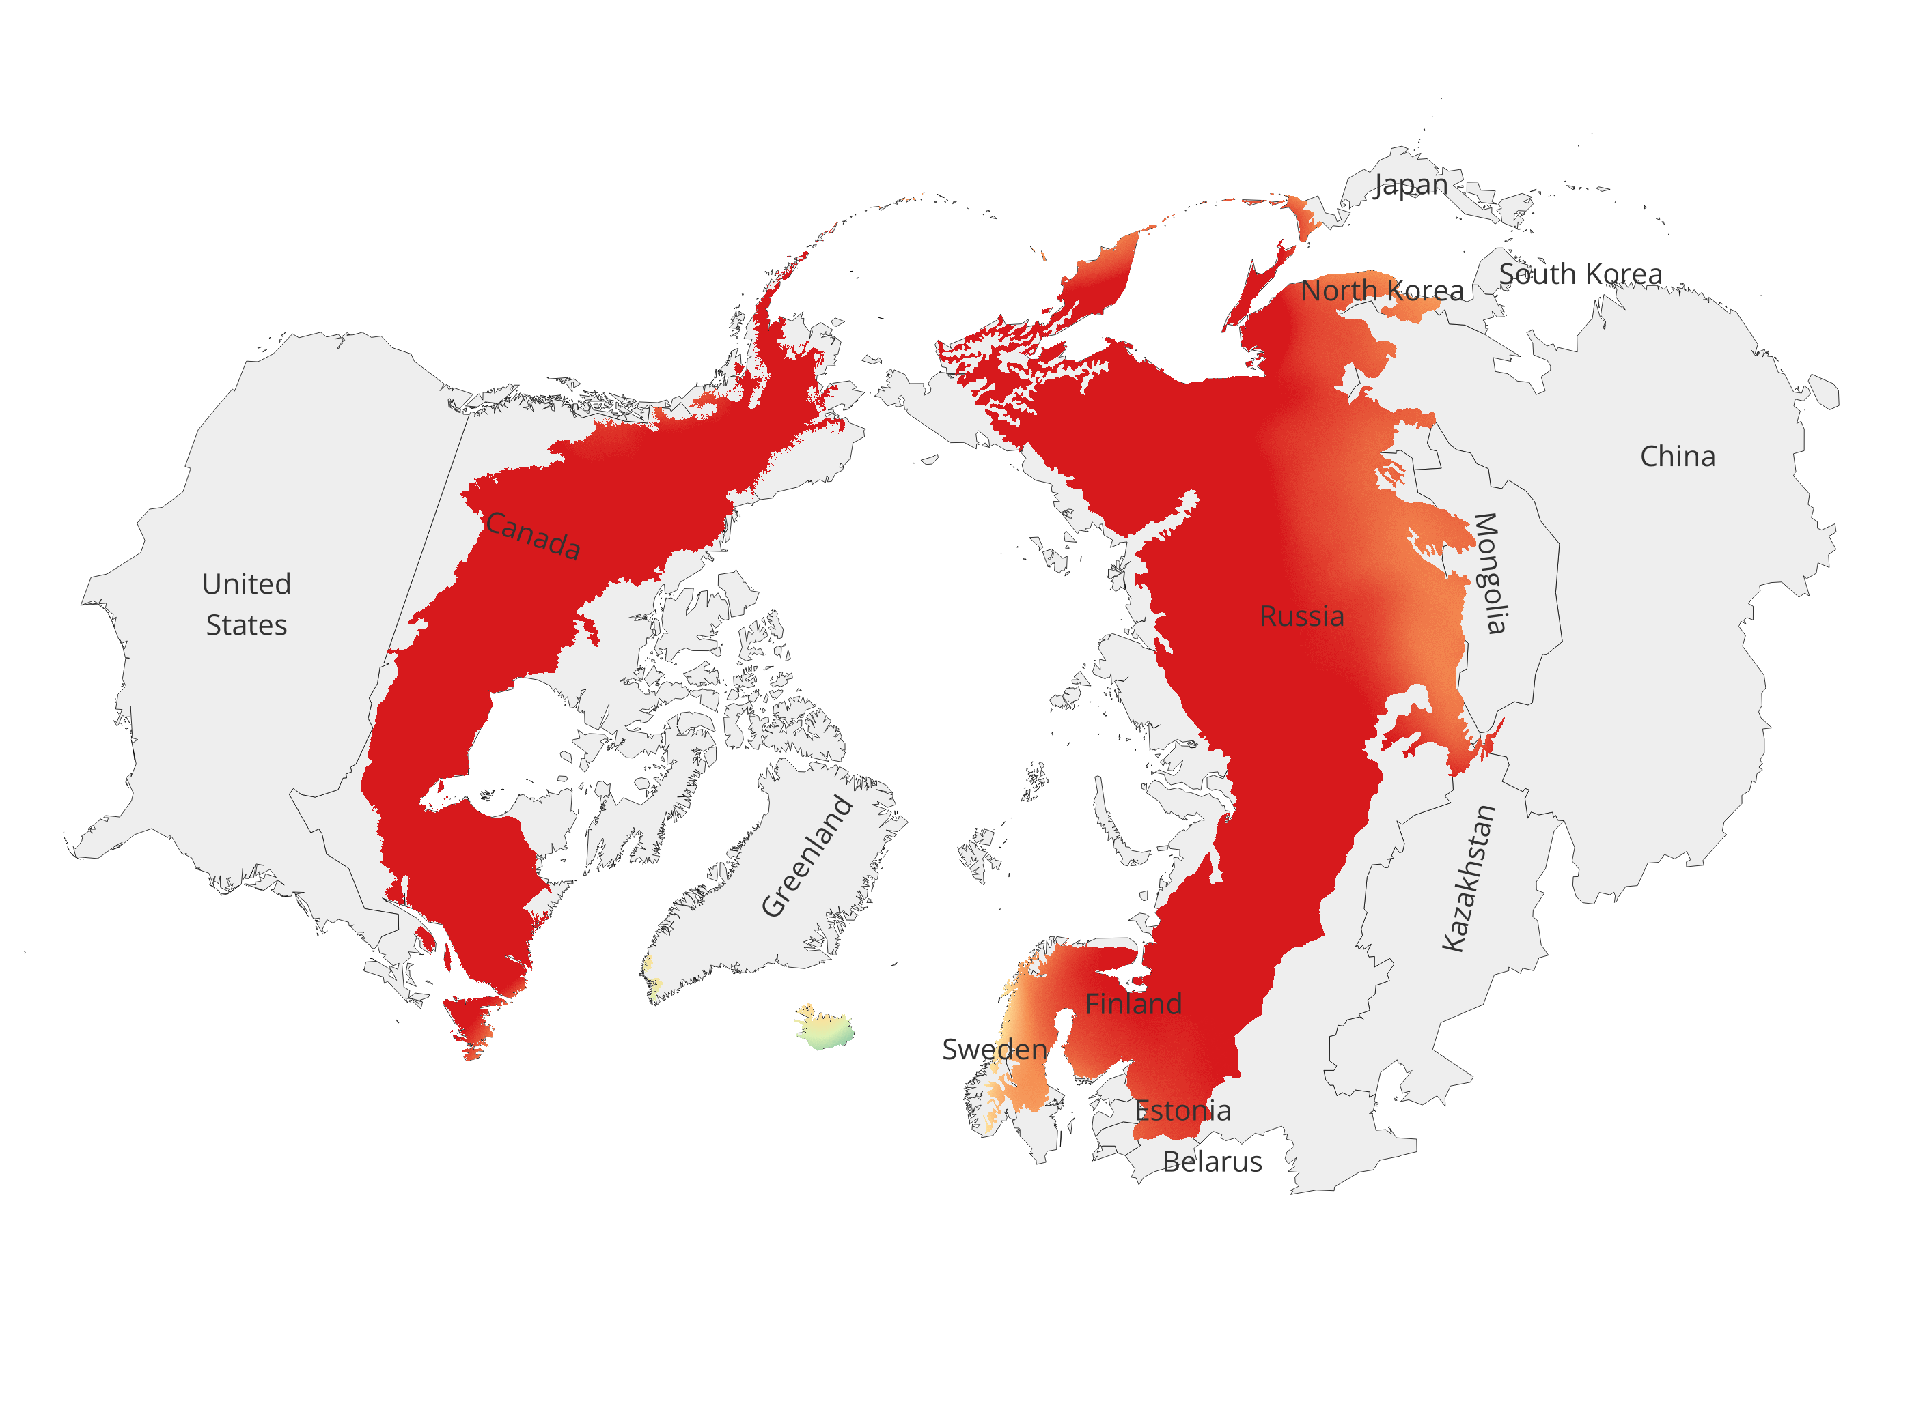
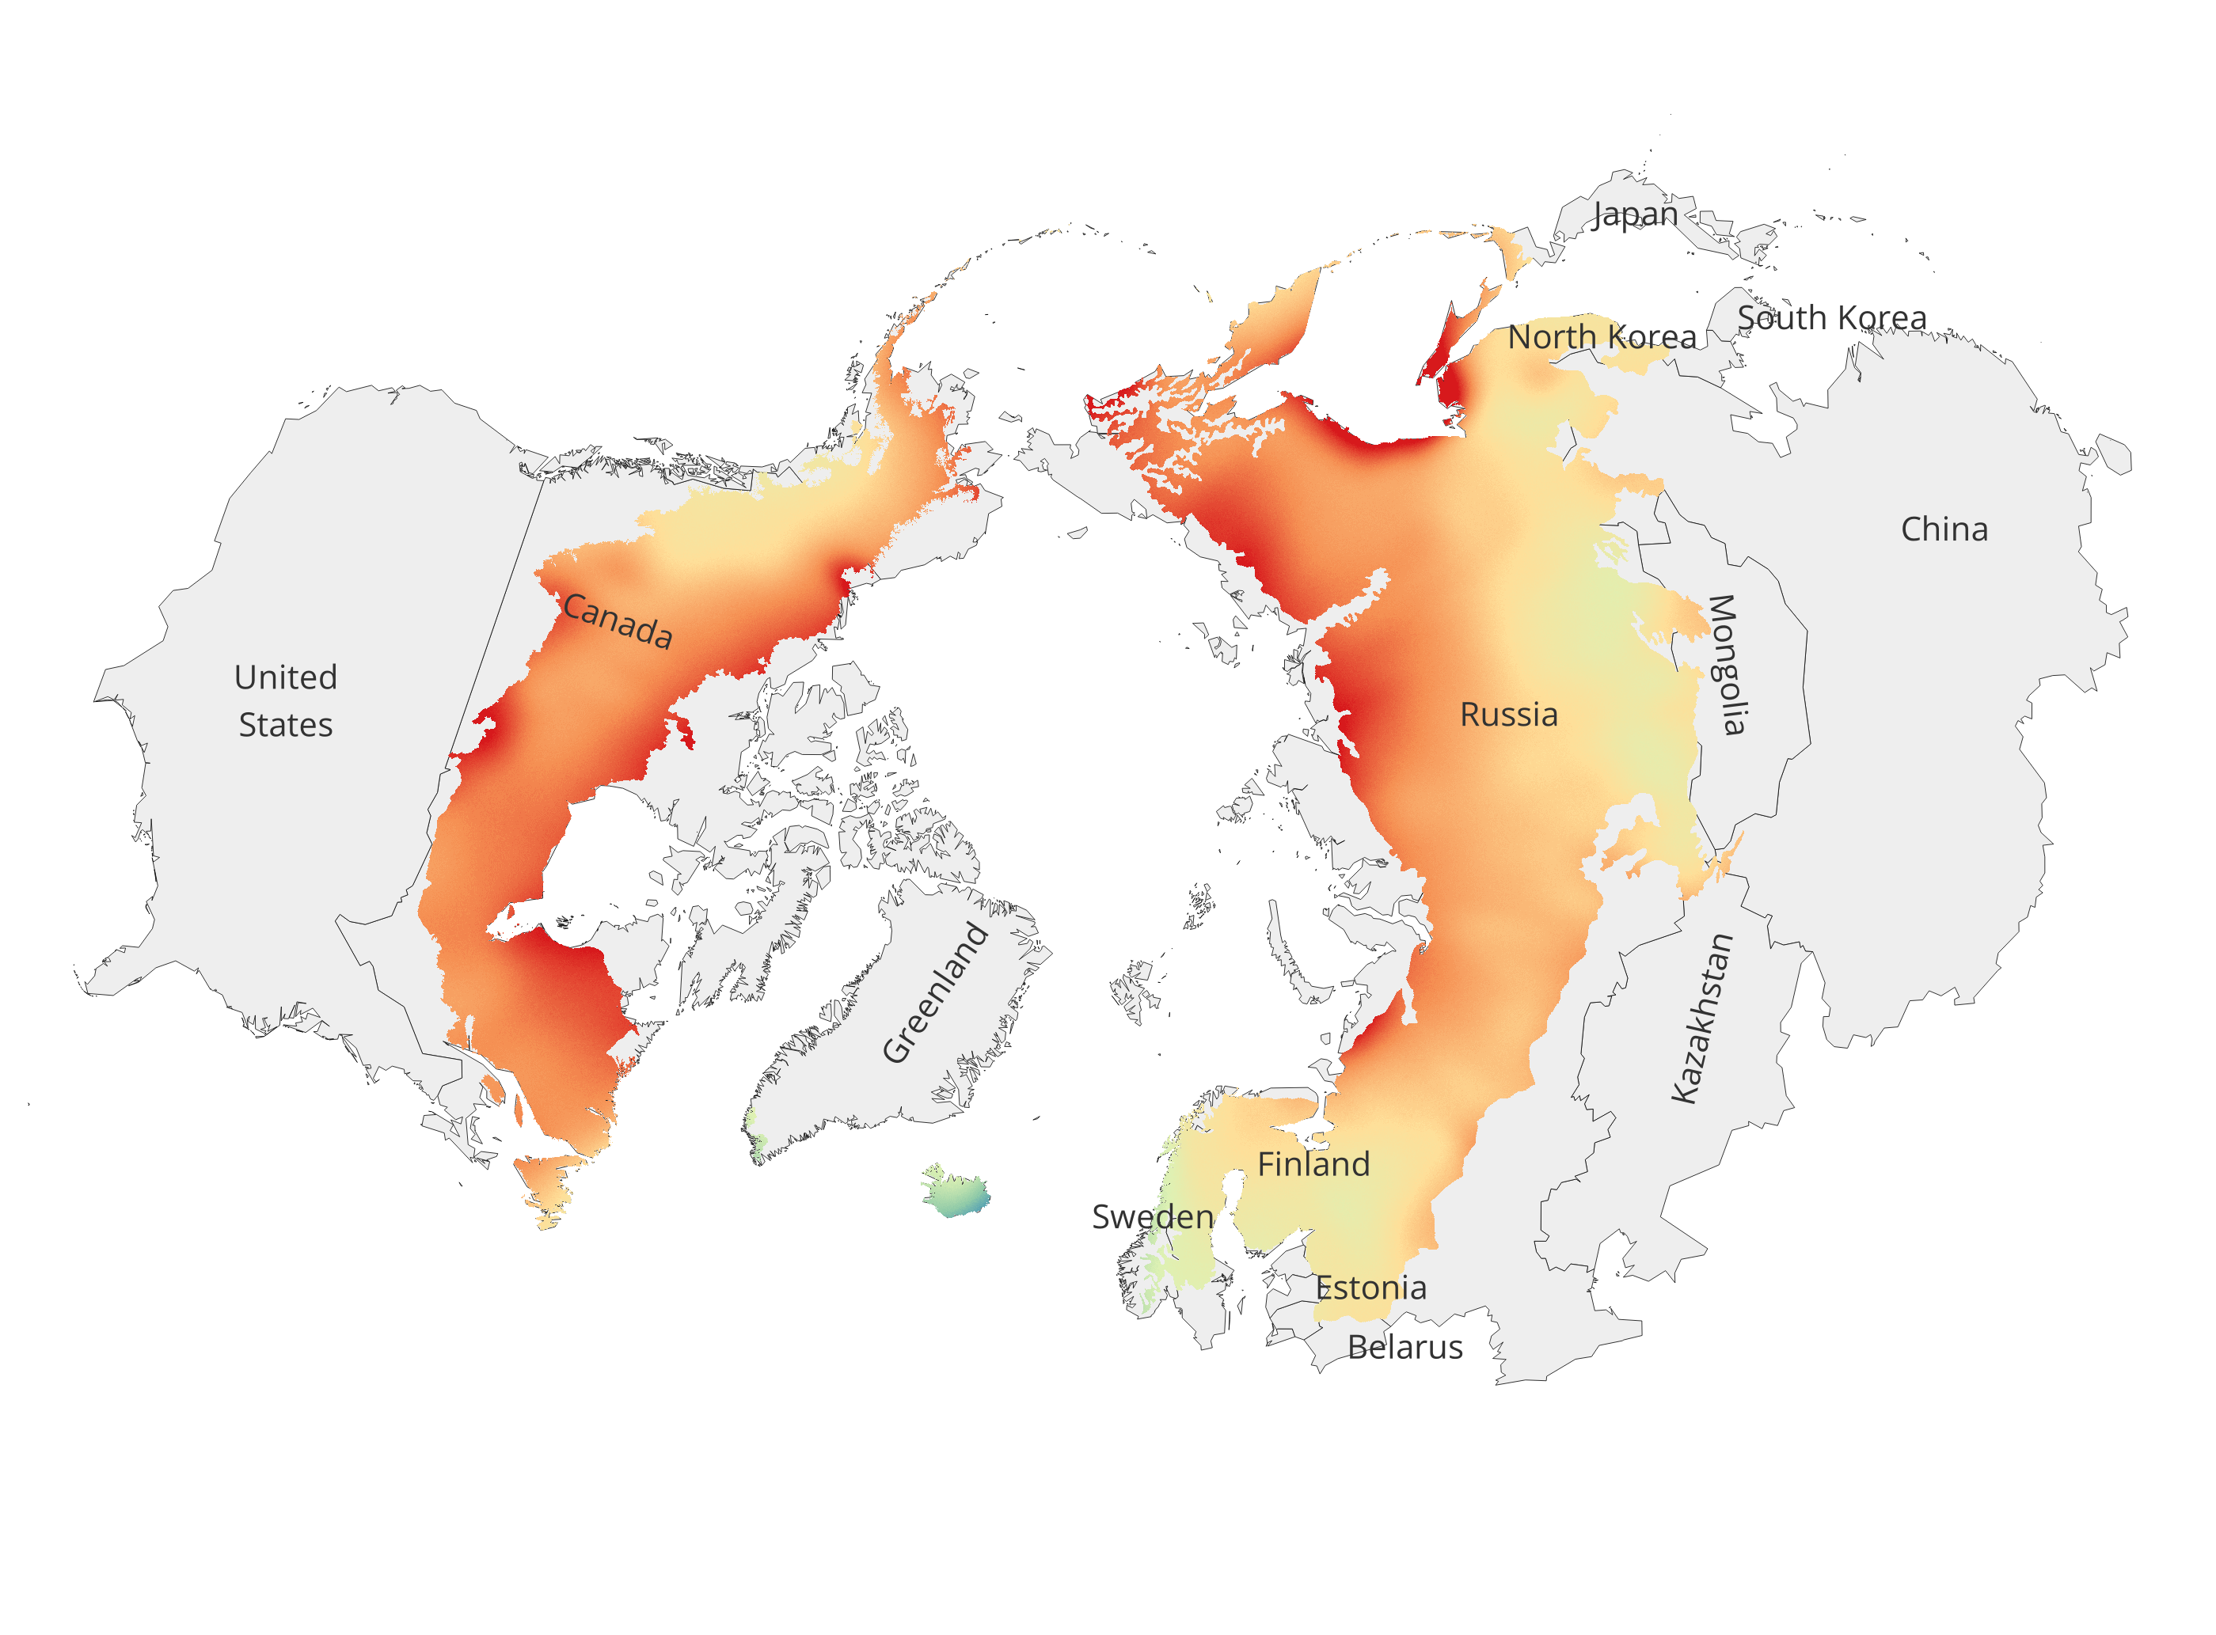
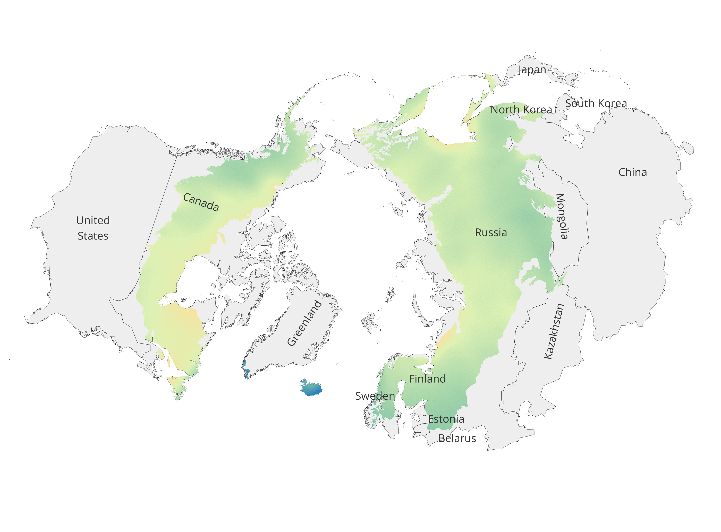
Temperature Projections
RCP8.5
RCP4.5
RCP2.6
2041-2060
2061-2080
Changes (ΔT) in annual mean temperature for future scenarios with respect to historical period

Slide 5
Temperature Projections
2041-60
2061-80
2061-80
2041-60
RCP 2.6
RCP 8.5

Slide 6
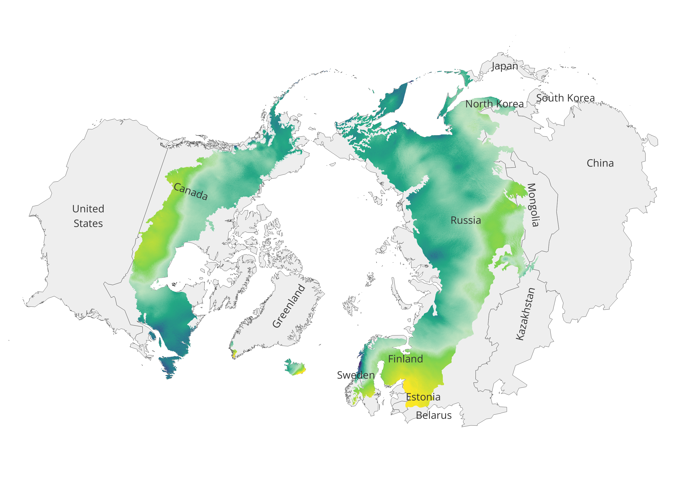
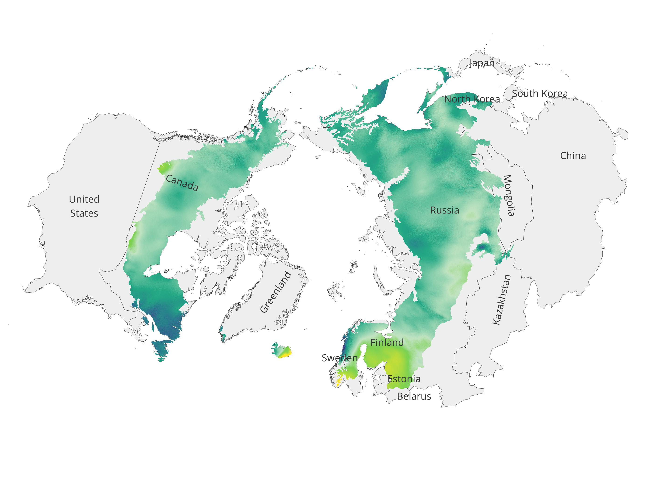
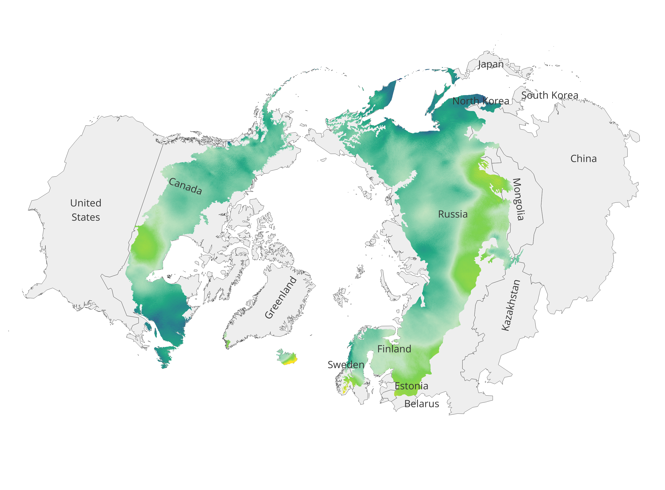
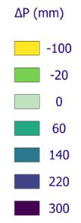
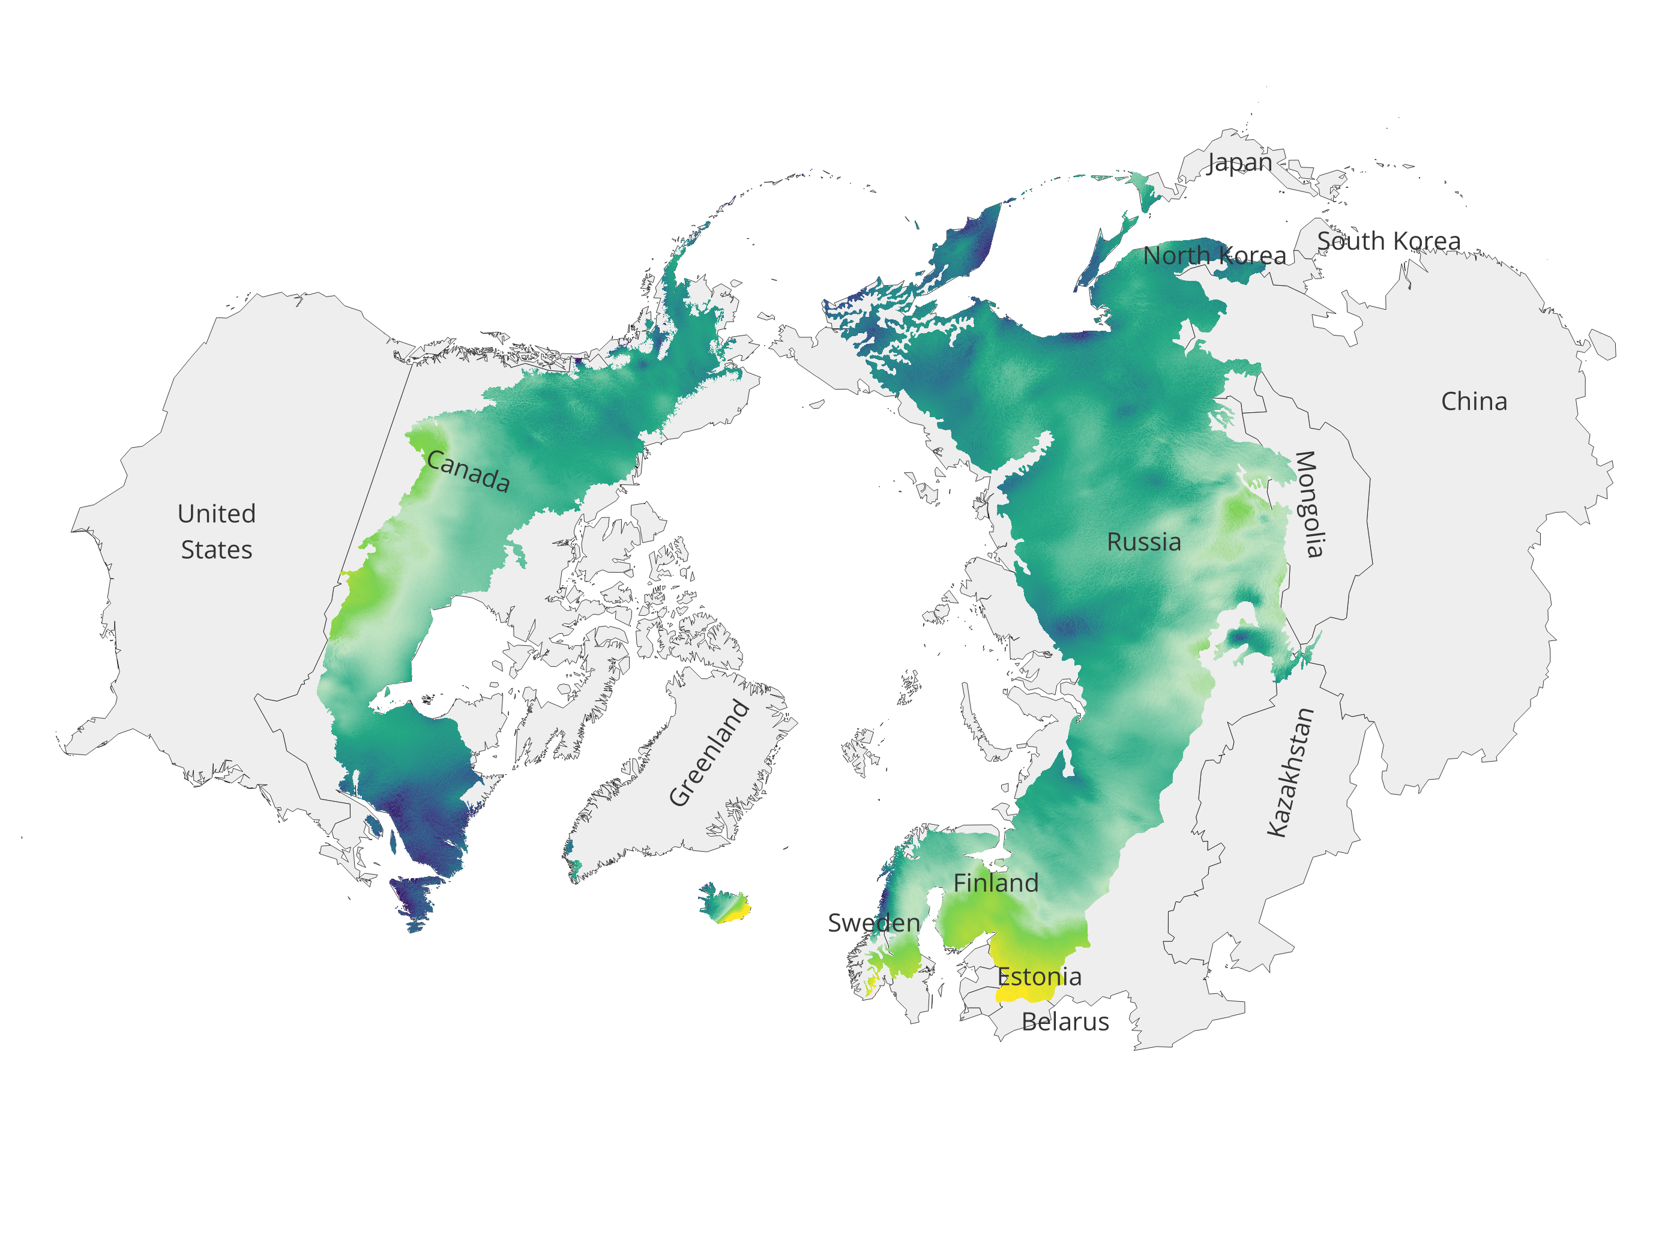
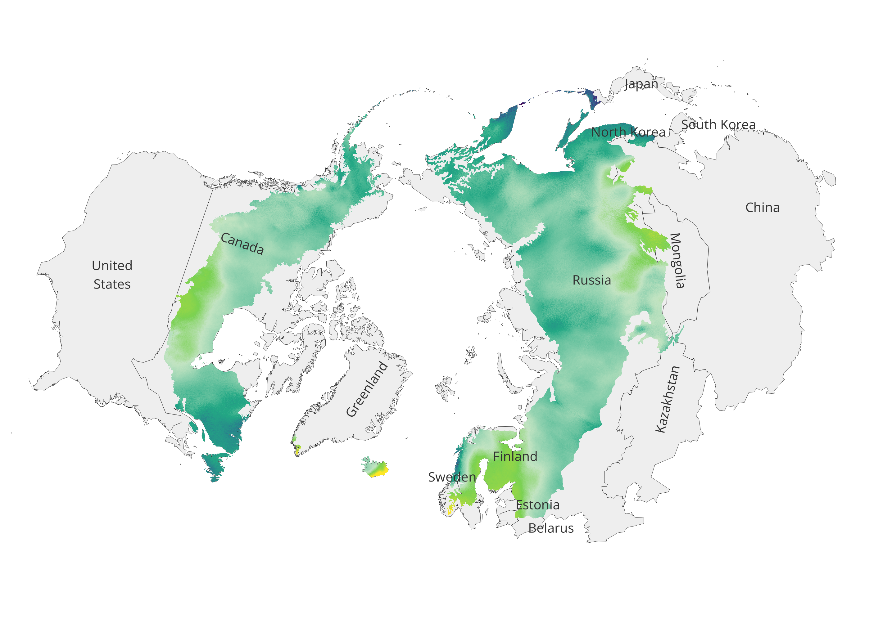
Precipitation Projections
RCP8.5
RCP4.5
RCP2.6
2041-2060
2061-2080
Changes (ΔPr) in annual mean precipitation for future scenarios with respect to historical period

Slide 7
Precipitation Projections
RCP 2.6
RCP 8.5
2041-60
2041-60
2061-80
2061-80

Slide 8
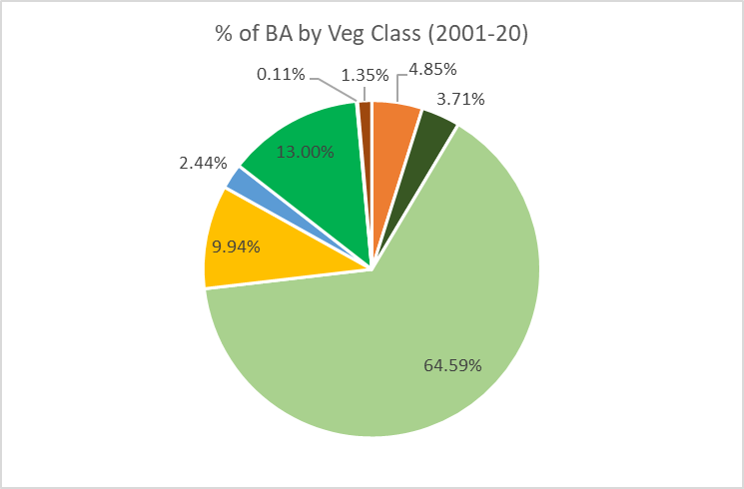
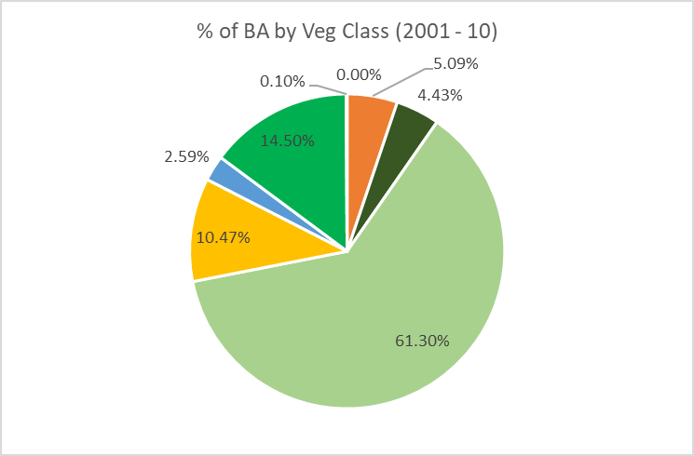
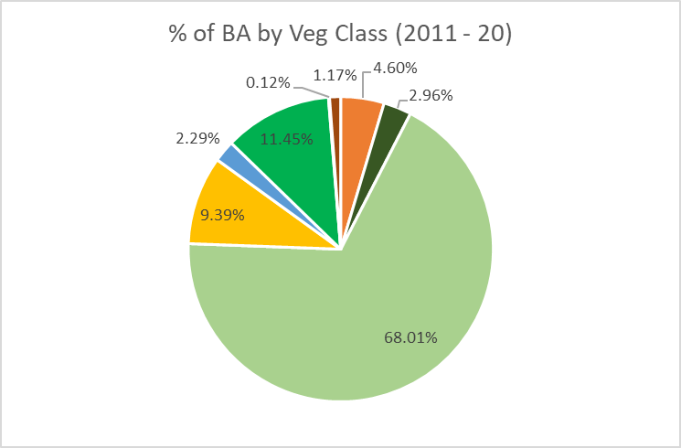
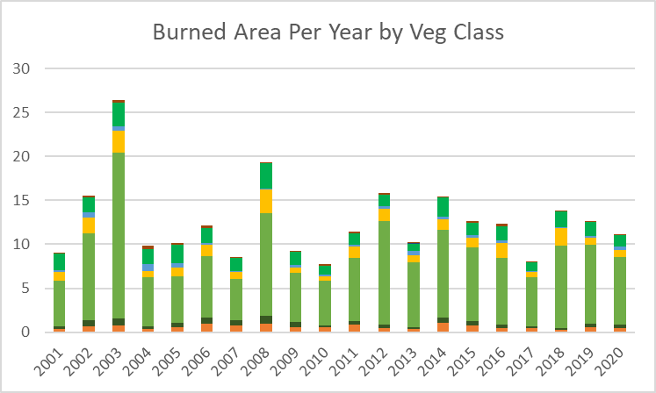
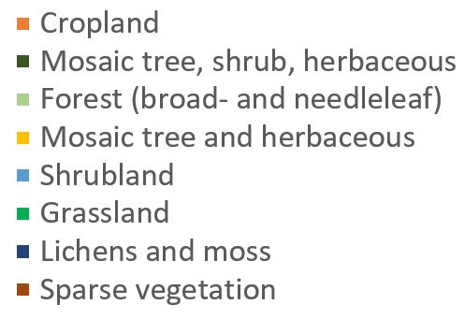
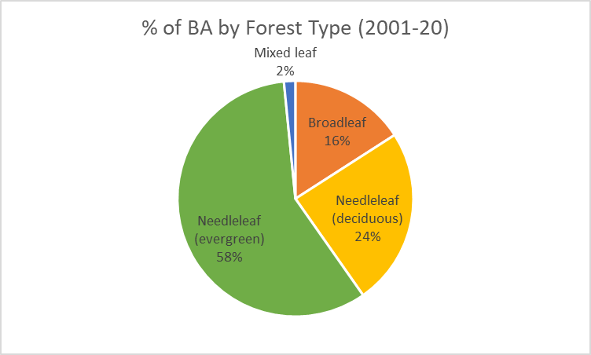
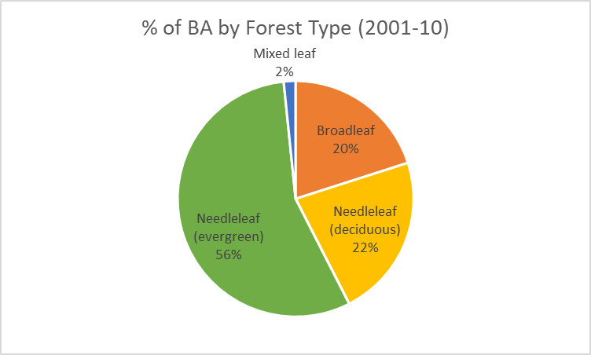
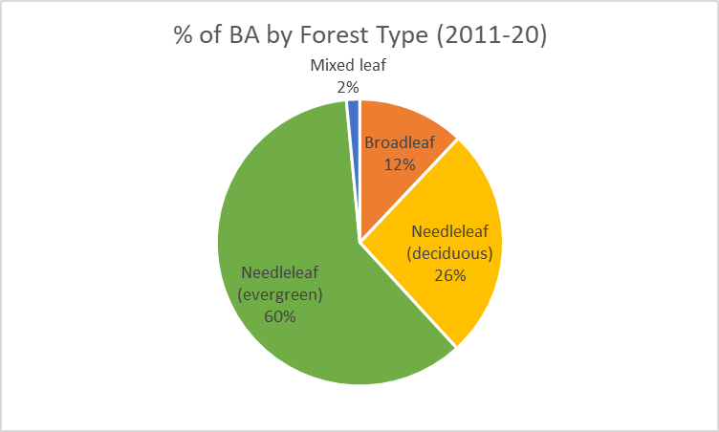
Wildfires in Boreal Forests: past and present
Source: ESA Fire CCI

Slide 9
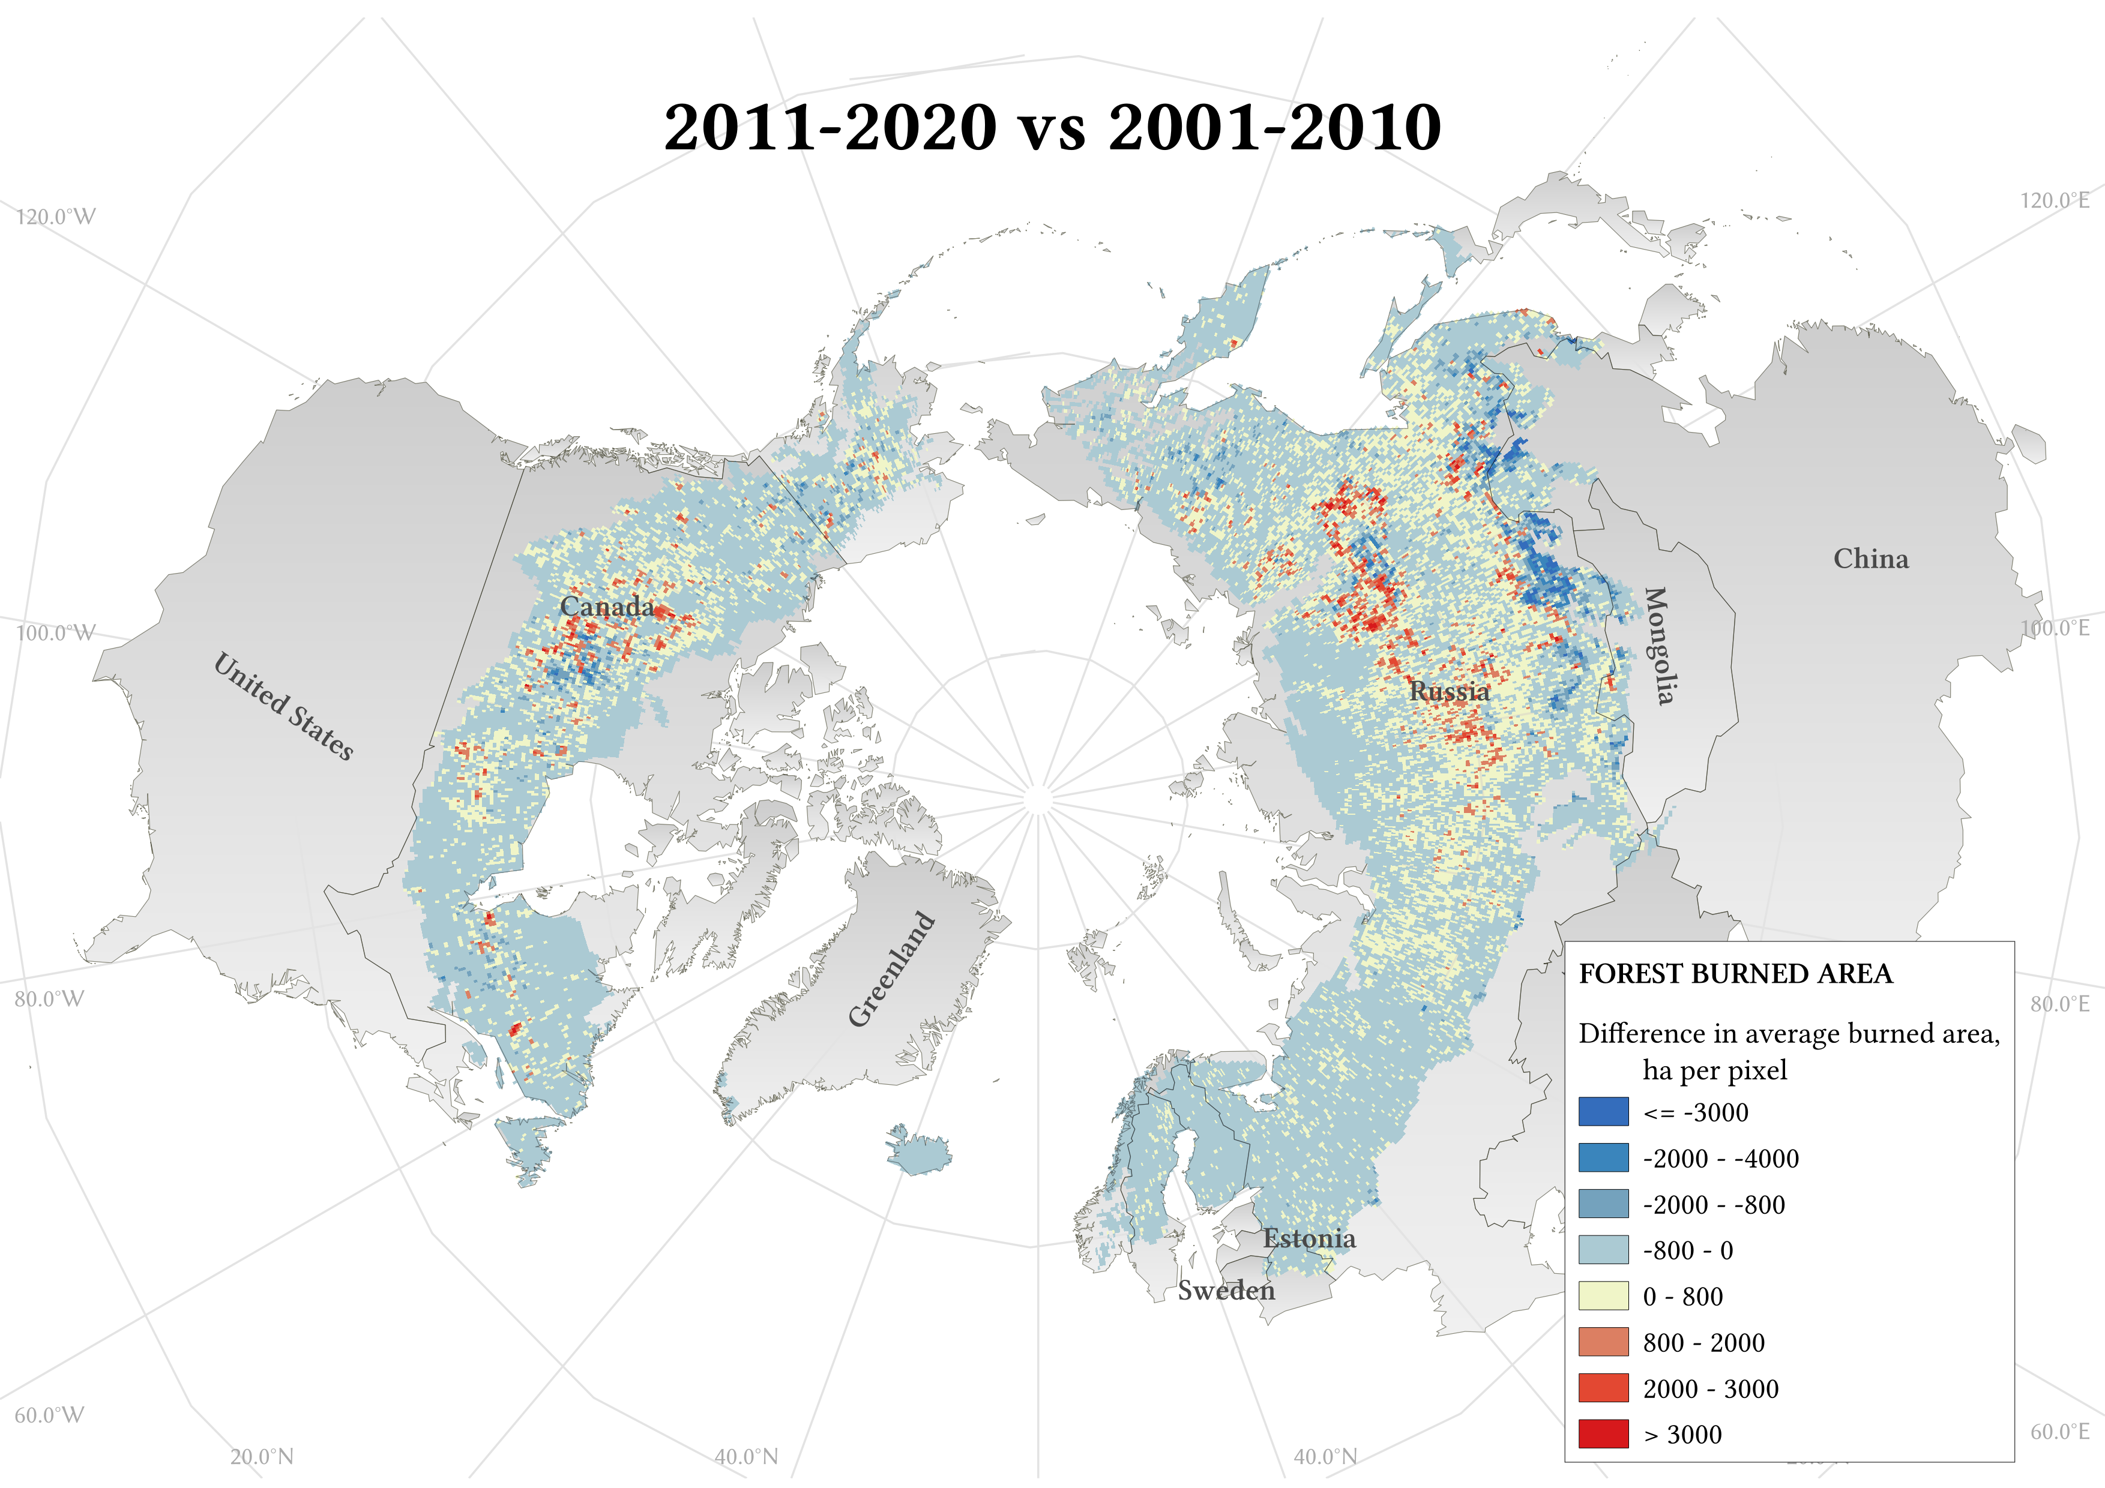
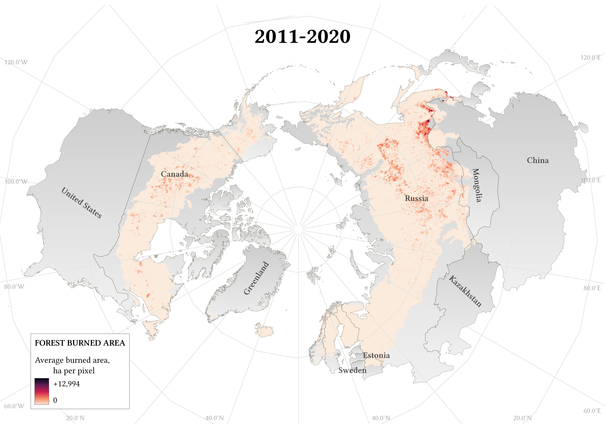
Wildfires in Boreal Forests: past and present

Slide 10
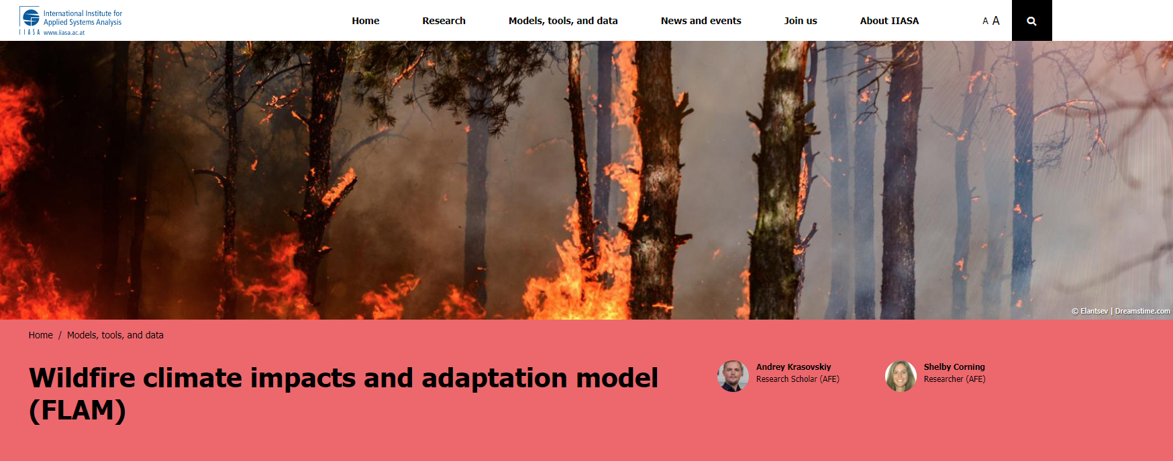
wildFire cLimate impacts and Adaptation Model (FLAM)
Mechanistic fire model that uses algorithms to parameterize the impacts of climate, fuel availability, and human activities on wildfire probabilities, frequencies, and burned areas
Operates with a daily time step at various resolutions (100m to 25km)
FLAM was calibrated and validated using the most recent publicly available GIS and remote sensing datasets
Allows for inclusion of additional fire-related factors into model
Ability to model and compare situations locally, regionally, and globally, under different warming and RCP scenarios.
Find more info at: www.iiasa.ac.at/flam

Slide 11
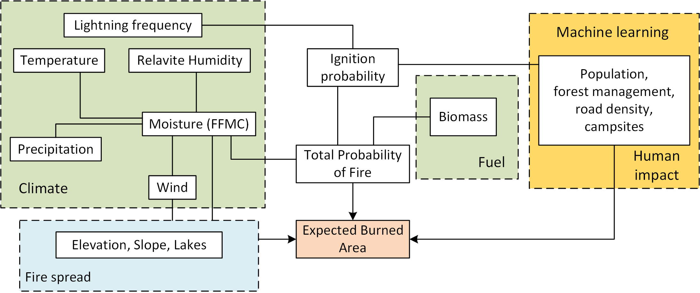
Wildfire climate impacts and adaptation model (FLAM)
Schematic of FLAM workflow
www.iiasa.ac.at/flam

Slide 12
Data Overview – FLAM inputs
Population density: Gridded Population of the World, v4 - 2000, 2005, 2010, 2015, 2020
Lightning frequency: monthly climatology averaged from 1995–2014 at 0.5-degree resolution from LIS/OTD Gridded Lightning Climatology Data Collection Version 2.3.2015
Fuel (biomass):
Forest: G4M model output – 0.5-degree resolution
Non-forest: Copernicus Above Ground Biomass Global Product
Daily climate data projections: ISIMIP2b HadGEM2-ES model
Calibration period: 2011-2020; Projection period: 2021-2099
Vegetation/land cover: ESA CCI MODIS landcover, split into forest and non-forest
Forest: broadleaf, needleleaf (deciduous), needleleaf (evergreen), and mixed leaf
Non-forest: Cropland; Mosaic tree, shrub, herbaceous; Mosaic tree and herbaceous; Shrubland; Grassland; Lichens and moss (excluded); and Sparse vegetation
Burned Area: ESA Fire CCI burned area product v5.0

Slide 13
FLAM in a Boreal Context: Burned Area

Slide 14
FLAM in a Boreal Context: Forest Burned Area
 | RCP Scenario | 2.6 | 4.5 | 6.0 | 8.5
Historical (2011-20)* | Average Annual BA | 7.93 | 7.93 | 7.93 | 7.93
2040-59 | Average Annual BA | 9.65 | 10.44 | 11.23 | 11.61
 | Δ Average Annual BA | 1.72 | 2.5 | 3.3 | 3.68
2060-79 | Average Annual BA | 10.08 | 12.69 | 14.08 | 17.25
 | Δ Average Annual BA | 2.15 | 4.76 | 6.14 | 9.31
2080-99 | Average Annual BA | 10.35 | 13.59 | 16.25 | 24.08
 | Δ Average Annual BA | 2.42 | 5.66 | 8.31 | 16.15
Table: Average annual burned forest area (bolded) for each scenario in 3 future projection periods, and as compared to historical average annual burned forest area (italicized) (all values in millions of hectares)

Slide 15
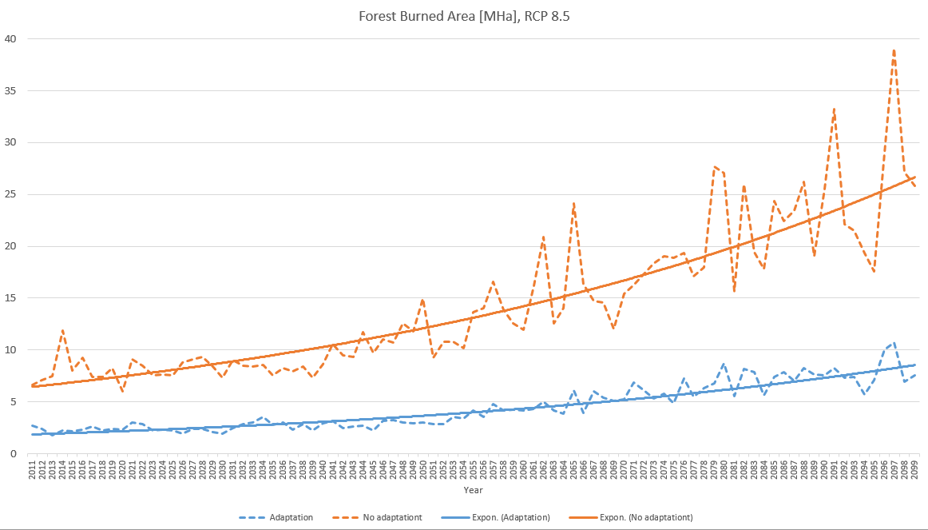
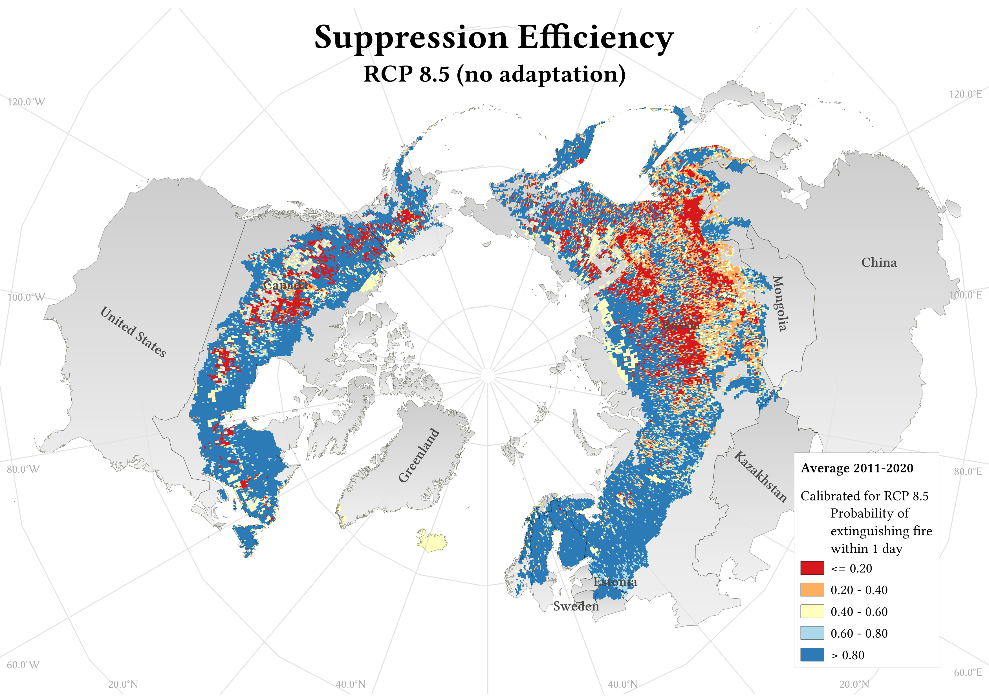
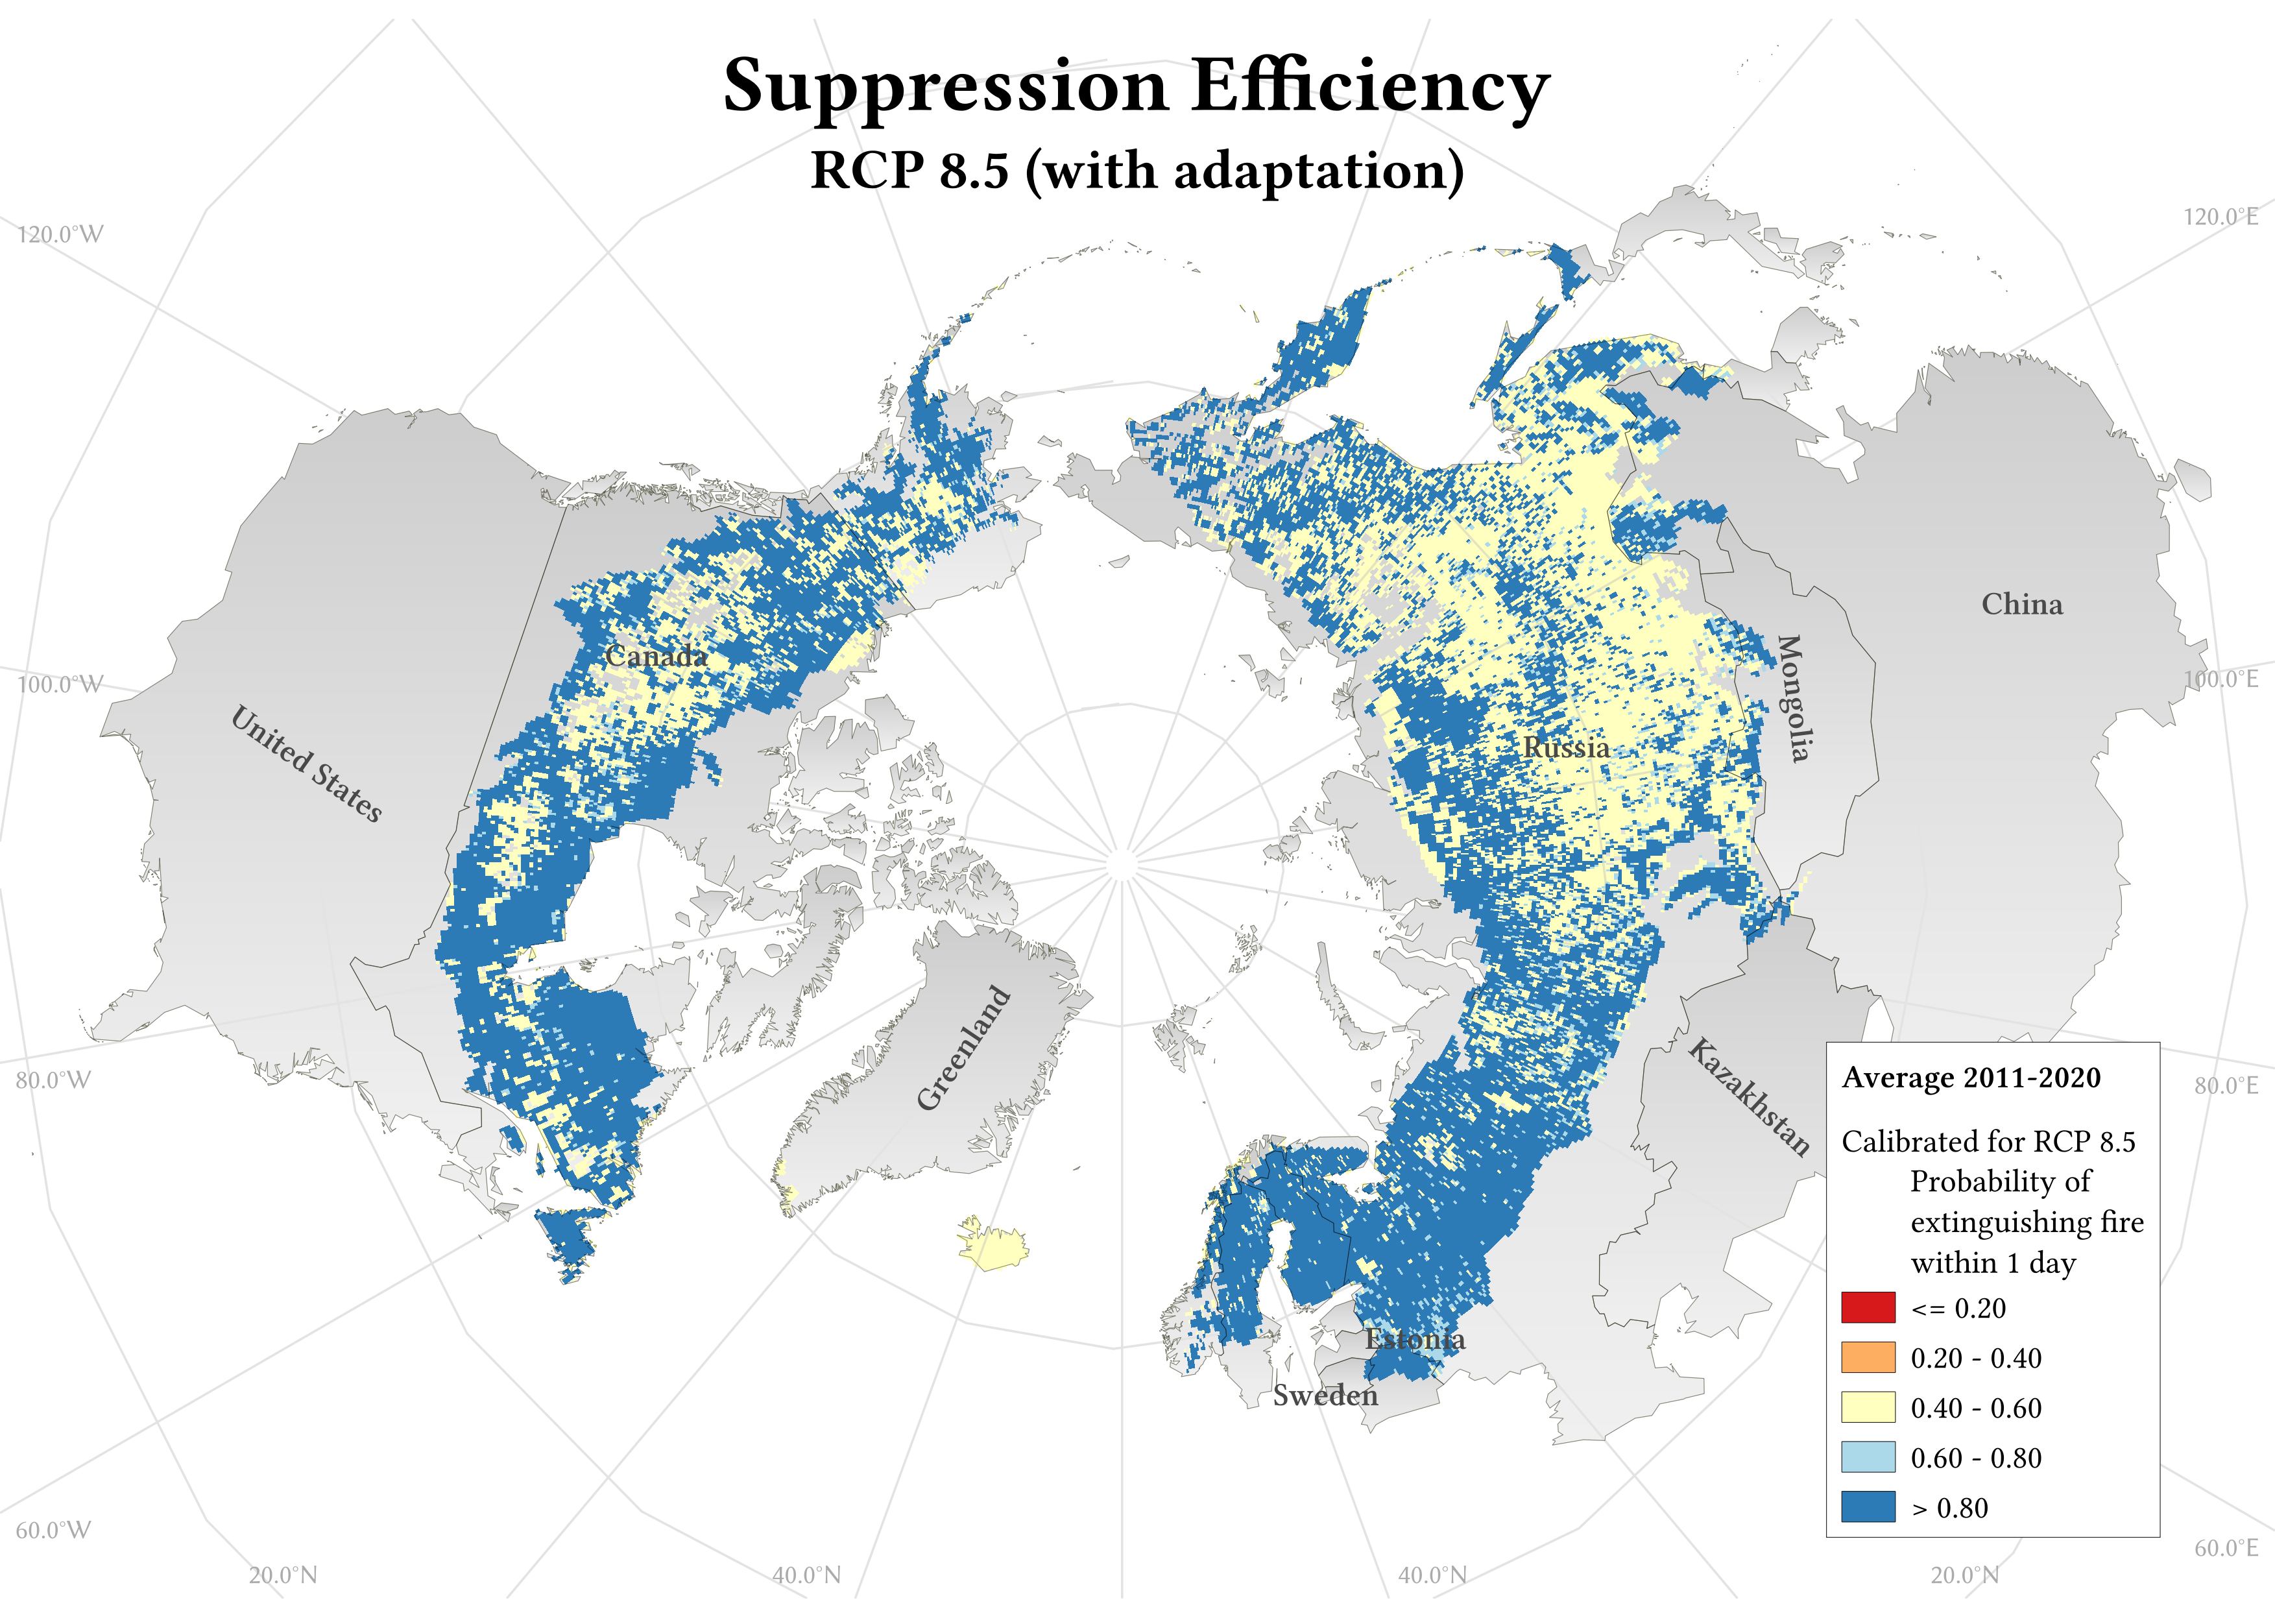
FLAM: Adaptation Options to combat wildfires in the boreal zone
Increase suppression efficiency in areas identified as hot spots by FLAM
Pixels with suppression efficiency <0.5 were set to 0.5 (ie probability of fire extinguishment within 2 days), to show the impact of improving suppression efficiency in identified hot spot areas

Slide 16
FLAM: Key Takeaways, Adaptation Options and Future Work
Key Takeaways:
Climate change will have a significant impact on burned area
Maintaining current temperatures (RCP 2.6) will still result in an increase of burned area (total and forest), but in the worst-case scenario (RCP 8.5), projected burned forest area will more than triple
Forests (specifically evergreen needleleaf) are the largest vegetation class at risk from fires
Improving the suppression efficiency in identified hot spot areas can greatly reduce total burned area
Ongoing and future work:
Analysis of the influence of
forest type,
vegetation type,
country,
and adaptation options
on the calibration of FLAM and projected burned areas/hot spots
Further analysis of monthly/seasonal trends
Assessment of carbon emissions associated with wildfires

Slide 17
Thank you for your time and attention!
Questions or comments?
Contact myself (corning@iiasa.ac.at) or Andrey Krasovskiy (krasov@iiasa.ac.at)
Visit our website: www.iiasa.ac.at/flam
Scan our QR code
Thank you to the HuT for supporting this work

Slide 18
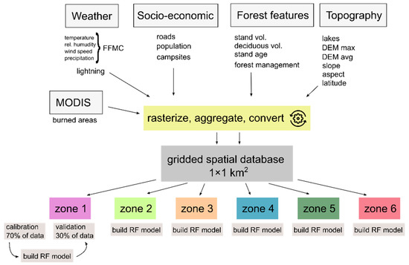
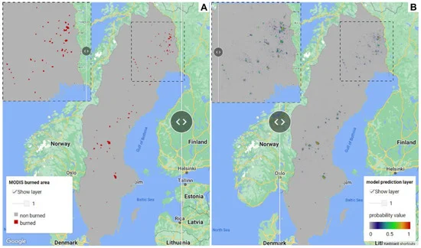
Regional Variability and Driving Forces behind Forest Fires in Sweden
Understand vulnerability of Swedish forests to wildfires
1km x 1km spatial grid on a monthly time step, with 6 biogeographical zones
Addition of road density, topography, and campsites to the parameters
Random forest to determine importance features for wildfire probability within zones
Hotspot mapping with visualization in Google Earth Engine (GEE)
Cimdins, R., Krasovskiy, A., Kraxner, F. "Regional Variability and Driving Forces behind Forest Fires in Sweden." Remote Sensing, vol. 14, no. 22, 2022.

