Slide 1
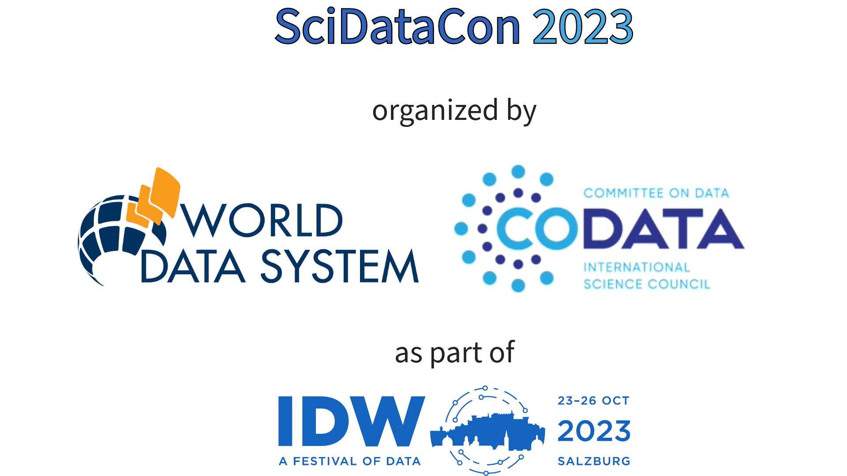
Meaningful engagement of all the actors to build trust in citizen science data and results
Dr. Dilek Fraisl
International Institute for Applied Systems Analysis (IIASA)
Email: fraisl@iiasa.ac.at
Twitter: dilekfraisl1
LinkedIn: dilekfraisl
Web: www.iiasa.ac.at

Slide 2
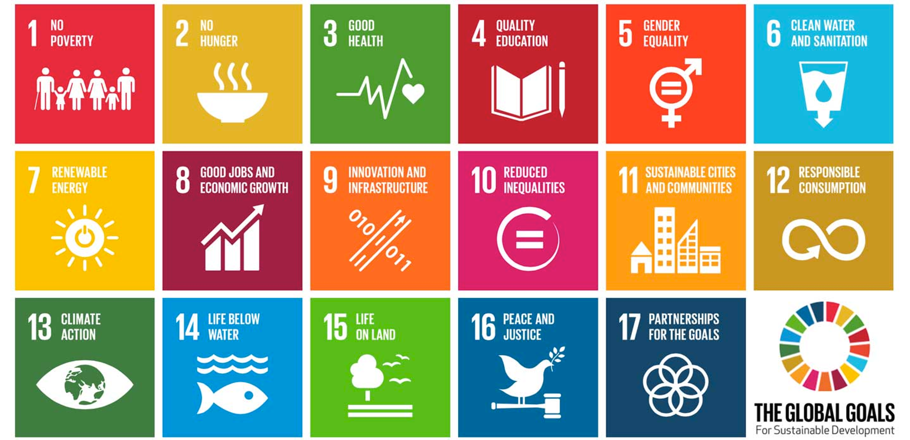
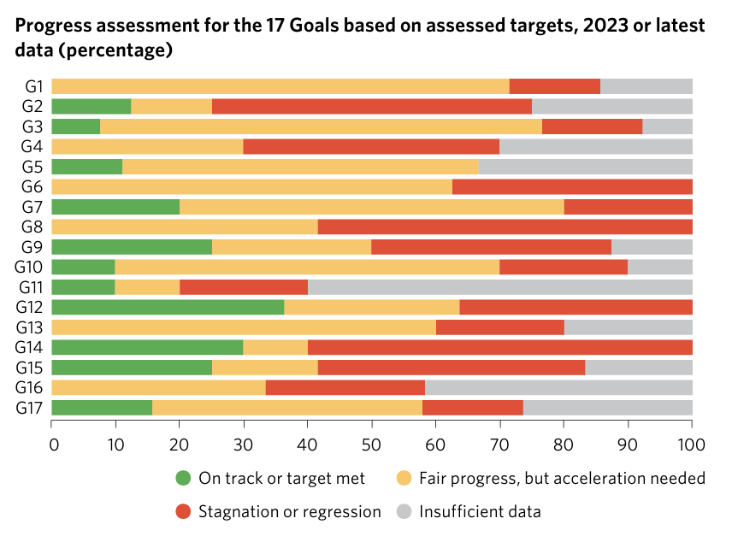
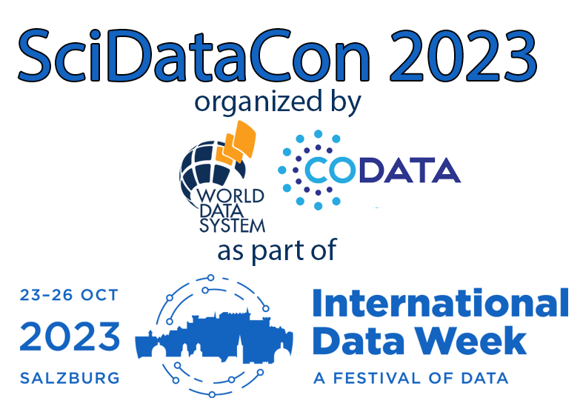
UN SDG Report, 2023

Slide 3
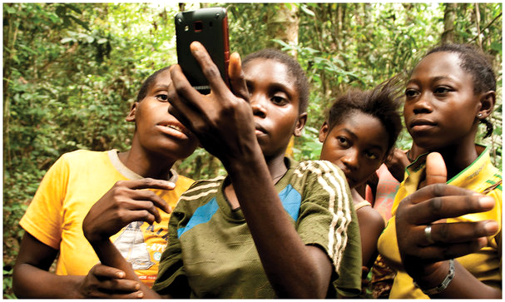
Citizen science
Gill Conquest, EXCITES, University College London
Public Participation
Knowledge production
Voluntary contributions

Slide 4
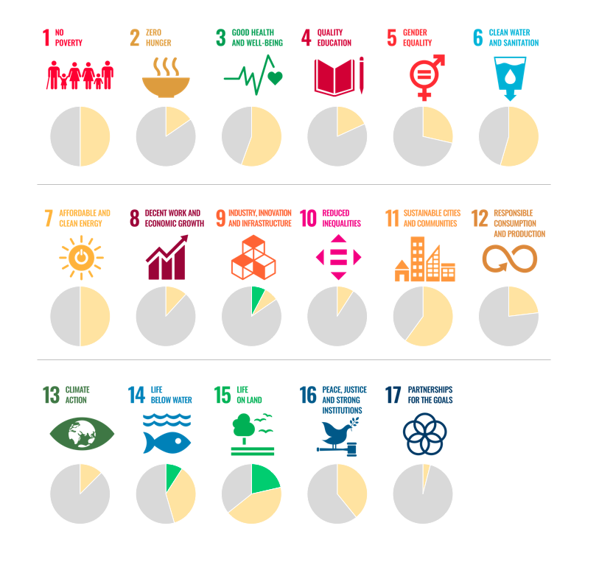
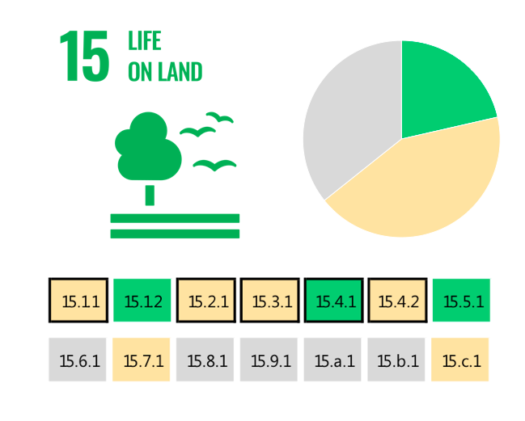
The SDG indicators where citizen science projects are
‘already contributing’, ‘could contribute’ or where there is ‘no alignment’
The SDG indicators where citizen science projects are “already contributing” (in green), “could contribute” (in yellow) or where there is “no alignment” (in grey). The overall citizen science contributions to each SDG are summarized as pie charts.

Slide 5
The health and well-being related SDG indicators and Triple Billion Targets covered in this study. Indicators where citizen science projects are “already contributing” are in dark blue, “could contribute” are in light blue or where there is “no alignment” are in grey. The values within each box are the indicator numbers or titles.
Fraisl D, See L, Estevez D et al (2023) Citizen science for monitoring health and wellbeing related sustainable development goals and the World Health Organization’s triple billion targets. Front Public Health 11:1202188 https://doi.org/10.3389/fpubh.2023.1202188

Slide 6
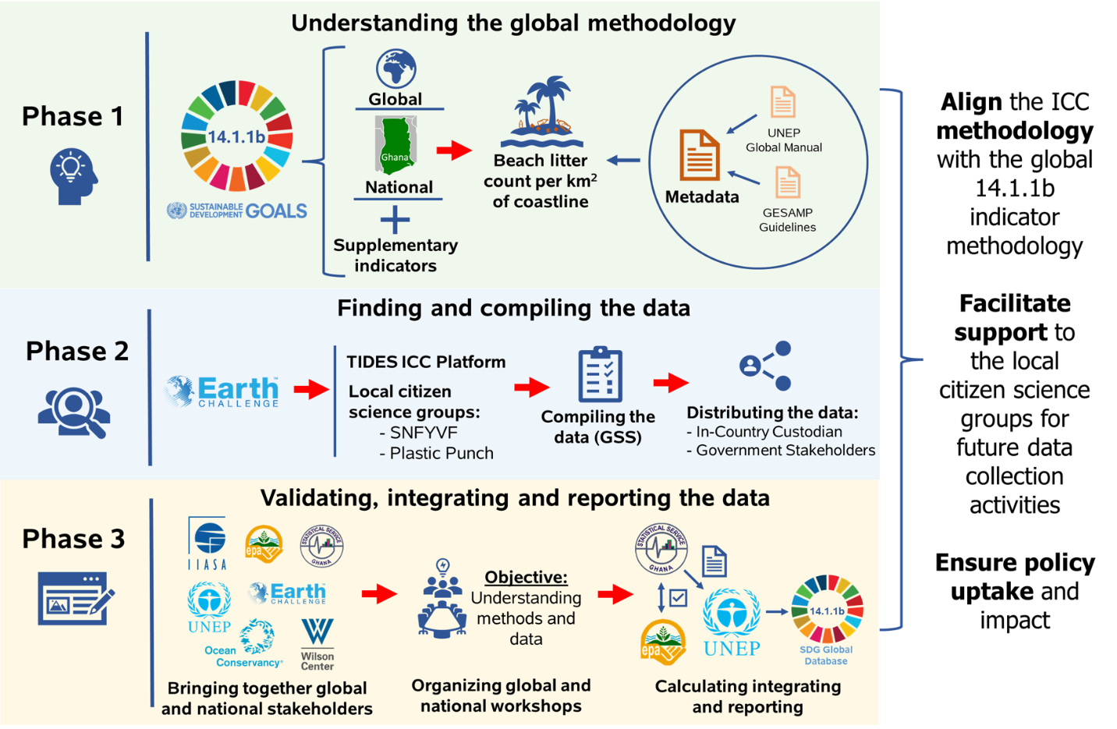
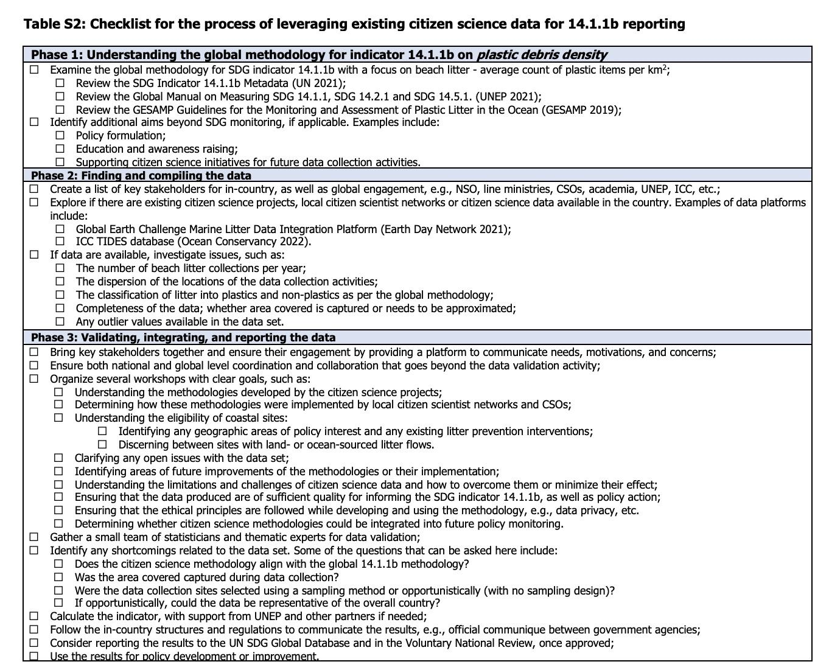
The process of integrating citizen science data on marine litter for SDG indicator 14.1.1b reporting in Ghana
Fraisl, D., See, L., Bowers, R. et al. The contributions of citizen science to SDG monitoring and reporting on marine plastics. Sustain Sci (2023). https://doi.org/10.1007/s11625-023-01402-4

Slide 7
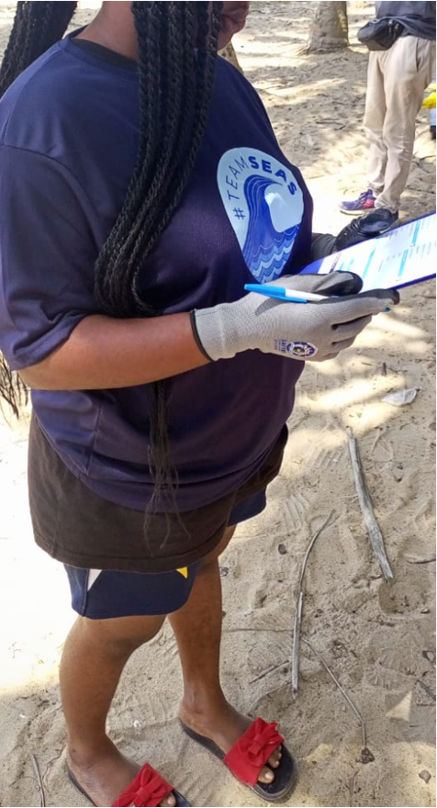
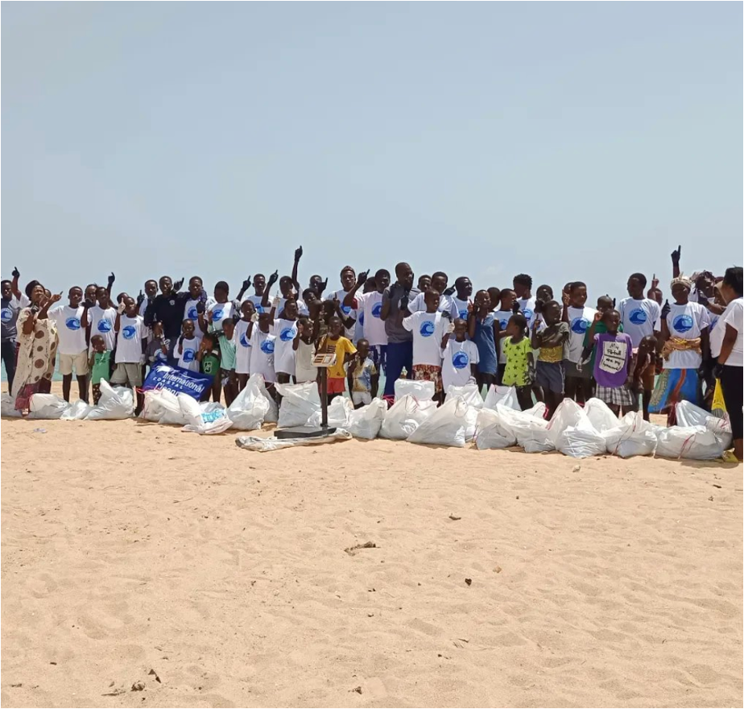
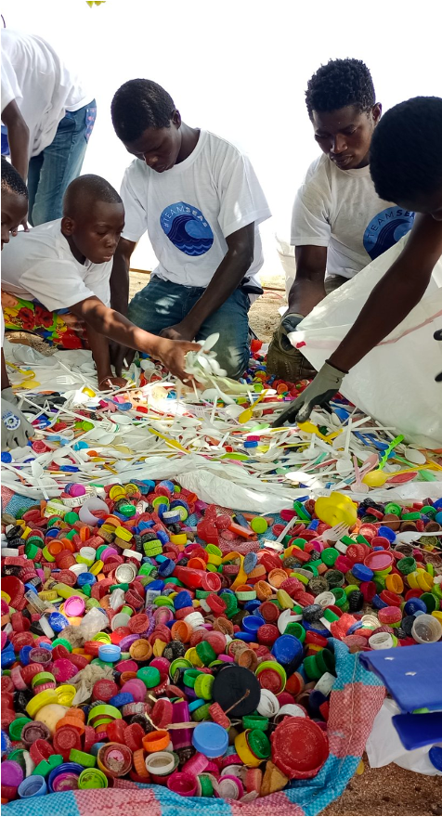
Bridging local data collection efforts with global monitoring processes by leveraging the SDG framework
Ensure inclusiveness through meaningful engagement of all stakeholders
Create time and space for these stakeholders to meet and connect
Listen and understand the motivations, interests and concerns
Be transparent about citizen science results and methodologies, especially how these methodologies were implemented
Citizens and communities are not free labor to close government data gaps; they should receive a share of the benefit from participating
@Smart Nature Freaks Youth Volunteers Foundation

Slide 8
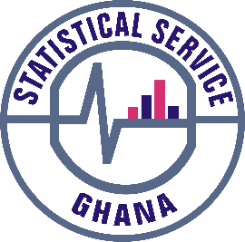
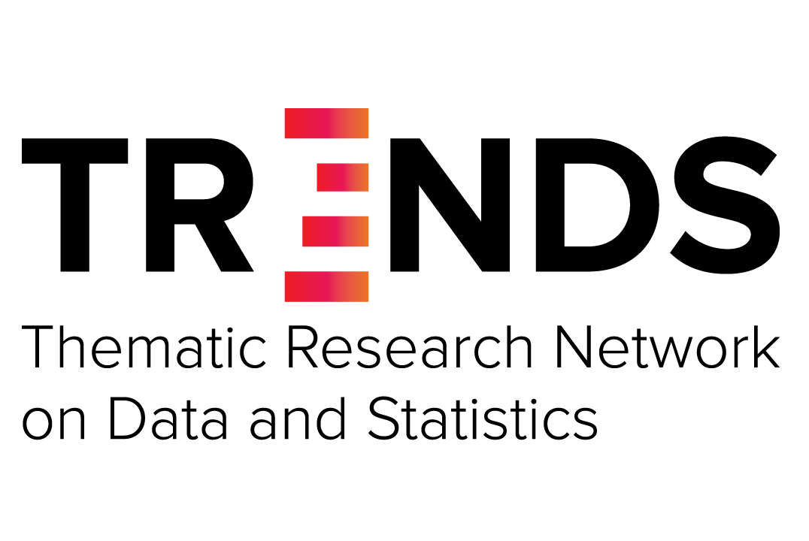
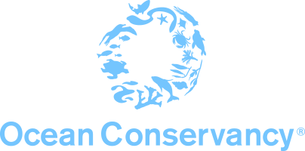
THANK YOU!
Dr. Dilek Fraisl
International Institute for Applied Systems Analysis (IIASA)
Email: fraisl@iiasa.ac.at
Twitter: dilekfraisl1
LinkedIn: dilekfraisl
Web: www.iiasa.ac.at

