Slide 1
The benefits of rural electrification to improve water access and irrigation in Sub-Saharan Africa, a water-energy-land assessment framework applied to Zambia.
Adriano Vinca¹, Falchetta, G.^{1,2} , Awais, M. ¹, Byers, E. ¹, Giordano, V. ³, Ireland, G. ⁴, Semeria, F. ³, Tuninetti, M. ³, Vinca, A. ¹, and Zulu, A⁵
IIASA - International Institute for Applied Systems Analysis, Laxenburg, Austria
CMCC, Venice, Italy
DIATI, Politecnico di Torino, Turin, Italy
University of Cape Town, Cape Town, South Africa
University of Zambia, Lusaka, Zambia
27th April 2023
EGU 2023
Notes:
30 sec

Slide 2
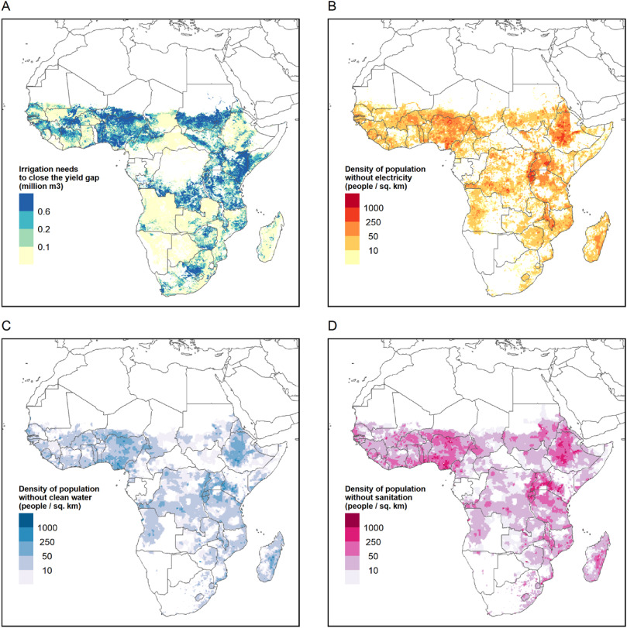
Rural SSA – WEF Nexus challenges
Potential crop yield gap
Population w/o electricity
900+ million people by 2050, UN 2019 prospects
30% of access to electricity in 2020
18% of the population with insufficient calories intake in 2020 (Falchetta, 2021, World Bank, FAO)
Rural electrification in the water-energy-land/food Nexus:
Irrigating currently-rainfed areas → Increase the productivity in agriculture​
Electricity for pumping → Improve drinking water & sanitation access
Population w/o drinking water
Population w/o sanitation
10.1016/j.esr.2022.100922
Notes:
Rainfed agriculture and no electricity in the community​
Low productivity and raw crops to wholesale​
Poverty and inequality trap​

Slide 3
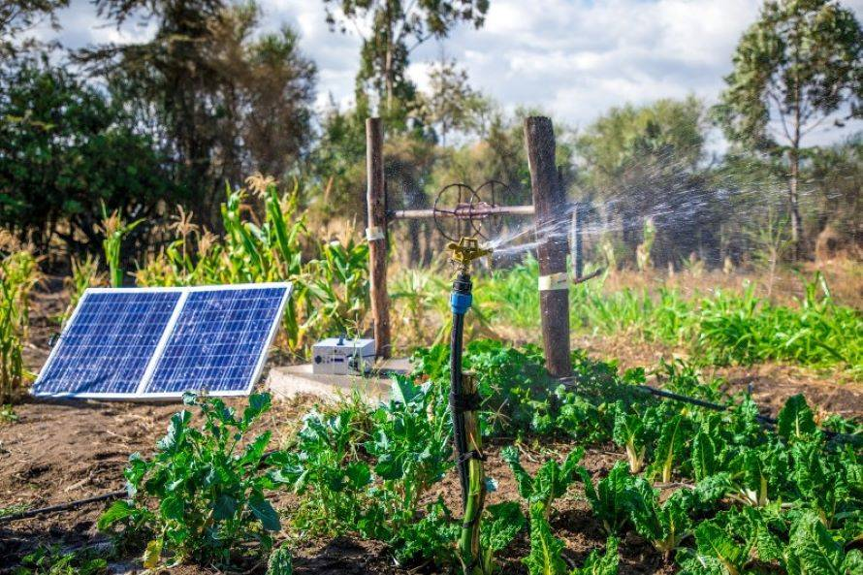
Questions and Objectives
Known solution to improve water-energy access and agriculture productivity in rural areas:
Sustainable irrigation and community-wide renewable electricity​
Questions:
Where to plan new infrastructure?
Which areas present the highest multi-sectoral benefits?
What are the expected costs?
Our Approach:
Multi-scale, multi-sectoral assessment framework: planning of technologies and policies that can promote integrated sustainable development in rural areas of developing countries.
Focus on countries: first case-study of Zambia.
Plan capacity building: Interactive dashboards; dissemination and hands-on workshops to teach our framework.
Notes:
Sustainable irrigation and community-wide renewable electricity​
Increased productivity & local crop processing ​
Agriculture as leverage for reduction of poverty and inequality
Multi-scale, multi-sectoral assessment and planning of technologies and policies that can promote integrated sustainable development in rural areas of developing countries.

Slide 4
Scenarios and data
Common assumptions: Socioeconomic: SSP2, climate: RCP 7.0
Story/question | National goals
“Baseline” | Current policies Agriculture: historical trend of production
Improved access | Electricity access: halving the gap in 2030 water access & sanitation: halving the gap in 2030; Food security: increasing water supply to meet domestic food crops production demand in 2030 (given current diet, no extensification, fertilization, trade)
Ambitious development, sustainable targets | Energy universal access by 2030, universal water access & sanitation by 2030; crop yield gap closure with irrigation nutrition security: improve yields to meet future food crop production demand to meet the EAT Lancet diet in 2030; Renewable electricity share = 100% + climate constraints
Main input datasets
ISIMIP3b climate data
RCP-SSP: socio-economic development and climate projections
MAPSpam 2017 SSA cropland extent
IEA energy balances
GRID3 population settlement extents
OSM power grid geometry
Global Solar & Wind Atlases (RES potential)
MESSAGEix database
Notes:
30 sec

Slide 5
The RE4AFAGRI modelling platform
WaterCROP
Crop water footprint
Resolution:
- 10km
- monthly
MLED
Sectoral energy demand
Resolution: - settlement clusters
- months
Land use, yield, water withdrawals
Tuninetti et al. (2015)
Falchetta et al. (2021)
Irrigation water withdrawals
Sectoral monthly energy demand
Sectoral monthly energy demand
NEST (MESSAGEix-Nexus)
Water-energy-land infrastructure planning
Resolution: - basins - monthly
OnSSET
Energy access planning
Resolution: -settlement clusters
-yearly
Electricity access and off-grid rates
Electricity prices
Vinca et al. (2020)
Awais et al. (in Review)
Mentis et al. (2017)
10.1016/j.esr.2022.100922
Notes:
Four models representing land-water-crop-food-energy requirements and dynamics (WaterCROP, M-LED, OnSSET and MESSAGE-NEST) are calibrated and soft-linked

Slide 6
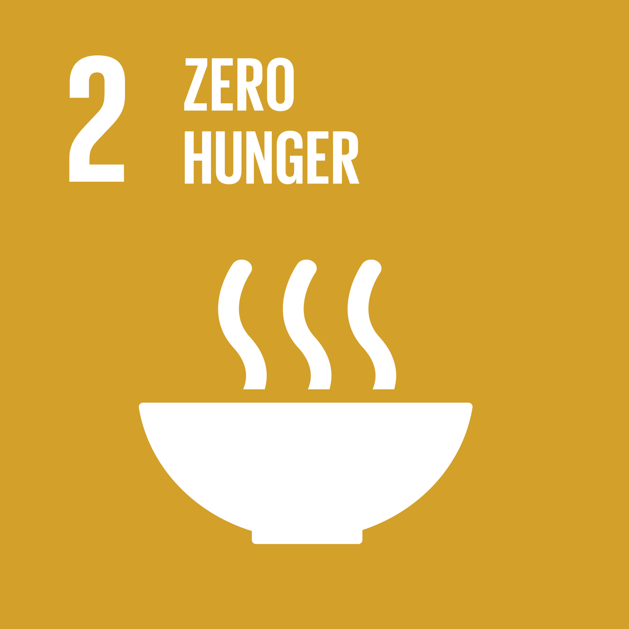
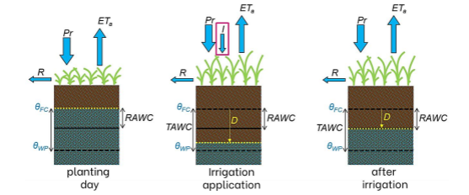
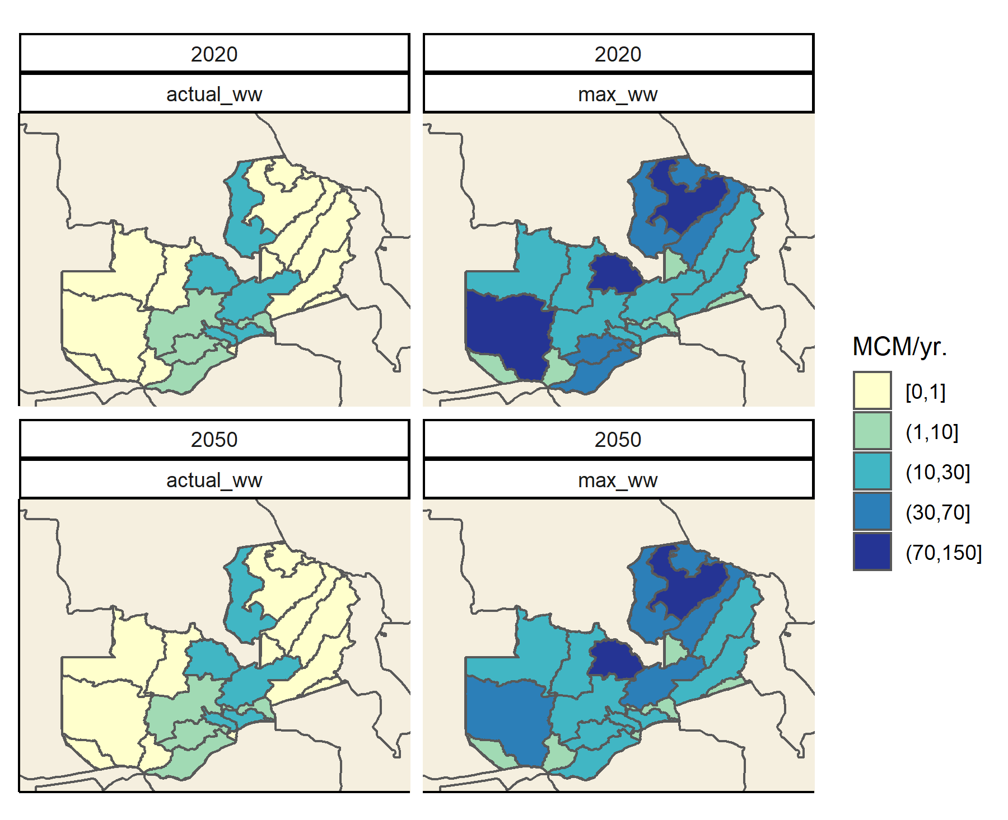
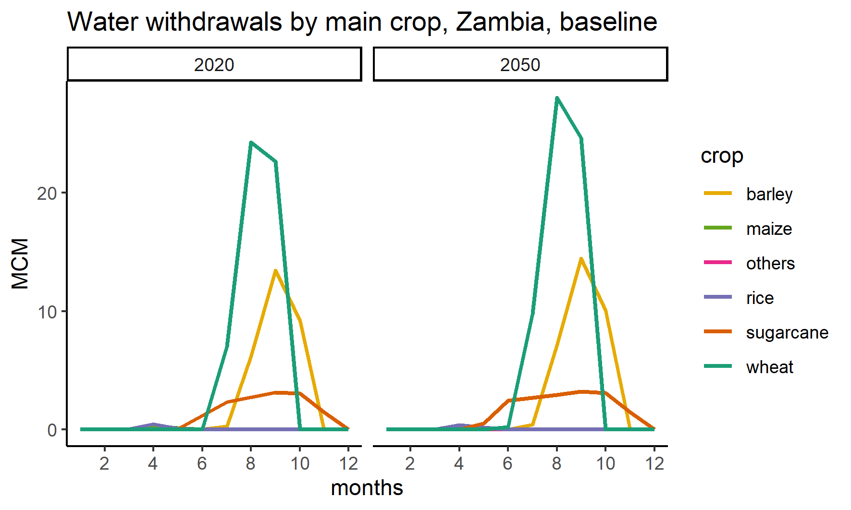
Results – irrigation gap and needs
In Zambia, irrigation needs is likely to be marginally affected by climate change (2020-2050 in baseline scenario), with differences by crops
Great part of the cultivated areas are still rainfed and could be irrigated. A maximum exploitation of the irrigation potential could lead to doubling of yields, but be more largely affected by climate change in some regions.
WaterCROP evapotranspiration model
About 2x yield
Notes:
30 sec

Slide 7
The RE4AFAGRI modelling platform
WaterCROP
Crop water footprint
Resolution:
- 10km
- monthly
MLED
Sectoral energy demand
Resolution: - settlement clusters
- months
Land use, yield, water withdrawals
Tuninetti et al. (2015)
Falchetta et al. (2021)
Irrigation water withdrawals
Sectoral monthly energy demand
Sectoral monthly energy demand
NEST (MESSAGEix-Nexus)
Water-energy-land infrastructure planning
Resolution: - basins - monthly
OnSSET
Energy access planning
Resolution: -settlement clusters
-yearly
Electricity access and off-grid rates
Electricity prices
Vinca et al. (2020)
Awais et al. (in Review)
Mentis et al. (2017)
10.1016/j.esr.2022.100922
Notes:
Four models representing land-water-crop-food-energy requirements and dynamics (WaterCROP, M-LED, OnSSET and MESSAGE-NEST) are calibrated and soft-linked

Slide 8
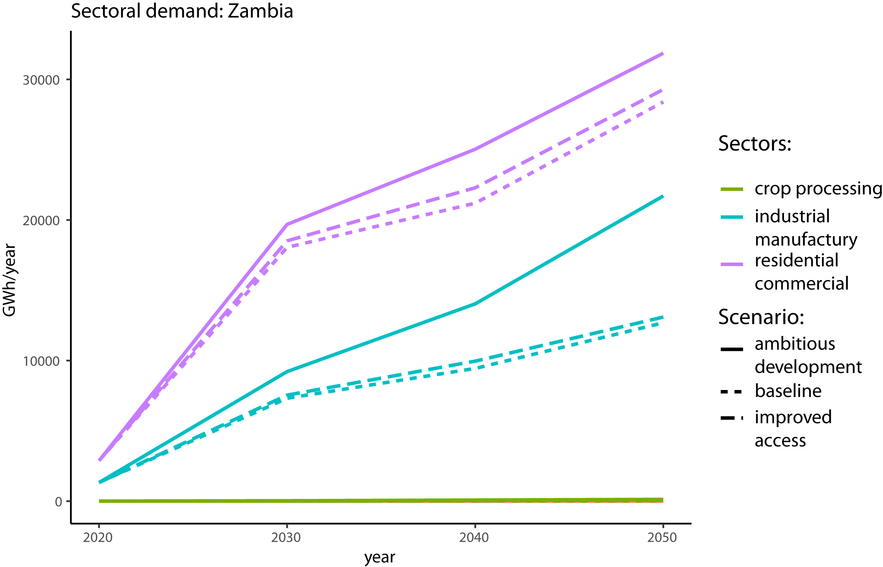
Results – electricity demand (total)
MLED outputs 9 sub-sectoral demand and high-resolution cluster level. Which are then used in the other models
Notes:
30 sec

Slide 9
The RE4AFAGRI modelling platform
WaterCROP
Crop water footprint
Resolution:
- 10km
- monthly
MLED
Sectoral energy demand
Resolution: - settlement clusters
- months
Land use, yield, water withdrawals
Tuninetti et al. (2015)
Falchetta et al. (2021)
Irrigation water withdrawals
Sectoral monthly energy demand
Sectoral monthly energy demand
NEST (MESSAGEix-Nexus)
Water-energy-land infrastructure planning
Resolution: - basins - monthly
OnSSET
Energy access planning
Resolution: -settlement clusters
-yearly
Electricity access and off-grid rates
Electricity prices
Vinca et al. (2020)
Awais et al. (in Review)
Mentis et al. (2017)
10.1016/j.esr.2022.100922
Notes:
Four models representing land-water-crop-food-energy requirements and dynamics (WaterCROP, M-LED, OnSSET and MESSAGE-NEST) are calibrated and soft-linked

Slide 10
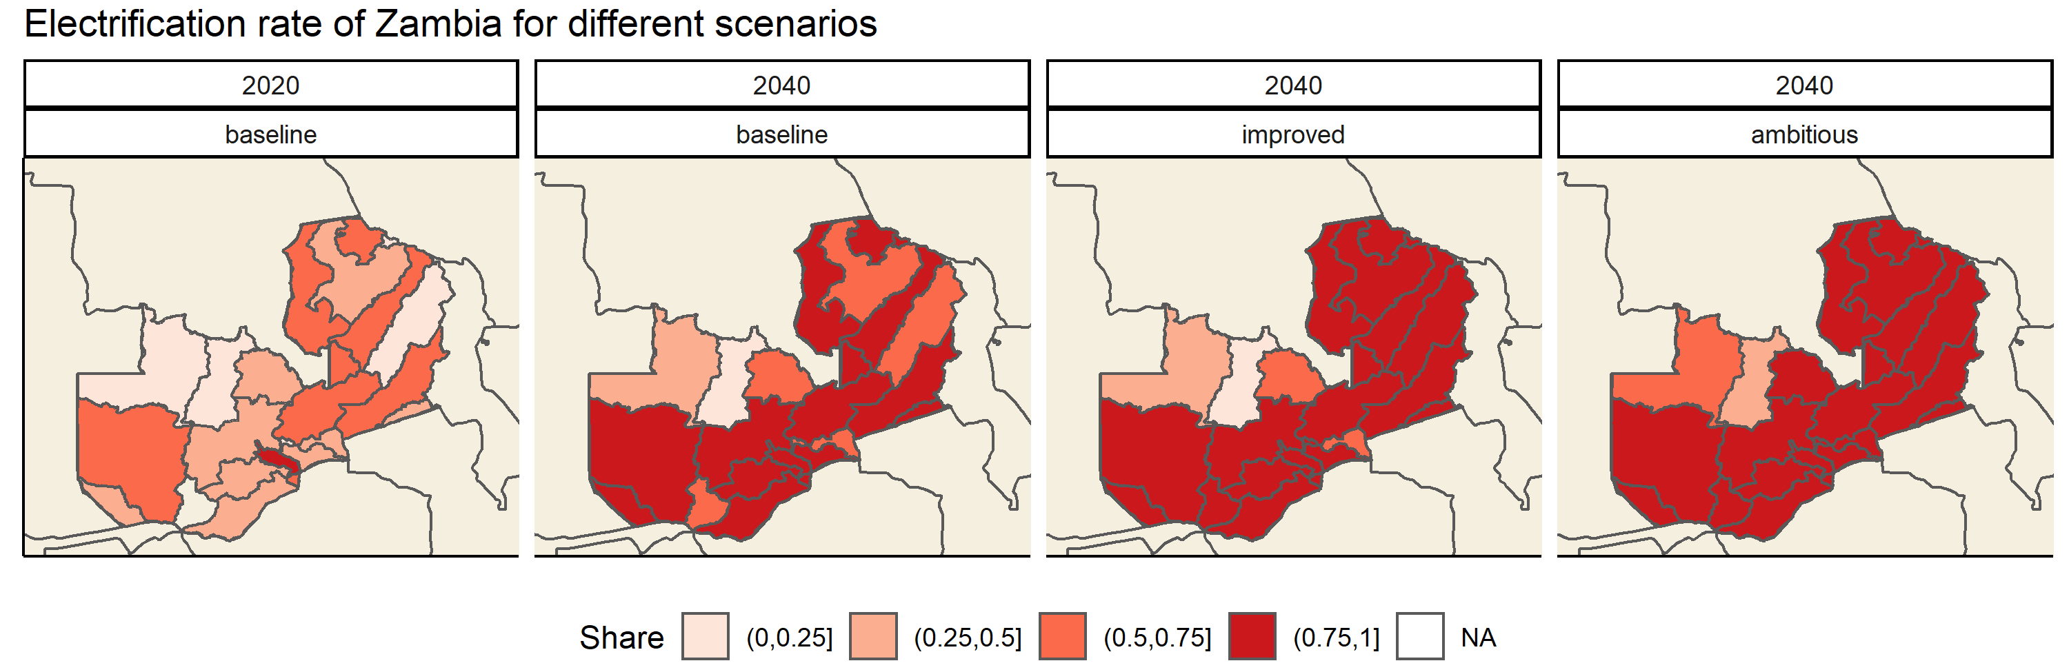
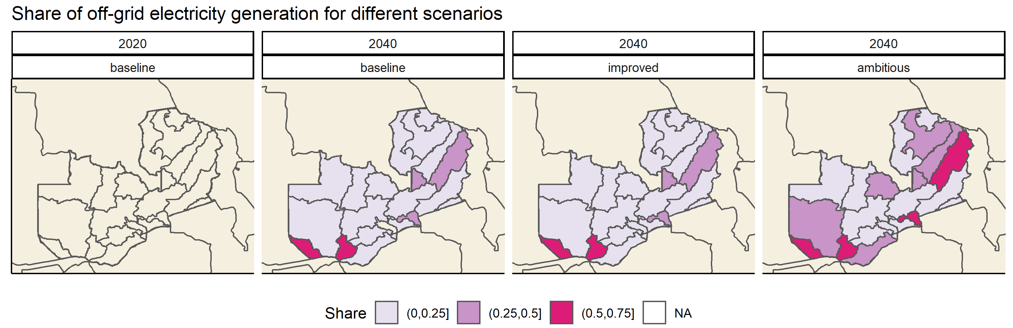
Results – energy access, OnSSET
Regions with lower electrification rate in 2020 are those where off-grid generation is most convenient
INCREASED ACCESS
Notes:
30 sec

Slide 11
The RE4AFAGRI modelling platform
WaterCROP
Crop water footprint
Resolution:
- 10km
- monthly
MLED
Sectoral energy demand
Resolution: - settlement clusters
- months
Land use, yield, water withdrawals
Tuninetti et al. (2015)
Falchetta et al. (2021)
Irrigation water withdrawals
Sectoral monthly energy demand
Sectoral monthly energy demand
NEST (MESSAGEix-Nexus)
Water-energy-land infrastructure planning
Resolution: - basins - monthly
OnSSET
Energy access planning
Resolution: -settlement clusters
-yearly
Electricity access and off-grid rates
Electricity prices
Vinca et al. (2020)
Awais et al. (in Review)
Mentis et al. (2017)
10.1016/j.esr.2022.100922
Notes:
Four models representing land-water-crop-food-energy requirements and dynamics (WaterCROP, M-LED, OnSSET and MESSAGE-NEST) are calibrated and soft-linked

Slide 12
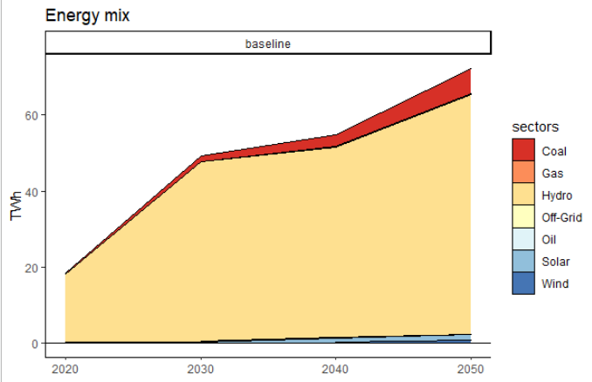
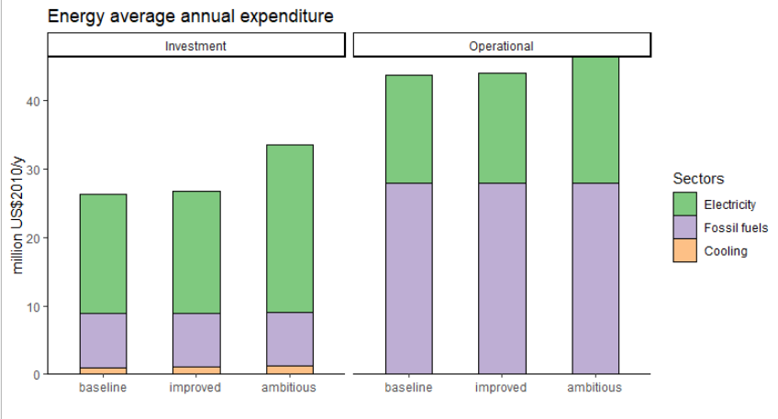
Results – integrated water-energy needs
Increased requirements to achieve full electricity access in 2030:
+ 27% increase in annual investment + 6% increase in annual operational costs
Notes:
30 sec

Slide 13
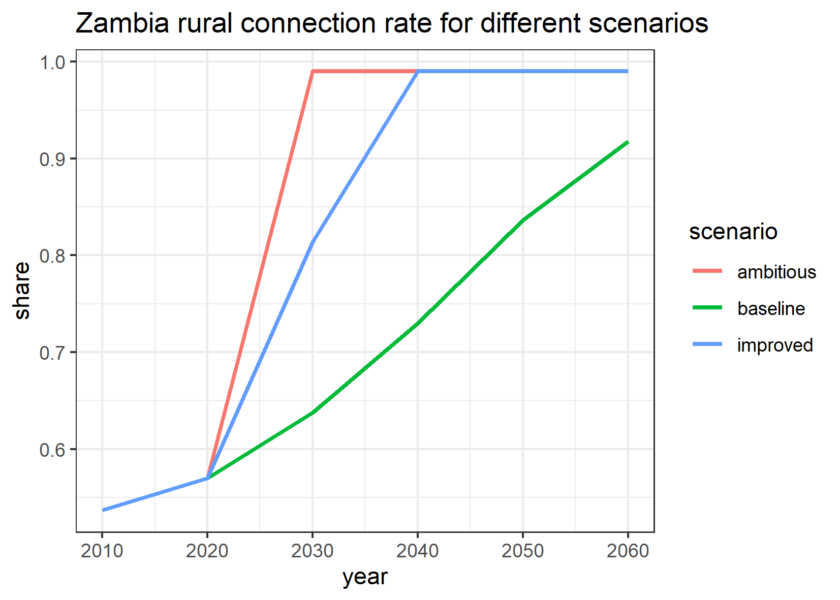
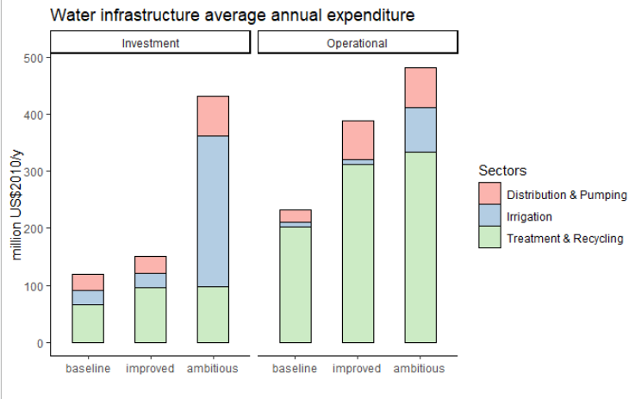
Results – integrated water-energy needs
Water access gap closure by 2040:
+ 34% increase in annual investment + 70% increase in annual operational costs
Irrigation gap closure, leading to 2x yields:
≈10x investment and operational costs for irrigation technologies
Other solution should be pursued: fertilizers, land extensification
Notes:
30 sec

Slide 14
Summary and conclusions
RE4AFAGRI needs-based modelling platform
which links water needs, electricity demand, climate impacts, the local system configuration and investment costs, and the information for financing energy and water supply technologies.
open modelling framework to scale and replicate in other countries / basins
Nexus infrastructure and investment multi-scale planning-oriented modelling along the climate-water-renewable energy-agriculture-development Nexus
Feasibility of yield improvement strategies, e.g. boosting irrigation
Optimal energy supply options for rural areas (either grid or off-grid generation)
Costs of achieving energy-water access targets
Focus on food policies and crop demand
Financial viability assessment
Pilot implementation in Zambia
Current/future effort
Notes:
30 sec

Slide 15
Thank you!
vinca@iiasa.ac.at

Slide 16
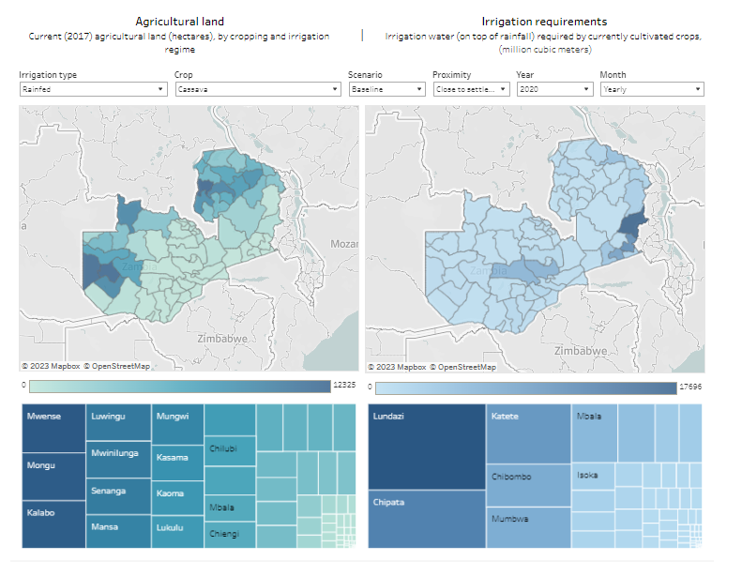
Code, data, and dashboards
Interactive results visualisation dashboards for stakeholders
Data:
The RE4AFAGRI Zenodo channel hosts both the data products generated as outputs of the modelling platform (visualised in the Dasbhoards) and the original input data to operate the modelling platform and replicate the analysis.
Code:
The RE4AFAGRI Github repository hosts the source code of the modelling platform, which, in combination with the data bundles, allows to run the analysis from scratch with customised assumptions and data, or adapt it to other geographies.
Documentation:
The RE4AFAGRI Wiki page hosts the official documentation of the modelling platform, to be used during the RE4AFAGRI capacity building activities, as well as by autonomous users willing to operate their own version of the platform.
Enter the dashboards
Notes:
30 sec

Slide 17
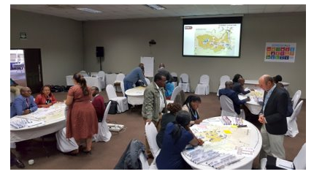
Forthcoming training and events
LEAP-RE Stakeholder Forum
Kigali, 11-14th October 2023
RE4AGRI – WRI Workshops - 2023
Addis Ababa, 16-20th October 2023
High-level course on tools, assessment and policy analysis of the water-energy-land nexus in SSA​
Technical course on WEL-nexus modelling tools​
WRI offices, UNDP complex​
Approx 30 participants​, free to attend
A workshop to support African policy makers and private developers on topics relating to the water-energy-land nexus and rural development - focusing on making data-informed decisions with support of the RE4AFAGRI dashboards and business models.
Notes:
30 sec

Slide 18
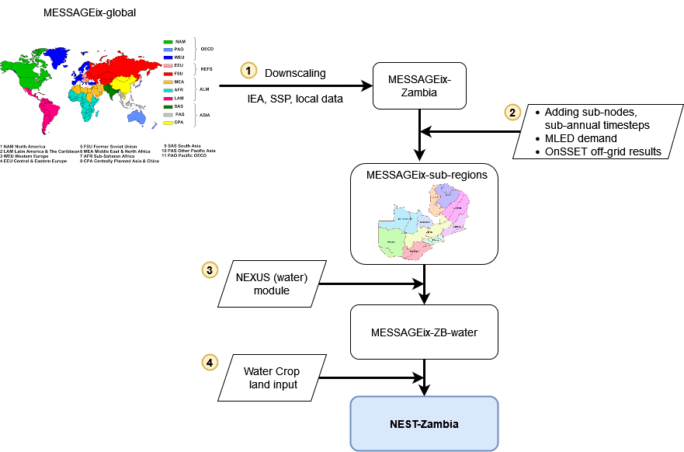
Development process or MESSAGEix-Nexus (NEST) Zambia

Slide 19
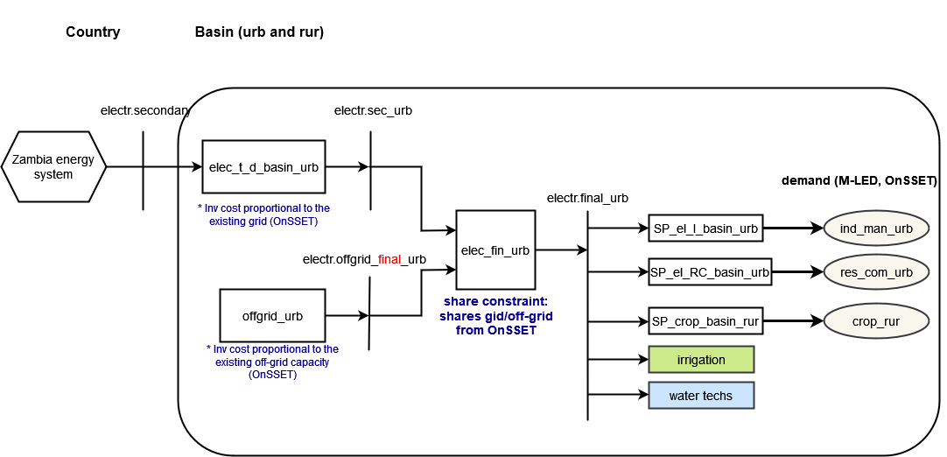
Integration with OnSSET, multiple scales

Slide 20
Background
Selected indicators for sub-Saharan Africa
Under baseline trends, most development gaps still open (or even larger) by 2030
900+ million people by 2050, UN 2019 prospects
Figures: Falchetta (2021)
Data: World Bank, FAO
Notes:
In rural areas of Africa most communities live in poverty and lack access to services such as electricity and clean cooking fuels, water supply that is safe for human use, sufficient and nutritious food, crop irrigation systems, and appliances and services that can foster income generation. Promoting sustainable development requires an integrated understanding and planning along such dimensions.
RE4AFAGRI (“Renewables for African Agriculture”) project of LEAP-RE (Long- Term Joint Research and Innovation Partnership on Renewable Energy between the European Union and the African Union)

