Slide 1
Leveraging Integrated Assessment Model to Assess Climate Feedbacks on Energy, Water, and Land Systems
April 26, 2023
Muhammad Awais, Adriano Vinca, Edward Byers, Oliver Fricko ,Stefan Frank, Volker Krey, Keywan Riahi

Slide 2
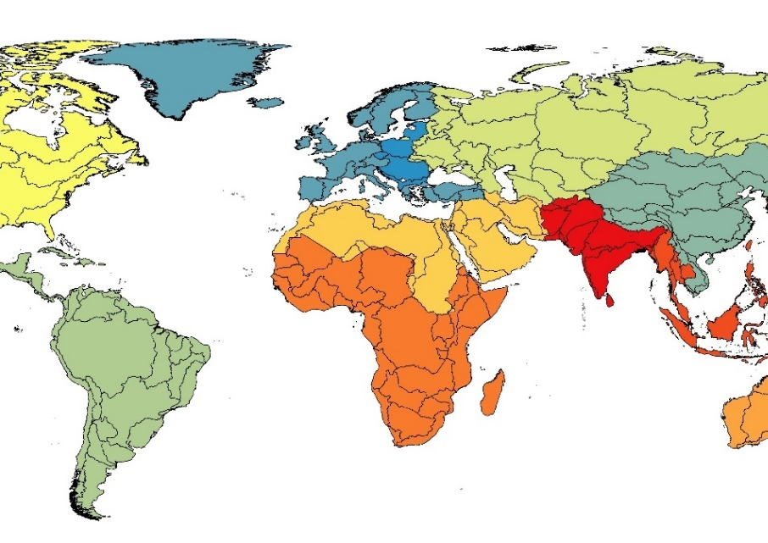
Understanding Climate Resilient Pathways
Better representation of adaptation in quantitative climate assessments [van Mannen et al. 2023 (Nature Climate Change)]
Current development pathways, combined with the observed impacts of climate change, are leading away from, rather than towards, sustainable development, as reported in recent literature [AR6, WGII, Chapter 18]
Previous Approaches:
Top-down macro-economic assessment (damage functions, Social cost of carbon etc.)
Multi-sectoral approach assessing economic implications and feedbacks across sectors: water, energy, land policy analysis with Integrated Assessment Model (MESSAGEix-GLOBIOM).
Enhanced water sector representation
Biophysical Impacts across sectors
Scenarios considering climate impacts & SDGs
Notes:
IAMs are useful tool widely used in cutting edge climate assessments. Current scenarios don’t include climate impacts

Slide 3
Scenarios
SDG measures
Climate Impacts
Reference scenario
No Climate Impacts
No SDGs
Impacts
Climate impacts (RCP 6.0)
SDGs, Impacts & Adaptation
SDGs
Climate impacts (RCP 6.0)
Heathy (EAT-Lancet) diet, reduce food waste
Efficiency improvements, environmental flow constraints, piped water access, wastewater treatment
Hydrology: Precipitation pattern/runoff, groundwater intensity
Crop Yield changes
Renewable energy
Cooling/heating demand
Desalination potential
Power plant cooling capacity
Based on: ISIMIP 3b data, Byers et al., 2018, Gernaat et al., 2021 etc.)
Maximized electrification, phase-out traditional bio, cooling gap
Protected natural land (>30%)
2.6 W/m² target
Based on: Doelman et al. 2022, MESSAGE-ACCESS, Van Vuuren et al., 2019, Parkinson et al., 2019, Frank et al., 2021, Hasegawa et al., 2015, Pastor et al., 2019

Slide 4
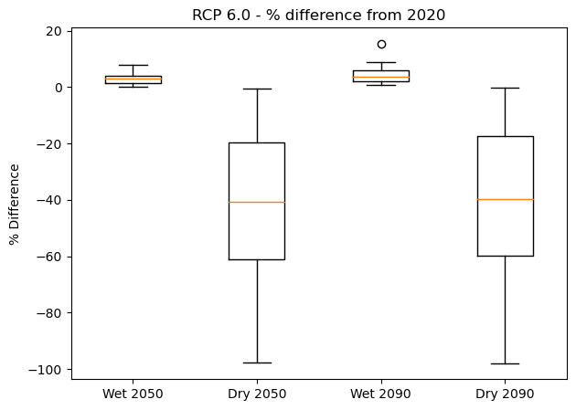
Climate Impacts: Hydrology
Large hydrological uncertainties with pronounced regional differences
Climate Whiplashing - Impacts implies wetter and dryer basins based on geophysical conditions
Sustainable & Non-sustainable adaptation options:
water recycling/treatment,
Desalination
Unsustainable groundwater extraction (depletion)
Limitation:
5 year annual time step in IAM
Aggregation bias
8.40 billion people
8.41 billion people
0.18 billion people
0.24 billion people
Regional variation of wet and dry runoff for the basins

Slide 5
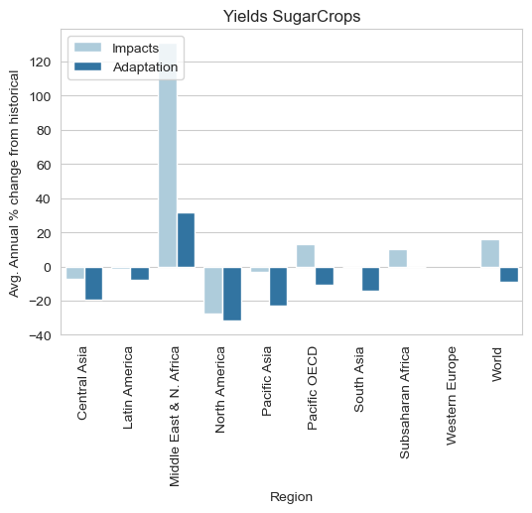
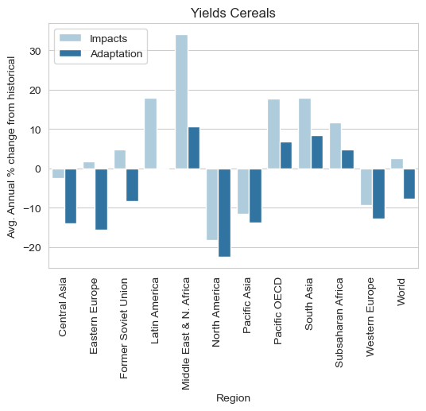
Climate Impact: Crop yields
Some regions will gain yield, other will have yield losses.
EPIC crop model (ISIMIP, CWatM input) → MESSAGEix-GLOBIOM
Adaptation options include crop shift, irrigation vs rainfed
CO2 fertilization of crops have impacts in climate scenarios
Responses to meet SDG 2 (diet), 15 crop choices and SDG6 (env flow)
Yield also significantly impact water withdrawals and significantly water investments across scenarios
Percentage difference of Crop Yields of a climate impact scenario from historical climate
Adaptation – Yields of land use output after land allocation and water constraints
Impacts – Yields calculated from crop models

Slide 6
Key Indicators from Scenarios
Energy
Energy use (Primary, Secondary, Final)
Energy prices
CO₂ emissions pathways
Capacity requirements
Investment pathways
Energy use of water commodities)
Water
Water withdrawals based on constraints
Water supply outlook (combination of different sources)
Capacity requirements of of water infrastructure technologies (wastewater, water distribution)
Investment in the water infrastructure sector
Drinking & irrigation water marginal prices
Water footprint of energy sector
Land
Water Withdrawals for Irrigation
Crop Yields
Land Cover (different categories)
Agriculture production & demand
Fertilizer use & intensity
Land use CO2 emissions
Socio-economics
Population with access to drinking water, sanitation
Urban & rural municipal demands
Population with access to electricity, clean-cooking fuels
Population with risk of hunger
Energy supply portfolio
A/C cooling gap
Adjusted residential demands with increased access to electricity

Slide 7
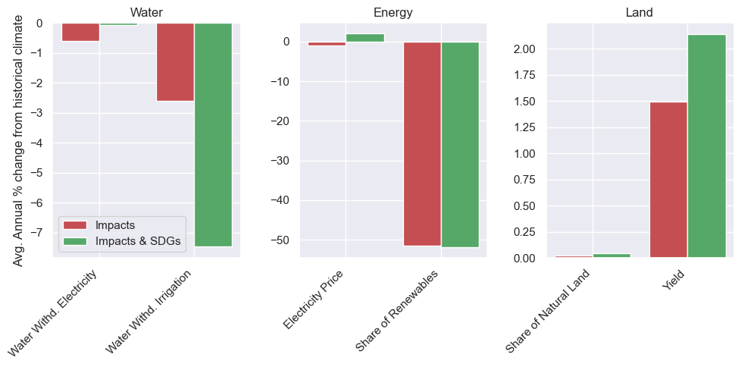
Energy, Water, Land (Brief Outlook)
Some regions show increase/decrease in CO2 emissions due to climate feedbacks
Increased food prices globally due to impacts whereas SDGs with Impacts reduce food price.
Water Resources vary mostly due to geophysical and hydrological conditions.
Electricity withdrawals decrease due to climate impacts on cooling water for power plants.
Yield & Irrigation withdrawals changes are due to endogenous adaptation and water constraints.
Overall SDGs in combination with Impacts and adaptation have some co-benefits in land sector (yields, food prices).
The values represent percentage change of the indicator value from the reference (no climate , no SDG scenario)

Slide 8
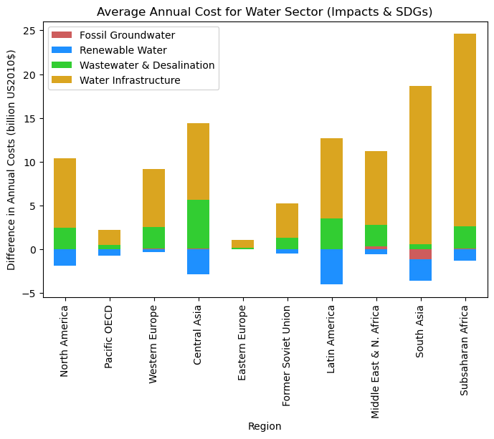
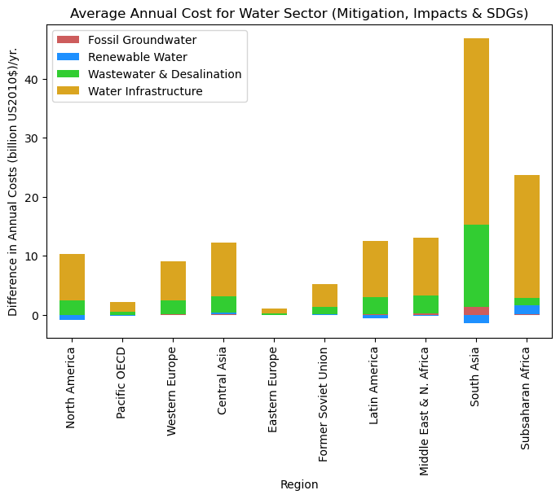
Investments Needs (Water)
Withdrawals are mostly affected by land sector changes
Increased water Infrastructure investments are due to increased access to piped connection in SDGs.
Wastewater, desalination and fossil groundwater can be tracked as ‘Adaptation Investments’ with fossil groundwater as ‘maladaptation’.
Alternative water adaptation investments are higher in South Asia due to limited freshwater availability, lesser access to piped connection of water infrastructure.
In terms of investments difference, renewable water changes are lesser compared to other
The values represent average annual change from 2025-2100 of investments from the reference mitigation scenario (no climate , no SDG scenario)

Slide 9
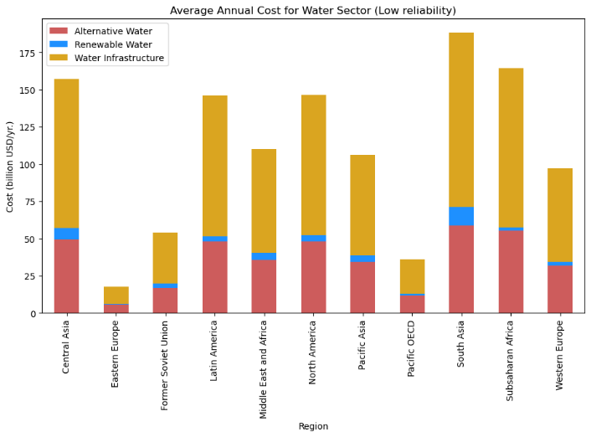
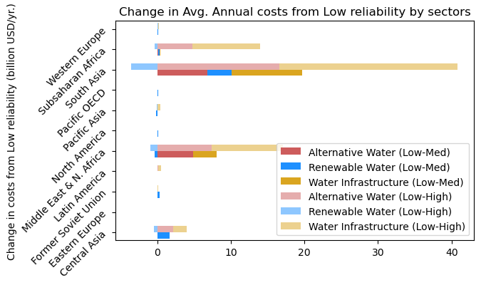
Understanding the Water Sector Constraints
Water Supply quantiles to see the reliability of monthly flow averaged over the year
This in combination with SDGs could help understand the response on system due to sustainable extraction of surface water
Scenarios with Q90, Q70, Q50 (flow exceeded 90%, 70%, 50% of the time) helps to see the renewable water supply portfolio
A higher reliability scenario results in significant investments on alternative water (non-renewable fossil)
Change in average annual costs from the low-reliability scenario to see how the sectoral outlook changes when the water system changes from low to medium and low to high reliability.

Slide 10
Final Comments
A first step towards better integration of biophysical climate impacts in a process based IAM.
Scenarios inform regional pathways addressing trade-offs between climate impacts and sustainable development objectives.
Vulnerable regions have the challenge of adapting and achieving SDGs simultaneously thus increased investment needs.
Improved representation of climate extremes and temporal granularity to better track the model responses.
More model sensitivity to understand hydrological uncertainties and responses
Model Description Paper Open for discussion
For queries: awais@iiasa.ac.at
https://egusphere.copernicus.org/preprints/2023/egusphere-2023-258/

