Slide 1
IAM investment response to biophysical climate impacts on water, energy and land in SDGs and climate policies
Adriano Vinca, Muhammad Awais, Edward Byers, Oliver Fricko, Volker Krey, Keywan Riahi
International Institute for Applied Systems Analysis (IIASA)
Sixteenth IAMC Annual Meeting 2023
Venice, Italy, 15 November 2023

Slide 2
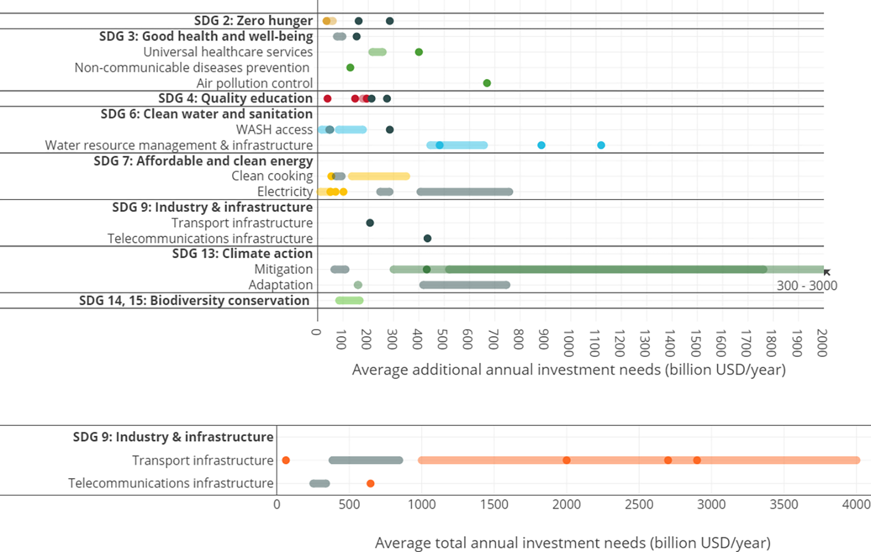
Former investment assessments using IAMs do not include climate impacts
Now several IAMs are detailed enough to include some biophysical climate impacts and assess climate uncertainty on investments
Kulkarni et al., 2022. PLOS Sustain Transform
Notes:
Adaptation is from: Schinko et al. [41] Global costs of building dikes in adaptation to sea-level rise

Slide 3


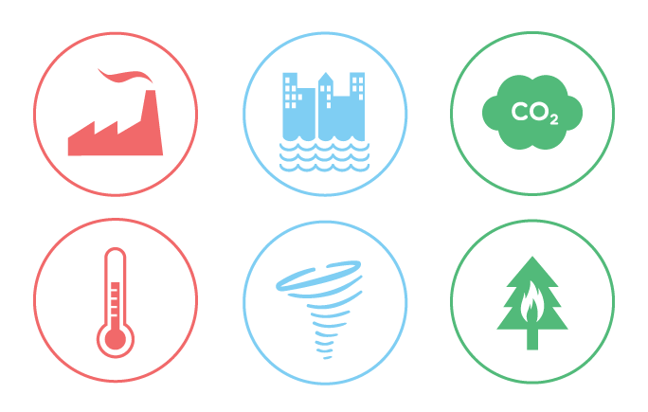




Approach: MESSAGEix-GLOBIOM IAM
Climate policy
SDG measures
Climate impacts
RCP 2.6, 6.0
Food Heathy (EAT-Lancet) diet, reduce food waste
Water Efficiency improvements, environmental flow
constraints, piped water access, wastewater
treatment
Energy Maximized electrification, phase-out traditional bio, cooling gap
Life on land Protected natural land (>30%)
Hydrology: Precipitation pattern/runoff, groundwater intensity
Desalination potential
Crop Yield changes
Renewable energy
Cooling/heating demand
Thermal power plant cooling capacity
Based on: ISIMIP 2b (Frieler et al. 2017 ),Byers et al., 2018, Gernaat et al., 2021 etc.)
2.6 W/m² target
Based on: Doelman et al. 2022, MESSAGE-ACCESS, Van Vuuren et al., 2019, Parkinson et al., 2019, Frank et al., 2021, Hasegawa et al., 2015, Pastor et al., 2019

Slide 4
Scenario | Climate Forcing (W/m²) | SDGs | Impacts | Water supply reliability
SSP2-noCF | 6.0 | No additional effort | Frozen to 2020 | Low-Med-High*
SSP2-CF | 6.0 | No additional effort |  | Low-Med-High
SSP2-SDG-noCF | 6.0 |  | Frozen to 2020 | Low-Med-High
SSP2-SDG-CF | 6.0 |  |  | Low-Med-High
SSP2-26-SDG-CF | 2.6 |  |  | Low-Med-High
SSP2-26-CF | 2.6 | No additional effort |  | Low-Med-High
SSP2 – Middle of the Road Socio Economic Pathway
CF – Climate Feedback
* Low = average values of multi-annual monthly distribution
Med = 70th percentile
High = 90th percentile
Notes:
Radiative forcing (or climate forcing^{[1]}) is the change in energy flux in the atmosphere caused by natural or anthropogenic factors of climate change as measured by watts / metre

Slide 5
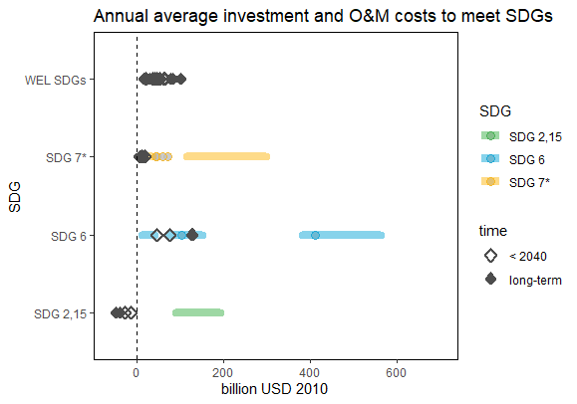
Energy supply and water infrastructure investments to achieve WEL SDGs
Limitation: SDG7*
Energy access & clean cooking demand–side costs not taken into account. Soft-link to MESSAGE-Access-E-use
Literature estimates
SDG 2,15: Clear benefits in energy and water investments. Less agriculture demand
SDG6: long-term higher costs than short term
Our results
Notes:
This is the sum of the difference for all regions
Focus on wel range and reliability
Explore regional differentiation
Figure with the effect of diff SDG on water costs

Slide 6
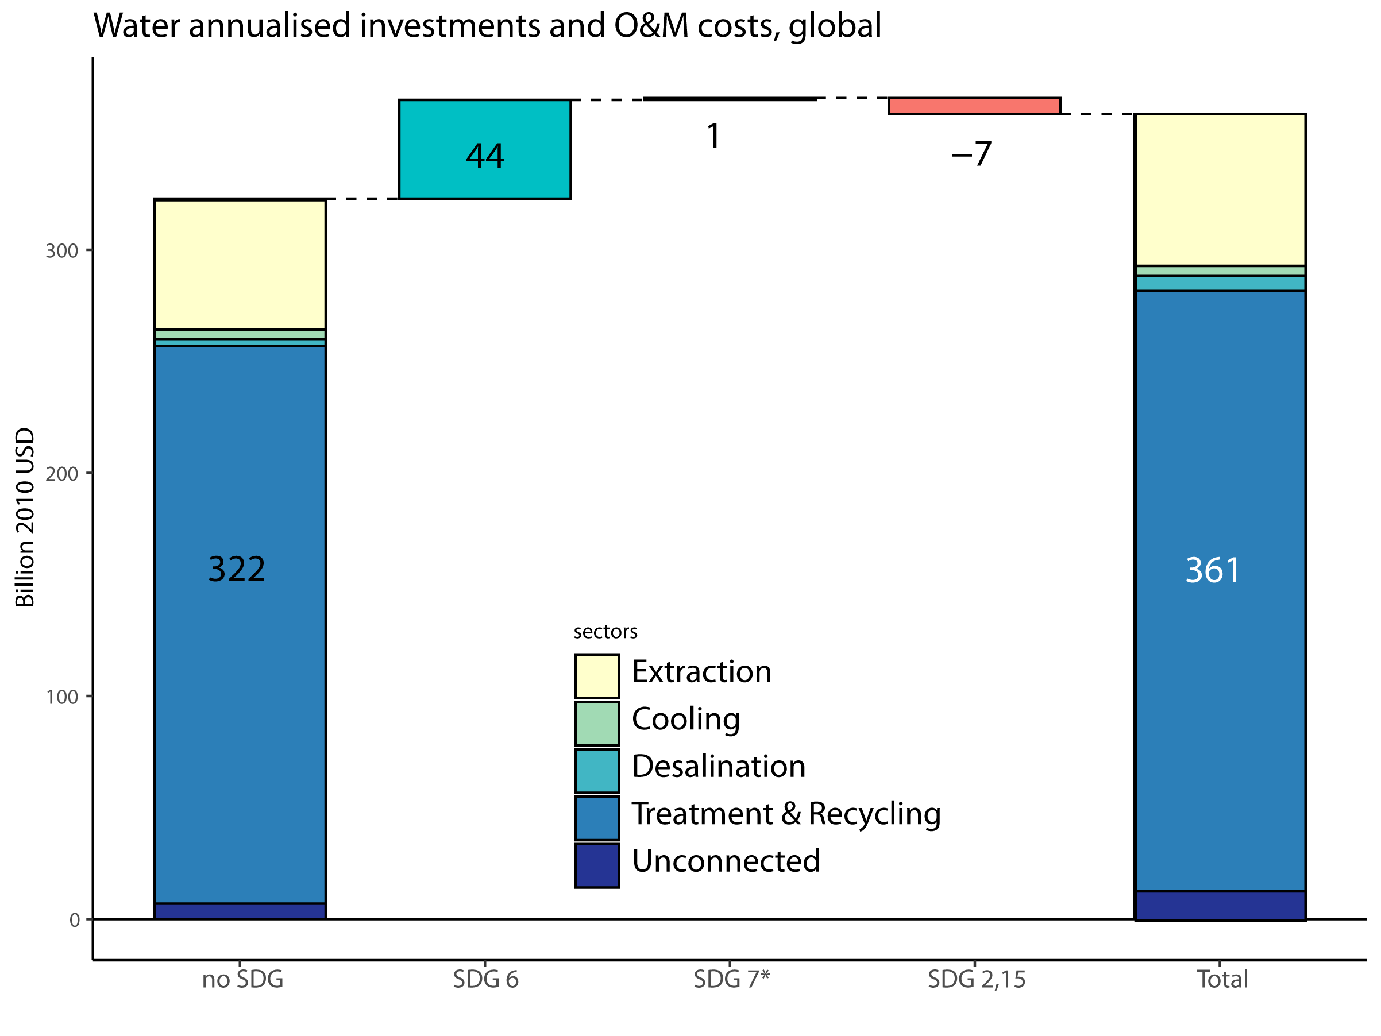
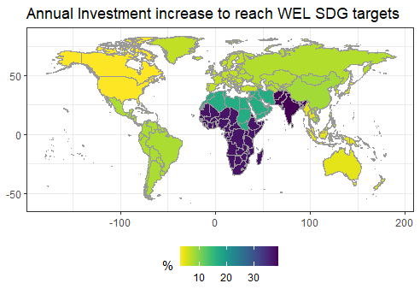
Water investments breakdown
Climate
Uncertainty
?
Cost increase to meet WEL SDGs
World: +12%
South Asia: +30%
How much does it vary when including climate impacts?
Notes:
What are the sectoral increase in SDG6 and reduction in SDG2,15

Slide 7
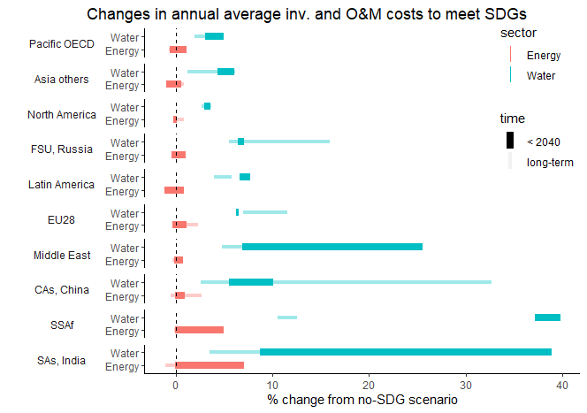
Cost changes in the Energy supply and water infrastructure to meet WEL SDGs
Regions with high water cost increase also have the highest climate change uncertainty, and the lowest adaptive capacity
Climate
Uncertainty
Notes:
Why FSU high long term water cost?

Slide 8
Cost changes in the Energy supply and water infrastructure to meet WEL SDGs
Regions with high water cost increase also have the highest climate change uncertainty, and the lowest adaptive capacity
Energy:
Sub-Saharan Africa and South Asia have high energy investment increase
Notes:
Why FSU high long term water cost?

Slide 9
Cost changes in the Energy supply and water infrastructure to meet WEL SDGs
Regions with high water cost increase also have the highest climate change uncertainty, and the lowest adaptive capacity
Energy:
Sub-Saharan Africa and South Asia have high energy investment increase
Temporal dimension:
long-term cost of maintaining the SDG targets is often higher and more uncertain than reaching the targets.
Notes:
Why FSU high long term water cost?

Slide 10
Climate impacts and mitigation scenarios

Slide 11
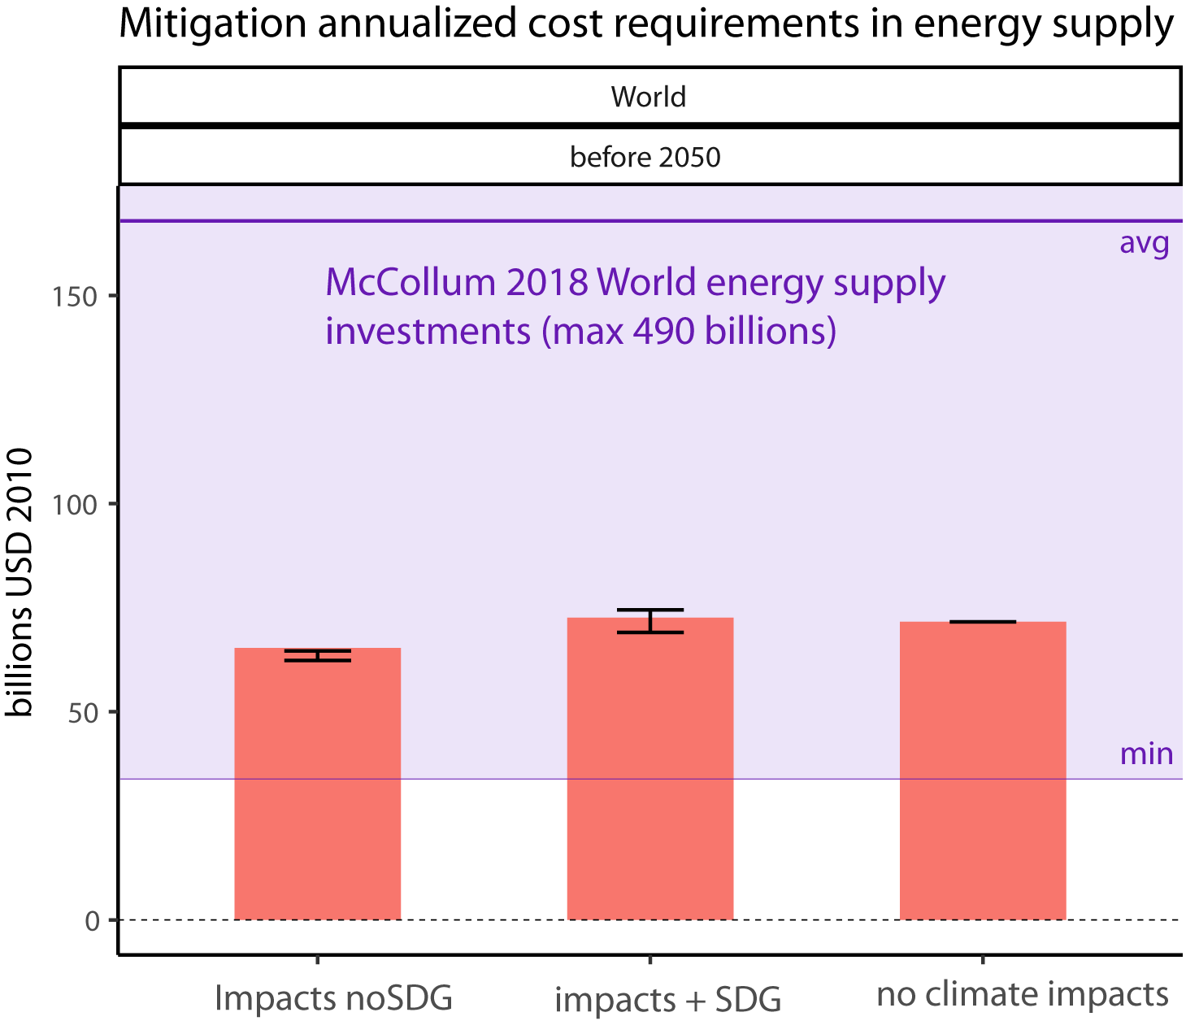
Climate mitigation Energy Supply investments
Scenarios to limit temp. increase to 2DC
Results fall in the lower range of previous estimates.
Energy supply mitigation inv and O&M affected by max 20% by climate impacts.
Impacts on energy in MESSAGEix-Nexus:
Capacity factor of thermal power plants (low share in mitigation)
Hydropower potential
Electricity for water
Cooling gap, not changing in our sensitivity

Slide 12

Conclusions
Insights:
SDG costs might vary up to 30pp because of climate change in the most stressed regions
Maintaining long-term SDG targets might be more costly than reaching them, and highly impacted by climate
Land SDG benefits for WE investments
Limitations:
Land cost assessment
Model intercomparison complicated due to model differences
Supply vs demand detail
Climate impacts included: no floods and droughts
Model temporal resolution
Limited to two RCP climate scenarios
Recommendations and way forward
Coordinate among land IAM modellers to include investments in their outputs
Improve demand side investment assessment in MESSAGEix
Sensitivity on land-use models to improve robusteness of the results
Solutions to represent seasonal impacts or higher temporal resolution
Cover a continuous space of climate scenarios

Slide 13
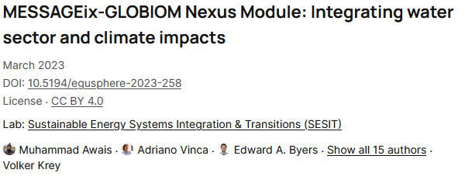

IAM investment response to biophysical climate impacts on water, energy and land in SDGs and climate policies
Thank you!
Contact: Adriano Vinca
vinca@iiasa.ac.at
Sixteenth IAMC Annual Meeting 2023
Venice, Italy, 15 November 2023

Slide 14
Back-up

Slide 15
MESSAGEix-GLOBIOM-Nexus
MAGICC
simple climate model
Population
Economy
National level Projections
socio-economic drivers
G4M
spatially explicit forest management model
GLOBIOM
integrated agricultural, bioenergy and forestry model
socio-
economic
drivers
EPIC
agricultural
crop model
GHG and aerosol emissions
GAINS
GHG and air pollution mitigation model
air pollution emission
MESSAGEix
comprehensive energy system representation, covering all GHGs,
integration across different modules
carbon and biomass price
energy structure
consistency of land-cover changes (spatially explicit maps of agricultural, urban, and forest land)
demand
response
agricultural and forest bioenergy potentials, land-use emissions and mitigation potential
+ water requirements
MACRO
Aggregated macro-economic model
water availability
iteration
CWatM
global hydrological model
service
prices
Buildings
buildings stock, appliances, energy access
Materials production and recycling of key materials
Transport vehicle stock, modal split,
cost and value of time
Nexus Water and agriculture
Limitation: GLOBIOM does not provide investment assessment of land-related infrastructure or practices

Slide 16
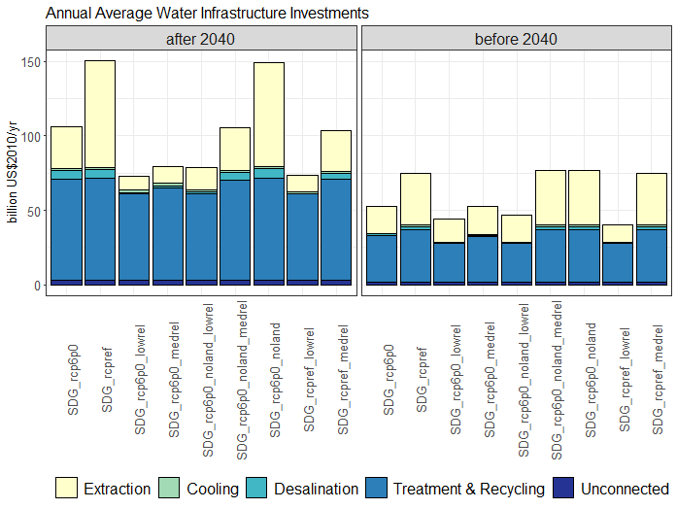
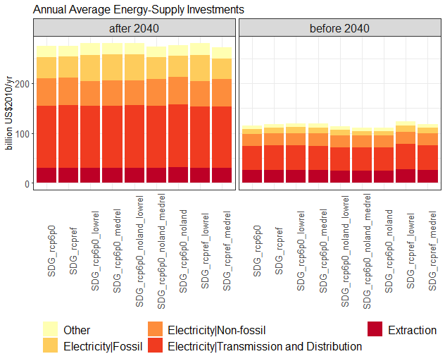
South Asia, India. Investments to meet WEL SDGs
Variability in water extraction (pumping gw, desalinating, treating). Small variations in fossil and renewable electricity generation investments

Slide 17
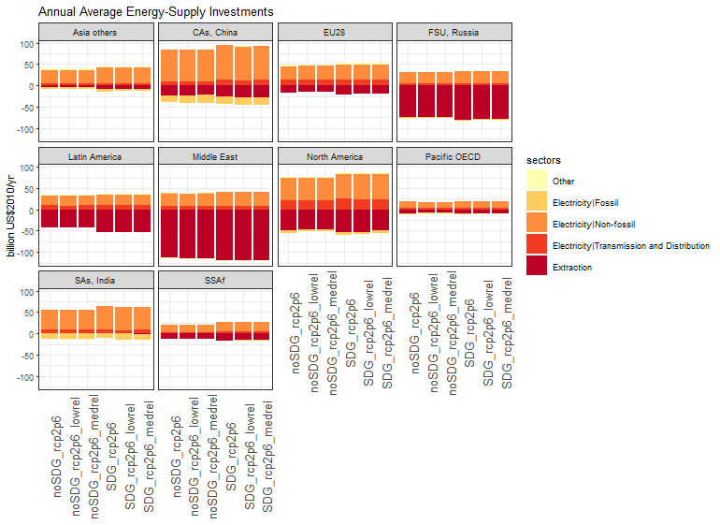
Limited intra-regional variability on mitigation costs
Impacts on energy in MESSAGEix-Nexus:
Capacity factor of thermal power plants (low share in mitigation)
Hydropower potential
Electricity for water
Cooling gap, not changing in our sensitivity

Slide 18
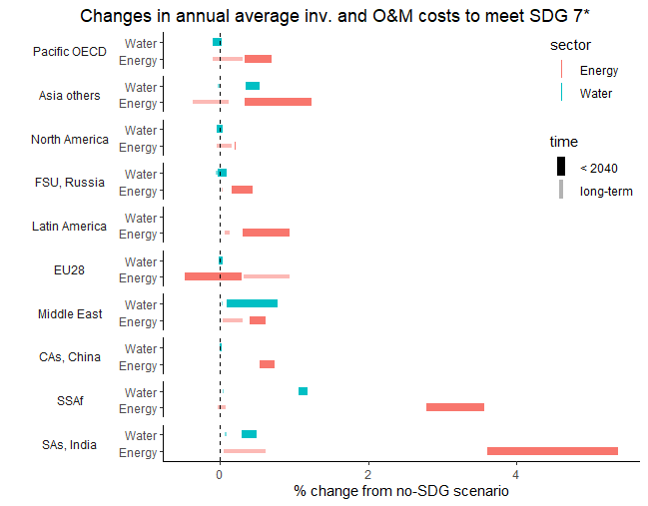
Water and Energy supply investment requirements with SDGs 7*

Slide 19
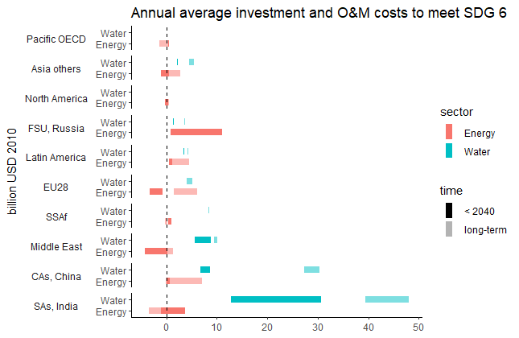
Water and Energy supply investment requirements with SDGs 6
Notes:
Why FSU increase inv in energy for SDG6?

Slide 20
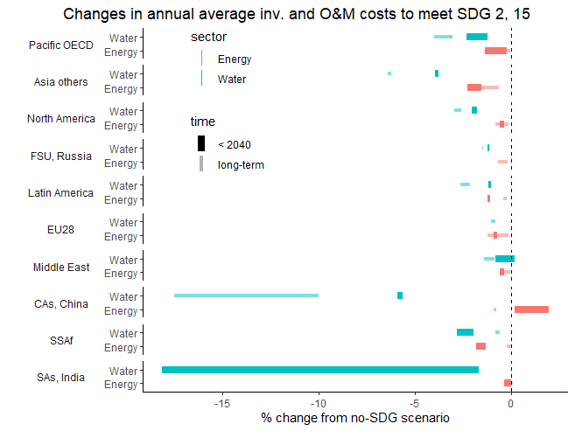
Water and Energy supply investment requirements with SDGs 2 and 15
Notes:
Why China had energy cost increase?

Slide 21
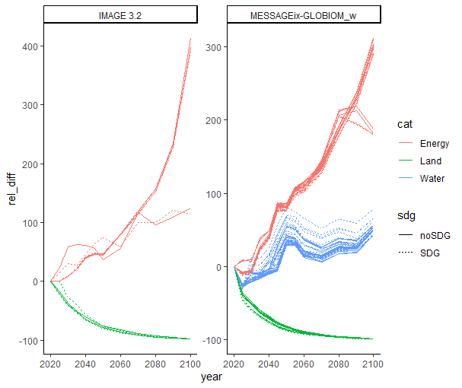
Timeseries and model comparison

Slide 22
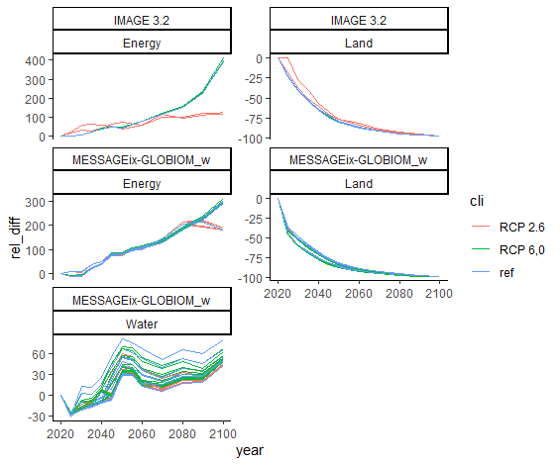
Timeseries and model comparison

Slide 23
Climate impacts on business as usual

Slide 24
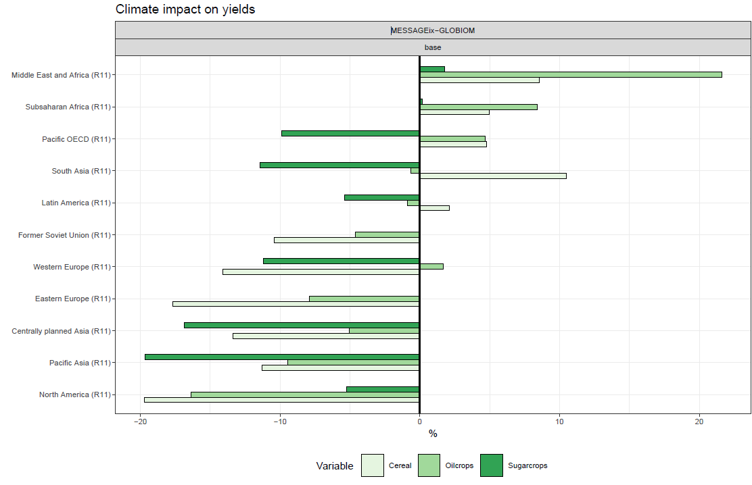
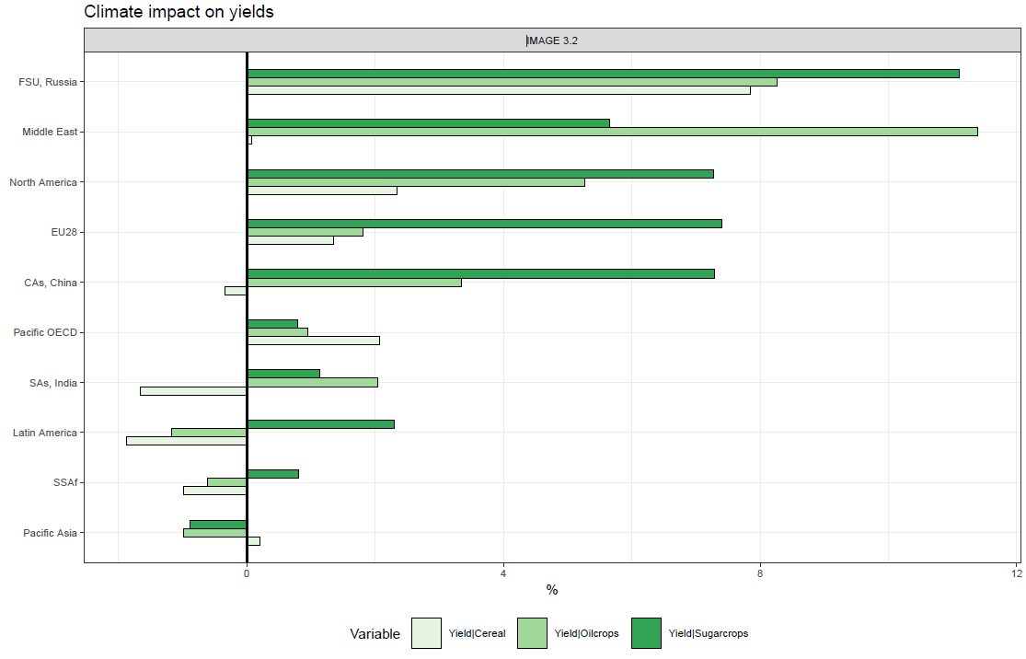
Climate impacts on yield
Similarities with IMAGE: Middle east yield increase, pacific asia yield losses. Higher changes in MESSAGE-GLOBIOM

Slide 25
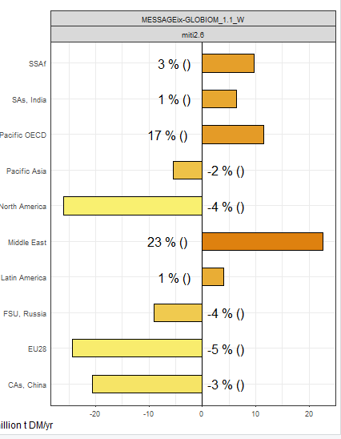
2.6 impacts: crop production
Land impacts still play a role, but not as much as in 6p0. The range was +- 50%

Slide 26
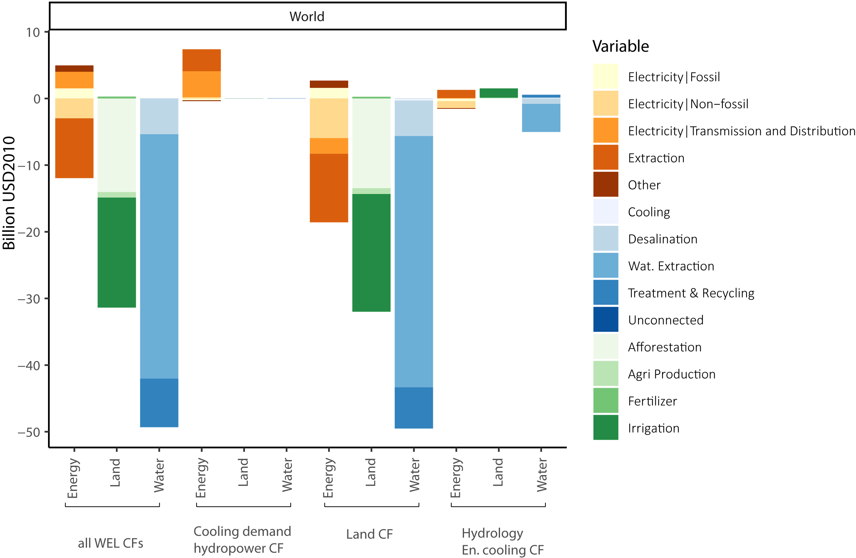
Decompose investment by 3 impacts
Biggest contribution is the land impact (GLOBIOM)
Cooling gap impact mostly affect Middle east and Central Asia
Greatest water inv reduction in South Asia (90%). Related to huge agriculture production loss

Slide 27
Land costs assessment: not investments
Afforestation = missed revenue from timber production
(timber price – timber harvest cost) * forest land diff
Fertilizer use
Fertilizer cost * fertilizer consumption
Irrigation (no info on the technologies)
average irrigation cost(r,y) * irrigated land
Crop production cost
Production cost(cr) * production

Slide 28
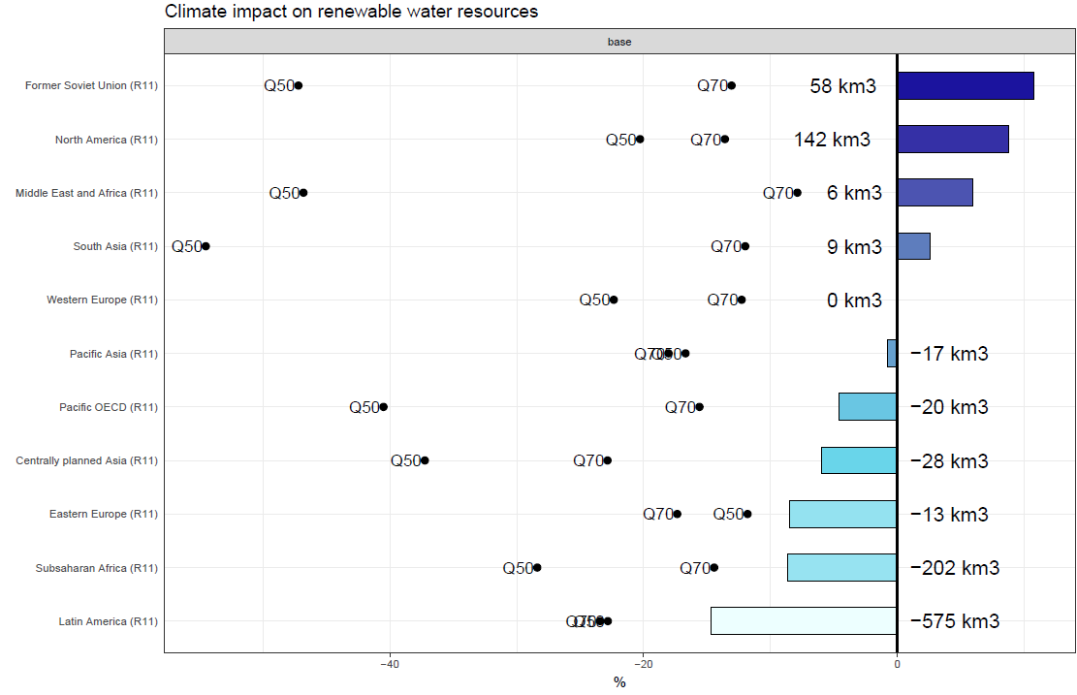
Renewable water availability

Slide 29
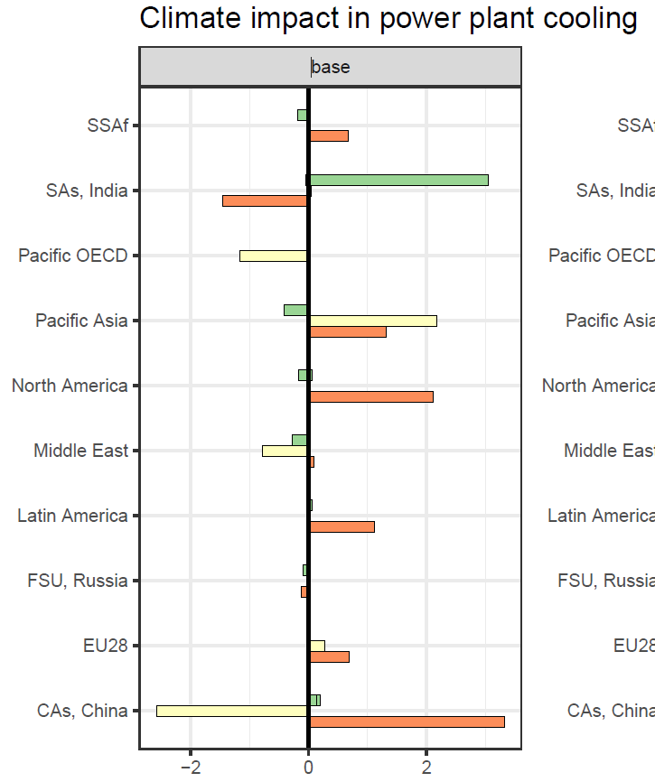
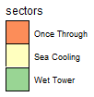
Power plant cooling
Small %

Slide 30
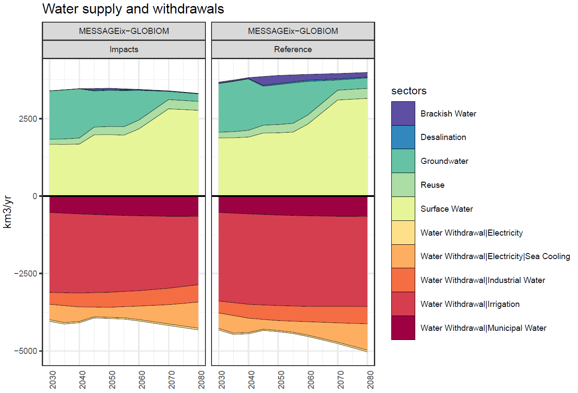
v
Most significant change in is the water withdrawals for irrigation as adaptation strategy

Slide 31
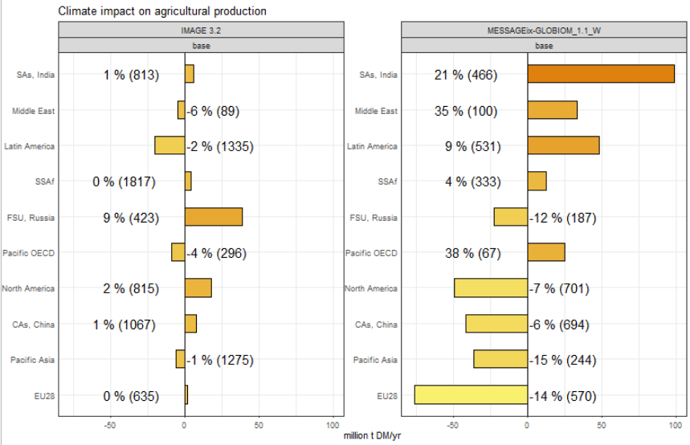
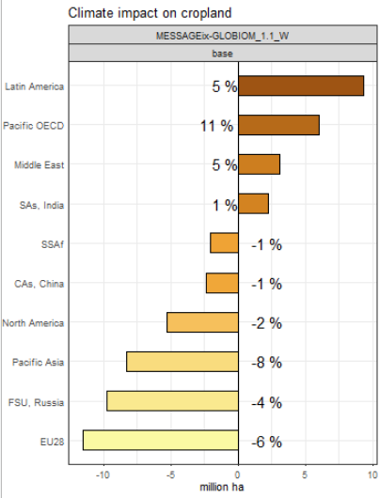
Crop production and land
Very different sensitivity across the two models

Slide 32
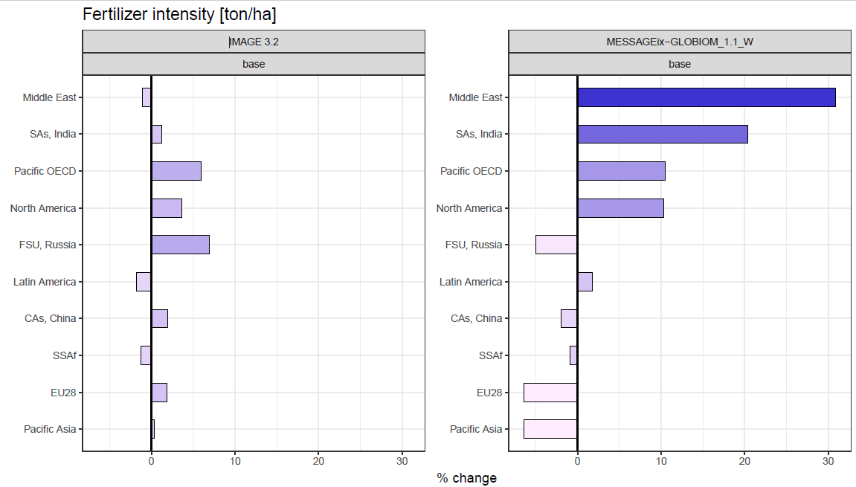
Fertilizer use
Important role of fertilizers in changing yields in the land sectors.
NH3 nexus GLOBIOM-MESSAGE could be explicitly represented, in order to take into account energy needs

