Slide 1
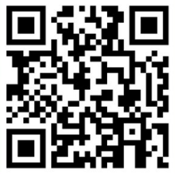
Building a Community of Practice
for inclusive and sustainable urban green transitions through citizen-powered science
October 2023
Notes:
Sophie

Slide 2
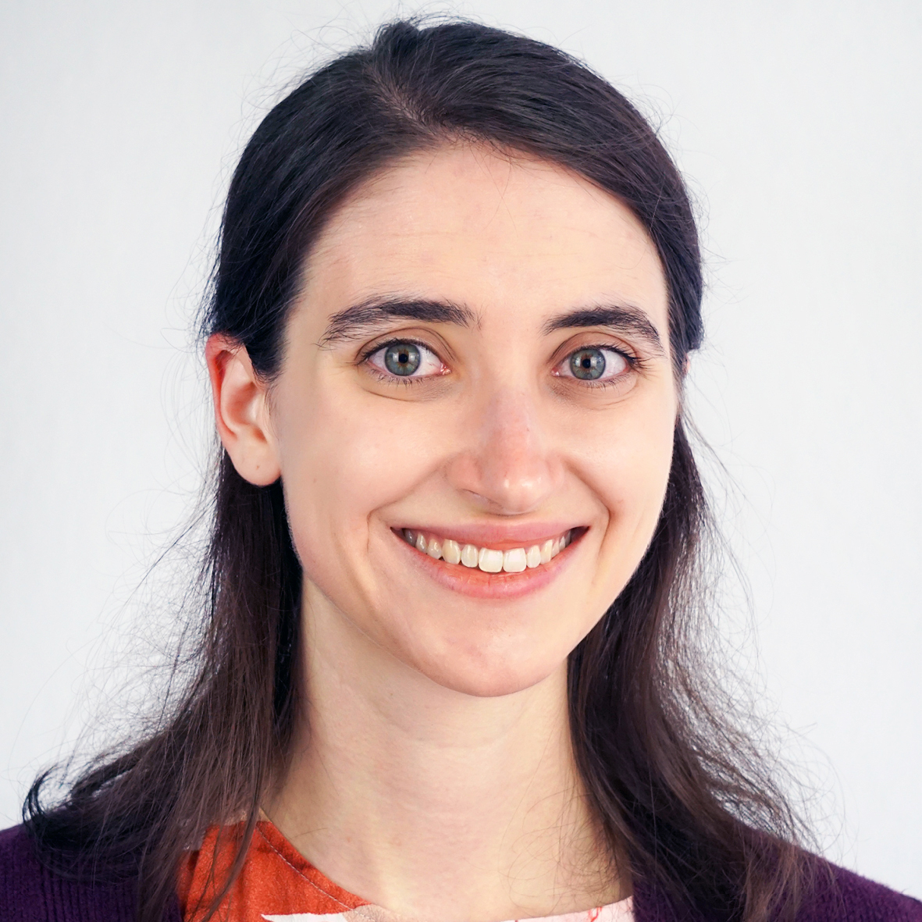
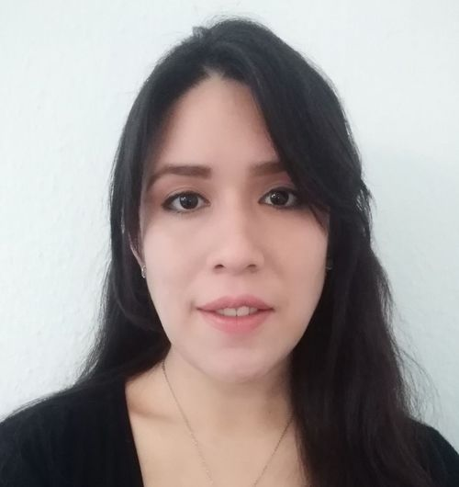
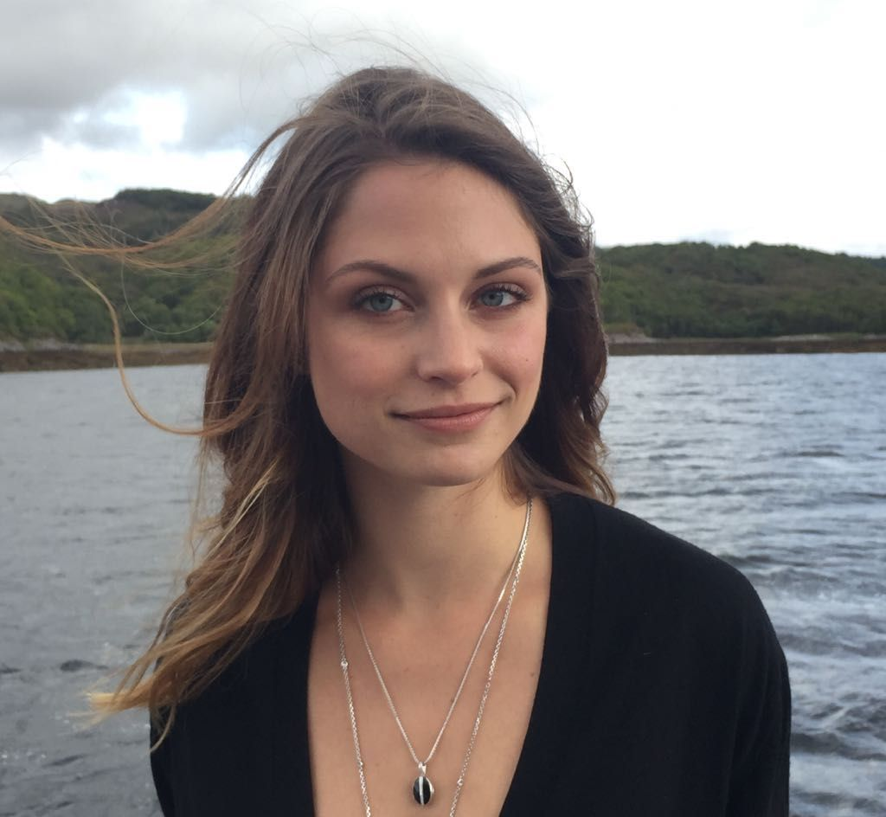
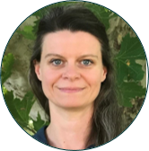
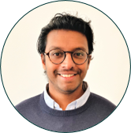
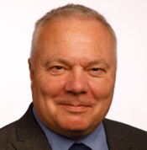
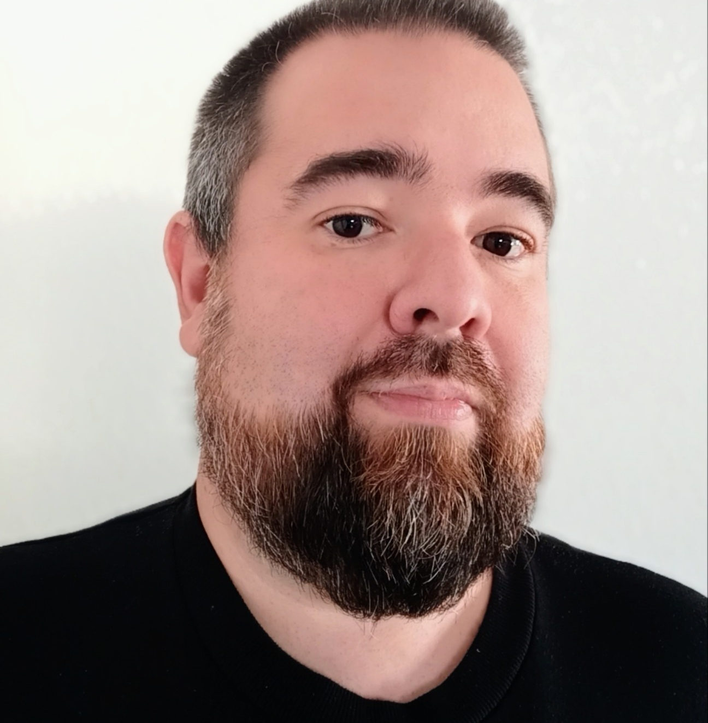
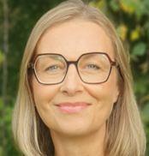
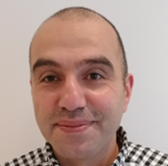
Have any pressing questions or needs during the session? Our facilitators will be happy to help if they aren't speaking!
Notes:
Sophie

Slide 3
Why are we here today?
Workshop objectives:
Introduce you briefly to the Urban ReLeaf project
Officially launch the Urban ReLeaf Community of Practice and its three thematic Working Groups
Identify your key questions of interest, experiences, and perspectives on the goals and working modes that a Community of Practice on inclusive citizen science and urban greening can pursue moving forward
Expected outcomes:
A miro board capturing today's discussion
The discussion's outcomes will be synthesized and inform a first working draft of a Working Group Terms of Reference
Upon interest: your invitation to complete our non-committal Expression of Interest (to learn more about the Community of Practice, and be the first to know when registration opens)
Notes:
Sophie

Slide 4
Agenda
Part 1 (20 minutes):
Welcome & housekeeping
Micro-introduction to the Urban ReLeaf initiative
Introduction to the Community of Practice & Working Groups
Part 2 (45 minutes):
Group discussions
Wrap up
Notes:
Sophie

Slide 5
Citizen-powered data ecosystems for inclusive and green urban transitions
@releafcities
https://urbanreleaf.eu

Slide 6
Inclusive Citizen Science
Methods that encourage the contributions of the public, including vulnerable communities to the advancement of research and monitoring in ways that may include:
co-identifying research questions
co-designing/conducting investigations
co-designing/building/testing low-cost sensors
co-collecting and analysing data
collaboratively solving complex problems

Slide 7
Urban ReLeaf provides an opportunity to capture citizen-driven data on urban greening and build city resilience

Slide 8
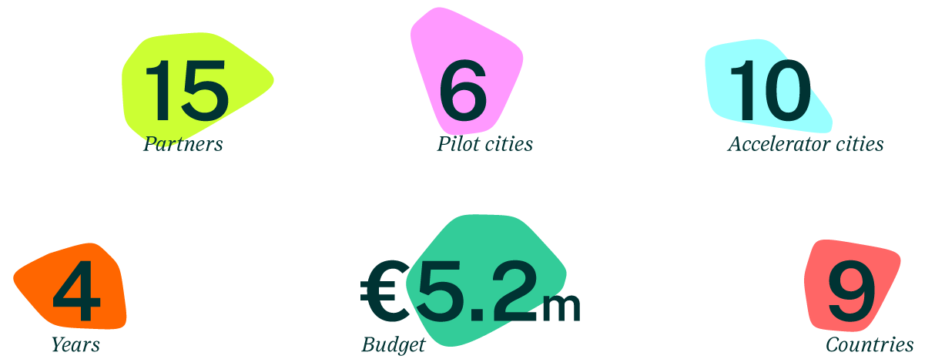

Slide 9
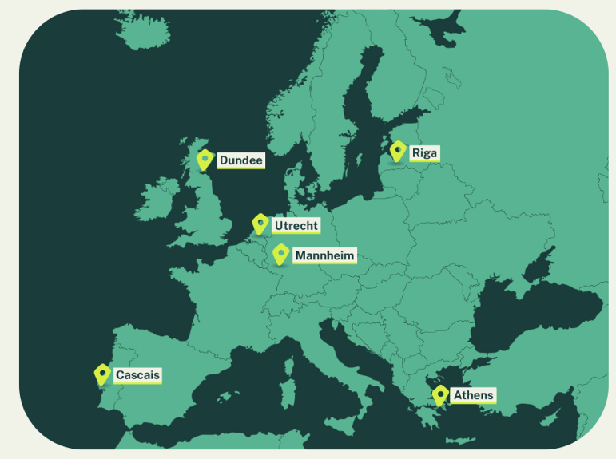
1. Policy Analysis 2. Data Ecosystem Mapping
3. Gap identification
4. Design citizen science
5. Innovative governance
Notes:
Together with 5 other cities Dundee is participating in a European (Horizon Europe) 4-year project.
The project aims to deliver citizen-powered data ecosystems to support cross-sectoral innovation and political agenda setting for climate change adaptation and green infrastructure planning in urban environments, for an inclusive and green transition.
The projects Mission is to: Advance citizen-powered science to be a central resource for inclusive urban green planning and policy in support of the European Green Deal and SDG 11.7 target.

Slide 10
ATHENS
Participatory tree registry
Civic engagement platform for mapping, monitoring, and caring of trees
Low-cost air quality monitoring
Improve spatiotemporal resolution and mapping of exposure to air pollution (PM2.5)

Slide 11
CASCAIS
Perception mapping
Thermal comfort and perception of people around greenspaces compared with built-up areas
Insights for policymaking and financial investment, especially under climate change scenarios and heat waves

Slide 12
The Urban ReLeaf CoP in a nutshell
Why?
What?
Create greener, more just, and resilient cities for all
A collaborative forum with three thematic Working Groups (WG) for knowledge-sharing, partnership building, and amplifying impact.
Key outputs foreseen, defined by each WG
How?
Link citizen-powered science and public authority innovation, Earth Observation, and urban design foresight.
Final Terms of Reference
Knowledge products *
Action commitments
* #, formats, and target channels based on a joint knowledge sharing & dissemination plan
Notes:
Sophie

Slide 13
The Urban ReLeaf CoP in a nutshell
When?
Who?
Activities from
Spring 2024 – end of 2026
Practitioners and experts from a wide range of disciplines, such as but not exclusively:
Municipalities
Citizen associations
Civil Society Organizations
Businesses
Authoritative data agencies
Urban planners
Architects
Where?
Online regularly (once every 3 months) with opportunities to connect in-person at two+ forums
Notes:
Sophie

Slide 14
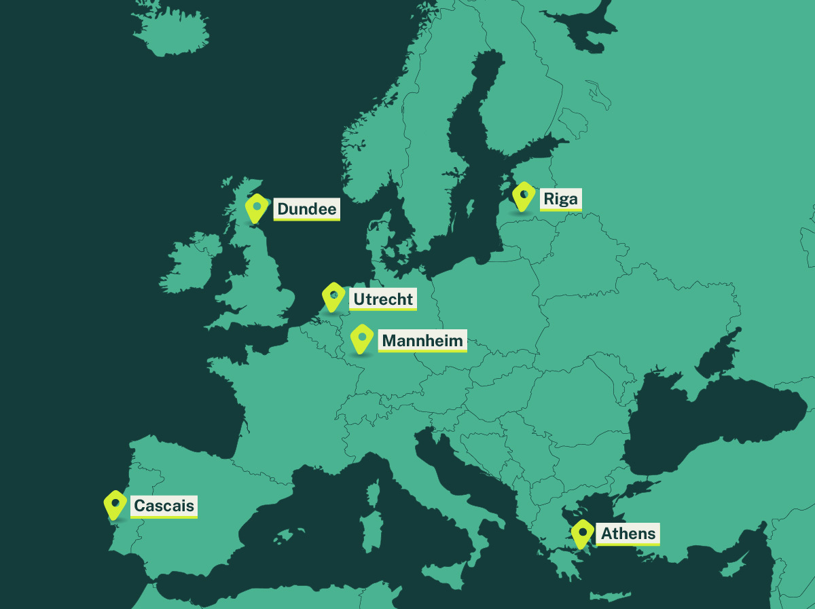
CoP overarching purpose
Engage a broader group of stakeholders within the Urban ReLeaf pilot cities (Dundee, Riga, Mannheim, Athens, Utrecht, and Cascais),
vertically and horizontally
Connect passionate individuals and institutions beyond the Urban ReLeaf pilots
Facilitate sense-making of shared challenges, sharing
knowledge, and committing to future actions
Notes:
Sophie

Slide 15
One Community. Three Working Groups.
All of the CoP's three topical Working Groups (WGs) share a consistent central concept, formats and meeting structures, and communication channels.
Members maintain co-ownership over their respective specific objectives, content, and ways of working.
1
2
3
Triggering innovation in public authorities with citizen-powered science
Coupling citizen science and EO for the European Green Deal & SDG 11 monitoring
Urban design foresight for NBS and green infrastructure scenario planning
Notes:
Sophie

Slide 16
Process map
– Nov 2023
1) Ideation
Oct 2023 – Feb 2024
2) First open call application and selection process
Feb – Mar 2024
3) Programme launch
4) First wave of regular programming
Mar – Nov 2024
Oct – Nov 2024
5) Second open call application & selection process
Jan 2025 – Dec 2026
6) Second wave of regular programming
Late 2026 –
7) Life and impact beyond the Urban ReLeaf project
Notes:
Sophie

Slide 17
What's in it for me?
 | ENGAGE with institutions and policymakers involved in decision-making processes that matter to you.
 | CONNECT with practitioners and experts from a wide range of disciplines, across Europe and beyond.
 | SHOWCASE your commitment to driving positive change in urban landscapes in a sustainable, citizen-centered, inclusive, and collaborative way.
 | AMPLIFY the impact of your and your organisation’s efforts through opportunities to collectively network, commit to action, and create outputs to advance the debate at multiple scales.
Notes:
Sophie

Slide 18
Working Groups
Notes:
Sophie

Slide 19
Working Group 1
Triggering innovation in public authorities with citizen-powered science
Lead organization
Notes:
Sophie

Slide 20
WG1 Context
The problem
Public authorities often face limitations in collecting essential data for evidence-based policymaking due to resource constraints.
How citizen-powered science can help
Contributions from citizens can make data collection more comprehensive and inclusive, and provide valuable data for monitoring policy impacts and adapting future approaches.
Notes:
Sophie

Slide 21
WG1's contribution
Three key needs WG1 members could help address
A wider array of examples on how to successfully use citizen science data for policy revisions and adoption
Fostering awareness and organizational culture change to embrace citizen science
Building and sustaining good community engagement and interdisciplinary collaboration
Notes:
Sophie

Slide 22
Who should join WG1?
Key participant group:
⭐ Local government representatives⭐
Others who may benefit:
Citizen's Associations
Civil Society Organizations
Business community members
Notes:
Sophie

Slide 23
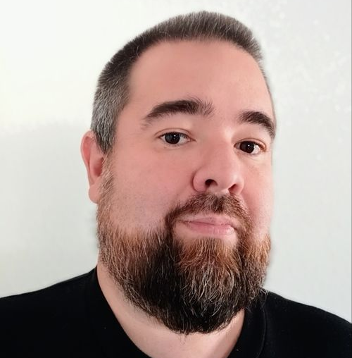
WG1 | Team Contact
Sophie Callahan (Lead) she / her
Expert, Governance Innovation
✉️ sophie.callahan@iclei.org
Karen Naciph Mora (Support)
Officer, Nature Based Solutions
✉️ karen.naciph@iclei.org
Dr. Marcelo Lampowski (Support)
Expert, Data Governance
✉️ marcelo.lampkowski@iclei.org
Notes:
Sophie

Slide 24
Working Group 2
Lead organization
Coupling citizen science and Earth Observation for the European Green Deal and SDG 11 monitoring
Notes:
Gerid

Slide 25
WG2 Context
The problem
Mismatch between data availability/accessibility and monitoring/reporting requirements (i.e. Green City Accord, European Green Deal, SDGs…)
How citizen-powered science & EO can help
Novel citizen science and EO data streams have great potential to complement and add value to official data assets and aid the delivery of climate adaptation measures
Notes:
Gerid

Slide 26
WG2's contribution
Three key needs WG2 members could help address
Build a greater collective understanding of official monitoring/reporting requirements and implications (i.e. Green City Accord, Green Deal, SDGs,…)
Create pathways of sustainably integrating novel data streams into official data ecosystems
Proliferate citizen-powered science and strengthen trust in its uptake
Notes:
Gerid

Slide 27
Who should join WG2?
Key participant group(s):
⭐ Local/Regional Authorities⭐
⭐ People involved in citizen science⭐
Others who may benefit:
Official data agencies
UN Organizations
Academia
EO data providers
Notes:
Inian

Slide 28
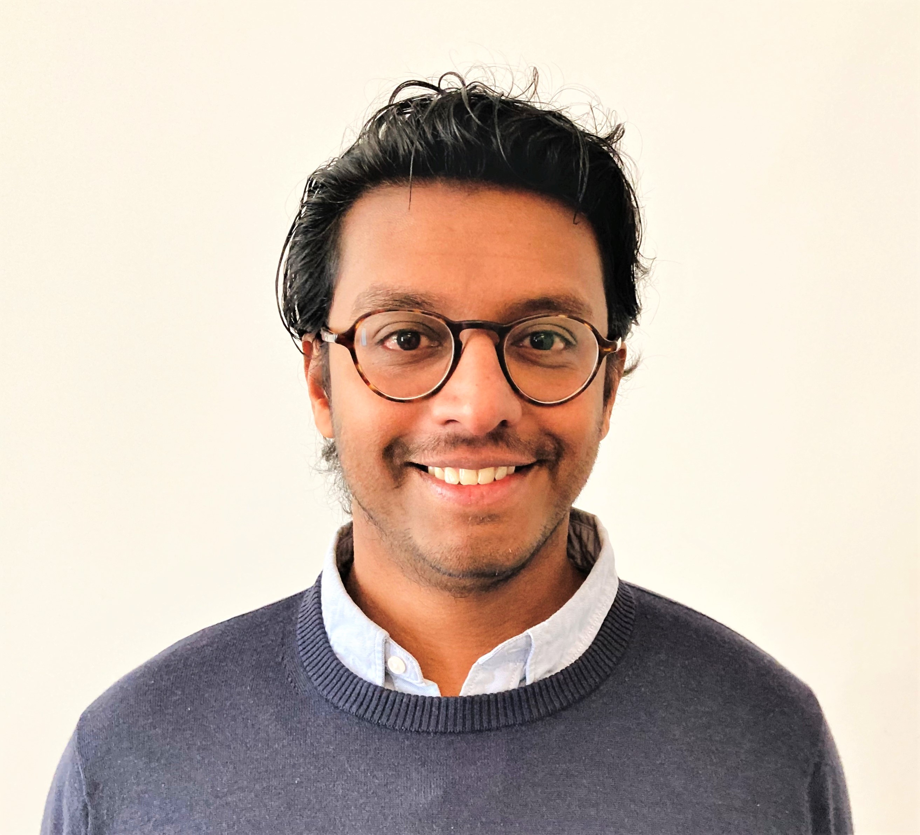
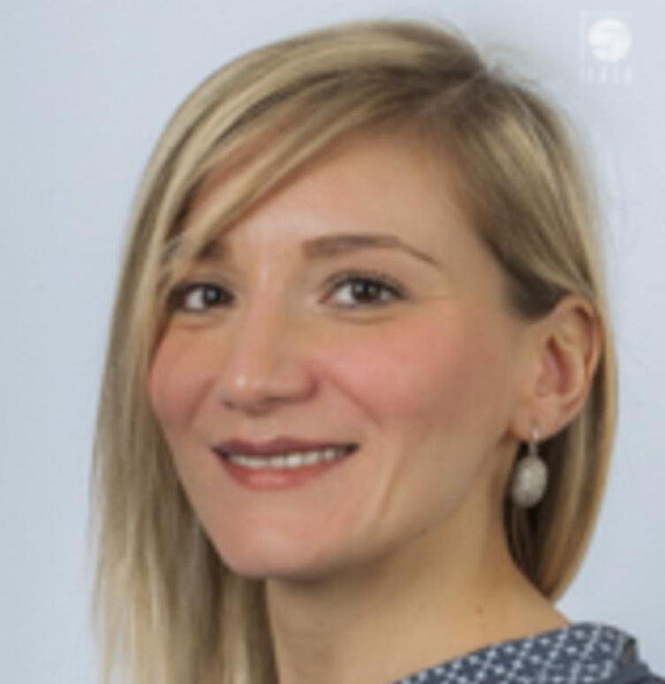
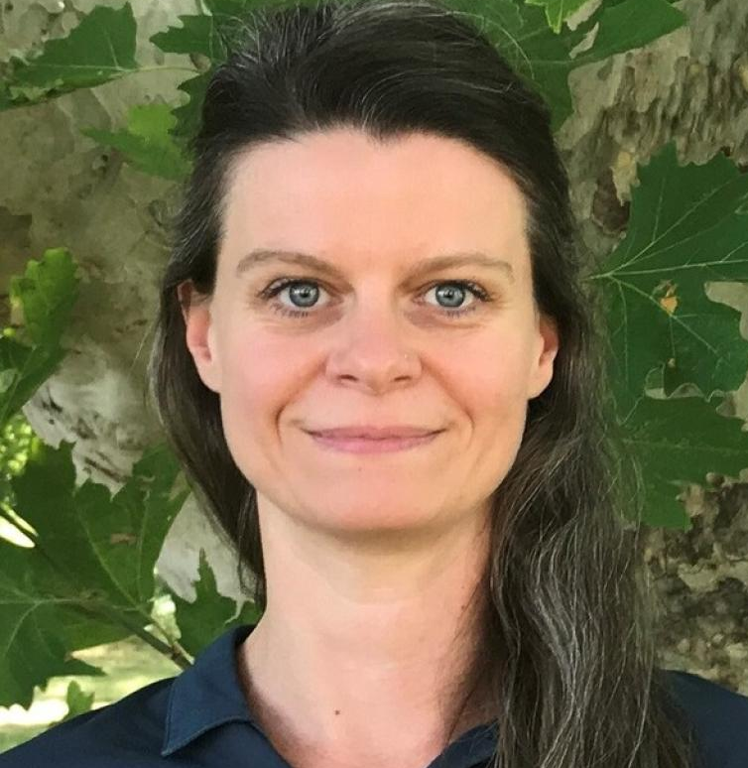
WG2 | Team Contact
Inian Moorthy (co-lead) he / him
Researcher, Citizen Science & EO
✉️ moorthy@iiasa.ac.at
Dilek Fraisl (co-lead) she/her
Researcher, Sustainability Transitions
✉️ fraisl@iiasa.ac.at
Gerid Hager (support) she/her
Researcher, Citizen Science & Systems Dynamics
✉️ hager@iiasa.ac.at
Notes:
Inian

Slide 29
Working Group 3
Urban design foresight for nature-based solutions and green and blue infrastructure scenario planning
Lead organization
Notes:
Mel

Slide 30
WG3 Context
The problem
Urban planners and decision makers are struggling to engage citizens in understanding the benefits of climate resilience planning.
How citizen-powered science can help
Valuable local insights and data can be integrated to supplement conventional planning approaches, simultaneously increasing awareness, enriching local knowledge, fostering collaboration, while building trust, and nurturing relationships during short and long-term scenario planning.
Notes:
Mel

Slide 31
WG3's contribution
Three key needs WG3 members could help address
Identifying and showcasing urban design foresight best practices and improvement areas for climate resilience planning with NBS.
Sharing methods and tools for short to long-term scenario planning using citizen science and complex data, for effective community engagement.
Safeguarding inclusivity in all aspects of planning and decision-making processes from mitigation, adaptation to change.
Notes:
Mel

Slide 32
Who should join WG3?
Key participant group(s):
⭐ Municipalities, City Council, Urban Planners, Architects, Environmental Protection Agencies, Community Engagement Officers, NbS Specialists
Others who may benefit:
Academics (Geography, Art and Design, Social Sciences, Climate science, Urban Ecology)
Community Representatives
Futures experts
Notes:
Mel

Slide 33
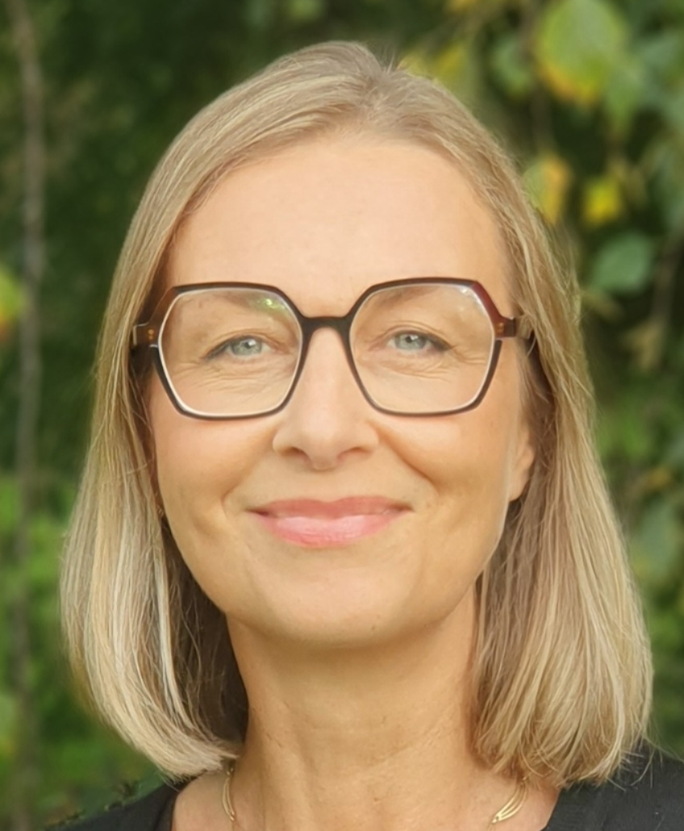
WG3 | Team Contact
Dr. Husam Al Waer
Expert, Urban Planning and Architecture
✉️ H.Alwaer@dundee.ac.uk
Kevin Frediani
Curator, Botanic Gardens
✉️ kfrediani001
Professor Mel Woods
Expert: Creative Intelligence, Design for Environment
✉️ m.j.woods@dundee.ac.uk
Notes:
Mel

Slide 34
Intrigued?
Fill in our Expression of Interest to stay in touch and learn more:
forms.office.com/e/UuxrhksPZz
Notes:
Sophie

Slide 35
Instructions for groups
EURESFO Urban ReLeaf Community of Practice Workshop
October 2023
Notes:
Sophie

Slide 36
Group discussion steps
Step 1 – Split up
Join the Working Group that most closely aligns with your interest or expertise. If you're torn, please choose the smallest open group.
Sub-group facilitators: Sophie, Karen, Marcelo, Viola
Sub-group facilitators: Inian, Gerid
Sub-group facilitators: Mel, Kevin, Husam
1
2
3
Triggering innovation in public authorities with citizen-powered science
Coupling citizen science and EO for the European Green Deal & SDG 11 monitoring
Urban design foresight for NBS and green infrastructure scenario planning
Notes:
Sophie

Slide 37
Group discussion steps
Step 2 – Break the ice
Please share with the group in one sentence:
Name
Affiliation
Notes:
Sophie
Either flipchart or tape A1 paper to the walls
A1 sheets will have answers to five questions total :
Section for drivers (from the motivations) - one color or cluster
Section for each of the four guiding questions

Slide 38
Group discussion steps
Step 3 – Solo work
Please take 10 minutes individually to write down an answer to each of the three guiding questions (to be shown on next slide).
Please write each answer on a separate post-it (or other slip of paper) and number it according to the guiding question you are answering. Hold on to your papers – these will be collected at the end of the session.
Step 4 – Discussion
Share your answers and discuss with your breakout group for the remainder of the time.
We will collect all groups' answers at the end of the session. Those of you who fill out the Expression of Interest will receive the link to the new Miro board we will create capturing our conversations (and our slides).
Notes:
Sophie

Slide 39
Group discussion steps
Guiding questions
What are key challenges on this topic and why?
What is one key individual, organization, or initiative that this topic should engage with?
What would motivate you to join a Working Group on this topic? Or not?
Notes:
Sophie
If you were leading a project with this Working Group's title, what is one value that should define your mission? E.g., accessibility, democracy, transparency
What is one central value the members of your Working Group should prioritize to guide their collaboration? E.g., co-creation, reciprocity, creativity

Slide 40
Intrigued?
Fill in our Expression of Interest to stay in touch and learn more:
forms.office.com/e/UuxrhksPZz
Notes:
Sophie

