Slide 1
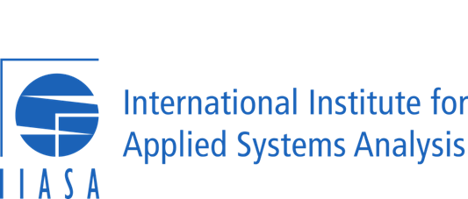
Citizen science to improve people’s wellbeing and gain acceptance by policy makers
Dr. Dilek Fraisl
International Institute for Applied Systems Analysis (IIASA)
Citizen Science Global Partnership (CSGP)
Email: fraisl@iiasa.ac.at
Twitter: dilekfraisl1
LinkedIn: dilekfraisl
Web: www.iiasa.ac.at

Slide 2
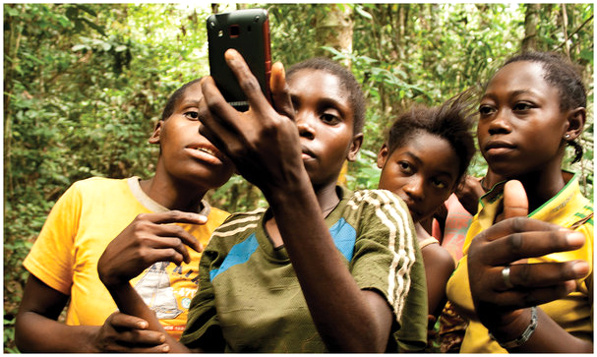
Citizen science
Gill Conquest, EXCITES, University College London
Public Participation
Knowledge production
Voluntary contributions

Slide 3
Benefits of citizen science
Addressing data gaps and needs;
Providing an opportunity to bring the public and science closer together;
Contributing to transformative actions needed to address societal challenges by raising awareness and mobilizing action, which in turn can support behavioral change;
Informing policies at the local, national and global levels, promoting more “democratic” decision-making;
Empowering hard to reach individuals and communities and support more inclusive decision making;
Helping to design effective policies and reveal gaps in the data to support unheard voices and marginalized groups, disclose misconceptions in existing data and provide a more complete overview of the real situation, especially for those who are left behind.

Slide 4
Challenges of citizen science
Data Quality;
Representativeness and inclusivity (digital divide and reaching out to the most marginalized);
Recruitment and retainment of participants;
Overburdening the public especially those whose daily lives are a struggle;
Health and safety issues;
Data privacy;
Irregular funding that could hinder empowerment.

Slide 5
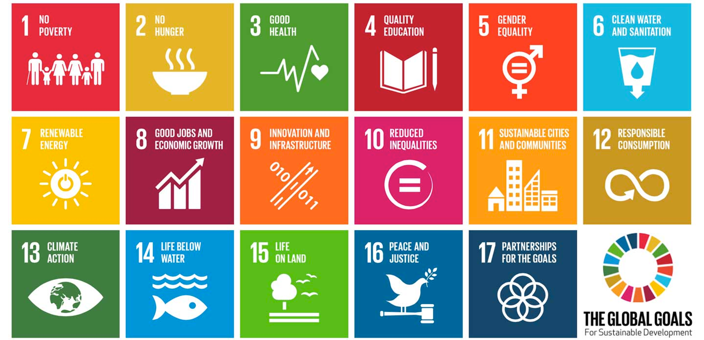
Citizen science for improving wellbeing by addressing societal challenges:
the SDGs

Slide 6
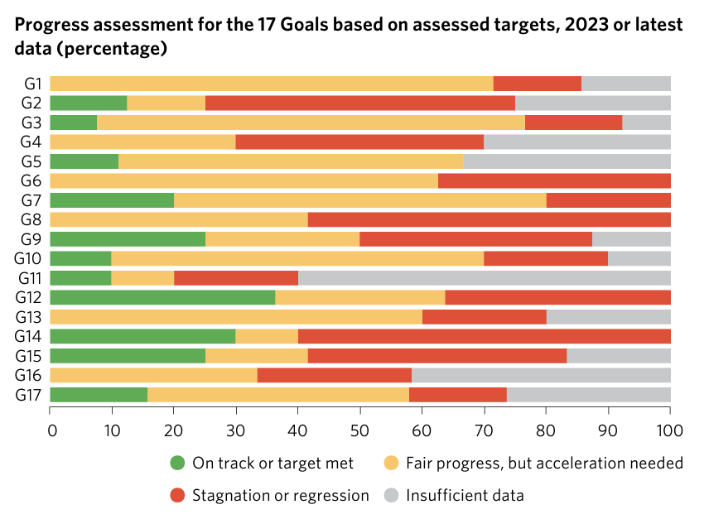
UN SDG Report, 2023
Almost half of the 92 environmental SDG indicators lack data

Slide 7
We cannot improve what we cannot measure…

Slide 8
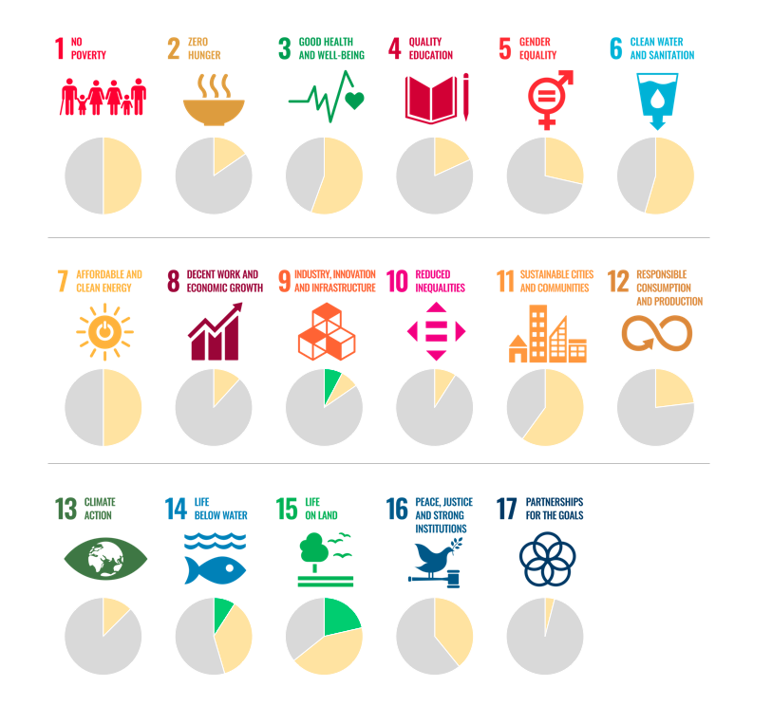
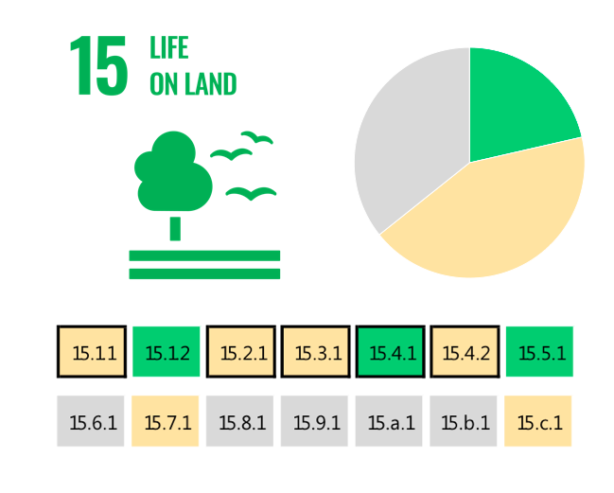
The SDG indicators where citizen science projects are “already contributing” (in green), “could contribute” (in yellow) or where there is “no alignment” (in grey). The overall citizen science contributions to each SDG are summarized as pie charts.
Fraisl, D., Campbell, J., See, L. et al. Mapping citizen science contributions to the UN sustainable development goals. Sustain Sci 15, 1735–1751 (2020). https://doi.org/10.1007/s11625-020-00833-7

Slide 9
The greatest contribution of citizen science data to SDG monitoring would be in:

Slide 10
Citizen science to improve people’s wellbeing
Fraisl D, See L, Estevez D, Tomaska N and MacFeely S (2023) Citizen science for monitoring the health and well-being related Sustainable Development Goals and the World Health Organization’s Triple Billion Targets. Front. Public Health 11:1202188. doi: 10.3389/fpubh.2023.1202188

Slide 11
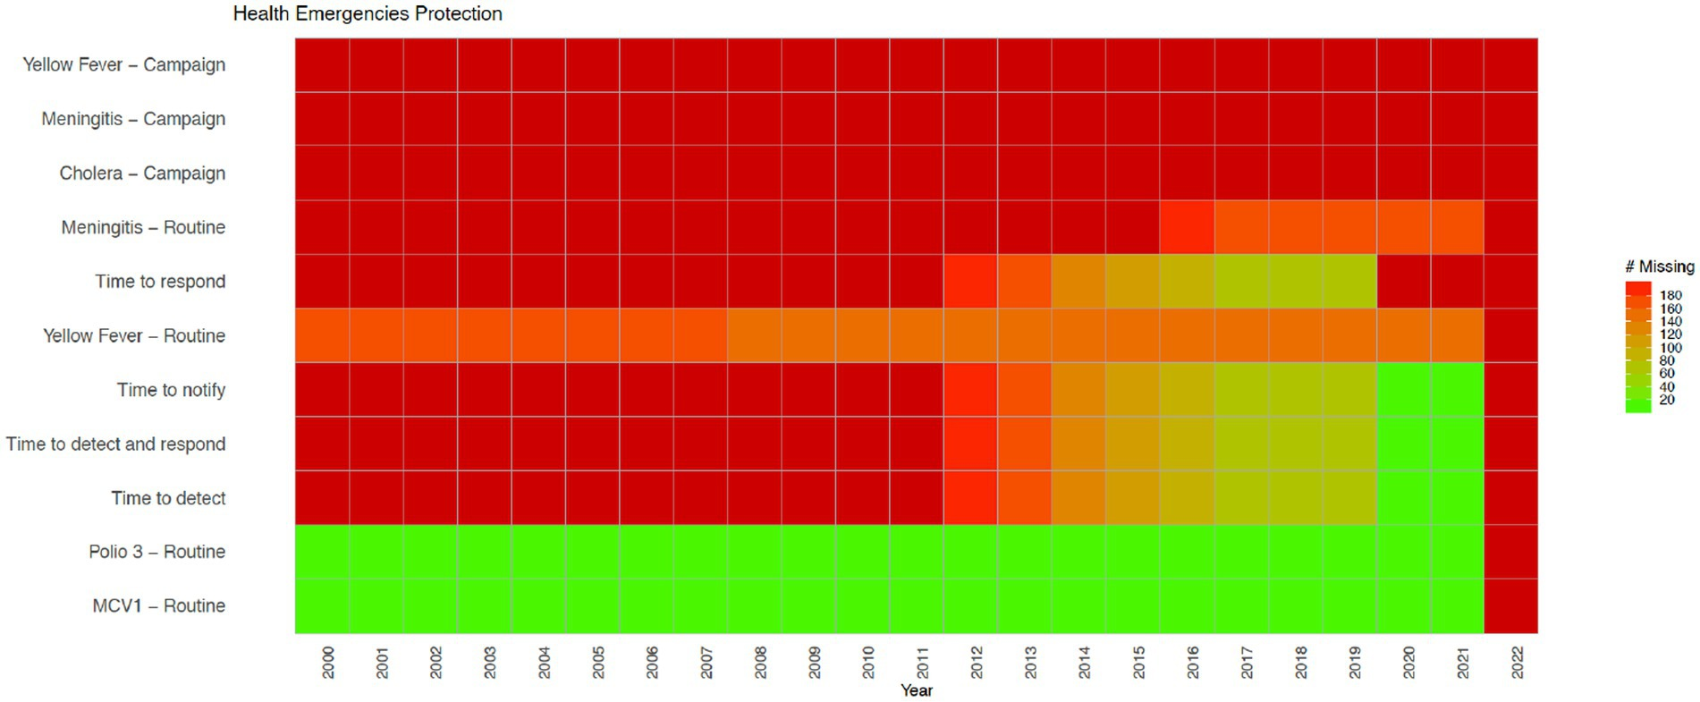
Health Emergencies indicators from the WHO’s Triple Billion Targets and the SDG framework. Dark red indicates that data are missing for all countries for the mentioned year while bright green on the opposite end of the spectrum shows that there are no missing values reported for all countries, which is 194 in total. Shades in between show partial data availability.

Slide 12
The health and well-being related SDG indicators and Triple Billion Targets covered in this study. Indicators where citizen science projects are “already contributing” are in dark blue, “could contribute” are in light blue or where there is “no alignment” are in grey. The values within each box are the indicator numbers or titles.
Fraisl D, See L, Estevez D et al (2023) Citizen science for monitoring health and wellbeing related sustainable development goals and the World Health Organization’s triple billion targets. Front Public Health 11:1202188 https://doi.org/10.3389/fpubh.2023.1202188

Slide 13
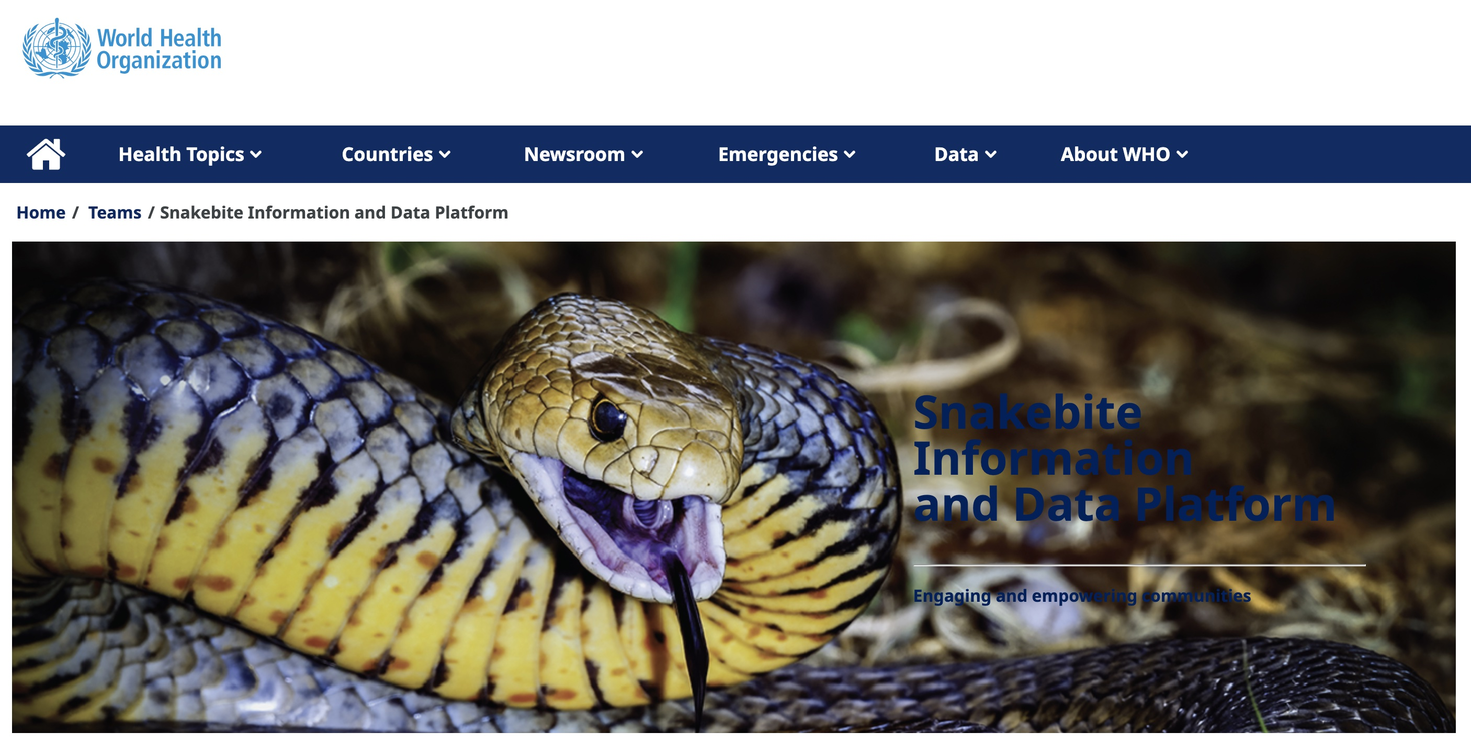
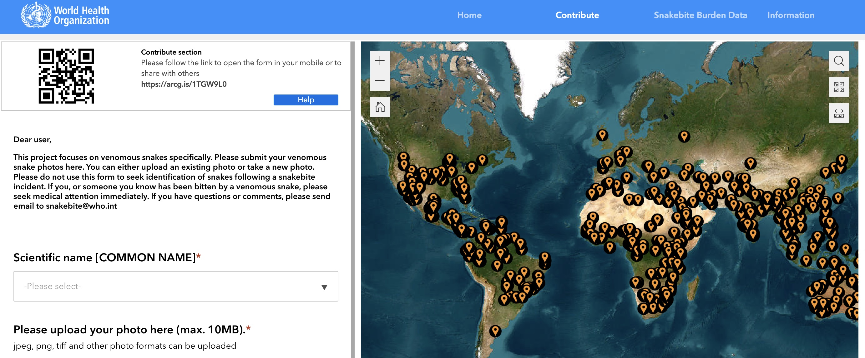
Indicator 3.3.5 Number of people requiring interventions against neglected tropical diseases
Snakebite Information and Data Platform
Source: WHO

Slide 14
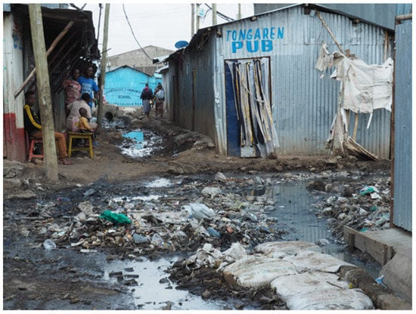
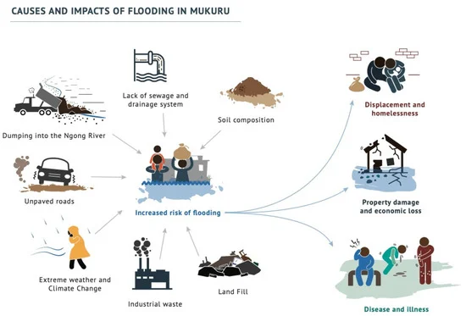
Indicator 6.2.1 Proportion of population using (a) safely managed sanitation services and (b) a hand-washing facility with soap and water
Corburn, J.; Njoroge, P.; Weru, J.; Musya, M. Urban Climate Justice, Human Health, and Citizen Science in Nairobi’s Informal Settlements. Urban Sci. 2022, 6, 36. https://doi.org/10.3390/urbansci6020036

Slide 15
Citizen science to gain acceptance by policy makers

Slide 16
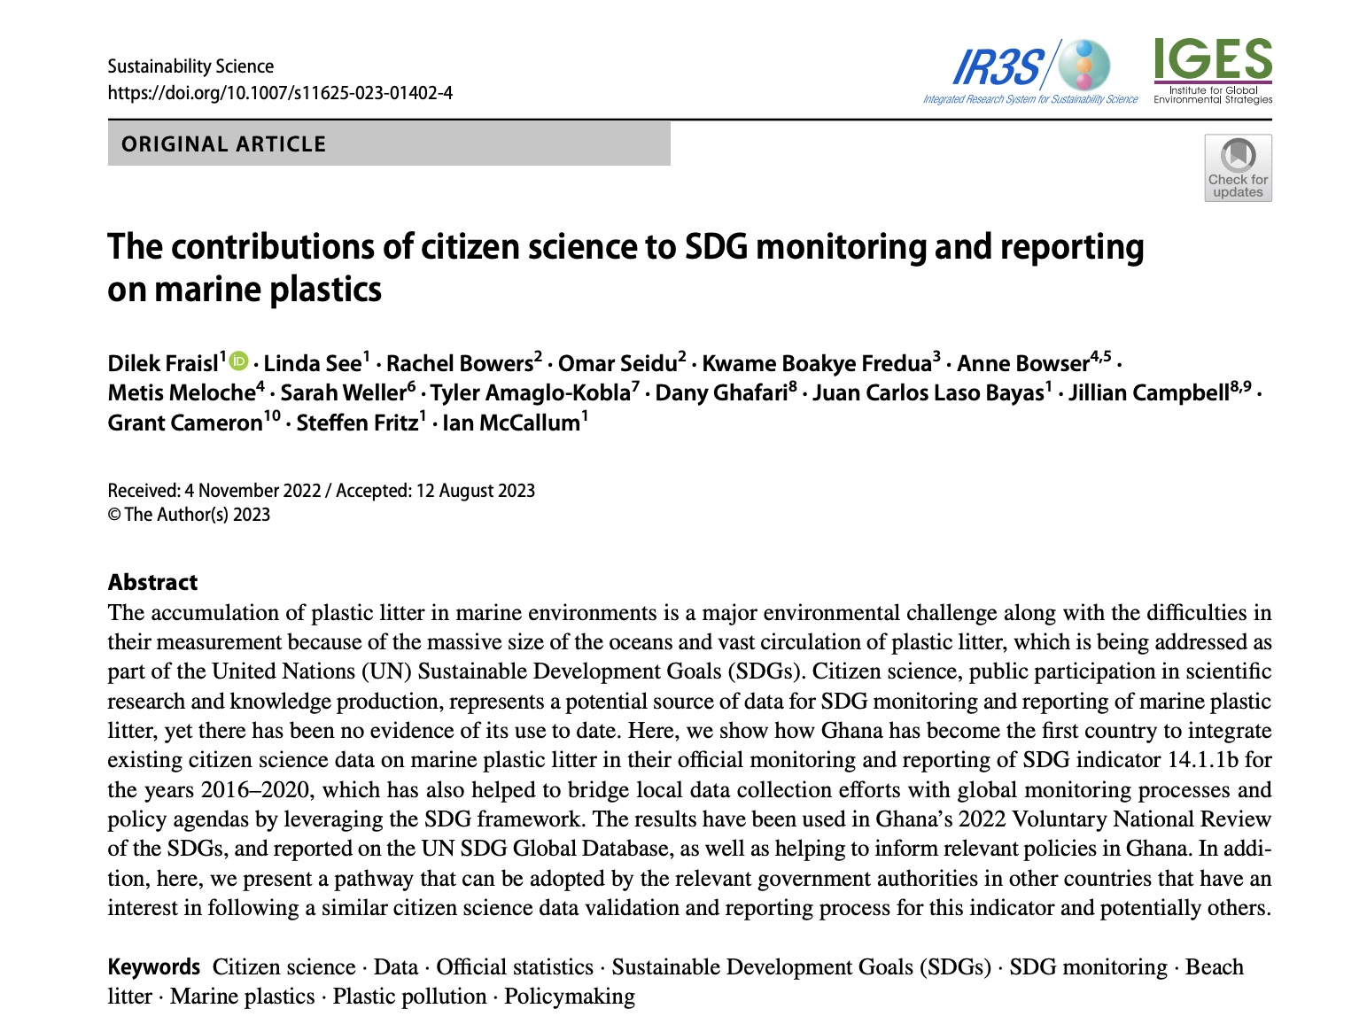
Fraisl, D., See, L., Bowers, R. et al. The contributions of citizen science to SDG monitoring and reporting on marine plastics. Sustain Sci (2023). https://doi.org/10.1007/s11625-023-01402-4

Slide 17
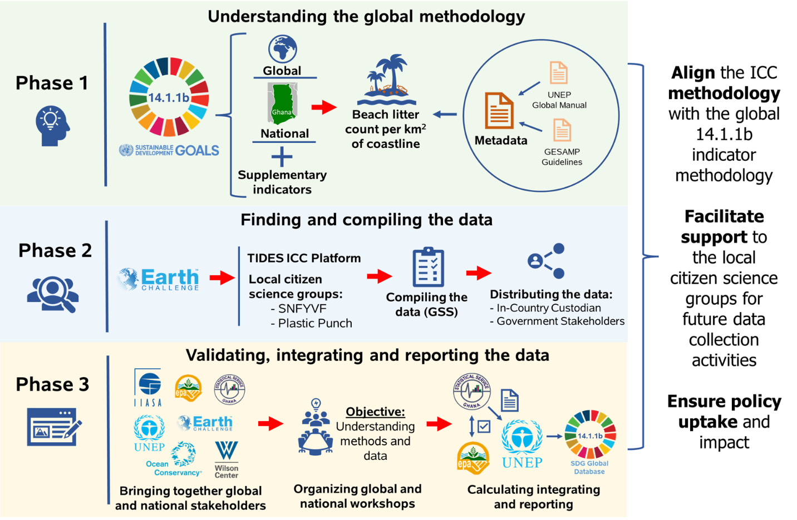
The process of integrating citizen science data on marine litter for SDG indicator 14.1.1b reporting in Ghana
Fraisl, D., See, L., Bowers, R. et al. The contributions of citizen science to SDG monitoring and reporting on marine plastics. Sustain Sci (2023). https://doi.org/10.1007/s11625-023-01402-4

Slide 18
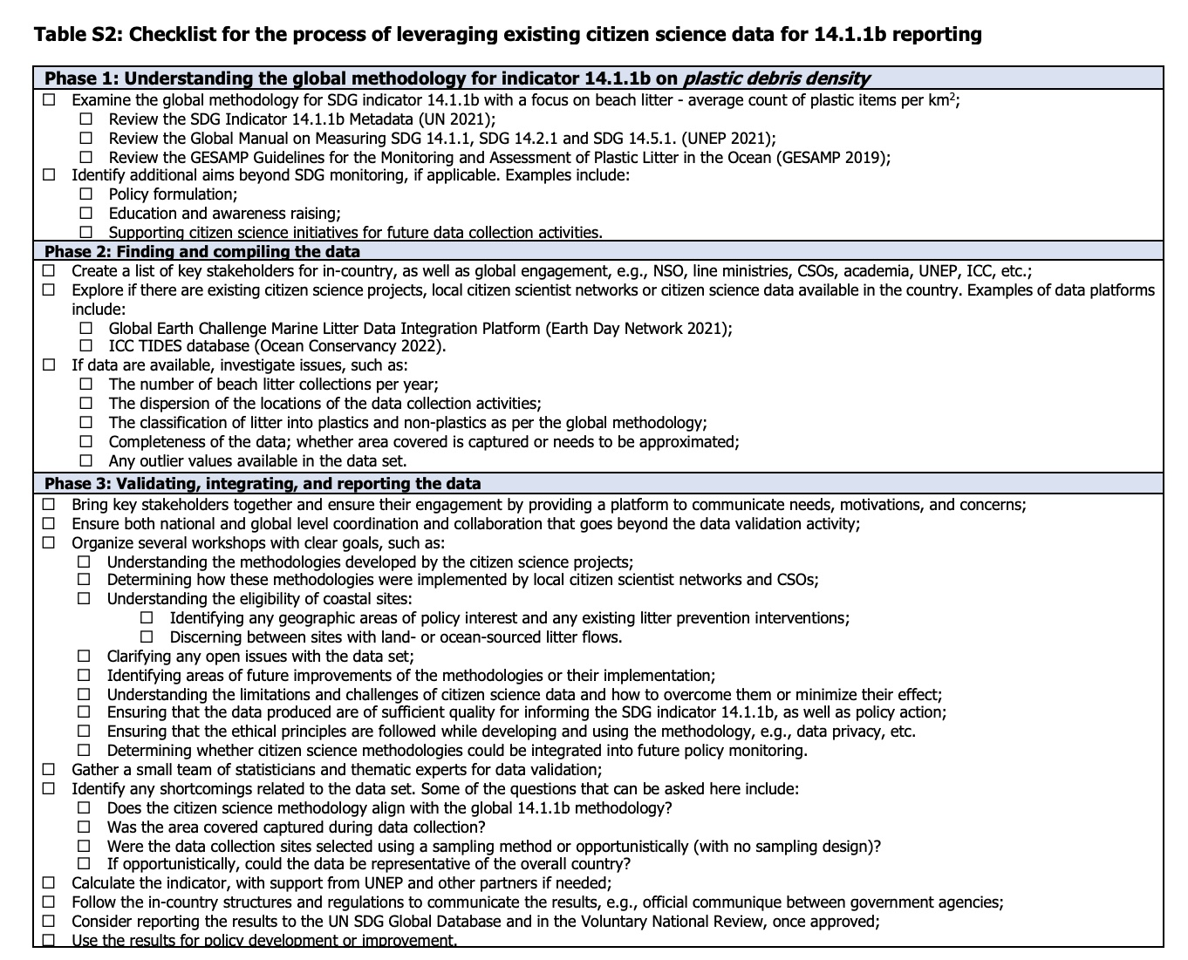

Slide 19
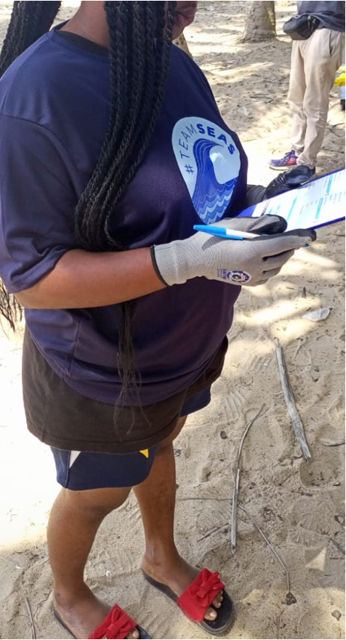
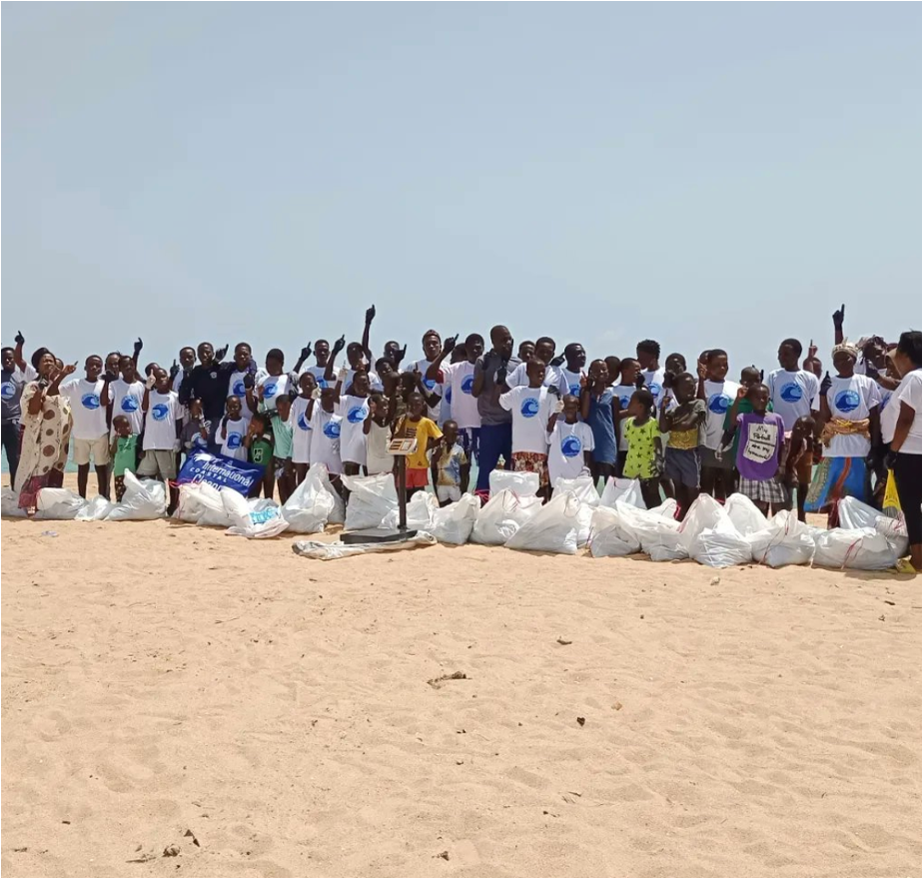
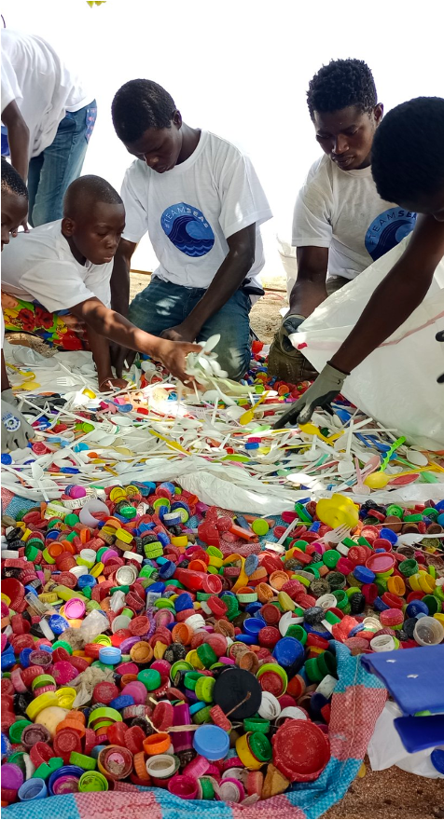
Bridging local data collection efforts with global monitoring processes by leveraging the SDG framework
Encure inclusiveness through meaningful engagement of all stakeholders
Create time and space for these stakeholders to meet and connect
Listen and understand the motivations, interests and concerns
Be transparent about citizen science results and methodologies, especially how these methodologies were implemented
Citizens and communities are no free labor to close government data gaps; they should receive a share of the benefit from participating
@Smart Nature Freaks Youth Volunteers Foundation

Slide 20
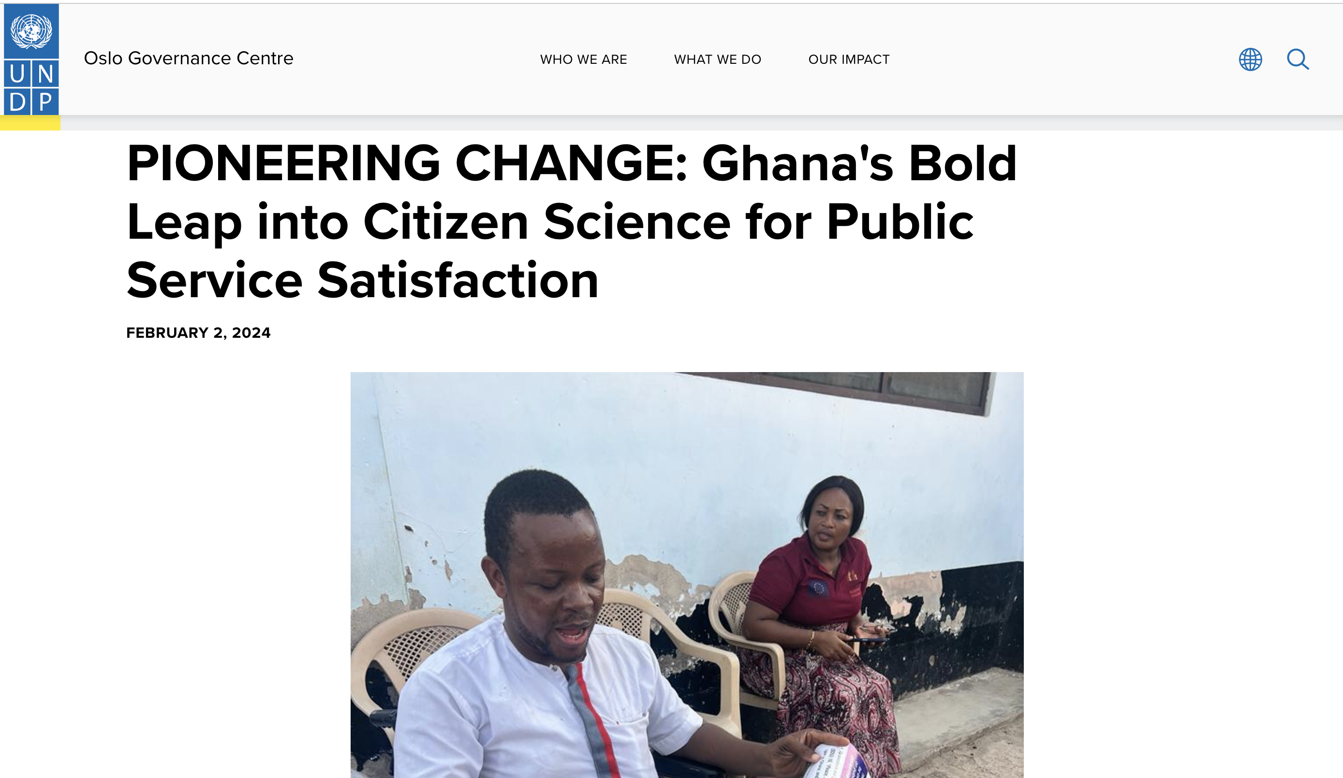
https://www.undp.org/policy-centre/oslo/news/pioneering-change-ghanas-bold-leap-citizen-science-public-service-satisfaction

Slide 21
Kenya National Bureau of Statistics (KNBS)
Technical Working Committee on Citizen-Generated Data (CGD) to strengthen stakeholder collaboration in adoption of quality CGD as an alternative source of data for official reporting where data gaps exist, especially in reporting on Sustainable Development Goals (SDGs).

Slide 22
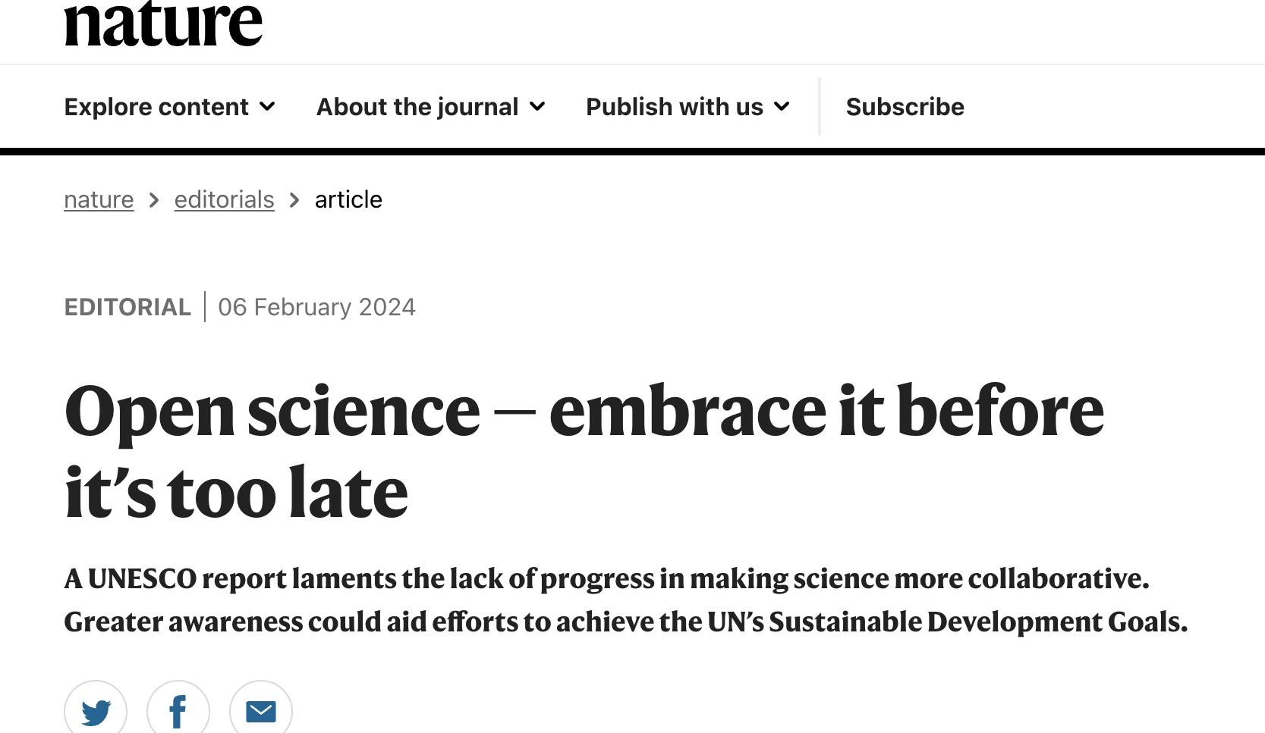
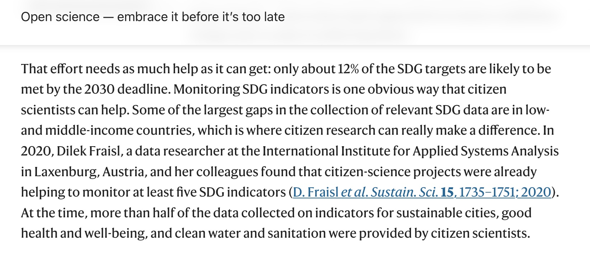
Nature 626, 233 (2024)
doi: https://doi.org/10.1038/d41586-024-00322-2

Slide 23
Submit your input to the open consultation of the Framework
(https://unstats.un.org/UNSDWebsite/citizen-data/news)
The Copenhagen Framework on Citizen Data
Links to submit your input: https://forms.office.com/e/HtuKLNAG0q
https://unstats.un.org/UNSDWebsite/statcom/session_55/documents/BG-4c-CGD_Framework-E.pdf
Work with us to test/pilot the Framework: citizen.data@un.org
Join the upcoming information/consultation sessions:
In-person (link)
Follow our Newsletters, if interested email citizen.data@un.org

Slide 24
What is needed to achieve impact at scale with citizen science
An urgent dialogue and action among citizen science practitioners and researchers, the official statistics community, citizens, and other actors to build partnerships and to work together to advance citizen science for sustainable development;
Citizen Science Global Partnership, a network of networks that aims to advance citizen science to achieve sustainability at scale, to bridge the gap between these communities and actors;
The official statistics community to reflect on the inclusiveness and relevance of their practices to individuals, communities, and to society, to keep an open mind for a more constructive discussion and not to get lost in an unproductive debate about citizen science data quality with a biased perception;
We invite funders to rethink their strategies, to go beyond short-term pilot studies, and to provide genuine financial support to citizen science initiatives working towards monitoring and achieving sustainable development.
Fraisl, D., See, L., Campbell, J., Danielsen, F. and Andrianandrasana, H.T., 2023. The Contributions of Citizen Science to the United Nations Sustainable Development Goals and Other International Agreements and Frameworks. Citizen Science: Theory and Practice, 8(1), p.27.DOI: https://doi.org/10.5334/cstp.643

Slide 26
THANK YOU!
Dr. Dilek Fraisl
International Institute for Applied Systems Analysis (IIASA)
Citizen Science Global Partnership (CSGP)
Email: fraisl@iiasa.ac.at
Twitter: dilekfraisl1
LinkedIn: dilekfraisl
Web: www.iiasa.ac.at

