Slide 1
Citizen science for policy: is the citizen science community ready for change?
Dr. Dilek Fraisl, Dr. Steve MacFeely, Dr. Linda See
ECSA 2024

Slide 2
Agenda
Welcome and Introduction
Potential of citizen science for contributing to official monitoring and statistics and policy development
Citizen science for monitoring the health and well-being related Sustainable Development Goals and the WHO’s Triple Billion Targets
Are the UN and the citizen science community ready to embrace the change?
World Cafe & Discussion
Next Steps and Closing

Slide 3
Aims and Expected Outcomes
Present the IIASA and WHO joint work on the contributions of citizen science to the monitoring of health and well-being related SDGs and WHO’s Triple Billion Targets
Introduce the UN Statistics Division Collaborative on Citizen Data and how the participants can contribute to it
Initiate a discussion around the preparedness of the citizen science community to embrace the change that is happening at the policy level?
Outcome: A better-informed citizen science community regarding the next concrete steps to realise the potential of citizen science for official monitoring and policy development.

Slide 4
Speakers
Dr Dilek Fraisl, Research Scholar, IIASA - Managing Director, CSGP
Dr Linda See, Principal Research Scholar, IIASA
Dr Steve MacFeely, Director of Data and Analytics, WHO

Slide 5
Potential of citizen science for contributing to official monitoring and statistics and policy development
Dr. Dilek Fraisl
Email: fraisl@iiasa.ac.at
Twitter/X: dilekfraisl1
LinkedIn: dilekfraisl
Web: www.iiasa.ac.at

Slide 6
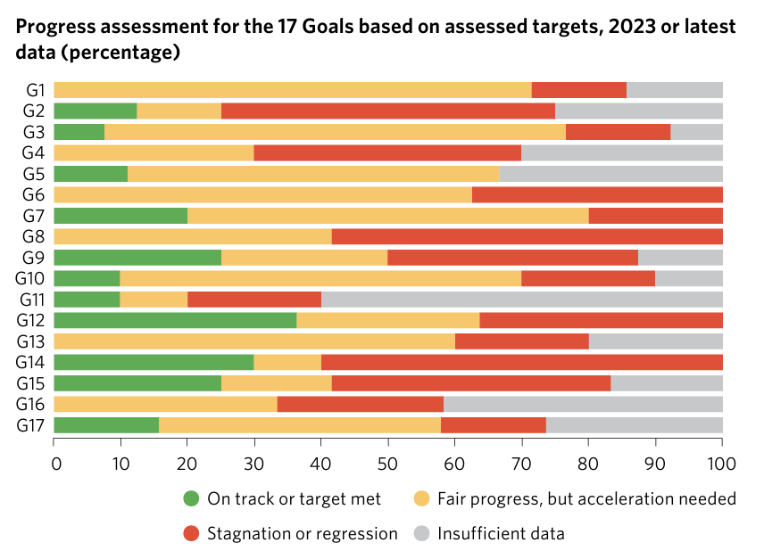
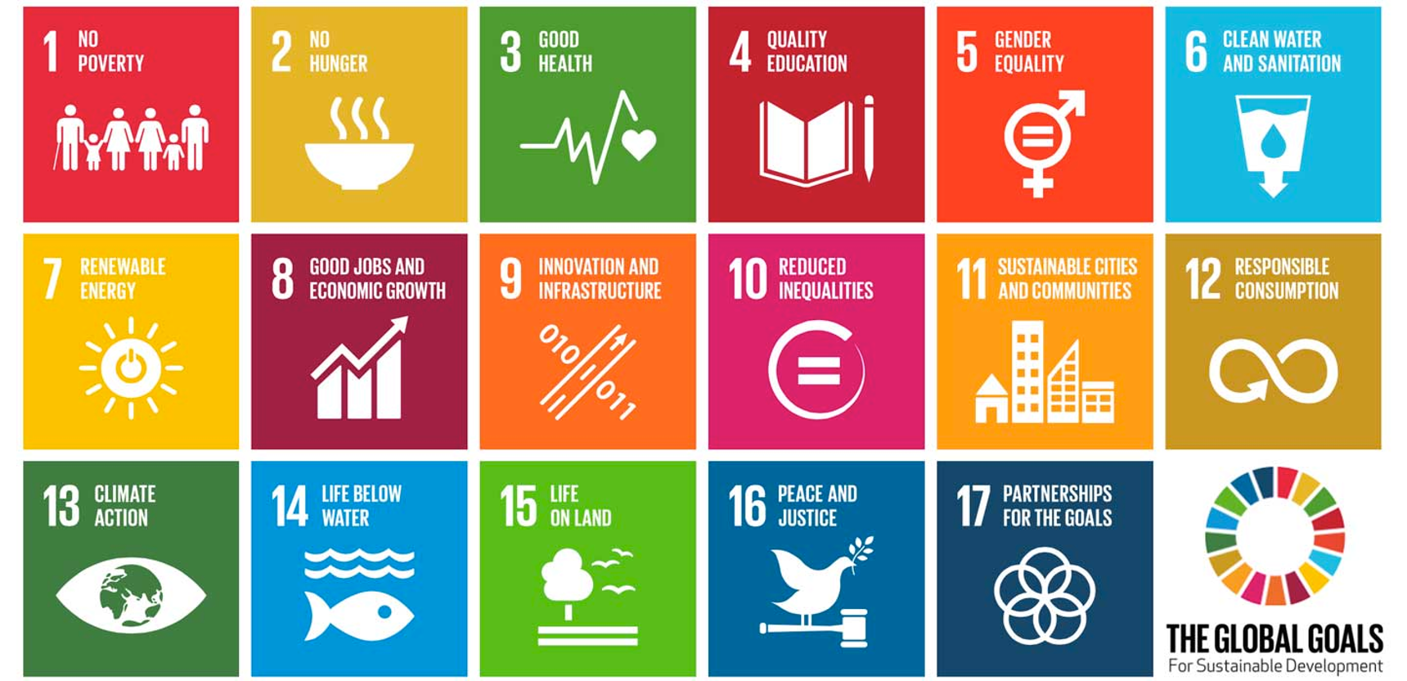
UN SDG Report, 2023

Slide 7
We cannot improve what we cannot measure…

Slide 8
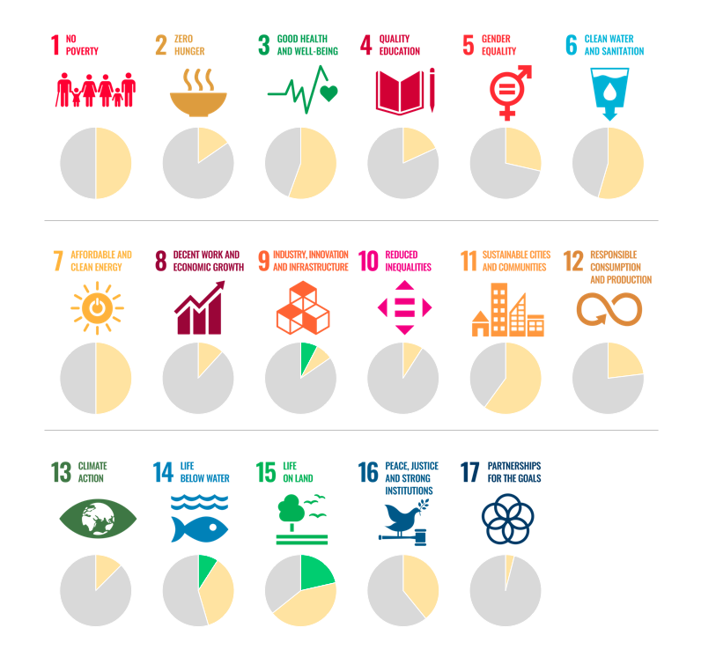
The SDG indicators where citizen science projects are ‘already contributing’, ‘could contribute’ or where there is ‘no alignment'
Fraisl, D., Campbell, J., See, L. et al. Mapping citizen science contributions to the UN sustainable development goals. Sustain Sci 15, 1735–1751 (2020). https://doi.org/10.1007/s11625-020-00833-7

Slide 9
The greatest contribution of citizen science data to SDG monitoring would be in:
WHY SPECIFIC FOCUS ON HEALTH??
SDG 3 has a great potential to be supported by citizen science data…
WHO is the agency that could be supported through citizen science data the most…

Slide 10
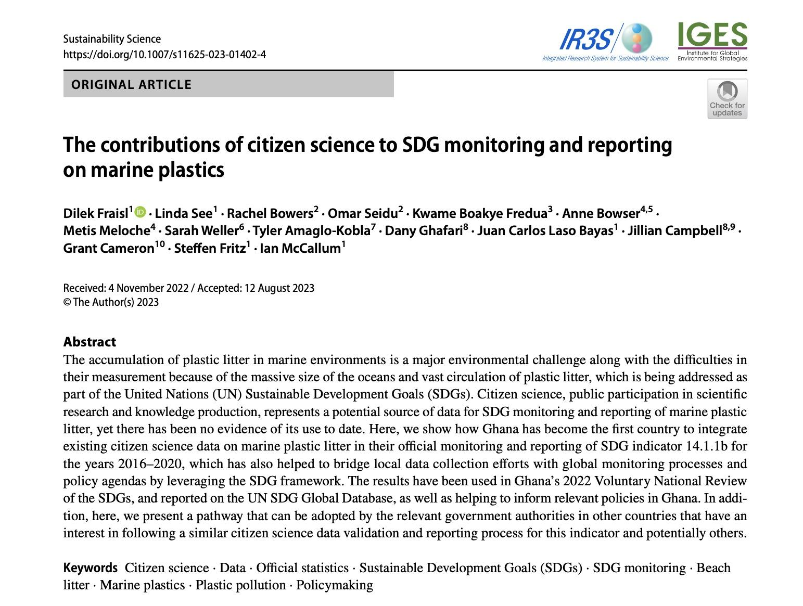
What’s next? How to integrate citizen science data into SDG monitoring and reporting processes?
Fraisl, D., See, L., Bowers, R. et al. The contributions of citizen science to SDG monitoring and reporting on marine plastics. Sustain Sci (2023). https://doi.org/10.1007/s11625-023-01402-4

Slide 11
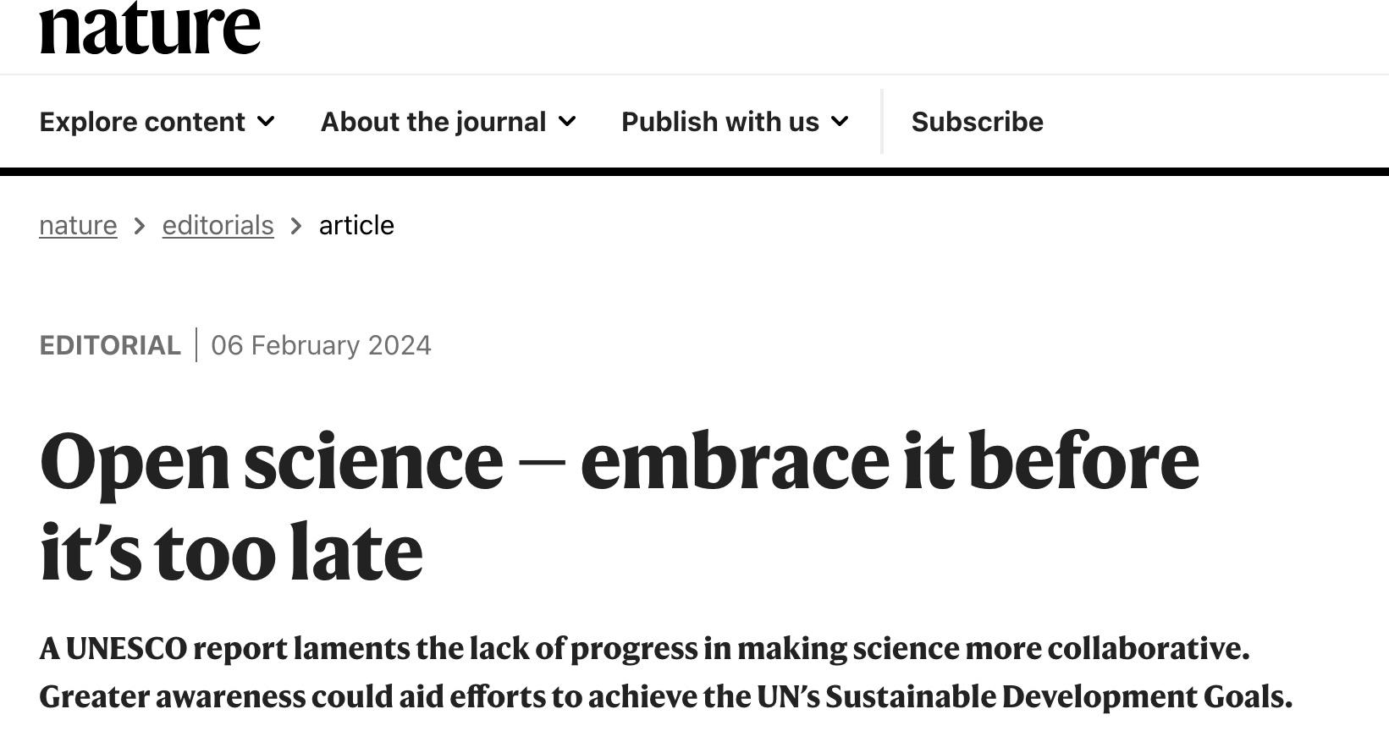
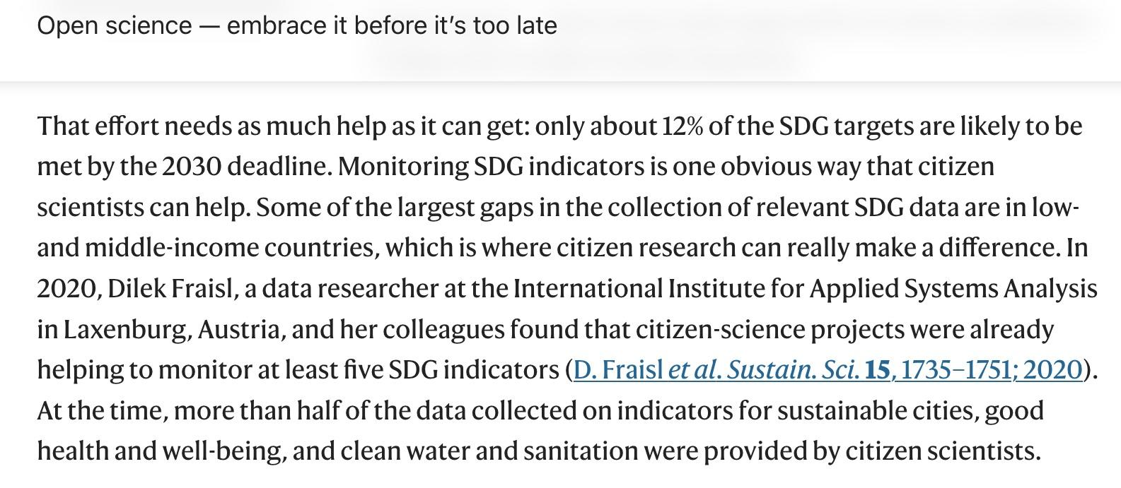
Change is happening…
The citizen science efforts are gaining recognition and attracting attention…

Slide 12
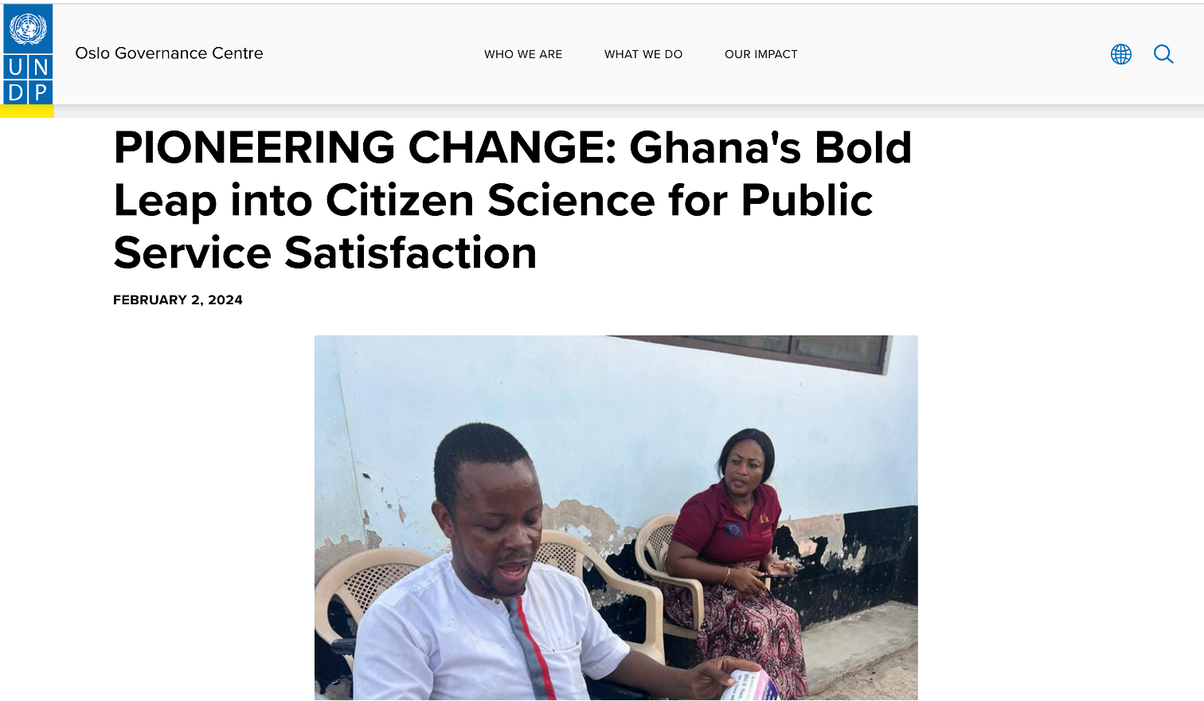

Slide 13
•Submit your input to the open consultation of the Framework
(https://unstats.un.org/UNSDWebsite/citizen-data/news)
•The Copenhagen Framework on Citizen Data
•Links to submit your input: https://forms.office.com/e/HtuKLNAG0q
https://unstats.un.org/UNSDWebsite/statcom/session_55/documents/BG-4c-CGD_Framework-E.pdf
•Work with us to test/pilot the Framework: citizen.data@un.org
•Join the upcoming information/consultation sessions:
•In-person (link)
•Follow our Newsletters, if interested email citizen.data@un.org

Slide 14
Kenya National Bureau of Statistics (KNBS)
Technical Working Committee on Citizen-Generated Data (CGD) to strengthen stakeholder collaboration in adoption of quality CGD as an alternative source of data for official reporting where data gaps exist, especially in reporting on Sustainable Development Goals (SDGs).

Slide 15
THANK YOU!!
Dilek Fraisl
International Institute for Applied Systems Analysis (IIASA)
Citizen Science Global Partnership (CSGP)
Email: fraisl@iiasa.ac.at
Twitter/X: dilekfraisl1
LinkedIn: dilekfraisl
Web: www.iiasa.ac.at

Slide 16
Citizen science for monitoring the health and well-being related Sustainable Development Goals and the World Health Organization’s Triple Billion Targets
Dilek Fraisl, Linda See, Diana Estevez, Nola Tomaska, Steve MacFeely
Dr. Linda See
Email: see@iiasa.ac.at
Twitter/X: @LindaMSee
Web: https://www.iiasa.ac.at

Slide 17
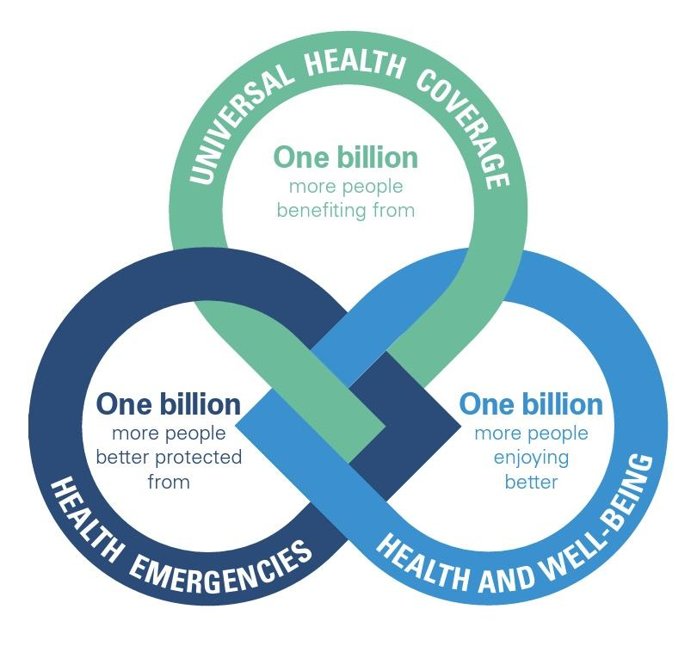
Triple Billion Targets
Source: WHO. Thirteenth general Programme of work (GPW13): Methods for impact measurement. Geneva: World Health Organization (2020).

Slide 18
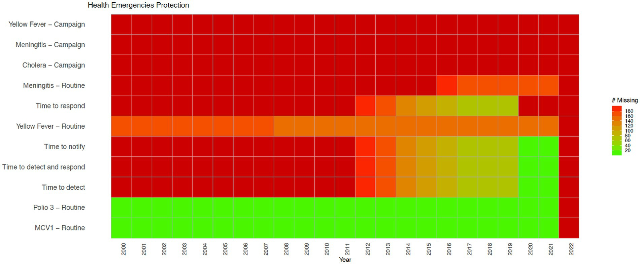
Health Emergencies indicators from the WHO’s Triple Billion Targets and the SDG framework. Dark red indicates that data are missing for all countries for the mentioned year while bright green on the opposite end of the spectrum shows that there are no missing values reported for all countries, which is 194 in total. Shades in between show partial data availability.
Fraisl D, See L, Estevez D, Tomaska N and MacFeely S (2023) Citizen science for monitoring the health and well-being related Sustainable Development Goals and the World Health Organization’s Triple Billion Targets. Front. Public Health 11:1202188. doi: 10.3389/fpubh.2023.1202188

Slide 19
Methodology
Fraisl D, See L, Estevez D, Tomaska N and MacFeely S (2023) Citizen science for monitoring the health and well-being related Sustainable Development Goals and the World Health Organization’s Triple Billion Targets. Front. Public Health 11:1202188. doi: 10.3389/fpubh.2023.1202188

Slide 20
The health and well-being related SDG indicators and Triple Billion Targets covered in this study. Indicators where citizen science projects are “already contributing” are in dark blue, “could contribute” are in light blue or where there is “no alignment” are in grey. The values within each box are the indicator numbers or titles.

Slide 21
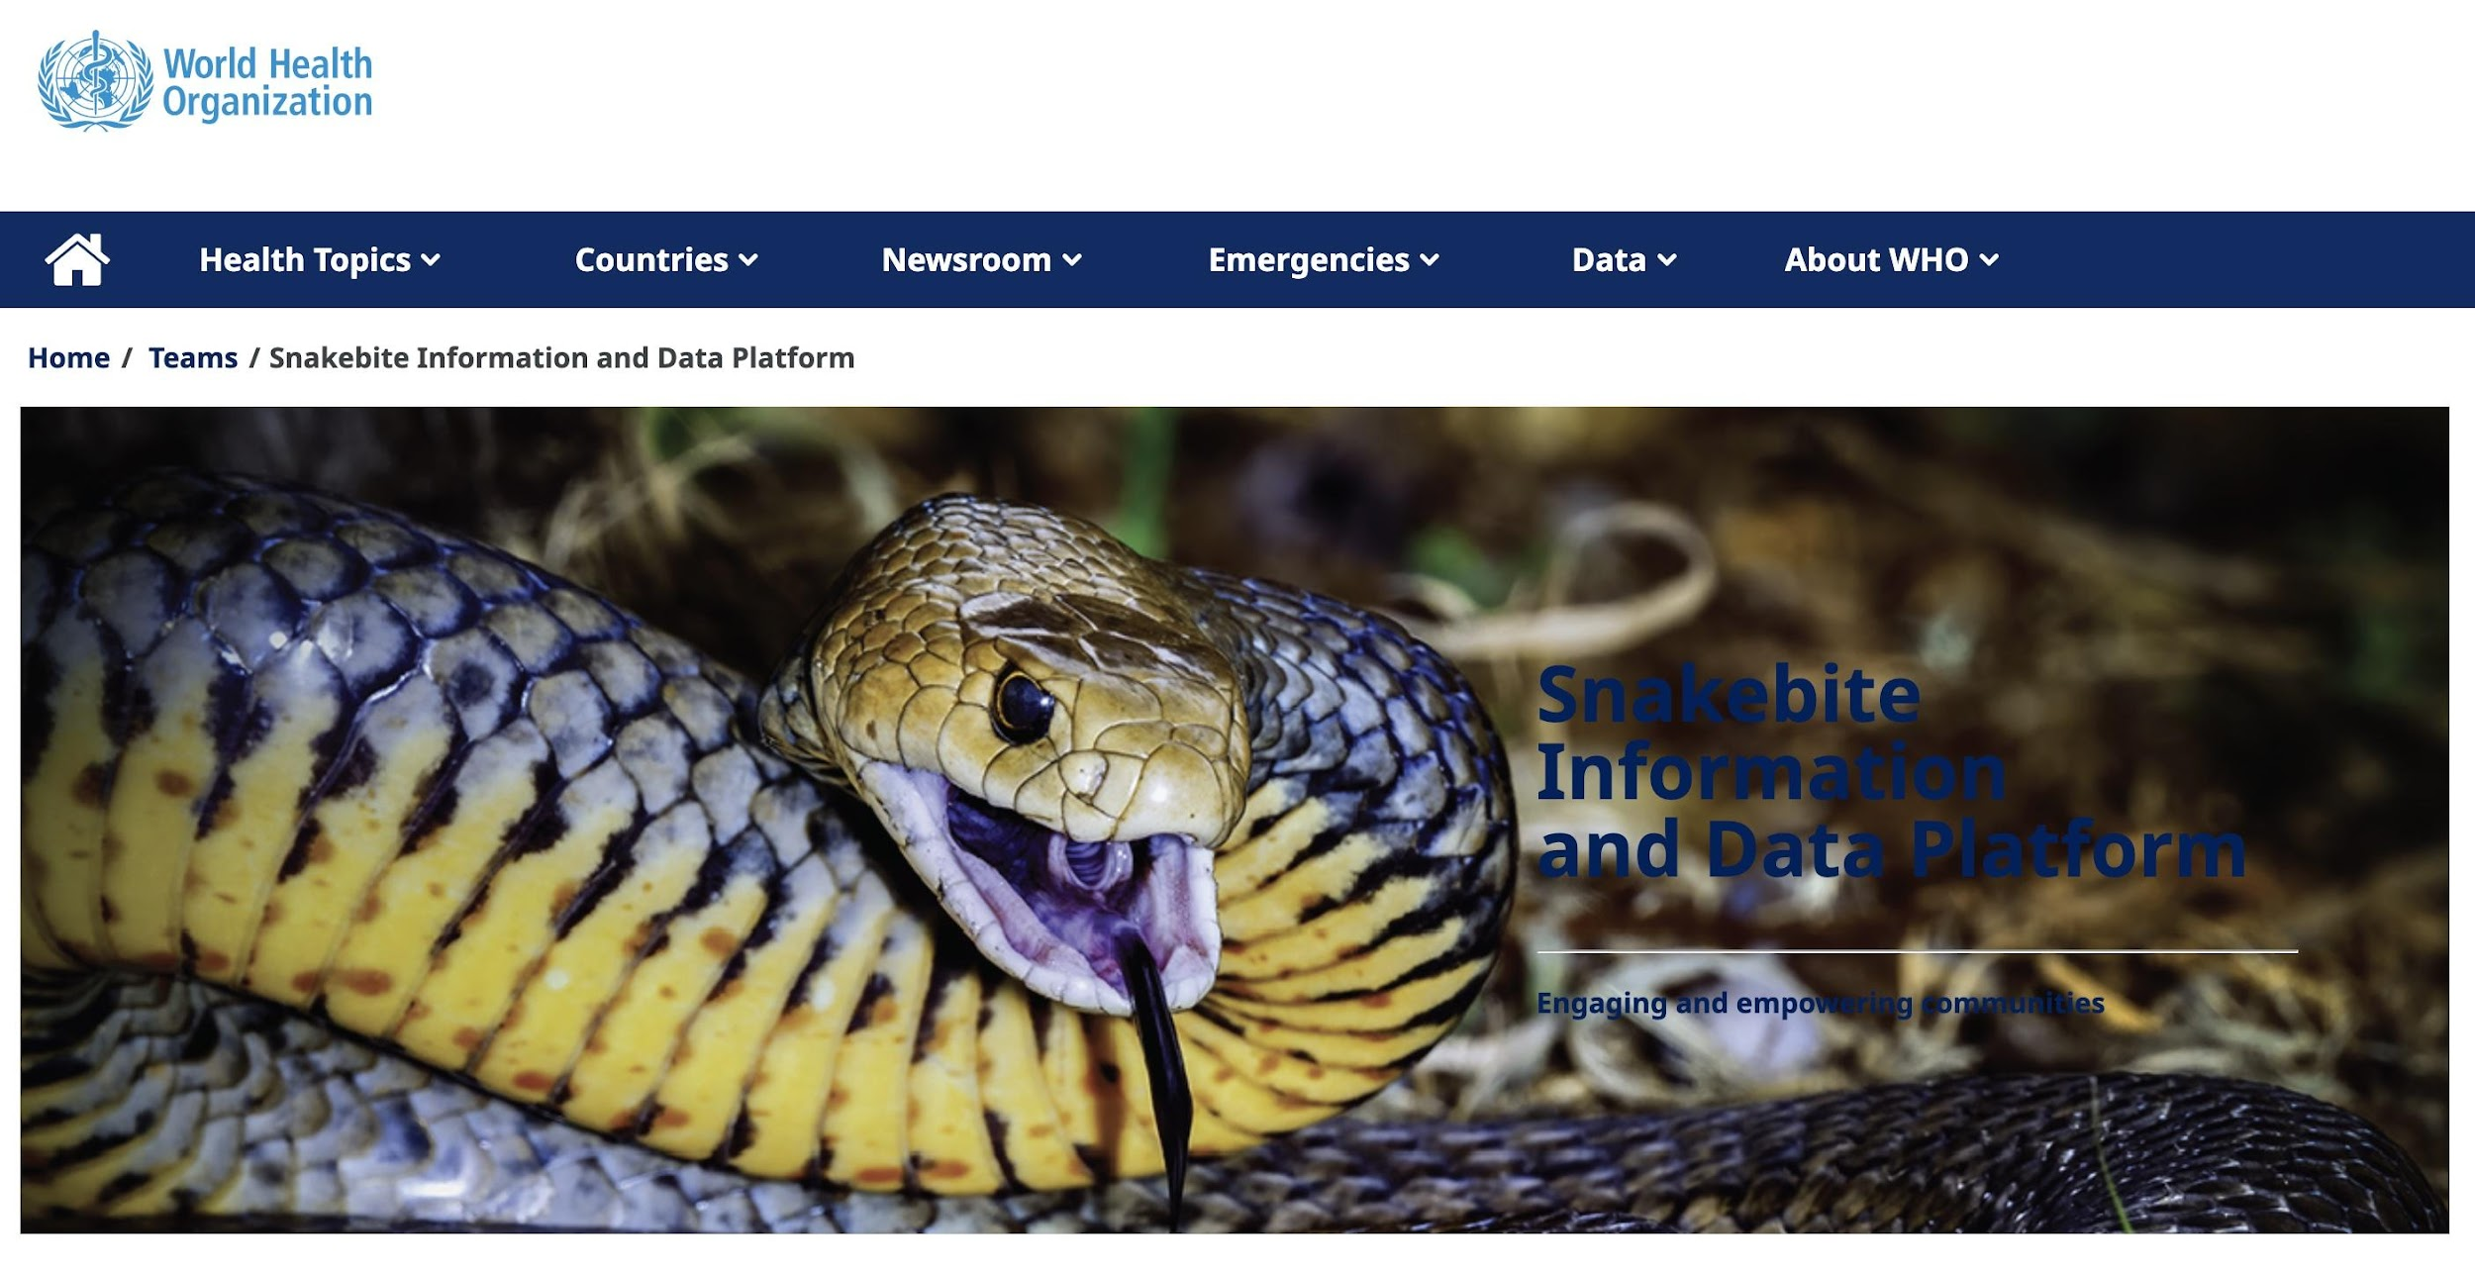
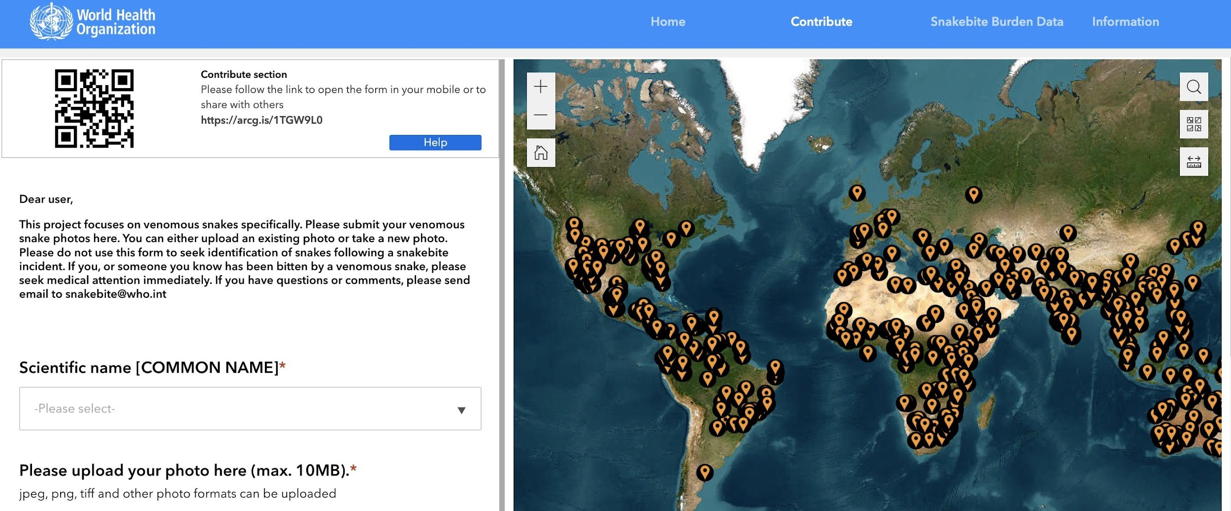
Indicator 3.3.5 Number of people requiring interventions against neglected tropical diseases
Snakebite Information and Data Platform
Source: WHO

Slide 22
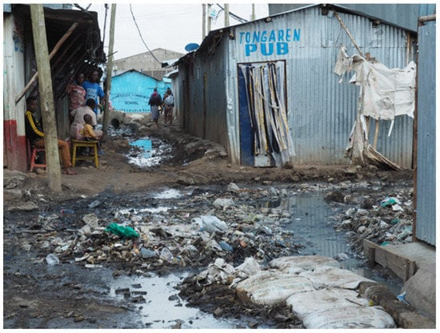
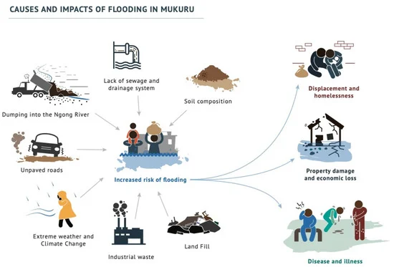
Indicator 6.2.1 Proportion of population using (a) safely managed sanitation services and (b) a hand-washing facility with soap and water
Corburn, J.; Njoroge, P.; Weru, J.; Musya, M. Urban Climate Justice, Human Health, and Citizen Science in Nairobi’s Informal Settlements. Urban Sci. 2022, 6, 36. https://doi.org/10.3390/urbansci6020036

Slide 23
Supplementary Material

Slide 24
THANK YOU!
Dr. Linda See
Novel Data Ecosystems for Sustainability Research Group (NODES)
International Institute for Applied Systems Analysis (IIASA)
Email: see@iiasa.ac.at
Twitter/X: @LindaMSee
Web: https://www.iiasa.ac.at

Slide 26
Interactive exercise
There are questions to spark discussion in different parts of the room;
Two or three rounds of conversation on these questions in small groups of participants moving around the room;
At the end of each round, each member of the group moves to a different group;
Leave one person as the “table host” for the next round, who welcomes the next group and briefly fills them in on what happened in the previous round.

Slide 27
Interactive exercise
Is the citizen science community prepared for this change? What do we need to do to be better prepared?
What are the main barriers to change and how can we overcome them?
How can we make linkages between the citizen science and policy communities and who should drive this forward?
How could technology and Artificial Intelligence facilitate this change?
What are the ethical implications?

Slide 28
Take part in the CSGP activities: info@globalcitizenscience.org
Submit your input to the open consultation of the Citizen Data Collaborative Copenhagen Framework:
https://unstats.un.org/UNSDWebsite/citizen-data/news
https://forms.office.com/e/HtuKLNAG0q
https://unstats.un.org/UNSDWebsite/statcom/session_55/documents/BG-4c-CGD_Framework-E.pdf
Join our other sessions today:
13:00-14:30 CROPS: Creating transnational communities to support the upscaling of citizen science - Room: ILWA-SR 25
15:00 - 16:30 Achieving change through global citizen science - Room: ILWA-SR 27

