Slide 1
CROPS
Curating, Replicating, Orchestrating and Propagating Citizen Science across Europe
January 2024 – December 2026

Slide 2
Agenda
Introduction
Welcome and introduction
CROPS project
EU Missions
Interactive exercise on the scalability of citizen science
CROPS Transnational Communities
Interactive exercise for co-creating the objectives of the CROPS Transnational Communities
Key messages, next steps and closing
CROPS – Curating, Replicating, Orchestrating and Propagating Citizen Science across Europe

Slide 3
Session aims and outcomes
Introduction
Introduce the CROPS project, CROPS Transnational Communities and other CROPS activities
Co-design the CROPS Transnational Communities to support the upscaling of citizen science with the citizen science community
Discuss how citizen science can contribute towards the EU Missions
Outcome: A better-informed citizen science community about the issues surrounding the upscaling of citizen science actions, and a better-informed community support structure, taking a user-centred approach towards its design and implementation.
CROPS – Curating, Replicating, Orchestrating and Propagating Citizen Science across Europe

Slide 4
What’s in it for you?
Introduction
Become a founding member of the CROPS Transnational Communities for each EU Mission;
Become a member of the CROPS Special Interest Group (SIG) and get a chance to influence the European Commission’s work on upscaling citizen science;
Access CROPS resources and guidance for upscaling citizen science projects;
Contribute to and be credited in the CROPS outputs, e.g., scientific papers, policy papers, MOOC, etc.;
Get a chance to be featured in the CROPS outputs, e.g., the MOOC, training resources, interviews, citizen science champions work, live events such as webinars;
Extend your networks and learn from others’ experiences on upscaling citizen science.
CROPS – Curating, Replicating, Orchestrating and Propagating Citizen Science across Europe

Slide 5
Speakers
Who we are
Dilek Fraisl, Research Scholar, IIASA - Managing Director, CSGP
James Sprinks, Senior Citizen Science Researcher, and Scientific Principle Investigator of CROPS, Earthwatch
Catarina Azevedo, Senior Consultant, INOVA+
Giovanni Maccani, Research Director, Ideas for Change
Steve MacFeely, Director of Data and Analytics, WHO
CROPS – Curating, Replicating, Orchestrating and Propagating Citizen Science across Europe

Slide 6
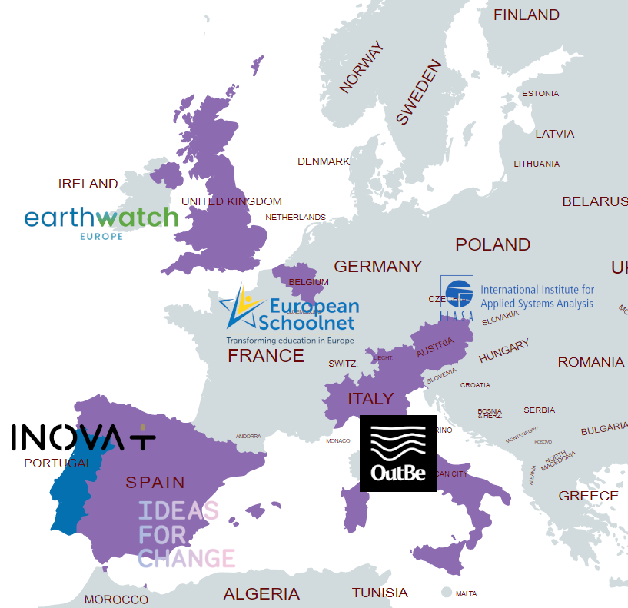
Who are you?
Exersise
Citizen scientist
Project coordinator
Researcher
Policy maker
Community member (in industry,
business, local authority)
CROPS – Curating, Replicating, Orchestrating and Propagating Citizen Science across Europe

Slide 7
HORIZON-WIDERA-2023-ERA-01-08 - Laying the groundwork towards Europe-wide citizen science campaigns
CROPS and ScienceUs
Many citizen science initiatives could achieve much higher impact if they were implemented on a transnational basis, collecting, analysing and exploiting vast amounts of cross-country data and, thereby, building a multinational community of citizen scientists. However, small-scale national citizen science projects often face practical, technical, or conceptual challenges and lack the support, the transnational coordination skills, and the resources, to upscale their efforts to a transnational level.

Slide 8
CURATE the current citizen science landscape, through screening and identifying suitable citizen science projects for upscaling to a Europe-wide level
1.
The CROPS project will conduct a thorough review of current citizen science activities, selecting the most suitable to undergo a scalability potential assessment, evaluating their potential at an upscaled level.

Slide 9
REPLICATE and use as a foundation the best practice of potentially scalable projects, to support citizen science activities to fully realise their impact potential at an upscaled level
2.
Existing methodologies regarding user-centred design, communication, stakeholder engagement, training, education, RRI, inclusivity and trust will be included. Support will be given in terms of understanding the impact of upscaling citizen science activities when considering these issues, and the potential contribution towards the EU mission goals.

Slide 10
ORCHESTRATE the upscaling process, through maximising the uptake of outputs and the sustainability of citizen science activities when moving to wider scales
3.
Existing methodologies, mechanisms, models and standards regarding open data repositories and funding streams will be evaluated in terms of their applicability to citizen science at different scales. Through this process, modalities and protocols will be developed to help ensure citizen science practices fully exploit their data and outputs to as wide an audience as possible

Slide 11
PROPAGATE the potential of upscaled citizen science, and the CROPS support, through the creation of transnational communities, societal coalitions and the identification of citizen science ‘champions’
4.
Through the creation of transnational citizen science communities, built on existing networks (for instance European Citizen Science), and targeted towards the Horizon Europe EU missions, CROPS will propagate the potential of citizen science at the ERA scale.

Slide 12
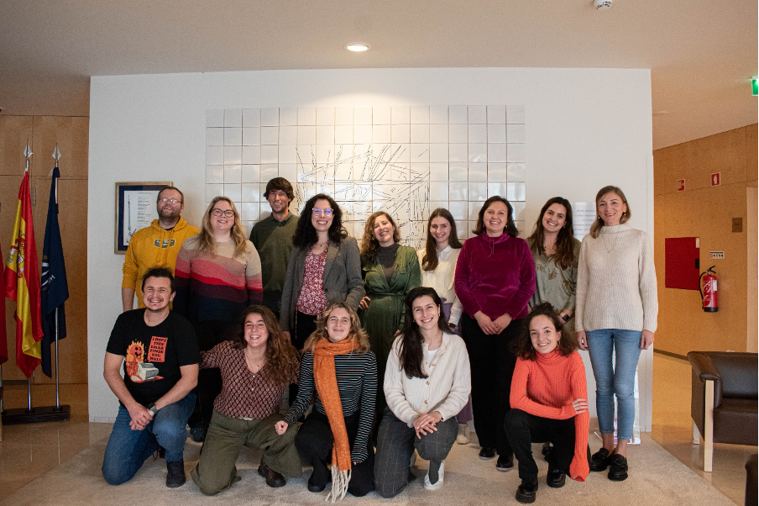

Slide 13
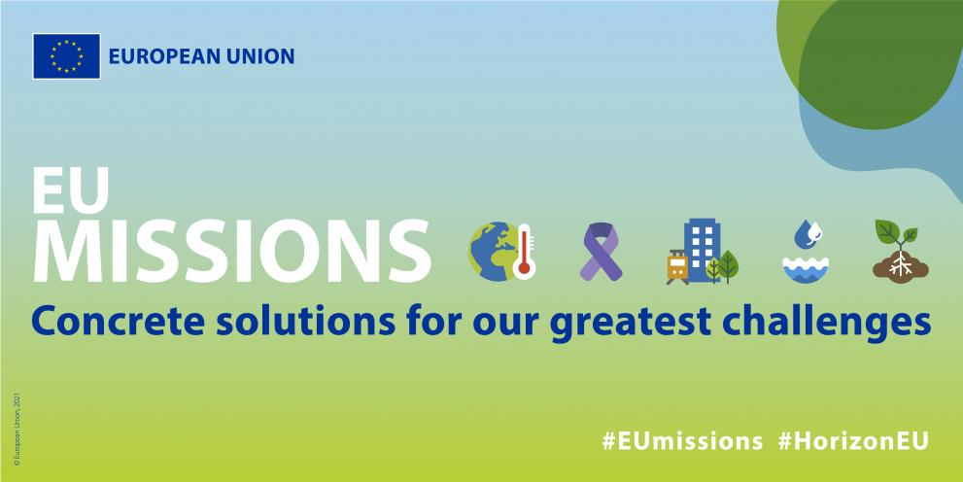
The EU Missions in Horizon Europe

Slide 14
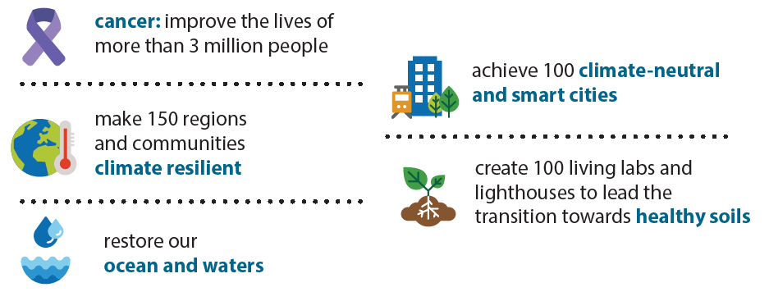
EU Missions: Concrete solutions for our greatest challenges
EU Missions
New approach to work together towards a healthy, green and digital future.
Missions have ambitious goals and are designed to deliver concrete results by 2030:
CROPS – Curating, Replicating, Orchestrating and Propagating Citizen Science across Europe

Slide 15
EU Missions
EU Missions
A mission is a portfolio of actions across disciplines intended to achieve a bold and inspirational and measurable goal within a set timeframe, with impact for society and policy making as well as relevance for a significant part of the European population and wide range of European citizens.
Missions directly support several of the EU priorities: European Green Deal, New European Bauhaus, Europe fit for the Digital Age, Europe’s Beating Cancer Plan, An Economy that Works for People, EU’s Long-term Vision for Rural Areas
Missions are part of the Horizon Europe research and innovation programme, and are expected to deliver impact by putting research and innovation into a new role, combined with new forms of governance and collaboration, as well as by engaging citizens. EU Missions are designed to inspire and empower citizens to improve their lives and those of others.
CROPS – Curating, Replicating, Orchestrating and Propagating Citizen Science across Europe

Slide 16
Adaptation to Climate Change: focuses on supporting EU regions, cities and local authorities in their efforts to build resilience against the impacts of climate change.
Contributes to putting the EU’s adaptation strategy in practice by helping the regions to:
better understand the climate risks they are and will be confronted with in the future
develop their pathways to be better prepared and cope with the changing climate
test and deploy on the ground innovative solutions needed to build resilience
Target: accompany by 2030 at least 150 European regions and communities towards climate resilience.
1.

Slide 17
100 Climate-Neutral and Smart cities: involves local authorities, citizens, businesses, investors as well as regional and national authorities to -
Deliver 100 climate-neutral and smart cities by 2030
Ensure that these cities act as experimentation and innovation hubs to enable all European cities to follow suit by 2050
It takes a cross-sectoral and demand-led approach, creating synergies between existing initiatives and basing its activities on the actual needs of cities.
The 112 selected cities (100 EU) are developing Climate City Contracts, which include an overall plan for climate neutrality across all sectors such as energy, buildings, waste management and transport, together with related investment plans. They are co-created with local stakeholders and citizens, with the help of a Mission Platform (NetZeroCities).
2.

Slide 18
Restore our Ocean and Waters by 2030: to protect and restore the health of our ocean and waters through research and innovation, citizen engagement and blue investments.
The Mission’s new approach addresses the ocean and waters as one. It is expected to play a key role in achieving climate neutrality and restoring nature.
This Mission includes broad public mobilisation and engagement and a digital ocean and water knowledge system, known as Digital Twin Ocean.
The Mission supports regional engagement and cooperation through area-based “lighthouses” in major sea/river basins: Atlantic-Arctic, Mediterranean Sea, Baltic-North Sea, and Danube-Black Sea.
3.

Slide 19
Cancer Mission: “By 2030, more than 3 million lives saved, living longer and better”
The Mission joins efforts across Europe with citizens, stakeholders and Member States, and together with the Europe’s Beating Cancer Plan aims to provide a better understanding of cancer, allow for earlier diagnosis and optimisation of treatment and improve cancer patients’ quality of life during and beyond their cancer treatment.
The 4 Mission objectives:
Understanding of cancer
Prevention and early detection
Diagnosis and treatment
Quality of life for patients and & their families
4.

Slide 20
A Soil Deal for Europe: Life on Earth depends on healthy soils. However, it is estimated that between 60 and 70% of EU soils are unhealthy.
5.
The Mission leads the transition towards healthy soils by:
funding an ambitious R&I programme with a strong social science component
putting in place an effective network of 100 living labs and lighthouses to co-create knowledge, test solutions and demonstrate their value in real-life conditions
developing a harmonised framework for soil monitoring
raising people’s awareness on the vital importance of soils
8 Objectives
reduce desertification
conserve soil organic carbon stocks
stop soil sealing & increase re-use of urban soils
reduce soil pollution and enhance restoration
prevent erosion
improve soil structure to enhance soil biodiversity
reduce the EU global footprint on soils
improve soil literacy in society

Slide 21
Interactive Exercise
Workshop
Go to the EU Mission that is related to your citizen science project or work.
Discuss the following questions with the others in your Mission:
What are the contributions of Citizen Science to the mission?
What are the examples of projects you are aware of for each of the contribution statements provided.
15 min group work - 10 min to discuss together
CROPS – Curating, Replicating, Orchestrating and Propagating Citizen Science across Europe

Slide 22
CROPS Transnational Communities
Workshop
Creating communities at a transnational scale to help upscale citizen science to contribute to the achievement of EU Missions.
Join the CROPS Transnational Community now and be a founding member to shape the conversations and influence policies around upscaling citizen science: https://forms.office.com/e/b5izd5FkdU
The CROPS Communities will build on the existing citizen science networks formed by previous EU actions, projects and communities and on the WeObserve Communities of Practice.
CROPS – Curating, Replicating, Orchestrating and Propagating Citizen Science across Europe

Slide 23
SDG CoP: UN Sustainable Development Goals and Citizen Observatories
www.weobserve.eu
Our objectives, which were co-created by our CoP participants, are to:
Understand the opportunities and challenges for the use of data from citizen science/citizen observatories for SDG monitoring; and
Advance our knowledge of how citizen science/citizen observatories can help behaviour change towards achieving the SDGs.
CROPS – Curating, Replicating, Orchestrating and Propagating Citizen Science across Europe

Slide 24
Interactive Exercise
Workshop
Divide into groups, e.g., 6 people per group;
Focusing on the overarching theme of the Transnational Communities that align with the EU Missions, come up with some ideas/keywords about what the objectives of these Communities can or should be;
Overarching theme is upscaling citizen science in alignment with/in the context of the EU Missions
Using the post-its for your keywords and ideas for a clustering exercise to be turned into specific objectives for the Transnational Communities later
15 min group work - 10 min to discuss together
CROPS – Curating, Replicating, Orchestrating and Propagating Citizen Science across Europe

Slide 25
Key messages from today
Remember to sign up for the CROPS Transnational Community and other CROPS activities now:
https://forms.office.com/e/b5izd5FkdU
Transnational Community will be launched January 2025. We will be in touch!
By then, visit our website regularly for updates:
https://crops-cs.eu/
Thank you!
Dilek Fraisl, IIASA, fraisl@iiasa.ac.at
Giovanni Maccani, Ideas for Change, giovannimaccani@ideasforchange.com
James Sprinks, Earthwatch, jsprinks@earthwatch.org.uk
Catarina Azevedo, INOVA+, catarina.azevedo@inova.business

