Slide 1
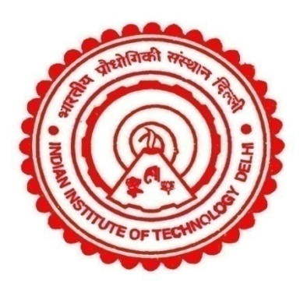
Health Benefits of Meeting 2-degree Warming Scenario in India
Debajit Sarkar (asz218001@iitd.ac.in)¹, Fahad Imam¹, Alok Kumar¹, Sagnik Dey¹, Pallav Purohit², Gregor Kiesewetter², Zbigniew Klimont², Sourangsu Chowdhury³
¹Centre for Atmospheric Sciences, Indian Institute of Technology Delhi, India; ²International Institute for Applied Systems Analysis, Luxemburg, Austria;
³CICERO Center for International Climate Research, Oslo, Norway
ITS2.12/CL0.1.4 EGU24-5480 April 16, 2024.

Slide 2
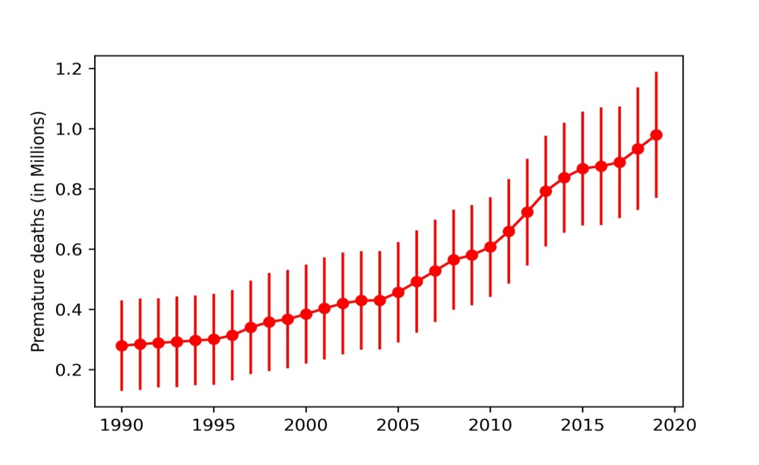
Background
2 of 3
Air pollution is the largest environmental risk factor in India (GBD, 2019).
Growing population aging is expected
in India till 2060s (Vollset et al., 2020).
Air pollution-related health impacts
may be enormous.
GBD-India
MAPS
Strictest emission controls may reduce
air pollution level and lead to the
warming level below 2℃ by 2100.
The potential health benefits at the subregional level from keeping the warming level below 2℃ is unknown in India.
Methodology
GAINS-simulated PM2.5 exposure and sectoral
apportionments.
Baseline mortality rates (GBD-India Foresight).
Age-distributed population (Census projections).
ARIMA model for projection
till the mid-century.
[GBD Framework]

Slide 3
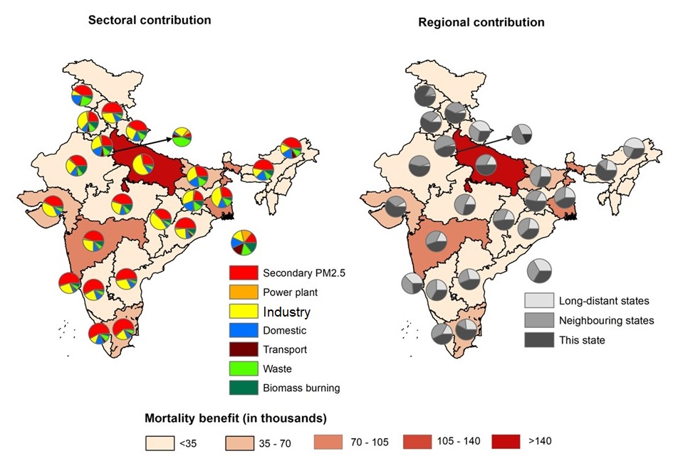
Health Burden Scenario in Mid-century
3 of 3
/ below 2℃ warming
Summary
0.77 million (0.58-0.97) premature deaths could be prevented following the climate-control pathway; low SDI states would have largest share.
Emissions from industry, domestic, and waste would contribute to largest co-benefits.
**Please visit Poster ID-5480

