Slide 1
Robust increase in CO₂ effective radiative forcing in warmer climates
Chris Smith^{1,2,3}, Duncan Watson-Parris⁴, Ryan Kramer⁵, Tim Andrews¹, Ada Gjermundsen⁶, Harry Mutton¹, Jing Feng⁵, David Paynter⁵, Robin Chadwick¹, Hervé Douville⁷, Romain Roehrig⁷
EGU General Assembly, Vienna, 18 April 2024
¹ Met Office Hadley Centre, Exeter, United Kingdom
² Institute for Climate and Atmospheric Science, University of Leeds, Leeds, United Kingdom
³ International Institute for Applied Systems Analysis, Laxenburg, Austria
⁴ Scripps Institution of Oceanography, UC San Diego, San Diego, United States
⁵ NOAA Geophysical Fluid Dynamics Laboratory, Princeton, United States
⁶ Norwegian Meteorological Institute, Oslo, Norway
⁷ Météo France, Toulouse, France

Slide 2
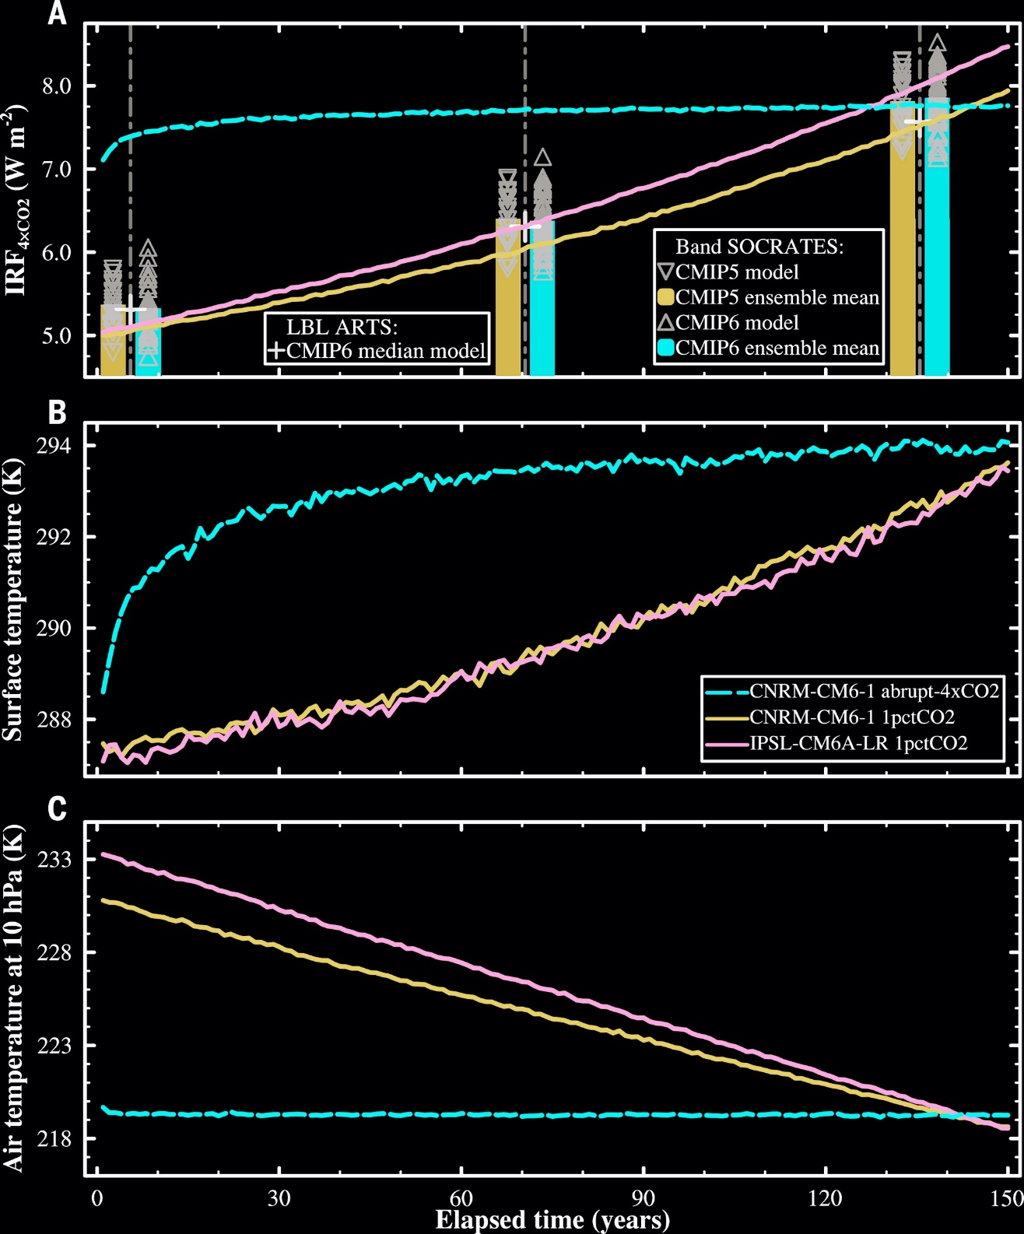
Motivation
He et al. (2023) found increase in instantaneous radiative forcing for CO₂ in a warmer climate base state
Is this also true for effective radiative forcing?
If CO₂ forcing is state dependent, we might need to adjust simplified relationships e.g.
$$F=α\log\left(C/C_{0}\right)+βΔT$$
He et al. 2023, 10.1126/science.abq6872

Slide 3
Patterned experiments
Pre-industrial control SSTs and forcing (piSST)
SSTs and sea ice from years 111–140 of abrupt-4xCO2, pre-industrial forcing (a4SSTice)
As above, with 4xCO2 forcing (piSST-4xCO2, a4SSTice-4xCO2)
Uniform +4K experiments
AMIP climatology 1979–2008, with pre-industrial forcing (amipClim-control)
Uniform SST perturbation of 4 K, pre-industrial forcing (amipClim-control-p4K)
4xCO2 forcing (amipClim-4xCO2, amipClim-4xCO2-p4K)
Present-day aerosol forcing (amipClim-aer, amipClim-aer-p4K
Adapted from Webb et al. 2017, 10.5194/gmd-10-359-2017

Slide 4
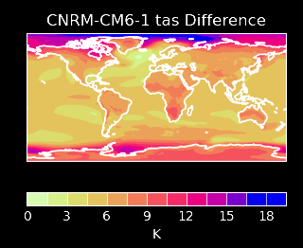
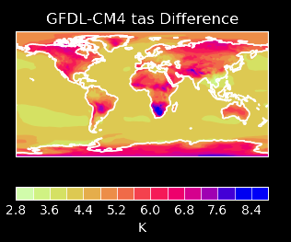
Patterned experiments
HadGEM3-GC31-LL
IPSL-CM6A-LR
CESM2
CNRM-CM6-1
ΔT in the range 6.0–7.2 K
Part of CFMIP for CMIP6
Uniform +4K experiments
HadGEM3-GC31-LL
GFDL-CM4
ECHAM6-HAM
NorESM2-LM
ΔT in the range 4.4–4.6 K
New experiments

Slide 5
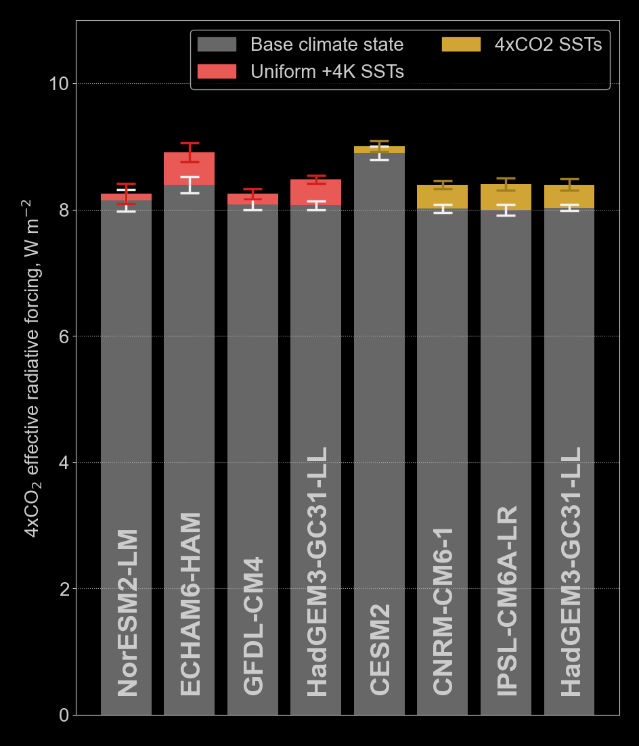
CO₂ climate dependency
All 8 experiments (7 models) show increased 4×CO2 ERF in the warmer climate
5 out of 8 are statistically significant (95% confidence intervals of 30-year means do not overlap)
ERF increase 0.1–0.5 W m^{–2}
or 0.02–0.11 W m^{–2} K^{–1}
or 0.2–1.4 % K^{–1}

Slide 6
HadGEM3-GC31-LL: Patterned versus uniform
Patterned SSTs clear-sky ERF difference
Uniform SST clear-sky ERF difference
W m⁻²
W m⁻²

Slide 7
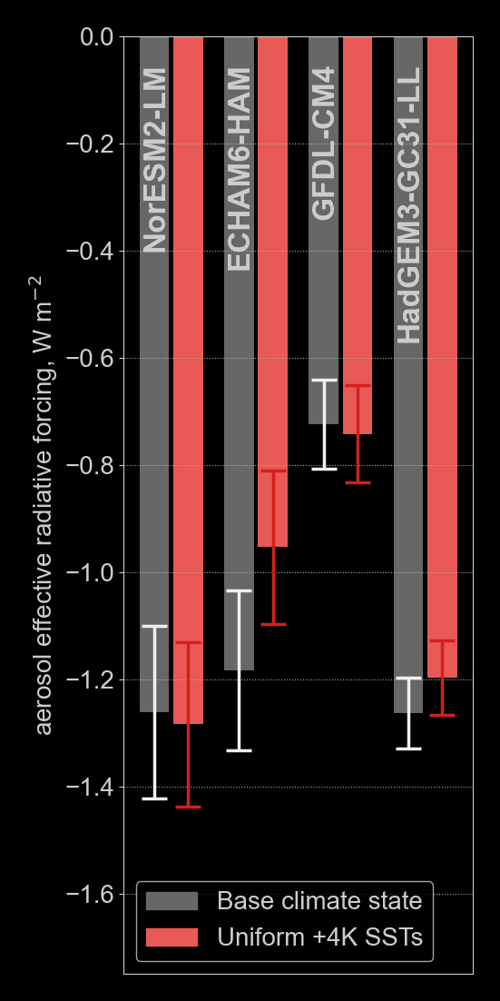
Aerosol climate dependency (or a lack of)
No agreement on sign change between models, and no statistical significance

Slide 8
Conclusions and next steps
We find a robust increase in CO₂ effective radiative forcing in warmer climate states, irrespective of SST pattern
Aerosol forcing does not show a robust increase or decrease
The paper isn’t written yet & much analysis to do: modellers, there is still time to contribute patterned or amipClim +4K SST runs
What is driving this difference? Instantaneous radiative forcing, rapid adjustments?
We propose these fixed-SST 4xCO2 experiments with different climate states within RFMIP for CMIP7
c.j.smith1@leeds.ac.uk
chrisroadmap.bsky.social
@chrisroadmap

