Slide 1
Climate damage projections beyond annual temperature
17 April 2024 | Paul Waidelich (ETH) Fulden Batibeniz (ETH) James Rising (UDel) Jarmo Kikstra (Imperial/IIASA) Sonia Seneviratne (ETH)

Slide 2
Why this study?
A few past findings and developments.
Limited economic data has made it difficult to convincingly isolate multiple signals that damages can be attributed to
Precipitation projections have been uncertain which leads to future economic signals being drowned in uncertainty ranges across climate models
Temperature changes capture some precipitation patterns which leads to future economic signals being drowned in uncertainty
2 | Damages beyond temperature | Introduction

Slide 3
Why this study?
A few past findings and developments.
Limited economic data has made it difficult to convincingly isolate multiple signals that damages can be attributed to
Precipitation projections have been uncertain which leads to future economic signals being drowned in uncertainty ranges across climate models
Temperature changes capture some precipitation patterns which leads to future economic signals being drowned in uncertainty
New economic data and research DOSE - Global data set of reported sub-national economic output; and studies like Kotz et al. 2021, 2022 (historical)
New precipitation research CMIP6 and related work identifying robust forced changes in mean and extreme precipitation
We know temperature does not capture all variability and extremes which was confirmed by recent work including on temperature variability (Linsenmeier, 2023), heatwaves (Callahan & Mankin, 2023), and precipitation (Kotz et al. 2021)
3 | Damages beyond temperature | Introduction

Slide 4
Why this study?
A few past findings and developments.
Limited economic data has made it difficult to convincingly isolate multiple signals that damages can be attributed to
Precipitation projections have been uncertain which leads to future economic signals being drowned in uncertainty ranges across climate models
Temperature changes capture some precipitation patterns which leads to future economic signals being drowned in uncertainty
New economic data and research DOSE - Global data set of reported sub-national economic output; and studies like Kotz et al. 2021, 2022 (historical)
New precipitation research CMIP6 and related work identifying robust forced changes in mean and extreme precipitation
We know temperature does not capture all variability and extremes which was confirmed by recent work including on temperature variability (Linsenmeier, 2023), heatwaves (Callahan & Mankin, 2023), and precipitation (Kotz et al. 2021)
Forward-looking study: contribution of non-temperature indicators.
Research question: “How does the inclusion of additional indicators capturing climatic variability & extremes alter our understanding of future economic impacts at different global warming levels?”
4 | Damages beyond temperature | Introduction

Slide 5
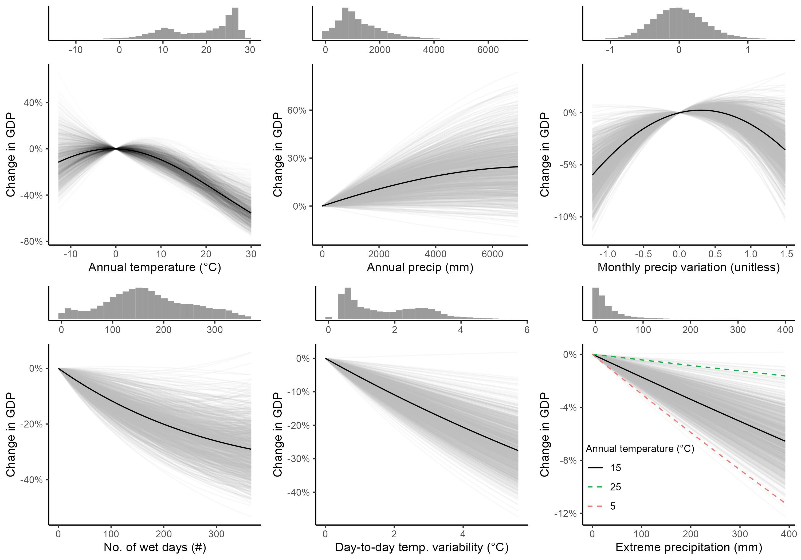
Methods: damage function
Using Kotz et al. (2022)
Black line: Kotz et al., 2022; point estimates
Grey lines: 1,000 Monte Carlo draws from multivariate Gaussian estimated via country-level clustering
Histograms: Distribution of respective indicators across ADM1 regions and CMIP6 models during the period corresponding to historical 1979-2019 in terms of global warming (+0.84C)
5 | Damages beyond temperature | Methods

Slide 6
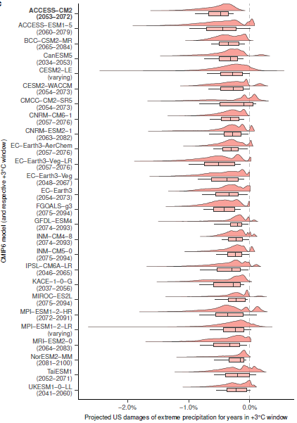
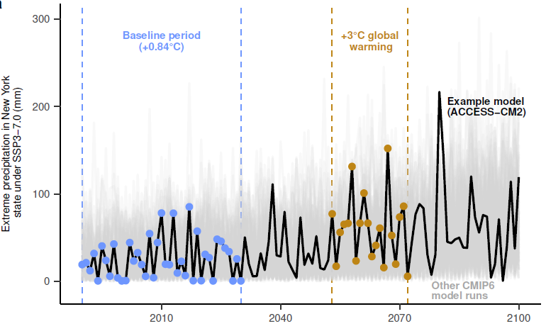
Methods: climate projections
Using CMIP6 (ScenarioMIP, 33 models)
6 | Damages beyond temperature | Methods

Slide 7
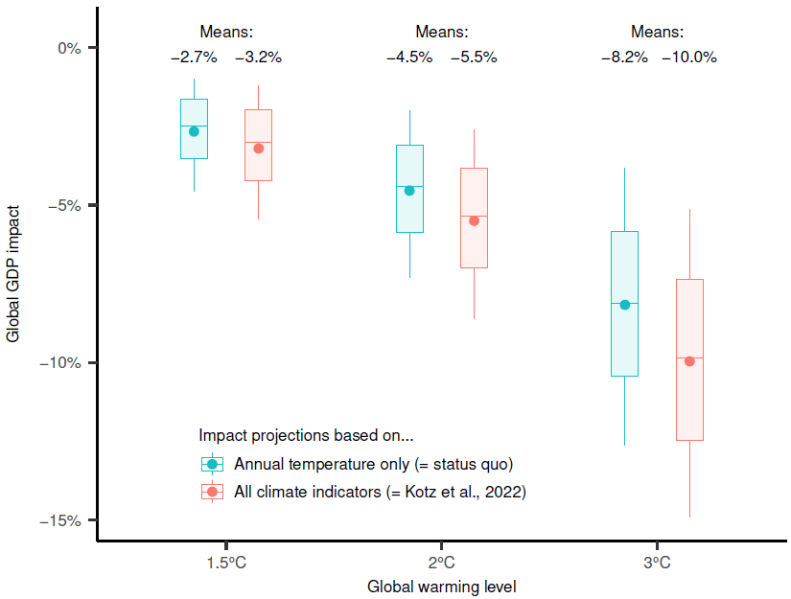
Results: higher expected damages
Somewhat higher total damages
7 | Damages beyond temperature | Results

Slide 8
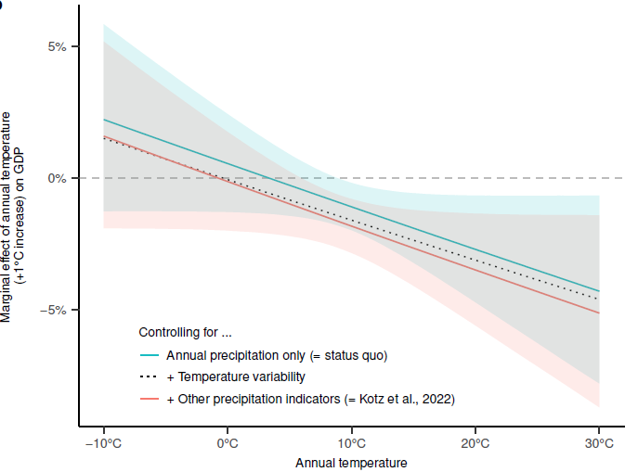
Results: higher expected damages
In part because of model becoming more sensitive to temperature changes
8 | Damages beyond temperature | Results

Slide 9
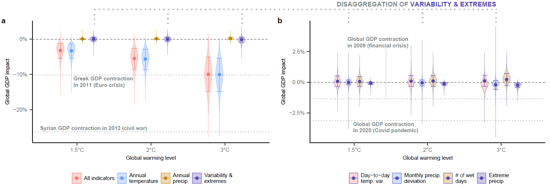
Results: contributions of indicators
Still mainly temperature (9/10) with some variability and extremes (1/10)
9 | Damages beyond temperature | Results

Slide 10
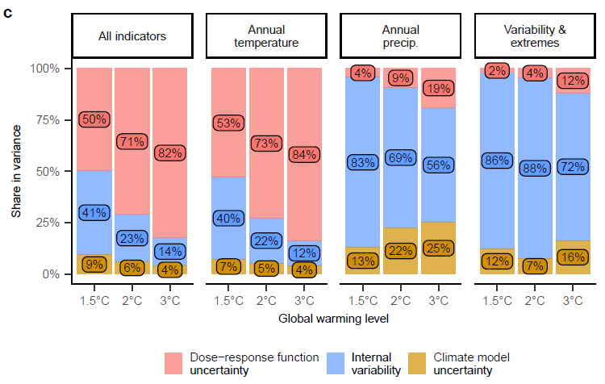
Results: sources of uncertainty
Temperature: damage function. Other: climate variability and uncertainty
10 | Damages beyond temperature | Results

Slide 11
Results: confidence in direction of sign
Temperature: very confident
11 | Damages beyond temperature | Results and discussion

Slide 12
Results: confidence in direction of sign
Total precipitation: somewhat confident
12 | Damages beyond temperature | Results and discussion

Slide 13
Results: confidence in direction of sign
Other indicators:
particular differences in climate temp. variability and wet days
13 | Damages beyond temperature | Results and discussion

Slide 14
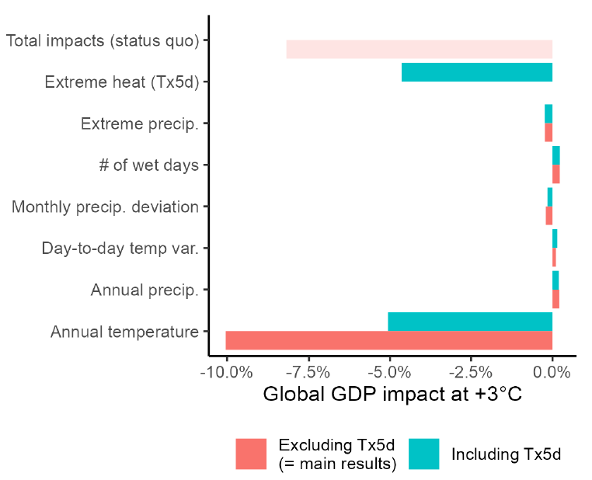
Results: heatwaves
About half of temperature may reflect damages from heatwaves
14 | Damages beyond temperature | Results and discussion

Slide 15
Paul Waidelich (ETH)
Fulden Batibeniz (ETH)
James Rising (UDel) Jarmo Kikstra (Imperial/IIASA)
Sonia Seneviratne (ETH)
Thank you.
kikstra@iiasa.ac.at

Slide 16
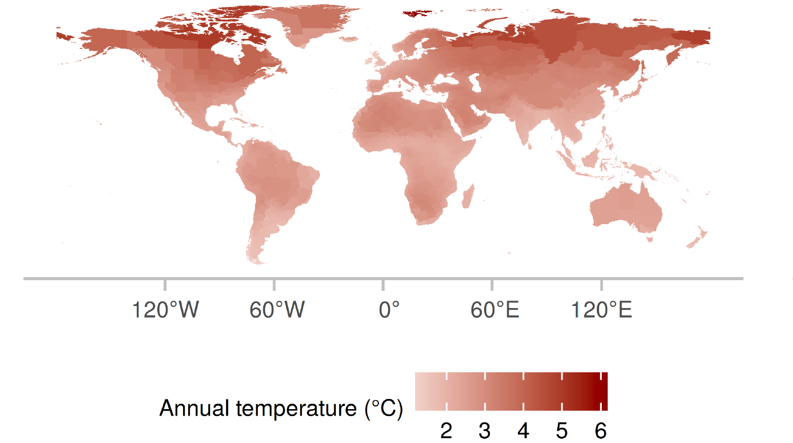
Results: average shifts in climate indicator
Annual temperature
16 | Damages beyond temperature | Extra results: climate change indicator changes

Slide 17
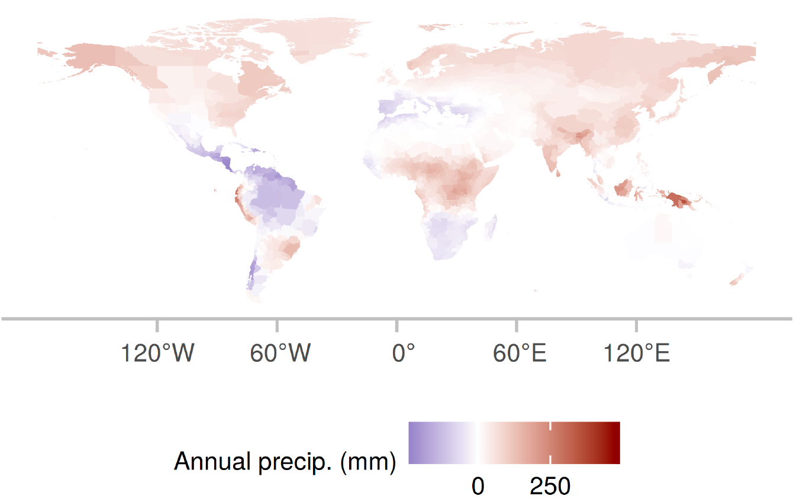
Results: average shifts in climate indicator
Annual precipitation
17 | Damages beyond temperature | Extra results: climate change indicator changes

Slide 18
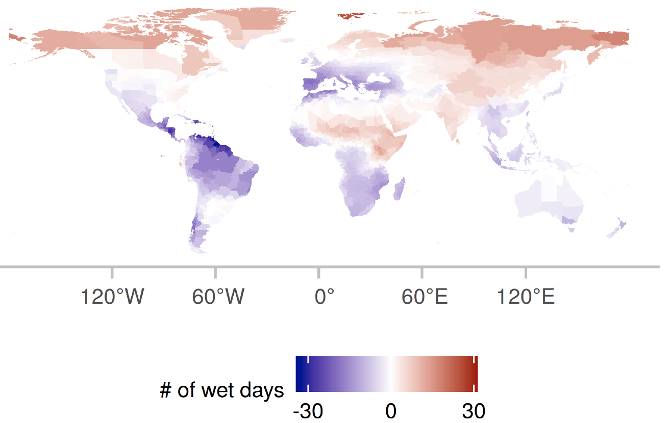
Results: average shifts in climate indicator
Number of wet days
precipitation
above 1mm/d
18 | Damages beyond temperature | Extra results: climate change indicator changes

Slide 19
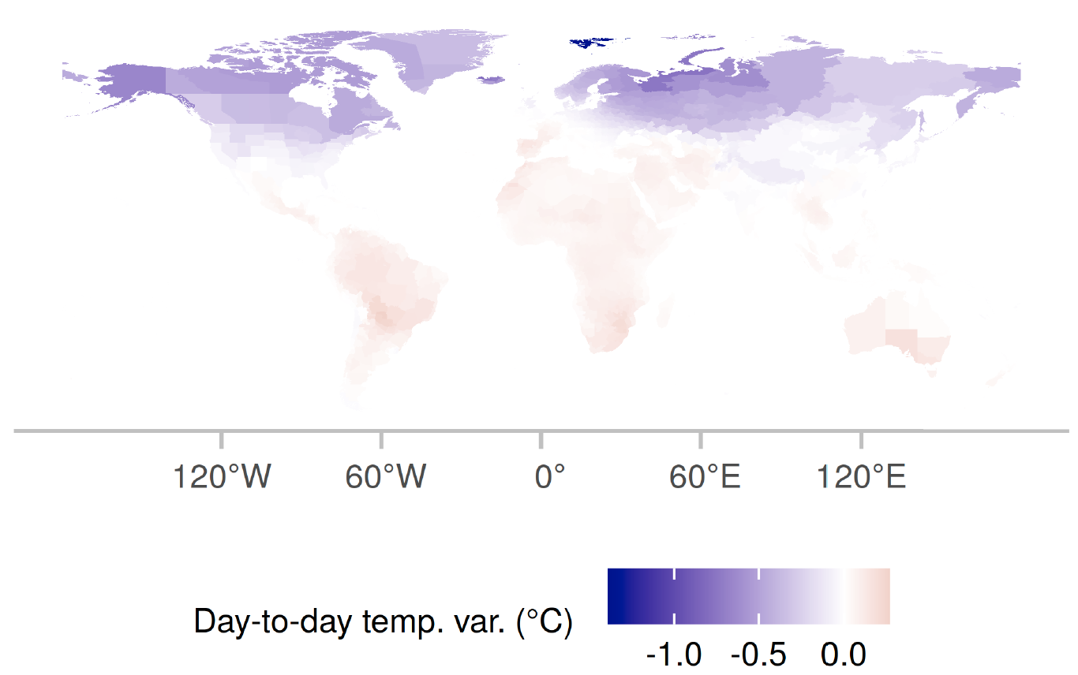
Results: average shifts in climate indicator
Day-to-day temperature variability
how
much daily temperatures deviate from monthly means
19 | Damages beyond temperature | Extra results: climate change indicator changes

Slide 20
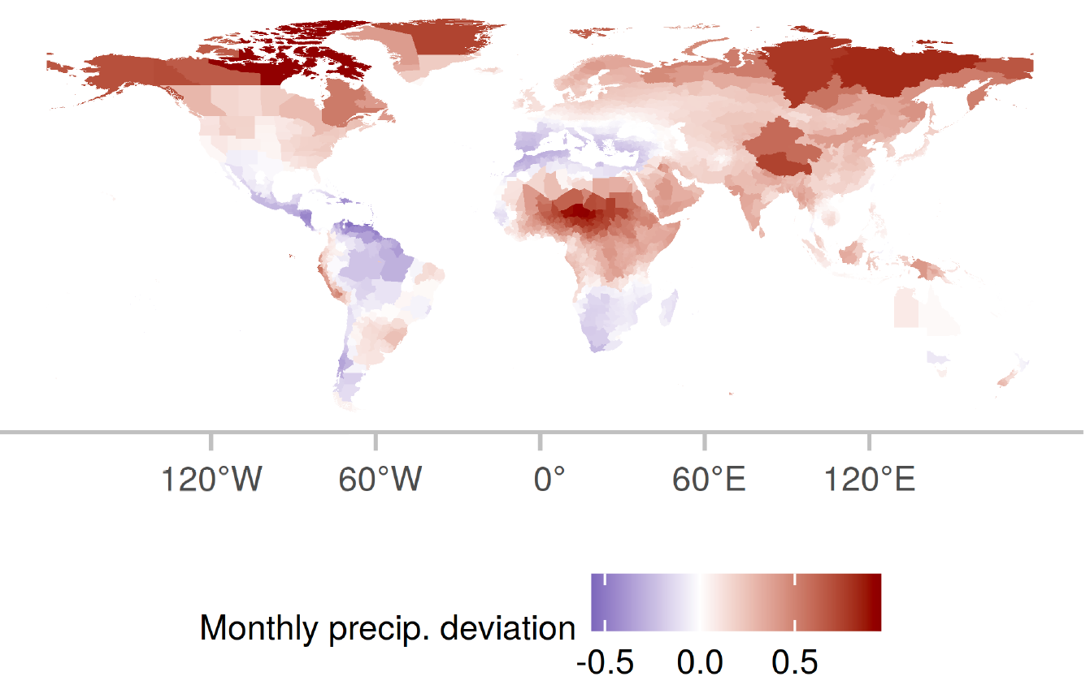
Results: average shifts in climate indicator
Monthly precipitation deviation
how much
monthly precipitation deviates from historical means throughout the year
20 | Damages beyond temperature | Extra results: climate change indicator changes

Slide 21
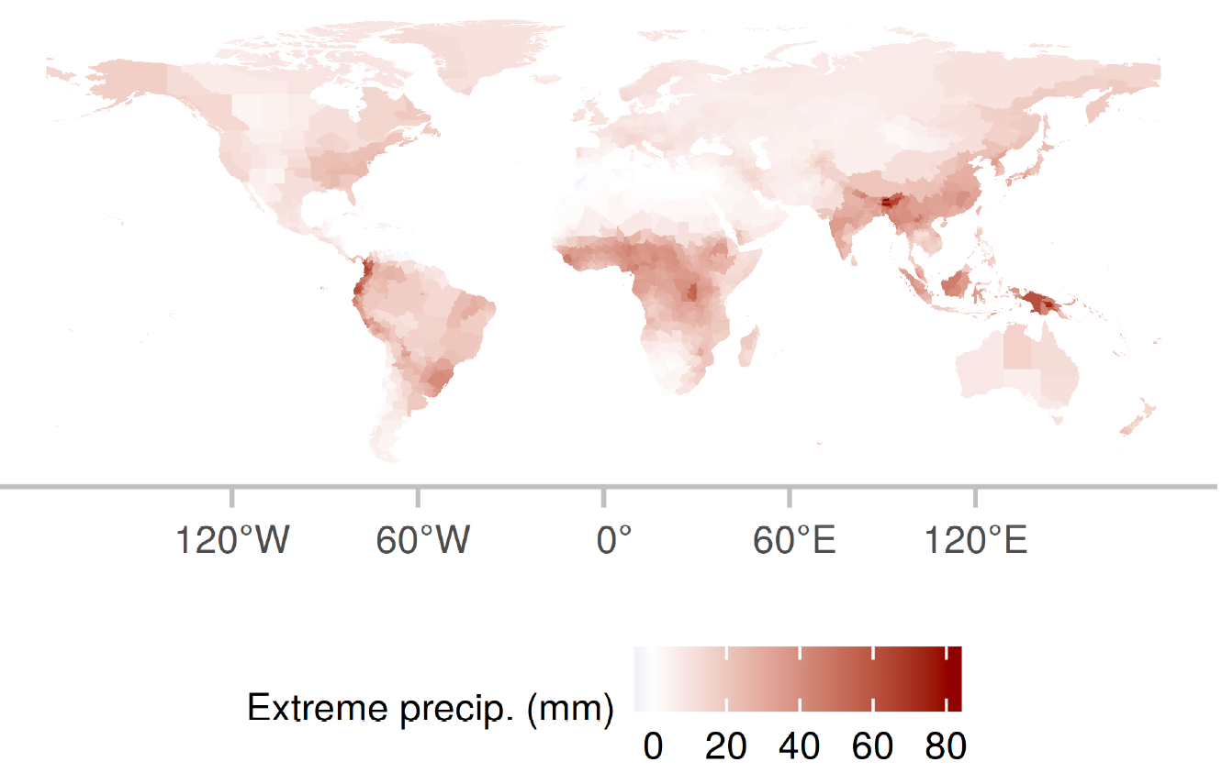
Results: average shifts in climate indicator
Extreme precipitation
the annual sum of precipitation on days with
exceptionally high precipitation exceeding the historical 99.9th percentile
21 | Damages beyond temperature | Extra results: climate change indicator changes

Slide 22
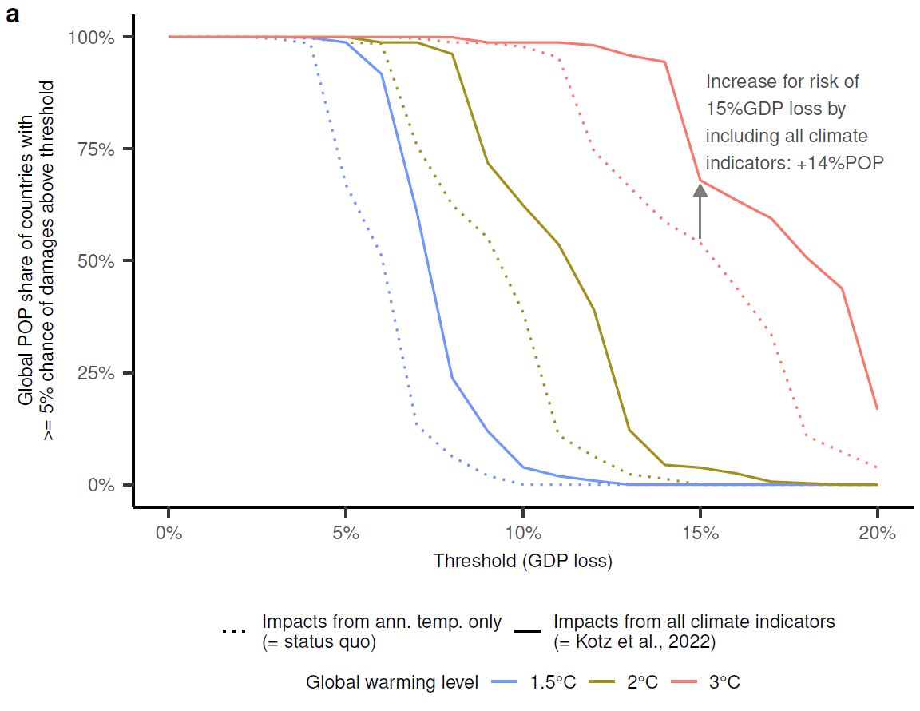
Results: a reason to care
More than a billion extra people would see >5% chance of 15% GDP loss at 3C.
22 | Damages beyond temperature | Extra results: reasons to care

Slide 23
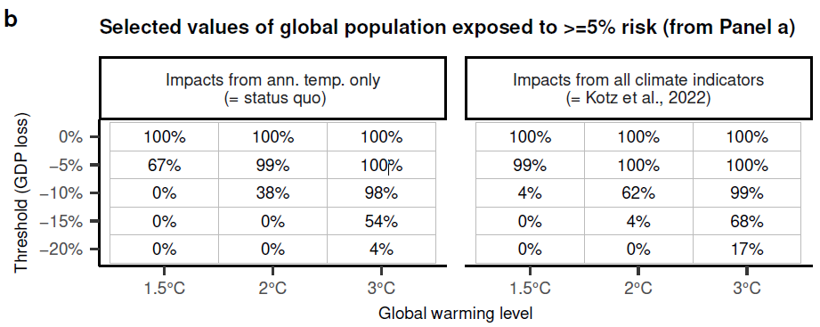
Results: a reason to care
99% of global population at risk of >5% damages already at 1.5C.
23 | Damages beyond temperature | Extra results: reasons to care

