Slide 1
Cyber-Echoes of Climate Crisis: Unraveling Anthropogenic Climate Change Narratives on Social Media
Abraham (Avi) Yosipof, Or Elroy, Nadejda Komendantova
Faculty of Information Systems and Computer science, The College of Law & Business, Ramat-Gan, Israel
International Institute for Applied Systems Analysis, Laxenburg, Austria
EGU General Assembly 2024, Vienna, Austria,17/04/2024

Slide 2
Presentation Outline
1
Introduction and objective
Methodology
Results and Analysis
Practical Implications

Slide 3
Introduction
2
Objective: To Unravel and to analyze the Narratives about climate change on Social Media Using AI
Understanding of the discourses can assist efforts of mitigation, adaptation and policy measures development
Collect data from Social Media
Analyze the data using NLP and machine learning methods
Social media platforms have a key role in spreading narratives about climate change

Slide 4
Methodology
3
Social Media: X (formerly Twitter)
Collected ~300K English tweets (January 2022-May 2023)
Query: Key words related to Anthropogenic Climate Change, including climate change crisis, global warming, etc.
Key task: Cluster analysis using Machine Learning (k-Means)
NLP: RoBERTa (Embedding): to embed the semantic meaning of the tweets into vectors.

Slide 5
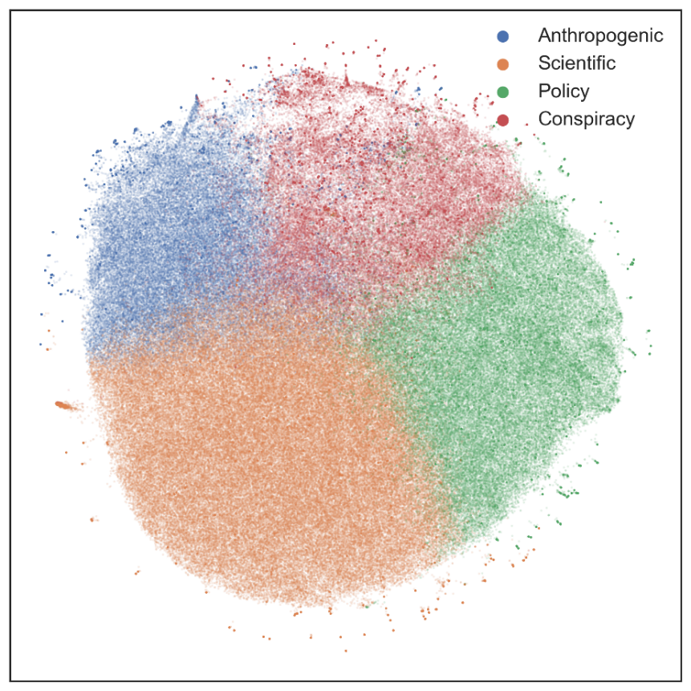
Results
4
Four Clusters
Anthropogenic cluster: (blue)
Whether anthropogenic climate change is real or not.
Scientific cluster: (orange)
Focused on scientists and scientific findings.
Policy cluster: (green)
Discusses the policy matters, climate change mitigation and policies.
Conspiracy cluster : conspiracy theories. (red)

Slide 6
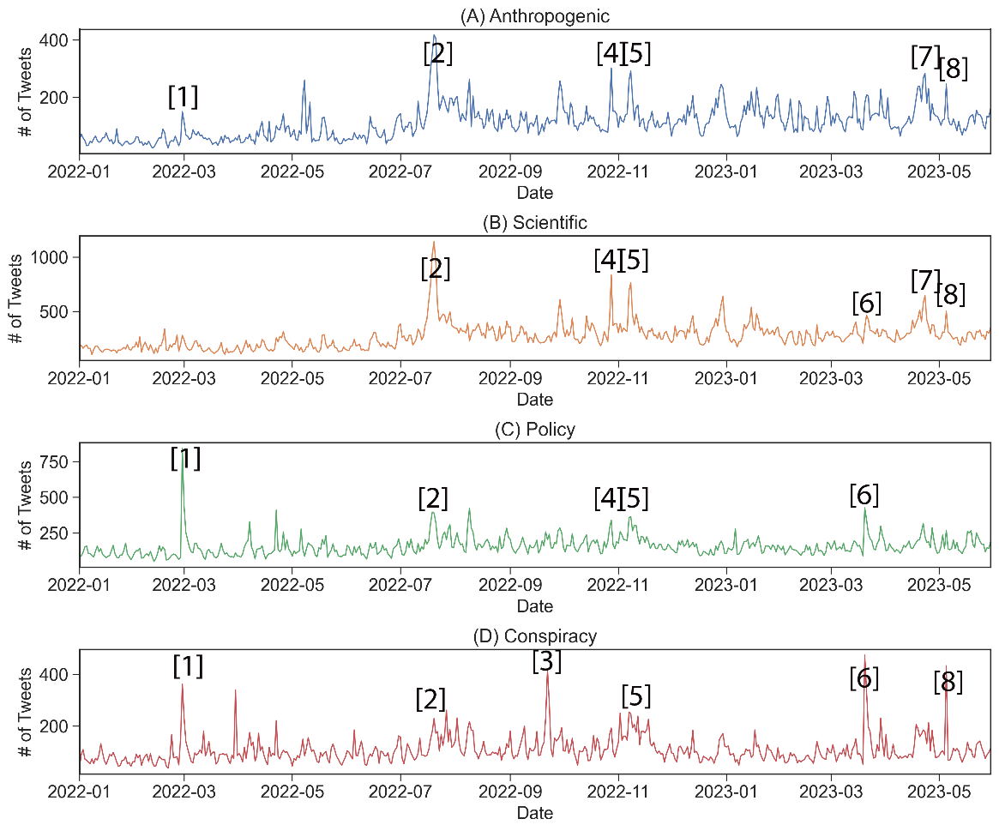
Analysis
5
Annotation 1: Feb. 28, 2022
IPCC Sixth Assessment Report (AR6)
Annotation 2: Jul. 19-20, 2022
Record breaking heat wave
Annotation 5: Nov. 7-8 2022
UN Climate Change Conference (COP27);
Daily tweet frequency in each cluster

Slide 7
Analysis
6
URL are used more frequently in the Policy and Conspiracy clusters.
Policy cluster mostly references websites that discuss policy matters and the IPCC’s website
The Anthropogenic and Conspiracy clusters mainly reference new websites and websites that allow users to upload and publish their own content (YouTube, Rumble).

Slide 8
Practical Implications
7
The different narratives emphasizes the challenges related to climate change adaption and mitigation measures, and awareness of the population to climate change as part of the process
Communication strategies of official organization to raise awareness, communicate and improve the readiness of the public
to help educate the public through the dissemination of correct information and measures to counteract conspiracy theories.

Slide 9
Practical Implications
8
Users tend to be more involved in the discussion when significant reports are issued.
The issuance of IPCC reports may provide an optimal time window for dissemination of such information
To keep monitoring social media for the change of narratives over time. Which can provide a baseline for decision making and developing decision support tools.
AI tools can help improve the communication and awareness-raising measures for climate change adaption and mitigation policies.

Slide 10
Acknowledgments
9
Ph.D. Student
Or Elroy

