Slide 1
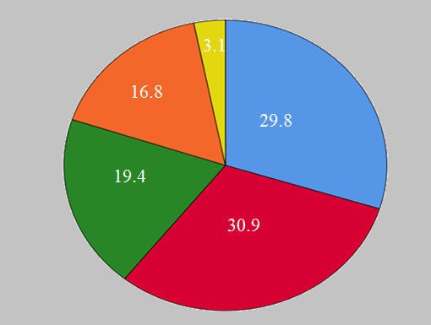
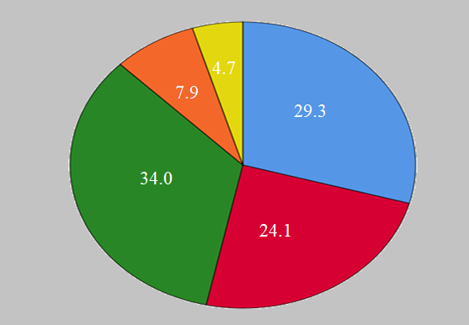
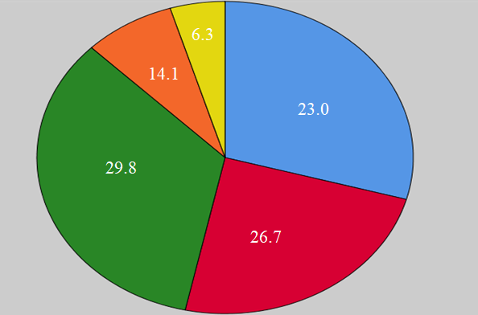
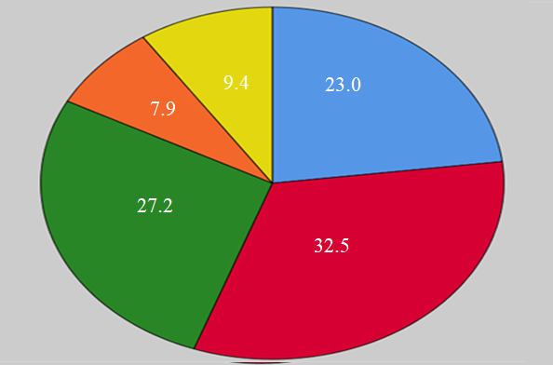
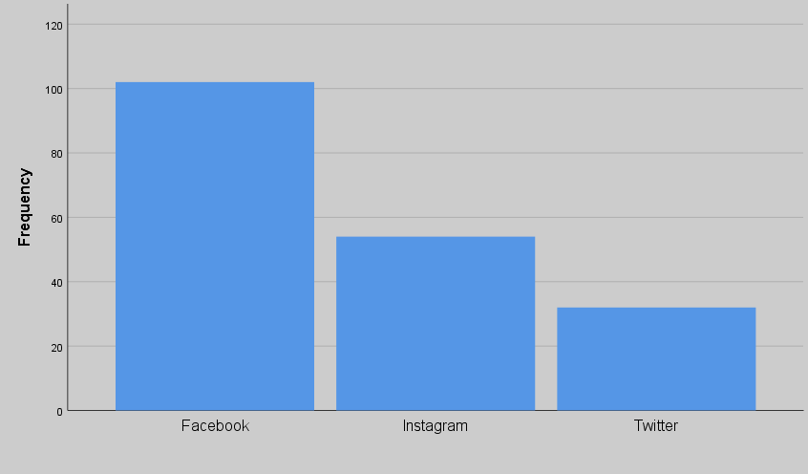
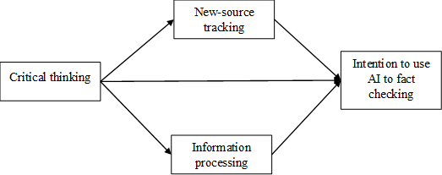
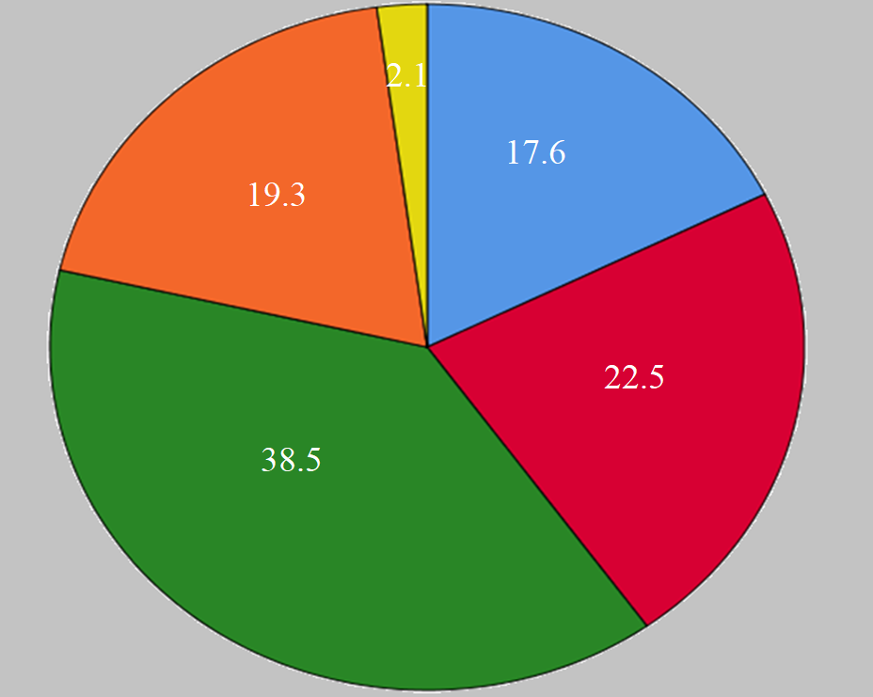
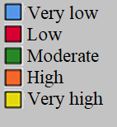
Intention to apply Artificial Intelligence using fact-checking tools in disaster management
Tahereh Zobeidi¹ and Nadejda Komendantova¹
¹Cooperation and Transformative Governance Research Group, Advancing Systems Analysis Program, International Institute for Applied Systems Analysis (IIASA)
Contact: Nadejda Komendantova, komendan@iiasa.ac.at
Findings
Introduction
How often do you use social media (Facebook, Instagram, Twitter) information to get news for each disaster?
The daily dissemination of a substantial amount of information concerning to disasters and crises on social media platforms, including Facebook, Instagram and Twitter in one side, and the sensitivity of this information, on the other hand, underscores the importance of evaluating the credibility of online information in this area. Fact-checking tools employing artificial intelligence represent a novel approach to verifying the validity of online information across various fields, including disaster management. The inclination of individuals to utilize fact-checking tools in such circumstances is influenced by their perceptions. The aim of this study is to investigate factors affecting intention to use Artificial intelligence (AI) for fact checking during disaster?
Earthquake
Wildfire
Discussion and conclusion
The study employed structural equation modeling (SEM) to examine the relationships between critical thinking, heuristic processing, new-source tracking, and the intention to use fact-checking tools.
Critical thinking, defined as meticulous assessment of unclear or requiring careful consideration information, significantly influenced both heuristic processing and new-source tracking within the model. Specifically, critical thinking had a substantial positive effect on new-source tracking (β = .49; p < 0.0001) and heuristic processing (β = .41; p < 0.0001).
Moreover, the results revealed direct effects of new-source tracking and heuristic processing on the intention to use fact-checking tools. This suggests that individuals who are more open to social media information are more inclined to utilize fact-checking resources. Similarly, heuristic processing, defined as acceptance of news content without filtering, had a significant positive effect on the intention to use fact-checking tools (β = .31; p = 0.001), indicating that individuals who tend to accept news content without thorough evaluation are more likely to engage with fact-checking mechanisms.
Interestingly, despite its significant influence on both heuristic processing and new-source tracking, critical thinking did not directly predict the intention to utilize fact-checking tools. This finding suggests that while critical thinking plays a vital role in information assessment and processing, its impact on the intention to use fact-checking tools may be mediated through other cognitive processes, such as heuristic processing and new-source tracking.
In summary, the findings underscore the importance of critical thinking, heuristic processing, and new-source tracking in shaping individuals' intentions to use fact-checking tools. Understanding these cognitive mechanisms can inform interventions aimed at promoting the adoption of fact-checking practices to combat misinformation and enhance information literacy in society.
Objectives
Flood
Industrial accidents
What impact do critical thinking and information processing factors have on the intention to utilize Artificial Intelligence tools for fact-checking during times of disaster?
Research Model
Although there is a limited studies on the impact of perceptions and information processing on the intention to employ fact-checking tools in disaster-related contexts, it is anticipated that factors like critical thinking, as a concept that involves meticulous assessment of unclear or requiring careful consideration, heuristic processing, a concept indicating acceptance of news content without filtering, and the new-source tracking a concept demonstrating openness and positivity towards social media information, play pivotal roles in predicting this intention. Consequently, a conceptual framework was formulated wherein critical thinking, aside from its direct impact on the intention to use fact-checking tools, also exerts influence through two mediators of information processing and the new source tracking variables.
Which of the following platforms have you used to get news on disasters for more than three days in the past week?
Research model
Limitation
While the study analyzed a broad spectrum of natural and human disasters, it didn't account for potential variations in social media usage across specific disaster types. By not focusing on individual disaster scenarios, the study may have overlooked nuanced differences in how social media is utilized during distinct types of crises. Future research could benefit from concentrating on a single disaster type and its associated information, providing more comprehensive insights into social media usage patterns in disaster contexts.
How familiar are you with the tools of detector misinformation?
Policy implication
Methodology
In light of these results, policy recommendations could focus on fostering critical thinking skills alongside promoting awareness and education about heuristic processing and new-source tracking. By addressing these cognitive processes, interventions can effectively encourage the utilization of fact-checking tools, thereby mitigating the spread of misinformation and bolstering societal information literacy.
The survey aimed to investigate the perspectives and attitudes of European citizens towards the utilization of Artificial Intelligence (AI) and fact-checking tools in disaster management scenarios.
The study sample consisted of 202 participants residing in various European countries. A random selection process was used to choose one country from each of the following regions: Sweden, England, Italy, Germany, Croatia, and Lithuania, ensuring a diverse representation across six countries
The collection of data was conducted using an online survey administered in April and May of 2022
The conceptual framework was analyzed using structural equation modeling via the AMOS software.
Results of testing hypotheses
Critical thinking significantly influenced the new source tracking (β=.49; p <0.0001).
Critical thinking significantly influenced heuristic processing (β=.41; p <0.0001).
New source tracking has direct effect on the intention to use fact-checking tools (β=.19; p=0.043).
Heuristic information processing has direct effect on the intention to use fact checking tools (β=.31; p=0.001).
Critical thinking did not directly predict the intention to utilize fact-checking tools.
The evidence examined in this study provides empirical support that the conceptual framework has been able to predict 22% of the changes in the intention to use fact checking tools and still a significant amount of it needs to be researched.

