Slide 1
Participatory Elements in Spanish Climate Change Adaptation Policies
7 June 2024
Dmitry Erokhin, IIASA – presenter
Nadejda Komendantova, IIASA – co-author
Marina Mattera, CMCC – co-author

Slide 2
Table of content
Introduction and Methodology
Findings
Discussion and Conclusion
Project: 101093921 — AGORA — HORIZON-MISS-2021-CLIMA-02

Slide 3
Introduction and Methodology
Project: 101093921 — AGORA — HORIZON-MISS-2021-CLIMA-02

Slide 4
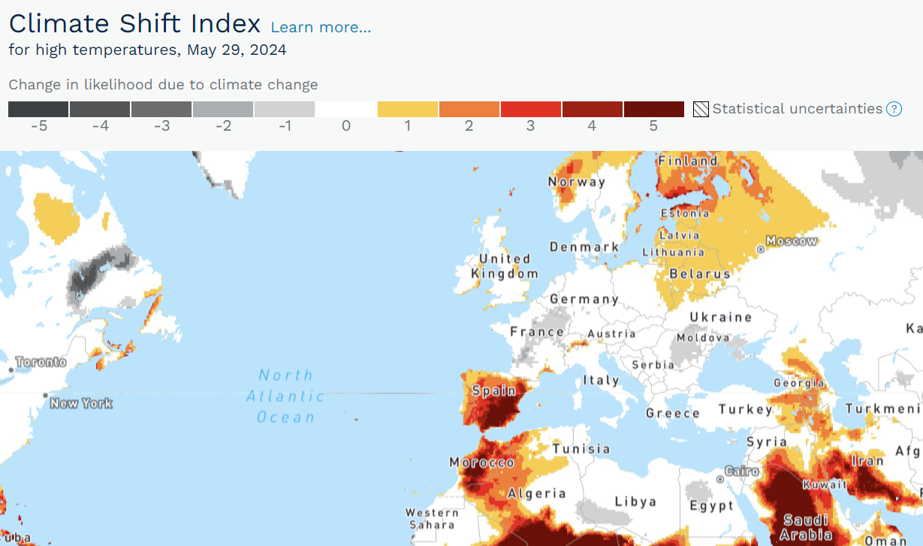
Introduction
• Importance of climate change adaptation policies.
• Role of participatory elements in adaptation policies.
• Focus on Spain as a vulnerable EU country.
Research questions:
How well do Spanish policies incorporate participatory elements?
Where are the policy gaps?
Project: 101093921 — AGORA — HORIZON-MISS-2021-CLIMA-02

Slide 5
Methodology
• Two major steps: policy identification and policy analysis.
• Use of Climate Change Laws of the World database.
• Selection of six relevant policies for analysis.
•Criteria for participation: stakeholder identification, consultation mechanisms, capacity building, transparency, monitoring and feedback.
Project: 101093921 — AGORA — HORIZON-MISS-2021-CLIMA-02

Slide 6
Policy identification
Step 1
Step 2
Manual check whether relevant “adaptation” (e.g., exclusion of adaptation to new legislation etc.)
Step 3
Check the number of “adaptation” mentions (exclusion of policies where adaptation does not play a major role)
Result: 13 policies
Step 4
Step 5
Exclusion of outdated policies
Result: 6 policies
Analysis of participatory elements in the selected policies
Search for climate policies containing the keyword “adaptation”
Result: 56 policies
Result: 18 policies
Project: 101093921 — AGORA — HORIZON-MISS-2021-CLIMA-02

Slide 7
Spain
English | Spanish | Year
Spain's Adaptation Communication | Comunicación de Adaptación de España | 2021
National Climate Change Adaptation Plan 2021-2030 | Plan Nacional de Adaptación al Cambio Climático 2021-2030 | 2020
Long Term Decarbonisation Strategy 2050 | Estrategia de Descarbonización a Largo Plazo 2050 | 2020
Law 7/2021 on Climate Change and Energy Transition | Ley 7/2021 de Cambio Climático y Transición Energética | 2021
Spain’s Integrated National Energy and Climate Plan for 2021-2030 | Plan Nacional Integrado de Energía y Clima 2021-2030 | 2020
Spain’s Recovery and Resilience Plan | Plan de Recuperación, Transformacion y Resiliencia | 2021
Project: 101093921 — AGORA — HORIZON-MISS-2021-CLIMA-02

Slide 8
Criteria for the analysis
Stakeholders:
1=local communities
2=academia and research
Consultation mechanisms:
1=surveys
2=focus groups
3=interviews
4=workshops
Type of instruments to promote participation: 1=voluntary, 2=binding
Supporting finance mechanisms: Which supporting finance mechanisms are mentioned? (1=public, 2=private)
Capacity building:
1=training and education
2=technical assistance
3=organizational development
4=resource mobilization
3=governments and decision makers
4=civil society representatives
5=citizens​
6=investors/economic actors​
7=media
5=training sessions
6=gamification
7=online forums
8=webinars and live streams
9=interactive content
10=personalized communication
11=meetings
12=public hearings
13=participatory research
14=civic hackathons
15=online platforms 16=mobile apps
17=field data collection​​
5=networking and partnership
6=information and knowledge management
7=policy and advocacy
8=monitoring and evaluation
Project: 101093921 — AGORA — HORIZON-MISS-2021-CLIMA-02

Slide 9
Criteria for the analysis
Transparency and information sharing:
Are there mechanisms to inform stakeholders about participation? (yes/no)
Are there mechanisms to inform vulnerable populations about participation? (yes/no)
Are there mechanisms for stakeholders to request and access information? (yes/no)
Monitoring and feedback:
How is the implementation of climate adaptation policies monitored and evaluated?
1=data collection and reporting
2=performance indicators
3=stakeholder engagement
4=evaluation and review
5=international reporting and accountability
6=financial control
7=cross-cutting themes
Is there a system for stakeholders to provide feedback on policy effectiveness and implementation? (yes/no)
Project: 101093921 — AGORA — HORIZON-MISS-2021-CLIMA-02

Slide 10
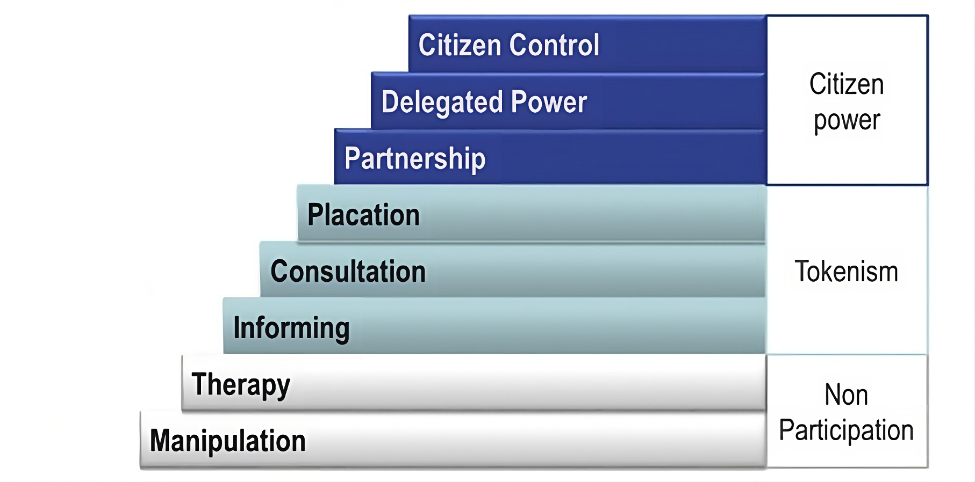
Arnstein’s ladder of citizen participation
Project: 101093921 — AGORA — HORIZON-MISS-2021-CLIMA-02

Slide 11
Findings
Project: 101093921 — AGORA — HORIZON-MISS-2021-CLIMA-02

Slide 12
Stakeholders
A diverse array of stakeholders:
governmental bodies at different levels
research institutions
civil society organizations
private sectors, communities
international organizations
financial institutions
energy system operators
societal groups like rural and aging populations
local entities across different sectors.
Critical roles in shaping policies, strategies, and actions.
Engagement and necessity to tailor strategies, policies, and initiatives according to the specific needs and contexts of these stakeholders.
Project: 101093921 — AGORA — HORIZON-MISS-2021-CLIMA-02

Slide 13
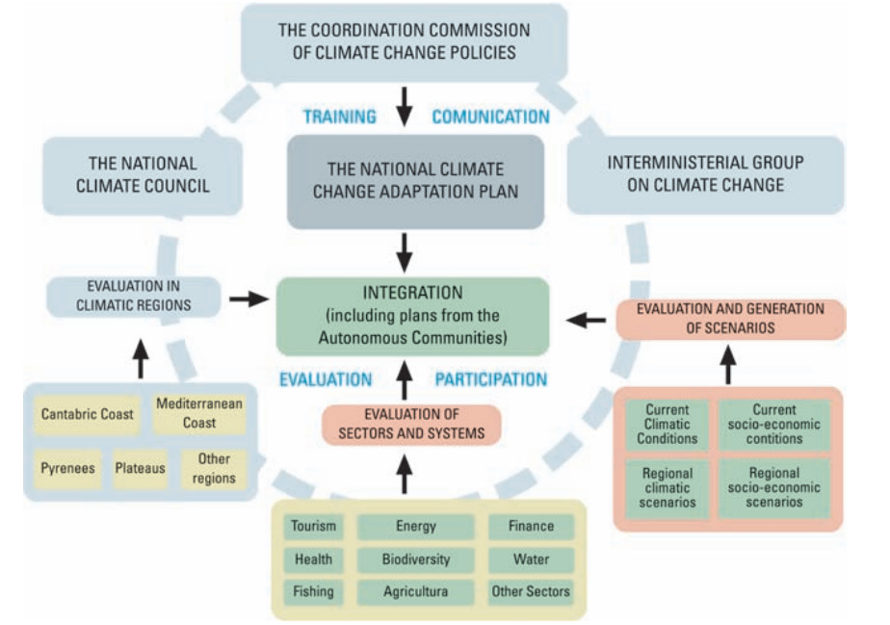
Consultation mechanisms
Multiple consultation mechanisms: surveys, focus groups, workshops.
Use of innovative methods: participatory research, gamification, and design thinking.
The National Climate Council as a platform for proposing and recommending policies across critical areas such as climate science, adaptation strategies, and emission reduction initiatives.
The Working Group on Impacts and Adaptation to Climate Change coordinating national and regional adaptation strategies. Its technical groups, focusing on coastal adaptation and port strategies, exemplify a targeted approach to address specific challenges.
The process of defining the PNACC and main institutions involved
Source: Ministerio de Medio Ambiente y Medio Rural y Marino (2008)
Project: 101093921 — AGORA — HORIZON-MISS-2021-CLIMA-02

Slide 14
Type of instruments
Voluntary instruments
1. Knowledge-sharing platforms: Initiatives like the Plataforma sobre Adaptación al Cambio Climático (AdapteCCa) act as voluntary knowledge-sharing platforms to encourage participation and sharing of best practices.
2. Funding tools for pilot projects: Programs like the PIMA Adapta funding tool encourage voluntary participation by supporting the implementation of pilot projects.
3. Input collection: The use of "manifestations of interest" allows economic actors to propose transformative projects and provides a way for ministries to gather diverse proposals. This can be seen as an encouragement of voluntary action.
Combination of voluntary and binding instruments
Participation promotion: A mix of mandatory requisites and voluntary initiatives aimed at promoting gender equality and inclusion. These range from integrating gender impact requirements in competitive grants and strategic subsidy plans to ensuring balanced representation in evaluation committees. The balanced representation in evaluation committees implies an obligatory step towards gender balance, whereas voluntary participation of experts and civil society representatives aims to include diverse perspectives.
Binding instruments
1. Establishment of National Citizens' Assembly and local assemblies: These assemblies have structured participation, implying a mandatory nature.
2. Obligations for ministries and organizations: Requirements for ministries and organizations to provide data and collaborate on climate change policies indicate binding obligations for cooperation and information sharing.
Project: 101093921 — AGORA — HORIZON-MISS-2021-CLIMA-02

Slide 15
Supporting finance mechanisms
Public financing
Private financing
Private contributions
Regulatory and institutional mechanisms
Financial institution requirements: Mandates for credit entities to publish decarbonization objectives for their portfolios aligned with the Paris Agreement
Risk assessment and reporting: Requirements to assess and report climate change risks associated with their activities.
Policy integration and support
Private sector integration: Encouraging businesses to internalize adaptation measures within their operations
European funds: Including Next Generation EU, Multiannual Financial Framework (MFF) 2021-27, European Social Fund Plus (FSE+), and InvestEU
National funds: Such as PIMA ADAPTA and sectoral budgets
Public-private partnership instruments: Co-investment fund by Innvierte and Technology Transfer fund by Innvierte - involving a mix of public and private investment
Financial instruments: Taxonomy framework, European green bond standard, calls for tenders, and support mechanisms for participatory citizen projects
Integration into public procurement
Integration into budgetary allocation
Incentivizing private sector involvement
Project: 101093921 — AGORA — HORIZON-MISS-2021-CLIMA-02

Slide 16
Capacity building
Empowering stakeholders with knowledge, skills, and awareness across diverse sectors.
Targeted training programs and workshops equip professionals with essential insights into climate risks and adaptation strategies, enhancing decision-making frameworks.
In various sectors such as construction, initiatives focus on identifying necessary qualifications and providing subsidies for professional requalification, underlining the importance of ongoing skill development.
Additionally, cross-sectoral integration remains crucial, emphasizing the integration of climate goals into normative frameworks and planning processes to ensure coherence and effectiveness.
Project: 101093921 — AGORA — HORIZON-MISS-2021-CLIMA-02

Slide 17
Transparency and information sharing
Stakeholders are informed and engaged in climate change adaptation through various channels like the AdapteCCa platform, workshops, consultations, public feedback sessions.
AdapteCCa serves as a crucial hub connecting government, scientists, planners, and stakeholders.
Clear communication, translating technical information into understandable language and integrating gender perspectives for tailored strategies, involving diverse stakeholders in workshops.
Sessions are organized for stakeholders to contribute insights, emphasizing transparency and accessible tools for visualizing climate data and tracking progress across domains.
Project: 101093921 — AGORA — HORIZON-MISS-2021-CLIMA-02

Slide 18
Monitoring and feedback
Rigorous monitoring and evaluation through a structured methodology known as Monitoring, Reporting, and Evaluation (MRE).
Purpose-built to offer comprehensive insights, track progress, and report on adaptation measures' efficacy, evaluating impacts, vulnerabilities, risks, and adaptive capacity progress.
Comprises various tools and processes tailored for effective monitoring and evaluation of adaptation actions: climate risk and adaptation reports, indicators, evaluation reports, territorial and social vulnerability monitoring, cross-border effects evaluation, gender integration and maladaptation prevention, cost-benefit analysis, action-oriented approach.
Systematic observation systems, regionalized climate scenarios, a knowledge management platform for adaptation are further tools to monitor adaptation progress, evaluate effectiveness, and foster coordination among sectors and policies to address climate change challenges comprehensively.
Structured citizen participation is also possible via the National Citizens' Assembly on Climate Change as well as regional and municipal assemblies.
High-level councils and working groups offer spaces for debate, advice, and monitoring involving government departments, private sector representatives, social agents, and civil society.
Citizen participation platforms and innovation labs aim to involve citizens and stakeholders in policy development.
Project: 101093921 — AGORA — HORIZON-MISS-2021-CLIMA-02

Slide 19
Examples of instruments
Partnership
National Climate Council
Impacts and Adaptation Working Group
Partnerships between municipalities and citizen groups
Collaboration between different levels of administration and private sector
Informing
Exhibitions
Informational breakfasts for journalists
Online platform
Provisions for access to information
Efforts to inform citizens
Consultation
1500 comments from 182 organizations and individuals
1175 comments
Deliberative workshops
National Citizens' Assembly on Climate Change
Placation
Committee of Expert Persons on Climate Change and Energy Transition
Consideration of input from various stakeholders
Project: 101093921 — AGORA — HORIZON-MISS-2021-CLIMA-02

Slide 20
Discussion and Conclusion
Project: 101093921 — AGORA — HORIZON-MISS-2021-CLIMA-02

Slide 21
Summarizing policies
Involvement:
Various stakeholders, including experts, key actors in the field of adaptation, and different administrative units responsible for the development of adaptation measures.
Engagement with a wide range of organizations, individuals, and public entities.
Mechanisms for participation:
Diverse mechanisms for participation, such as deliberative workshops, online forms for expert contributions, and meetings with relevant stakeholders.
Open communication, the exchange of viewpoints, and the prioritization of proposals related to different aspects of the policies.
Feedback and reporting:
Public consultation processes and soliciting comments and feedback from a wide range of organizations and individuals.
Incorporation of external input into the policy development process.
Preparation and publication of regular reports.
Inclusivity:
Identification of emerging themes that require attention, such as the influence of social and demographic factors on vulnerability to climate change
Consideration of transnational impacts.
Integration of human rights and gender perspectives, and the role of lifestyles in building resilience to climate change.
Project: 101093921 — AGORA — HORIZON-MISS-2021-CLIMA-02

Slide 22
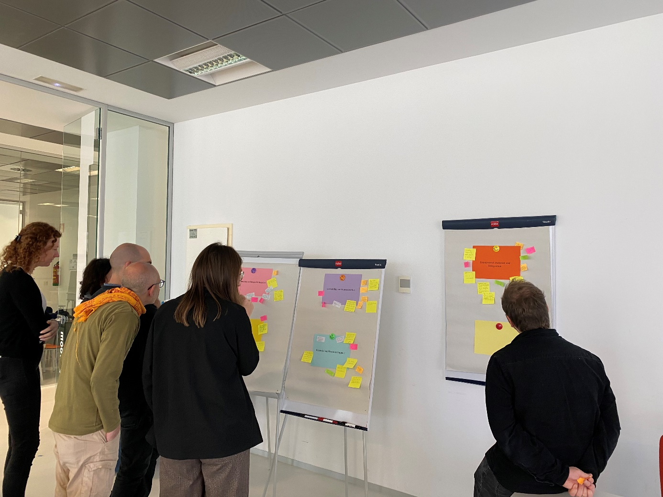
Identifying gaps
Need for
Comprehensive and effective mechanisms to engage and involve the general public, including local communities, in the adaptation planning process.
More specific details on how participation is facilitated.
A clear articulation how feedback from stakeholders is incorporated into decision-making.
A systematic study of gaps and barriers to stakeholder participation.
An explicit mention of mechanisms to ensure the representation of vulnerable and marginalized communities in the adaptation planning and decision-making processes.
Project: 101093921 — AGORA — HORIZON-MISS-2021-CLIMA-02

Slide 23
Policy gap clusters
Accessibility and representation: Need for an inclusive approach, better minority representation, clearer definitions of vulnerability, and improved engagement with vulnerable groups and civil society.
Communication and education: Inaccessible language, limited educator knowledge, insufficient climate change topics in curricula, ineffective top-down strategies, and a lack of local knowledge recognition and proactive scientific communication.
Feedback mechanisms: Unavailability, lack of whistleblower channels, insufficient accountability, overreliance on online platforms, and a disconnect between stakeholders and relevant parties.
Financial and resources: Outdated cost-benefit analyses, lack of accountability, excessive bureaucracy, insufficient funding, limited capacity building resources, confusion over large financial figures, and inefficient resource allocation.
Engagement duration and integration: Lack of continuity post-project, inflexible political timelines, insufficient expertise in knowledge brokering, unclear engagement goals, and inadequate integration of engagement processes into decision-making.
Project: 101093921 — AGORA — HORIZON-MISS-2021-CLIMA-02

Slide 24
Citizen participation
Mostly tokenism.
Effectiveness? ← Actual implementation and practical application.
How do decision makers consider inputs received in the participatory processes?
Do stakeholders actively participate in the participatory processes?
Analysis validation ← survey April-May 2024 with a randomized sample of citizens and interviews
Current Line of Research
1, 2, 3, 5, 6
2, 4, 5, 6
1, 2, 4, 5, 6
1, 3, 4, 5, 6
Project: 101093921 — AGORA — HORIZON-MISS-2021-CLIMA-02

Slide 25
Conclusion
• Spain’s policies show strong participatory elements.
• Need for more structured and inclusive mechanisms.
• Emphasis on practical application and stakeholder feedback.
• Future steps: address gaps, enhance stakeholder engagement, ensure effective implementation.
Project: 101093921 — AGORA — HORIZON-MISS-2021-CLIMA-02

Slide 26
Thank you for your attention!
Project: 101093921 — AGORA — HORIZON-MISS-2021-CLIMA-02

