Slide 1
Modelling Water and Biodiversity in the context of Forest Resilience
Elisa Z. Stefaniak
(contact: Stefaniak@iiasa.ac.at)
EGU 2024, VIenna

Slide 2
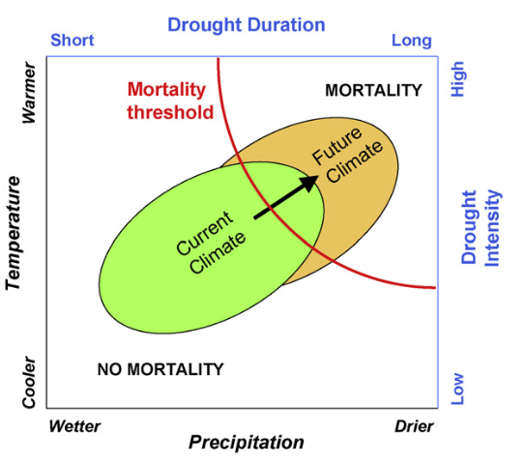
Changes to water and temperature regimes will affect the feedbacks between forests and the hydrological cycle
Climate change is pushing tree survival beyond current threshold – increasing mortality events around the globe
Tree recovery from drought can take days (photosynthesis) to years (growth) compared to potentially rapid death
Allen et al 2010, A global overview of drought and heat-induced tree mortality reveals emerging climate change risks for forests

Slide 3
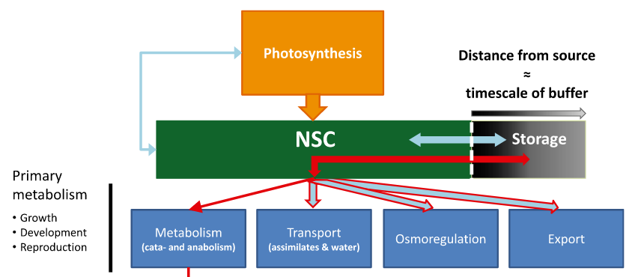
Tree survival mediated by resistance and acclimation and species diversity
After water stress plants can have different C allocation strategies (especially carbon storage) suggesting potential for local acclimation
Forests with greater biodiversity affect water use and potential survival during drought
However, these responses are complex, species dependent
Hartmann and Trumbore (2016) NPH

Slide 4
Tree survival mediated by acclimation and species diversity
After water stress plants can have different C allocation strategies (especially carbon storage) suggesting potential for local acclimation
Forests with greater biodiversity affect water availability and potential survival during drought
However, these responses are complex, species dependent
Hartmann and Trumbore (2016) NPH

Slide 5
Current hydrological models missing good forest representation...
Forests usually represented as simplified big-leaf models and Plant Functional Types (PFTs)
PFTs simplify the complex inter-species interactions and dependencies

Slide 6
… and forest models will benefit from better soil water processes and plant hydraulics
Many root processes are still underrepresented in models
Competition for water is generally not represented in vegetation models
Mortality during drought needs better representation understand forest change

Slide 7
PlantFATE (Plant Functional Acclimation and Trait Evolution): acclimation and adaptation
Short term acclimation of photosynthesis to environmental forcings (e.g. Temperature, soil water potential)
Competition drives resource availability – species represented by traits
Long term trait evolution towards maximising seed production
Joshi et al (2023) Competition for light can drive adverse species-composition shifts in the Amazon Forest under elevated CO2 (bioRxiv)

Slide 8
PlantFATE (Plant Functional Acclimation and Trait Evolution): acclimation and adaptation
Talk: (P-hydro) "Inferring geographic and climatic variation in plant hydraulic traits from flux data" Jaideep Joshi 16:55-17:05
Room 2.95
(Joshi, J. et al. 2022 Towards a unified theory of plant photosynthesis and hydraulics. Nat. Plants)
Short term acclimation of photosynthesis to environmental forcings (e.g. Temperature, soil water potential)
Competition drives resource availability – species represented by traits
Long term trait evolution towards maximising seed production

Slide 9
What's missing?
Spatial representation: effect of forest function and biodiversity on downstream water availability
Better tree mortality and recovery representation
Soil and root dynamics

Slide 10
CWatM – Community Water Model
Burek et al 2020 Development of the Community Water Model (CWatM v1.04) – a high-resolution hydrological model for global and regional assessment of integrated water resources management (GMD)

Slide 11
Coupling PlantFATE with CWatM (and ABCWatM)

Slide 12
Coupling PlantFATE with CWatM (and ABCWatM)
Bug creep so no preliminary results yet...
:-(

Slide 13
Better mortality: introduce Carbon Storage strategy
Mortality = f(C Storage concentration, net C uptake)
Storage strategy: phenology (timing of storage) and growth rate
Stefaniak et al (in preparation)

Slide 14
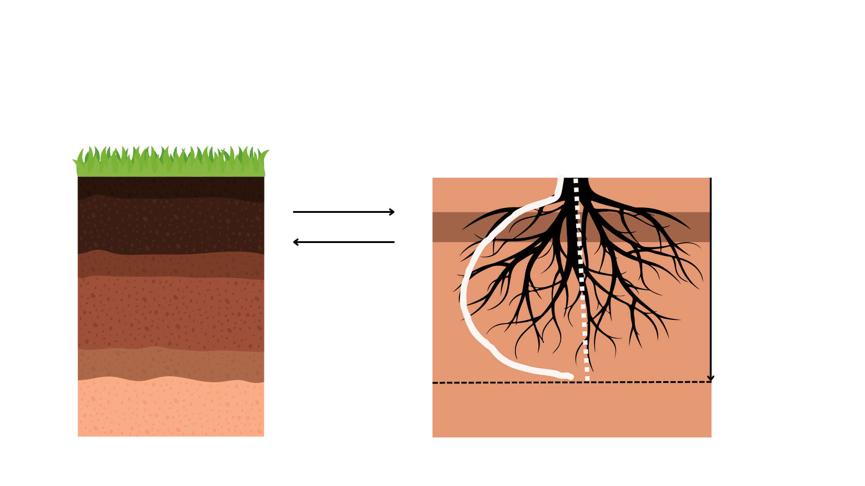
Root dynamics development (in progress – poster by Tania Maxwell)
CWatM: three soil layers
PlantFATE: continuous root profile (in progress)
ET=f(P50, LAI, …) = ΔWsoil
AIM: (1) explore optimal root traits and trade-offs
in terms of root diameter, SRL, maximum rooting depth and rooting architecture
(2) competition for water availability (future)
Soil Water Potential
ΔWsoil​ = f(root traits, SWP,
root shape,
depth …)
Water Use
depth
Dmax (max rooting depth)

Slide 15
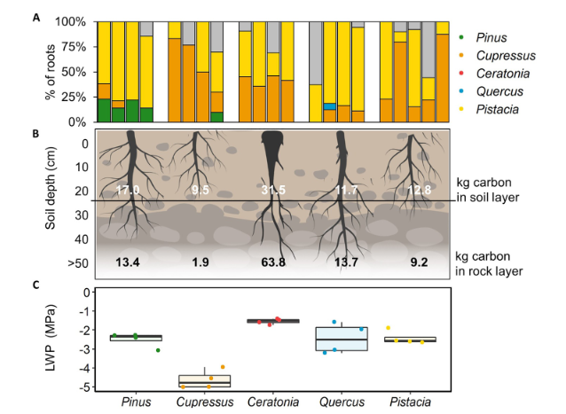
Current Applications
Drought Model Intercomparison Project
Coordinatedy by Jeremy Lichstein
Amazon response to drought
2 sites x 2 droughts x 2 biodiversity regimes
Single grid point
Yishi Forest (Israel) study site
5 species
Aridity gradient
Bhima Basin (India) - evaluating the food-water-biodiversity nexus
Bhima Basin
Water use and forest management scenarios informed by local stakeholders
Rog et al (2021) JGR Biogeosciences

Slide 16
Thank you
IIASA:
Jens De Bruijn
Jaideep Joshi,
Florian Hofhansl,
Tania Maxwell,
Mikhail Smilovic,
Silvia Artuso,
Juliette Martin
WSU:
Belinda Medlyn,
David Tissue
UNSW:
Daniel Falster
Weizmann Institut:
Tamir Klein (data)
Contact: stefaniak@iiasa.ac.at
Links: PlantFATE: https://iiasa.ac.at/models-tools-data/plantfate
CWatM: https://iiasa.ac.at/models-tools-data/cwatm

Slide 17
Root dynamics development (in progress)
CWatM: three soil layers
PlantFATE: continuous root profile (in progress)
ET=f(P50, LAI, …) = ΔWsoil
Soil Water Potential
ΔWsoil​ = f(root traits, SWP,
root shape,
depth …)
Water Use
depth
Dmax (max rooting depth)

