Slide 1
libpspm: a feature-rich numerical package for solving Physiologically Structured Population Models
Jaideep Joshi, Lai Zhang, Elisa Z. Stefaniak, Ulf Dieckmann, Åke Brännström

Slide 2
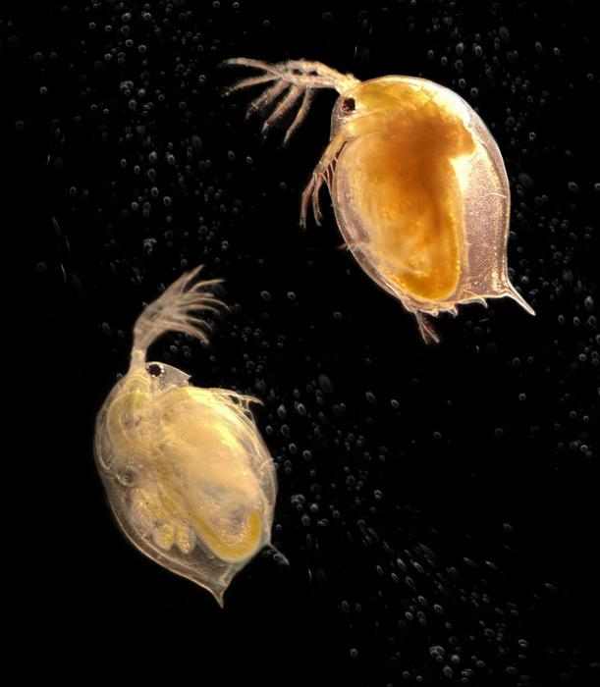
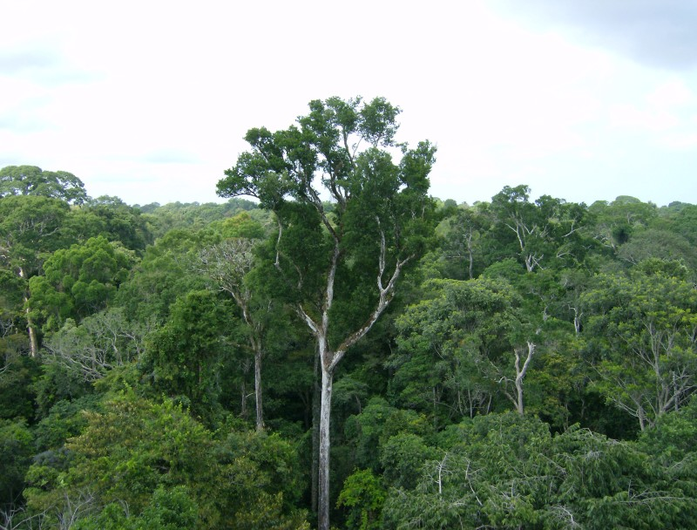
How do populations change over time?
Daphnia (water flea) growth depending on resource (algae) availability?
Tree communities in light-competitive environments?

Slide 3
Assumption
On a population level demographic rates (such as growth, fecundity and mortality) are size-dependent:
a cohort of size x will (statistically) behave in the same way

Slide 4
Two crucial components
Growth
Fecundity
Death
Environment
Population
Environmental
processes

Slide 5
Two crucial components
Growth
Fecundity
Death
Environmental
controls
Environment
Population
Population structure
feedbacks
Environmental
processes

Slide 6
Daphnia Example
Size-dependent demographic trade-offs in Growth
Fecundity
Death
Algae
Provision
Environment
Population
Algae
Demand
Algae growth

Slide 7
Forest Example
Height-dependent demographic trade-offs in Growth
Fecundity
Death
Light
Availability,
Environmental
Limitations (e.g. temperature)
Environment
Population
Tree crown shading
Update light
environment

Slide 8
PSPM definition (McKendrick-von Foerster equation)
$$\frac{∂u\left(x,t\right)}{∂t}=−∇∙\left(g\left(x,t,E\right)u\left(x,t\right)\right)−μ\left(x,t,E\right)u\left(x,t\right)$$
$$ψ ∙\left(g\left(x_{b},t,E\right)u\left(x_{b},t\right)\right)=\int_{Ω}{β\left(x,t,E\right)u\left(x,t\right)dx}$$
$$u\left(x,0\right)=u_{0}\left(x\right)$$
$$E\left(t\right)=\int_{Ω_{s}}{w\left(x,t\right)u\left(x,t\right)dx}$$
$u$ – density
$g$ – growth
$μ$ – mortality
$u_{0}$ - initial density
$E$ – environment
$w$ – weights
$β$ – birth rate
$x$ – state
$x_{b}$ - boundary state
$Ω$ – state space
$ψ$ - inward normal to the boundary surface

Slide 9
PSPM definition (McKendrick-von Foerster equation)
GROWTH
MORTALITY
DENSITY
$$\frac{∂u\left(x,t\right)}{∂t}=−∇∙\left(g\left(x,t,E\right)u\left(x,t\right)\right)−μ\left(x,t,E\right)u\left(x,t\right)$$
$$ψ ∙\left(g\left(x_{b},t,E\right)u\left(x_{b},t\right)\right)=\int_{Ω}{β\left(x,t,E\right)u\left(x,t\right)dx}$$
$$u\left(x,0\right)=u_{0}\left(x\right)$$
$$E\left(t\right)=\int_{Ω_{s}}{w\left(x,t\right)u\left(x,t\right)dx}$$
$u$ – density
$g$ – growth
$μ$ – mortality
$u_{0}$ - initial density
$E$ – environment
$w$ – weights
$β$ – birth rate
$x$ – state
$x_{b}$ - boundary state
$Ω$ – state space
$ψ$ - inward normal to the boundary surface

Slide 10
PSPM definition (McKendrick-von Foerster equation)
$$\frac{∂u\left(x,t\right)}{∂t}=−∇∙\left(g\left(x,t,E\right)u\left(x,t\right)\right)−μ\left(x,t,E\right)u\left(x,t\right)$$
$$ψ ∙\left(g\left(x_{b},t,E\right)u\left(x_{b},t\right)\right)=\int_{Ω}{β\left(x,t,E\right)u\left(x,t\right)dx}$$
$$u\left(x,0\right)=u_{0}\left(x\right)$$
$$E\left(t\right)=\int_{Ω_{s}}{w\left(x,t\right)u\left(x,t\right)dx}$$
$u$ – density
$g$ – growth
$μ$ – mortality
$u_{0}$ - initial density
$E$ – environment
$w$ – weights
$β$ – birth rate
$x$ – state
$x_{b}$ - boundary state
$Ω$ – state space
$ψ$ - inward normal to the boundary surface
DENSITY at
boundary
FECUNDITY

Slide 11
PSPM definition (McKendrick-von Foerster equation)
$$\frac{∂u\left(x,t\right)}{∂t}=−∇∙\left(g\left(x,t,E\right)u\left(x,t\right)\right)−μ\left(x,t,E\right)u\left(x,t\right)$$
$$ψ ∙\left(g\left(x_{b},t,E\right)u\left(x_{b},t\right)\right)=\int_{Ω}{β\left(x,t,E\right)u\left(x,t\right)dx}$$
$$u\left(x,0\right)=u_{0}\left(x\right)$$
$$E\left(t\right)=\int_{Ω_{s}}{w\left(x,t\right)u\left(x,t\right)dx}$$
$u$ – density
$g$ – growth
$μ$ – mortality
$u_{0}$ - initial density
$E$ – environment
$w$ – weights
$β$ – birth rate
$x$ – state
$x_{b}$ - boundary state
$Ω$ – state space
$ψ$ - inward normal to the boundary surface
ENVIRONMENT

Slide 12
How do we solve this?

Slide 13
Environment Model
libpspm package
PSPM solver
Individual Model
USER

Slide 14
Step 1: Define the PSPM model
$$\frac{∂u\left(x,t\right)}{∂t}=−∇∙\left(g\left(x,t,E\right)u\left(x,t\right)\right)−μ\left(x,t,E\right)u\left(x,t\right)$$
$$ψ ∙\left(g\left(x_{b},t,E\right)u\left(x_{b},t\right)\right)=\int_{Ω}{β\left(x,t,E\right)u\left(x,t\right)dx}$$
$$u\left(x,0\right)=u_{0}\left(x\right)$$
$$E\left(t\right)=\int_{Ω_{s}}{w\left(x,t\right)u\left(x,t\right)dx}$$

Slide 15
Step 1: Define the PSPM model
class Environment : public EnvironmentBase{ public: // Compute the current Environment and rates for unstructured species void computeEnv(double t, Solver * S, vector<double>::iterator s, vector<double>::iterator dsdt);
};
// The i-state dimensionality is specified using the template parameter DIM class Individual : public IndividualBase<DIM>{ public: // return the initial density (initial condition) double init_density(void * _env, double bf); // return demographic rates as functions of // the physiological variable x, time t, and environment _env vector<double> growthRate(double t, void * _env); double mortalityRate(double t, void * _env); double birthRate(double t, void * _env); };

Slide 16
Step 2: chose solver (the numerical solution implementations available in libpspm)
Fixed-mesh upwind method (FMU)
Characteristic method (CM)
Escalator-boxcar-train method (EBT)
Agent-based method
All 4 implemented in libpspm (as semi-implicit and explicit integration methods)

Slide 17
Step 2: chose solver
Environment E; Species<Individual> spp;
Solver S("ifmu", "rk45ck"); // Choose the PSPM method and the ODE solver
// add the created Environment 'E' and Species 'spp' to the solver S.setEnvironment(&E);
// While adding species, specify the initial resolution, birth state, etc,
// along each state dimension
S.addSpecies({25, 25}, {xb0, xb1}, {xm0, xm1}, {false, false}, &spp, 0, -1);

Slide 18
Step 3: run model
S.initialize(); // usually only needed if initial time is non-zero S.step_to(10);

Slide 19
Performance

Slide 20
Test models
Daphnia model (De Roos et al., 1990)
RED+ (Robust Ecosystem Demographics) – tree model (mass-structured) (Argles et al., 2019)
‘plant’ – height-structured mixed-species community model (Falster et al., 2011, 2017)

Slide 21
Criteria
Accuracy (biomass relative error e at equilibrium)
$$e=\frac{|M_{numerical}−M_{analytical}|}{M_{analytical}}$$
$$M=\int_{x_{b}}^{x_{m}}{xu\left(x\right)dx}$$
Efficiency (execution time)
Robustness (qualitative measure – doesn’t break and doesn’t get stuck on unreasonably small timesteps)
Diffusion (numerical diffusions in the prediction)
Versatility (extension to multi-dimensional physiological states)

Slide 22
Results – Daphnia and RED+ (cohort density)

Slide 23
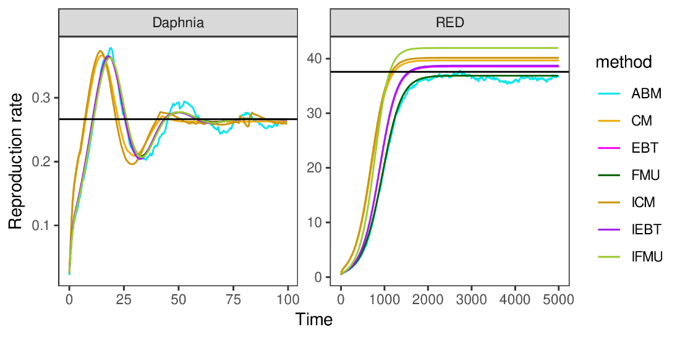
Results – Daphnia and RED+ (population level)

Slide 24
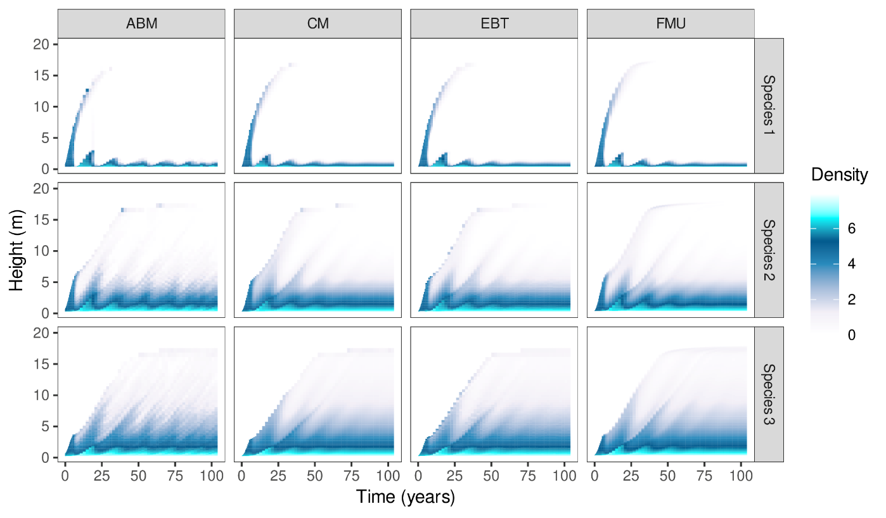
Results – ‘plant’

Slide 25
Recommendations
Method | Accuracy | Efficiency | Robustness | Diffusion | Versatility
FMU | Moderate | Moderate | Moderate | Moderate | Low
IFMU | Low-moderate | Low-moderate | Guaranteed | Very high | Moderate
EBT | Very high | Very high | Moderate | Zero | High
IEBT | Moderate | Very high | High | Zero | High
CM | Inconsistent | High | Moderate | Low | Low
ICM | Inconsistent | High | Moderate | Low | Low
ABM | Low | Very low | Guaranteed | Zero | Very high
25

Slide 26
Recommendations
Method | Problem is not stiff | Problem is stiff
Full density distribution desired | FMU | IFMU
Only integrated population-level quantities desired | EBT or CM | IEBT
26

Slide 27
Contact: stefaniak@iiasa.ac.at
joshi@iiasa.ac.at
doi: 10.1101/2023.08.04.551683
code: https://jaideep777.github.io/libpspm/
Thank you.

Slide 28
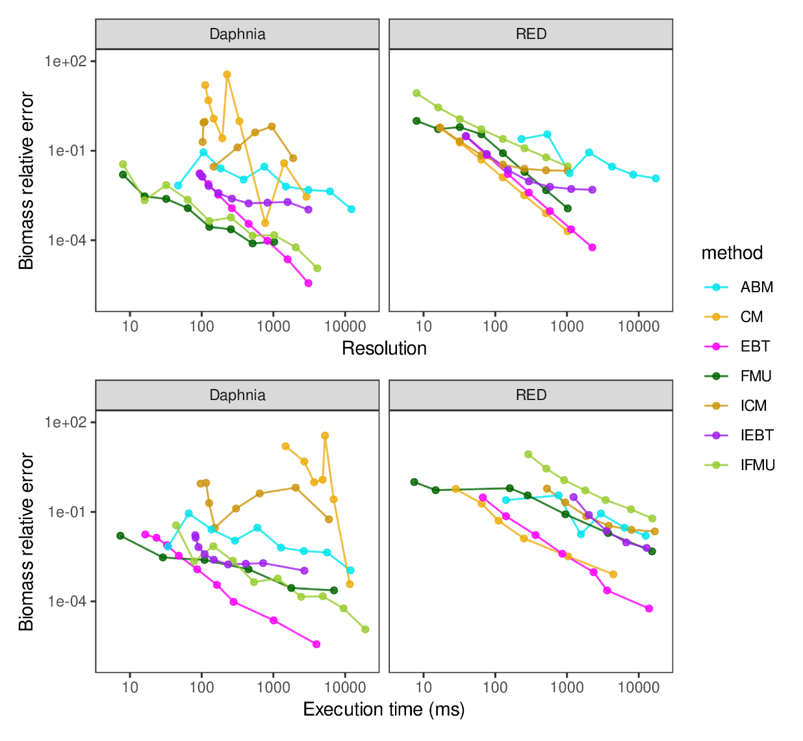
Results – Daphnia and RED+

