Slide 1
WG 4 - Stakeholder Engagement for Climate Impact Attribution Studies Opportunities, Challenges, and Pathways to Impact
April 25 | 2024
Albert Nkwasa (on behalf of a large team)
nkwasa@iiasa.ac.at

Slide 2
Rollercoaster ride
2. Perspective paper
3. Perspective paper
(current version)
Online meetings
2023
Not sure but soon
April 2024
1. Brainstorming Workshop
3. We need to submit
(climate impact assessments)
(at some point)

Slide 3
1. Paper writing workshop Best practices of addressing typical climate impact stakeholders
Vrije Universiteit Brussel

Slide 4
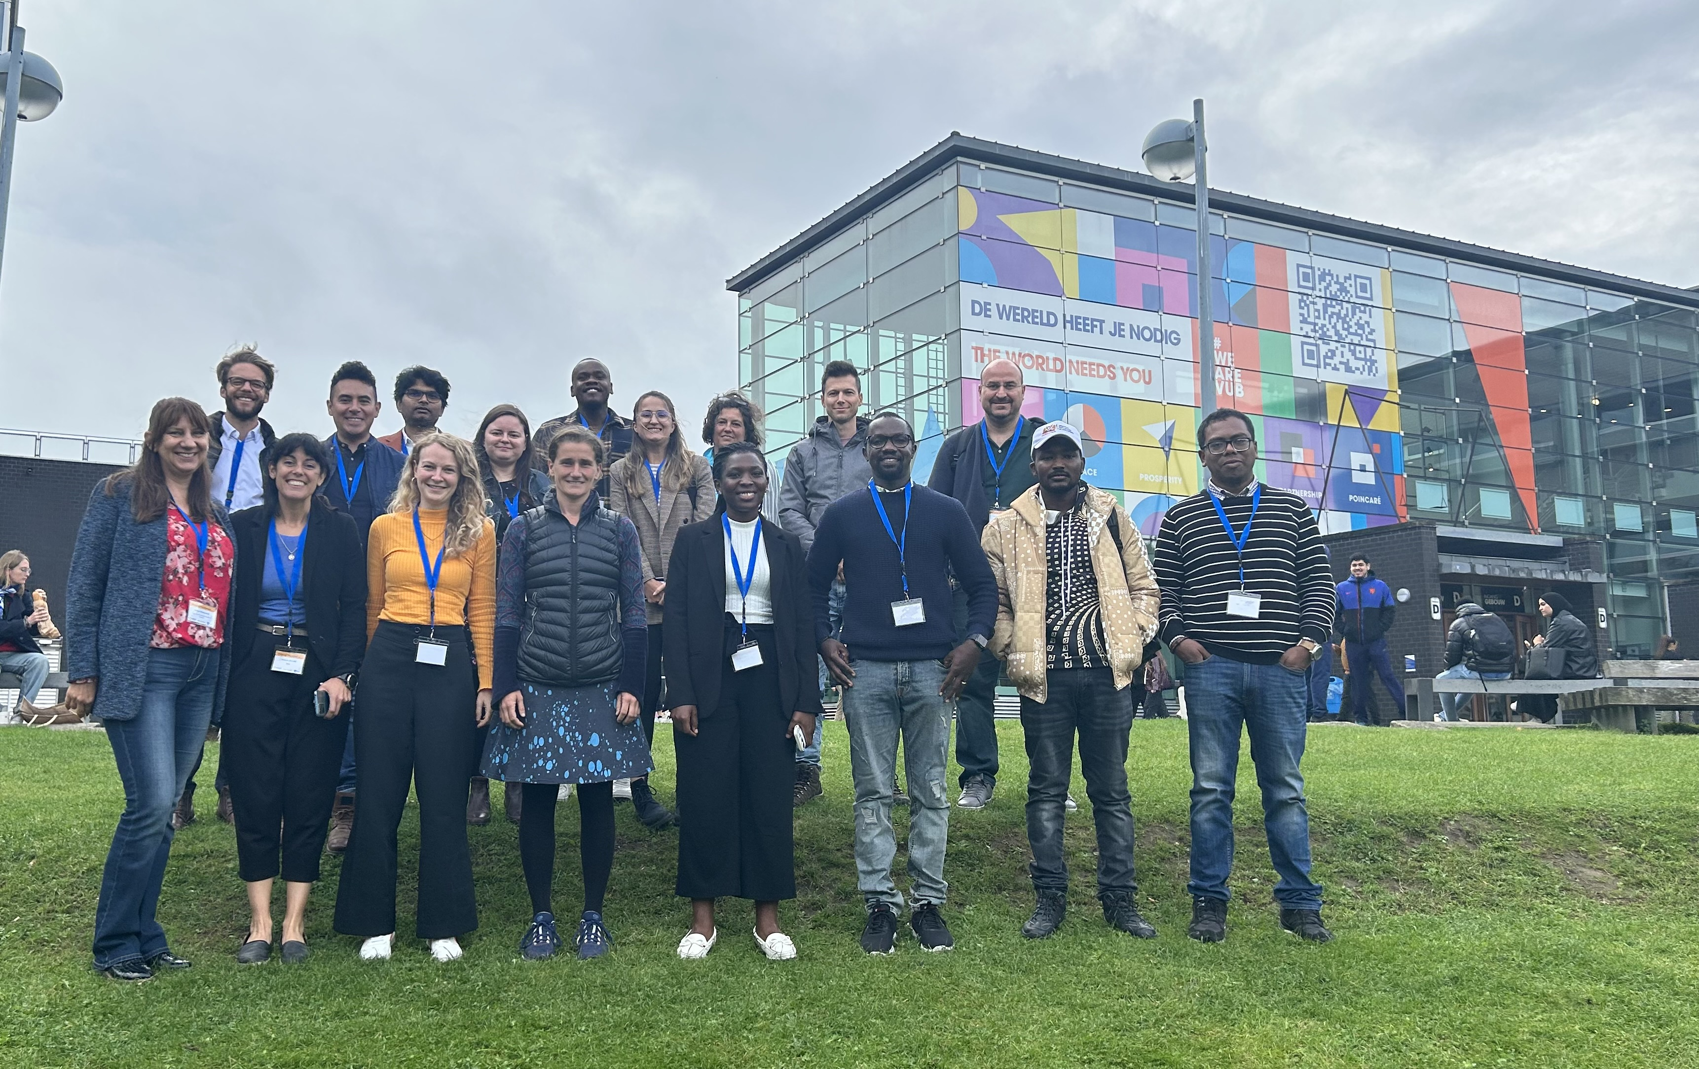
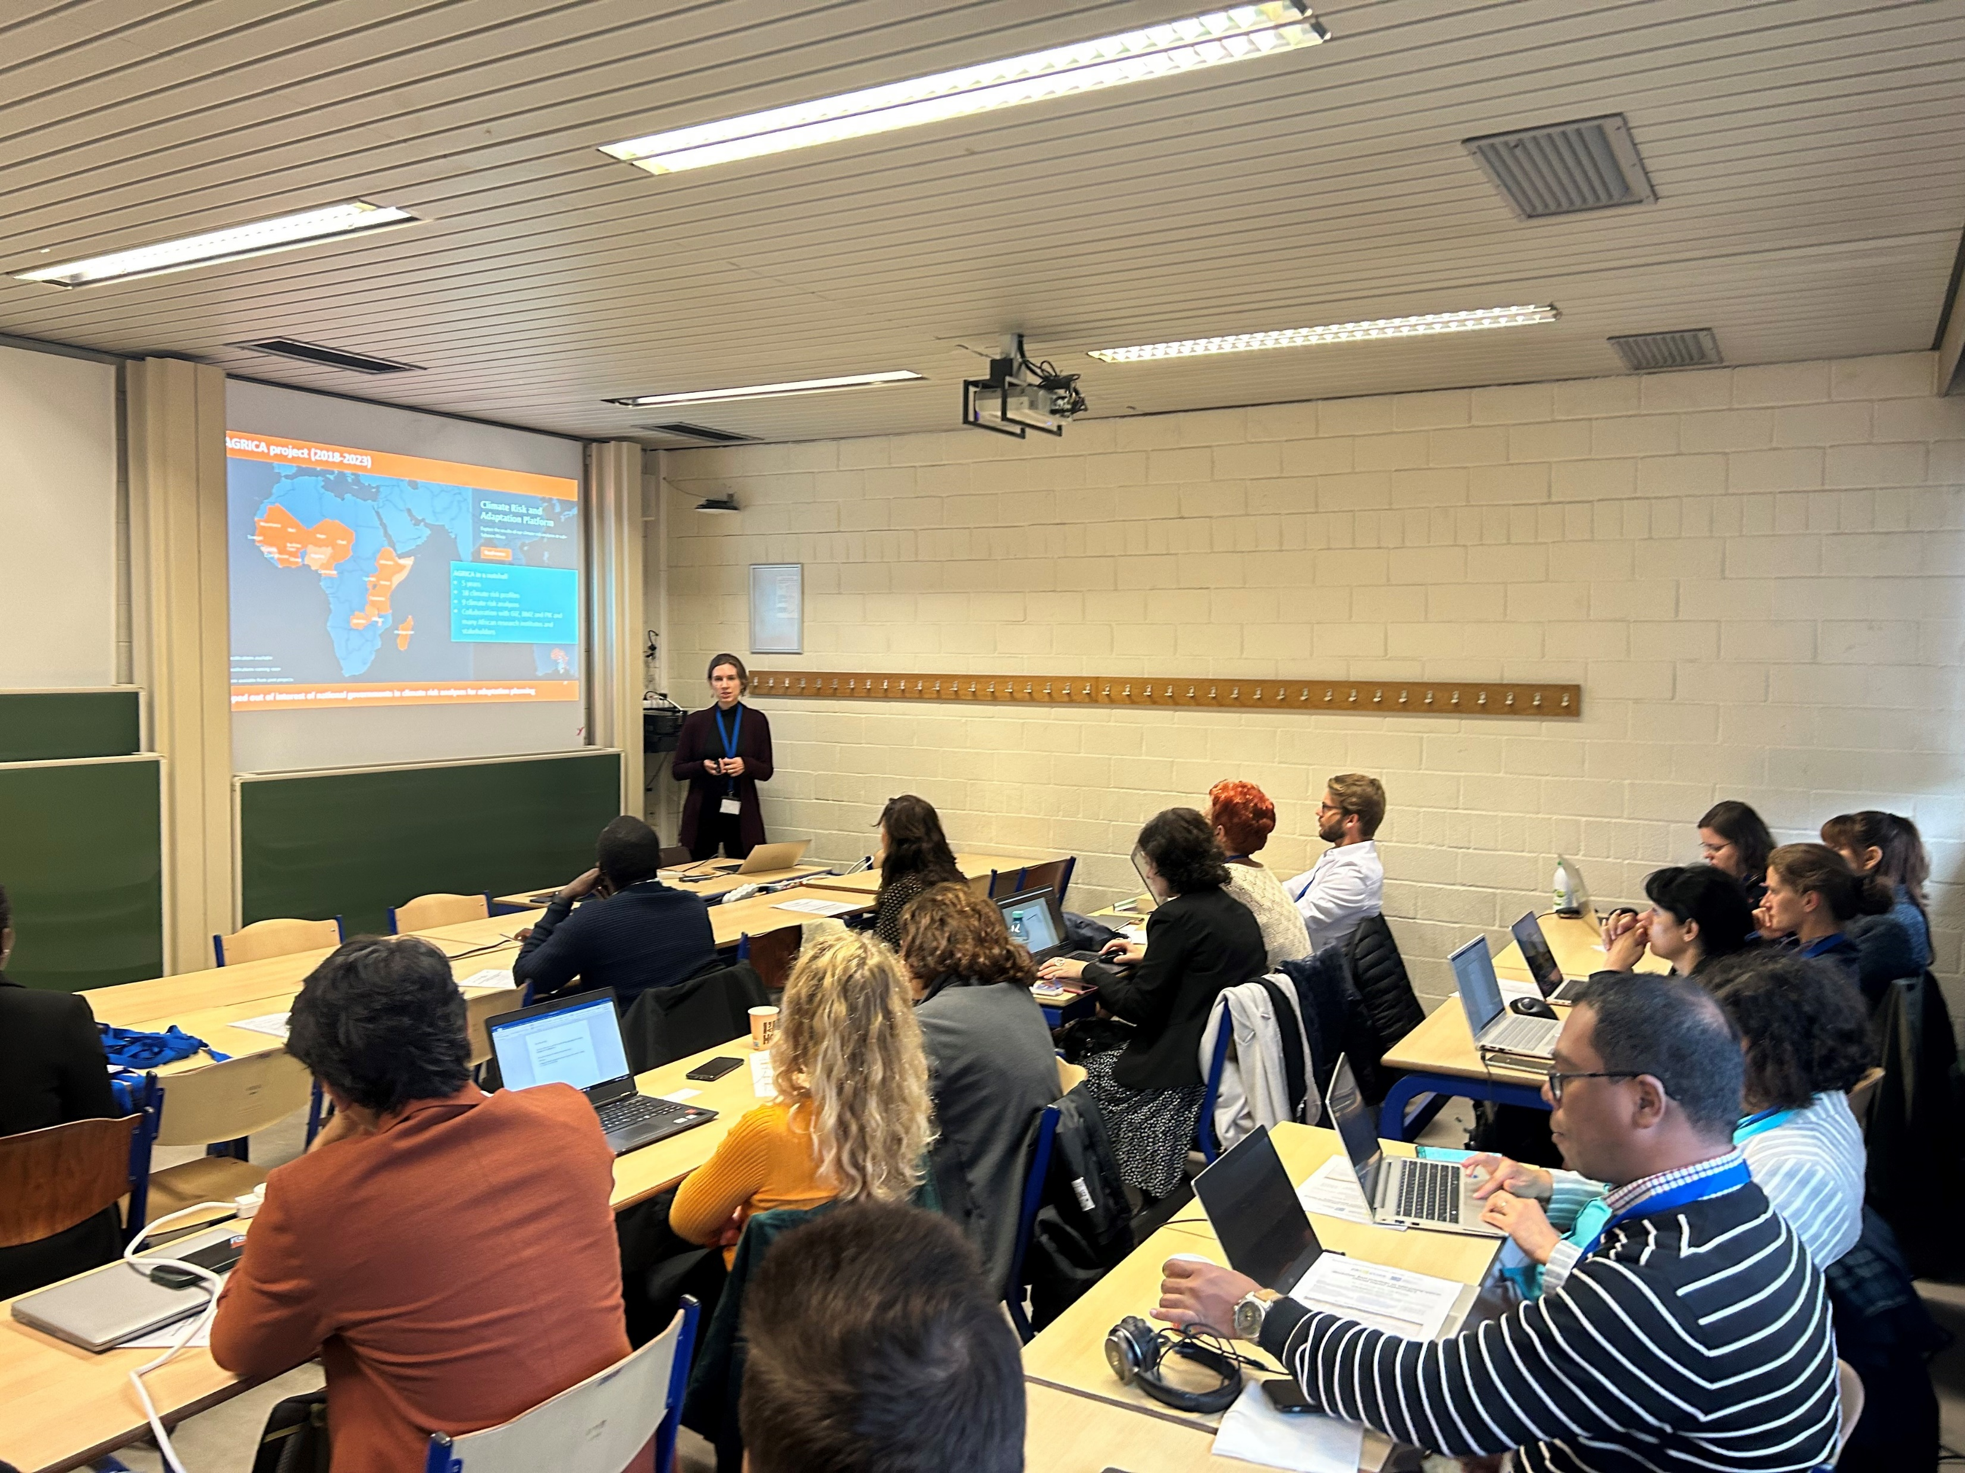
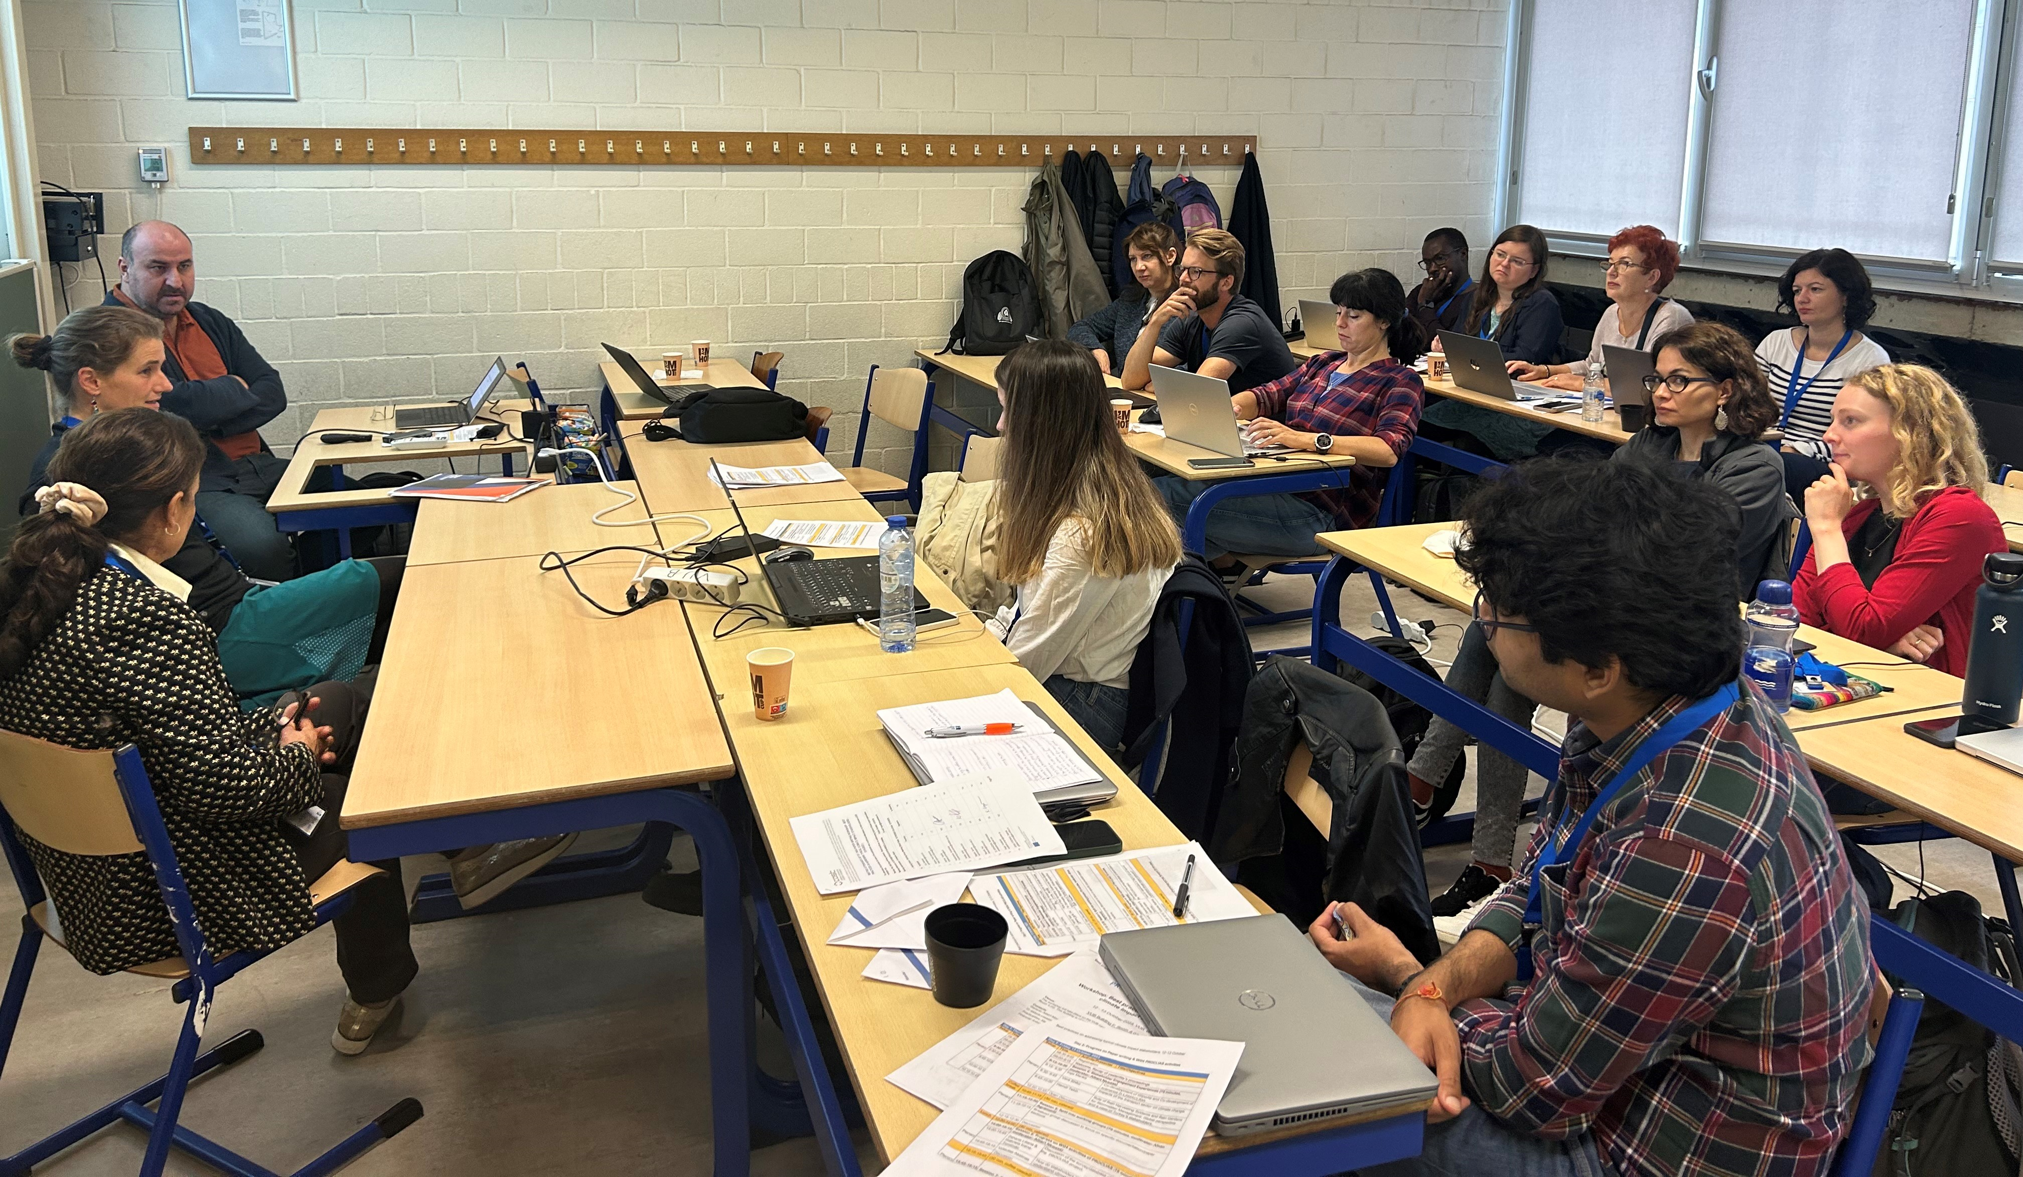
Sharing experiences about stakeholder engagement

Slide 5
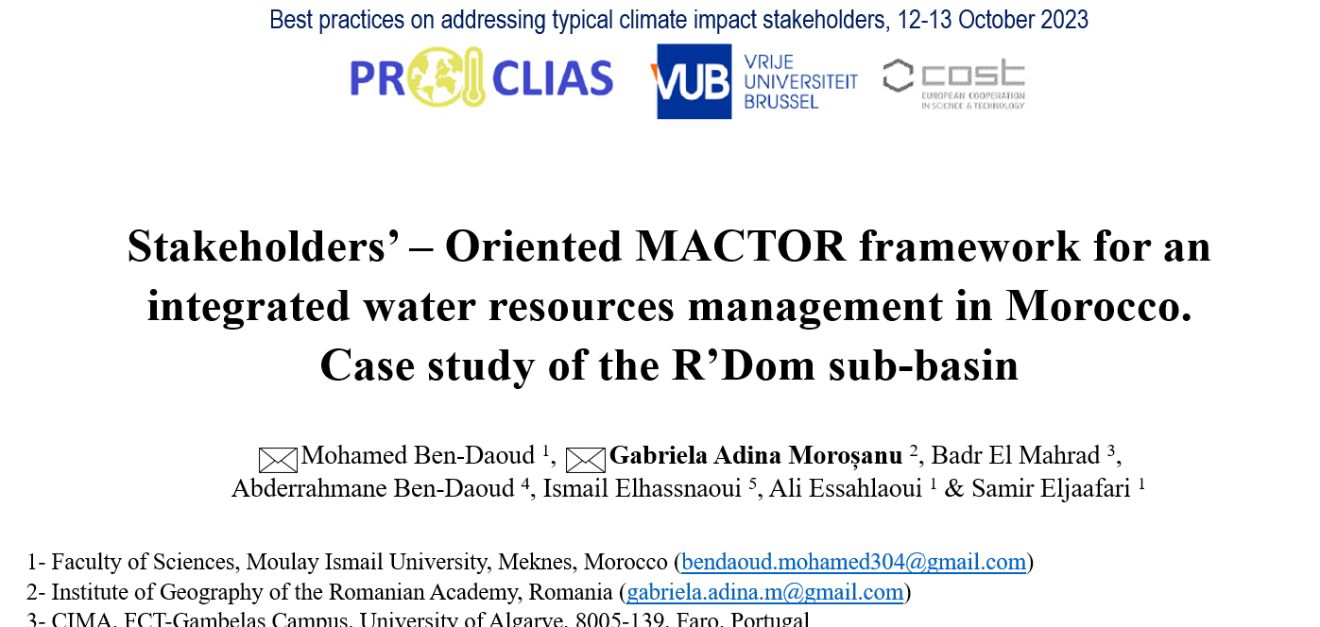
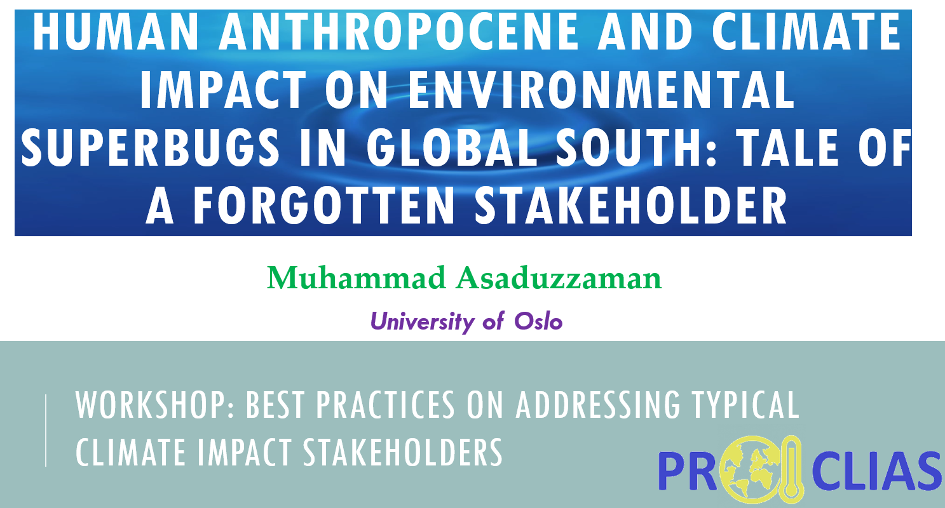
Engagement in several climate impact assessments
While strides have been made in the science of climate impact attribution, there remains a considerable amount of work in understanding the varied requirements of different stakeholders for such information.

Slide 6
2. Perspective piece Stakeholder engagement for climate impact attribution studies
6

Slide 7
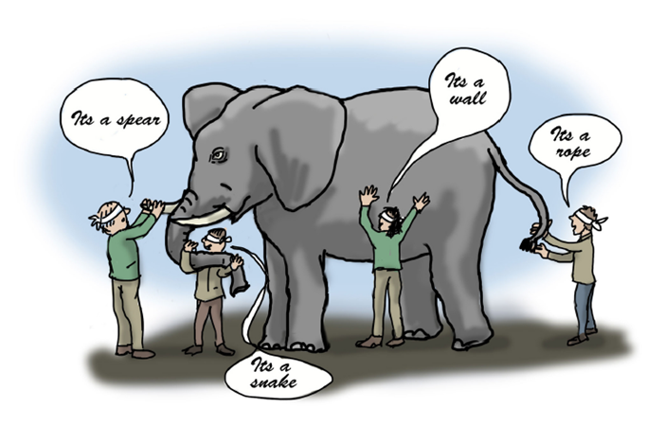
Relevance - Stakeholder engagement in climate impact attribution
(Franciss, 2015)
“Therefore, fragmented and isolated knowledge can become a form of ignorance if they resist integration into a broader understanding of reality”
7
Notes:
Stakeholder engagement in climate studies is crucial for ensuring that the decisions and actions taken to address climate change are not only scientifically sound but also responsive to the unique needs and perspectives of the communities affected

Slide 8
Cross-Learning: Benefits of stakeholder engagement
Modellers
Stakeholders
Typical stakeholder engagement process in climate impact assessments
Notes:
While methodologies and outputs should not be rigidly standardized, it is crucial to acknowledge that engagement approaches successfully applied in other climate impact assessments can be adapted for climate impact attribution studies

Slide 9
Challenges - Stakeholder engagement in climate impact attribution
Difficulties in consensus-building and potential delays due to the need to reconcile diverse interests
Requires substantial time, financial resources, and commitment for a successful engagement process
Most climate impact attribution research is conducted by researchers in high income countries
Notes:
While methodologies and outputs should not be rigidly standardized, it is crucial to acknowledge that engagement approaches successfully applied in other climate impact assessments can be adapted for climate impact attribution studies

Slide 10
Pathways to impact
Early engagement with stakeholders
Important to identify the relevant stakeholders
Uncertainty communication
Building expertise in low to middle income countries
Citizen science – low hanging fruit
Participatory approach
Notes:
Incorporating stakeholders at various levels in climate impact attribution science is pivotal to producing policy- and practically relevant outputs. Shifting the climate impact attribution research agenda from a scientist-centric approach to one that involves public participation, with various levels including not only stakeholder consultation, but also active involvement, is imperative

Slide 11
Next step(s)
Notes:
Incorporating stakeholders at various levels in climate impact attribution science is pivotal to producing policy- and practically relevant outputs. Shifting the climate impact attribution research agenda from a scientist-centric approach to one that involves public participation, with various levels including not only stakeholder consultation, but also active involvement, is imperative

Slide 12
Thank you for your attention.
nkwasa@iiasa.ac.at

Slide 13
Stakeholder Mapping Liliana Zaharia and Gabriela Ioana-Toroimac
University of Bucharest

Slide 14
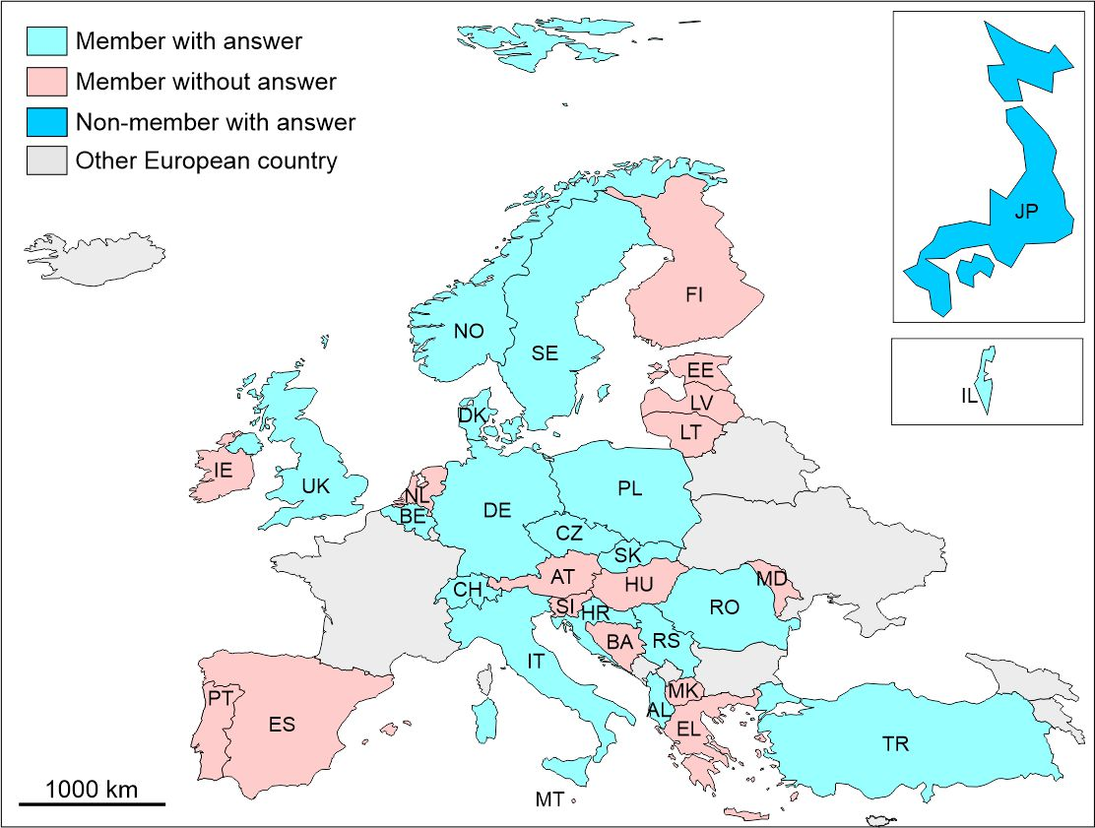
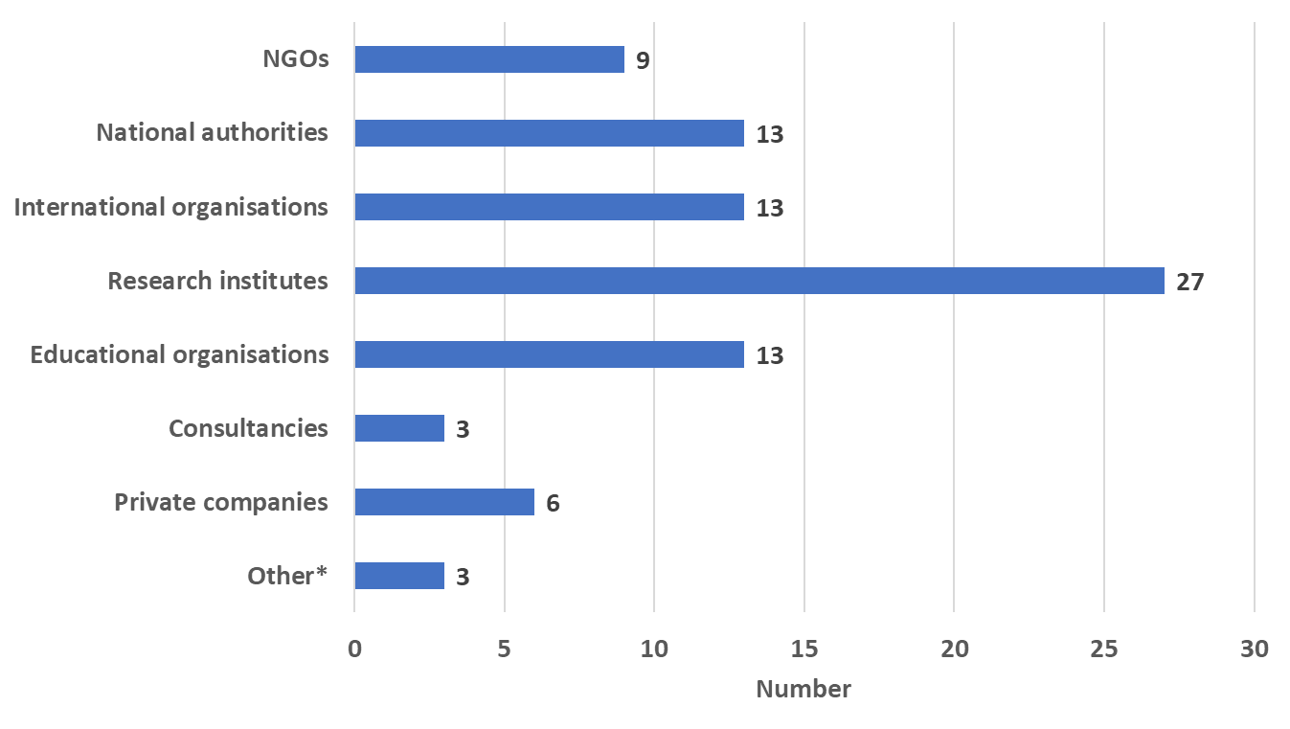
Identifying potential stakeholders & database creation
*Based on 2021 surveys
Geographical distribution of the countries involved in PROCLIAS
Stakeholder categories/types

Slide 15
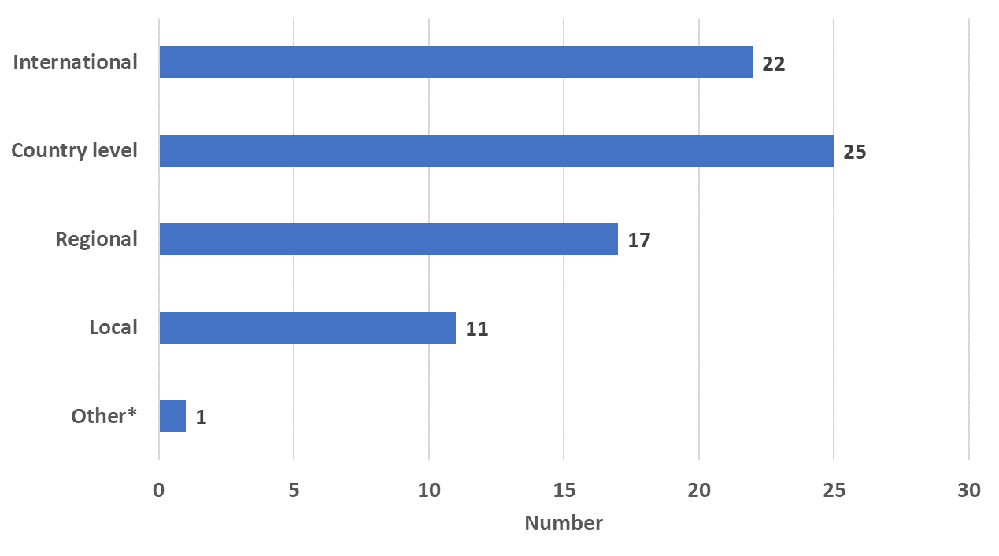
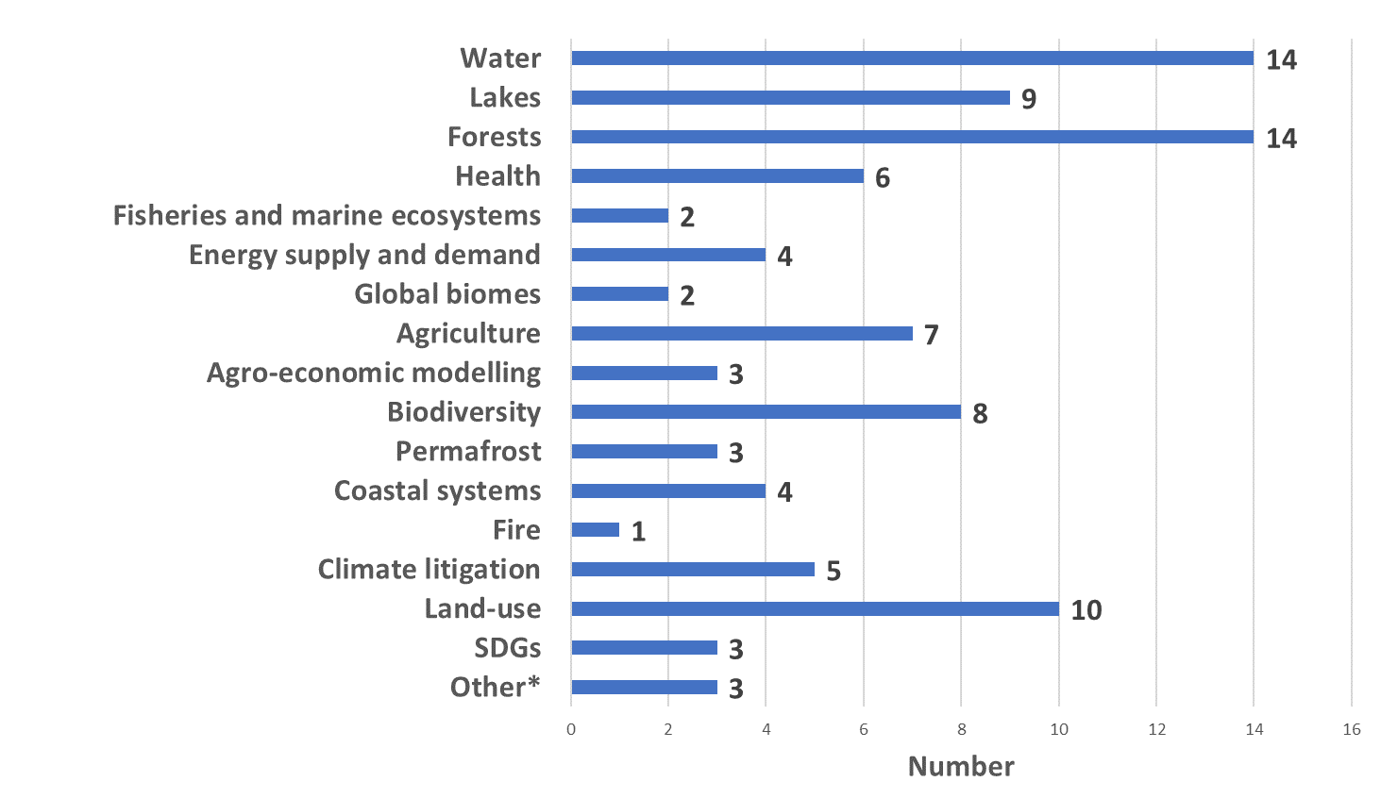
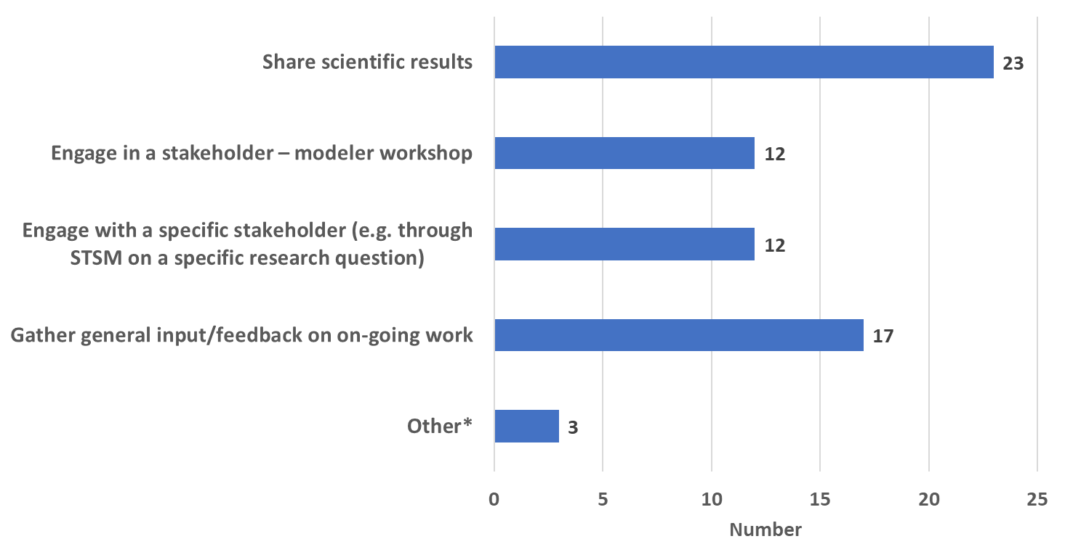
Identifying potential stakeholders & database creation
Geographical scale
*Based on 2021 surveys
Sectors of interest
Type of engagement

