Slide 1
A high-resolution community global SWATplus water quality model
11 July 2024
Albert Nkwasa, Celray James Chawanda, Ann van Griensven

Slide 2
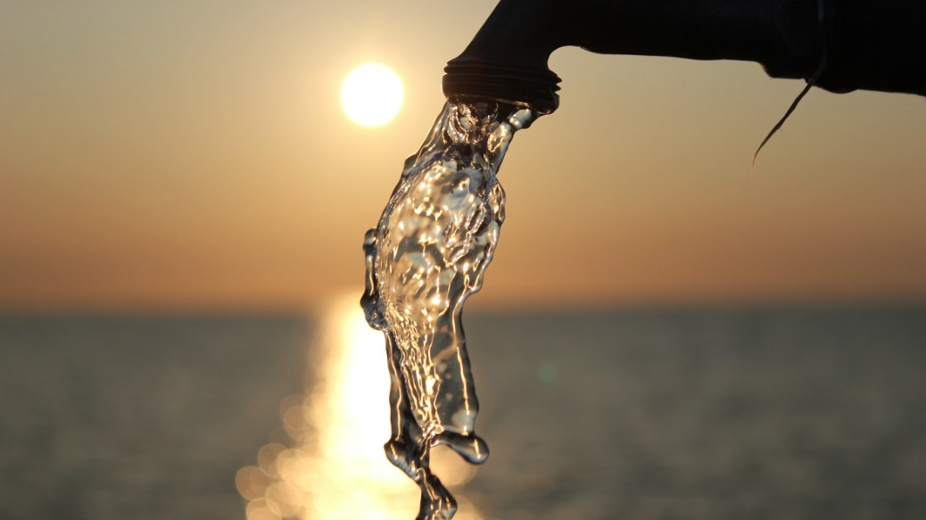
Quality Unknown: The invisible water crisis
2

Slide 3
Is Our Planet's Water Clean?
Uppsala Conflict Database Program
3
Notes:
-Water pollution has worsened since the 1990s in the majority of rivers in Latin America, Africa, and Asia (40%)/// people are using untreated water of unknown quality for drinking and domestic use
`-Water is polluted when the When water does not meet quality requirements
-0Water quality is determined by a large set of constituents (or parameters) representing the physical, biological and chemical aspects of water
→The most important current sources of pollution vary from pollutant to pollutant.
Ultimate causes of growing water pollution are population growth, increased economic activity, intensification and expansion of agriculture, and increased sewerage with no or low level of treatment
-Agriculture occupies 50 % of the habitable land.

Slide 4
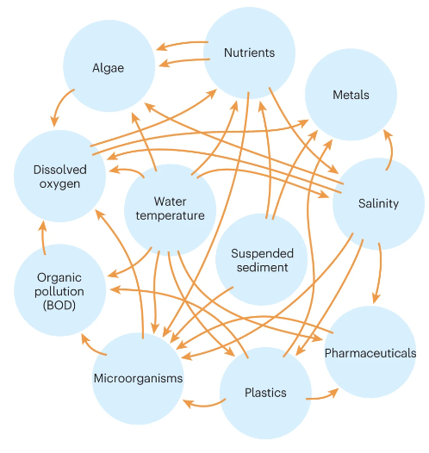
Which water quality variables?
By definition
1.Total Nitrogen (TN)
2. Total Phosphorus (TP)
Chemical
Physical
Biological
4
Notes:
Water quality refers to the chemical, physical, and biological characteristics of water. It is a measure of the suitability of water for specific purposes, such as drinking, irrigation, recreational activities, or supporting aquatic life.

Slide 5
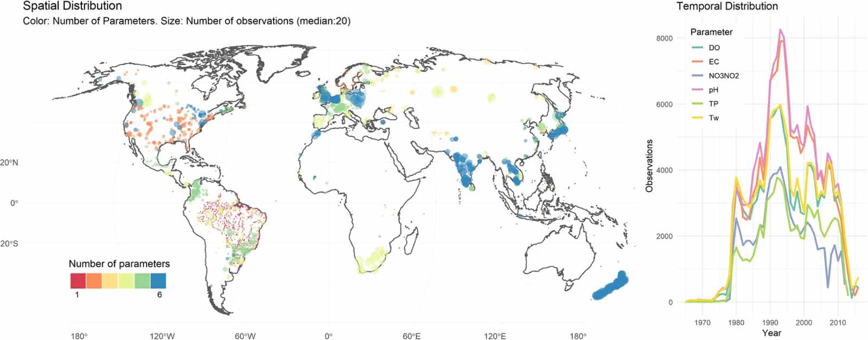
Data and Modelling Gap
(1) GEMStat data (Lacking & Incomplete)
(2) Existing Large scale Models
Only 2 global models (Nutrients)
Run at multi-yearly time step
Spatial resolution of ~ 55 km by 55 km
Lack model evaluations
(Desbureaux et al., 2022)
Limited observation data
Mostly > 30-year-old data
5

Slide 6
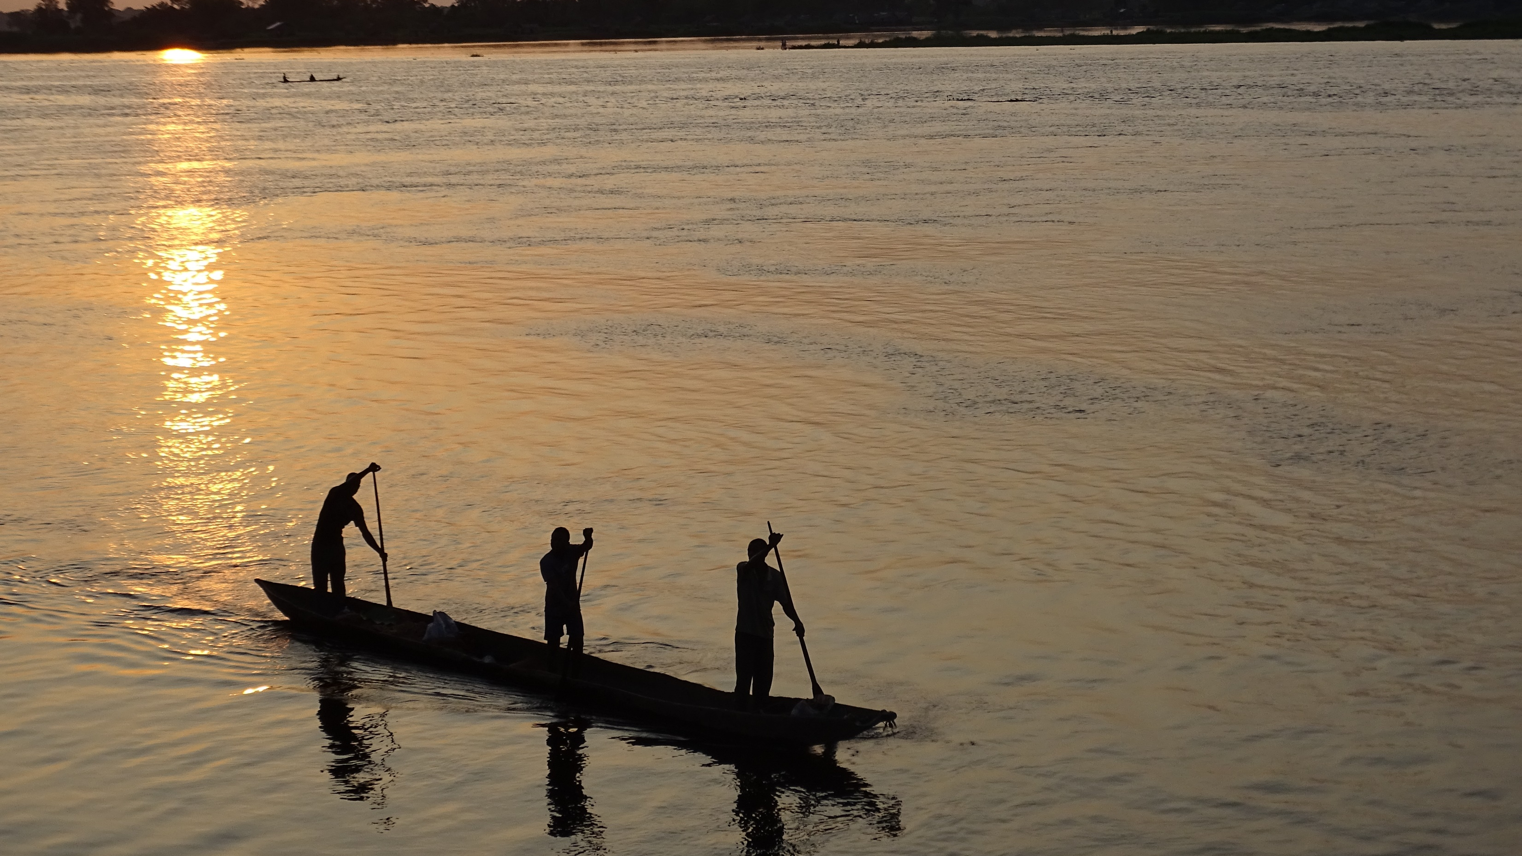
Bridge the data gap through modelling
6

Slide 7
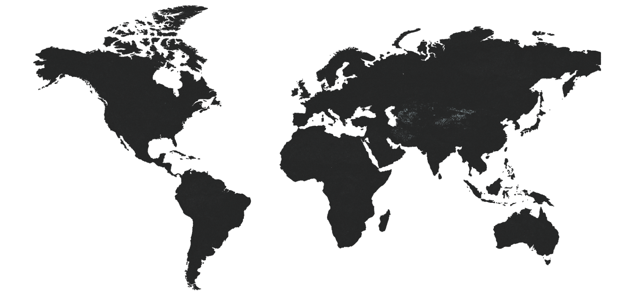
Global Datasets used for setup
DEM (SRTM)
Land use (ESA)
Soil (FAO)
2.6 Million HRUs
Climate data (ISIMIP2)
2 km Data resolution
7

Slide 8
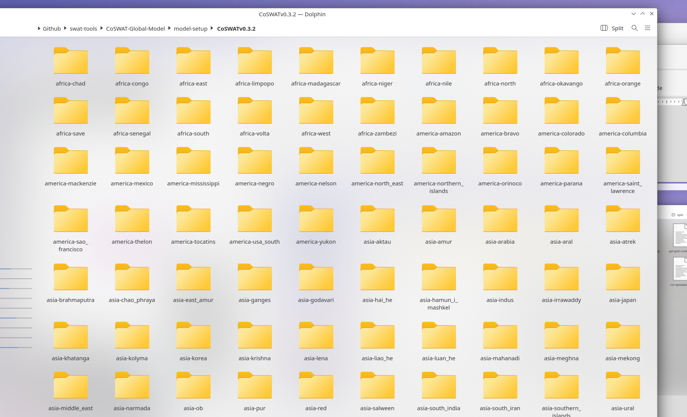
Setup is based on major basins and output is combined for global coverage
8

Slide 9
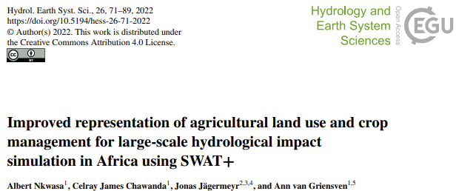
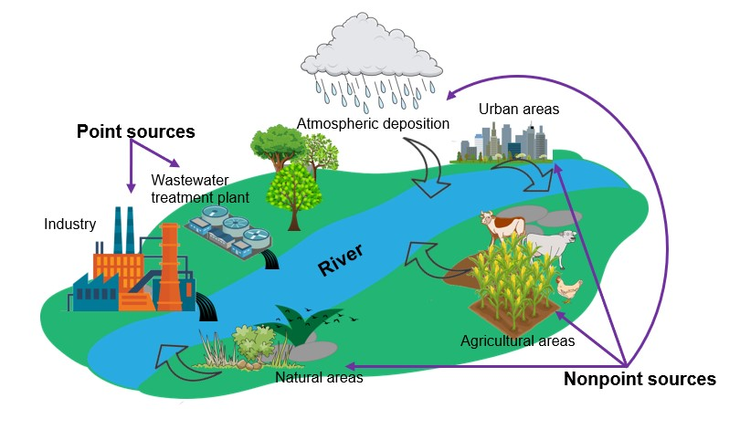
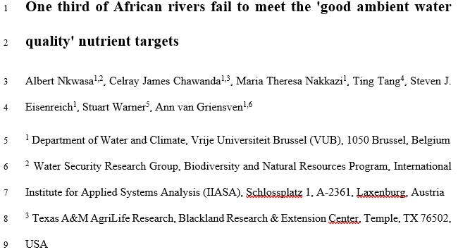
Water quality model setup
9

Slide 10
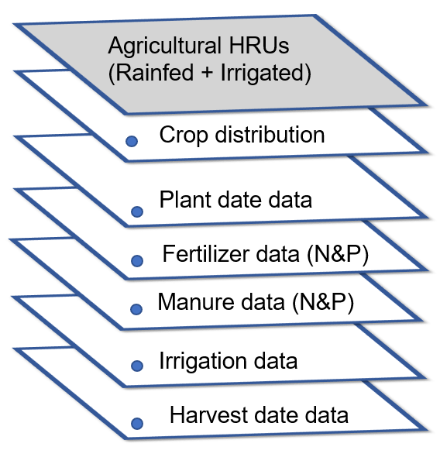
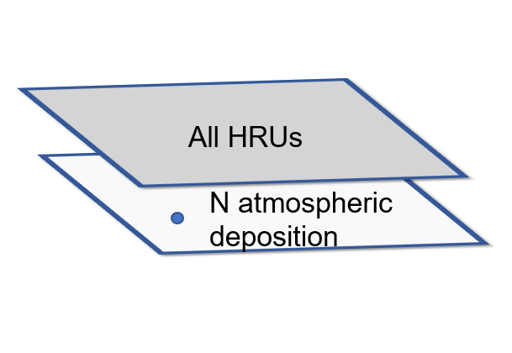
Water quality model setup
Non-point sources
Surface runoff + leaching
Surface runoff + leaching
Point source (Sewage)
Decision tables +
River export (Sediment load, TN & TP)
(Nkwasa et al., 2022a; Nkwasa et al., 2022b)
10

Slide 11
Methods and Data for historical & future runs
Climate
SSPs
SWAT+ model
ISIMIP2b:
Current: bias-corrected meteorological forcing dataset EWEMBI from 1980 - 2009
Future: bias-corrected global climate data (2010 – 2050)
for four GCMs (GFDL-ESM2M, IPSL-CM5A-LR, MIROC5, HadGEM2-ES) and
three climate scenarios (RCP2.6, RCP6.0, RCP8.5),
at 0.5° x 0.5° resolution
Climatic variables: Precipitation, temperature, solar radiation, wind speed, relative humidity
IMAGE-GNM
Scenarios for development of socio-economic and global environmental (SSP1, SSP3, SSP5) – (2010 – 2015)
Nitrogen and Phosphorus fertilizer & manure
Wastewater discharge (point sources)
Atmospheric deposition (Nitrogen)
*UNCALIBRATED GLOBAL MODEL*
11
11
Notes:
In SSP1, progress is made toward sustainable development, with ongoing efforts to achieve sustainable development goals by improving efficiencies and recycling, reducing food wastes, while reducing resource intensity and fossil fuel dependency. SSP2 is a middle of the road scenario, SSP3 portrays a fragmented world with regions differing widely in socio-economic development. SSP4 represents a strongly unequal world with a small elite and a large, poor and vulnerable group. SSP5 involves traditional development with a focus on economic growth relying strongly on fossil fuels

Slide 12
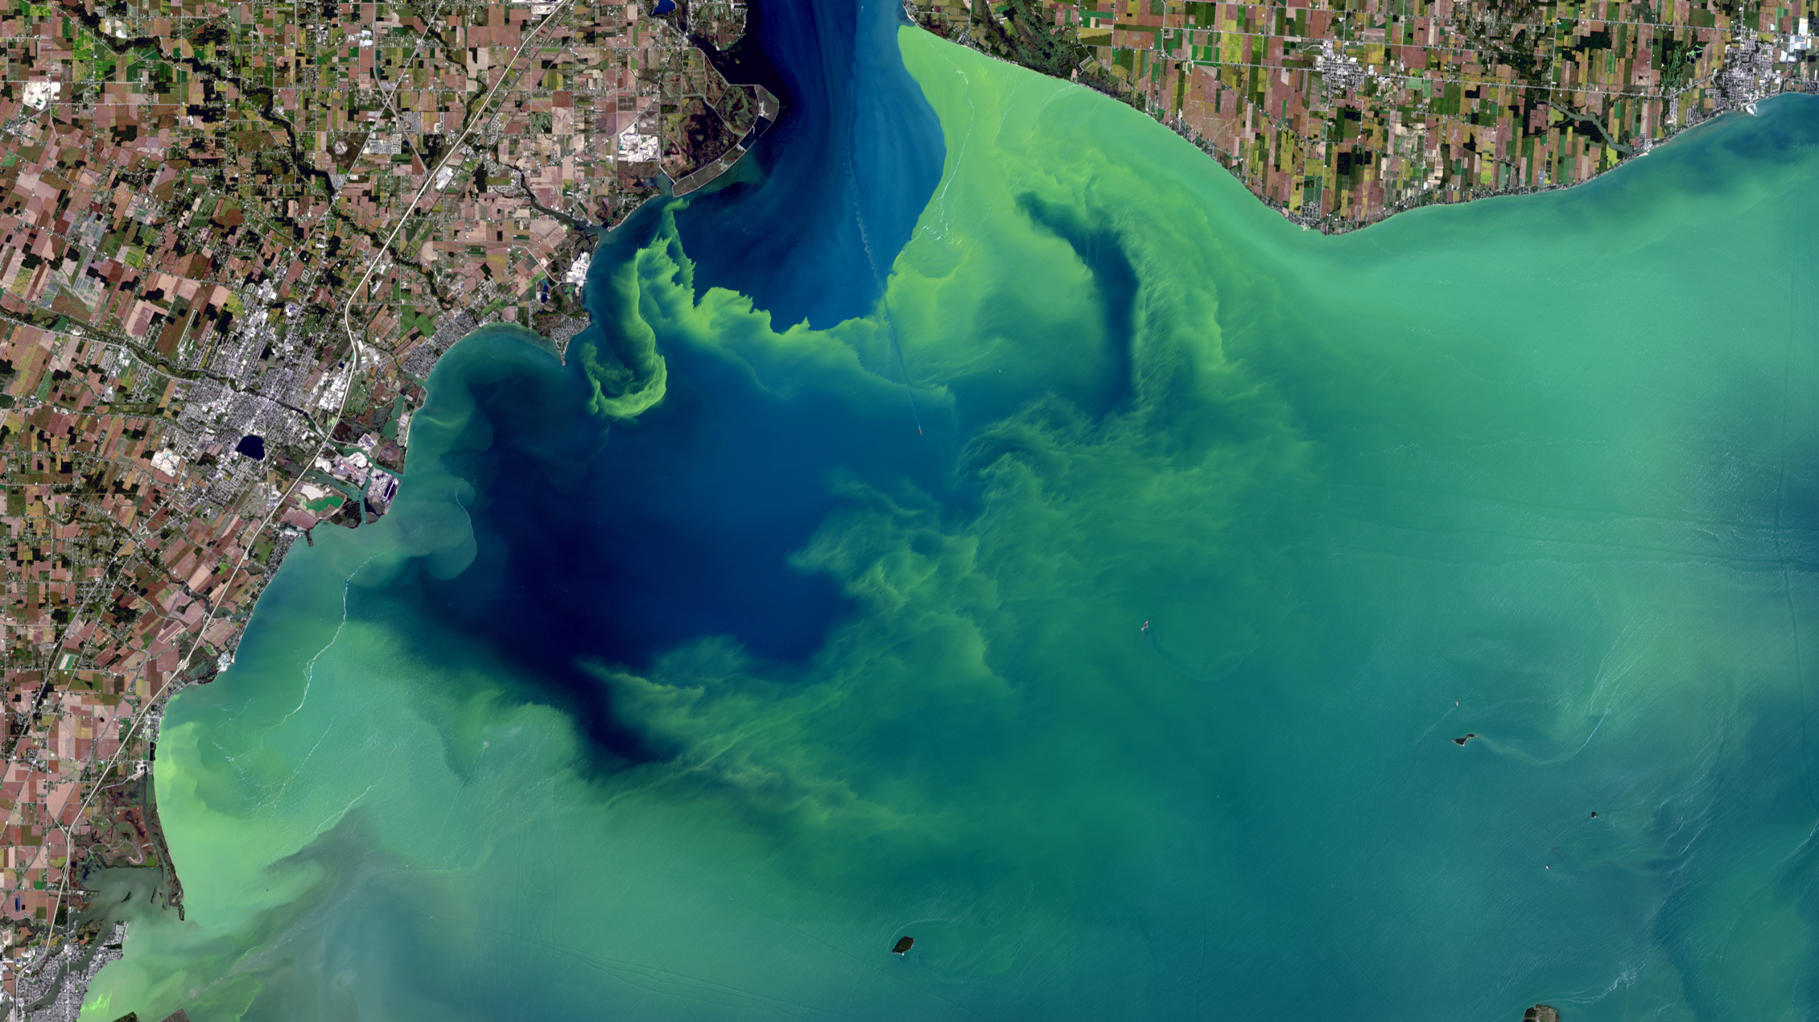
Increase in nutrient pollution in all scenarios
12

Slide 13
TN & TP - historical & future river loadings
IMAGE-GNM
SWAT+
TN load (Gg/yr)
IMAGE-GNM
SWAT+
TP load (Gg/yr)
13

Slide 14
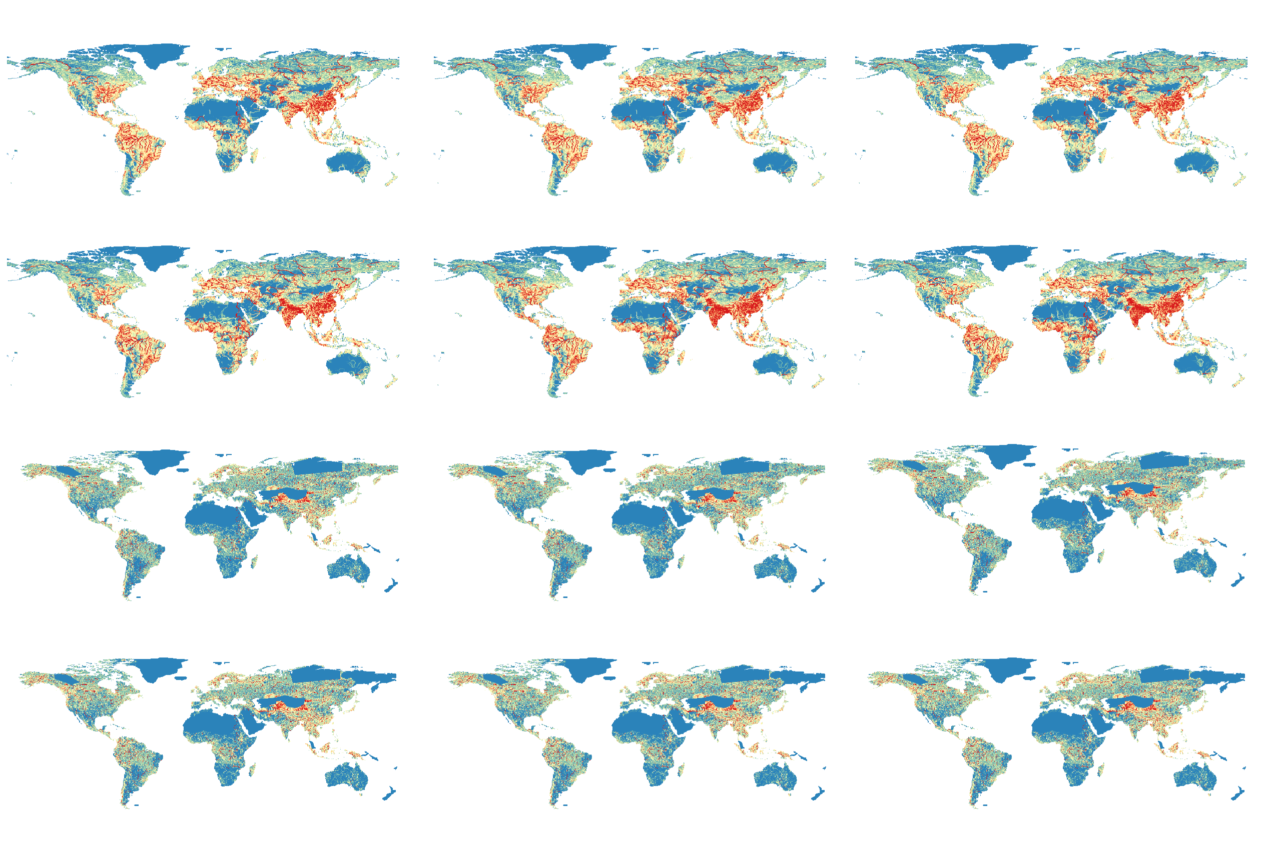
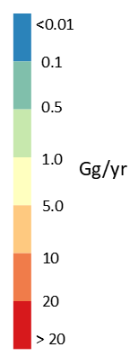
TN simulations
SSP1-RCP26
SSP3-RCP60
SSP5-RCP85
2010
IMAGE-GNM
2050
2010
SWAT+
2050
14

Slide 15
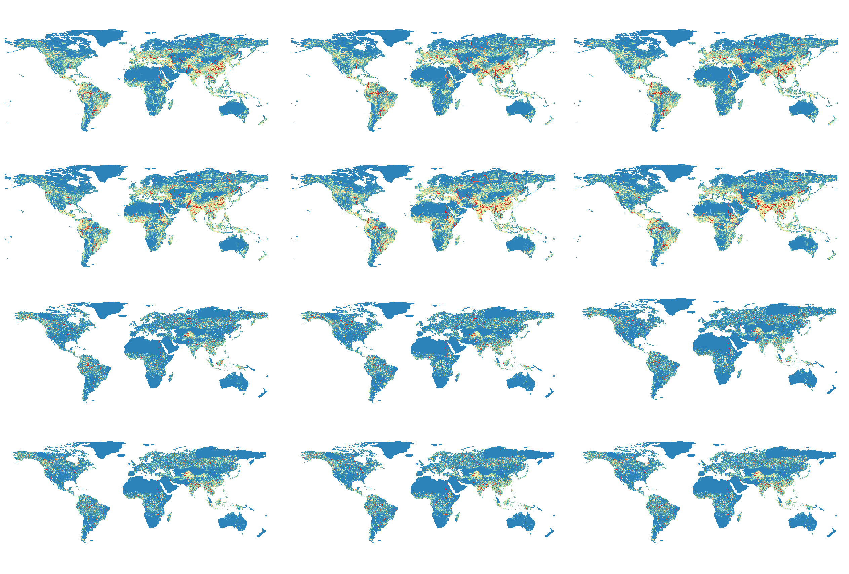
TP simulations
SSP1-RCP26
SSP3-RCP60
SSP5-RCP85
2010
IMAGE-GNM
2050
2010
SWAT+
2050
15

Slide 16
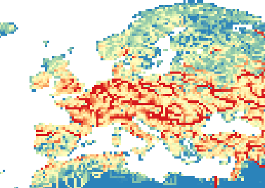
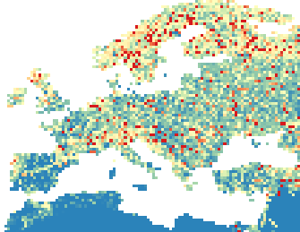
TN simulations – Europe
SSP5-RCP85
IMAGE-GNM
SWAT+
16

Slide 17
Why the differences?
Different model structures
Different climate GCM forcings
Run at different spatial and temporal resolutions
17

Slide 18
Key take-aways & outlook
Overall, regional bright and dark spots are captured
Focus should be on trends and hotspots but not absolute values
Both TN and TP river loads increase under all scenarios upto 2050
SWAT+ model simulates less load magnitude compared to IMAGE-GNM model
Model calibration and reservoir management operations to be implemented
18

Slide 19
Access to the simulation runs
Global water quality sector
DKRZ repository: /work/bb0820/scratch/water_quality/SWATplus/_doc/global/
19

Slide 20
Thank you.
nkwasa@iiasa.ac.at / albert.nkwasa@vub.be
20

