Slide 1
Complementary use of citizen science and EO data for addressing SDG data gaps
Dilek Fraisl, Linda See, Ian McCallum, Steffen Fritz

Slide 2
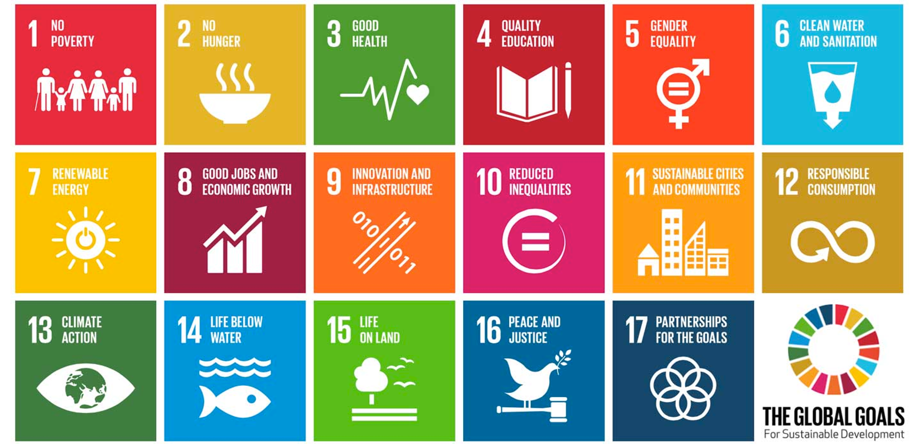
THE UN SUSTAINABLE DEVELOPMENT GOALS (SDGs)

Slide 3
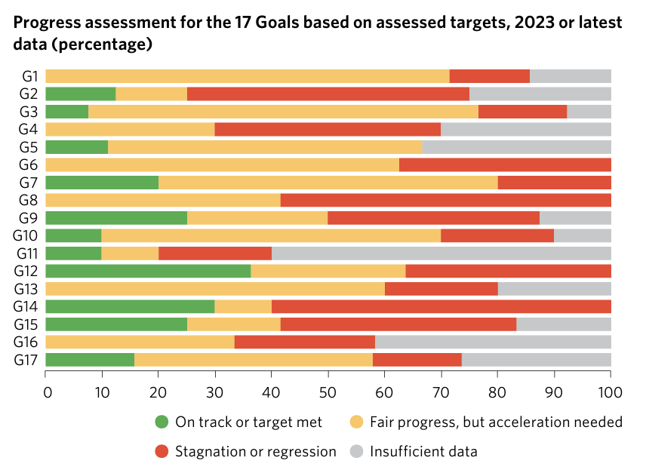
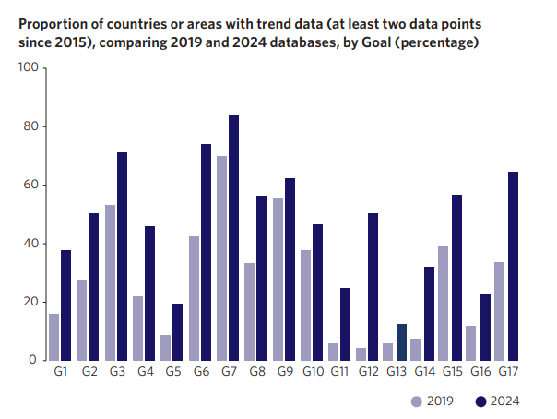
SDG DATA GAPS
Almost half of the 92 environmental SDG indicators lack data
Notes:
The variance in country data coverage plays out differently across the Goals, with major shortfalls in priority development areas, such as gender equality (Goal 5), climate action (Goal 13), and peace, justice and strong institutions (Goal 16). Moreover, data timeliness remains a challenge. Approximately one third of indicators lack data for the past three years, hampering the ability of policymakers to make timely informed decisions and course corrections.

Slide 4
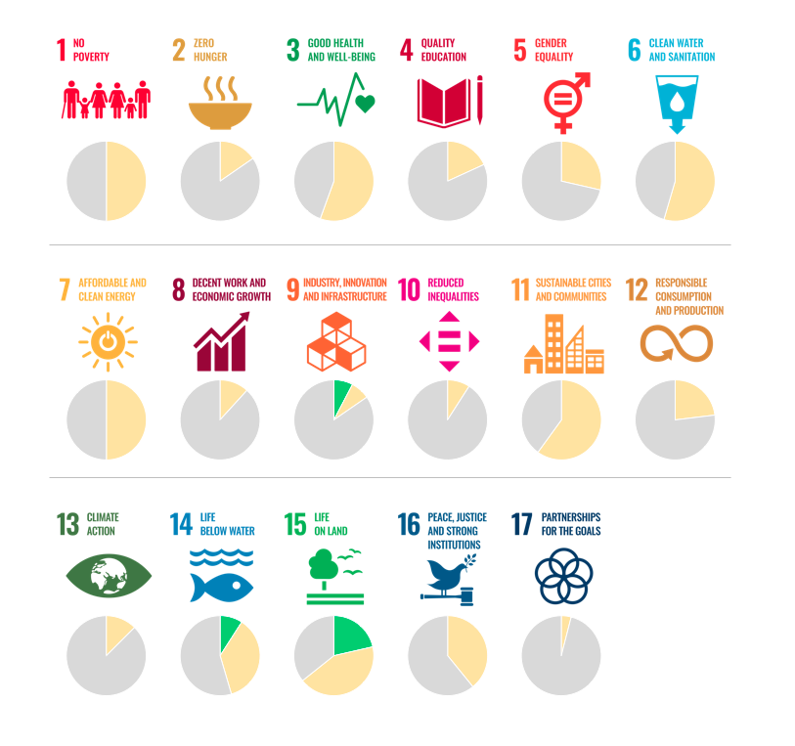
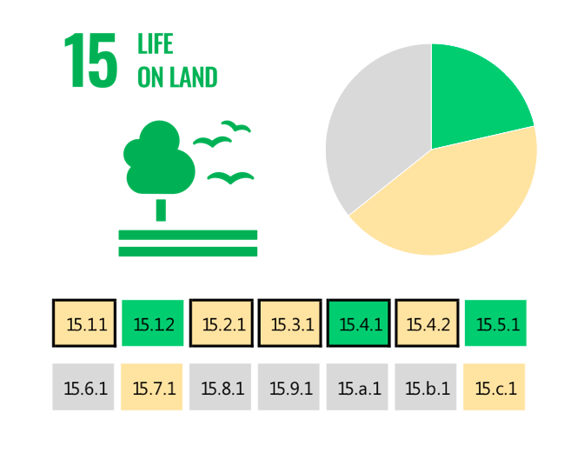
THE UN SUSTAINABLE DEVELOPMENT GOALS
The SDG indicators where citizen science projects are “already contributing” (in green), “could contribute” (in yellow) or where there is “no alignment” (in grey). The overall citizen science contributions to each SDG are summarized as pie charts.
Fraisl, D., Campbell, J., See, L. et al. Mapping citizen science contributions to the UN sustainable development goals. Sustain Sci 15, 1735–1751 (2020). https://doi.org/10.1007/s11625-020-00833-7

Slide 5
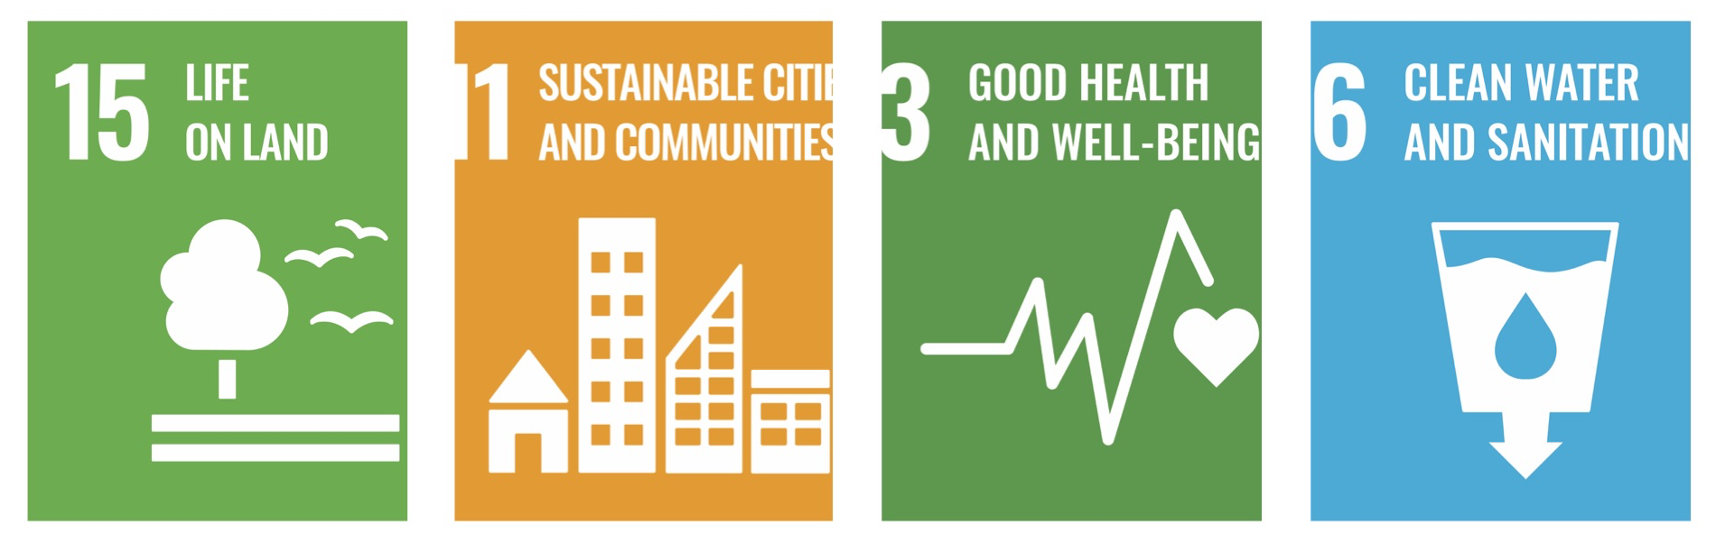
The greatest contribution of citizen science data to SDG monitoring would be in:

Slide 6
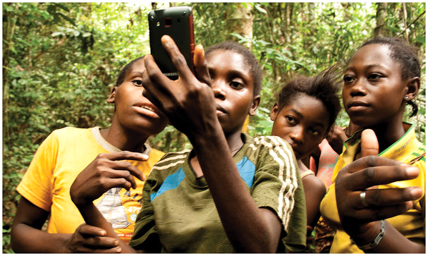



Citizen science
Gill Conquest, EXCITES, University College London
Public Participation
Knowledge production
Voluntary contributions

Slide 7
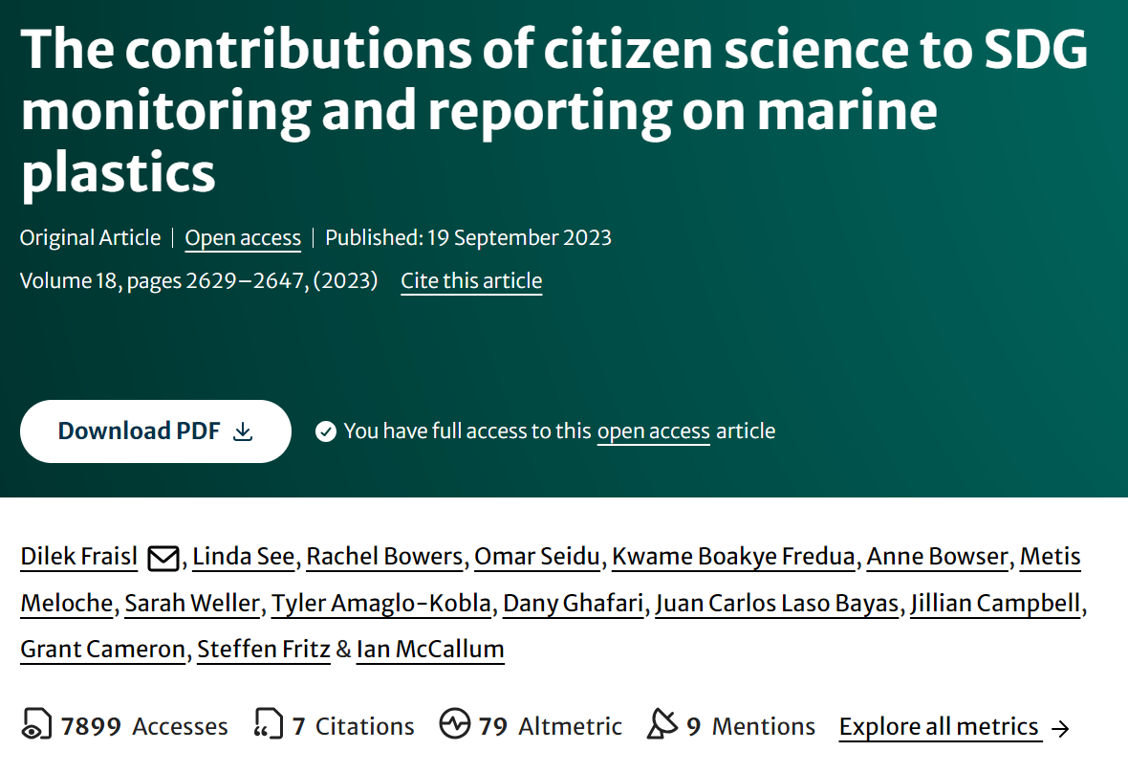

Slide 8
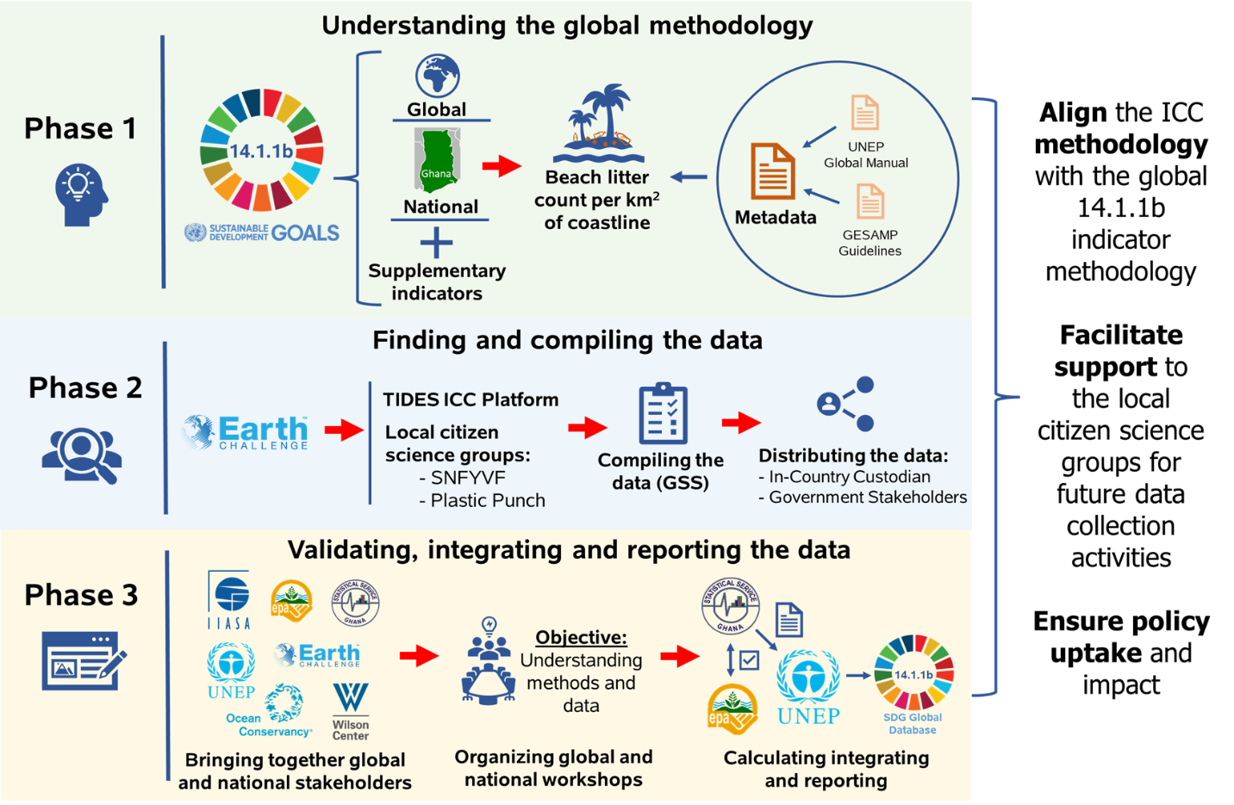
The process of integrating citizen science data on marine litter for SDG indicator 14.1.1b reporting in Ghana
Fraisl, D., See, L., Bowers, R. et al. The contributions of citizen science to SDG monitoring and reporting on marine plastics. Sustain Sci (2023). https://doi.org/10.1007/s11625-023-01402-4

Slide 9
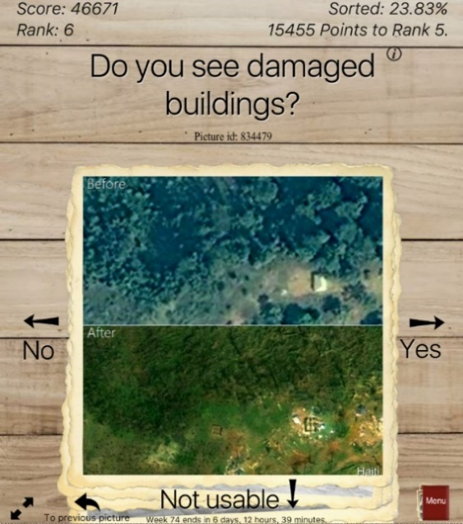
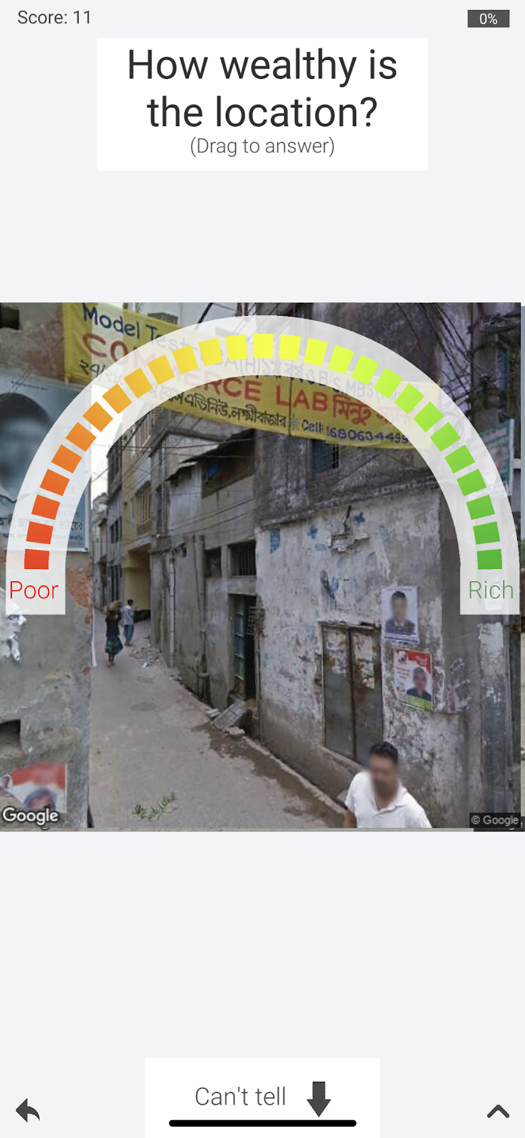
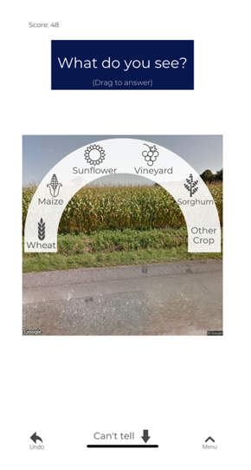
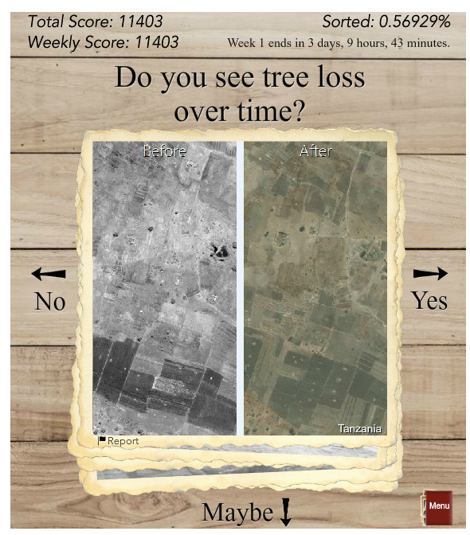
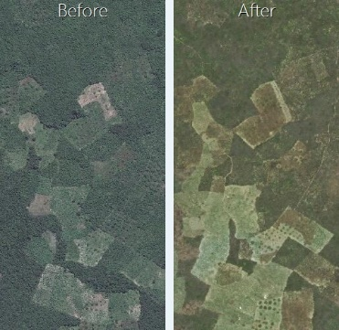
Picture Pile
Pairs of images for change detection
Wilderness, deforestation, building damage assessment
Yes/No/Maybe mechanic
Yes/No/Maybe mechanic modified for categorical and continuous variable data collection
Could contribute to the monitoring of 15 SDG indicators (SDGs 1, 2, 11, 13, 14, 15)
Fraisl D, See L, Sturn T, et al (2022b) Demonstrating the potential of Picture Pile as a citizen science tool for SDG monitoring. Environmental Science & Policy 128:81–93.
https://doi.org/10.1016/j.envsci.2021.10.034

Slide 10
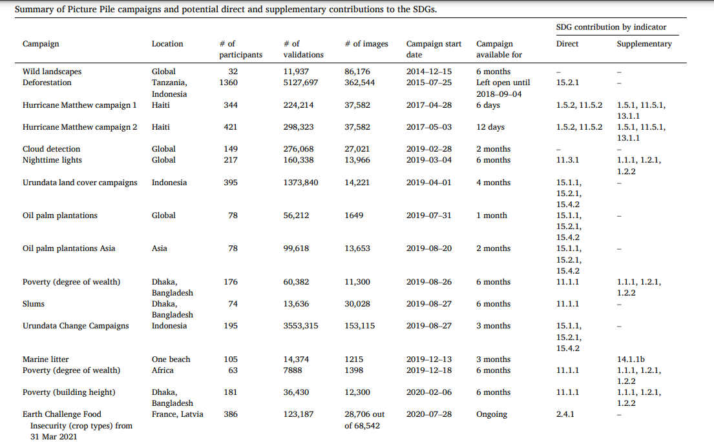
Picture Pile Campaigns to-date

Slide 11
CROPS
Curating, Replicating, Orchestrating and Propagating
Citizen Science across Europe
January 2024 – December 2026

Slide 12
THANK YOU!
Dr. Dilek Fraisl
International Institute for Applied Systems Analysis (IIASA)
Citizen Science Global Partnership (CSGP)
Email: fraisl@iiasa.ac.at
Twitter: dilekfraisl1
LinkedIn: dilekfraisl
Web: www.iiasa.ac.at

