Slide 1
Social-ecological security framework
UN Science Summit 2024
Side Event | Toward a New Global Security Paradigm
16 Sept 2024
Notes:
I am very pleased to present our conclusions for social ecological security framework concept from the IIASA project

Slide 2
Sustainability Science Perspective to Security Framework
Multiple perspectives, especially when it comes to international relations
Conclusions based on both biophysical realities and social realities
Security as under-studied and under-questioned aspect of sustainability science (Stoddard et al. 2022)
High relevance to the sustainable development goals and challenges related to global commons
Need for a transition in our security framework and we need to we talk about it similar to how we accept a need for energy transition and food systems transition
Notes:
There are always multiple perspectives and perhaps this is most glaringly illustrated when it comes to international relations
We come here from the perspective of sustainability science which includes conclusions based on both biophysical realities and social realities
Started thinking about security paradigm when working on the transformations within reach project and realised it is one of the under-studied and under-questioned aspects
We need to talk about transition of security framework in the same way as we talk about energy transition and food systems transition “militaries have for a long time had a direct, yet relatively neglected, role in causing climate change”

Slide 3
Why Focus on Security for Sustainability?
Total global military carbon footprint is approximately 5.5% of global emissions (e.g. US military 55th largest > Sweden, Portugal) (Scientists for global responsibility, 2022)
Constitutes wasteful spending of limited resources for destruction that can be much better utilised elsewhere (not a new observation but even more relevant as we have exceeded multiple planetary boundaries (Rockström et al 2023) )
Incidentally, military spending (over 2 trillions in 2022 and increasing) is comparable to the scale needed for funding the SDGs (SIPRI, 2023; FSDR 2024)
Military Security perpetuates an expansionist extractive mindset and will likely fuel more wars in an increasingly resource-constrained world
Notes:
More specifically,

Slide 4
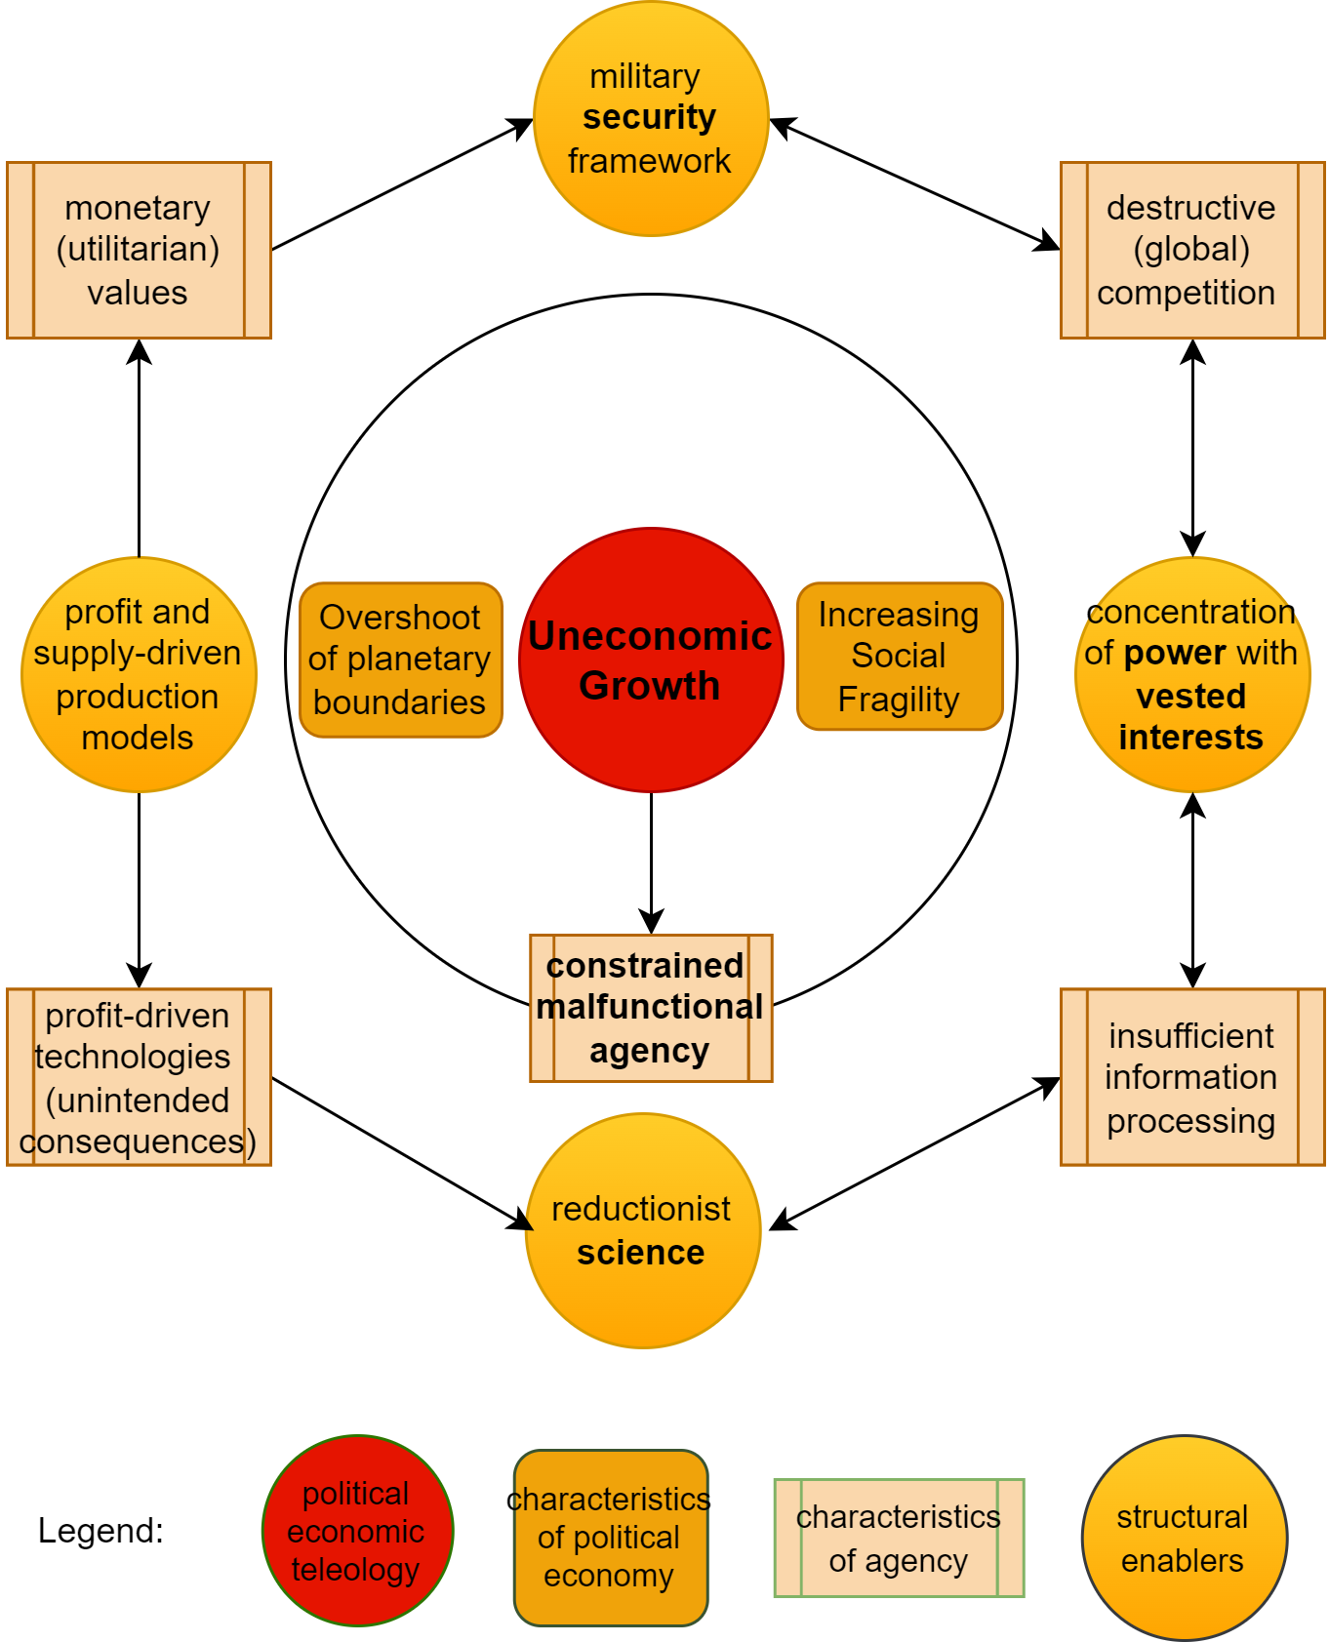
Sustainability Transformations
For details: https://pure.iiasa.ac.at/id/eprint/18462/
Notes:
High level leverage point That is why in our framework for societal transformations on the right side, we identified security framework as one of the key enablers that needs to transform

Slide 5
New Security Challenges
Shift in risk perception among experts is towards systemic risks (Science of Global Risks, 224)
New security challenges caused by anthropogenic climate change and earth system tipping points cannot be tackled via military power and armed conflicts but require cooperation.
Two ways to respond: either with control, that is doubling down on military security or by adapting to changing circumstances.
Dominance of military security mindset is already leading us to finding military solutions to new security challenges as “emergencies are (re)defined based on the behaviour of other states.” (Toal, 2024) This might lead us to mutual annihilation.
If you have a hammer, everything you see is a nail - we need better tools
Notes:
We also find that a nature of our security challenges is changing

Slide 6
Social-ecological Security framework
A positive human-centric security (enabler for all) rather than a negative state-centric security (at the expense of others) (HDR 1994)
Underpinned by the internalisation of biophysical and social realities:
Ecological : Human survival and flourishing are contingent upon resilient ecosystems. Hence, tackling a triple planetary crisis of global warming, biodiversity loss, and pollution should be an imperative of our collective global security
Social : Universal access to basic needs as a pre-requisite for social peace, means ensuring guaranteed access to food, shelter, education, and primary healthcare
Grounded in the realisation that these are not voluntary acts of charity but a pragmatic matter of ensuring collective security and survival
Prioritisation of the SDGs as a security matter (rather than military spending)
Notes:
That is why we conceptualise social-ecological security framework

Slide 7
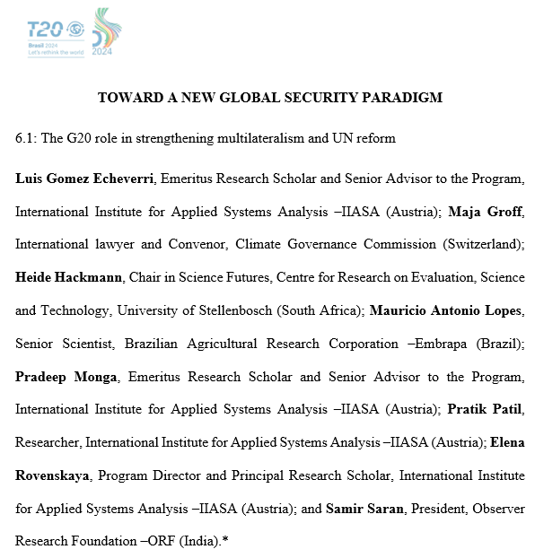
Policy Brief for G20 (Brazil, 2024)
Renewed commitment to multilateralism in recognition of the common threats
Public Participation in Shaping Global Security Priorities (MNC 2024 G7 survey)
Development aid and green finance as key levers
Building resilience without burning bridges
Strengthening global institutions for anticipation of and response to complex global shocks
Soon to be published at https://t20brasil.org/en/pbs
Notes:
We had an opportunity together with some of the panellists to provide inputs to G20 as a policy brief on this
For example, Food sovereignity while also creating more transnational grids for renewables

Slide 8
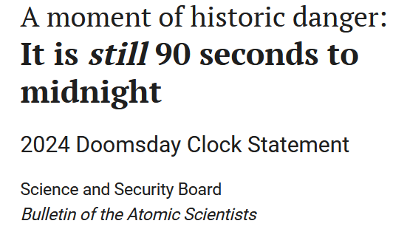
Thank you for your time!
A new security paradigm is no less urgent than food / energy systems transition – given the doomsday clock, closer than ever to midnight and as a pre-requisite for meeting the global (transition) goals
Pratik Patil ASA, IIASA patil@iiasa.ac.at
Notes:
Leave you with a thought that a new security paradigm is perhaps even more urgent

