Slide 1
Human Agency to Navigate the Anthropocene
Ability to hold values, make com­mitments and choices that may—or may not—advance the person’s wellbeing (HDR, 2022, p. 114).
Ability to “think, assess, evaluate, resolve, inspire, agitate, and, through these means, reshape the world” (Sen, 2013)​
Notes:
I would like to start by acknowledging that we had an opportunity to advance a concept of human agency and its implications for sustainable development, thanks to a project commissioned by HDRO

Slide 2
Motivation for focussing on Agency with HDRO
Until now the focus of development efforts has been on capabilities and material wellbeing achievements such as the standard of living. HDI for example, explicitly measures capabilities.
There is a need to bridge this gap for two reasons (HDR, 2022):
Individually, a sense of personal agency has been identified as a key marker of healthy psychology. “Agency is perhaps what truly distinguishes what is alive from what is not”. – Phil Ball
Collectively, agency is necessary to navigate today’s uncertain times (e.g. behavioural change). The evolution of global collective agency is one of the prerequisites for navigating the Anthropocene

Slide 3
Ontology of Agency
Any expression of agency is not an isolated instance, exercise of pure “free will” (choices divorced from the context)
We find that agency is a temporal process that is:
informed by the past – this is the iterative / habitual element
but oriented toward
The present
And also, the future (with a “projective” element to imagine alternative possibilities) (Emirbayer and Mische (1998, p. 962))
It includes choosing a reason for making choices (Williams et al., 2021)
Agency cannot be reduced to imposing our will onto the world but involves questioning the basis of our choices -> assumptions, social norms etc
Notes:
We started our investigation with an ontology of agency. Any expression

Slide 4
Concepts for Agency in the Anthropocene Context
Affordances:
Refer to what the environment offers to an agent (Roli et al., 2022) (originates in biology)
They can be considered a material basis for agency : resources, resilient earth systems, technology
Sustainability:
implies taking into consideration other people's needs (future generations or people who live far away) in the exercise of agency.
Technological Evolution:
It has reached a stage where “progress is increasingly defined by what we say no to versus what we say yes to.” (Center for Humane Technology)
Notes:
We focussed on these key concepts...

Slide 5
Different types of agency
Type | Definition | Feature | Example
Primary agency | Agency to fulfil essential needs for survival (satiable) | Material and individualistic | e.g., access to food, water, shelter (+ security)
Economic agency | Agency to fulfil material wants (insatiable) | Material and individualistic | e.g., consumption of energy and resources
Socio-political agency | Agency to affect social-political circumstances if desired | non-material and social | e.g., voting, participatory democracy, self-determination, ease of doing business, social status & influence
Sustainable agency | Agency to influence intentionally and positively, wellbeing of others (including future generations and non-human life forms), beyond self-centric wants | post-material and social | e.g., low-carbon lifestyles, voluntary limits on consumption (economic agency)
Notes:
Diving deeper, we formulated a typology to discern different dimensions of agency

Slide 6
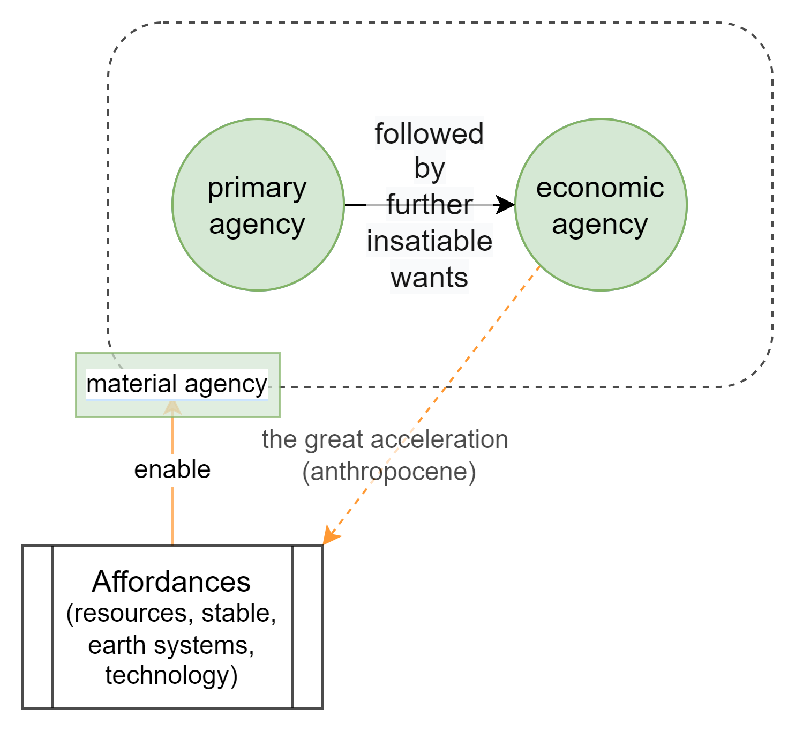
Agency Dynamic
Notes:
We further developed this dynamic between different types of agency – so we have primary agency, that is fulfilment of basic needs, followed by further insatiable wants, defined as economic agency. Both of these have a material basis, enabled by affordances that is limited resources and technologies.

Slide 7
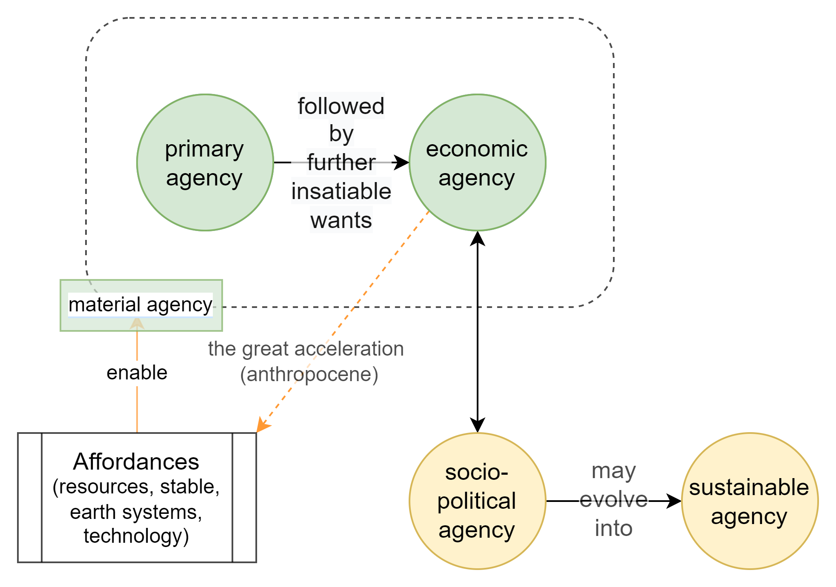
Agency Dynamic
Notes:
Economic agency interacts with socio-political agency, agency to affect social-political circumstances if desired. It may evolve into the sustainable agency, that is agency to include other's needs

Slide 8
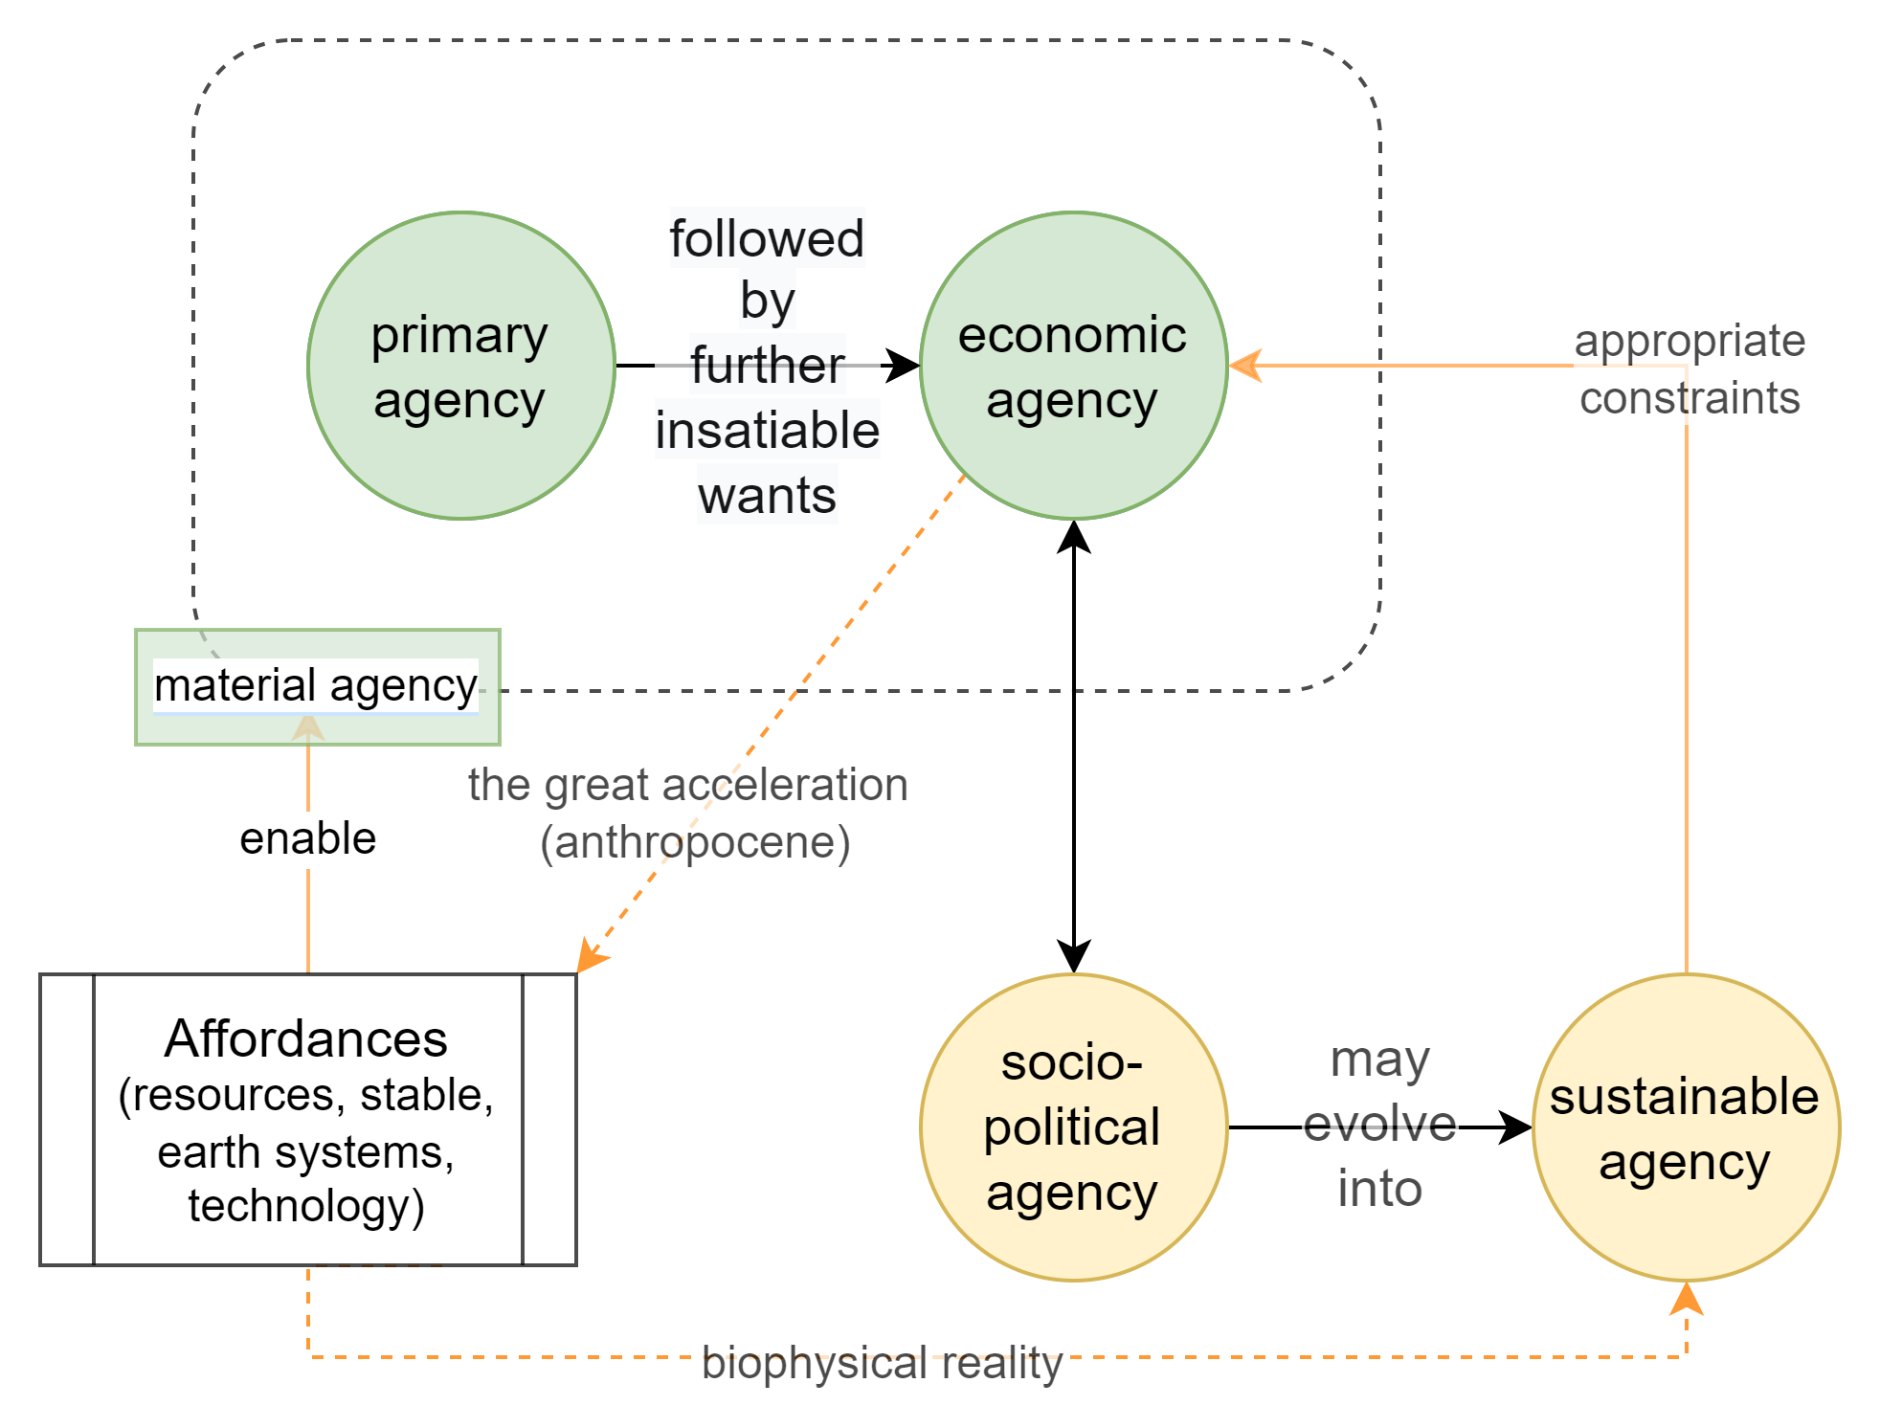
Agency Dynamic and Sustainability
Unconstrained economic
agency ->
malfunctional agency
Notes:
As we have already exceeded multiple planetary boundaries, we need to evolve this sustainable agency that can exercise appropriate constraints on economic agency. More is not always better. Unconstrained economic agency translates into

Slide 9
Thank you!
Concluding thought: The enhancement of human agency as an essential component of human development is an end in itself but also a means to navigate the challenges of sustainable development in the 21st century.

