Slide 1







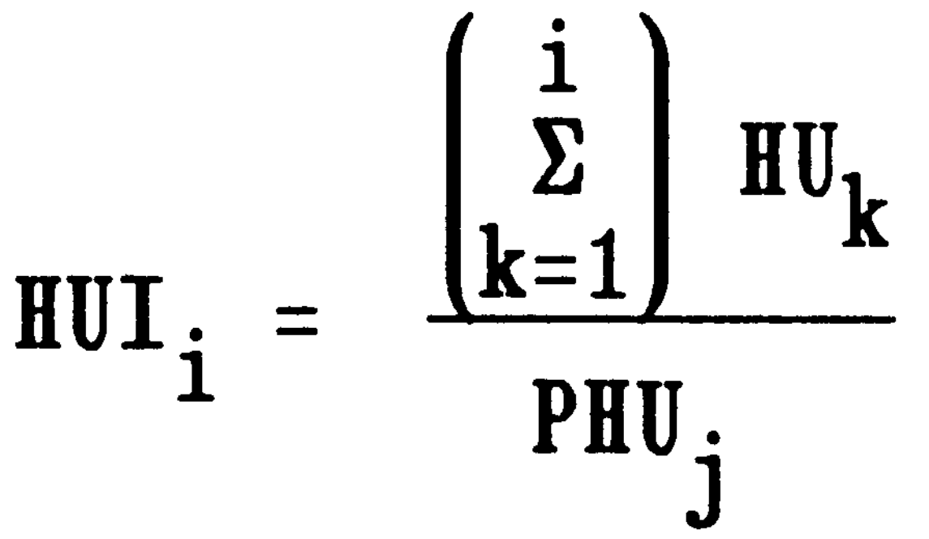



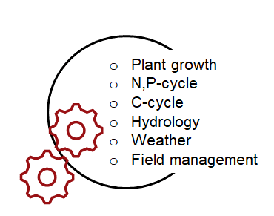
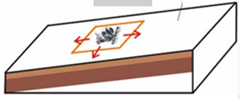

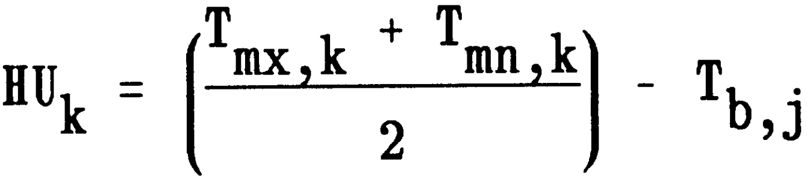
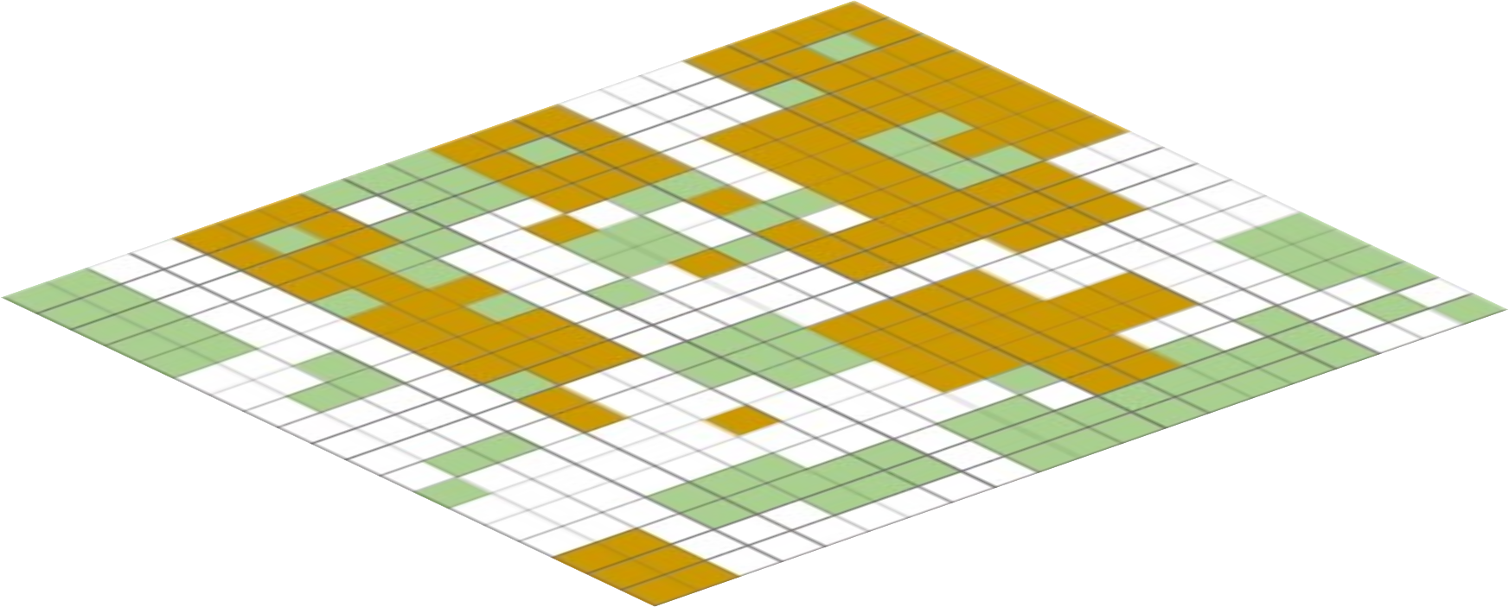
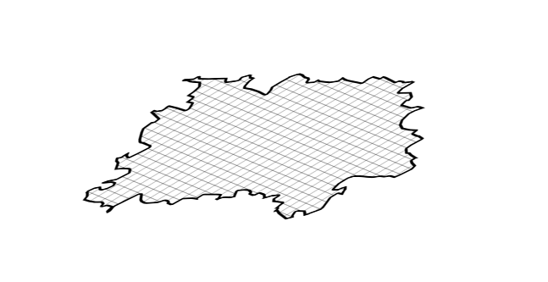
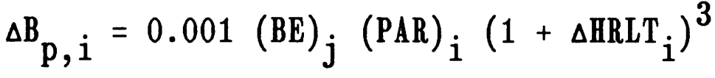


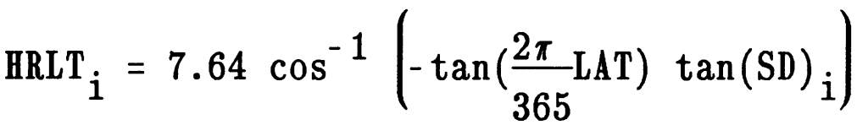
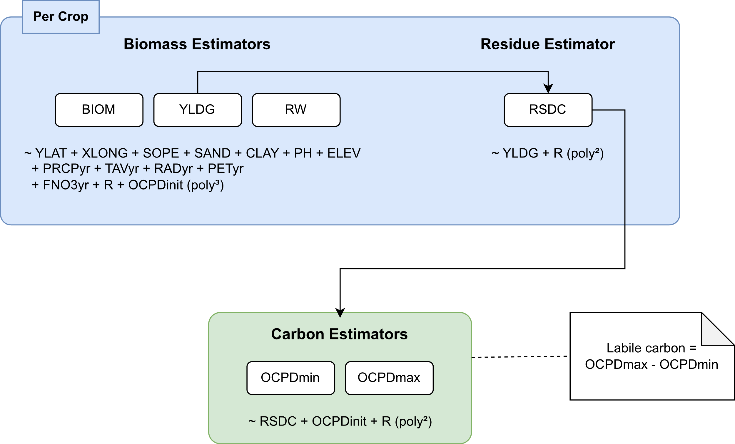
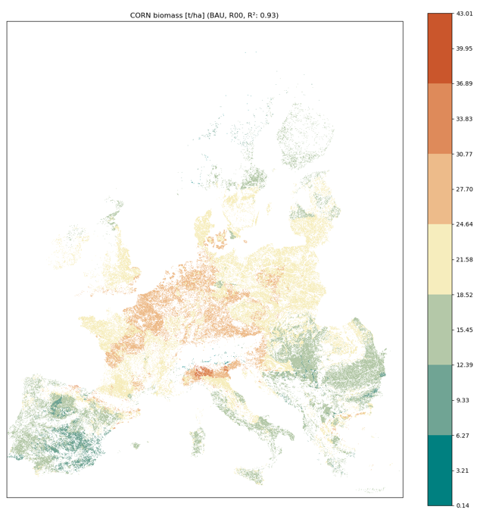
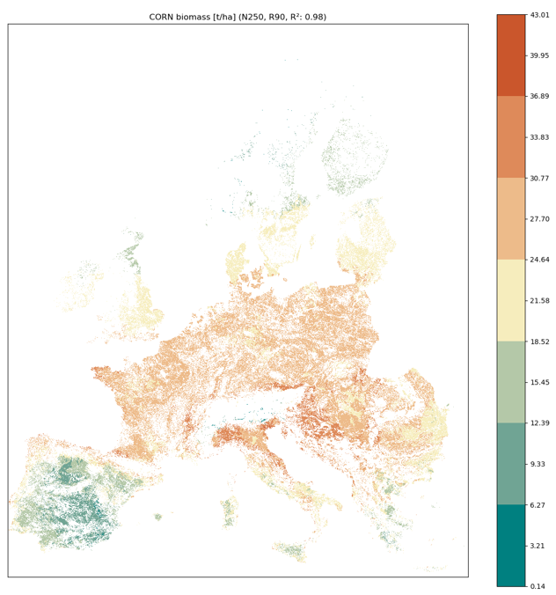
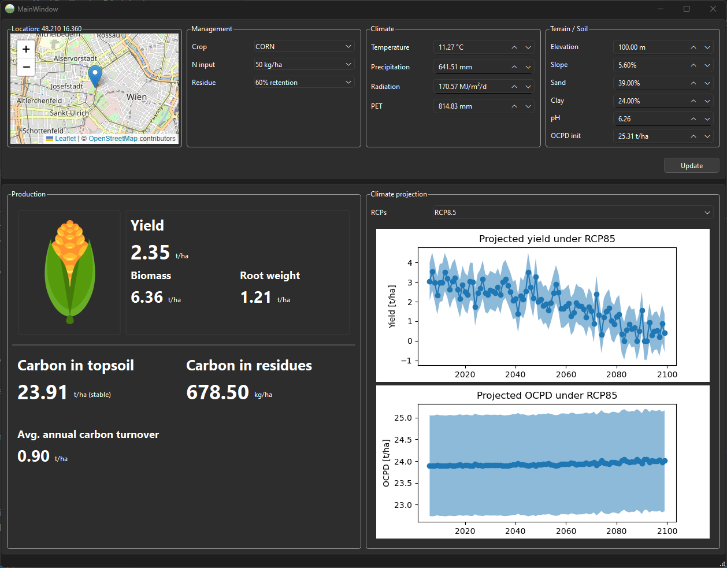
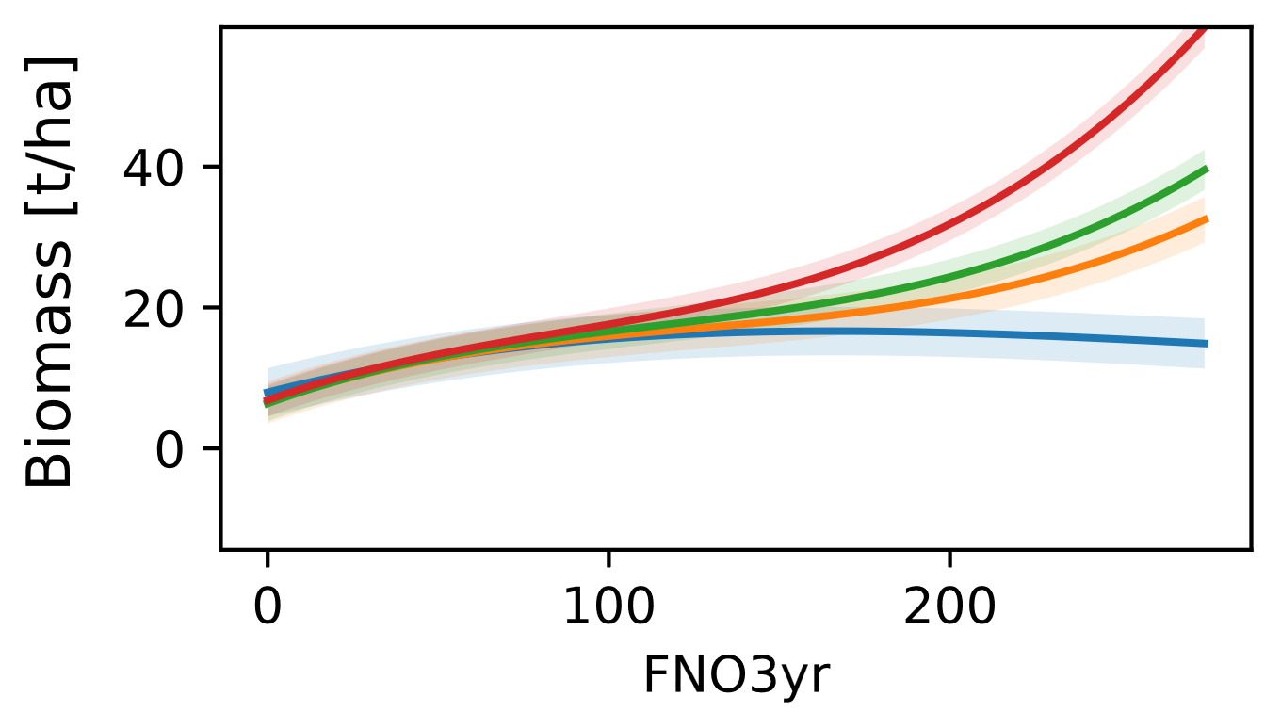
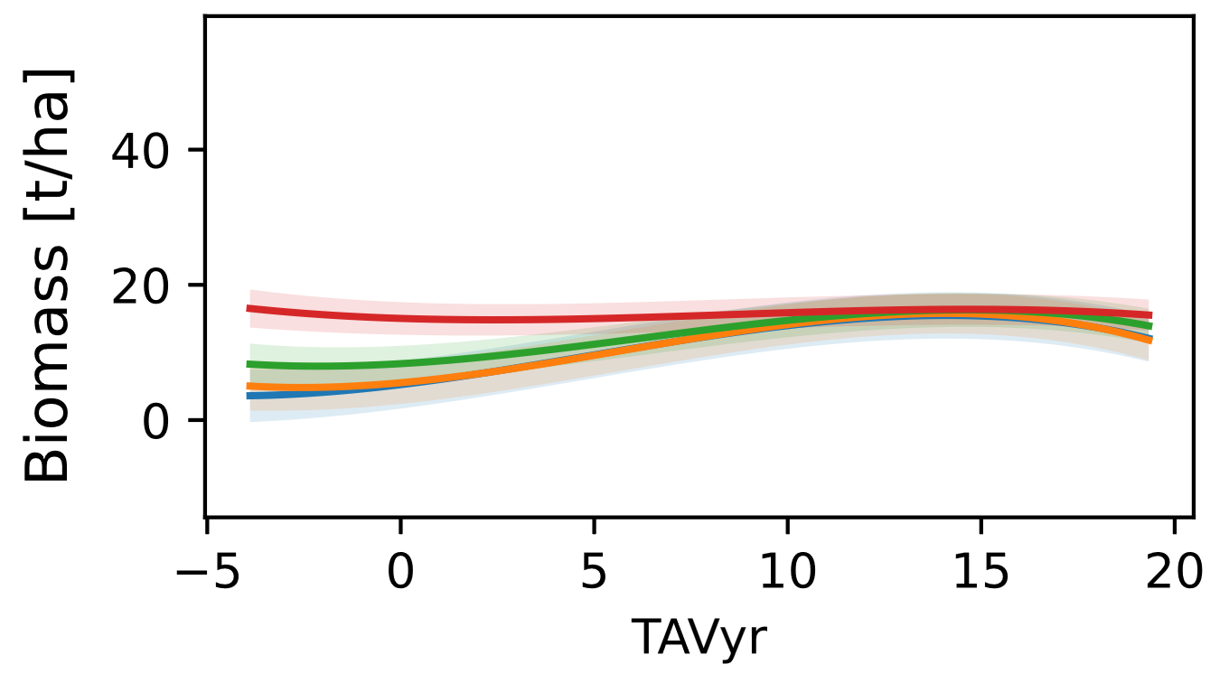
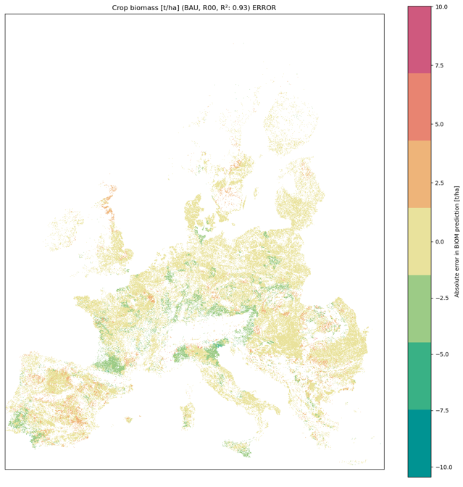
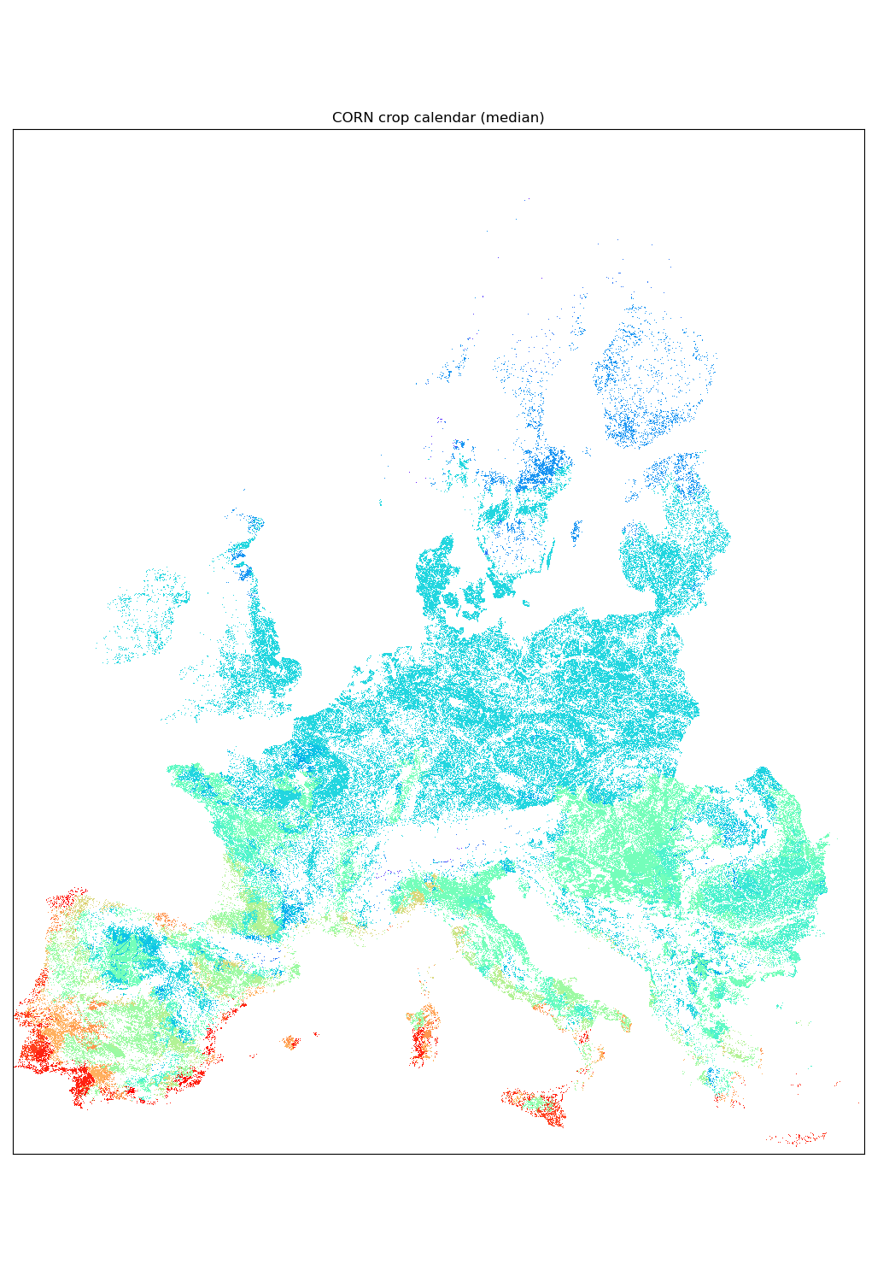



Mission Soil.at - Retrospect and Prospect
AI4SoilHealth: Supporting Europe’s Soil Deal Using AI Technology and Predictive Services
Thomas Oberleitner¹, Rastislav Skalsky¹, Juraj Balkovic¹, Christian Folberth¹, Tara Ippolito^{1,2}
¹ International Institute for Applied Systems Analysis (IIASA), Laxenburg, Austria
² Syngenta Group, Basel, Switzerland
Challenge
Action
Inconsistent and inadequate soil health monitoring across Europe hinders sustainable soil management.
Create a Soil Digital Twin, a Soil Health Index, and AI-powered tools to provide real-time soil health assessments and predictions.
Aim
Role of IIASA
Develop AI-driven tools and a digital infrastructure to enhance soil health data collection, assessment, and prediction across Europe.
Develop pan-European, predictive services for soil health, contributing to sustainable soil management policies.
Introduction
EPIC-IIASA (Crop Model)
Crop models are essential for simulating crop growth, nutrient and water cycling in soil and harvest, using climate data on a daily timescale.
These models are complex, requiring significant computational resources and site-specific parameters.
A data-driven approach, based on the EPIC-IIASA model, is proposed to emulate these crop simulations, making large-scale predictions more feasible.
Scenarios
Gridded (Top-Down)
Regional (Top-Down)
Fertilizers
Irrigation intensity
Tillage & residues mng.
Erosion control
Manuring
Crop Rotations/multi-cropping
LC-specific dynamic properties
BAU:
Monocrops & shares
Crop rotation & shares
N,P-application rates
Irrigation shares
Slope, SL & elevation
Field size
Dominant soil profile properties
Plant phenology
Meteorological forcing
EPIC
Top-Down
„Typical Field“
Top-Down
soil/site grid
meteo grid
LC grid
Biomass production
SOC stock and change
Heterotrophic respiration
Net Ecosystem C Exchange
Net Biome C Productivity
Water storage
Nutrient accumulation
Geospatial & gridded data
Statistical data & censuses
Ecosystem
Services Indicators
Global / Regional (Europe, Indonesia, Mexico)
SRTM/GTOPO
HWSD, WISE, ESDB
GLC, CORINE
FAOSTAT
EUROSTAT
Irrigation Map
Crop calendars
Polynomial Regression (Emulators)
Use Cases
EPIC-IIASA generates training data, capturing variability in climate, soil properties, and management practices.
Third-order polynomial regression models are trained on 20-year averages to emulate crop model outputs.
The model network breaks down biomass prediction into root weight, yield, and carbon accumulation.
Allows for efficient, real-time yield estimations / uncertainty intervals / explainable relationships as captured by the crop model.
a) Large-scale predictions of management change
b) Predictions for single location (Farmer’s App)
+ residue
retention
+ N appl.
Error maps
Crop calendars
Find out more and get in touch
Funded by the European Union. Views and opinions
expressed are however those of the author only and do not
necessarily reflect those of the European Union or European
Research Executive Agency. Neither the European Union nor
the granting authority can be held responsible for them.
This work has received funding from UK Research and
Innovation (UKRI) under the UK government’s Horizon
Europe funding guarantee
[grant numbers 10053484, 1005216, 1006329].
E
info@ai4soilhealth.eu
W
@ai4soilhealth
ai4soilhealth.eu

