Slide 1
Advancing Systems Analysis Program
IIASA Interaction Festival, 20 June 2024
Notes:
Good morning eveveryone, together with my colleagues Valeria, Inian, Reza, and Stefan, I am happy to present the ASA program to you today.

Slide 2
What is ASA?
Agent-based modelling
Optimal control
Evolutionary games
Risk perceptions
Resilience
Remote sensing
2
Notes:
If I asked a random person from IIASA what ASA is doing, I might get an answer – ABM, or risk perceptions, or ….

Slide 3
What is ASA?
ASA advances systems analysis as a meta-level approach to understand and govern complex socio-environmental systems
The overall objective is to increase realism, relevance, and agility of systems analysis
What is systems analysis?
Addresses global challenges that are crossing national and sectorial boundaries
Focuses on analyzing and reducing tradeoffs, and maximizing synergies
Utilizes mathematical/computer modelling
Works in partnership with stakeholders
3
Notes:
Indeed, ASA works with various methodologies and various applications. What unites this, is the objective to advance systems analysis as a meta-level approach to understand and govern complex socio-environmental systems by increasing realism, relevance and especially agility of research.
In this framing, systems analysis is understood as an approach that can address …, that focuses on … utilizing … and working ….

Slide 4
How?
By harvesting new opportunities provided, in particular, by
New sources of data and methods to convert data into knowledge
Novel modelling approaches and underlying theories enabled by increased computational capabilities
Innovation through transfer of methods across disciplines and expansion of system boundaries
Continuous horizon scanning to identify novel matches between methodologies and applications across all thematic areas of IIASA
Enhanced transdisciplinary research
4
Notes:
How do we do that? By harvesting …
You will see examples of specific research activities that achieve these

Slide 5
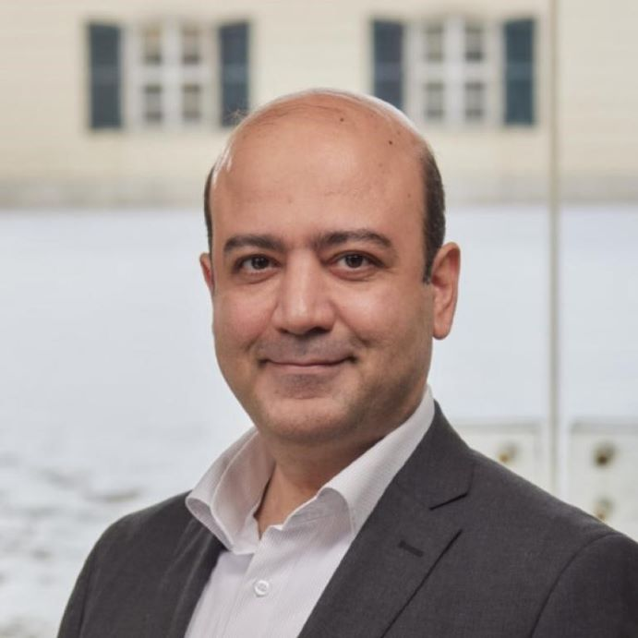
Four examples of How
Valeria
Stefan
Reza
Inian
massive data collection from communities
machine learning
vulnerabilities of communities to disasters
resilience strategies
reinforcement learning
multi-model linkage
globally-consistent national policies
social media data
advanced statistics
people’s views and perceptions
various low-cost devices
civic engagement
detailed environmental assessment
5
Notes:
Today we will present to you four examples of how we achieve our objectives in specific projects.
Reza will present how social media data, with the help of advanced statistics approaches, can help understand people’s views and perceptions
Stefan will present how massive data collection from communities and machine learning can unravel vulnerabilities of communities and inform us about their resilience strategies
Inian will present how various low-cost devices in combination with civic engagement can inform detailed environmental assessment
Valeria will speak about her work which applies reinforcement learning to enable linkage of multiple national models to identify national policies consistent with global targets

Slide 6
Deciphering the Pulse of Society through Data and Dialogue Social Intelligence mining
Cooperation and Transformative Governance (CAT) Advancing Systems Analysis (ASA) | Hossein Hassani Nadejda Kamendantova Elena Rovenskaya Mohammad Reza Yeganegi

Slide 7
What motivates us
Finding a sustainable solution is impossible without understanding the intelligence that society expresses; e.g., public perception & discussion.
People’s collective behavior, concerns, and perceptions are important factors in how the society would perceive a new policy.
The people’s diversity and the inclusive nature of public perception call for a large amount of data when it comes to capturing public perception.
The popularity of social media opens a new avenue for accessing such data.
We have been developing statistical methods and AI tools for deciphering society’s intelligence through the social media lens.
7
Notes:
Having a complete picture of society is important for finding sustainable solution and policy-making.
It includes intelligence that society is expressing as public perception; although getting such picture requires data.
The popularity of social media opens a new avenue for accessing such data. Though, since such data is not numerical, we would need to develop new tools to convert that data into a big data structure.
We have been developing statistical methods and AI tools to structure such big data and decipher society’s intelligence.

Slide 8
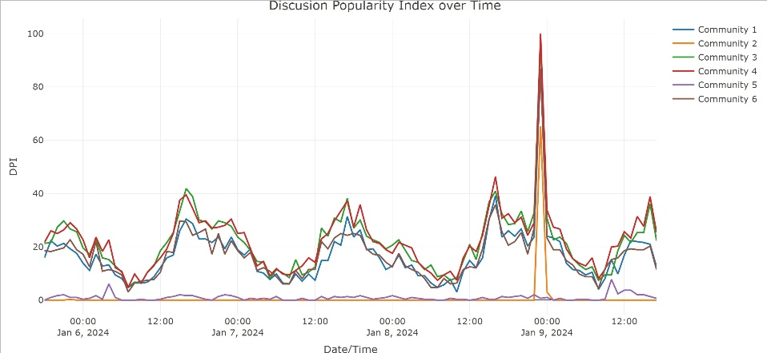
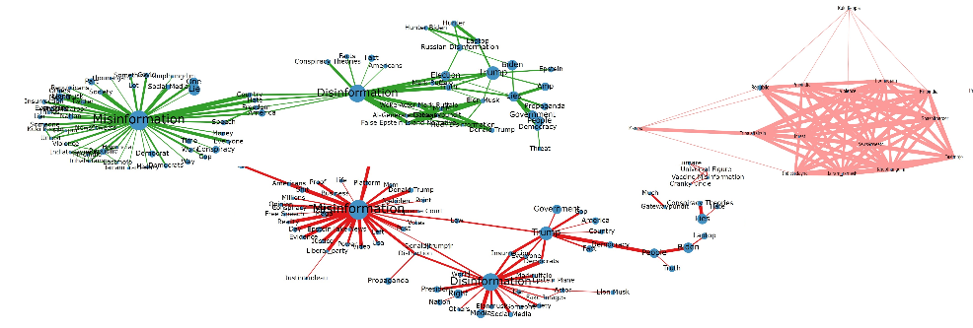
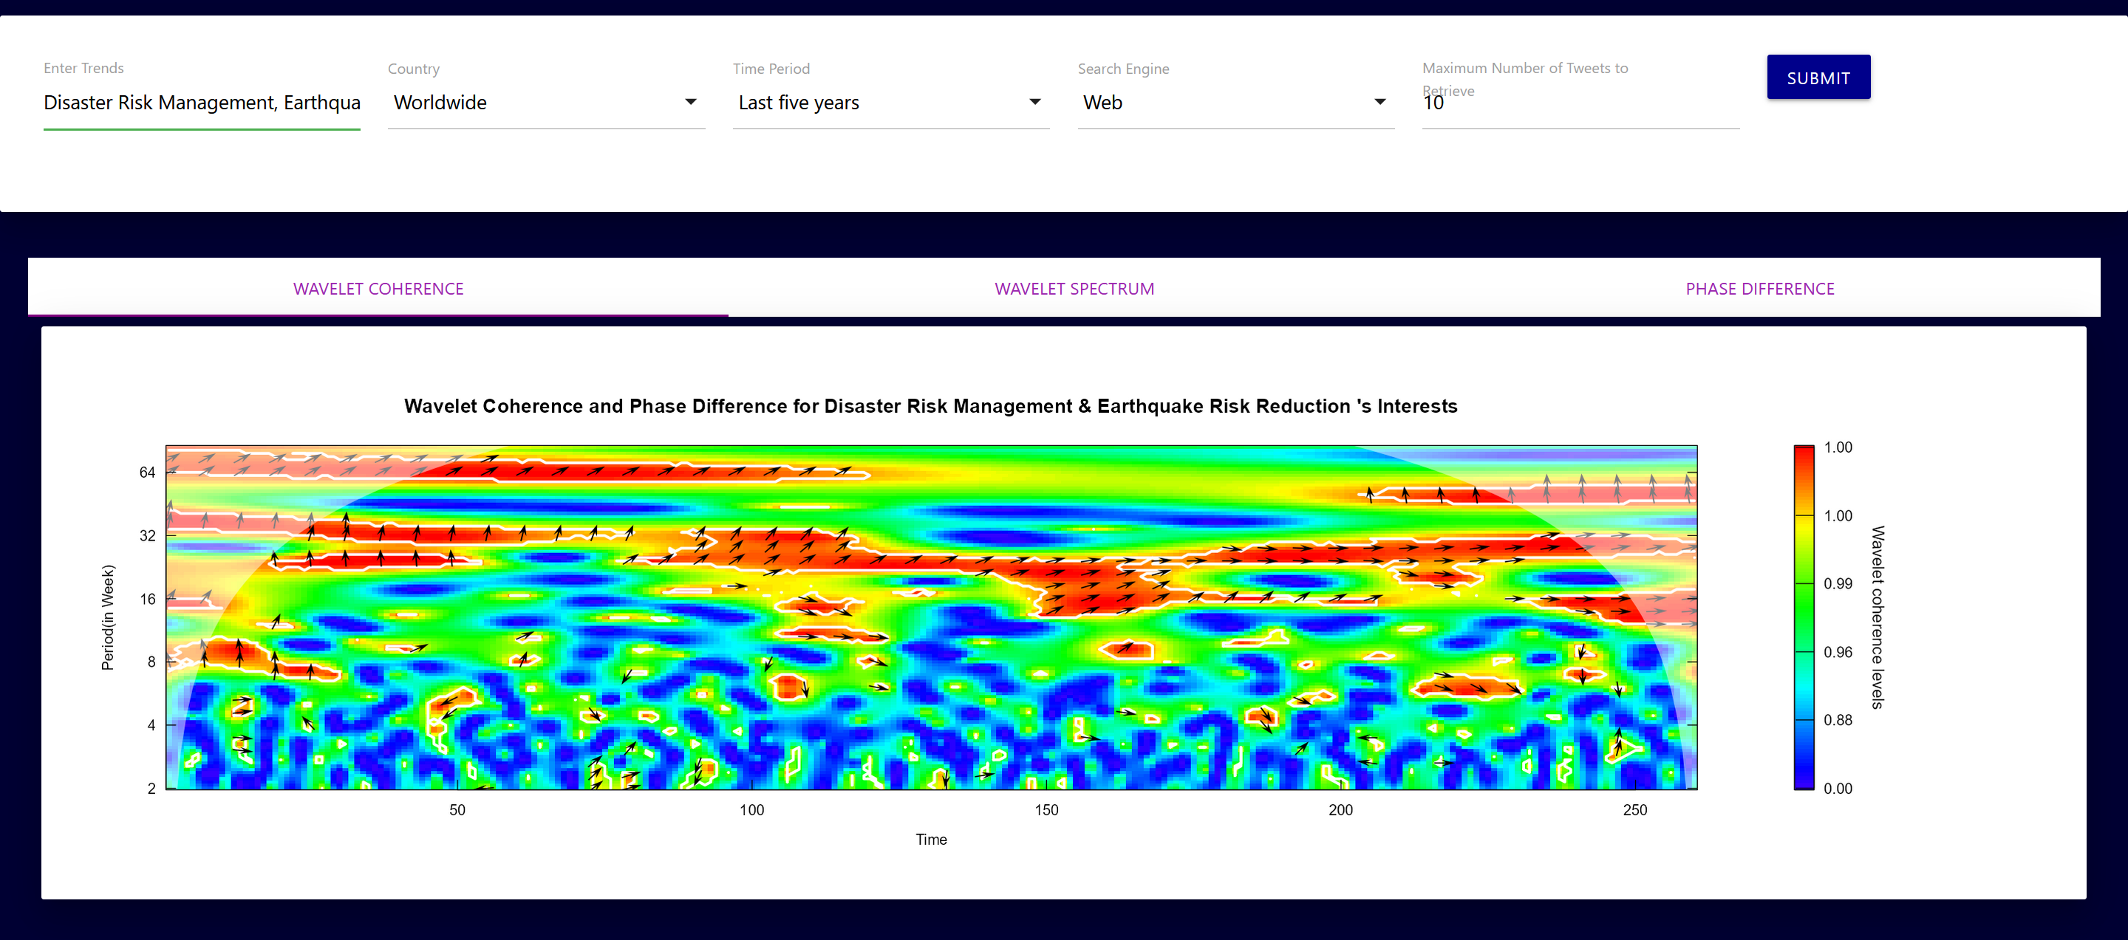
What we are developing
Data inquiry from online resources (e.g., X, Reddit, news outlets, and search queries).
Converting non-quantitative data from online resources to quantitative data to form a big data structure by developing various indicators.
Integrating stochastic network analysis and AI language models to develop methods for estimating public discussion’s contextual models.
Developing methods to capture social patterns and public perception by coupling wavelet and time series analysis, density estimation with deep learning, and natural language processing and language models.
Hassani, H.; Komendantova, N.; Rovenskaya, E.; Yeganegi, M.R. Unveiling the waves of mis and dis information from social media. In. J. Mode. Sim. & Sci. Comp. (2024).
Discussion Popularity indices
Show case: popularity of discussing misinformation among X users.
Public discussion contextual network:
Show case: Public discussion about misinformation and democracy among X users.
Hassani, H.; Komendantova, N.; Rovenskaya, E.; Yeganegi, M.R. Social Trend Mining: Lead or Lag. Big Data Cogn. Comput. 2023, 7, 171.
Periodic pattern analysis:
Show case: Periodic patterns and lead analysis of public interest in “Disaster risk management” and “Earthquake risk reduction”.
Notes:
We’ve developed different indicators to convert non-numerical data into quantitative big data structures.
The data comes from online resources: social media platforms, news outlets, and even search queries.
Using this data, we are building contextual models, extracting social patterns, and capturing public perception.
We are integrating wavelets, network and distribution analysis with machine learning and natural language processing to get these results.
In our recent paper, we integrated network analysis with LLM to extract structure of public discussion about “Misinformation”, “Disinformation” and “Democracy”. We introduced a Popularity Index and used wavelet to analyze its periodic behavior.

Slide 9
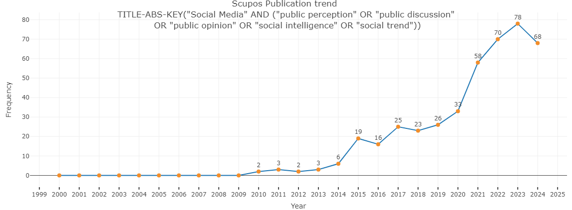
How it contributes to the ASA mission
The ASA program is partly devoted to expanding methodological and practical boundaries in the use of systems-analytical approaches for finding sustainable solutions to pressing global challenges.
This ranges from developing novel systems identification and control methods to building structured big data and incorporating systems thinking into equitable policy crafting.
Beginning in 2021, the ASA's CAT group joined the cause to unravel the public narratives.
We joined the cause
In the past year we moved to developing novel AI tools and analytical methods to unveil the picture of public opinion.
Social intelligence mining contributes to identifying social systems and offers a clearer understanding of societal concerns and behaviors.
This resonates with the ASA program and CAT group’s mission to push methodological boundaries in analyzing social systems, identify and address social dilemmas, and support policymakers in promoting more sustainable policymaking. ﻿
Notes:
We are devoted to expanding boundaries in the use of systems-analytical approaches for finding sustainable solutions to pressing global challenges.
This includes creating novel methods for system identification and control, building structured big data, and incorporating systems thinking into policy crafting.
Beginning in 2021, we are working to unravel the image of public opinion for policymakers. From the past year we’ve moved to developing novel AI tools and analytical methods for that cause.
Social intelligence mining research contributes to identifying social systems and offers a clearer understanding of public concerns and opinion.
This resonates with the ASA’s core agenda to push methodological boundaries in analyzing social systems, identify and address social dilemmas, and support policymakers in promoting more sustainable policymaking.

Slide 10
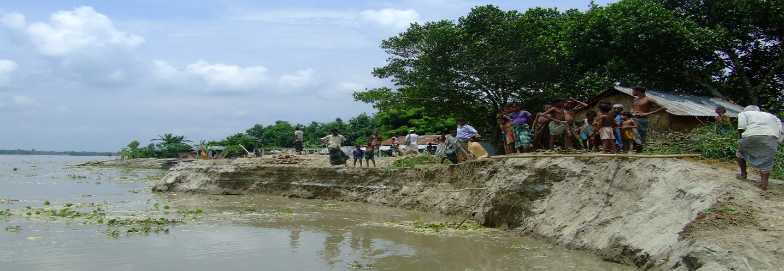
Measuring and modifying disaster resilience. Using soft and hard systems analysis for supporting resilience action for more than 2 million vulnerable households across 500 communities across the globe
Stefan Velev Systemic Risk and Resilience (SYRR) Advancing Systems Analysis (ASA)
Notes:
Imperative of Building disaster resilience in the context of worsening climate risk. Particularly for the most vulnerable
We are engaging in the climate resilience alliance an exciting partnership of research, leading NGOs and the private sector
For enhancing resilience, we need an understanding of what resilience actually is and what it entails.
Today I will shortly present our work at SYRR where we are working with 500 flood prone communities to measure and modify resilience

Slide 11
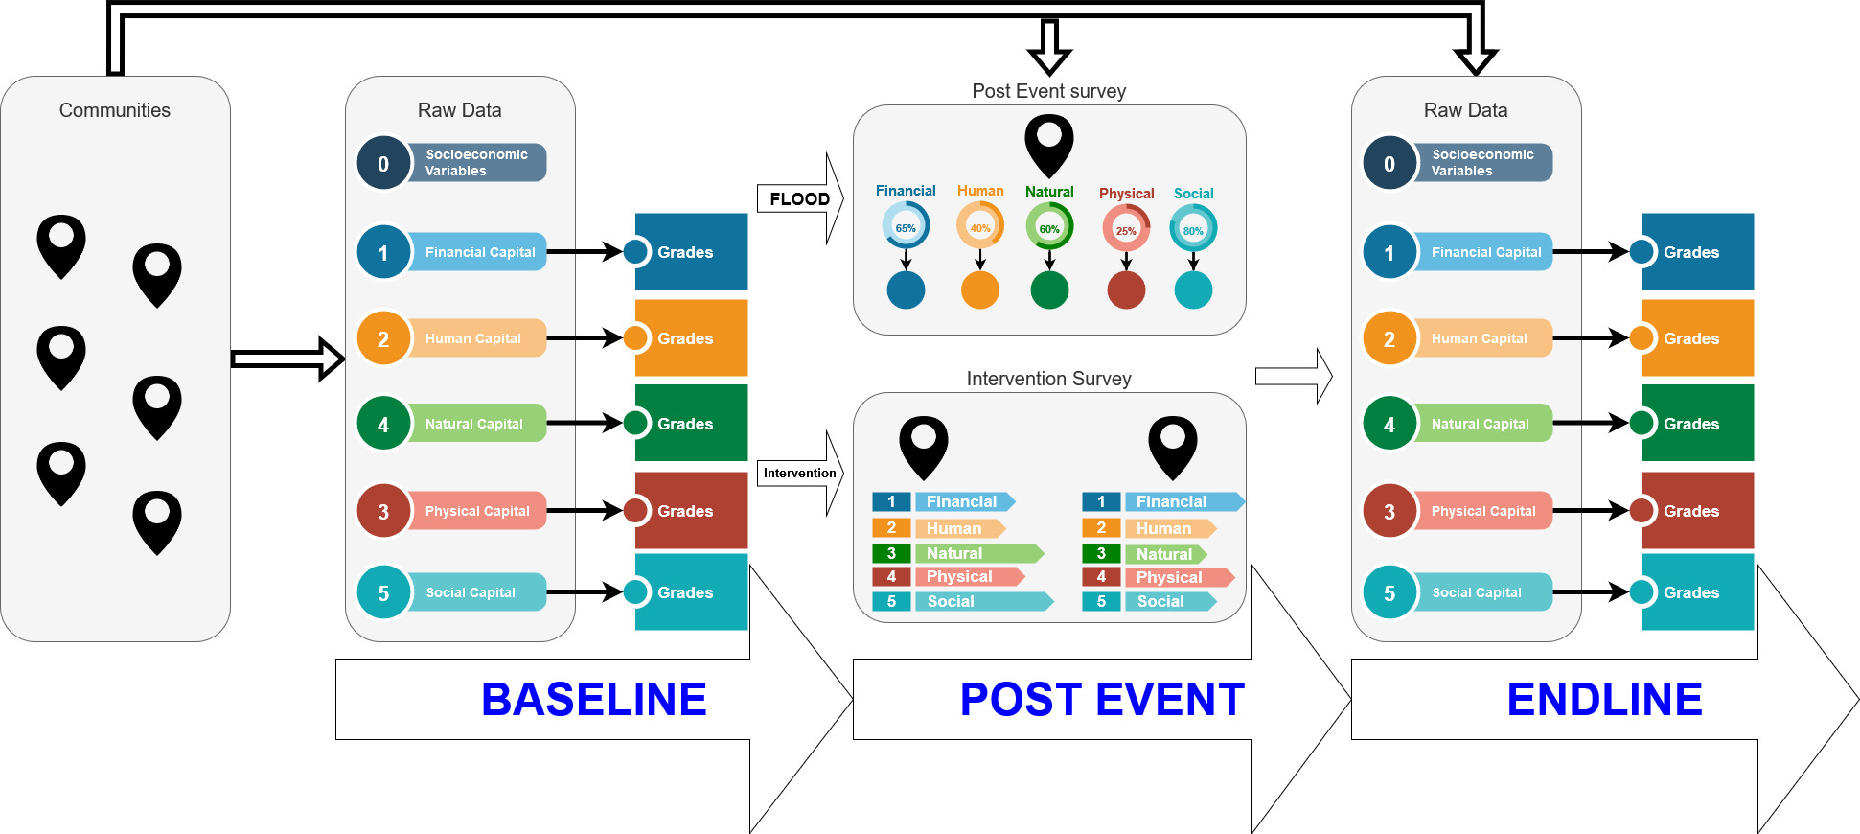
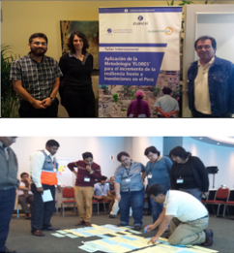
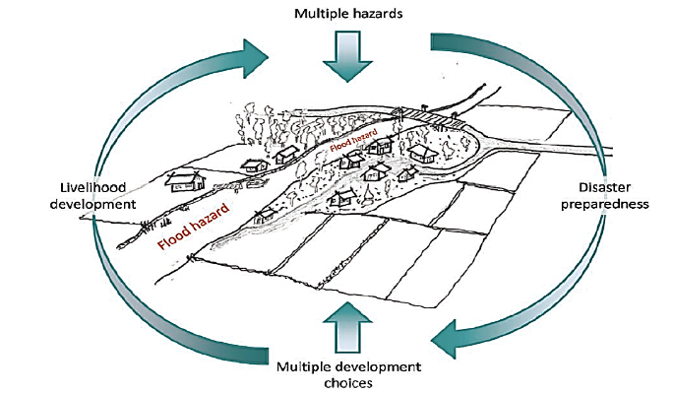
The imperative: Understanding and acting on disaster resilience. A development centric approach
Resilience as bouncing forward
“the ability of a system, community, or society to pursue its social, ecological, and economic development and growth objectives, while managing its disaster risk over time in a mutually reinforcing way.”(Keating et al. 2014; 2017)
Structure of the FRMC – Stefan Velev IIASA 2022
Chart by Colin McQuistan, Practical Action, 2014
Notes:
This is FRMC/CRMC which is the first global large scale empirical validate resilience measurement tool.
It is conducted in over 500 flood prone communities impacting around 2million people.
It consists of several on the ground surveys, measuring resilience over time as well as the impact of flood events and the conducted interventions

Slide 12
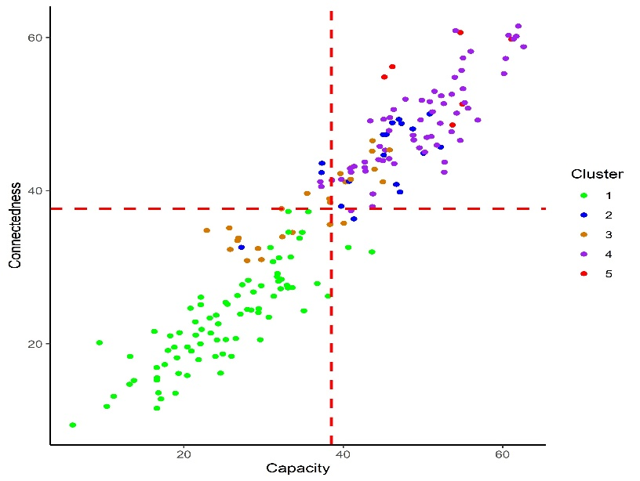
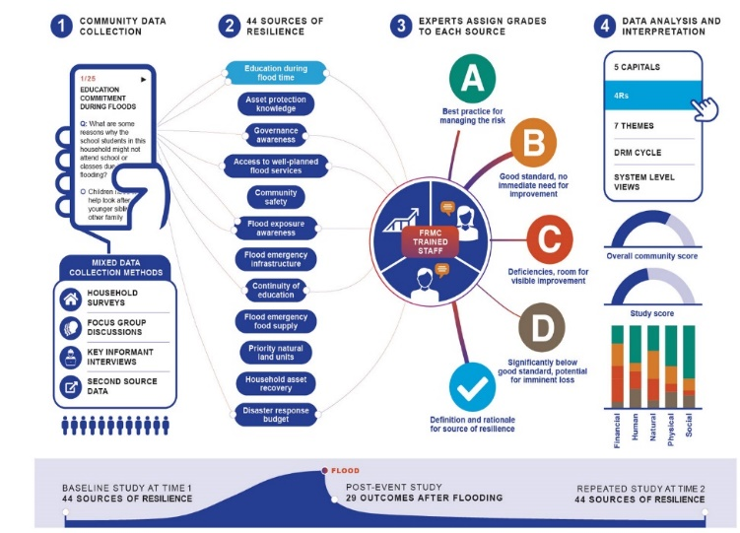
Methodology: Empirical Disaster resilience measurement using ML
Laurien et al., REC 2020
Connectedness vs Capacity of Communities
Gradient Boosted Machines Diagram
\w Trees
Notes:
As the tool has to be applicable across communities there is a number of standardized resilience scores. We define performance on an A to D scale.
Due to the large amount of data and the different ways of gathering, as well as augmenting it with open access satellite and weather data,
we rely on machine learning techniques in order to analyze it. We primarily focus on gradient boosted machines as well as classical statistical modeling.

Slide 13
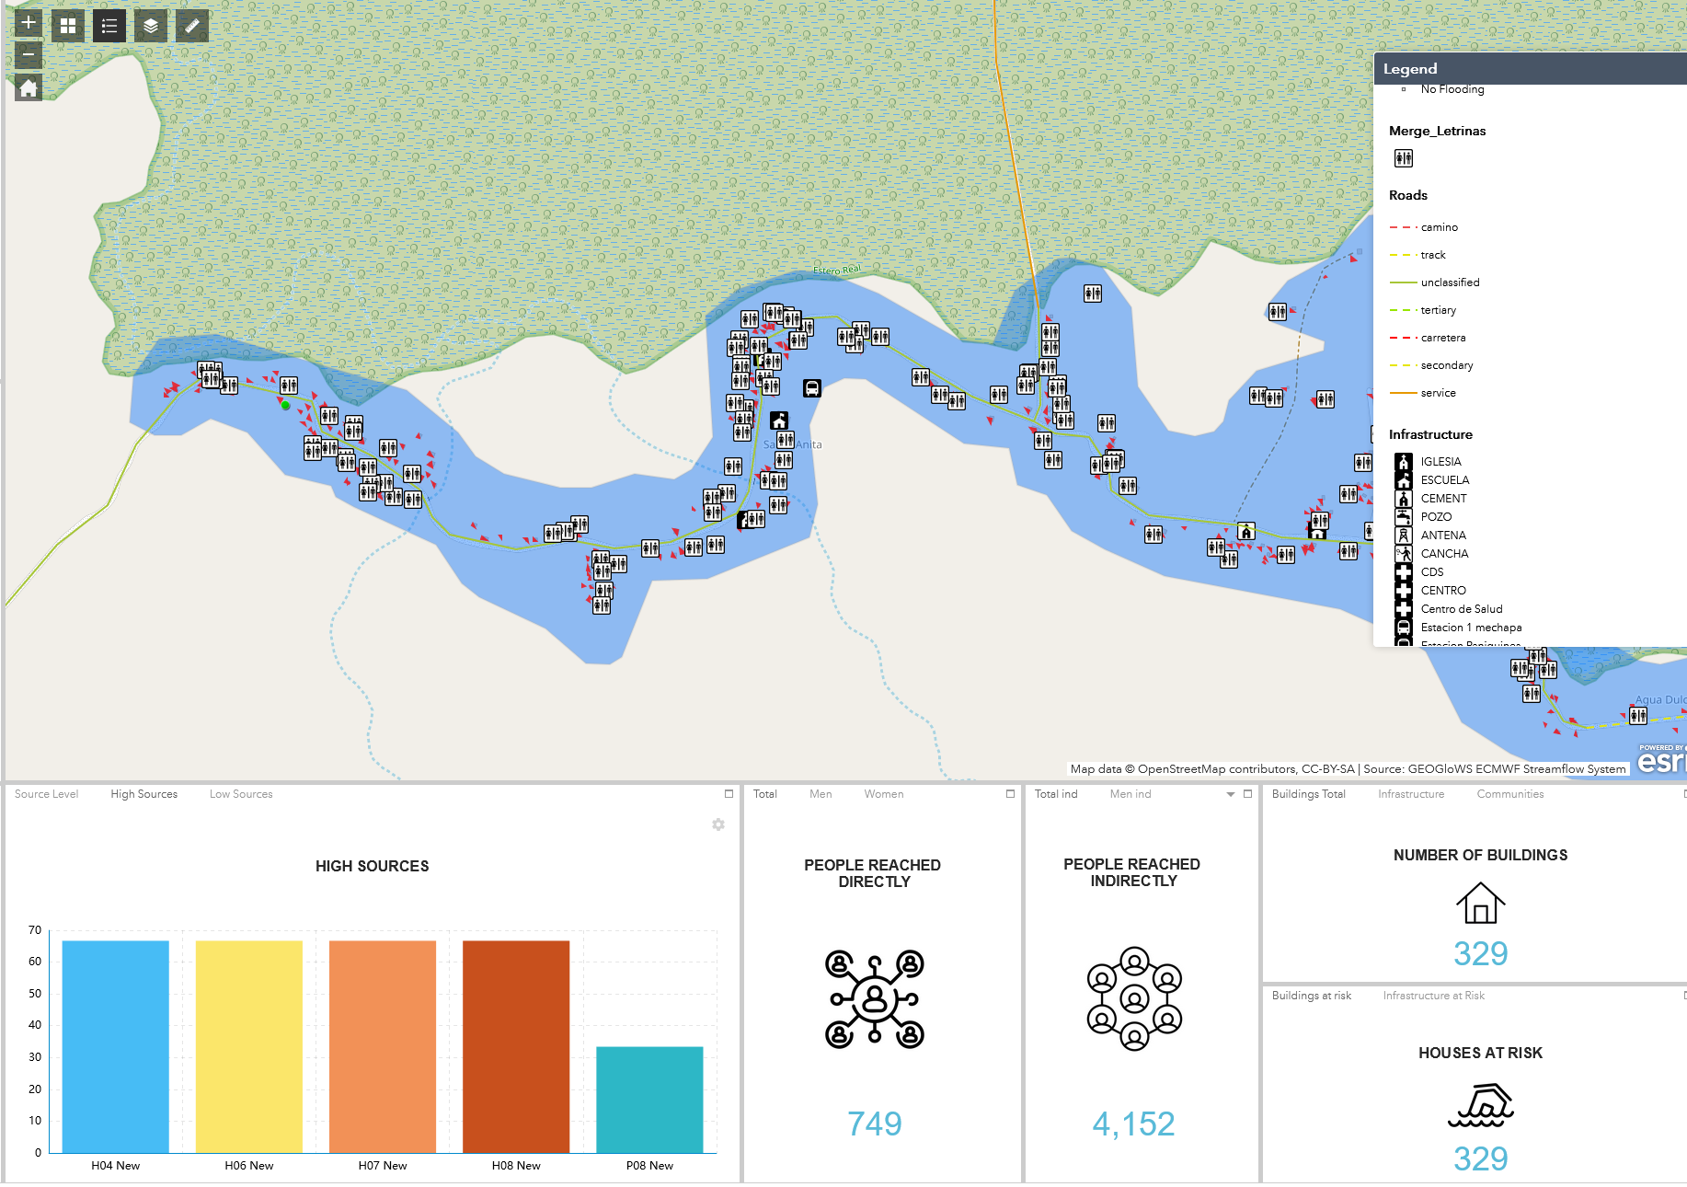
How it contributes to the ASA mission
Acting on a development centric resilience definition
Only validated resilience measurement tool
Big data & community engagement for big impact
Systems science for action research with long term perspective (10+12 years)
Work being extended to multiple climate-related hazards
Wildfire, Heatwaves, Drought
FRMC resilience dashboard

Slide 14
Citizen-powered data ecosystems for inclusive and green urban transitions
Inian Moorthy Novel Data Ecosystems for Sustainability (NODES) Advancing Systems Analysis (ASA)

Slide 15
Increasing environmental stresses in urban areas.
Accentuated inequalities in access to greenspace, ecosystem services and health-related benefits.
Important data gaps to support policy for just and sustainable cities.
Public participation developing slowly and variably.
15

Slide 16
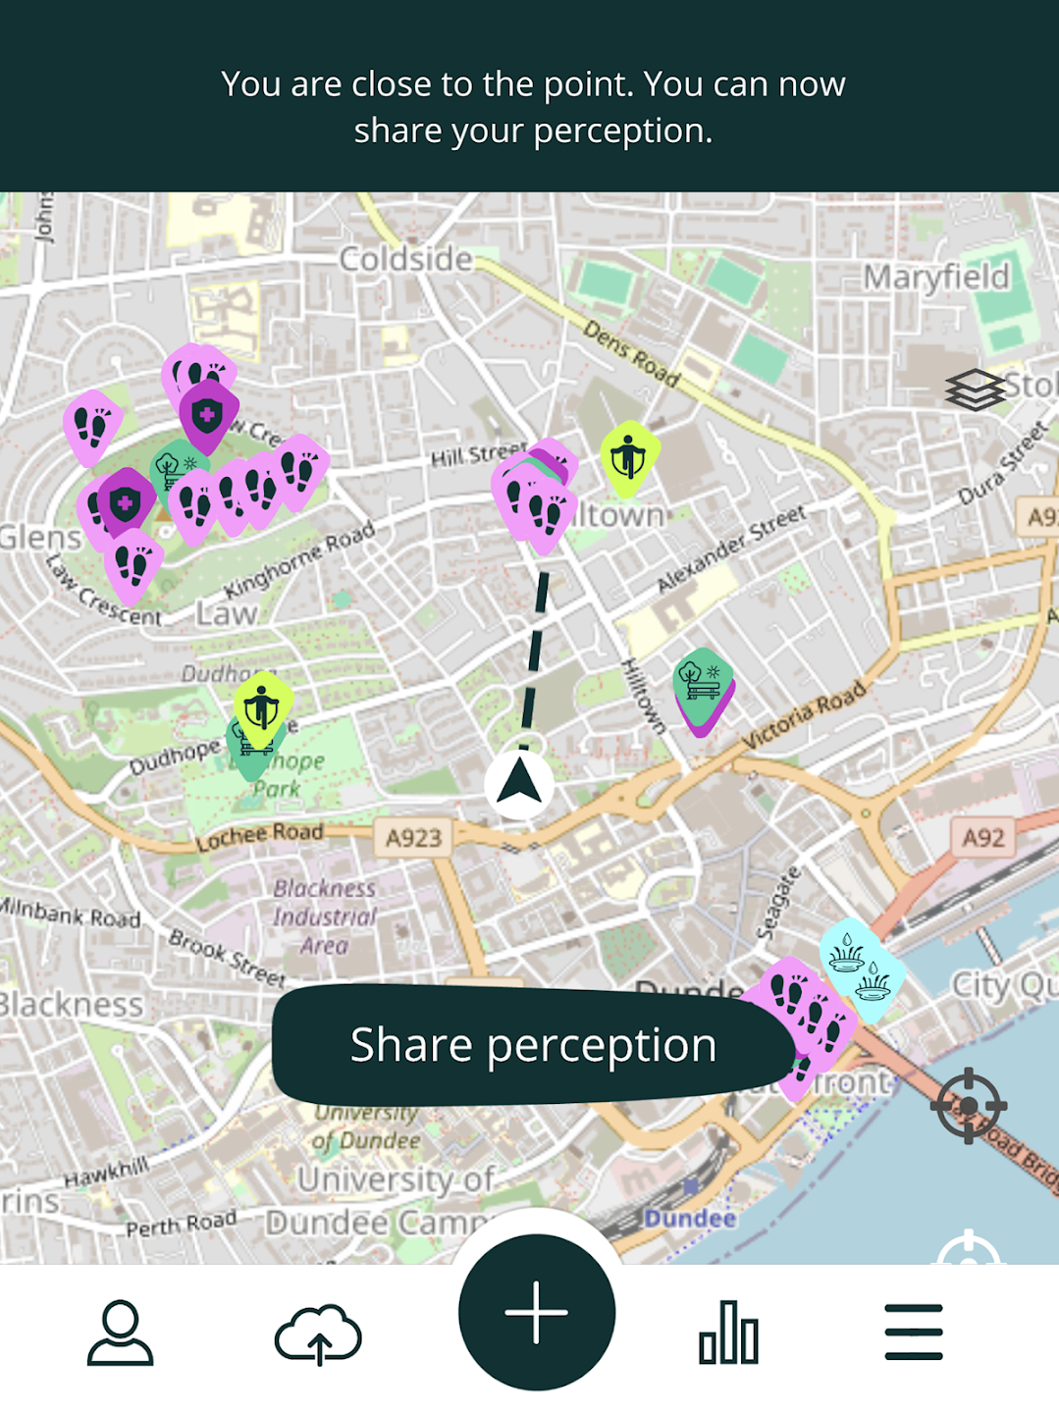
Novel data sources/methods coupled with civic engagement
6 Pilot cities
Greenspace perception
Urban Trees
Air quality
Heat Stress
Mobile apps and web-based surveys to collect insights on greenspace observations & perceptions
Deploying low-cost air quality monitors for localized mapping of air pollution (PM2.5)
Wearables for measuring temperature and relative humidity
16

Slide 17
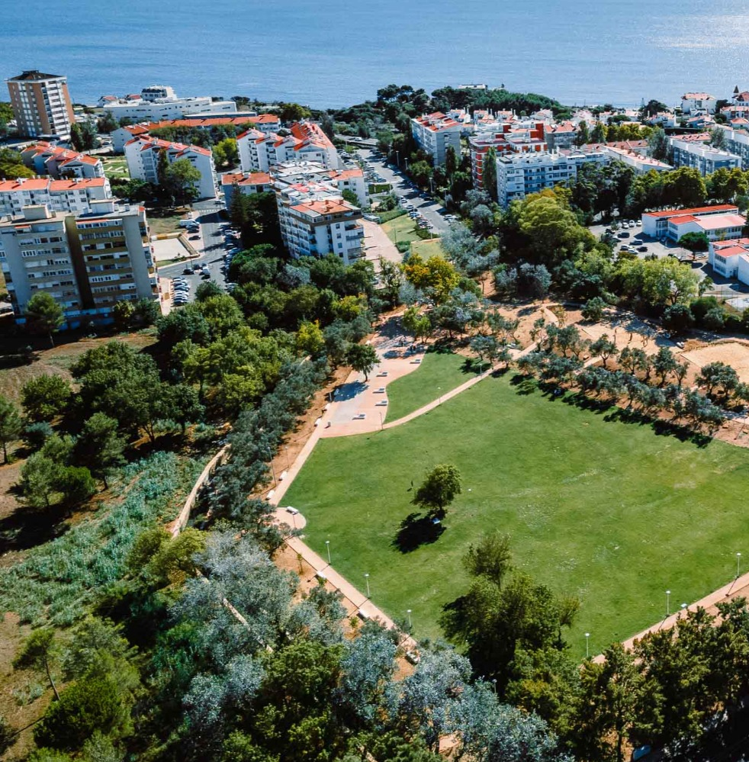
Combining multiple data ecosystems into the (local) policy landscapes
Contributions to ASA’s objectives
Demand-driven and scalable digital tools to enhance existing data ecosystems and open science practices
Understanding policy-specific data needs and identifying opportunities for citizen science
Advancing engagement opportunities with civic society and decision makers
Using participatory processes and building many-to-many relationships for urban resilience
17

Slide 18
The SmartLinker Platform as a cooperative AI tool Learning from a distributed models data highway
Valeria Javalera-Rincon Exploratory Modeling of Human-natural Systems (EM) Advancing Systems Analysis (ASA) | Fernando Orduna-Cabrera Marcial Sandoval Alejandro Rios

Slide 19
FABLE Scenathons: A distributed system of integrated models
Scenathon are participatory decision-making exercises to Integrate models and stakeholders to solve complex problems.
Bottom-up and iterative.
Balances trade inconsistencies using a proportional trade adjustment

Slide 20
FABLE Scenathon 2023 on the Sustainable Development Report 2024
22 countries and 6 rest of the world regions represented = 28 single models (FABLE Calculator)
83 commodities
The objective of this Scenathon was to collectively achieve 16 sustainability targets
FABLE (2024) Transforming food and land systems to achieve the SDGs. In Sachs et al. (2024) The Sustainable Development Report 2024. SDSN, New York and Paris.

Slide 21
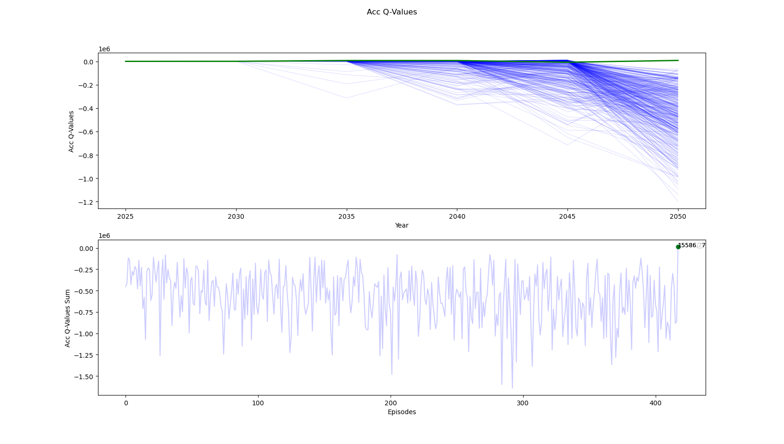
The SmartLinker platform (SLP) as a cooperative AI tool
The SmartLinker framework is based on RL algorithms tailored to the Multi-Agent and Multi-Objective.
It is a central coordinator/ optimizer capable of learning by interacting with independent agents (countries/regionals FABLE calculators) that integrate multiple goals.
Agents are the single-country and regional FABLE Calculators used in the Scenathon 2023.
The learning is fed by strategic data received by the country models
Accumulated Q values obtained during exploration (blue) and exploitation (green) on 420 episodes.

Slide 22
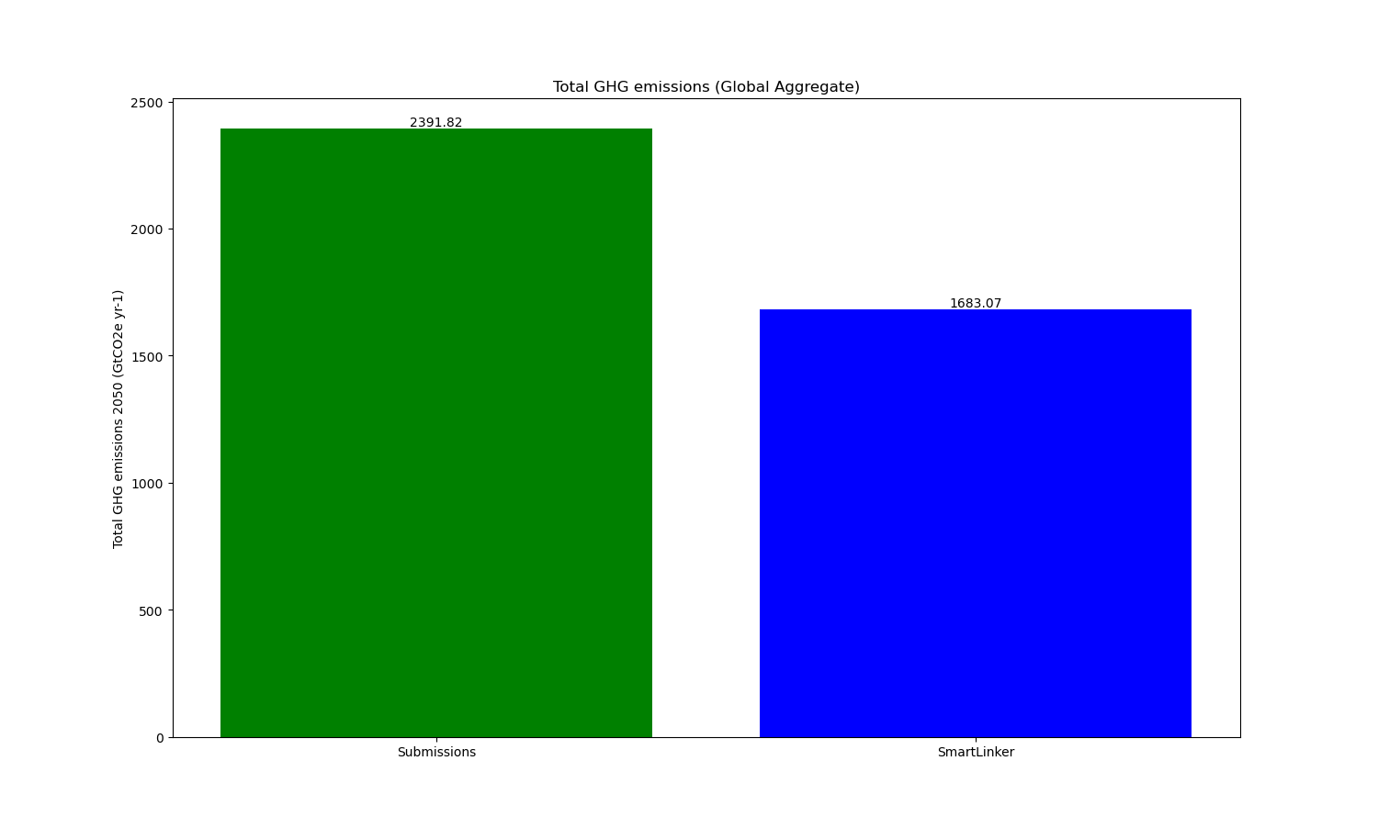
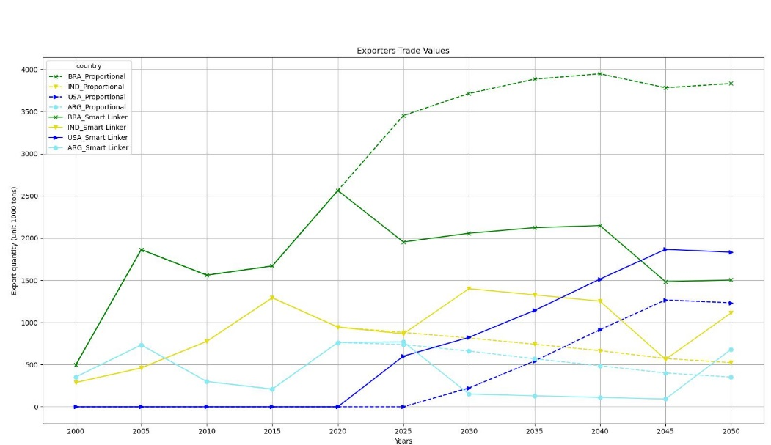
The SmartLinker is capable of advice on optimal bilateral trade that maximizes Global targets
2.39 GtCO2e
1.66 GtCO2e
Javalera-Rincon, V., Orduña Cabrera, F., Mosnier, A., Sandoval- Gastelum, M., Rios- Ochoa, A., Frank, F., Douzal, C., Chemarin, C., Jones, S., & Obersteiner, M. (2024). What if trade could enhance global sustainability? The SmartLinker Platform as a cooperative AI ( Presented during the 27th Annual Conference on Global Economic Analysis (Fort Collins, Colorado, USA)). Purdue University, West Lafayette, IN: Global Trade Analysis Project (GTAP).

Slide 23
ASA, FABLE and the SmartLinker Platform
To advance Systems Analysis: The SLP focus is to optimize complex interactions between already complex sub-systems by the development of new Machine Learning algorithms with Multi-Objective and Multi-Agent capacities.
To Enhance policy impact: With FABLE and the Scenathon.
To Exploit the digital revolution: The SLP is the technological infrastructure that makes the Scenathon possible. So, we use Science and technology to connect models, experts and stakeholders in a Novel Distributed, Integrated Assessment Model.
Our work is transdisciplinary, and methods can be applied to other contexts.

Slide 24
Thank you for your attention!
We welcome ideas on how we could collaborate!
Elena Rovenskaya: rovenska@iiasa.ac.at

