Slide 1
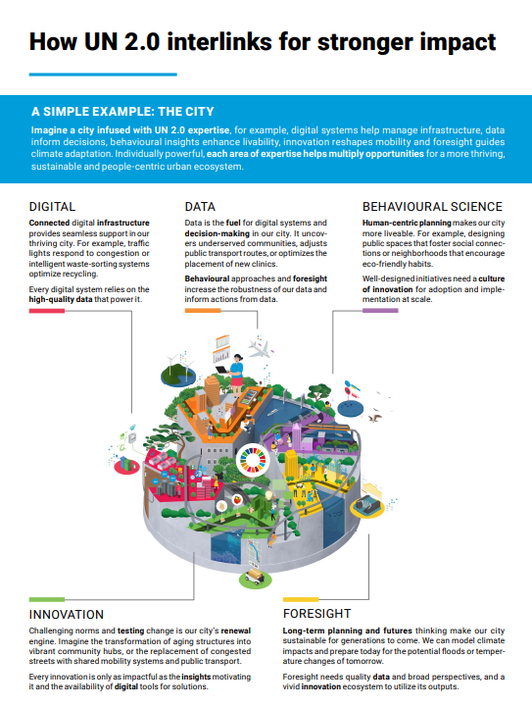
UN (2023). Our Common Agenda, Policy Brief 11, UN 2.0 Forward-thinking culture and cutting-edge skills for better United Nations system impact: https://www.un.org/sites/un2.un.org/files/our-common-agenda-policy-brief-un-2.0-en.pdf

Slide 2
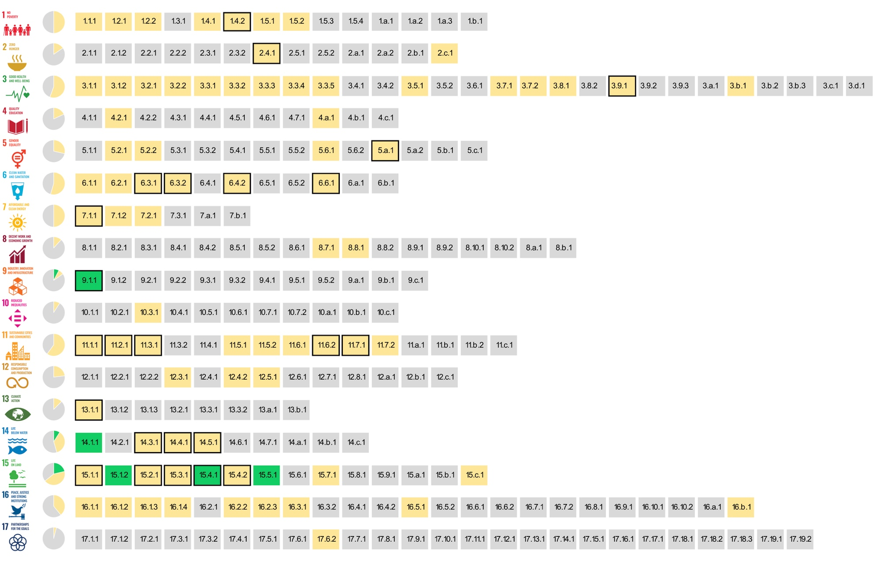
The SDG indicators where citizen science projects are ‘already contributing’, ‘could contribute’ or where there is ‘no alignment'
Fraisl, D., Campbell, J., See, L. et al. Mapping citizen science contributions to the UN sustainable development goals. Sustain Sci 15, 1735–1751 (2020). https://doi.org/10.1007/s11625-020-00833-7

Slide 3
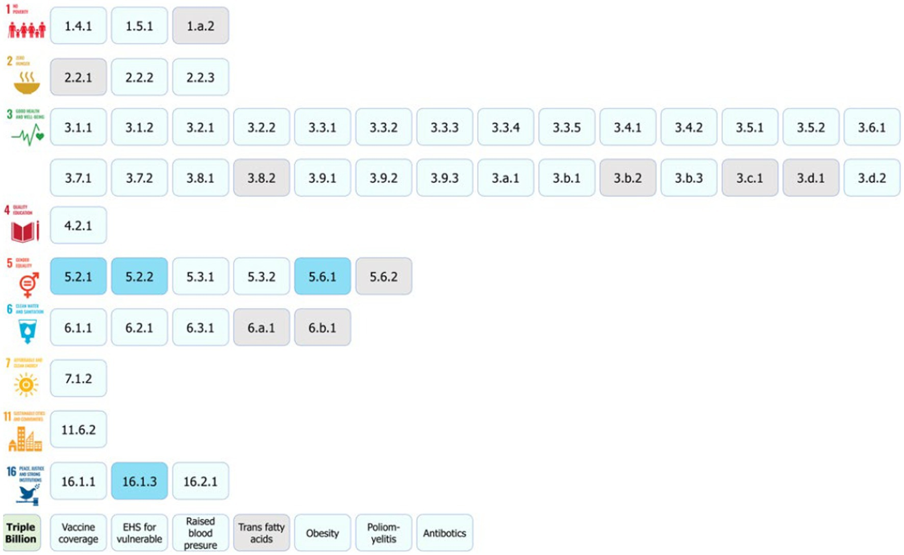
The health and well-being related SDG indicators and Triple Billion Targets covered in this study. Indicators where citizen science projects are “already contributing” are in dark blue, “could contribute” are in light blue or where there is “no alignment” are in grey. The values within each box are the indicator numbers or titles.
Fraisl D, See L, Estevez D et al (2023) Citizen science for monitoring health and wellbeing related sustainable development goals and the World Health Organization’s triple billion targets. Front Public Health 11:1202188 https://doi.org/10.3389/fpubh.2023.1202188

Slide 4
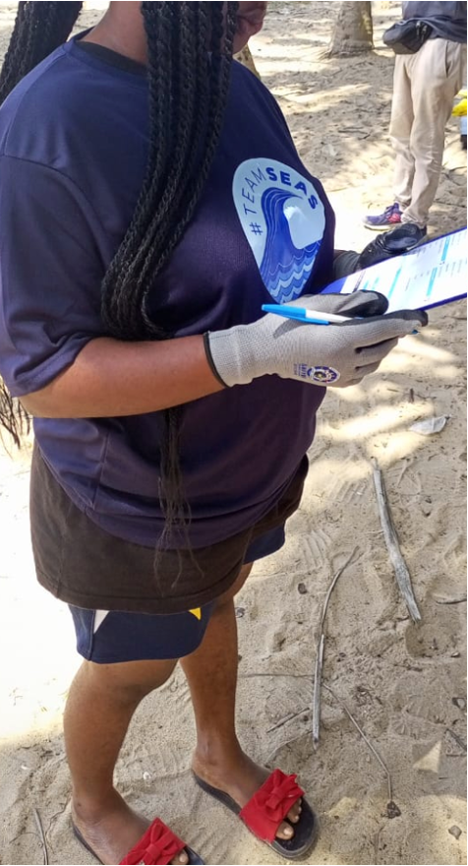
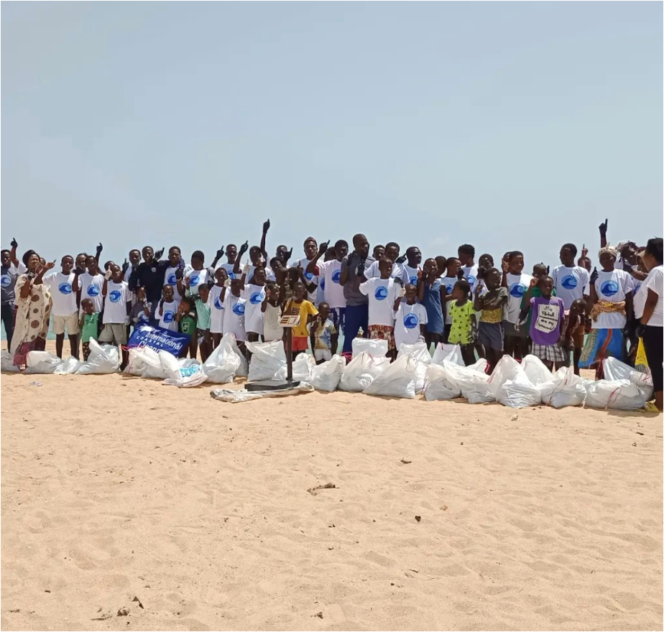
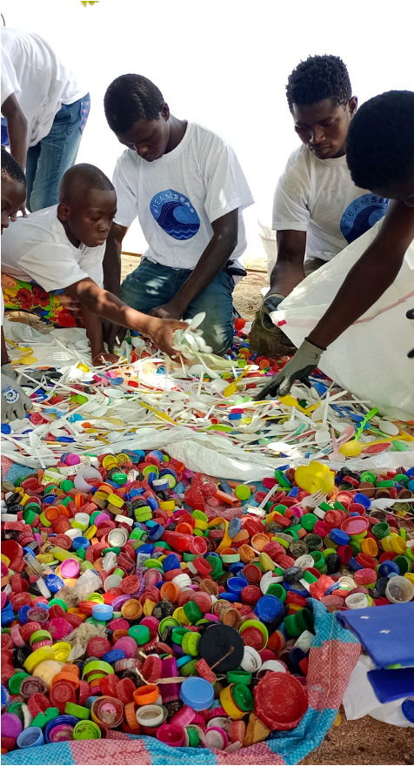
Bridging local data collection efforts and community needs with global monitoring processes by leveraging the SDG framework through collaborations
Encure inclusiveness through meaningful engagement of all stakeholders
Create time and space for these stakeholders to meet and connect
Listen and understand the motivations, interests and concerns
Be transparent about citizen science results and methodologies, especially how these methodologies were implemented
Citizens and communities are no free labor to close government data gaps; they should receive a share of the benefit from participating
@Smart Nature Freaks Youth Volunteers Foundation

