Slide 1
14 November, 13:30 to 14:30, Room 3, Plaza Mayor Medellín Conventions & Exhibitions, Medellín, Colombia
Citizen Science: Opportunities and Challenges for Enhanced Local to Global SDG Monitoring and Action
Dilek Fraisl
Fabrizio Scrollini
Samuel Kobina Annim
Research Scholar, IIASA Managing Director, Citizen Science Global Partnership
Acting Co Executive Director, Humanitarian OpenStreetMap Team
Government Statistician, Ghana Statistical Service
Julieth Alejandra Solano Villa
Austin Mast
Steve MacFeely
Technical Director of Regulation and Quality, DANE
Professor, Florida State University
Chief Statistician, OECD
@IIASAVienna
@iiasavienna
IIASA

Slide 2
Citizen Science: Opportunities and Challenges for Enhanced Local to Global SDG Monitoring and Action
November 14, 2024 | Medellín, Colombia

Slide 3
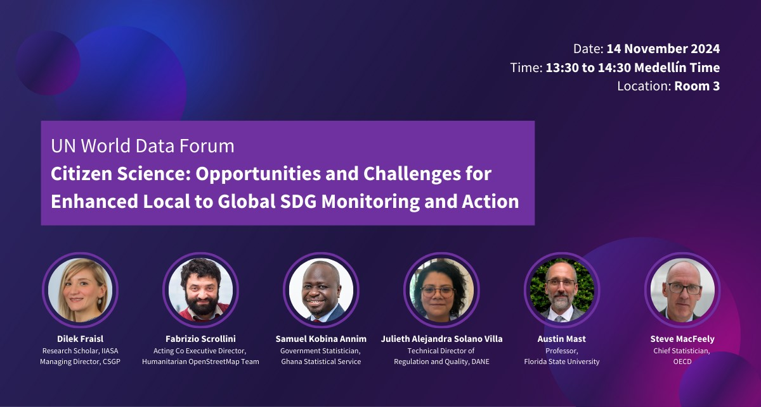

Slide 4
Citizen science
Citizen generated data
Community-based monitoring
Citizen observatories
Community science
Participatory mapping
Crowdsourcing
Volunteered computing
Volunteered geographic information
Participatory sciences

Slide 5
Public participation
Voluntary contributions
Scientific research and knowledge production

Slide 6
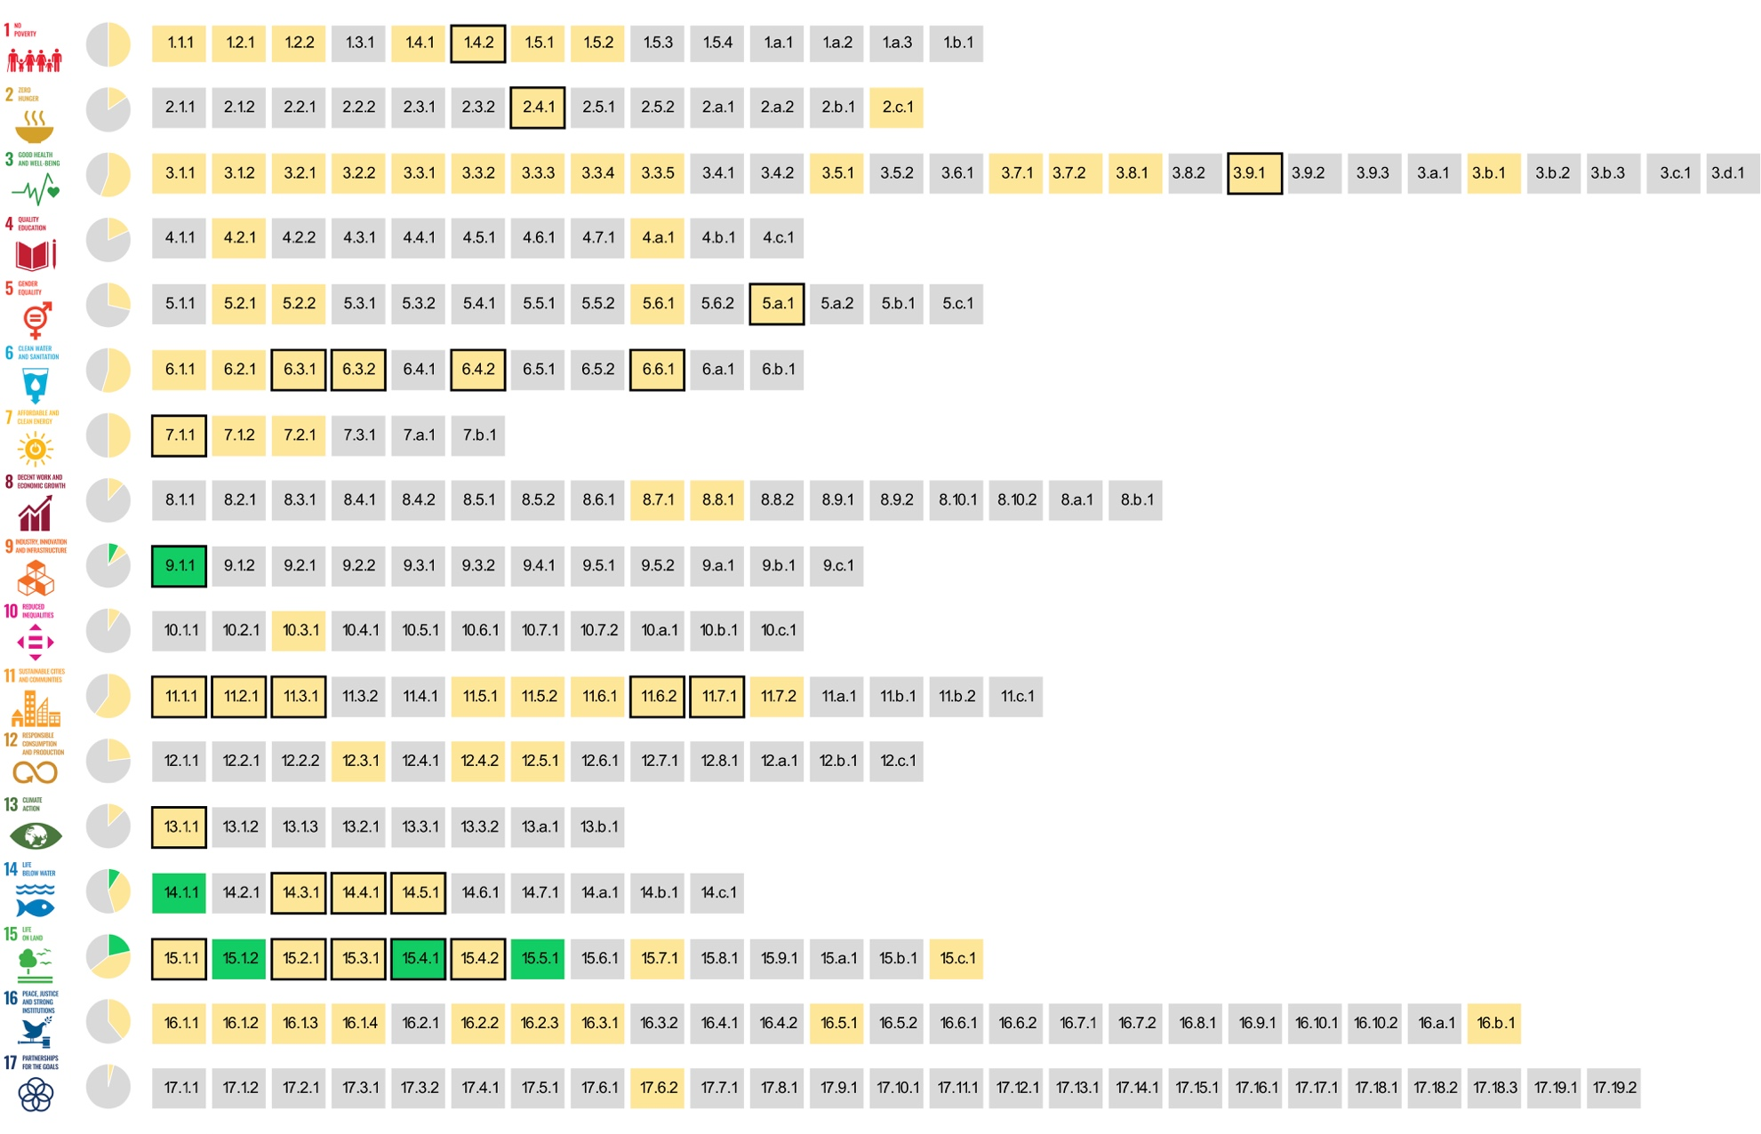
The SDG indicators where citizen science projects are ‘already contributing’, ‘could contribute’ or where there is ‘no alignment'
Fraisl, D., Campbell, J., See, L. et al. Mapping citizen science contributions to the UN sustainable development goals. Sustain Sci 15, 1735–1751 (2020). https://doi.org/10.1007/s11625-020-00833-7

Slide 8
Citizen Science: Opportunities and Challenges for Enhanced Local to Global SDG Monitoring and Action
November 14, 2024 | Medellín, Colombia

