Slide 1

Leveraging the collaborative power of AI and citizen science for sustainable development
Dilek fraisl, linda see, steffen fritz, muki haklay, ian mccallum
Dr. Dilek Fraisl
Senior Research Scholar
International Institute for Applied Systems Analysis (IIASA)
Managing Director
Citizen Science Global Partnership (CSGP)
fraisl@iiasa.ac.at

Slide 2
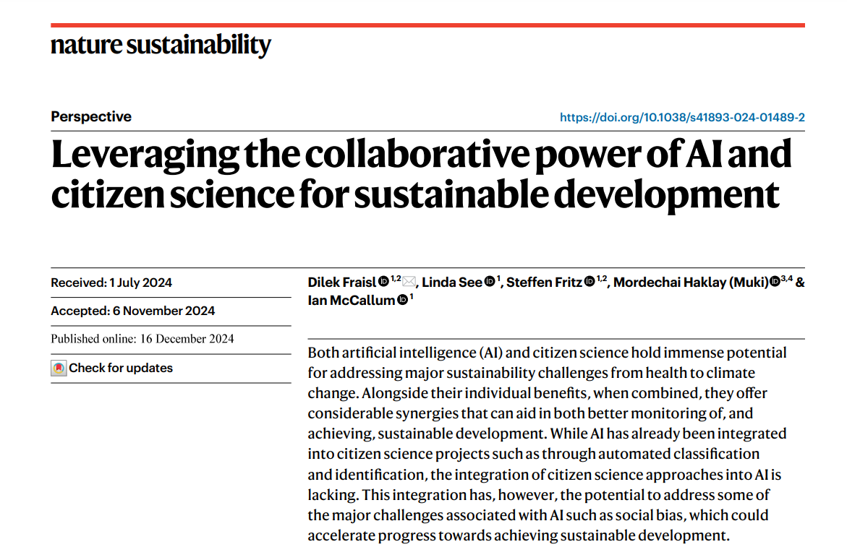
Fraisl, D., See, L., Fritz, S. et al. Leveraging The collaborative Power of AI and Citizen Science for sustainable development. Nat Sustain (2024). Https://Doi.Org/10.1038/S41893-024-01489-2

Slide 3
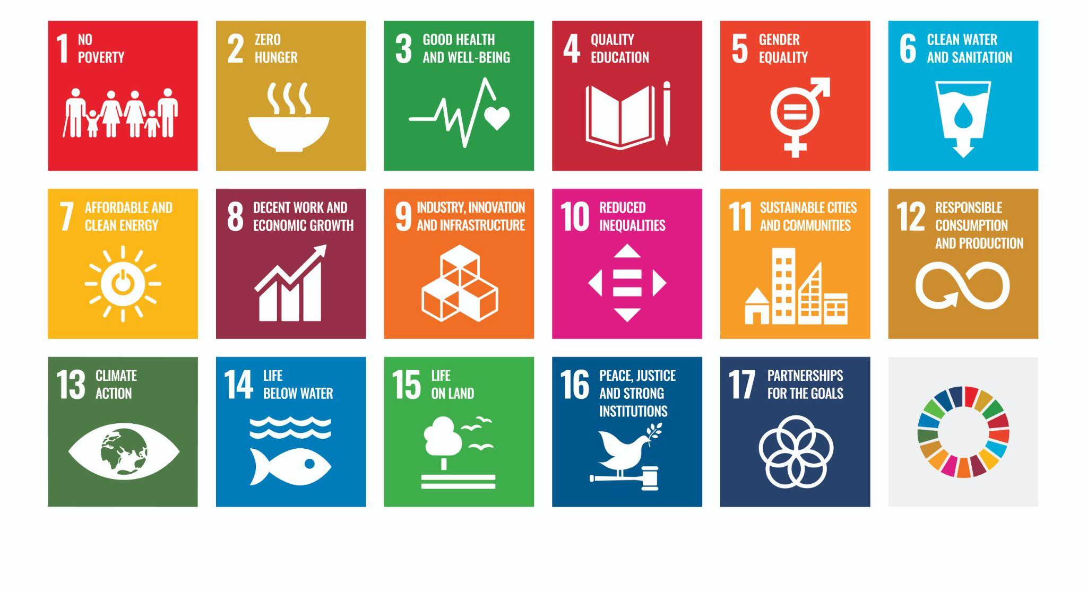
Sustainable Development Goals (SDGs)
17 Goals, 169 Targets, 231 INDICATORS

Slide 4
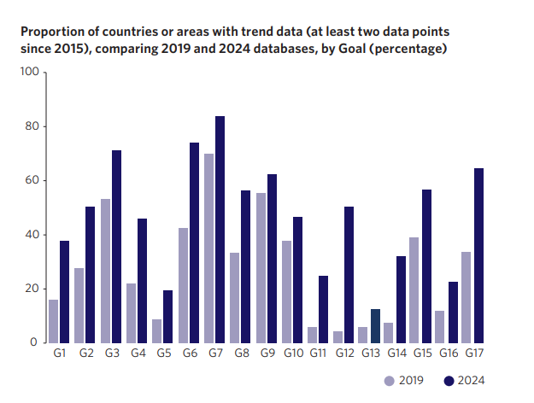
SDG REPORT 2024
data are still lacking for around half of the 92 environmental SDG indicators
while only 15% of targets are on track to be met by 2030, with all SDG targets having insufficient data

Slide 5
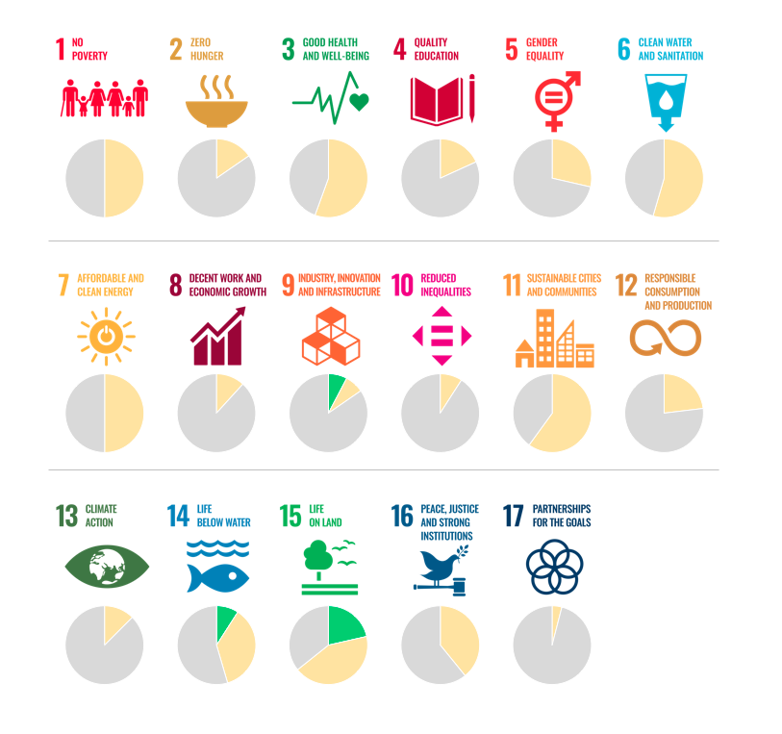
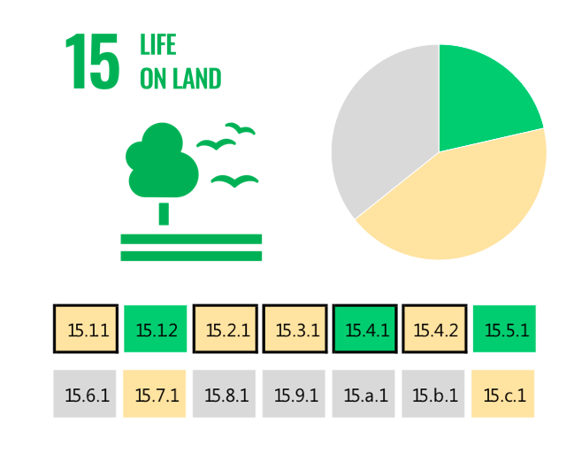
The SDG indicators where citizen science projects are
‘already contributing’ (GREEN), ‘could contribute’ (YELLOW) or where there is ‘no alignment’ (GREY)
Fraisl, D., Campbell, J., See, L. et al. Mapping citizen science contributions to the UN sustainable development goals. Sustain Sci 15, 1735–1751 (2020). https://doi.org/10.1007/s11625-020-00833-7

Slide 6
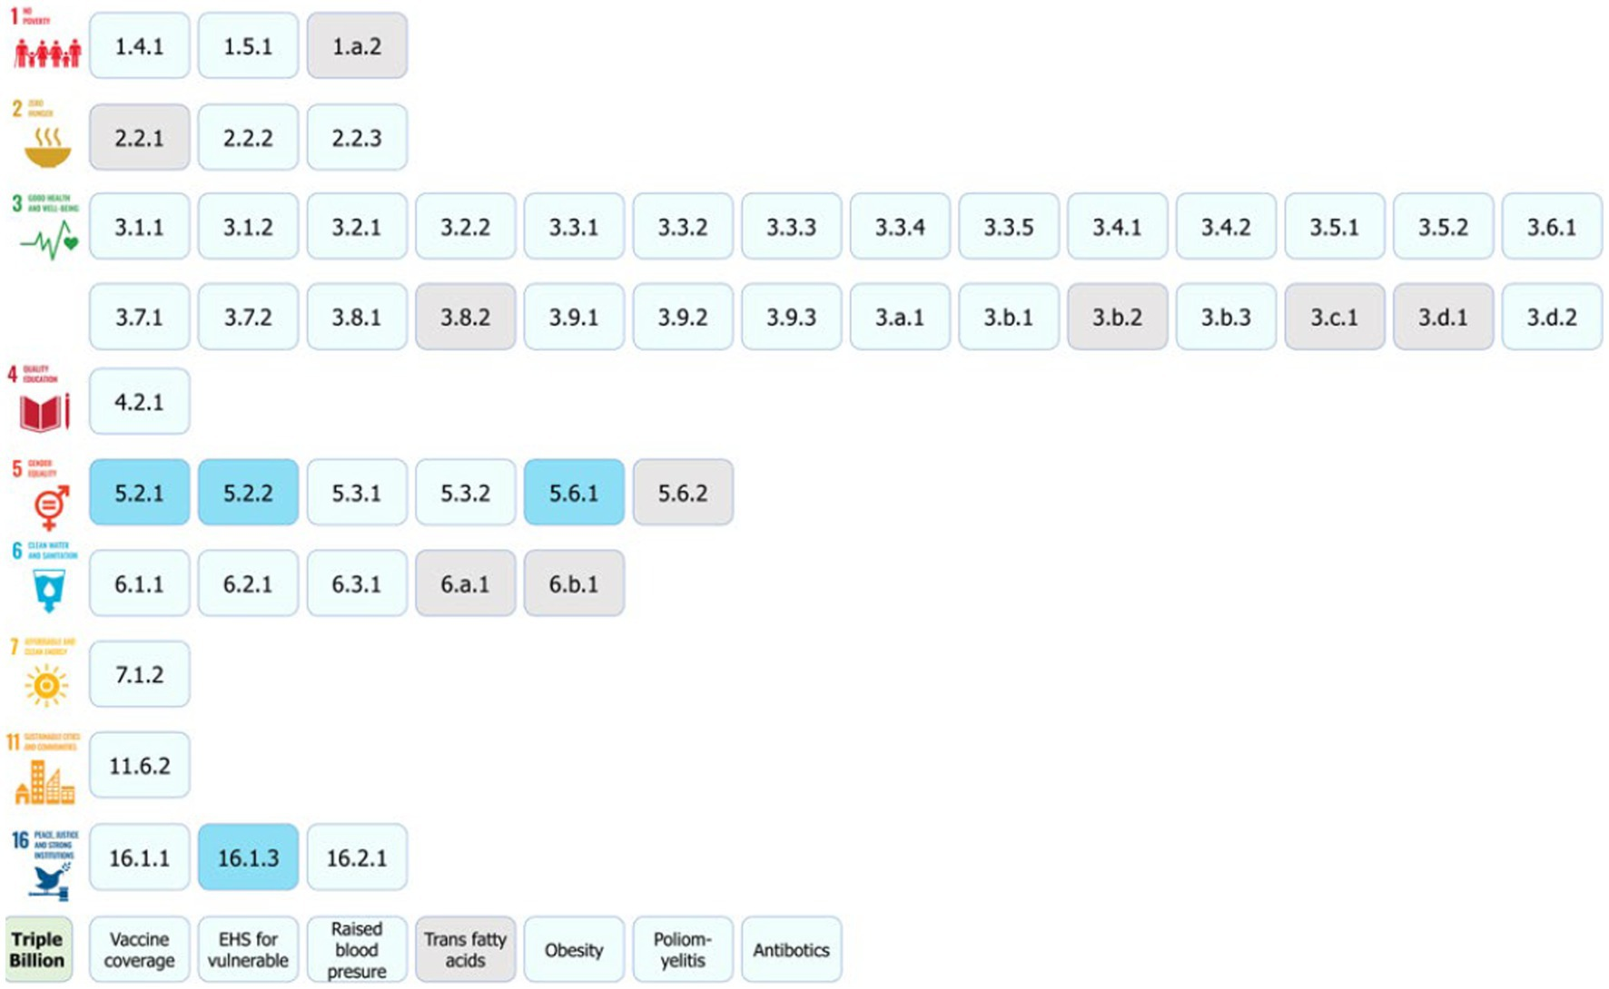
Citizen science for monitoring the health and well-being related SDGs and the WHO’s Triple Billion Targets
Fraisl, D., See, L., Estevez, D., Tomaska, N. & MacFeely, S. Citizen science for monitoring the health and well-being related Sustainable Development Goals and the World Health Organization’s Triple Billion Targets. Front. Public Health 11, 1202188 (2023).

Slide 7
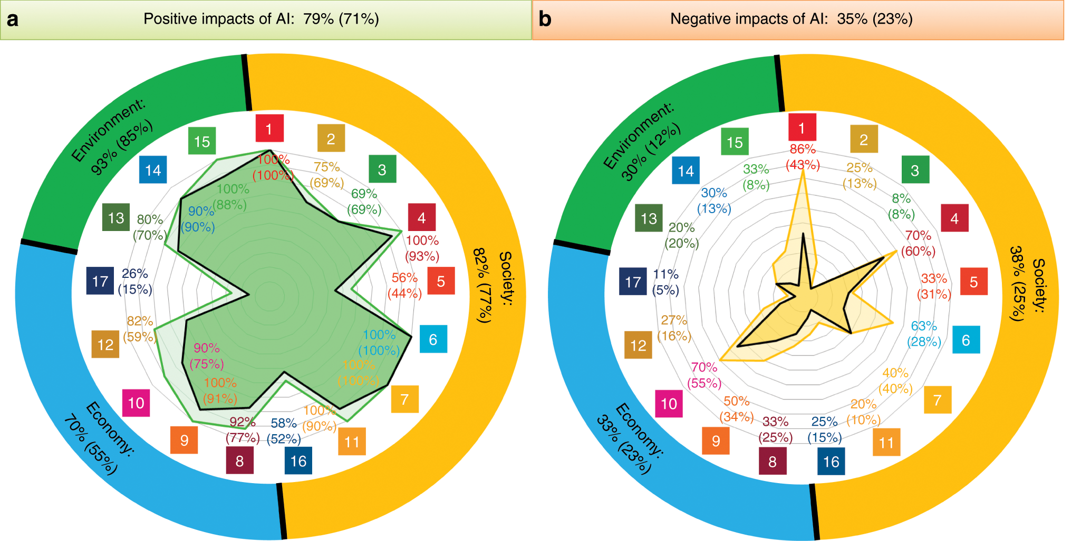
Positive and negative impact of AI on the various SDGs
AI can enable the accomplishment of 134 targets across all the goals…
Vinuesa, R., Azizpour, H., Leite, I. et al. The role of artificial intelligence in achieving the Sustainable Development Goals. Nat Commun 11, 233 (2020). https://doi.org/10.1038/s41467-019-14108-y

Slide 8
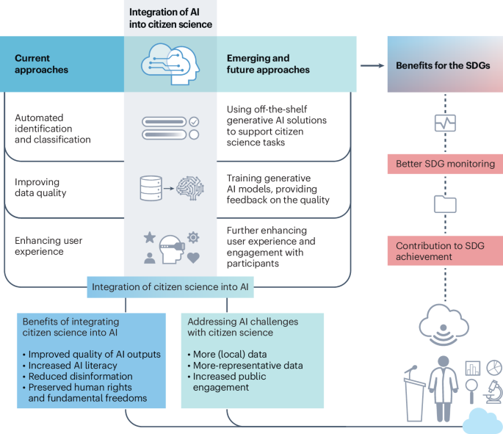
The current and future applications of AI in citizen science projects, benefits of combining AI and citizen science to address AI challenges, and ultimate benefits for the SDGs and sustainable development more broadly.

Slide 9
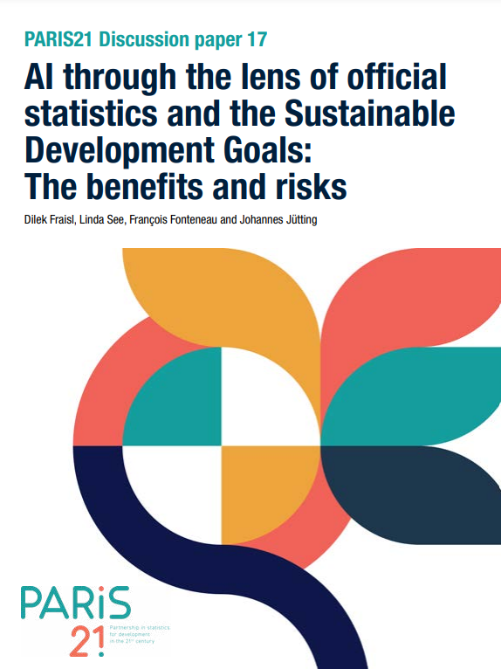
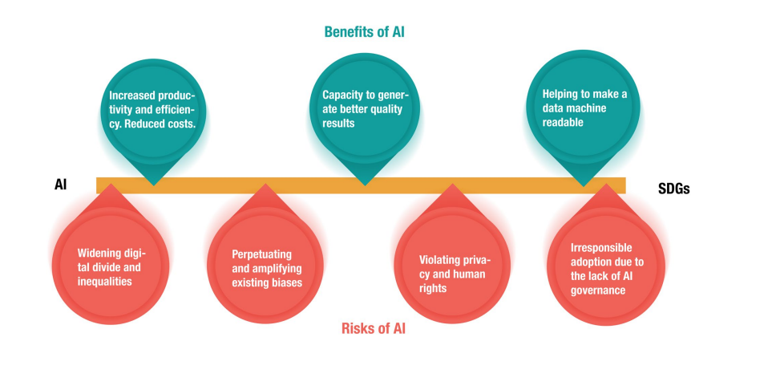
Benefits and risks of artificial intelligence in the context of the Sustainable Development Goals
Fraisl, D., See, L., Fonteneau, F., Jütting, J. (2024). AI through the lens of official statistics and the Sustainable Development Goals: The benefits and risks. PARIS21 Discussion paper 17. https://www.paris21.org/knowledge-base/ai-through-lens-official-statistics-and-sdgs-what-are-benefits-and-risks

Slide 10
The current and future applications of AI in citizen science projects, benefits of combining AI and citizen science to address AI challenges, and ultimate benefits for the SDGs and sustainable development more broadly.

Slide 11
The need to integrate citizen science into AI
Lack of (local) data: The lack of data can result in the use of algorithms that were trained using data that does not consider specific local circumstances.
Societal biases: AI, in all its forms, can exhibit and emphasize biases that exist in society, such as race, color, gender, disability and ethnic origin.
Lack of public engagement: AI typically lacks public engagement, which is important to ensure representativeness, reduce biases and enhance the quality of AI results.

Slide 12
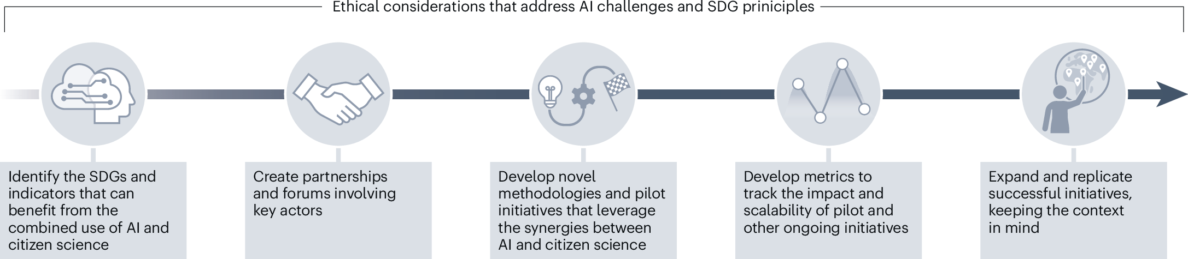
Roadmap for citizen science and AI integration

Slide 13
CHALLENGES AND RISKS
Citizen science has many challenges, e.g., limited resources – funding, etc.
Societal biases related to AI may worsen if potential biases in citizen science projects are not mitigated during this integration.
For citizen science to effectively address the challenges and potential risks of AI, as well as leverage its potential to achieve sustainable development and the SDGs, there must be a greater focus on increasing engagement, particularly in the Global South.
The substantial data requirements of AI highlight the importance of open data for training models. For citizen science data to effectively address AI challenges, they should be openly accessible.
The openness of AI is also an issue. The technical complexity of AI models and the dominance of corporations in the field create black boxes, hindering transparency in their decision-making.

Slide 14
FINALLY…
In light of the recent adoption of the Pact for the Future, which encompasses a Global Digital Compact, the first global framework for digital cooperation and AI governance that highlights the importance of AI in achieving sustainability, we urge all relevant actors, especially the UN and policymakers, to embrace the perspective and vision outlined in this paper to promote the advancement of AI through citizen science.

Slide 15
THANK YOU
Dr. Dilek Fraisl
Senior Research Scholar
International Institute for Applied Systems Analysis (IIASA)
Managing Director
Citizen Science Global Partnership (CSGP)
fraisl@iiasa.ac.at
Bluesky: dilekfraisl.bsky.social
LinkedIn: linkedin.com/in/dilekfraisl
iiasa.ac.at
citizenscienceglobal.org

